Slide 1

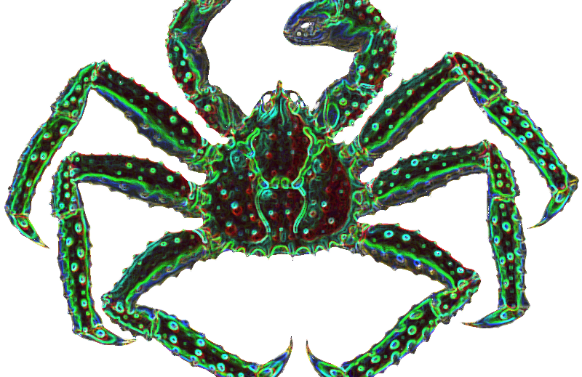
Crab Plan Team
Research Priorities
2021

Slide 2
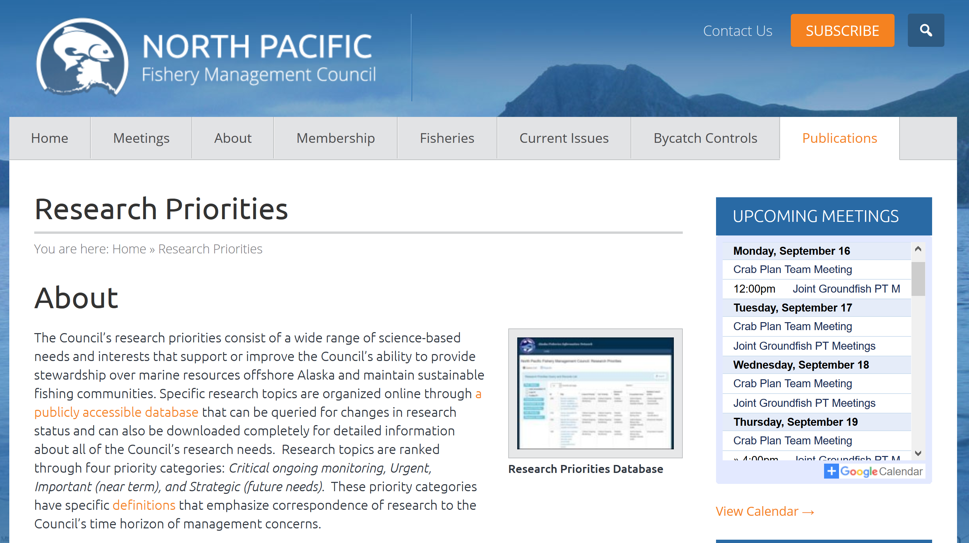

Slide 3
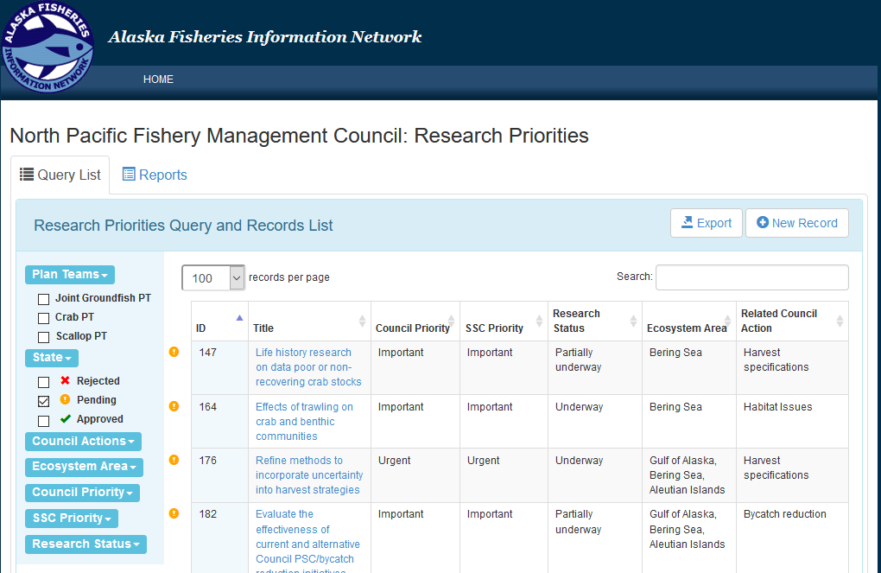

Slide 4
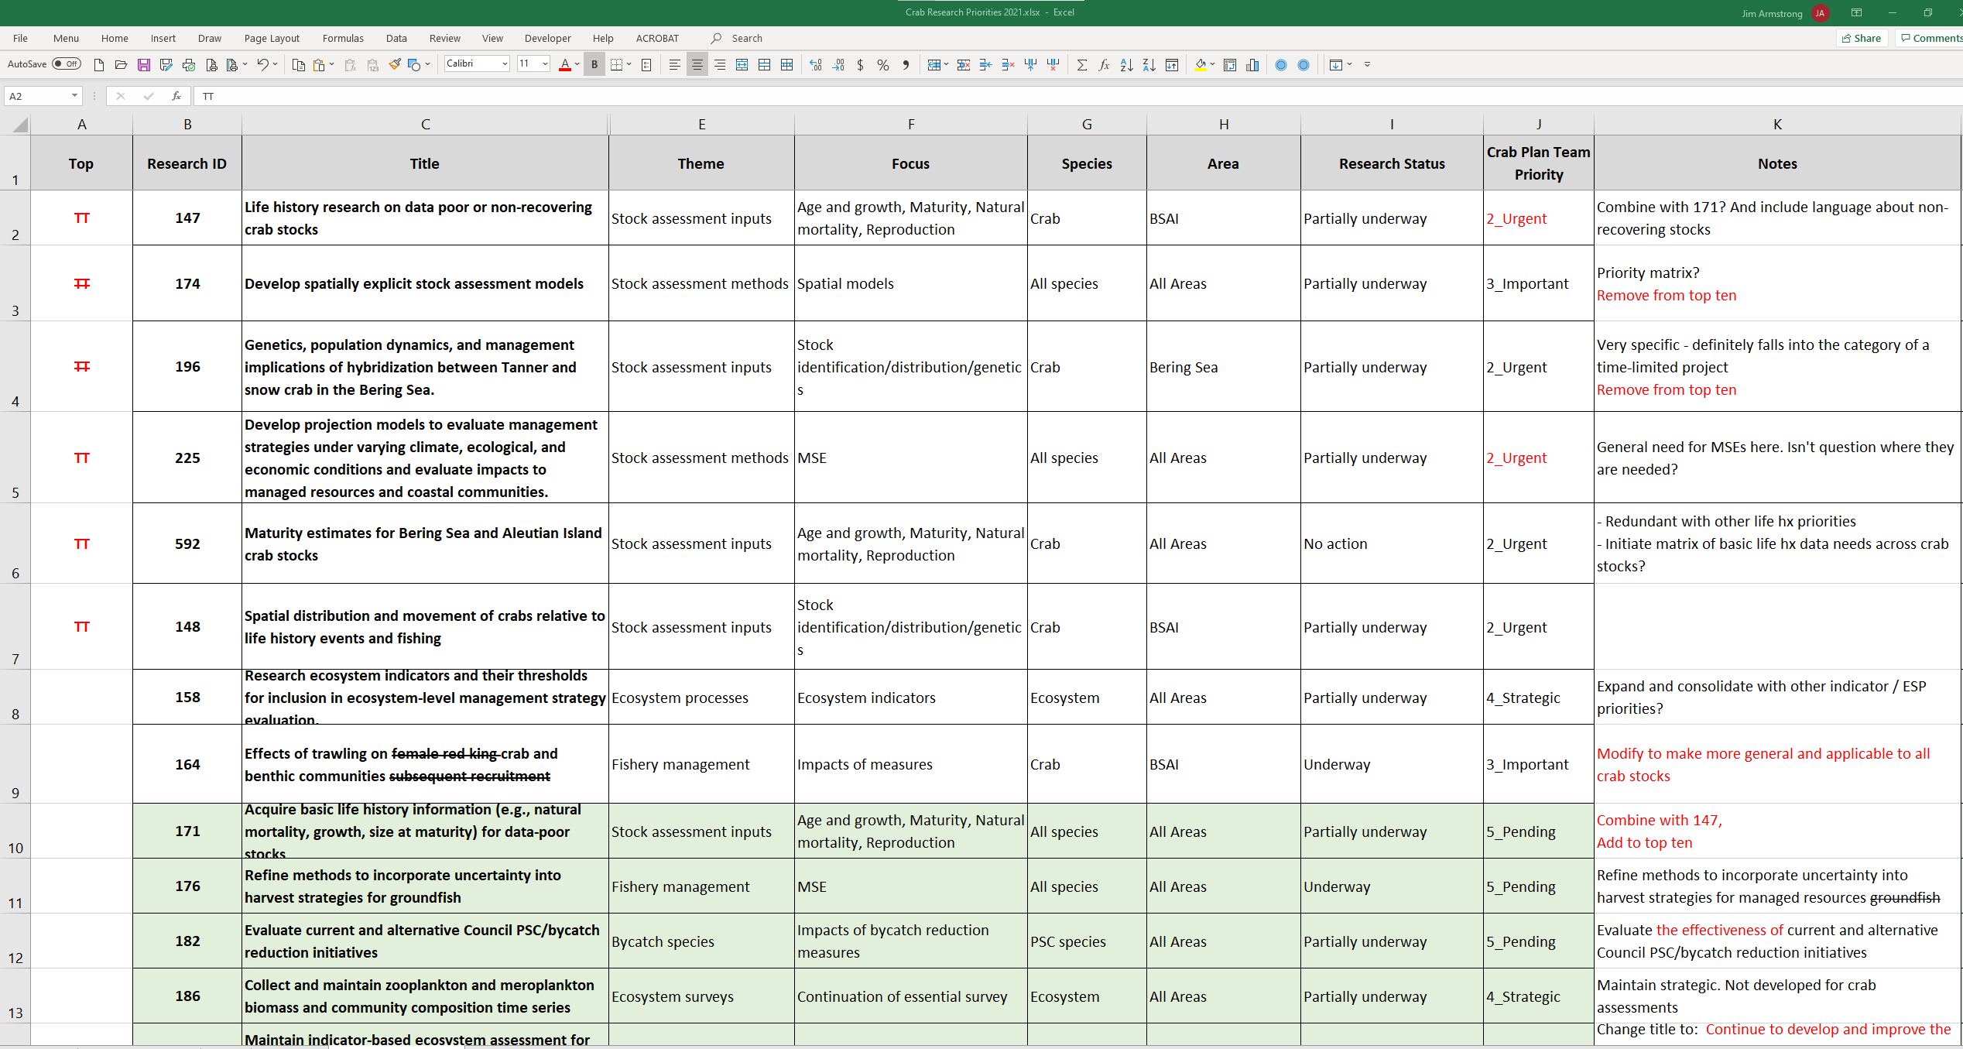


Slide 5
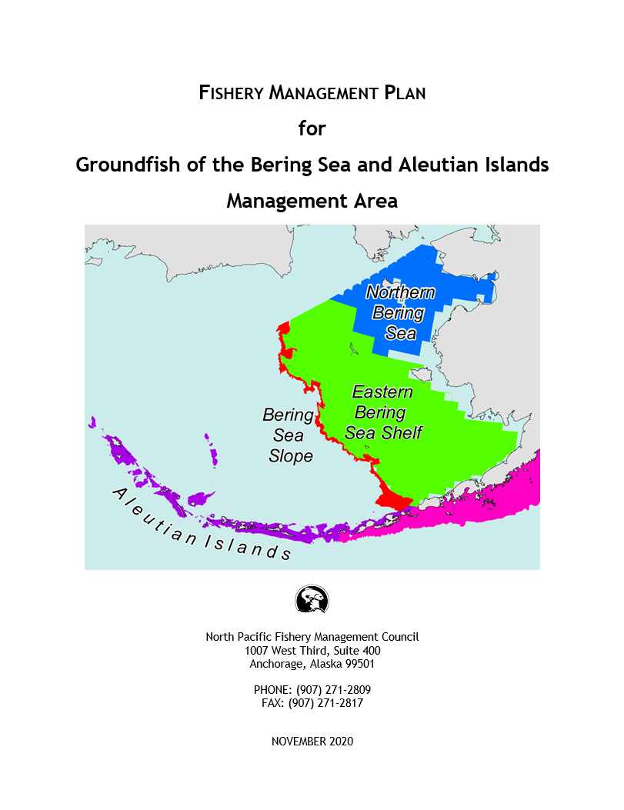



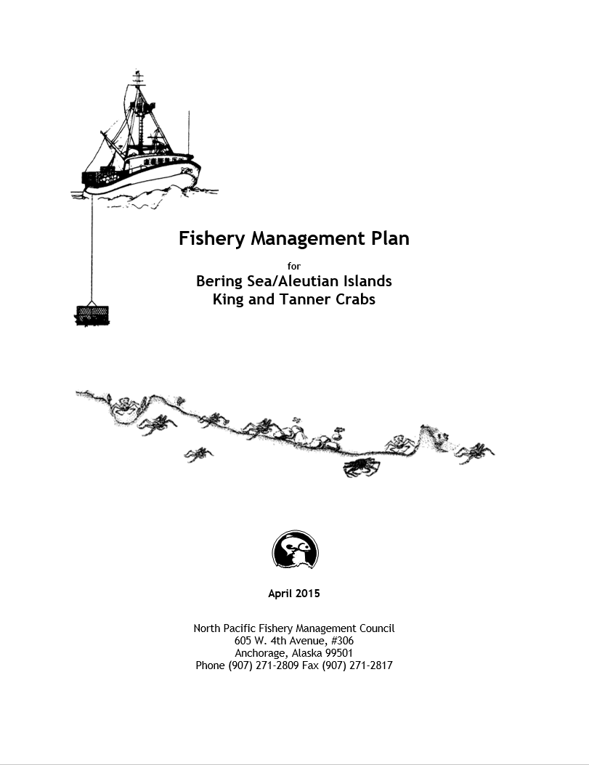
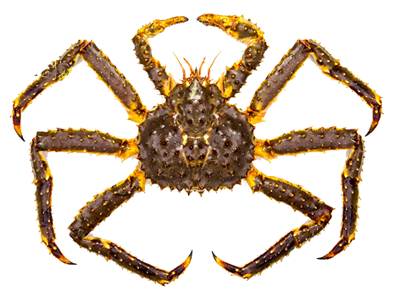

Options

Slide 6
PFMC
Economic and Social Science
EBFM
MPAs
EFH

Slide 7
FMP-based
BSAI Crab
  NS1, NS3, NS4, NS7, NS8, NS9, EFH, ESA
BSAI Groundfish
NS1, NS3, NS4, NS7, NS8, NS9, EFH, ESA
GOA Groundfish
NS1, NS3, NS4, NS7, NS8, NS9, EFH, ESA
Scallop
NS1, NS3, NS4, NS7, NS8, NS9, EFH, ESA
Salmon
NS1, NS3, NS4, NS7, NS8, NS9, EFH, ESA
Essential Fish Habitat
NS1, NS3, NS4, NS7, NS8, NS9,
Protected species
NS1, NS3, NS4, NS7, NS8, NS9, EFH, ESA

Slide 8
Nat. Standard based
NS 1 MSY, MSST, BMSY, OFL, MFMT, ABC
NS 3 Stock struct, distrib, genetics, spawning locat.
NS 4 Socio-econ
NS 7 Rationalization reviews
NS 8 Community status and vulnerability
NS 9 Bycatch issues
EFH
ESA
Interjurisdictional Research

Slide 9
Crab Plan Team

Slide 10
A hierarchical approach for research on crab stocks

Slide 11
A hierarchical approach for research on crab stocks

