Slide 1


Preliminary/Initial Review of Crab Prohibited Species Catch Limits in the BSAI Groundfish Trawl Fisheries
Presentation to the Crab Plan Team
January 2021
Sarah Marrinan and Sara Cleaver, NPFMC
Angela Forristall, NPFMC Sea Grant Fellow

Slide 2
History of action
Dec 2019
Council received public testimony on this issue
Initiated a preliminary/ initial review analysis
May 2020
Analysts briefed the CPT on the proposal
Introduced several questions on the about the relationship between bycatch, abundance and stock dynamics of crab
Sept 2020
Assessment authors presented sensitivity analyses on impact of a theoretical increase in bycatch (unobserved mortality)
Discussed of the impact of unobserved mortality
Jan 2021
CPT update on Preliminary/ Initial review analysis

Slide 3
Alternatives
Alternative 1: No Action
Alternative 2: Reduced PSC limits for BSAI trawl CDQ and non-CDQ groundfish fishing when the corresponding directed crab fishery is closed.
  When no Crab Rationalization Program individual fishing quota (IFQ) is issued in a season for BBRKC, bairdi, or opilio, set the crab PSC limit for that stock at the lowest abundance-based level. As described in regulation at 50 CFR 679.21(e)(1), the PSC limits for the groundfish fisheries would be as follows under this alternative when the directed crab fishery is closed:
    Bairdi Zone 1 - 0.5% of total abundance minus 20,000 animals
    Bairdi Zone 2 - 1.2% of the total abundance minus 30,000 animals
    BBRKC Zone 1 - 32,000 red king crab
    Opilio - 4.350 million animals

Slide 4
Purpose and Need
“…This action is intended to ensure there is consistency in management measures between directed fisheries and bycatch in groundfish fisheries, making more explicit the balance of impacts to all the fisheries and communities that are affected by the status of depressed stocks.”

Slide 5
Alternatives
The Council also requested that the analysis include source numbers for the crab abundance estimates used to calculate the PSC limits and clearly state whether they are from raw numbers from the NMFS bottom trawl survey or from stock assessment model estimates.
 | Abundance estimate | Effective spawning biomass
BBRKC | Modeled survey estimates of mature female abundance using data from NMFS bottom trawl survey | From stock assessment (mature males and females)
EBS Snow | Modeled estimates of total abundance (accounting for survey selectivity) using data from NMFS bottom trawl survey | N/A
EBS Tanner | Modeled estimates of total abundance (accounting for survey selectivity) using data from NMFS bottom trawl survey | N/A

Slide 6
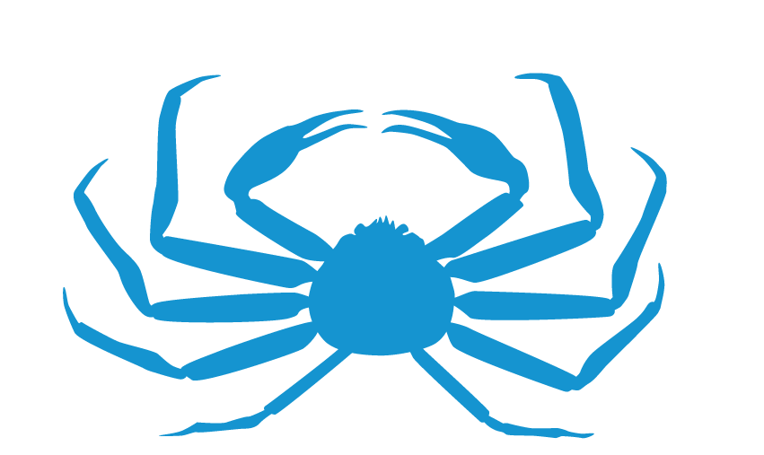
Background and Summary of Alt 1,
No Action

Slide 7
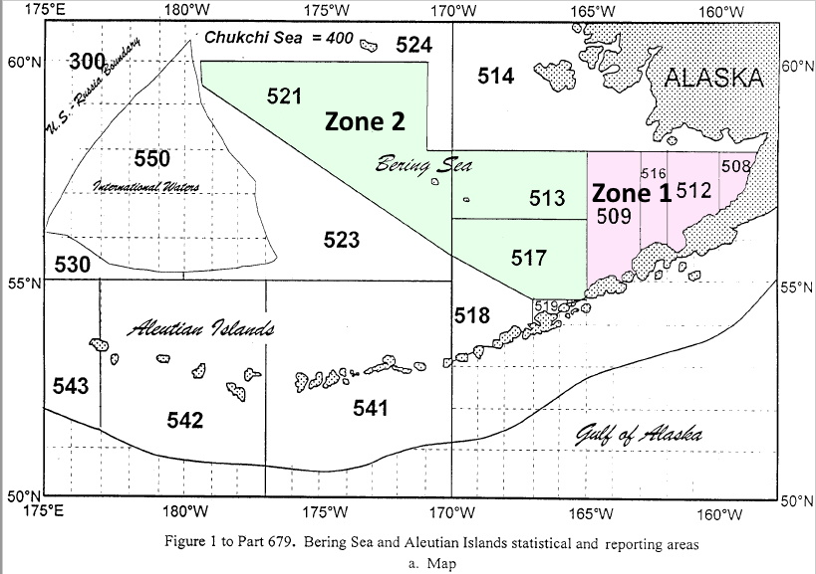
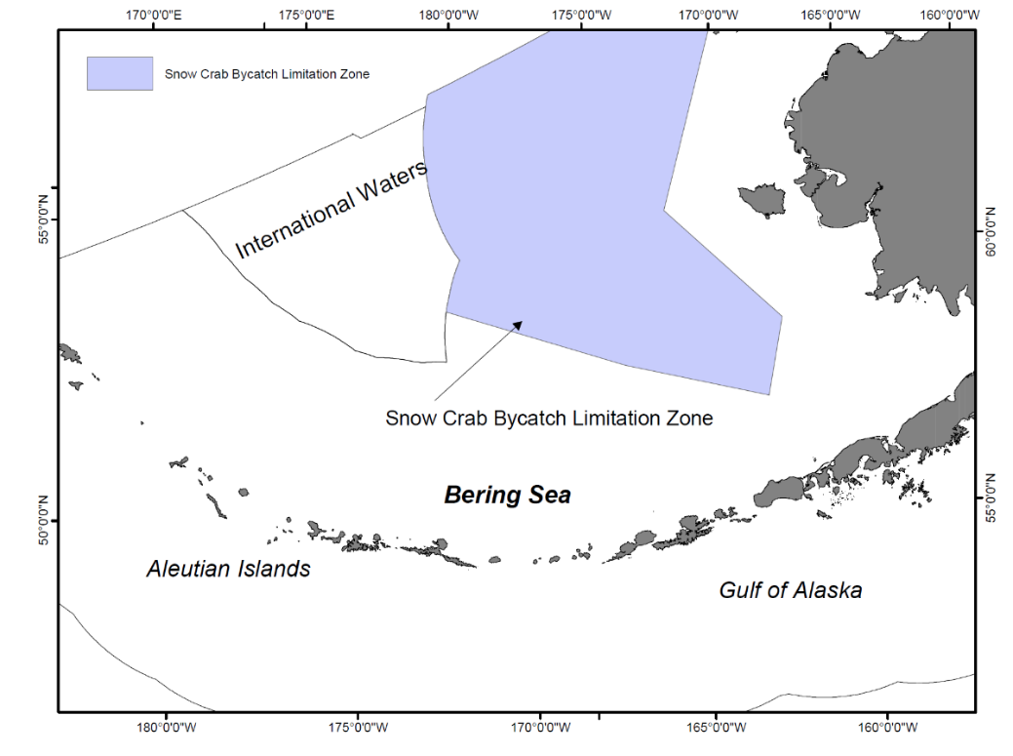
Triggered Area Closures
Zone 1 and 2 area closures
(BBRKC and EBS Tanner crab)
C. Opilio Bycatch Limitation Zone
(COBLZ)

Slide 8
Zone 1 Red King Crab PSC Limits
When the number of mature female red king crab is … | The zone 1 PSC limit will be …
(A) At or below the threshold of 8.4 million mature crab or the effective spawning biomass is less than or equal to 14.5 million lb (6,577 mt) | 32,000 red king crab.
(B) Above the threshold of 8.4 million mature crab and the effective spawning biomass is greater than 14.5 but less than 55 million lb (24,948 mt) | 97,000 red king crab.
(C) Above the threshold of 8.4 million mature crab and the effective spawning biomass is equal to or greater than 55 million lb | 197,000 red king crab.
Section 2.1

Slide 9
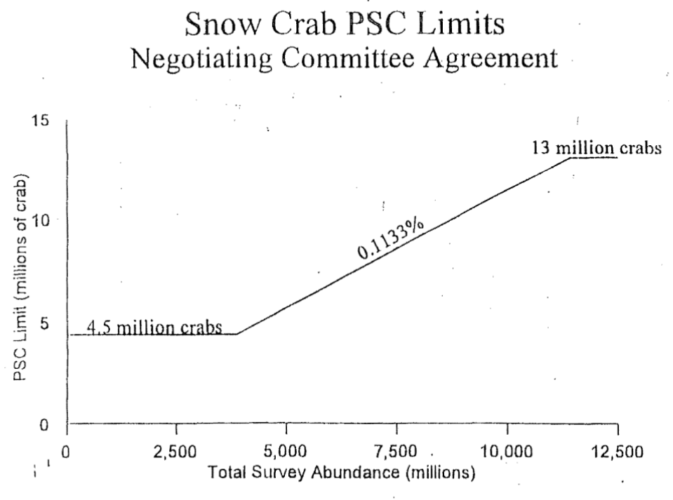
COBLZ Snow Crab PSC Limits
Set annually at 0.1133% of the snow crab abundance estimates minus 150,000 crab unless minimum or maximum abundance threshold is reached.
  If 0.1133% multiplied by the total abundance is less than 4.5 million, then the minimum PSC limit will be 4.350 million animals.
  If 0.1133% multiplied by the total abundance is greater than 13 million, then the maximum PSC limit will be 12.850 million animals.

Slide 10
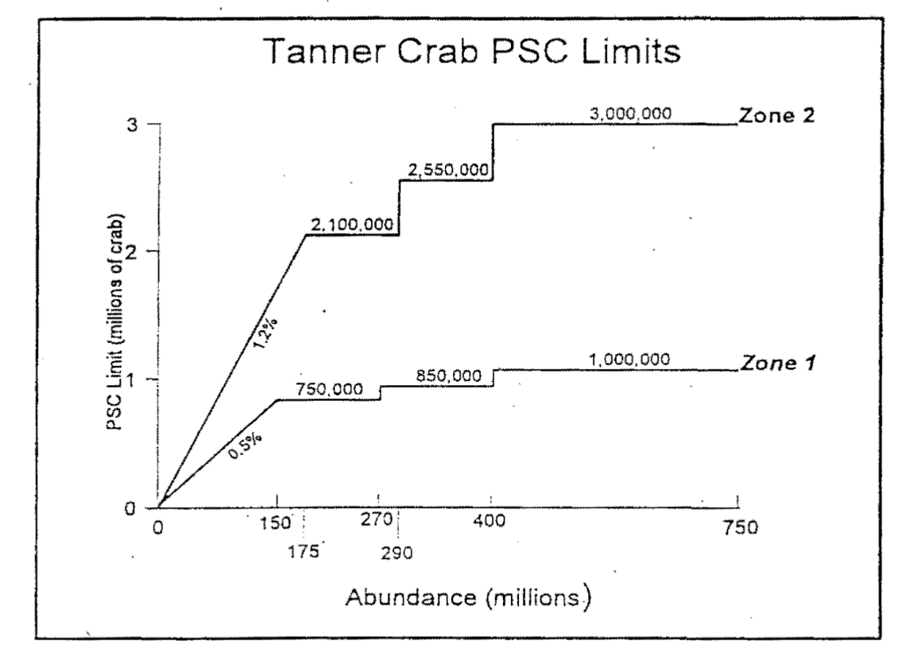
EBS Tanner Crab PSC Limits
Zone 1:
When the total abundance of C. bairdi crab is … | The PSC limit will be …
(1) 150 million animals or less | 0.5 percent of the total abundance minus 20,000 animals
(2) Over 150 million to 270 million animals | 730,000 animals
(3) Over 270 million to 400 million animals | 830,000 animals
(4) Over 400 million animals | 980,000 animals
Zone 2:
When the total abundance of C. bairdi crab is … | The PSC limit will be …
(1) 175 million animals or less | 1.2 percent of the total abundance minus 30,000 animals
(2) Over 175 million to 290 million animals | 2,070,000 animals
(3) Over 290 million to 400 million animals | 2,520,000 animals
(4) Over 400 million animals | 2,970,000 animals

Slide 11
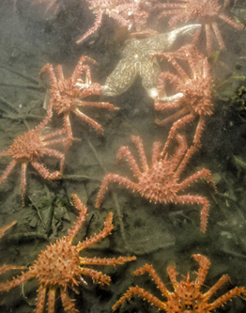
Bristol Bay Red King Crab in Zone 1

Slide 12
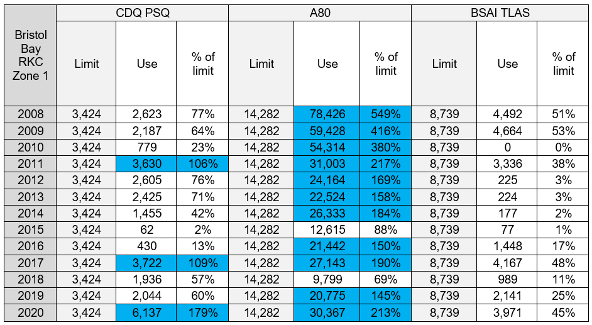
Alternative 1: BBRKC Use Based on the Lowest Limits
Have not been set to lowest threshold between 2008-2020
Past years where – had BBRKC been set to lowest limit – sectors may have reached limit and been closed out of Zone 1 (represented in blue)

Slide 13
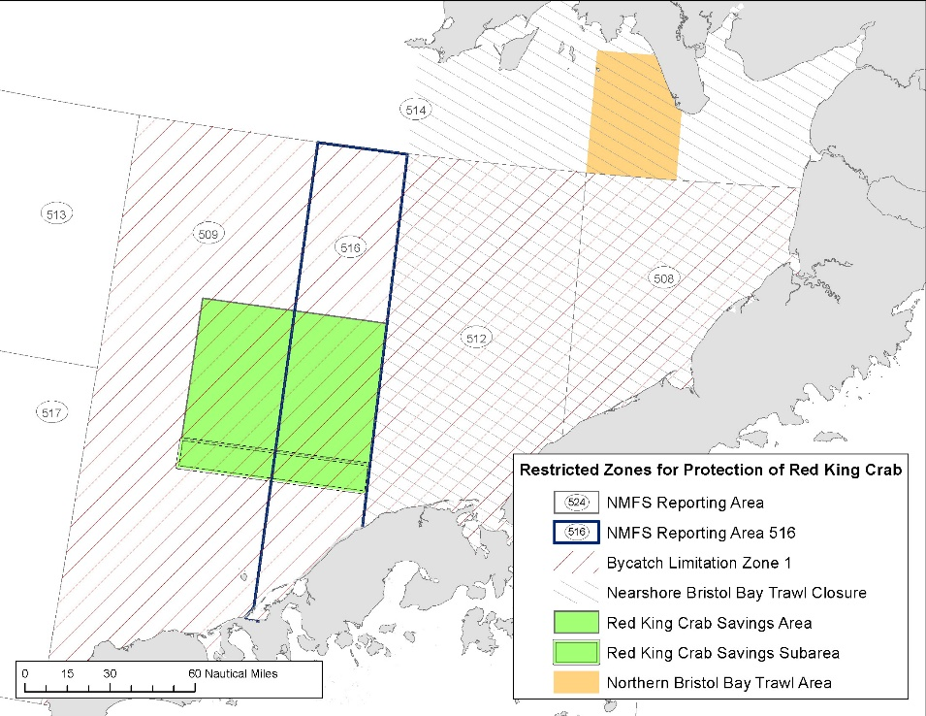
Alternative 1: Impact of Lower BBRKC Limits to the Groundfish Sectors
Thresholds for BBRKC PSC limits align with the State harvest strategy
Groundfish sector impacts if directed fishery is not opened/ thresholds not met:
  Closed out of Red King Crab Savings Subarea (RCKSS)
  Reduce A80 sector limit from 43,293 crab to 14,282 crab
  Lower PSC limits may come at a cost (even when catch is not approaching the limits)
  A Zone 1 closure likely to result in additional forgone revenue and increased costs associated with fishing

Slide 14
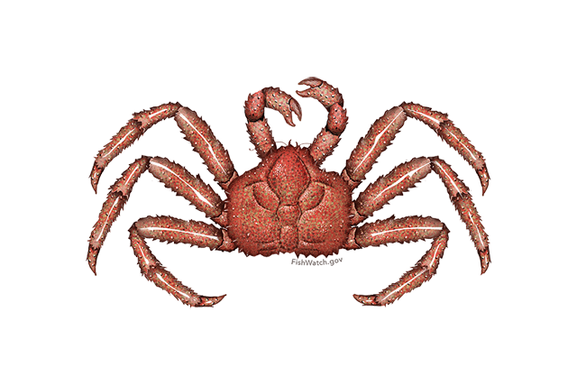
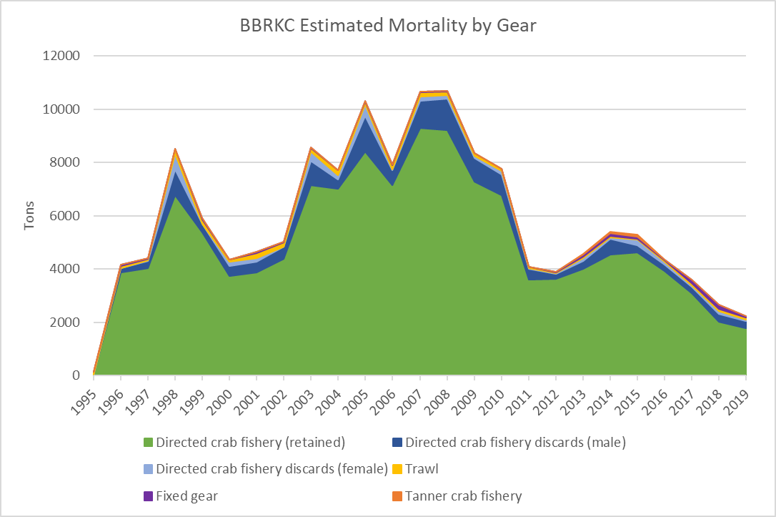
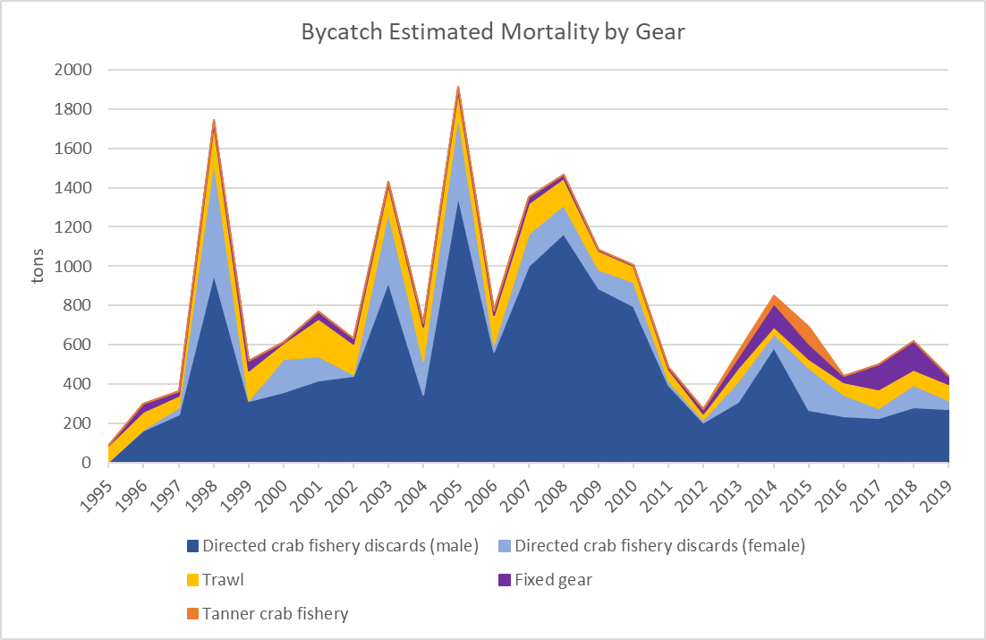
Alternative 1: Potential Effects on BBRKC
trawl PSC still represents a small portion of fishing mortality
other gear types are estimated to represent a greater portion of the crab PSC
crab PSC limits at their lowest threshold may have a modest impact on stock’s ability to rebuild

Slide 15
Sensitivity Analyses
Potential impacts of unobserved trawl mortality
For BBRKC, when bycatch biomass increases by 500% or more in the models, estimated MMB values in the terminal years could decrease about 14% or more; the decreases might be much larger for some years.
For Tanner crab, based on previous catch rates, increasing the bycatch by 1000% would have lowered the MMB in the 1970s by an estimated ~100,000 t, while in recent years it would have been estimated to be ~6,000 t less.
For snow crab, bycatch has been small enough that increasing the bycatch input by 1000% resulted in only a ~2% change in the terminal year of MMB (with largest changes in the mid-1990s through mid-2010).

Slide 16
Alternative 1: Impact of Lower BBRKC Limits on the Crab Directed Fishery
Rely on Economic SAFE (hopefully updated soon!) to describe some of the economic changes being experienced by the crab directed fisheries
Given the expectation for modest stock impacts, BBRKC PSC limits set to lower thresholds expected to have limited indirect impacts to the directed fishery

Slide 17
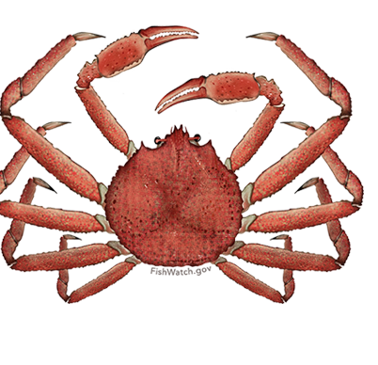
Snow Crab in COBLZ and Tanner Crab in Zone 1 and 2

Slide 18
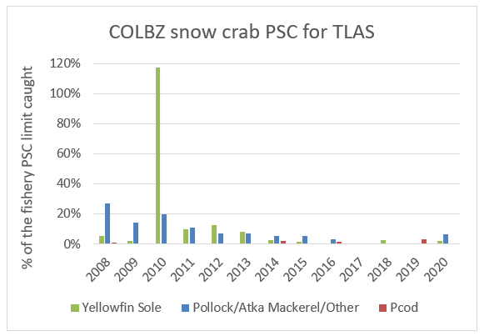
Alternative 1: EBS Snow in COBLZ and
Tanner Crab in Zone 1 and Zone 2
COBLZ limit only hit once
  BSAI TLAS in 2010
Snow Crab PSC limit hit lowest threshold in 2017
Tanner Crab PSC limit hit lowest threshold in 2008-2010

Slide 19
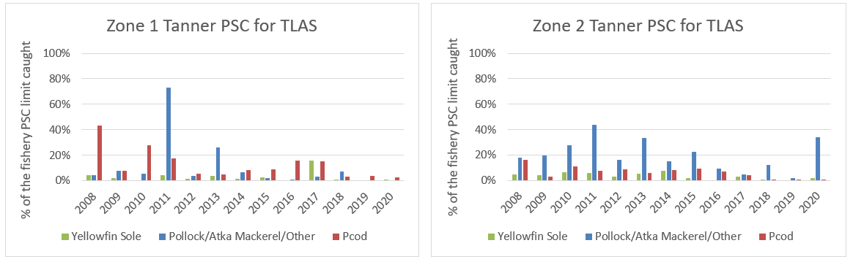
Tanner Crab PSC use for TLAS in Zone 1 and Zone 2

Slide 20
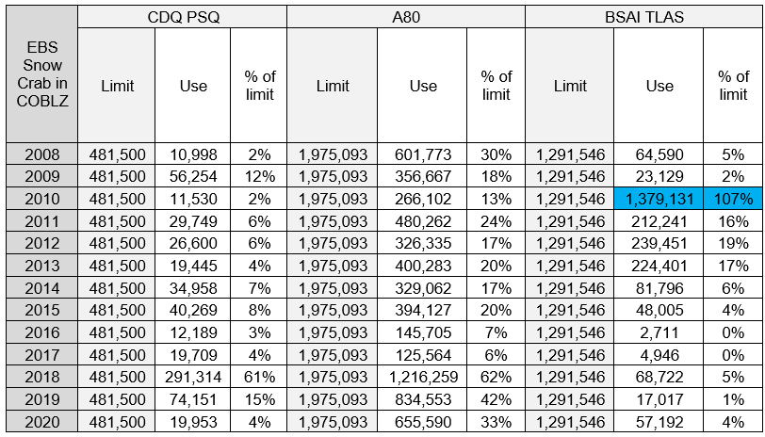
EBS Snow crab COBLZ PSC use relative to the lowest limits (# of crab), 2008-2020

Slide 21
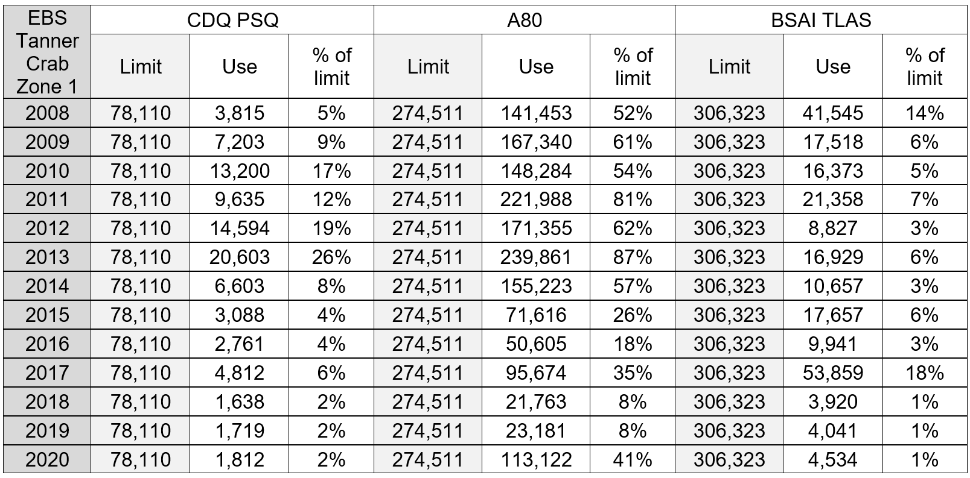
EBS Tanner Zone 1 PSC use relative to the lowest fixed limits (# of crab), 2008-2020

Slide 22
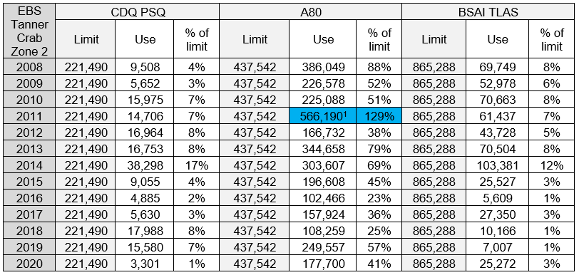
EBS Tanner Zone 2 PSC use relative to the lowest fixed limits (# of crab), 2008-2020

Slide 23

Tanner and Snow Crab Stock Status
Tanner Crab
Snow Crab
EBT and WBT directed fisheries have experienced variable closures over time
MMB has been declining since 2014/15
Harvest strategy amended in March 2020
  New thresholds for opening
  Reduces number of years the fishery is closed
MMB increase
Large recruitment, positive trends
Unlikely for directed fishery closure in the near term

Slide 24
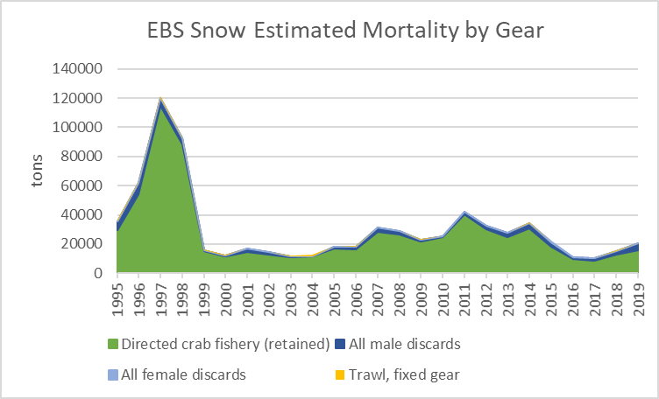
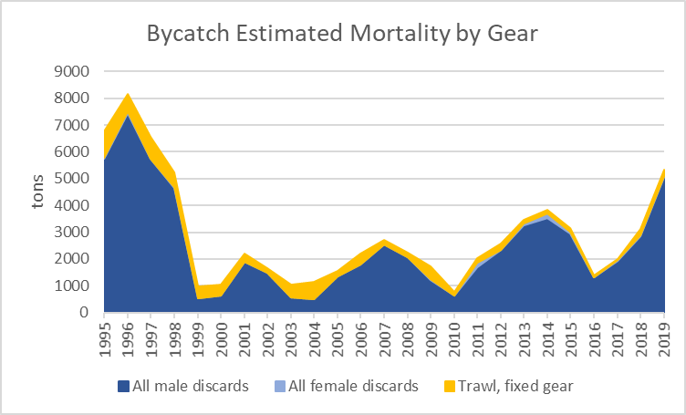

Slide 26
Summary of Anticipated Changes Under Alt 2

Slide 27
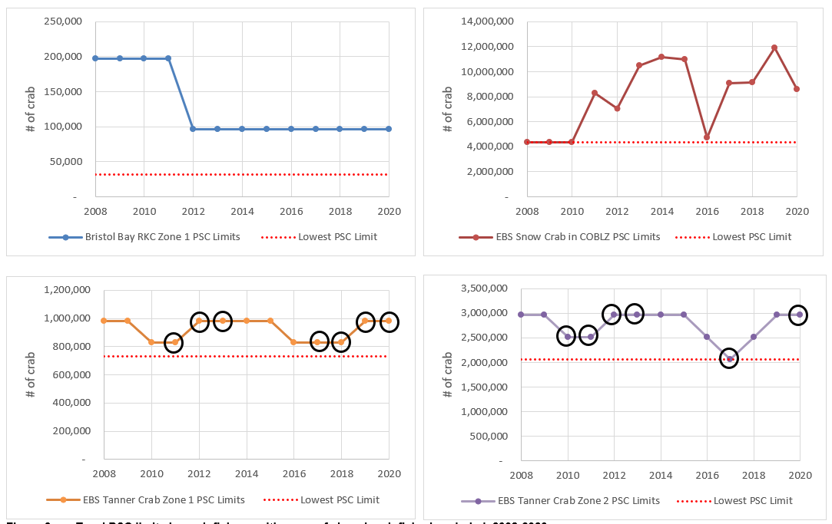
Trawl PSC limits by crab fishery, with years of closed crab fisheries circled, 2008-2020

Slide 28
Alternative 2
If directed _________ fishery is closed | PSC limit would be….
BBRKC | 32,000 animals in Zone 1
EBS snow crab | 4.350 million animals in the COBLZ
EBS tanner* | 730,000 animals in Zone 1 2.07 animals in Zone 2
*These limits are not the lowest tier currently specified in regulation, but the lowest fixed amount.
Expected impacts under Alternative 2 are essentially the same types of impacts highlighted under Alternative 1
Alternative 2 may increase the likelihood crab PSC would be applied at lowest abundance-based thresholds
  Particularly Zone 1 and Zone 2 Tanner PSC limits
Changes in groundfish trawl fishing behavior and thus changes in resource components are expected to be limited, relative to no action

Slide 29
Impacts of Alternative 2
Limited scope of impacts is expected for BBRKC because thresholds are already aligned (not because lower PSC limits would have no effect)
Limited scope of impacts expected for snow and Tanner based on past PSC relative to lowest PSC limits
  Large snow or Tanner crab recruitment events could change “typical” PSC pattern in groundfish trawl fisheries
  Snow and Tanner crab PSC based on abundance estimates that include juveniles
  Directed fishery may close due to low mature crab biomass, but large recruitment means PSC encounter rates could be higher
  Further investigation of size selectivity

Slide 30
Additional Implications of Alternative 2
Trawl crab PSC is a small portion of observed fishing mortality
  Reduced BBRKC limits in Zone 1 may adversely impact groundfish trawl sector, but is most likely to provide greatest PSC savings
  Reduced Tanner and snow crab limits would have limited impacts to groundfish sector, associated processors, and communities, based on past PSC use
More explicit and definitive link between management of directed crab fisheries and PSC limits in groundfish trawl fisheries

Slide 31

Thanks!
Especially to stock assessment authors-
  Jie Zheng
  William Stockhausen
  Cody Szuwalski
And all reviewers/ contributors!
(Section 6)
Questions?
Sarah Marrinan
sarah.marrinan@noaa.gov
907-602-1923

Slide 32
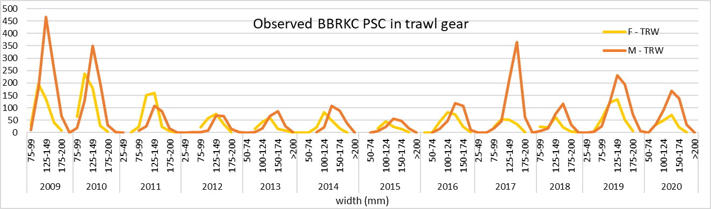
Crab PSC size/sex composition
Notes:
King crab are measured from the right eye socket to the middle of the posterior margin of the carapace. Do not include the second abdominal segment in your measurement. Be careful not to let the caliper tip slip into the eye socket; keep the tip at the socket rim. (really length)

Slide 33
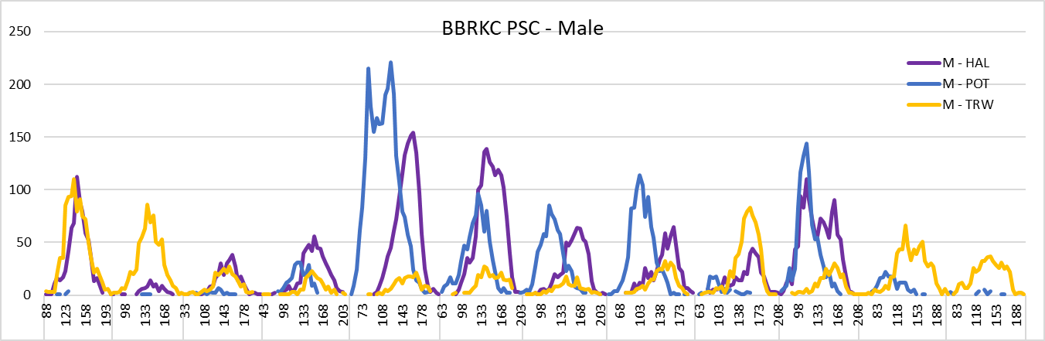
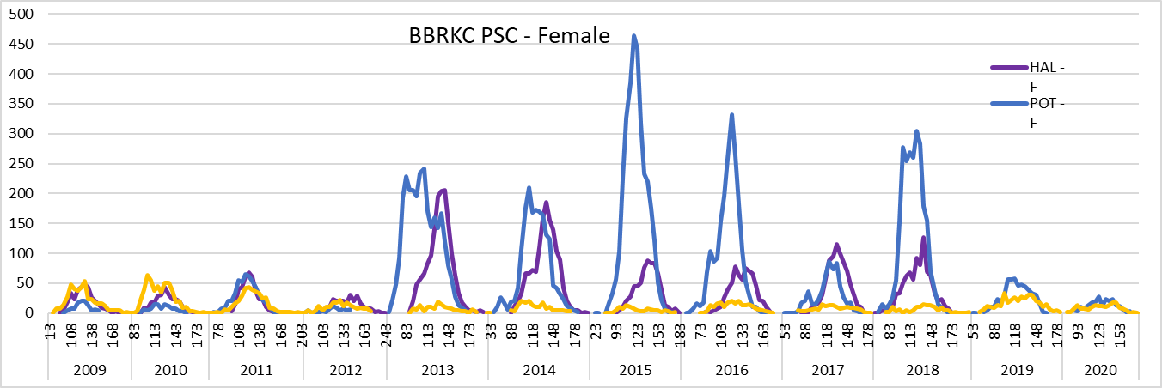

Slide 34
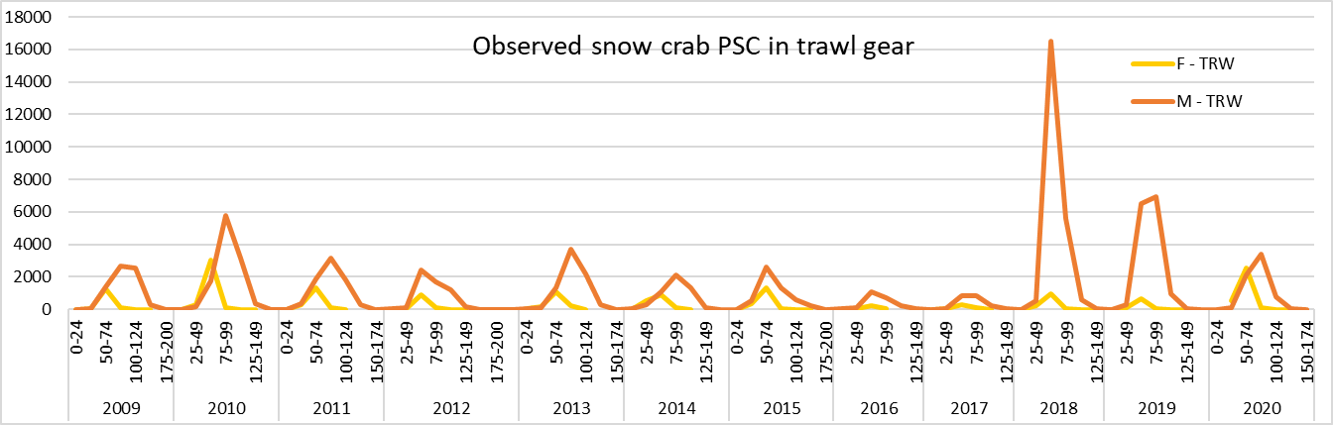
Crab PSC size/sex composition
Notes:
tanner crab are measured across the carapace. Measure at the widest part of the carapace on the lower lateral margin, not the branchial ridge.

Slide 35
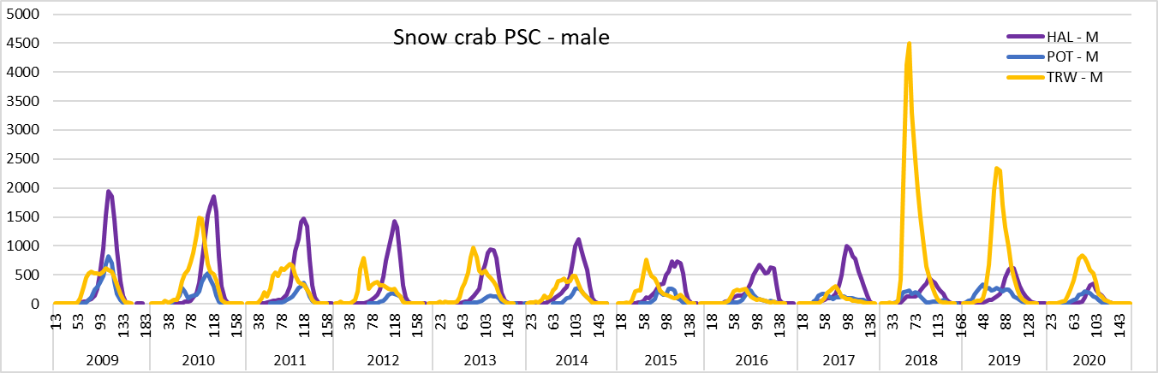
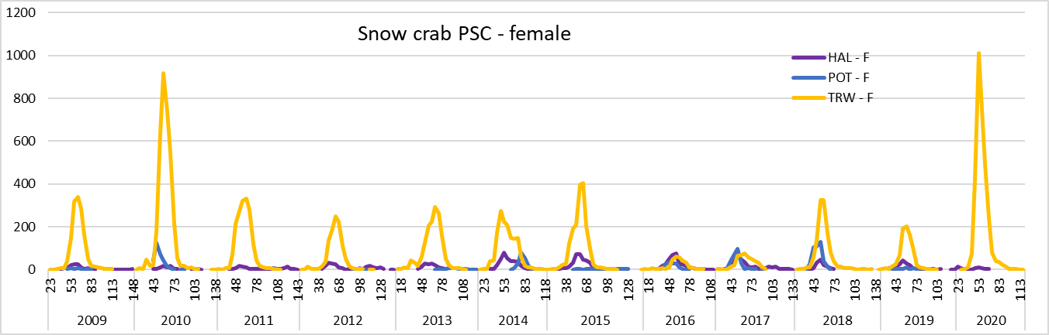

Slide 36
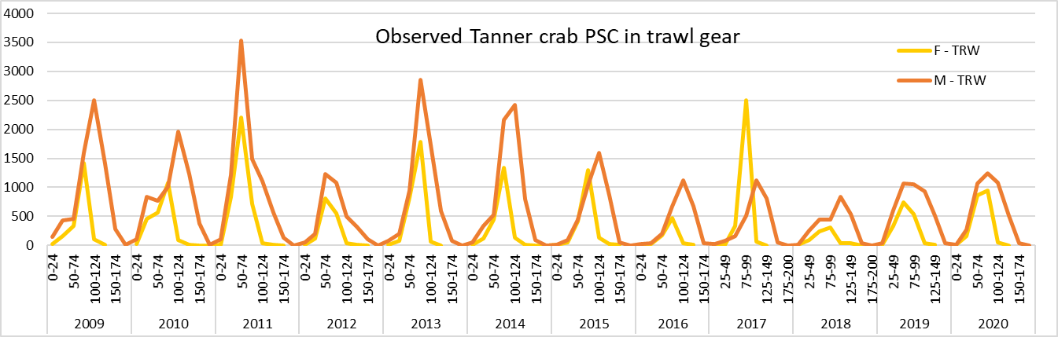
Crab PSC size/sex composition

Slide 37
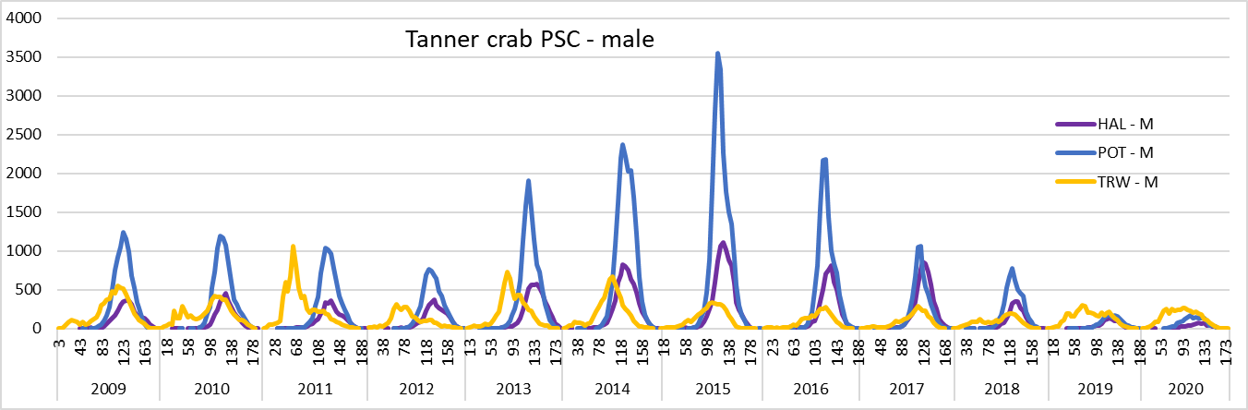
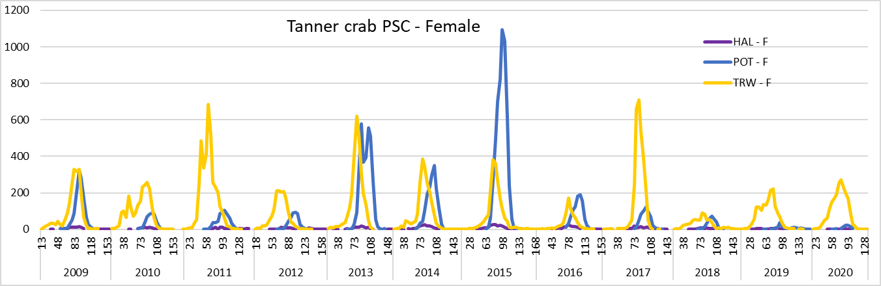

Slide 38
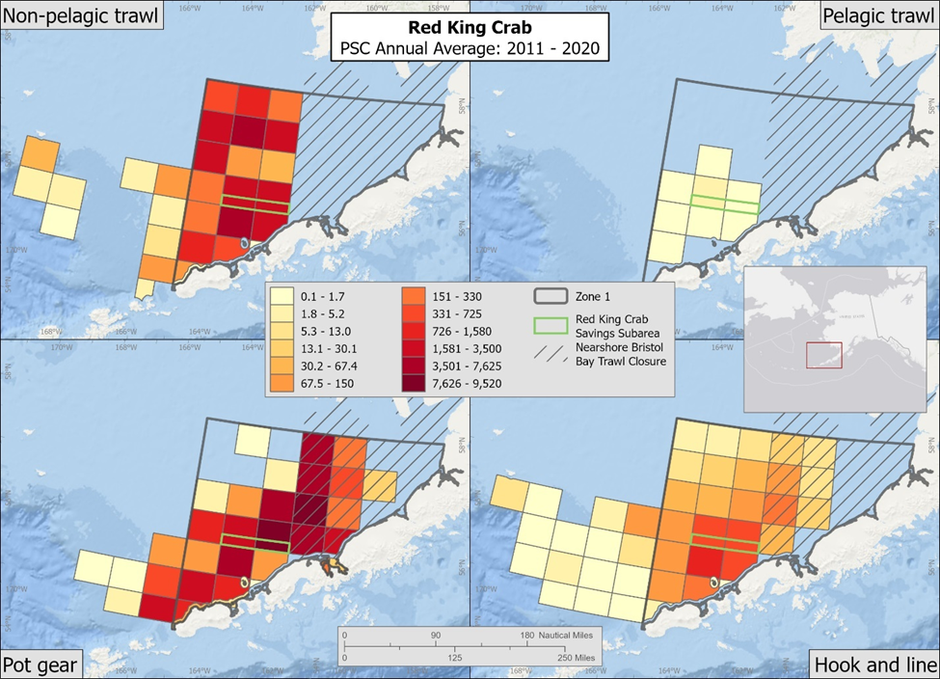

Slide 39
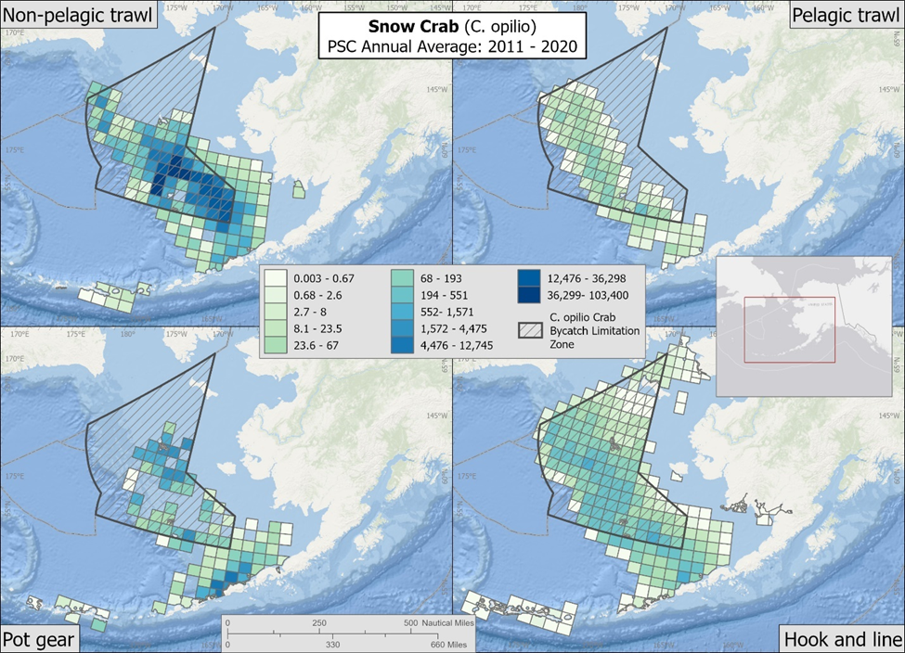

Slide 40
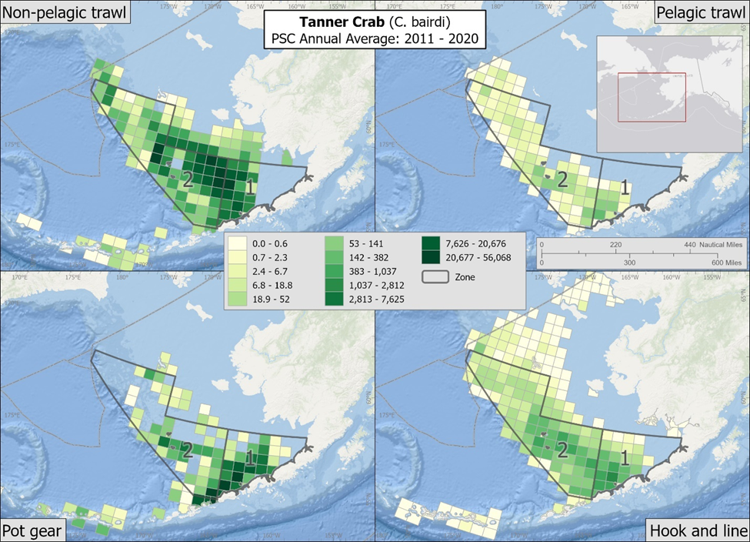

Slide 41
RKC PSC Limits and Use in the BBRKCSS
Notes:
Alternatively could use this image for slide 12?

