Slide 1


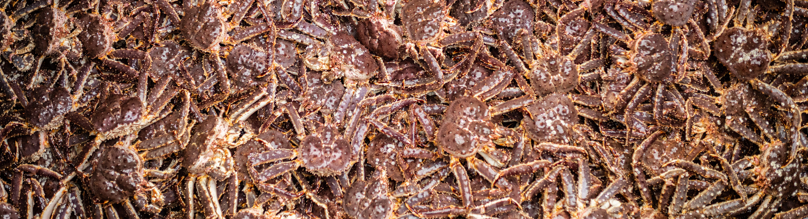


Skipper’s Survey
Alaska Bering Sea Crabbers
CPT Presentation, January 11, 2021
By
Cory Lescher
ABSC.Cory@gmail.com
Photo by Bri Dwyer
ALASKABERINGSEACRABBERS.ORG
@ALASKACRABBERS
Notes:
Alaska Bering Sea Crabbers is the trade association representing the harvesters of king, opilio (snow), and bairdi (Tanner) crab in the Bering Sea. We are actively involved in fisheries management, policy development, scientific research, and marketing. We consider ourselves stewards of the crab resource and are committed to ensuring the sustainability of our fishery for generations to come
Advocating for sustainable fisheries, sound science, economic stability, and safety in our crab fisheries.

Slide 2

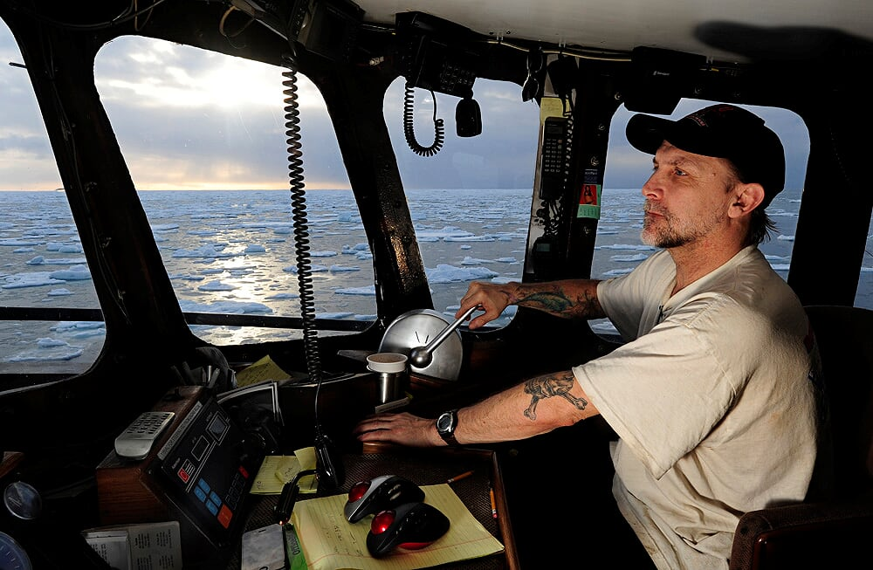
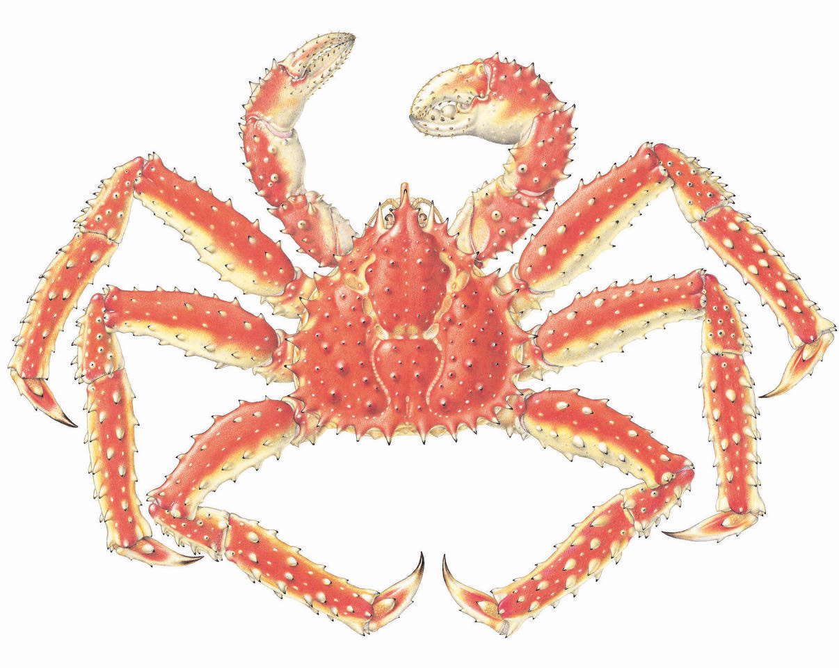
Background
Fishermen spend time on the grounds year after year
Unique vantage point independent from NMFS survey with offset timing
Local and traditional knowledge: how fishermen’s voices can be heard.
Citizen scientist opportunities to help efforts like BSFRF tagging projects
Photo by Chris Miller
A L A S K A B E R I N G S E A C R A B B E R S . O R G
@ALASKACRABBERS
Slide 2 of 11
Notes:
At the end of the 2020 Bristol Bay red king crab fishing season, ABSC sent an end-of-the-season poll to the active skippers asking a set of 10 questions to gather observations from the season, collect updated information pertaining to relevant issues with our fleet and aid BSFRF in detecting tagged crab and more. We had 20 skippers complete the online survey and here are a few abbreviated results conceptualized for easy visualization.
Season after season, fishermen spend time on the grounds and have a unique vantage point for what’s going on in the directed fishery and with the crab resource. As an additional information source that is independent from the NMFS survey/assessment data streams, Alaska Bering Sea Crabbers would like to explore surveying our active fishermen twice per season, after BBRKC and BSS, to document important observations and get feedback on issues affecting the fleet.

Slide 3
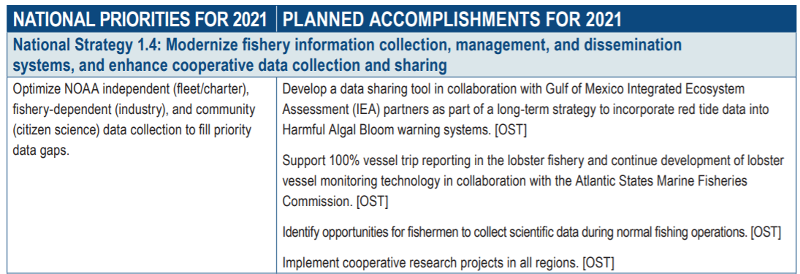
Motivation
Collect local knowledge from skippers’ first hand observations on the fishing grounds – Citizen Science
Establish database of observations
Build trust through communication, education and collaboration
2nd pilot: 2021 snow crab survey
A L A S K A B E R I N G S E A C R A B B E R S . O R G
@ALASKACRABBERS
Slide 3 of 11

Slide 4
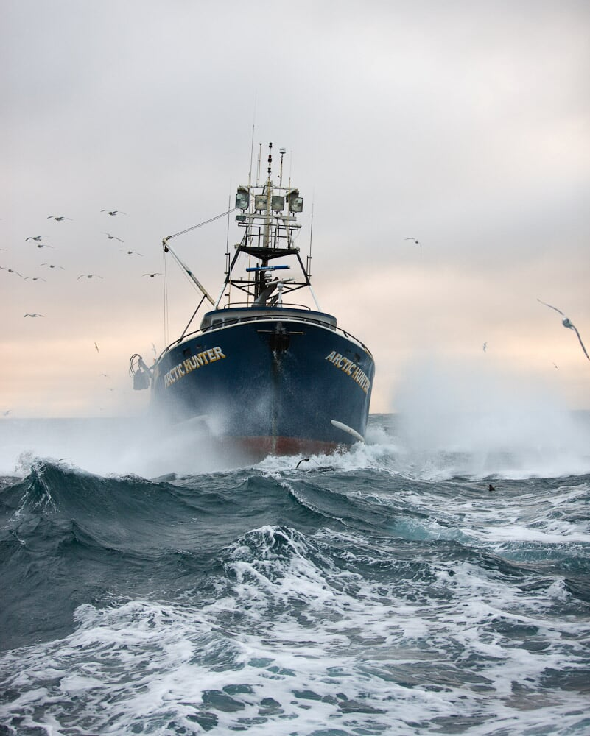
Pilot Poll
2020 BBRKC season
In this short survey, we hope to get the fleet’s impression on:
  Perceived crab abundance
  Areas fished
  Fishery interactions
This survey is anonymous, and the responses will be collated and housed with ABSC to be reported at the fleet level.
10 Questions:
  5 Skippers’ observations
  5 ABSC wants to know
    With comments
20 skippers participated
*This is not a representation of the entire fleet*
Photo by Corey Arnold
A L A S K A B E R I N G S E A C R A B B E R S . O R G
@ALASKACRABBERS
Slide 4 of 11
Notes:
In part, to build on observer data collected due to ~30% coverage.
Expand on bottom trawl survey due to disconnect in timing of fishery (Oct RKC; Jan-April snow) and survey offset (June-July, NBS August).

Slide 5
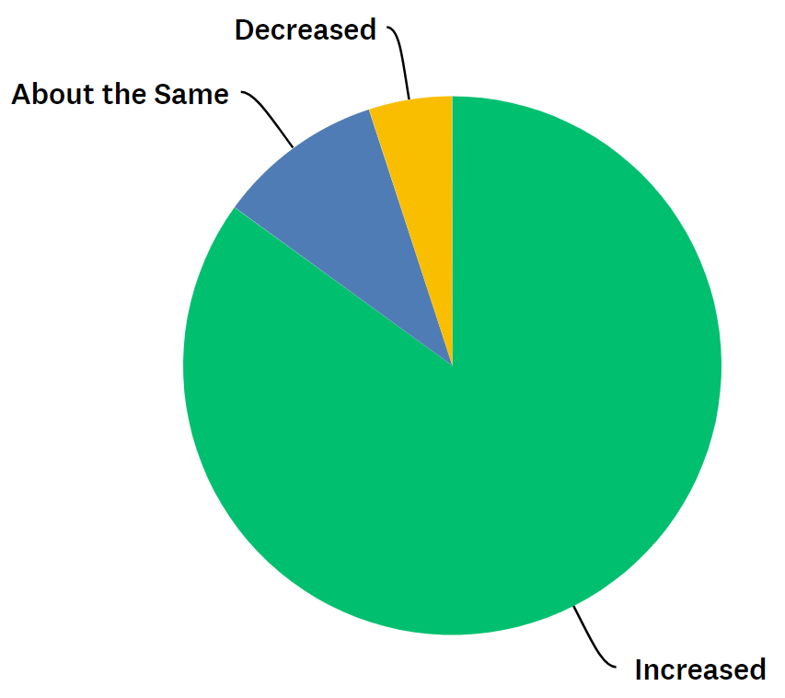

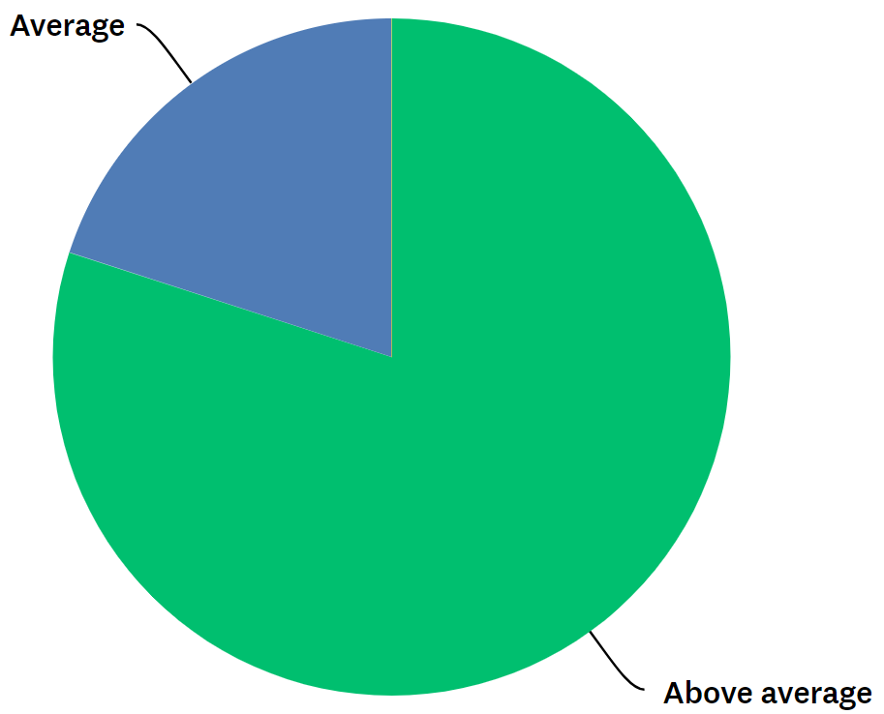
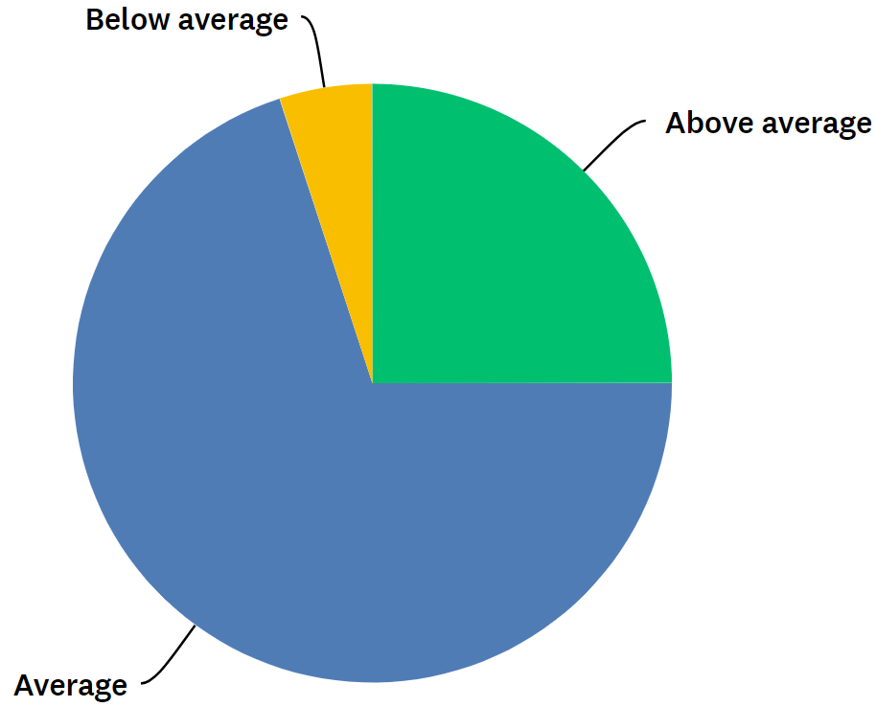
Skippers’ Observations
Q1: Based on your observations this year, did the amount of crab encountered during the fishery suggest a change in the overall abundance of the stock compared to the last three years?
A1:
Decreased
About the same
A2:
Average
Q2: The abundance of young males/pre-recruits compared to the last three years was:
Increased
Above average
Below average
Above average
Q3: The abundance of females compared to the last three years was:
A3:
Average
A L A S K A B E R I N G S E A C R A B B E R S . O R G
@ALASKACRABBERS
Slide 5 of 11

Slide 6
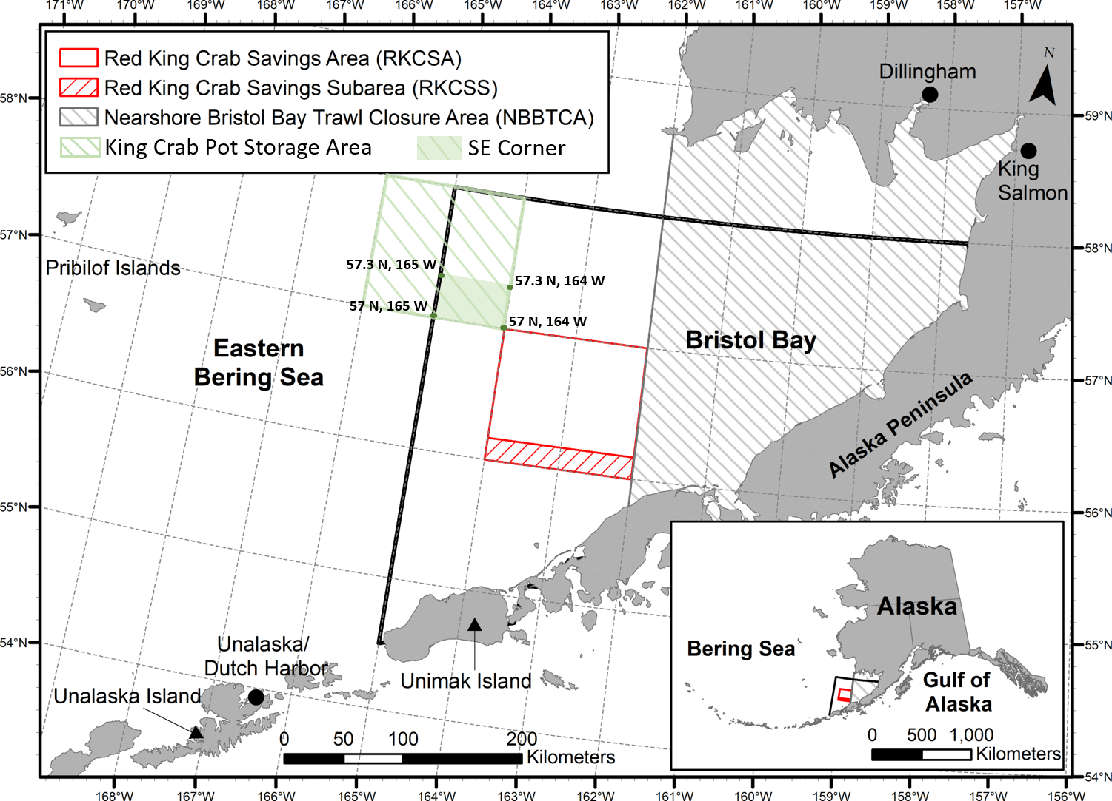
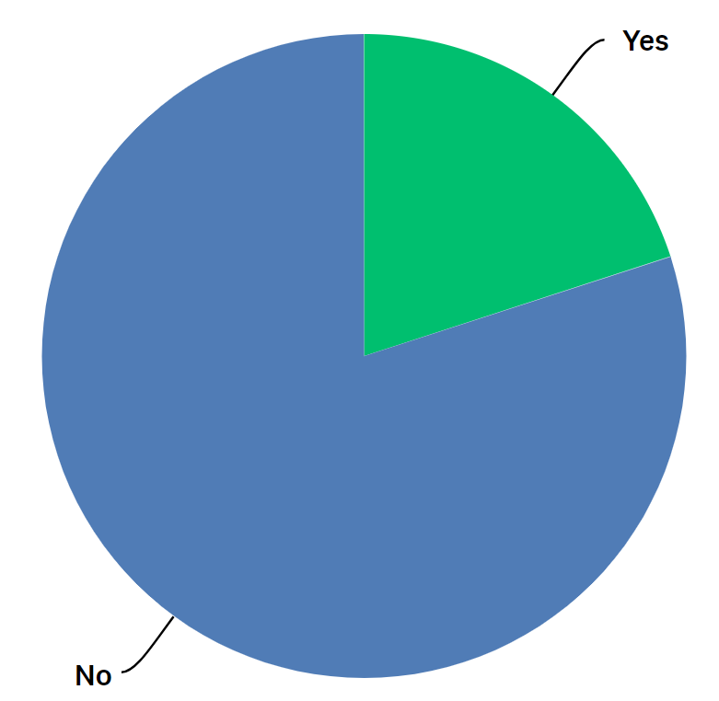
ABSC Wants to Know
Q: Has your vessel used the designated at-sea king crab pot gear storage area box, defined in the Alaska state code at 5 AAC 34.827, in the last 5 years?
Yes
No
Q: During crab fishing, did you observe other types of fishing vessels actively fishing in the vicinity? If so, what type of vessel?
A L A S K A B E R I N G S E A C R A B B E R S . O R G
@ALASKACRABBERS
Slide 6 of 11
Notes:
Yes – 30%
No – 70%

Slide 7
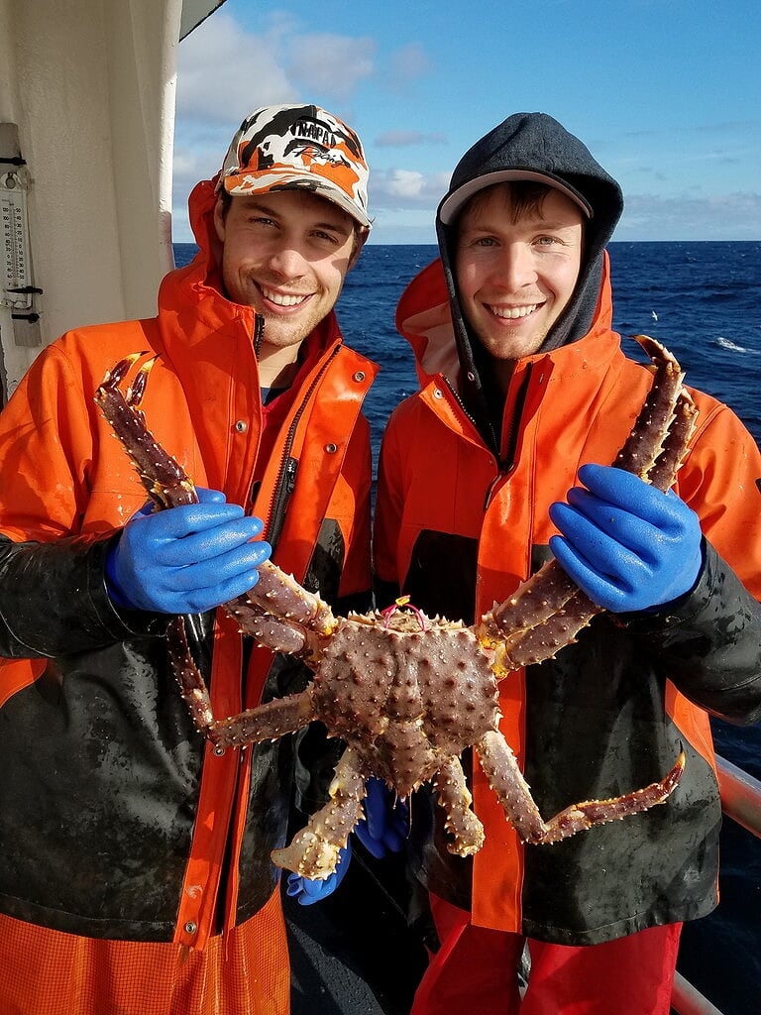
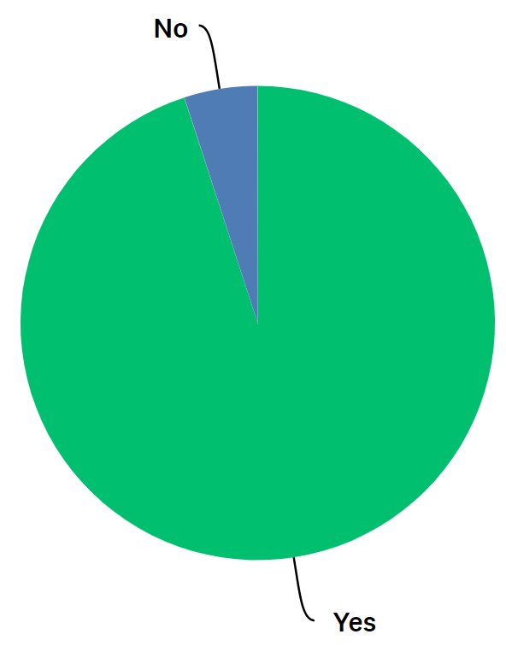
ABSC Wants to Know
Q: Did you encounter any tagged crab during this fishing season?
What type of tag did you encounter?
  46 Spaghetti
  7 Acoustic
  3 Harness
No
Yes
A L A S K A B E R I N G S E A C R A B B E R S . O R G
@ALASKACRABBERS
Slide 7 of 11

Slide 8
Survey Question Overview
Questions 1-5: Skippers’ Observations
Q1: Based on your observations this year, did the amount of crab encountered during the fishery suggest a change in the abundance of the stock compared to the past couple of years?
Increased? About the same? Decreased?
Q2: During this season, did you move fishing locations more frequently than the previous three years?
Yes? No?
Q3: During crab fishing, did you observe other types of fishing vessels actively fishing in the vicinity?
Yes? No?
Q4: During this fishing season, the abundance of young males/pre-recruits compared to the last three years was:
Above average? Average? Below average?
Q5: During this fishing season, the abundance of females compared to the last three years was:
Above average? Average? Below average?
A L A S K A B E R I N G S E A C R A B B E R S . O R G
@ALASKACRABBERS
Slide 8 of 11

Slide 9
Survey Question Overview
Questions 6-10: Additional Questions
Q6: Has your vessel used the designated at-sea king crab pot gear storage area box, defined in the Alaska state code at 5 AAC 34.827, in the last 5 years?
Yes? No?
Q7: If possible, do you think it would make sense to move the pot gear storage area to inside a corner of the Red King Crab Savings Area box where bottom trawling is prohibited?
Yes? No?
Q8: While actively fishing, did you report pot string locations through SeaState or another means?
Yes? No?
Q9: Did you encounter any tagged crab during this fishing season?
Yes? No?
Q10: Do you feel there are questions that should be added or removed from this poll? Are there any additional comments or concerns not addressed in the above questions that you feel should be taken into consideration?
A L A S K A B E R I N G S E A C R A B B E R S . O R G
@ALASKACRABBERS
Slide 9 of 11

Slide 10
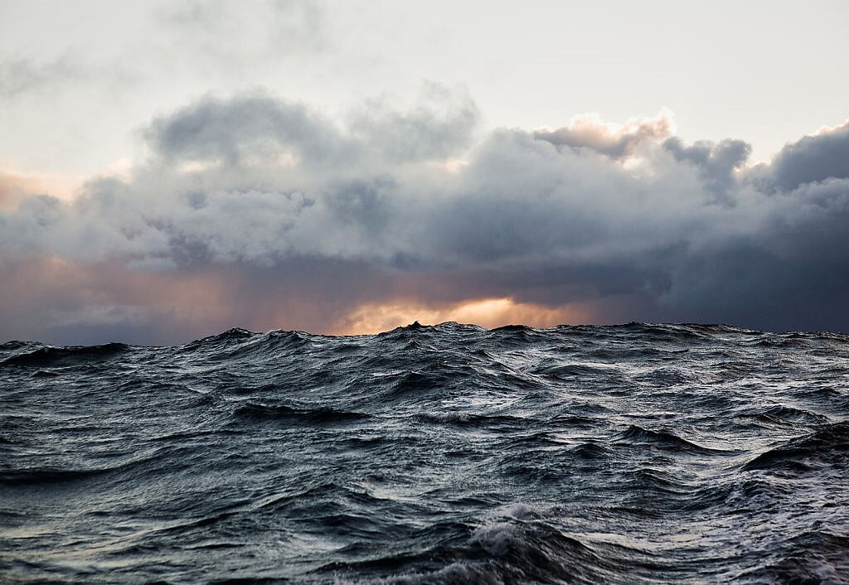
Conclusion
Great feedback from NOAA, ADFG, CPT, BSFRF and skippers prior to RKC pilot poll
Successful pilot
We hope to see more participation in the future
Database of observations for the future of our fish stocks
Photo by Corey Arnold
A L A S K A B E R I N G S E A C R A B B E R S . O R G
@ALASKACRABBERS
Slide 10 of 11

Slide 11
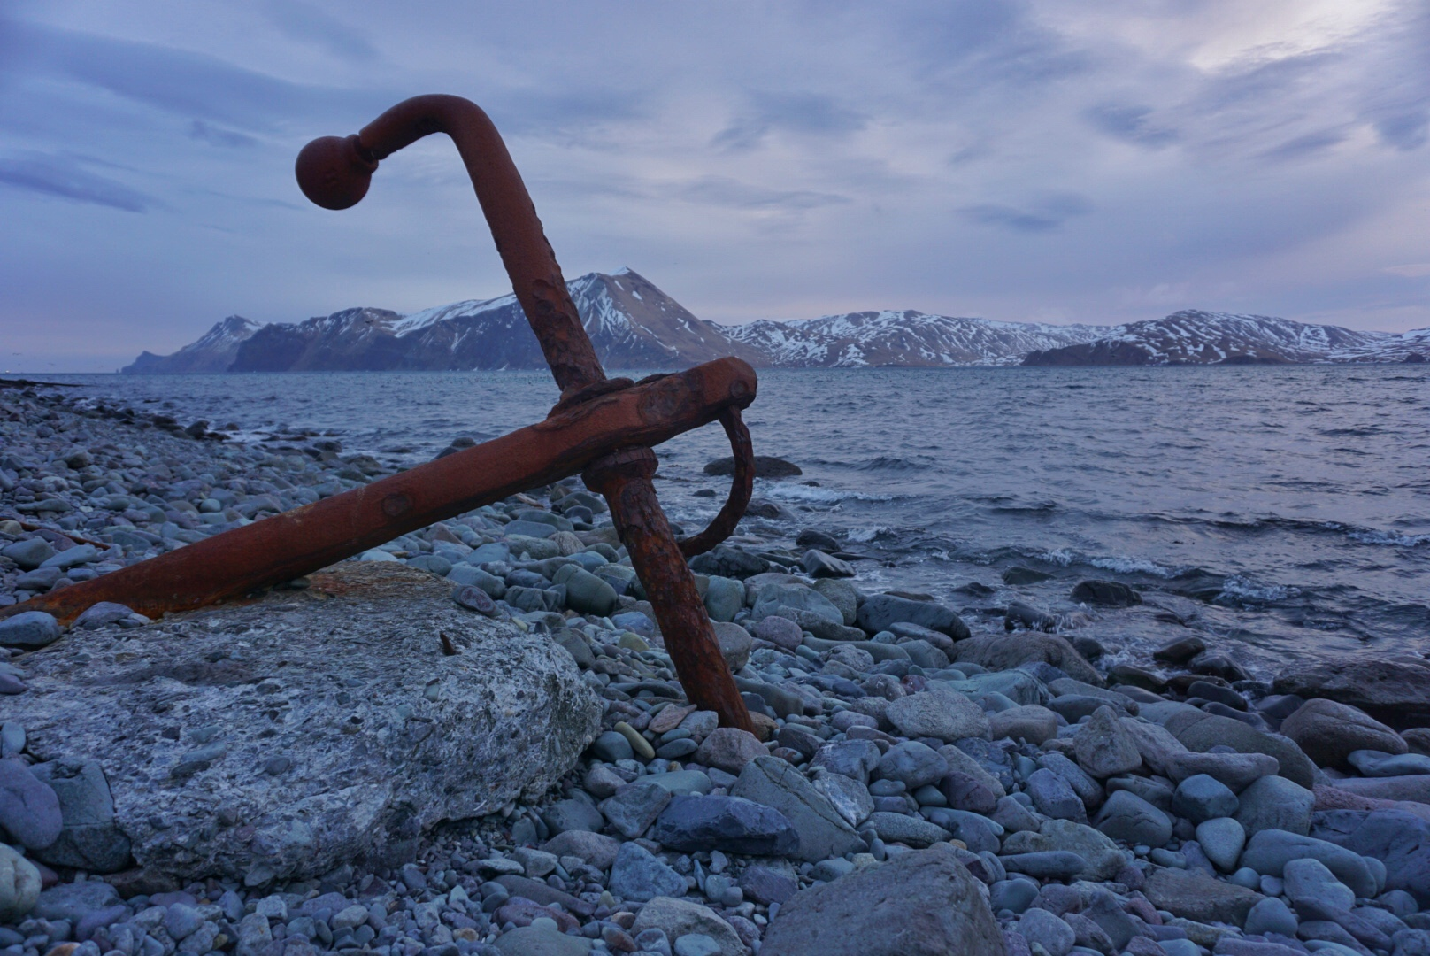
- Thank You -
Open for Discussion
ABSC.Cory@gmail.com
Photo by Cory Lescher
A L A S K A B E R I N G S E A C R A B B E R S . O R G
@ALASKACRABBERS
Slide 11 of 11

