Slide 1
Aleutian Islands Golden King Crab Model Scenarios for May 2021 Assessment
M.S.M. Siddeek^{1,} J. Zheng¹, C. Siddon¹, B. Daly², M.J. Westphal³, and L. Hulbert¹
Alaska Department of Fish and Game, Juneau¹, Kodiak², and Dutch Harbor³, Alaska
CPT meeting, January 12, 2021,

Slide 2
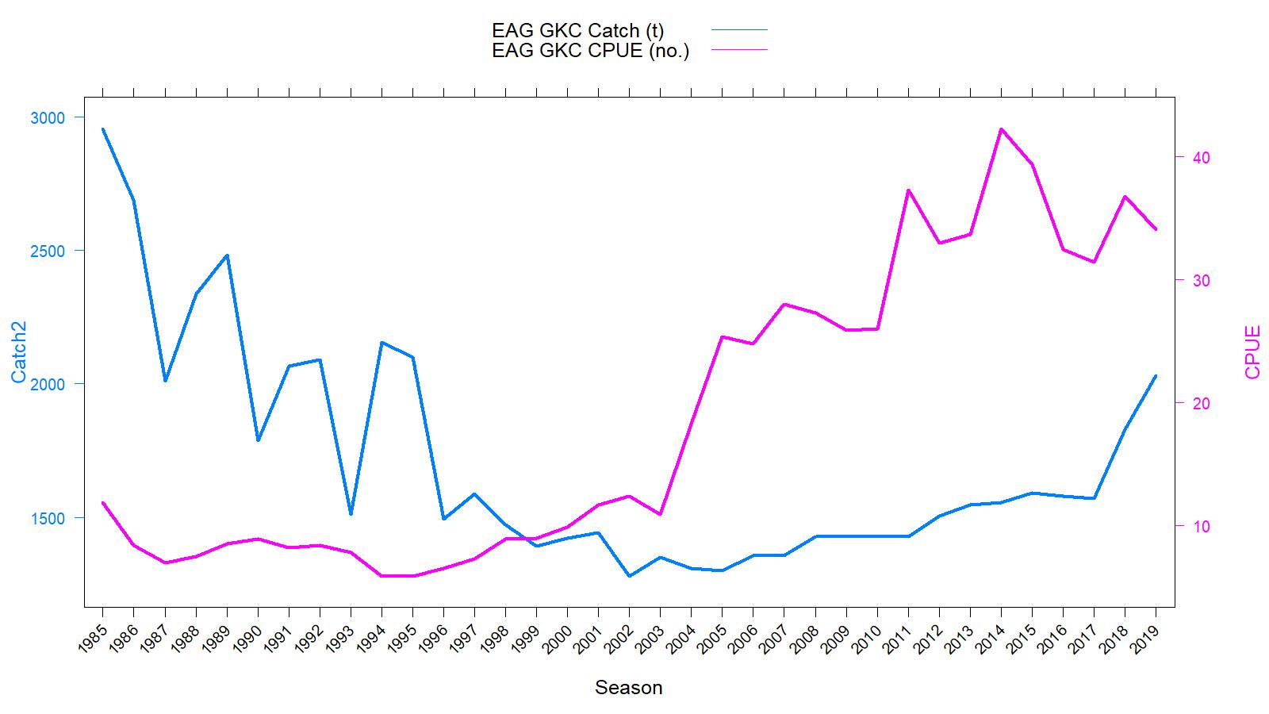
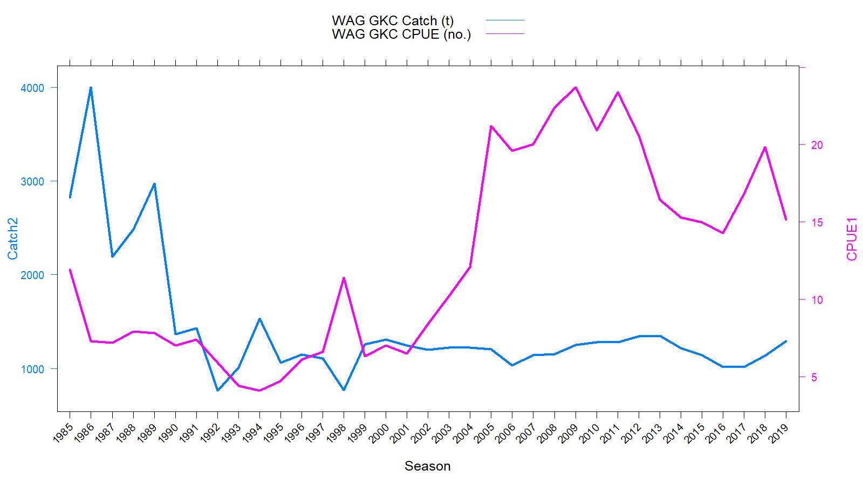
EAG
Catch (t) and CPUE
(number of crab per pot lift), 1985/86–2019/20
Rationalization
TAC
WAG
gear/mesh modification
TACs :
2020/21:
(1) EAG: 3.650 million pounds
(2) WAG: 2.960 million pounds

Slide 3
Topics
Responses to May 2020 CPT and June 2020 SSC comments
Model scenarios for May 2021 assessment consideration
Results and suggested model scenarios

Slide 4
Length based modeling approach
Integrated male-only length-based models fitted to fishery dependent catch and CPUE data.
Constant M of 0.21yr⁻¹.
Projected the abundance from unfished equilibrium in 1960 to initialize the 1985 abundance.
7 scenarios for EAG and 4 scenarios WAG.
Francis re-weighting method for Stage-2 effective sample sizes calculation for all scenarios.

Slide 5
May 2020 CPT (selected) comments
Comment 2: The CPT requested that the next assessment explore the sensitivity of the results to alternative percentages of R_{sigma} (e.g., 50%, 60%, 70%, 80%) and describe the trade-offs among alternatives (e.g., inclusion of imprecise estimates, a non-contiguous set of years, etc.)
Response:
Different percentages of R_{sigma} did not appreciably affect the MMB or recruit trends (Figs. R1 and R2). Therefore, we considered 60% -70% of R_{sigma} as a suitable range common to both regions to determine number of years for mean number of recruit estimation. The selected range was 1987-2017.
.

Slide 6
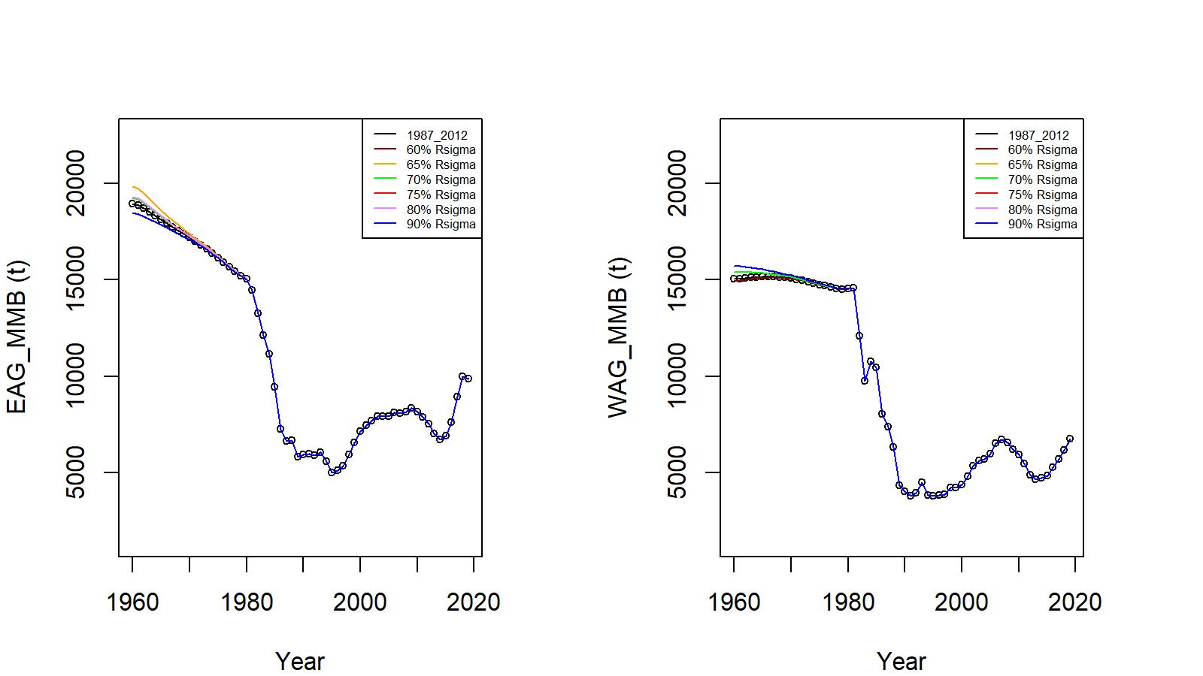
CPT comments continued
Figure R1. MMB trends for different percentages of R_{sigma} cut off mark to determine the period for mean R calculation (EAG: 60%: 1987-2017, 65%: 1987-2017, 70%: 1985-2017, 75%: 1984-2017, 80%: 1984-2017, 90%: 1975-2018; WAG: 60%: 1989-2017, 65%: 1987-2018, 70%: 1987-2018, 75%: 1986-2018, 80%: 1986-2018; 90%: 1986-2018).

Slide 7
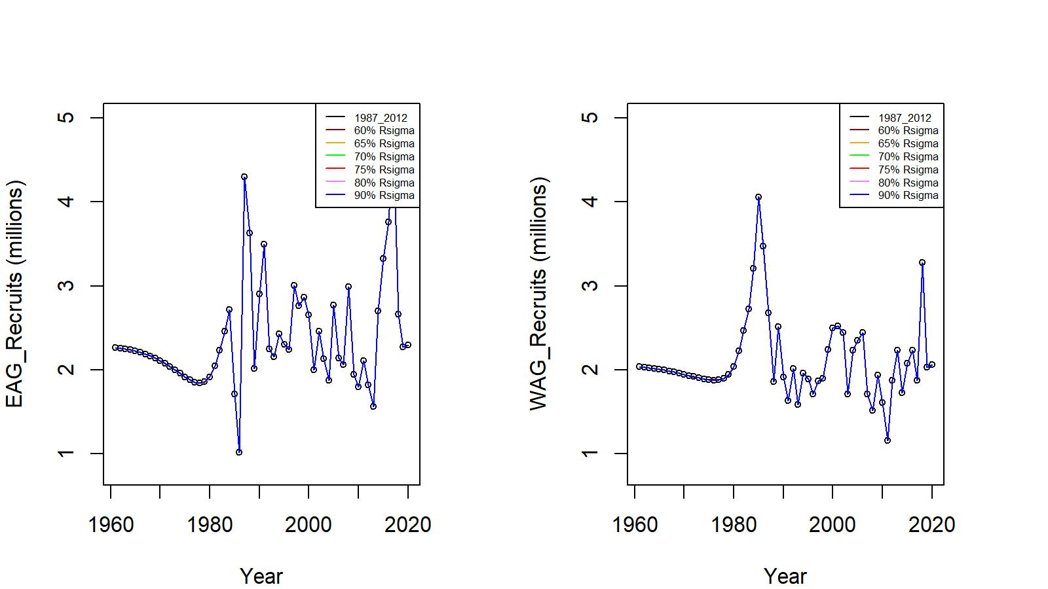
CPT comments continued
Figure R2. Recruit trends for different percent ages of R_{sigma} cut off mark to determine the time period for mean R calculation.

Slide 8

CPT comments continued
Comment 3: The method used to construct the CPUE indices accounts for years*blocks for which there are no data by filling them in using a log-linear model, i.e.,:
$\hat{B_{i, j}}= {e^{A_{i}+ C_{j}}}_{}$
The variance for the final indices (Equation B.16) accounts for the variance of the standardized CPUE values for years*blocks with data but ignores the biomass estimates based on the above formula. This variance should be based on two contributions: a) from block*years with data, and b) from those based on the above (prediction) formula for year*blocks with no or few data.
Response:
Done (Appendix A)

Slide 9
CPT comments continued
Comment 4: The fits to the observer CPUE series should be shown separately for the index based on area*year interactions and that based on the default approach.
Response:
Done (Figures A.2 and A.3).

Slide 10
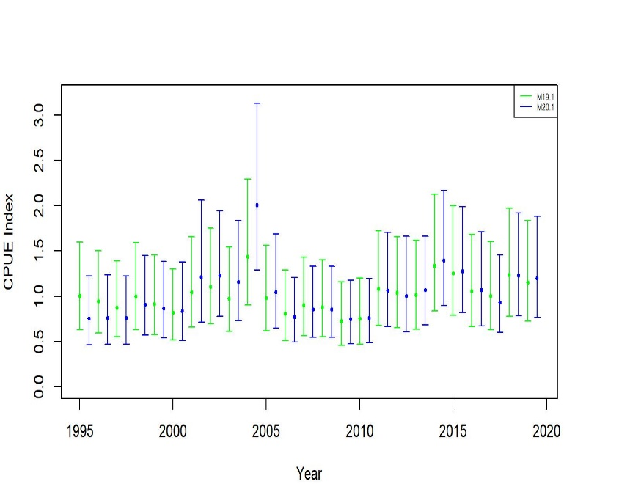
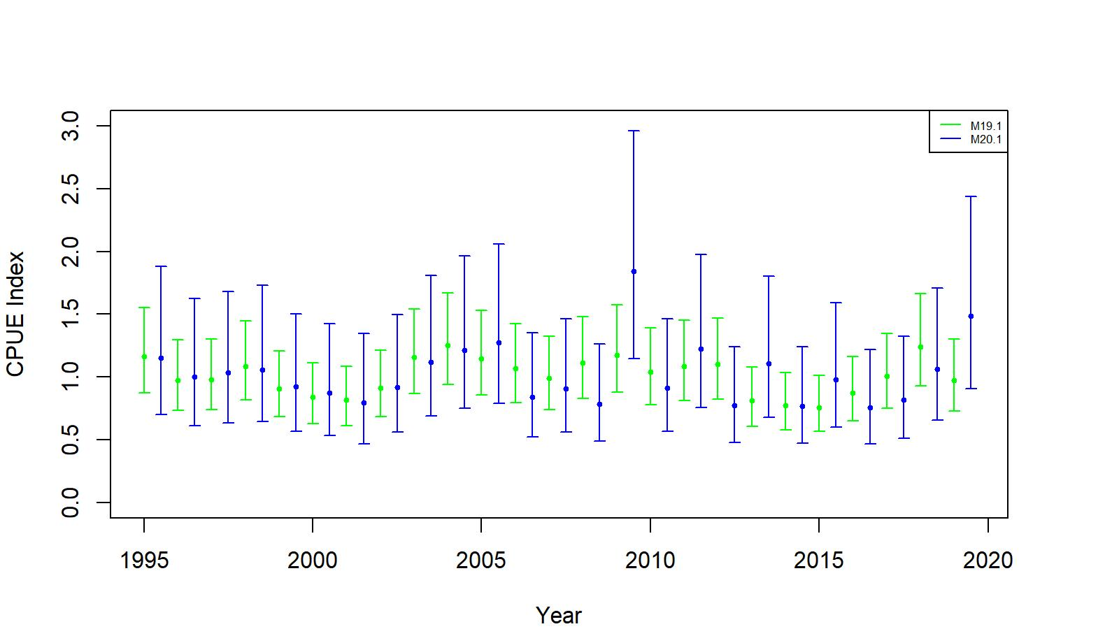
CPT comments continued
Figures A.2 and A.3. Comparison of standardized (negative binomial GLM) CPUE indices with +/- 2 SE between no interaction (green, 19.1) and Year:Area interaction (blue, 20.1) models for golden king crab observer data from EAG (left) and WAG (right). Model estimated additional standard error was added to SE.

Slide 11
CPT comments continued
Comment 5: Time-series of MMB should be shown for all years and for the most recent 15 years—this will help the CPT assess trends.
Response:
Done (Figure 12).

Slide 12
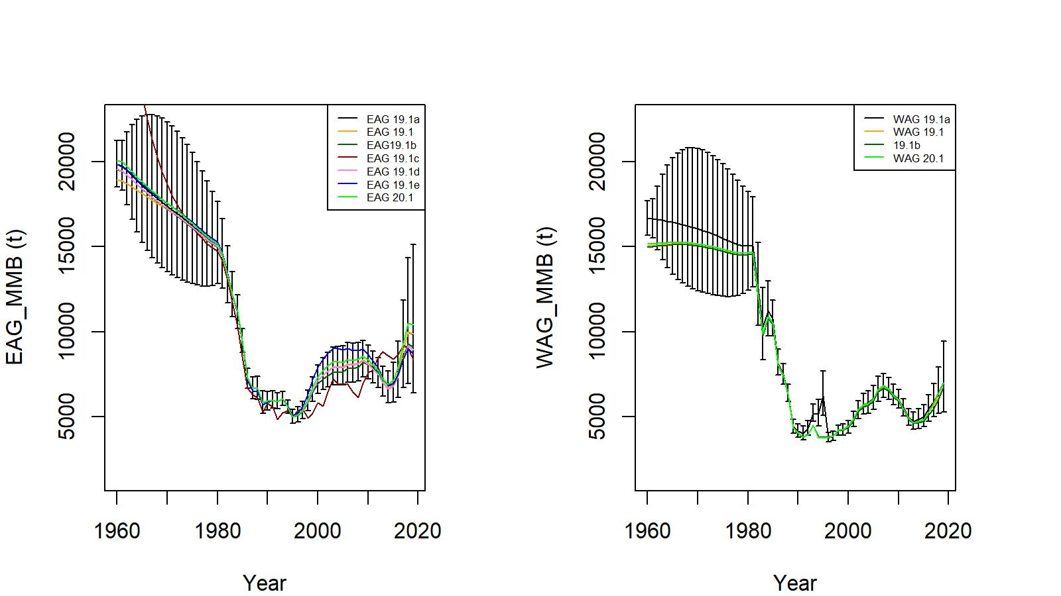
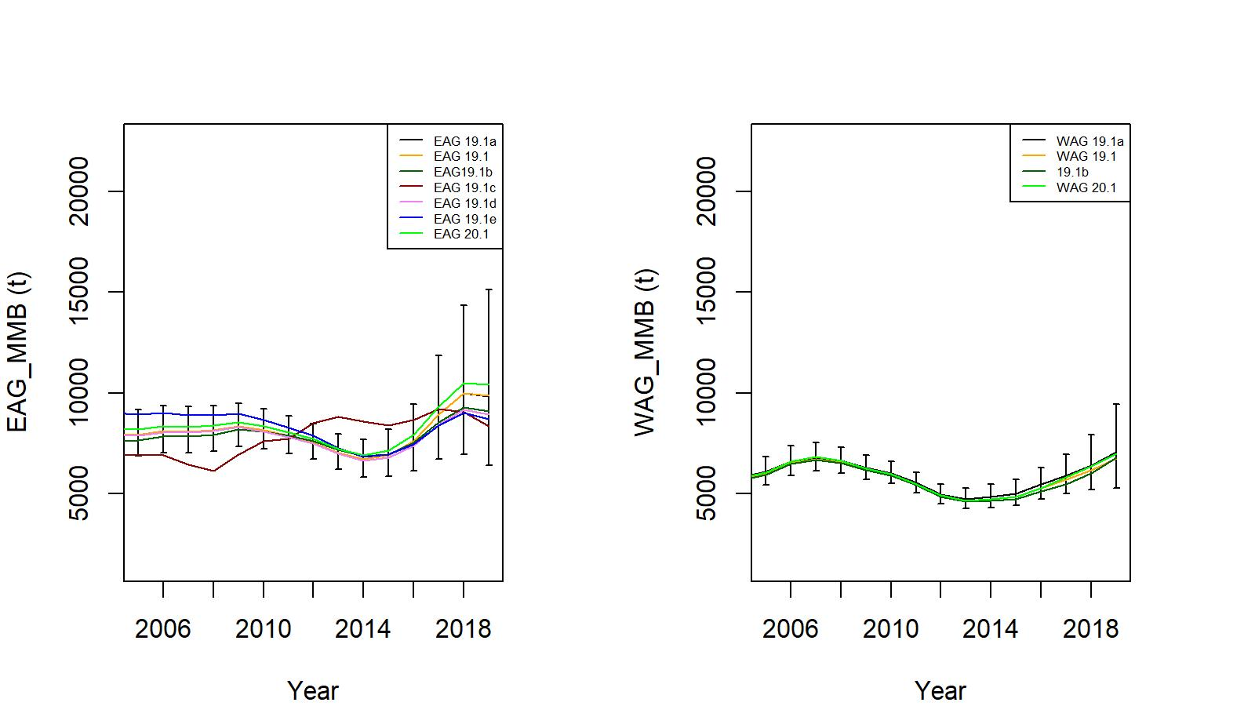
CPT comments continued
Figure 12. Trends in golden king crab mature male biomass for 19.1, 19.1a, 19.1b, 19.1c (EAG Gmacs fit), 19.1d, 19.1e, and 20.1 model fits to EAG (left) and WAG (right) data. Top panel: 1960/61–2019/20, bottom panel: 2005/06–2019/20. Model19.1a estimate has two standard error confidence limits.

Slide 13
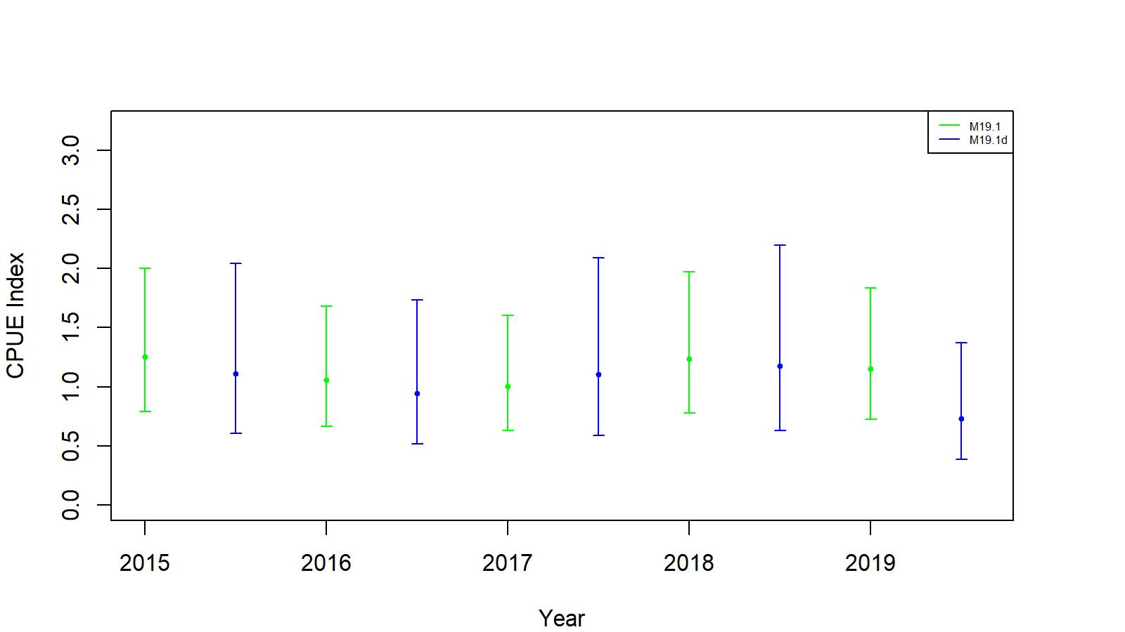
CPT comments continued
Comment 6: The fit to the cooperative survey index should be shown.
Response:
Done (Figure A.8).
Figure A.8. Comparison of cooperative survey model CPUE indices (blue, 19.1d) and observer non interaction factor model CPUE indices (green, 19.1). The confidence limits are determined with ±2SE. Model estimated additional standard error was added to SE.

Slide 14
June 2020 SSC (selected) comments
Comment 1: The annual fishery CPUE index is estimated by combining estimates from one model (model with year:area interaction) that was fit to all year-area combinations that had any fishing effort, and another model (without a year:area interaction) to estimate mean CPUE in those year-area combinations that did not have any fishing effort. The SSC requests more detailed documentation on how Year:Area interaction method is implemented in CPUE standardization.
Response:
The Year:Area interaction parameters were estimated for blocks reporting fishing effort by the GLM model, which included soak time as a predictor variable. This final model was then used to predict the biomass indices for those year-area combinations that did not have any fishing effort (Appendix A). Thus, predictions implicitly considered soak time.
.

Slide 15
SSC comments continued
Comment 2: The SSC recommends that the authors reexamine and justify the random effects structure in the model for the cooperative survey data if it is included in models next year.
Response:
We believe that our random effects structure was best configured following the cooperative sampling design after several trial-and-error formulations in previous iterations. If there are any better structural suggestions on the random effects model, we will consider them in the near future.

Slide 16
SSC comments continued
Comment 3:
The SSC recommends that the authors consider the advantages and disadvantages of combining the two areas because we are setting a single OFL/ABC.
Response:
We modelled EAG and WAG stocks separately for a number of reasons:
Alaska Board of Fisheries decided to manage the two areas with separate total allowable catches.
The productivity and extent of stock distribution in the two areas are different, e.g.,
- WAG has lower CPUE and wider area of stock distribution than EAG.
- There is a fishing area gap between EAG and WAG.
- Tagging studies have shown little mixing between the two areas.
The suggestion is well taken and it has the advantage of reducing the stock assessment workload from two to one. We will investigate this in the near future.
.

Slide 17
SSC comments continued
Comment 5: In the two WAG jitter runs for models 20.1 and 20.1b, there are runs that have lower objective function values (e.g., runs 15 and 78 in 20.1b). Typically, these runs would become the new global minimum and be the starting points for new jitter runs for a final model. The OFL for the WAG would be about 1,900 t instead of 1,800 t under these scenarios. Considering that the final gradients for these runs are also very small, the SSC requests an explanation as to why these model runs were not used.
Response:
Current jitter analysis indicated that EAG initial optimization appear to have achieved the global minimum, but WAG jitter runs showed that some runs have (e.g., run#8) lower log likelihood values than the initial optimized value. However, we need to consider other factors, for example, low negative log likelihood values resulted in an unexpected spike in predicted groundfish bycatch in a year. But groundfish bycatch removal in the golden king crab fishery is very minor. Therefore, for this exercise we used jitter run#8 input parameter values to estimate reference points by the model 19.1a for WAG.

Slide 18
Table A. Model scenarios
Model | CPUE data type | Period for mean number of recruit calculation
19.1 (accepted model in May 2019 , implemented with up to 2019/20 data) | Observer data from 1995/96–2019/20; fish ticket data from 1985/86–1998/99; two catchability and total selectivity for the 1960–2004 and 2005–2019 periods, one retention and groundfish bycatch selectivity; and observer and Fish Ticket CPUE standardization by negative binomial models. | 1987–2012 EAG and WAG
19.1a | 19.1+ change the period for mean number of recruit calculation. | 1987–2017 EAG and WAG
19.1b | 19.1a+ three total selectivity periods (1960–2004, 2005–2015, 2016–2019). | 1987–2017 EAG and WAG
19.1c | 19.1a+ Gmacs (EAG). | 1987–2017 EAG
19.1d | 19.1a+ EAG cooperative survey CPUE indices for 2015–2019. observer CPUE indices for 1995/96–2019/20 and Fish Ticket CPUE indices for 1985/86–1998/99. | 1987–2017 EAG
19.1e | 19.1a+ EAG cooperative survey CPUE indices for 2015–2019. Use Fish Ticket CPUE indices for 1985/86–2019/20 without observer CPUE indices. | 1987–2017 EAG
20.1 | 19.1a+ consider observer CPUE standardized with Year:Area interaction. | 1987–2017 EAG and WAG

Slide 19
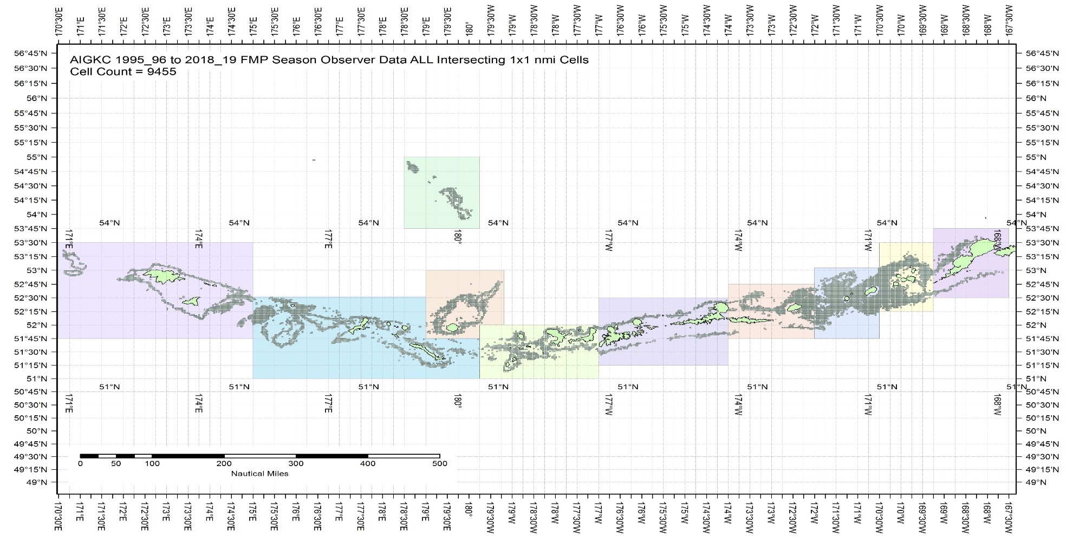
b. Estimation of observer CPUE index by the Year:Area interaction model
Figure A.1. The 1995/96 – 2019/20 observer pot samples enmeshed in 10 blocks.

Slide 20
Table A.1. Total number of 1 x 1 nmi cells ever fished, 1995/96 – 2019/20 AIGKC data. Blocks 1 – 4 belong to EAG and 5 – 10 to WAG.
 | Block_1 | Block_2 | Block_3 | Block_4 | Block_5 | Block_6 | Block_7 | Block_8 | Block_9 | Block_10
1995-2019: Total number of 1x1 cells ever fished | 375 | 1363 | 1754 | 907 | 452 | 1026 | 777 | 1940 | 998 | 325

Slide 21
Year:Area interaction model…. continued
library(MASS)
library(splines)
Step 1:
glm.object<- glm(Legals ~ Year : Area, family = negative.binomial(0.97), data = datacore)
wpotsampleoutAIC<- stepAIC(glm.object, scope = list(upper= ~(Year:Area + ns(SoakDays, df=7) + Month + Vessel + Captain + Gear + ns(Depth, df=10)),
Lower = ~Year:Area), family = negative.binomial(0.97), direction = "forward", trace = 9, k = log(nrow(datacore)) + 1.0)
Step 2:
glm.object<- glm(Legals ~ Year:Area, family = negative.binomial(0.97), data=datacore)
wpotsampleout<- stepCPUE(glm.object, scope = list(upper= ~ (Vessel + ns(SoakDays, df=7) + Gear + Month + Year:Area), lower = ~Year:Area), family = negative.binomial(0.97), direction = "forward", trace =9, r2.change = 0.01)

Slide 22

Observer CPUE index by the Year:Area interaction model …..continued
Final model for EAG:
$\ln\left(CPUE\right)= Gear+Captain+ns\left(Soak, 4\right)+Year:Area$ (A.9)
for the 1995/96–2004/05 period [θ=1.38, $R^{2}=0.2235$]
$\ln\left(CPUE\right)=Vessel+Gear+ns\left(Soak, 3\right)+Year:Area$ (A.10)
for the 2005/06–2019/20 period [$=2.32, R^{2}=0.1212$].

Slide 23

Observer CPUE index by the Year:Area interaction model ……continued
Final model for WAG:
$\ln\left(CPUE\right)= Vessel+ns\left(Soak, 7\right)+Gear+Year:Area$ (A.11)
for the 1995/96–2004/05 period [θ=0.97, $R^{2}=0.1719$]
$\ln\left(CPUE\right)=Gear+Month+ Year:Area+ns(Soak,19)$ (A.12)
for the 2005/06–2019/20 period [$=1.13, R^{2}=0.0866, Soak forced in$].

Slide 24
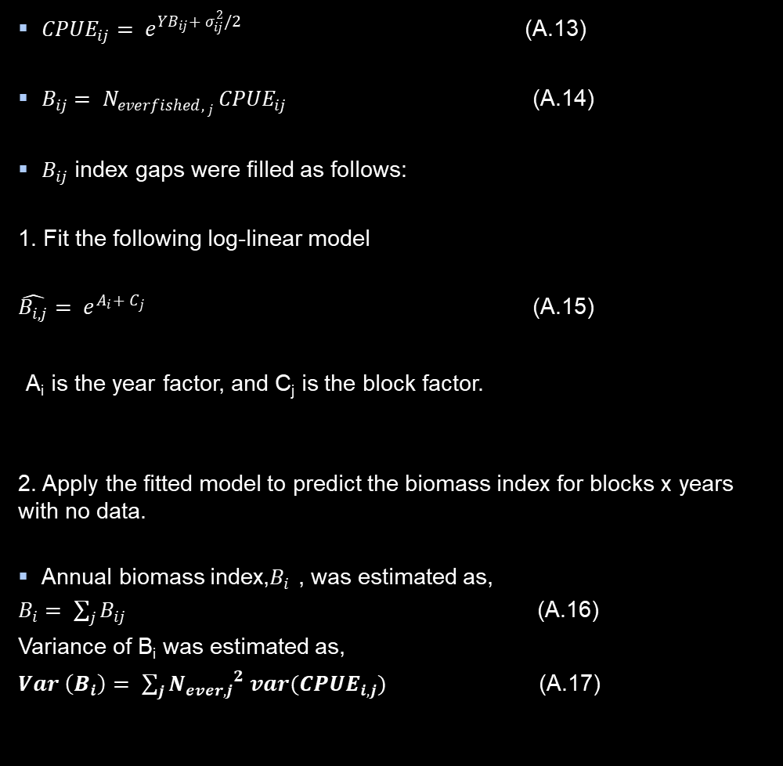
Observer CPUE index by the Year:Area interaction model ….. continued
Block-scale analysis:
${CPUE}_{ij}= e^{{YB}_{ij}+ σ_{ij}^{2}/2}$ (A.13)
$B_{ij}= N_{{everfished, }_{j} }{CPUE}_{ij}$ (A.14)
$B_{ij}$ index gaps were filled as follows:
1. Fit the following log-linear model
$\hat{B_{i, j}}= e^{A_{i}+ C_{j}}$ (A.15)
A_{i} is the year factor, and C_{j} is the block factor.
2. Apply the fitted model to predict the biomass index for blocks x years with no data.
Annual biomass index,$B_{i}$ , was estimated as,
$B_{i}= \sum_{j}{B_{ij}}$ (A.16)
Variance of B_{i} was estimated as,
$Var \left(B_{i}\right)= \sum_{j}{{N_{ever, j}}^{2} var({CPUE}_{i, j})}$ (A.17)
The variance for the final indices (A.16) comes from two contributions: (a) the variance of the standardized CPUE values for years*blocks with data, and (b) those based on the prediction formula (A.15) for year*blocks with no or few data.

Slide 25
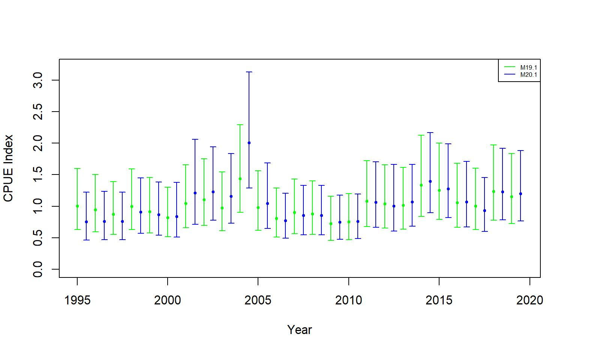
Observer CPUE index by the Year:Area interaction model….. continued
Figure A.2. Comparison of standardized (negative binomial GLM) CPUE indices with +/- 2 SE between no interaction (green line, 19.1) and Year:Area interaction (blue line, 20.1) models for EAG. Model estimated additional standard error was added to SE.
Figure A.3. Comparison of standardized (negative binomial GLM) CPUE indices with +/- 2 SE between no interaction (green line, 19.1) and Year:Area interaction (blue line, 20.1) models for WAG. Model estimated additional standard error was added to SE.

Slide 26
d. Cooperative survey CPUE index by mixed random effects model
Data:
27,255 records from 2015–2019 surveys.
Year, Vessel Code, Captain Code, String ID, Mesh ID, Sub Sample Rate, Sex, Carapace Length, Catch (count at each size), Legal ID, Latitude, Longitude, Depth, Soak Time, and EAG_WAG ID.
Created two new columns by concatenating Vessel Code with String# as well as with String and Pot# because String# and Pot# are not unique numbers to each vessel. The new additional column names were labelled as “VesString” and “VesStingPot.”
Model:
Mixed random effects model considered a random intercept procedure.
Started with the following model:
Sum Catch = Y+ns(Soak,df=3)+ns(Depth, df=10)+(1|Vessel/VesStringPot)+(1|Block/String)
And ended up with
Sum Catch = Y+ns(Soak,df=3)+ns(Depth, df=10)+(1|Block/String)

Slide 27
Cooperative survey CPUE index by mixed random effects model …. continued
Figure A.8. Comparison of cooperative survey model CPUE indices (blue, 19.1d) and observer non interaction factor model CPUE indices (green, 19.1). The confidence limits are determined with ±2SE. Model estimated additional standard error was added to SE.

Slide 28
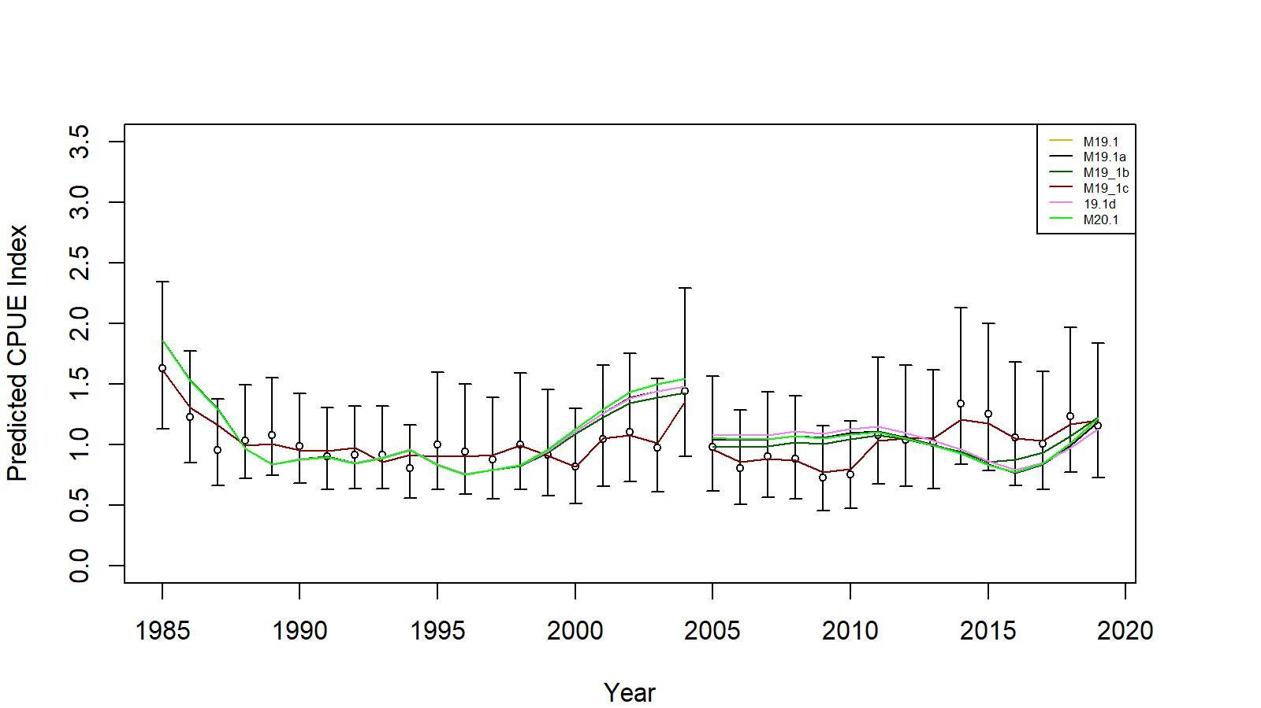
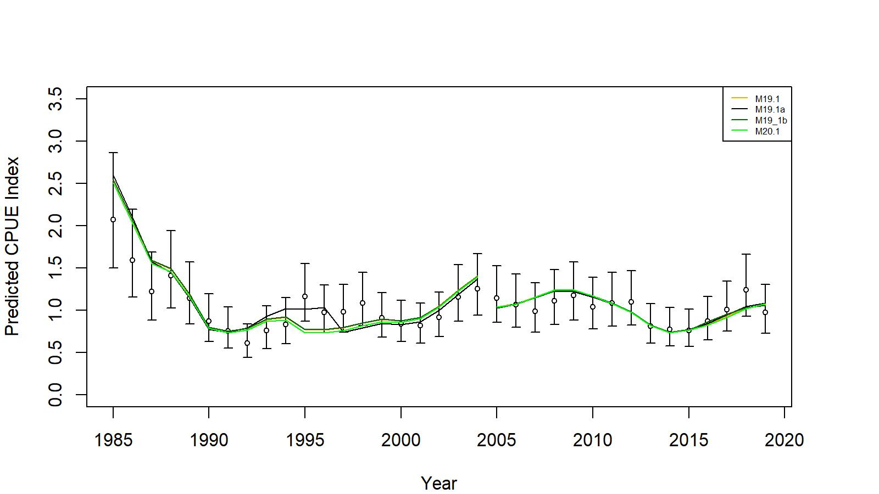
Model results
EAG
WAG
Figs 7 and 17. Comparison of input CPUE indices [with +/- 2 SE for model 19.1 (black small circles)] with predicted CPUE indices (colored solid lines) by 19.1, 19.1a, 19.1b, 19.1c (EAG Gmacs fit), 19.1d, and 20.1 model fits for EAG and 19.1, 19.1a, 19.1b, and 20.1 model fits for WAG, 1985/86–2019/20. Model estimated additional standard error was added to each input standard error.

Slide 29
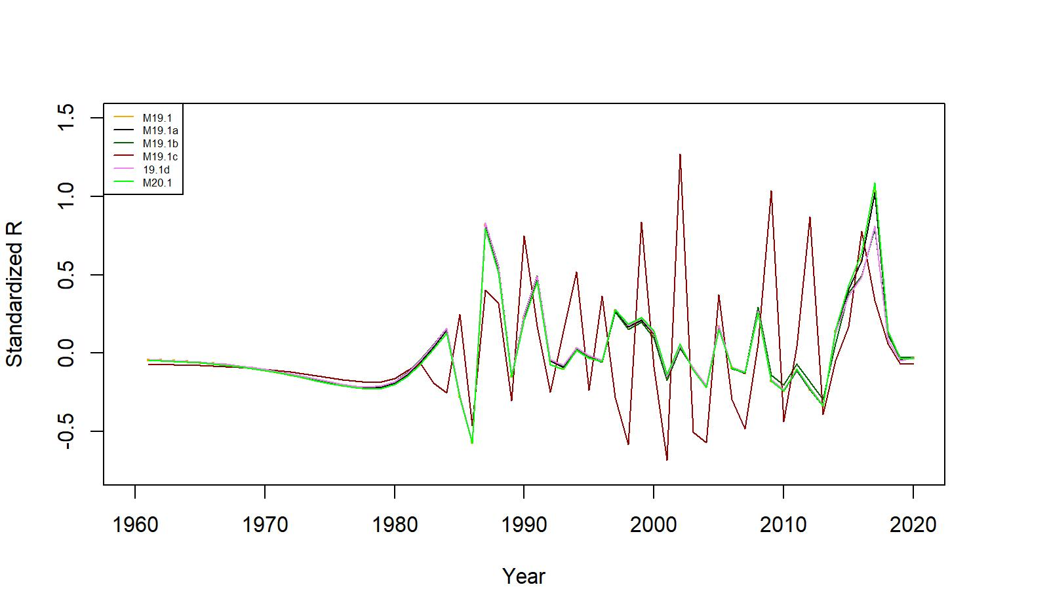
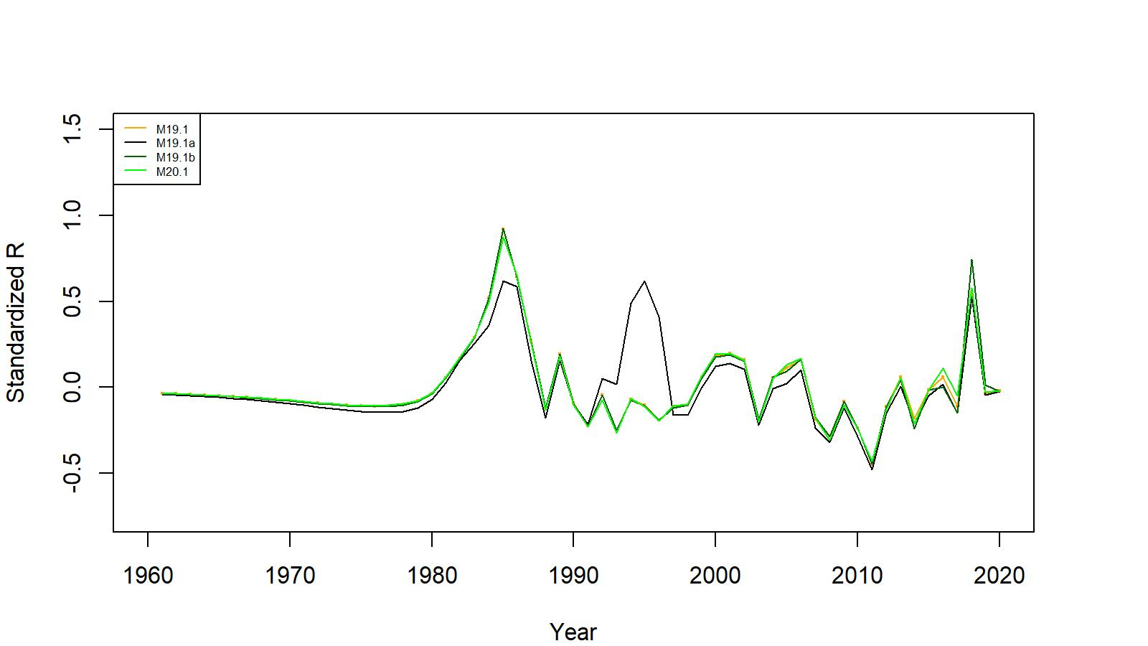
Figures 8 and 18 . Estimated number of male recruits for 19.1, 19.1a, 19.1b, 19.1c (EAG Gmacs fit), 19.1d, and 20.1 model fits for EAG and 19.1, 19.1a, 19.1b, and 20.1 model fits for WAG, 1961–2020. The number of recruits is standardized using (R-mean R)/mean R for comparing different models’ results
EAG
WAG

Slide 30
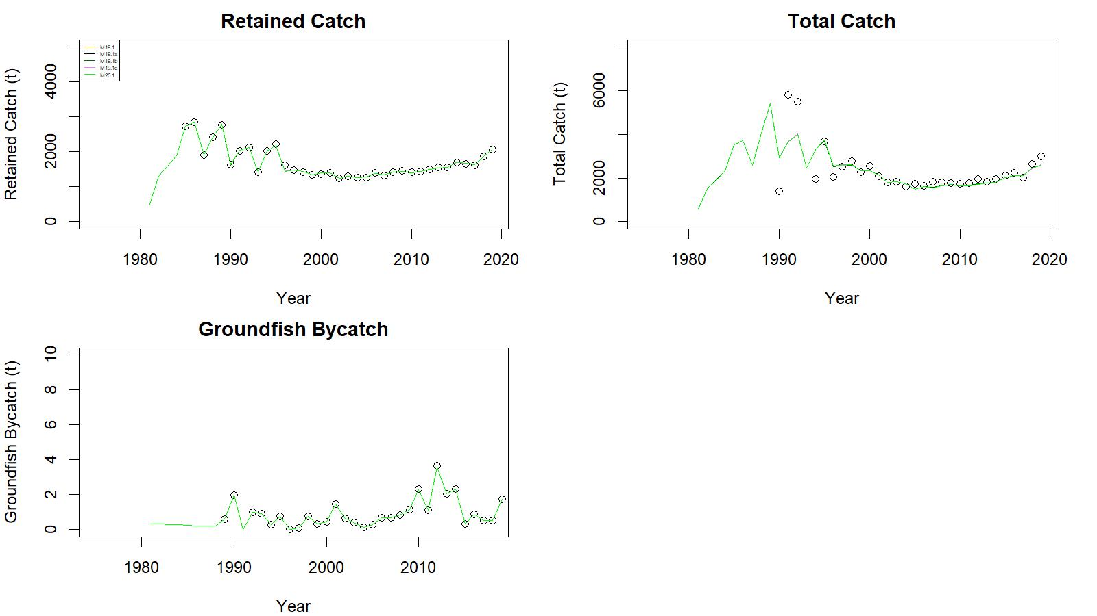
Figure 9. Observed (open circle) vs. predicted (solid line) retained catch (top left), total catch (top right), and groundfish bycatch (bottom left) of golden king crab for 19.1, 19.1a, 19.1b, 19.1d, and 20.1 model fits in EAG, 1981/82–2019/20.
.

Slide 31
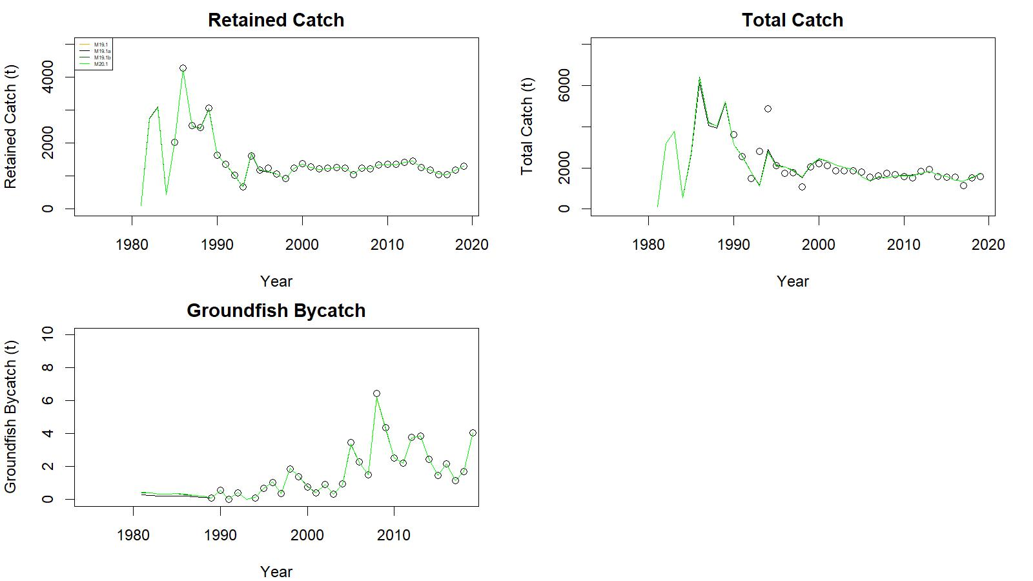
Figure 19. Observed (open circle) vs. predicted (solid line) retained catch (top left), total catch (top right), and groundfish bycatch (bottom left) of golden king crab for 19.1, 19.1a, 19.1b, and 20.1 model fits in WAG, 1981/82–2019/20.
.
.

Slide 32
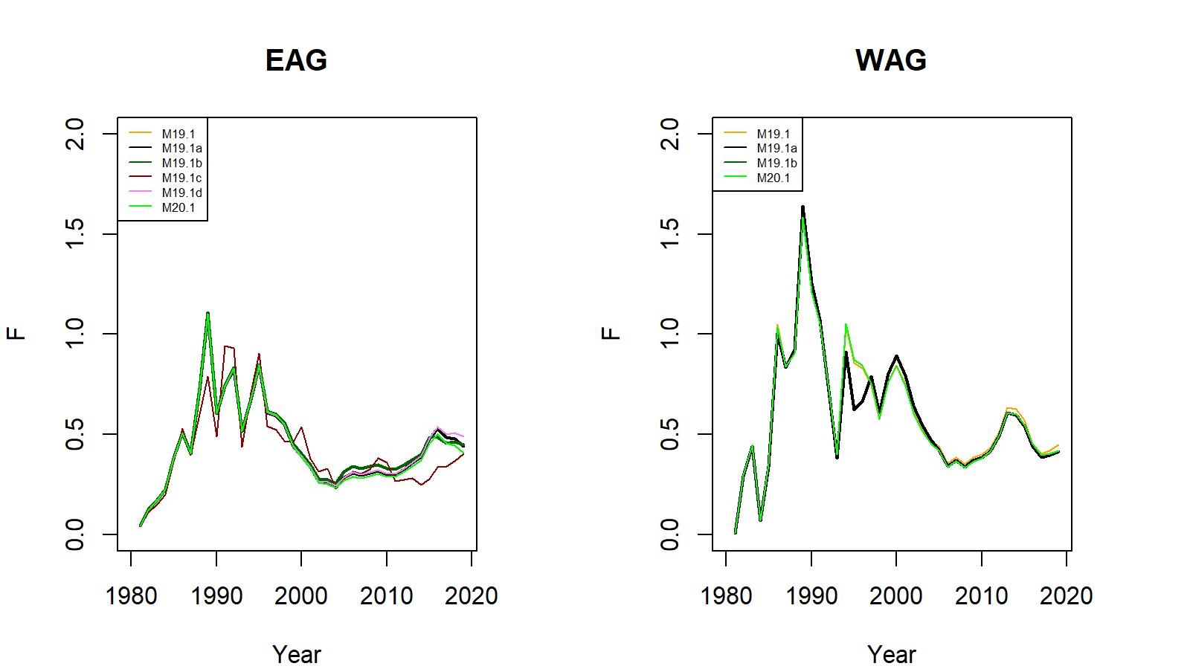
Figure 11. Trends in pot fishery full selection total fishing mortality of golden king crab for 19.1, 19.1a, 19.1b, 19.1c (EAG Gmacs fit), 19.1d, and 20.1 model fits to EAG (left) and for 19.1, 19.1a, 19.1b, and 20.1 model fits to WAG (right) data, 1981/82–2019/20.

Slide 33
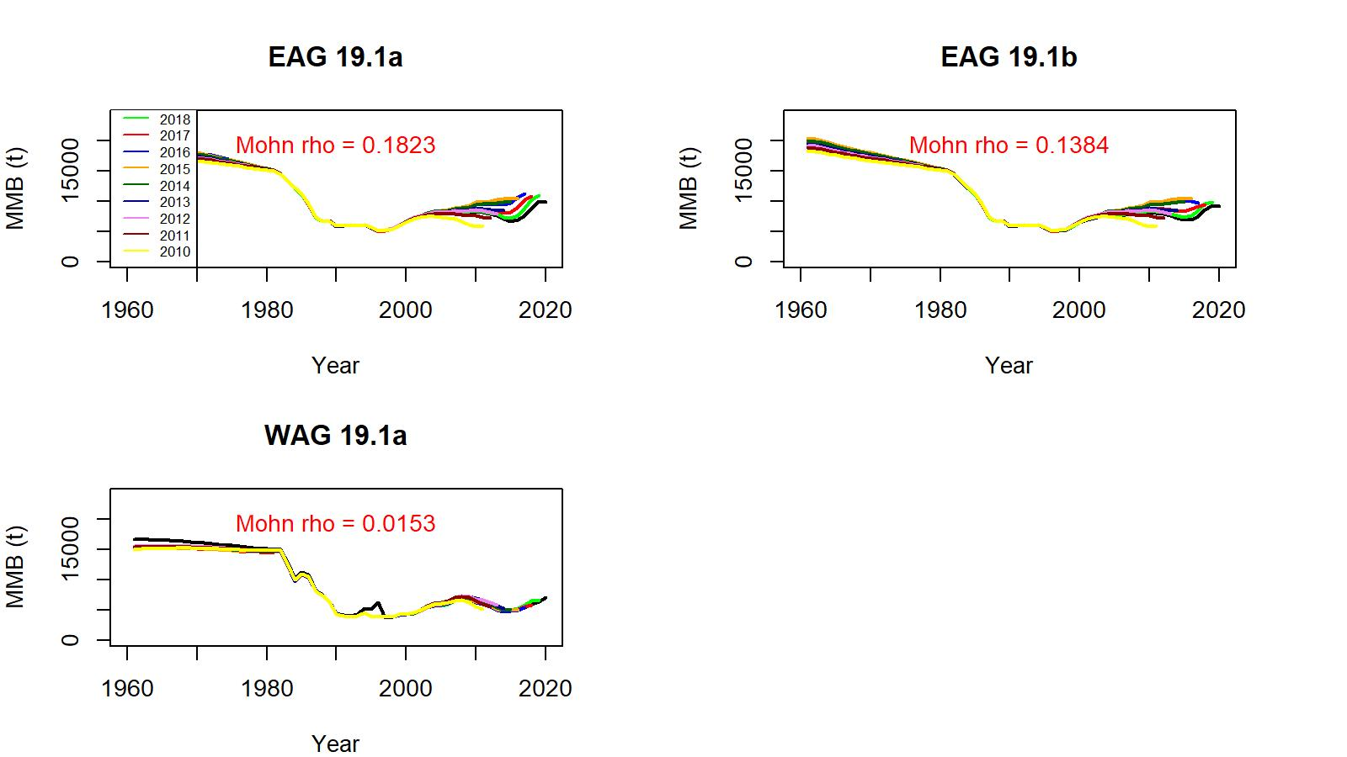
Figure 21. Comparison of 19.1a and 19.1b models’ retrospective fits for EAG and WAG.

Slide 34
Table 16. Stock status, reference biomass and fishing mortality, OFL (total catch), and ABC for various models for EAG, WAG, and AI golden king crab stock.
Biomass, OFL, and ABC are in t. Current MMB = MMB on 15 Feb. 2021.
EAG:
Model | Tier | MMB_{35%} | Current MMB | MMB/ MMB_{35%} | F_{OFL} | F_{35%} | OFL | ABC (0.75*OFL)
19.1 | 3a | 6,608 | 8,537 | 1.29 | 0.61 | 0.61 | 3,030 | 2,272
19.1a | 3a | 6,917 | 8,527 | 1.23 | 0.61 | 0.61 | 3,277 | 2,269
19.1b | 3a | 6,811 | 8,020 | 1.18 | 0.57 | 0.57 | 2,752 | 2,064
19.1c | 3a | 7,986 | 8,350 | 1.05 | 0.99 | 0.99 | 1,778 | 1,333
19.1d | 3a | 6,823 | 7,908 | 1.16 | 0.61 | 0.61 | 2,723 | 2,042
19.1e | 3a | 6,899 | 7,718 | 1.12 | 0.59 | 0.59 | 2,677 | 2,008
20.1 | 3a | 7,011 | 8,896 | 1.27 | 0.60 | 0.60 | 3,207 | 2,406

Slide 35
Table 16 continued.
WAG:
Model | Tier | MMB_{35%} | Current MMB | MMB/ MMB_{35%} | F_{OFL} | F_{35%} | OFL | ABC (0.75*OFL)
19.1 | 3a | 5,227 | 6,419 | 1.23 | 0.56 | 0.56 | 1,856 | 1,392
19.1a | 3a | 5,810 | 6,757 | 1.16 | 0.56 | 0.56 | 1,933 | 1,450
19.1b | 3a | 5,204 | 6,591 | 1.27 | 0.55 | 0.55 | 1,762 | 1,322
20.1 | 3a | 5,266 | 6,608 | 1.25 | 0.56 | 0.56 | 1,930 | 1,447
Model | OFL | ABC (0.75*OFL)
19.1 | 4,886 | 3,664
19.1a | 5,210 | 3,719
19.1b | 4,514 | 3,386
20.1 | 5,137 | 3,853
AI:

Slide 36
Suggested model scenarios for May 2021 assessment work:
Model19.1a
Model 19.1b (EAG) and Model 19.1a (WAG)
Model 20.1
Thank you

