Slide 1
Climate change and crab management in the Bering Sea
Cody Szuwalski

Slide 2
Climate is changing
2010
Warmer water
Less ice
Fewer large zooplankton
2050
2090
Hollowed et al. 2020. Alaska Climate Integrated Modeling Project.

Slide 3
Magnuson Stevens Act
SEC. 301 NATIONAL STANDARDS FOR FISHERY CONSERVATION AND MANAGEMENT
98-623
  (1) Conservation and management shall prevent overfishing while achieving on a continuing basis, the optimum yield from each fishery for the United States fishing industry
SEC. 303 CONTENTS OF FISHERY MANAGEMENT PLANS
95-354
  (3) assess and specify the present and probable future condition of, and the maximum sustainable yield and optimum yield from, the fishery, and include a summary of the information utilized in making such specification
109-479
  (A) specify a time period for rebuilding the fishery that shall
    (i) be as short as possible….
    (ii) not exceed 10 years, except in the case where biology of the stock of fish, other environmental conditions…dictate otherwise

Slide 4
Harvest control rule

Slide 5
What are we going to do?

Slide 6
What have we already done?

Slide 7
This has been interpreted differently over time
Tanner crab
PIBKC and PIRKC
SMBKC…BBRKC??

Slide 8
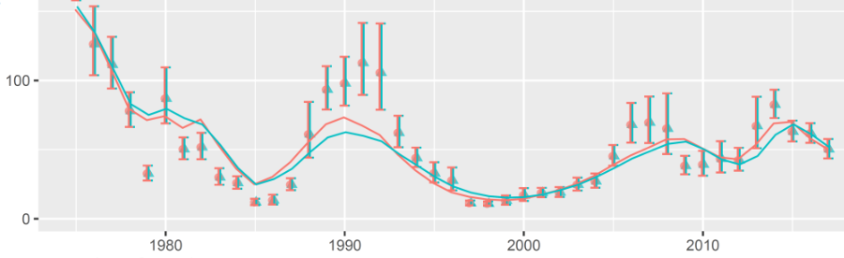
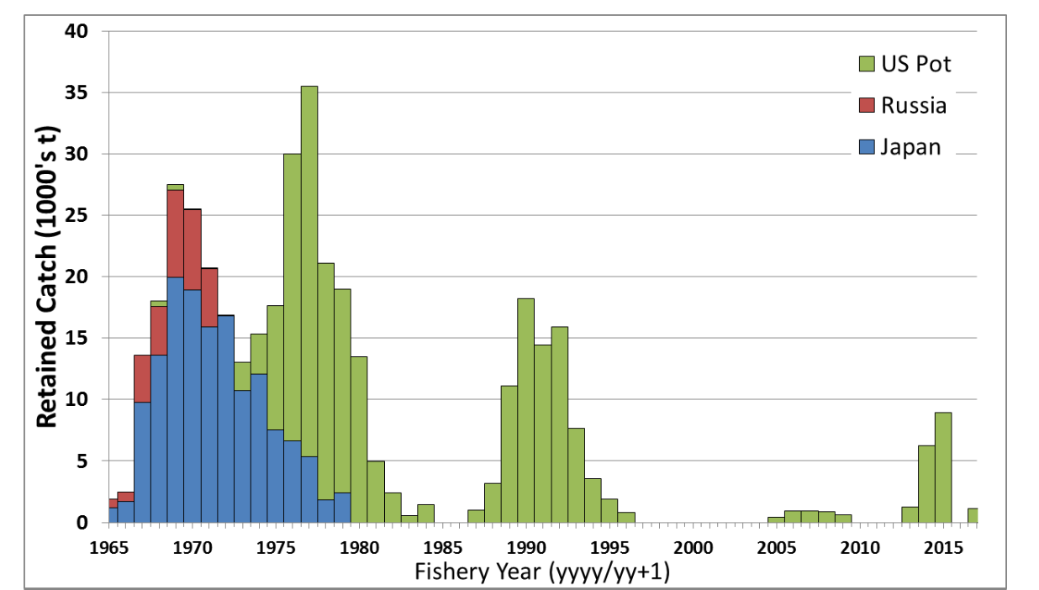
Tanner crab
Mature males
Declared overfished in 2011
Rebuilt in 2014 after moving to a different tier and assessment (which prompted a revision of reference points)

Slide 9
What are we going to do?

Slide 10
How big of a deal is climate change for Bering Sea crab?
How could climate change impact our management strategies?

Slide 11
How have the distribution and productivity changed for the major crab stocks in the Bering Sea?
Can we explain any of these changes with environmental indices?
Can we project what might be expected of these stocks in the future given observed relationships?

Slide 15
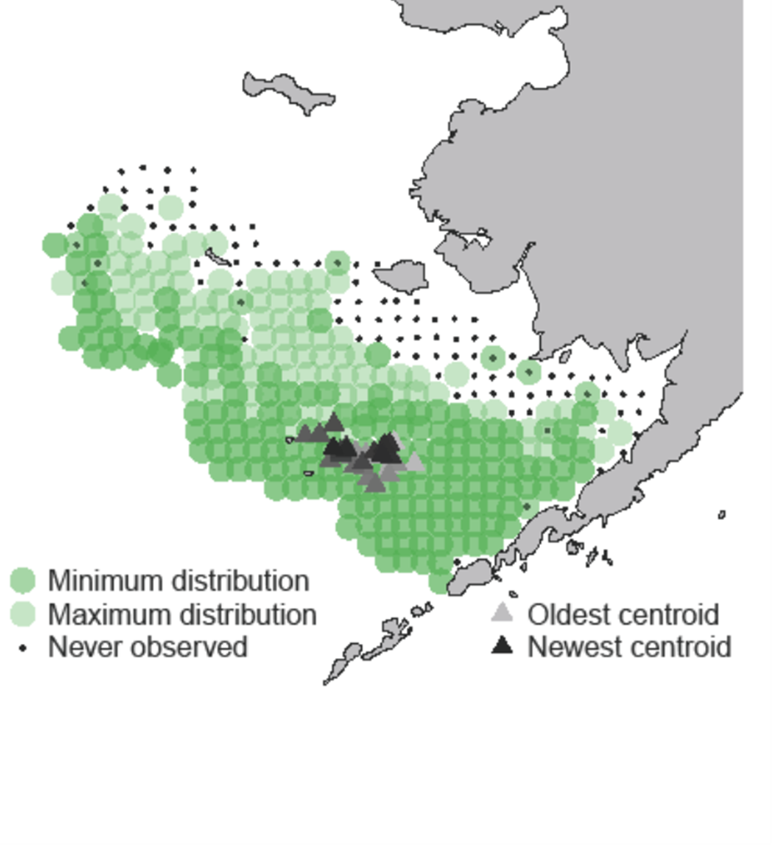
Dependent variables
Lagged MMB + estimated recruitment
Latitudinal component of centroid of abundance
Longitudinal component of centroid of abundance
Number of stations observing crab
Predictor variables
Local indices of environmental variation (4)
Large-scale indices of environmental variation (4)
Cod biomass
Modeling
Simple linear models

Slide 16
Dependent variables
Lagged MMB + estimated recruitment
Latitudinal component of centroid of abundance
Longitudinal component of centroid of abundance
Number of stations observing crab
Predictor variables
Local indices of environmental variation (4)
Large-scale indices of environmental variation (4)
Cod biomass
Modeling
Simple linear models

Slide 17
Dependent variables
Lagged MMB + estimated recruitment
Latitudinal component of centroid of abundance
Longitudinal component of centroid of abundance
Number of stations observing crab
Predictor variables
Local indices of environmental variation (4)
Large-scale indices of environmental variation (4)
Cod biomass
Modeling
Simple linear models

Slide 18
Dependent variables
Lagged MMB + estimated recruitment
Latitudinal component of centroid of abundance
Longitudinal component of centroid of abundance
Number of stations observing crab
Predictor variables
Local indices of environmental variation (4)
Large-scale indices of environmental variation (4)
Cod biomass
Modeling
Simple linear models

Slide 19
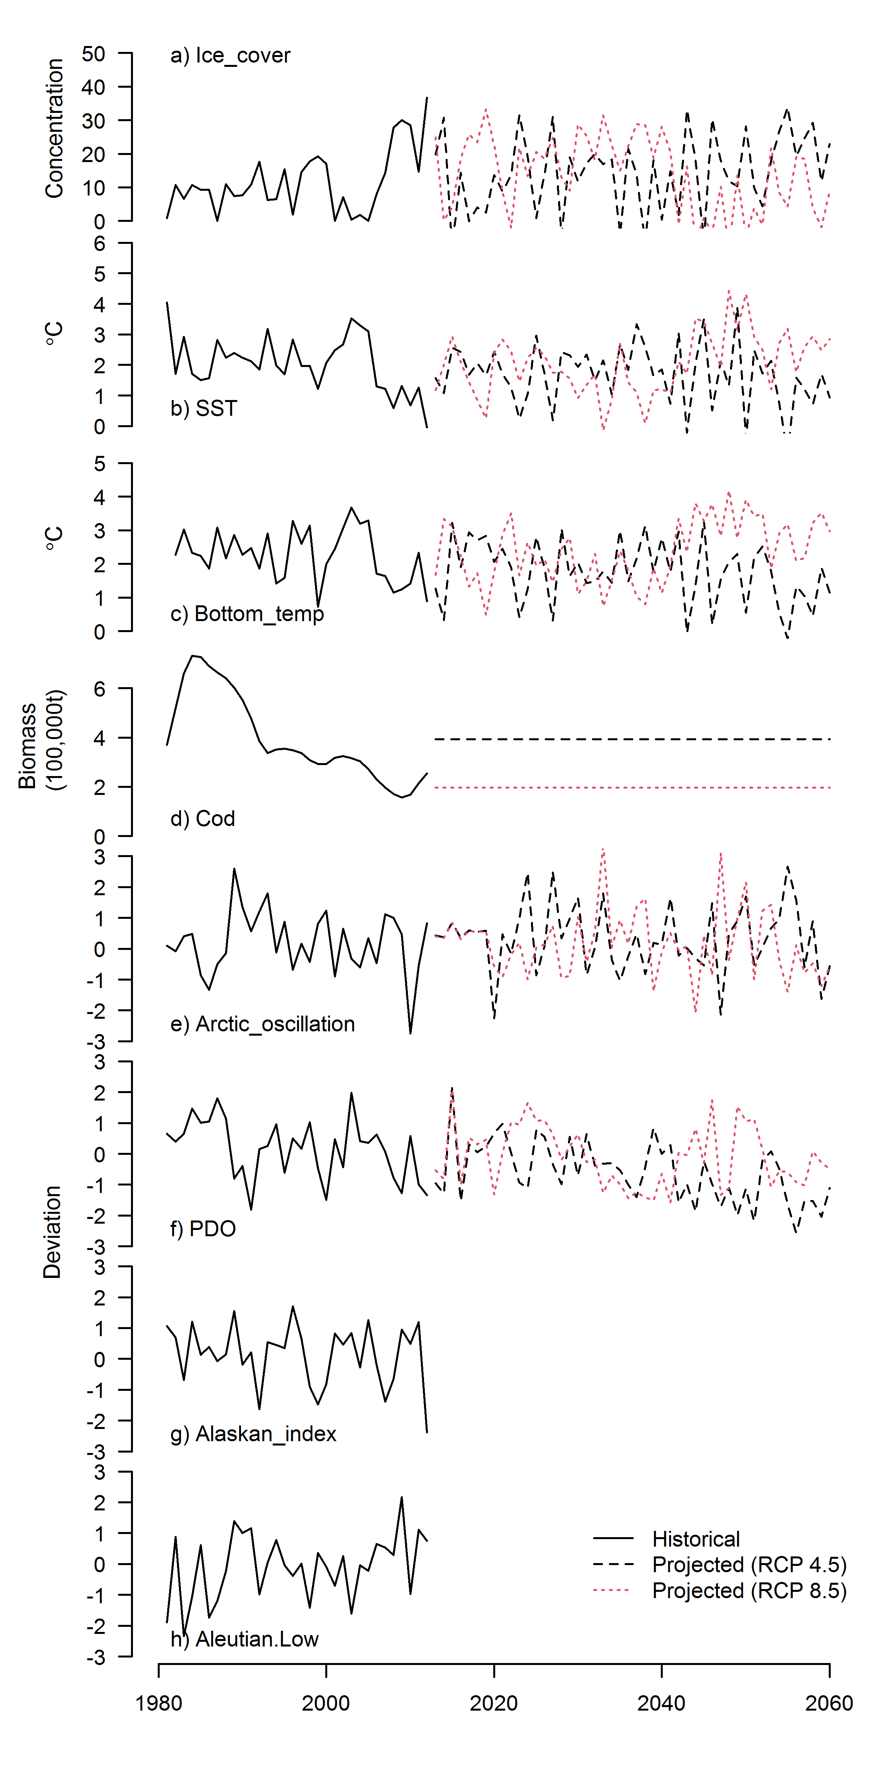
Dependent variables
Lagged MMB + estimated recruitment
Latitudinal component of centroid of abundance
Longitudinal component of centroid of abundance
Number of stations observing crab
Predictor variables
Local indices of environmental variation (4)
Large-scale indices of environmental variation (4)
Cod biomass
Modeling
Simple linear models
Max of 3 predictors: one local, one large-scale, one bio
AICc for model selection

Slide 20
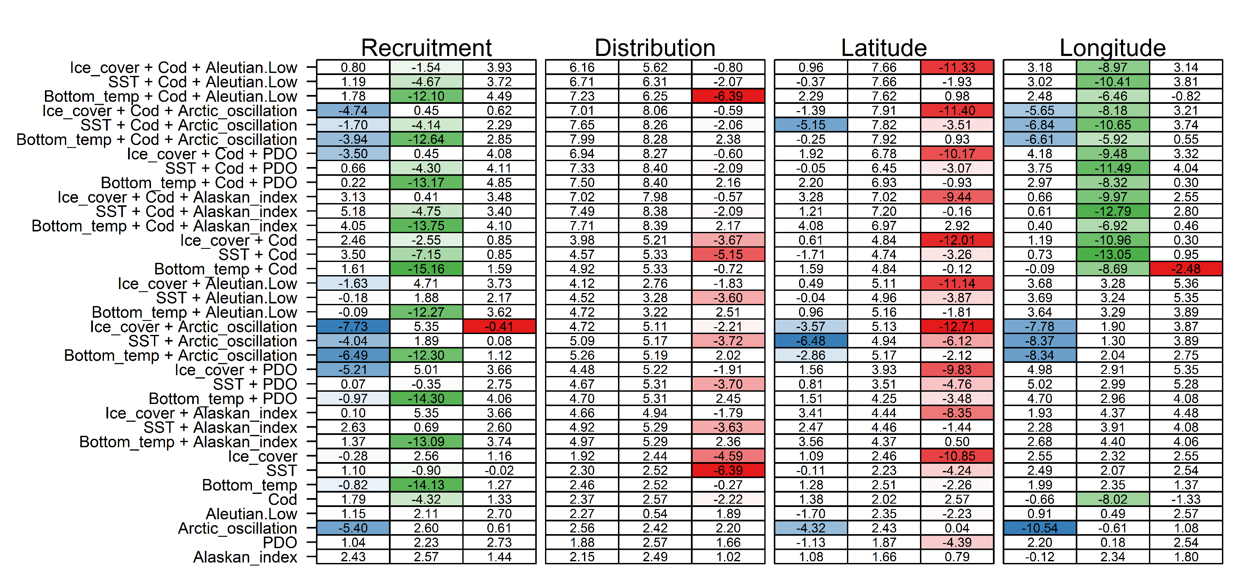

Slide 24
More productive long term related to projected increases in bottom temperature.

Slide 25
More productive long term related to projected decreases in ice cover.

Slide 26
Less productive in the long term in the current area due to decreased ice cover and changes in arctic oscillation

Slide 27
Caveat caveat

Slide 28
Projections
Recruitment: Ricker stock recruit curve + projected environmental driver
  Note that the harvest control rule does not consider an SRR
Fishing mortality determined by harvest control rule
All other population processes time invariant
Comparing exploitation rates, yields, and MMB

Slide 29
Harvest control rule
Status quo: biomass target uses the entire time series of recruitment
Climate adaptive: biomass targets uses only the time series of recruitment from 2025 on (once past 2030)

Slide 30
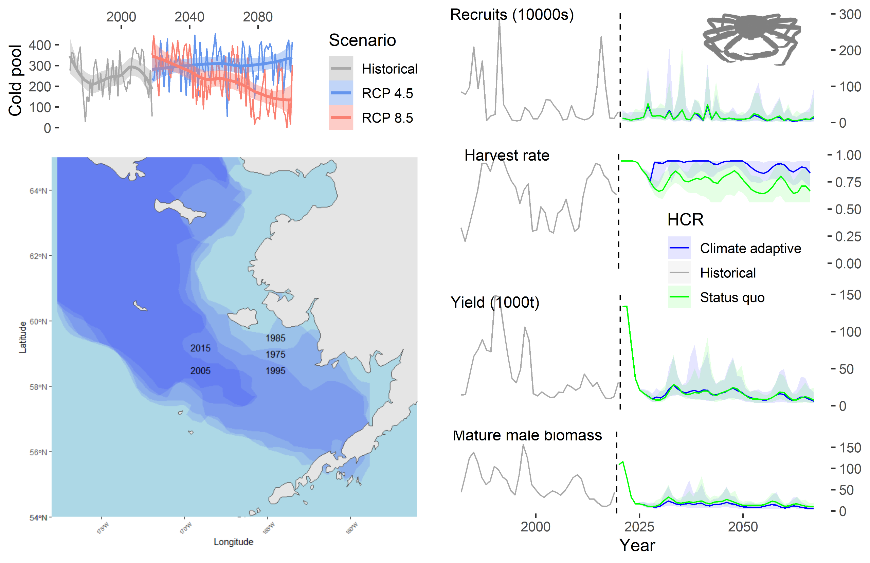
Harvest control rule
Status quo: biomass target uses the entire time series of recruitment
Climate adaptive: biomass targets uses only the time series of recruitment from 2025 on (once past 2030)
Climate adaptive
Status quo rule

Slide 32
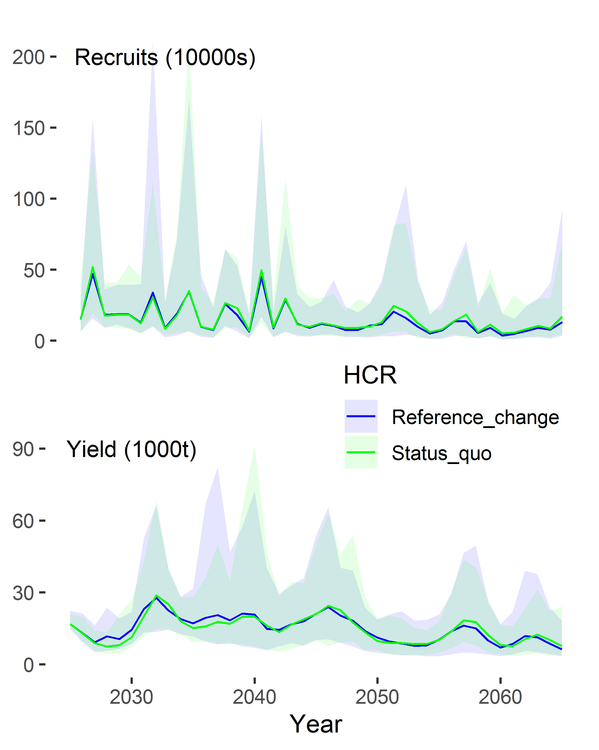

Slide 36
Status quo outcomes relative to climate-adaptive
Lower exploitation rates
Higher mature male biomass
Higher recruitment
Yield often higher, but not always
So, adapting to decreasing productivity results in higher exploitation rates?

Slide 37
“Productivity paradox”
Climate adaptive harvest control rules can result in higher exploitation rates than the status quo control rule.
Can arise when reference points adapt to a change in:
  Recruitment (when using a sloped harvest control rule; Szuwalski and Punt, 2013)
  Growth (Szuwalski et al., in prep)
  Natural mortality (Legault et al. 2016)
  Maturity

Slide 38
Perspectives
If there is a fishery that is closed because another population in the same area is overfished, should the overfished population ever be written off? If so, when?
Under what sorts of circumstances should reference points be changed? What criteria must be met?
Should a management target always be tied to the productivity of a population? If not, what other metrics could be used?

Slide 39
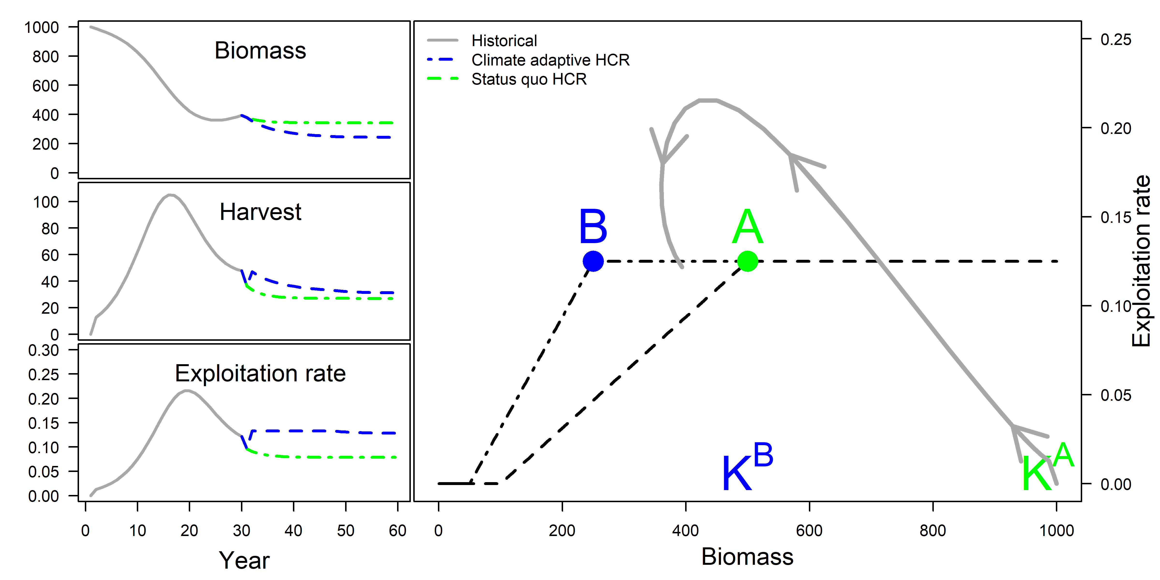

Slide 41
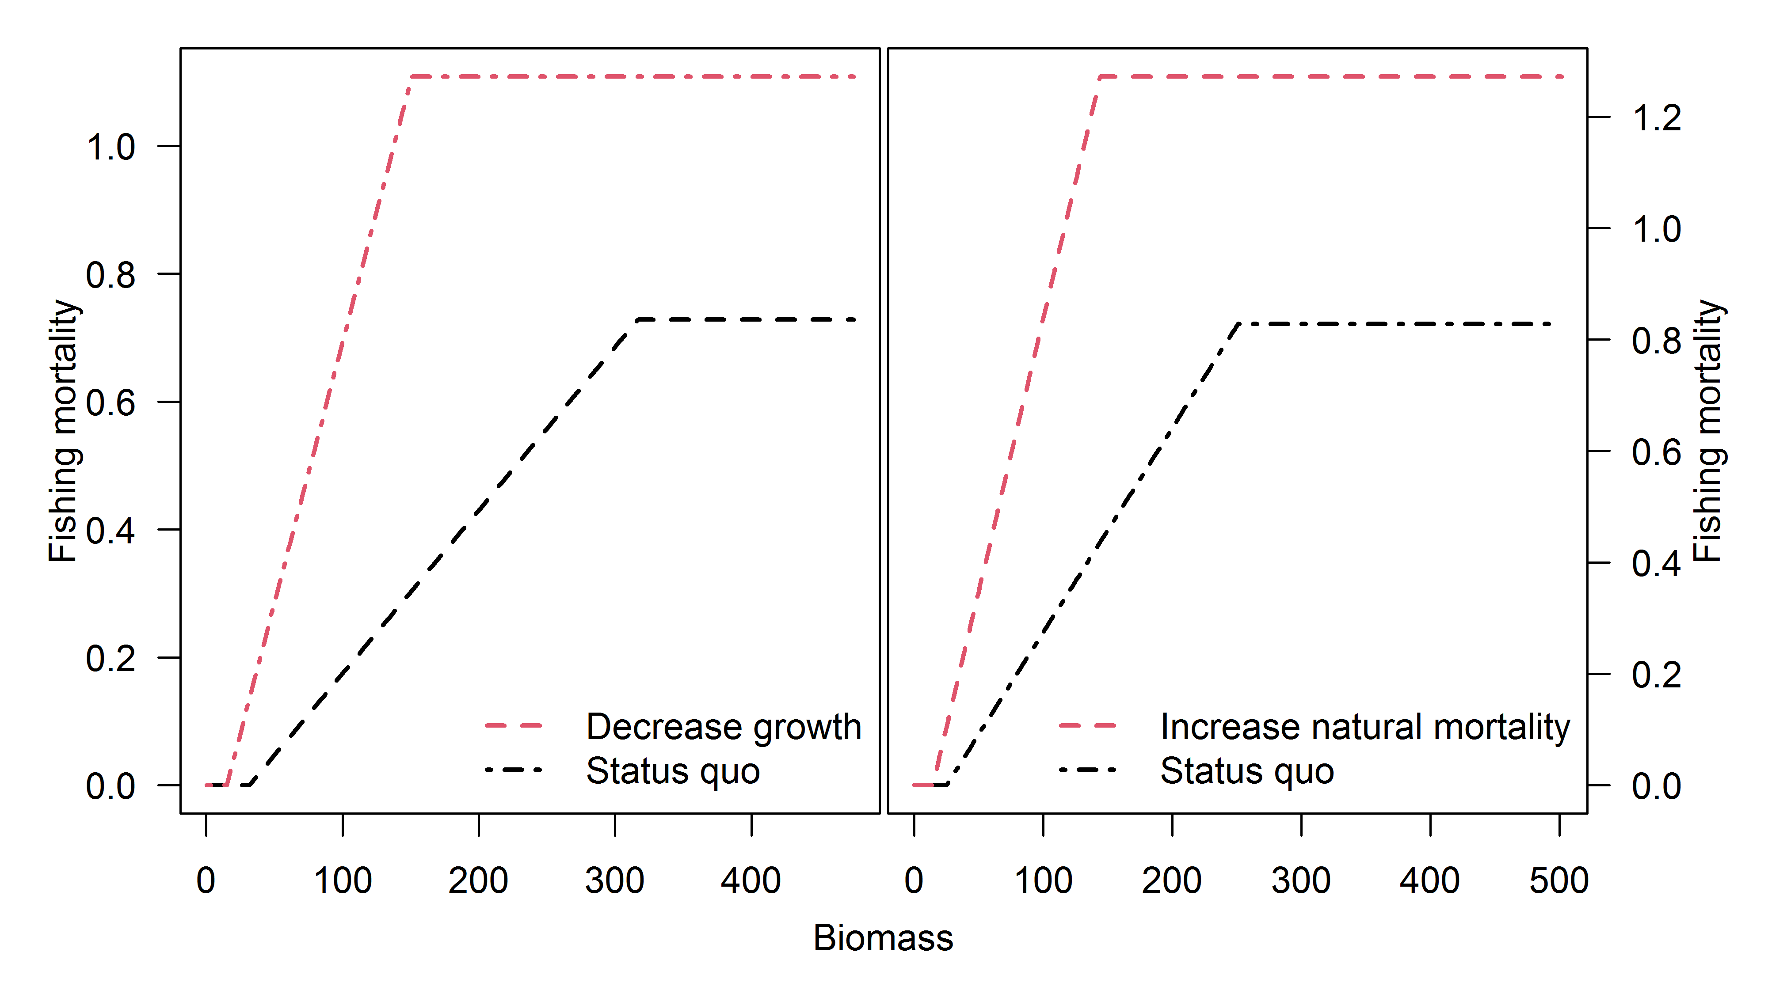

Slide 42
