Slide 1
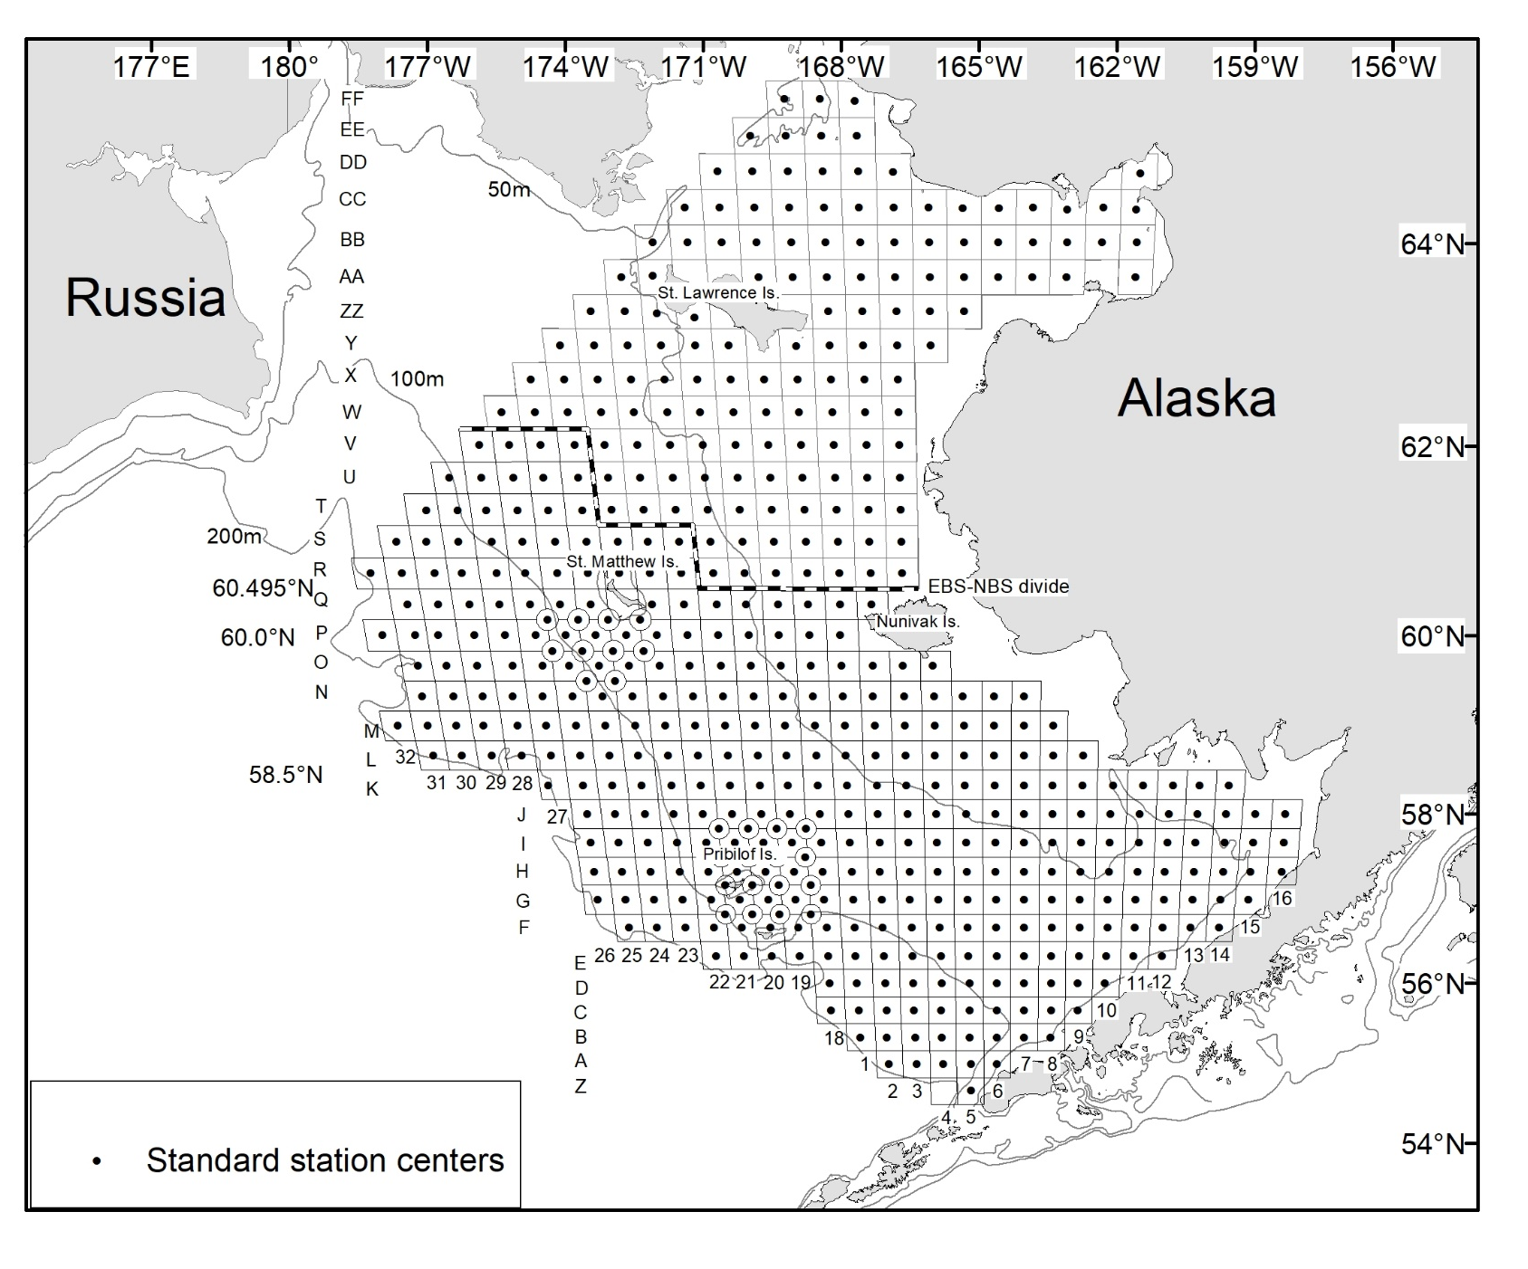
Crab survey planning for 2021
Mike Litzow
Shellfish assessment program, AFSC

Slide 2
Survey plans considered for 2021
Full Northern / Eastern Bering Sea grid - current plan
Eastern Bering only
Reduced Eastern Bering grid (e.g., no corner stations) – least likely / not currently planned
Biggest current challenge – staffing availability
quarantine time demands
staff family responsibilities

Slide 3
Drop St. Matt & Pribs corner stations?
Not currently planned
Would save 4-5 vessel-days
Jon Richar analysis of effects on assessment
  Large effects on SMBKC, PIBKC/RKC abundance estimates
  Negligible effects on snow crab estimates, increased variance in W166 bairdi estimates
Reasonable way to reduce effort if needed?

