Slide 1

Norton Sound Red King Crab
Jen Bell
Alaska Department of Fish and Game
Crab Planning Meeting, January 11, 2021

Slide 2
Overview
Lost pots
Male size and CPUE
Female clutch fullness
Functional maturity of males
Large males

Slide 3
Lost Pots: The Issue
Crab pots are lost when the ice breaks off unexpectedly; pots are dragged with the ice to some unknown destination
Predominantly a winter fishery occurrence
2017- 20 pot limit in winter fishery
2020- can’t get replacement for lost pot
Lost pots (2005-2020)
Year | Winter Commercial | Winter Subsistence | ADF&G pot studies | Summer Subsistence | Total
2005–06 | ND | 50 | 6 | 1 | 57
2006–07 | ND | 132 | 7 | 0 | 139
2007–08 | ND | 6 | 4 | 4 | 14
2008–09 | ND | 8 | 2 | 0 | 10
2009–10 | 30 | 23 | 2 | 1 | 56
2010–11 | 3 | 8 | 0 | 9 | 20
2011–12 | 64 | 19 | 4 | 0 | 87
2012–13 | 23 | 4 | 3 | 7 | 37
2013–14 | 105 | 16 | 1 | 4 | 126
2014–15 | 104 | 16 | 0 | 1 | 121
2015–16 | 38 | 20 |  | 11 | 69
2016–17 | 201 | 11 |  | 6 | 218
2017–18 | 179 | 33 |  | 5 | 217
2018–19 | 32 | 59 |  | 10 | 101
2019–20 | 3 | 33 |  |  | 36

Slide 4
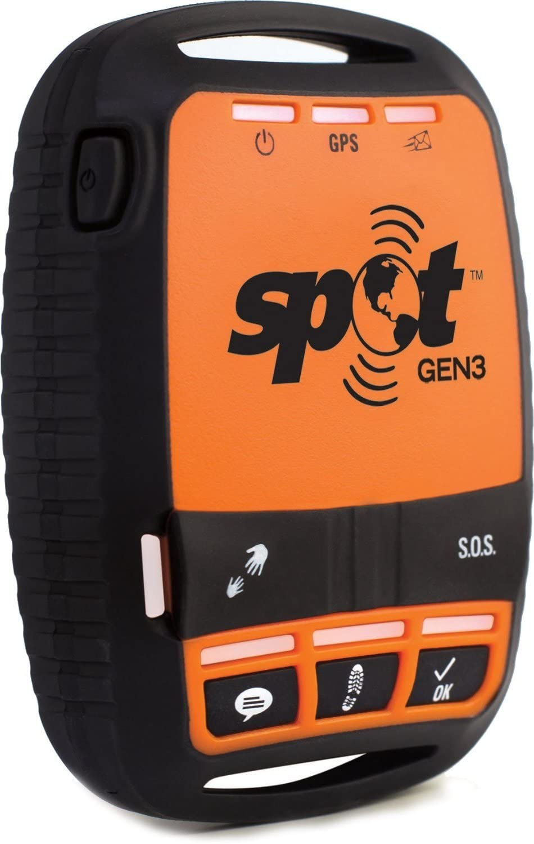
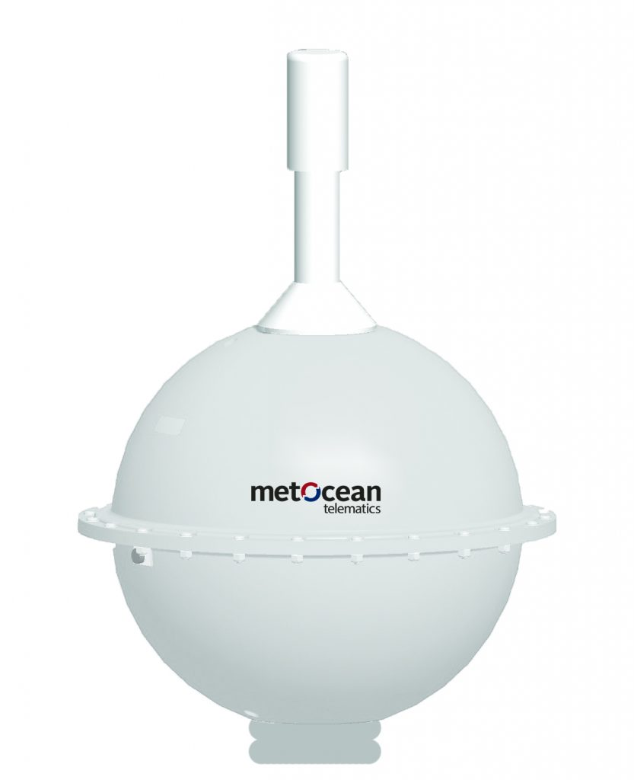
Lost Pots-What’s Being Done?
Hypothesis: Pots are pulled with the ice, west of NS and outside the red king crab fishing area
2018- NSEDC and ADF&G met with Natural Resources Consultants (NRC) to use DIDSON to search lost pots but search area is too large
2019- Started researching low-cost methods for tracking ice movement: SPOT device FAILED!
2020- NSEDC found relatively low-cost and cold tolerant ice trackers and ADF&G purchased one tracker.
Polar iSVP

Slide 5
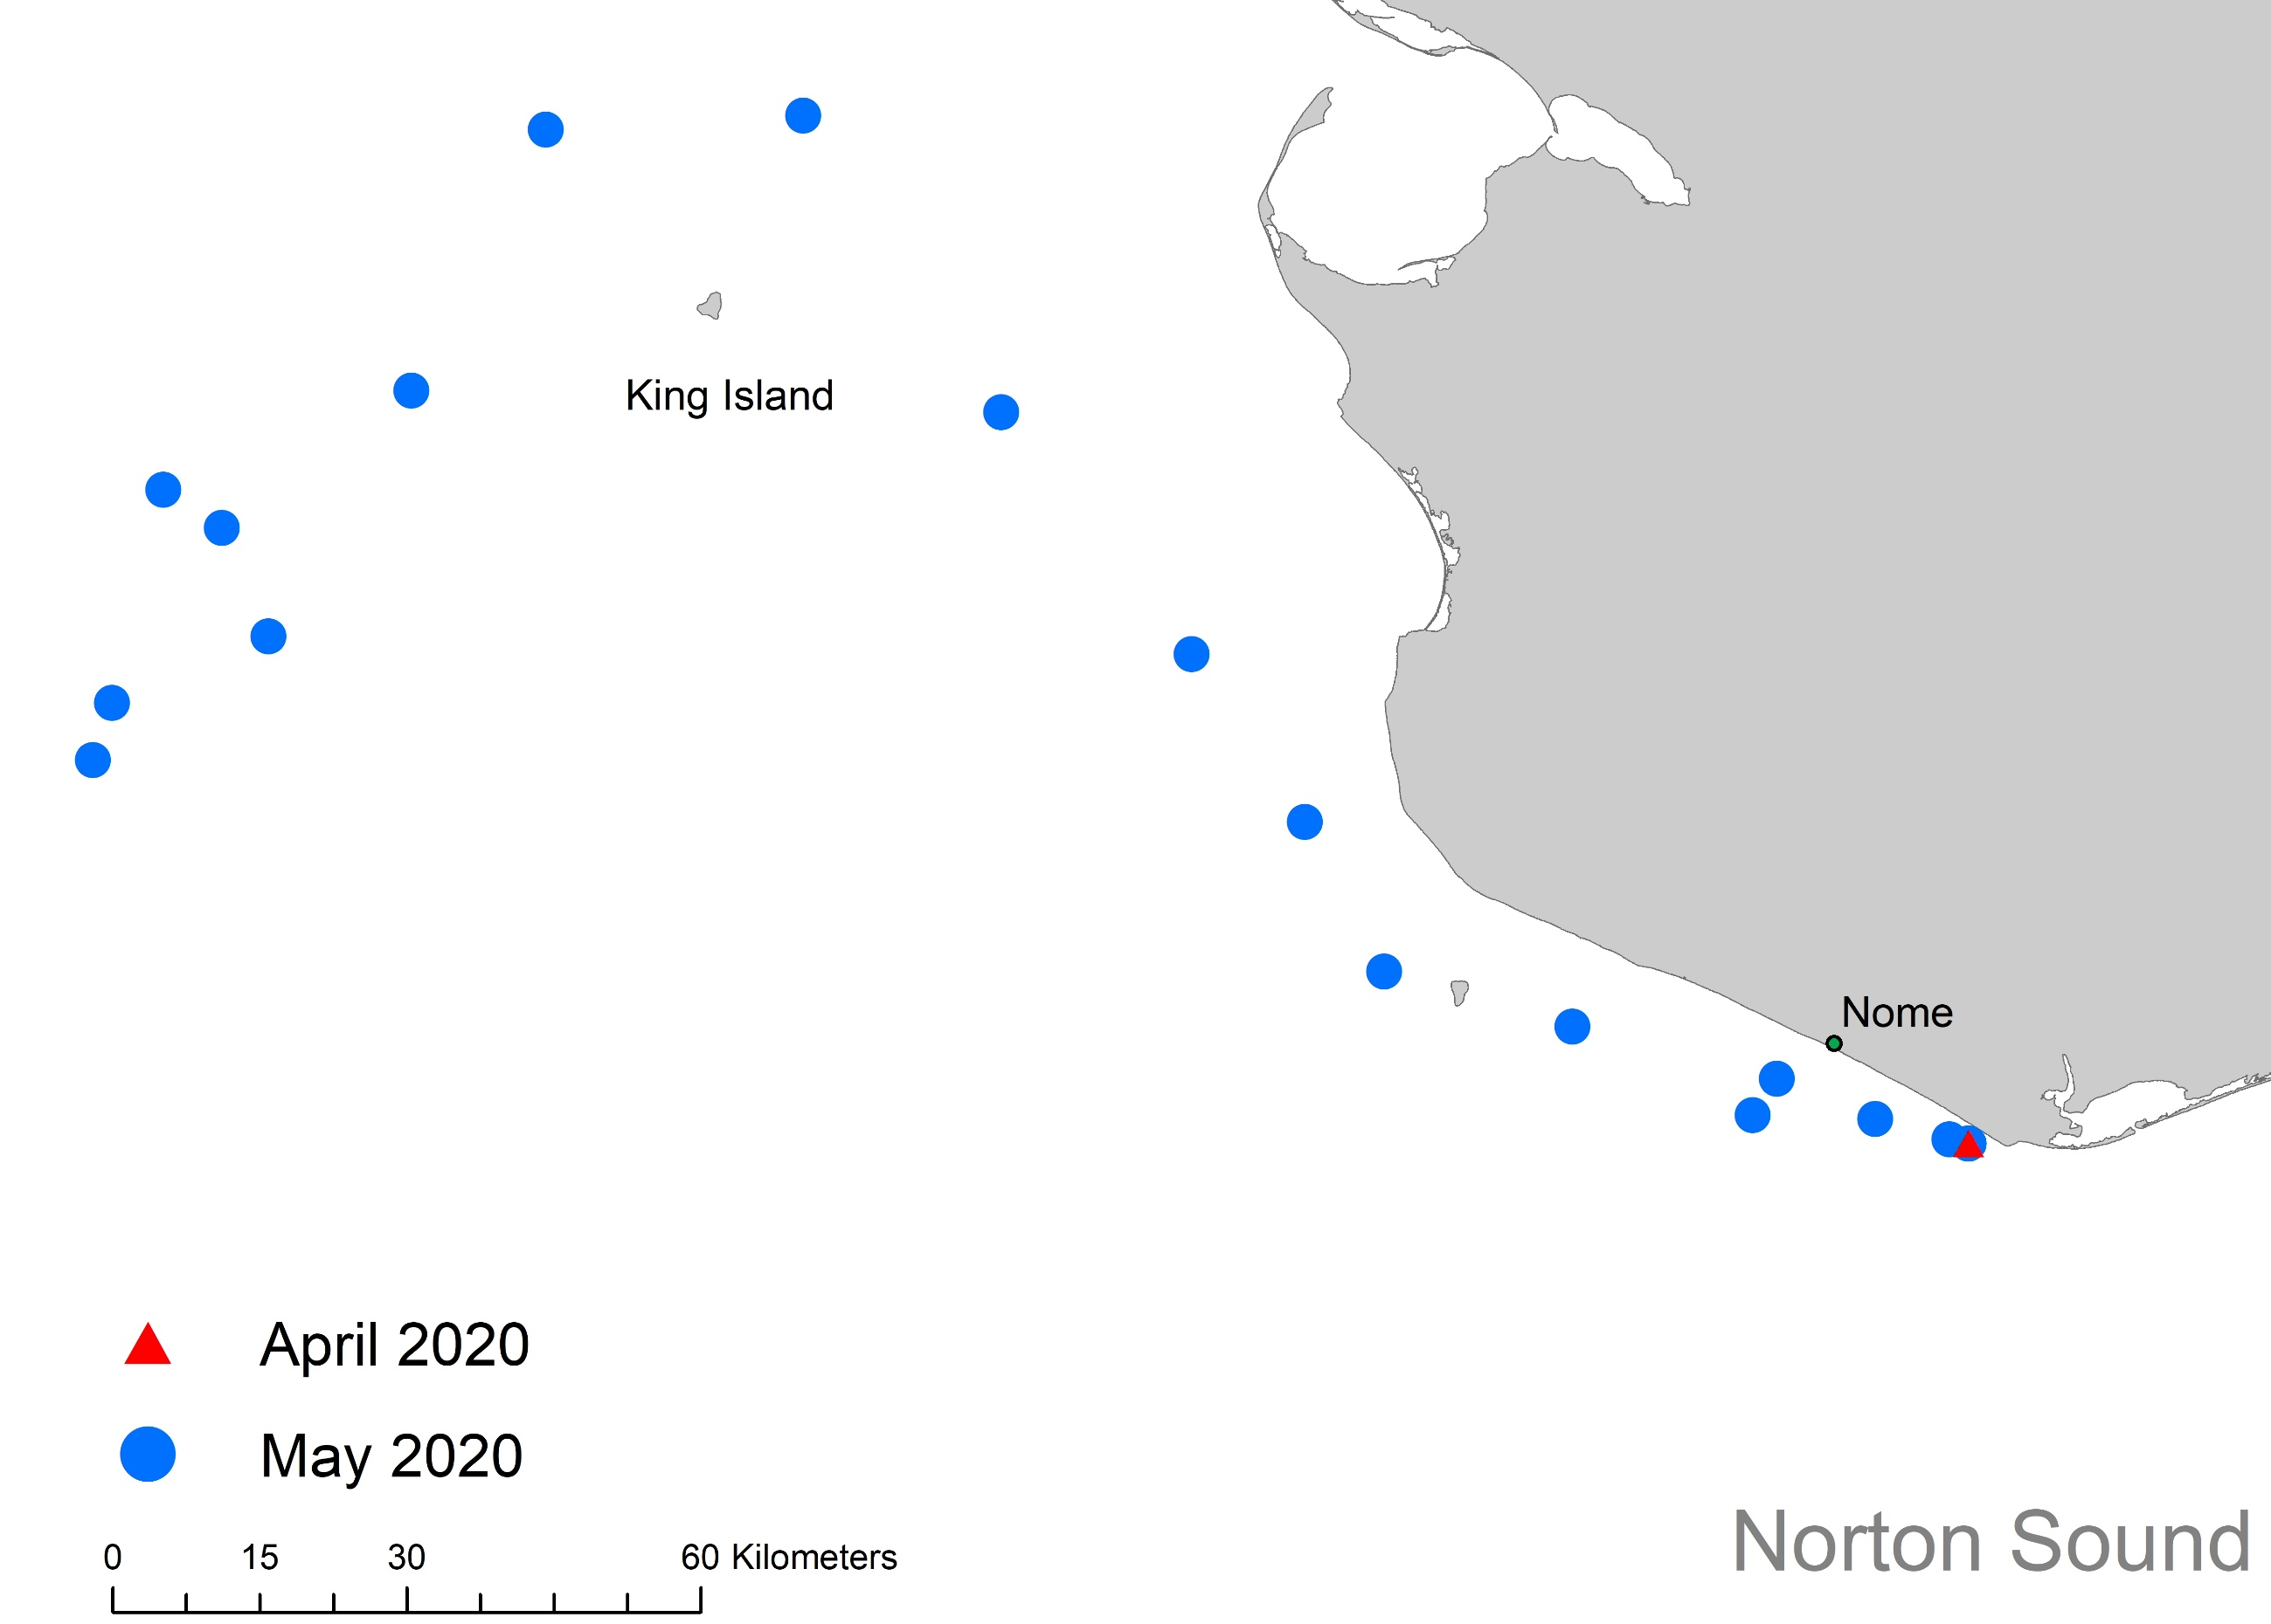

Lost Pots: 2020 Ice Movement
Average daily location by month

Slide 6
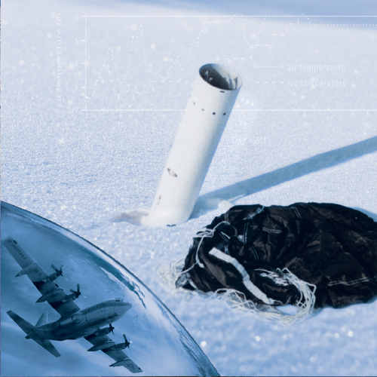
Lost Pots: Next steps
2021- Purchase additional ice trackers (Funded by: NSEDC-Outside Entity Funding)
Polar iSVP designed to float- maybe we need a device designed to sink?
Polar iSVP
Compact air launch ice beacon
sends out a satellite signal until it sinks
2021/ 2022- Obtain funds to start searching for lost pots?

Slide 7
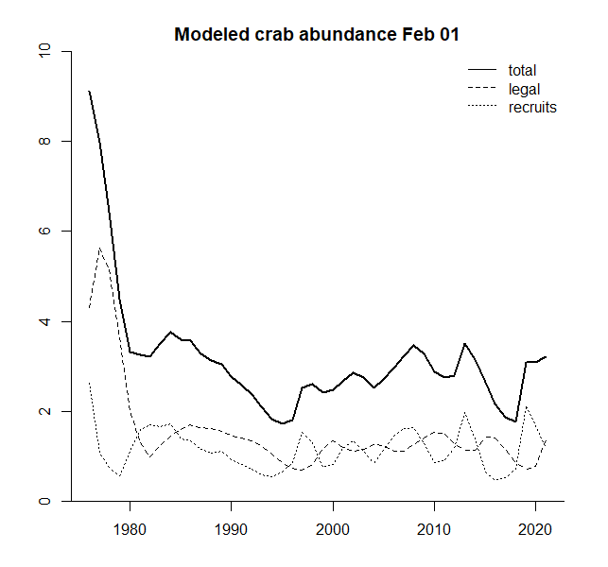
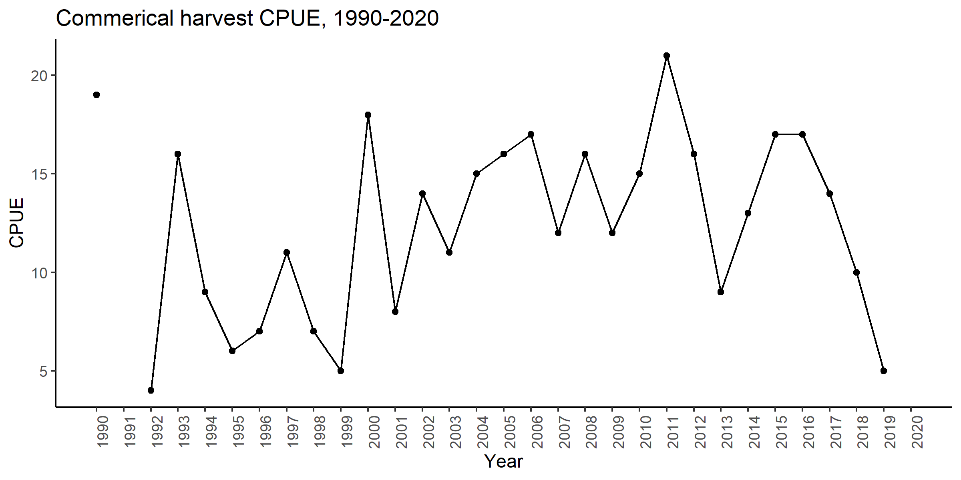
Male size and CPUE: The Issue
Peaks and valleys in model crab abundance and in summer commercial harvest CPUE
In 2013, 2018, and 2019 difficulty reaching guideline harvest levels
Hypothesis: Single cohorts are driving the pattern and this information can inform management decisions

Slide 8
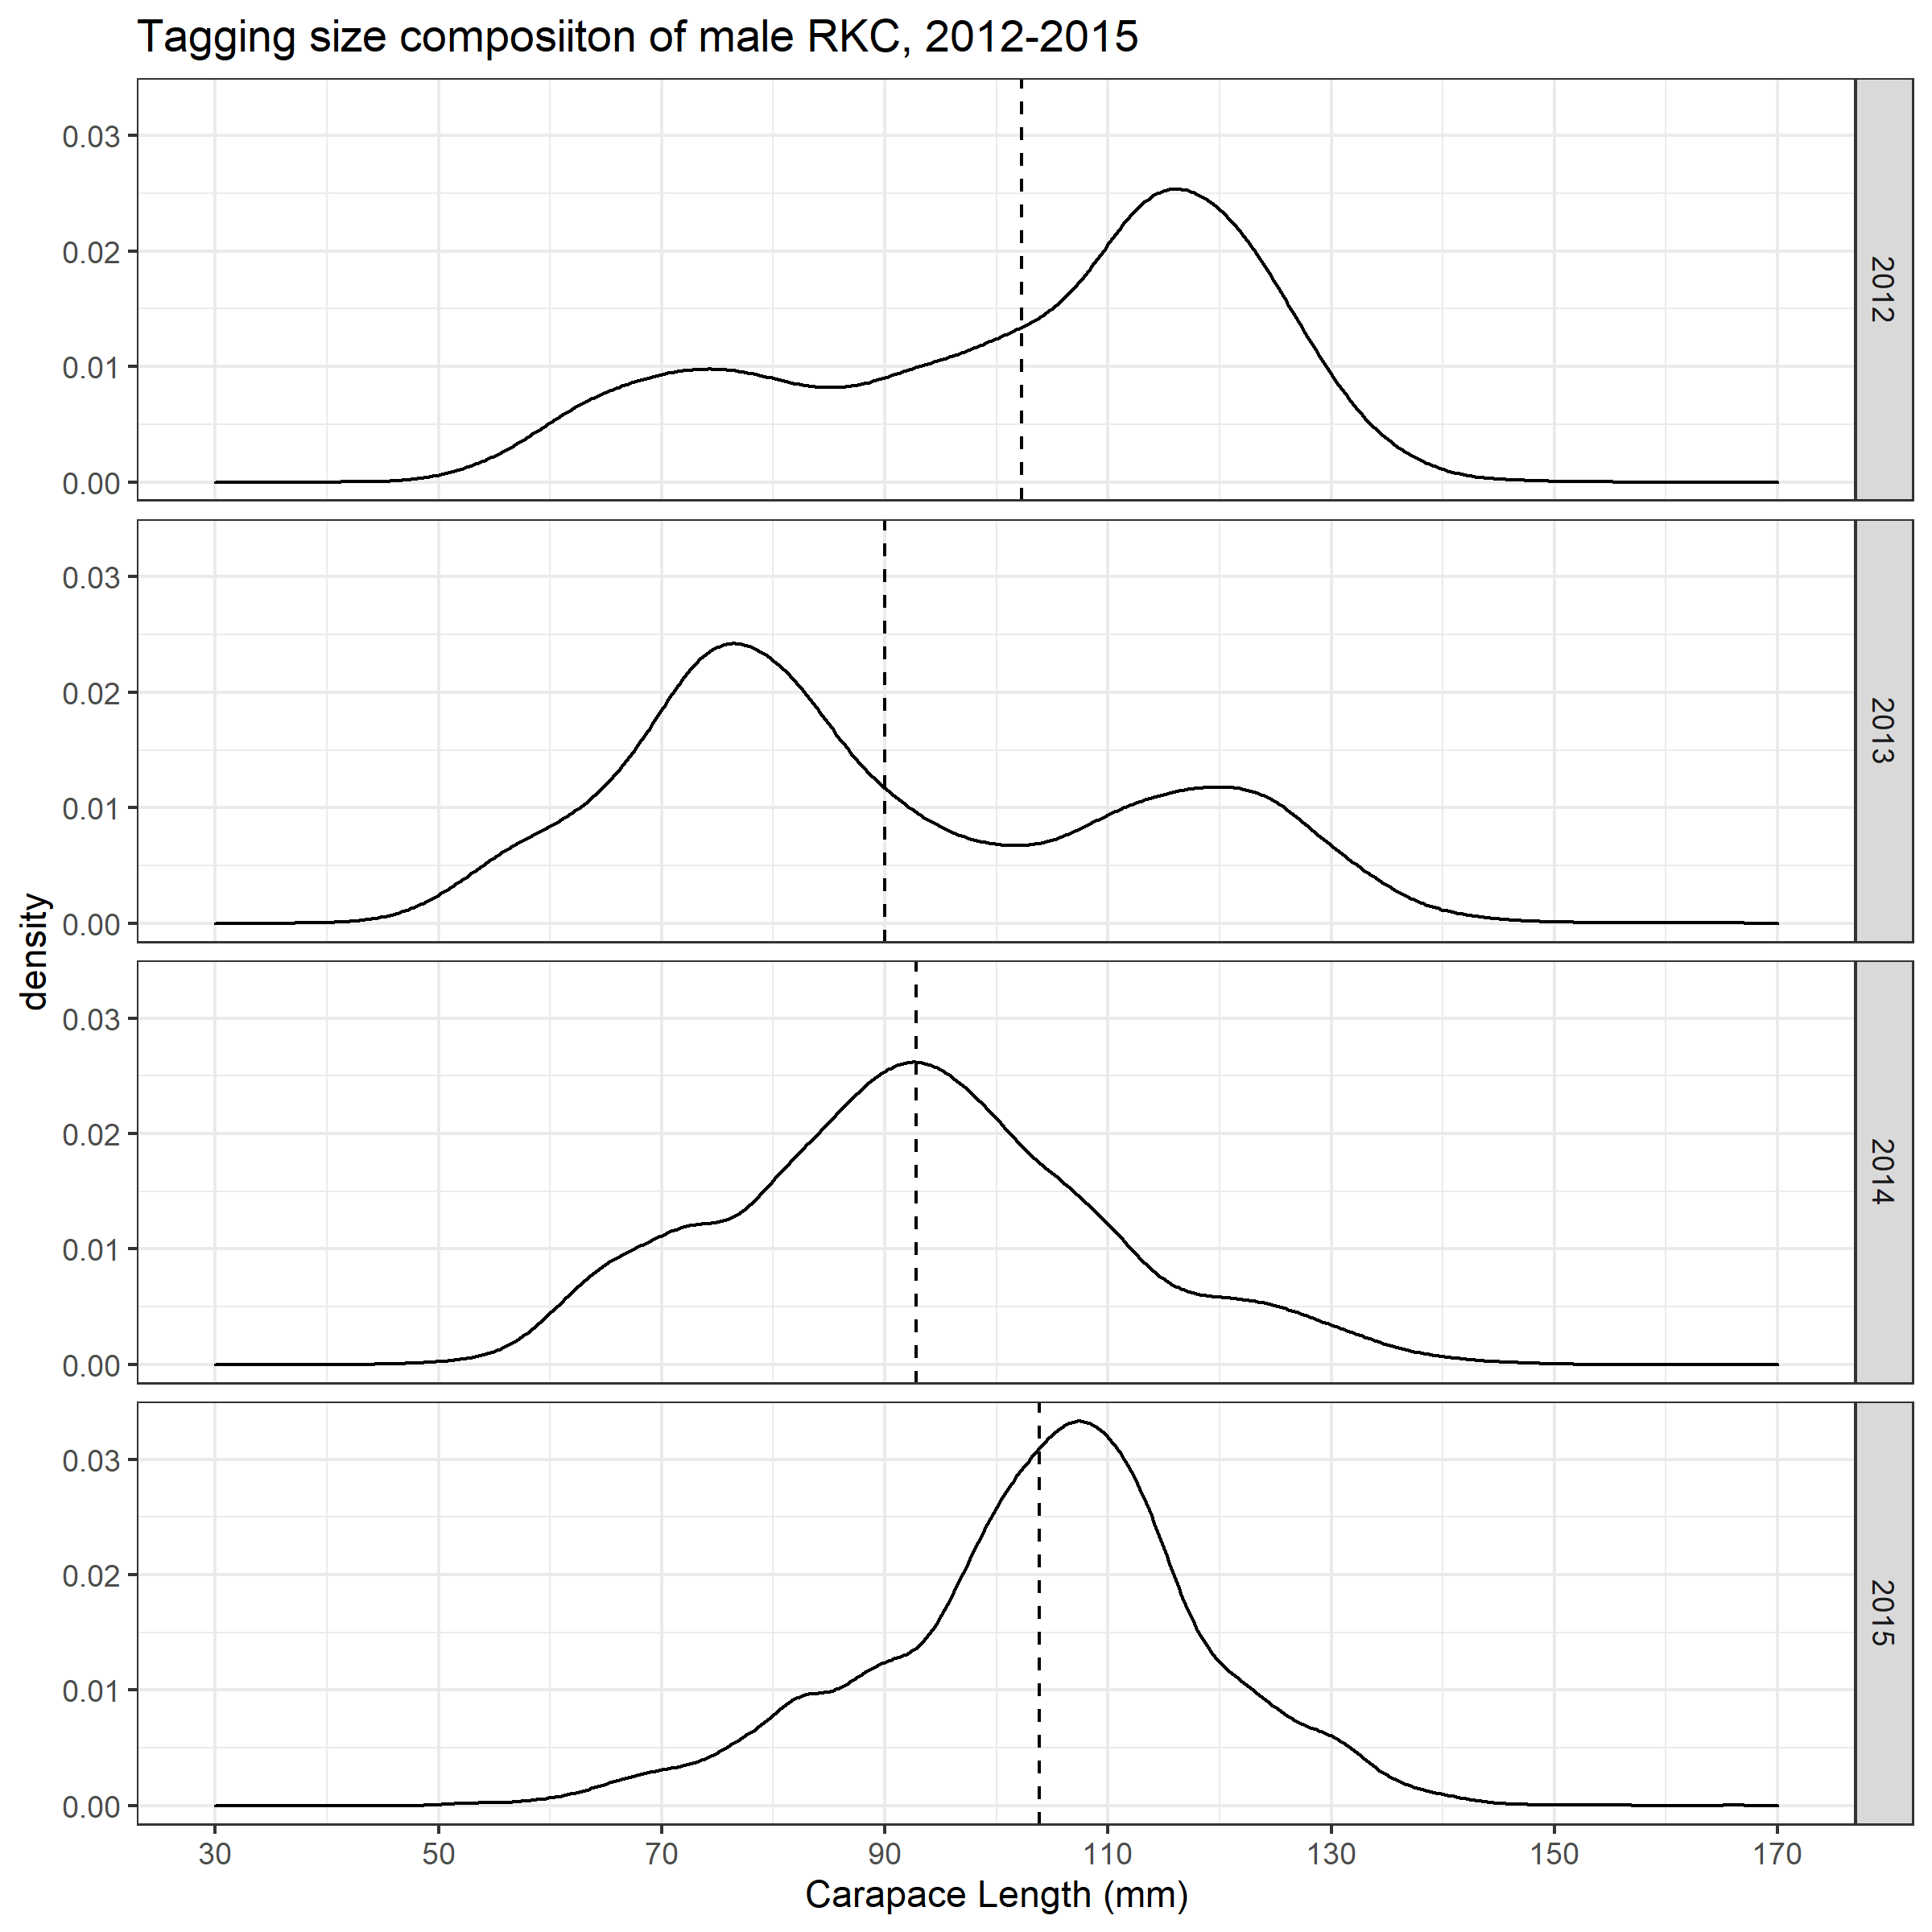
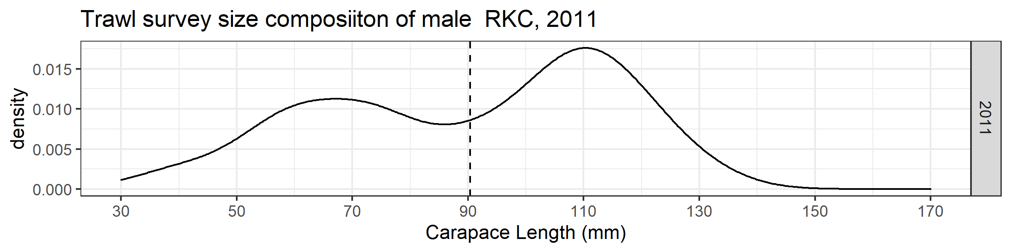
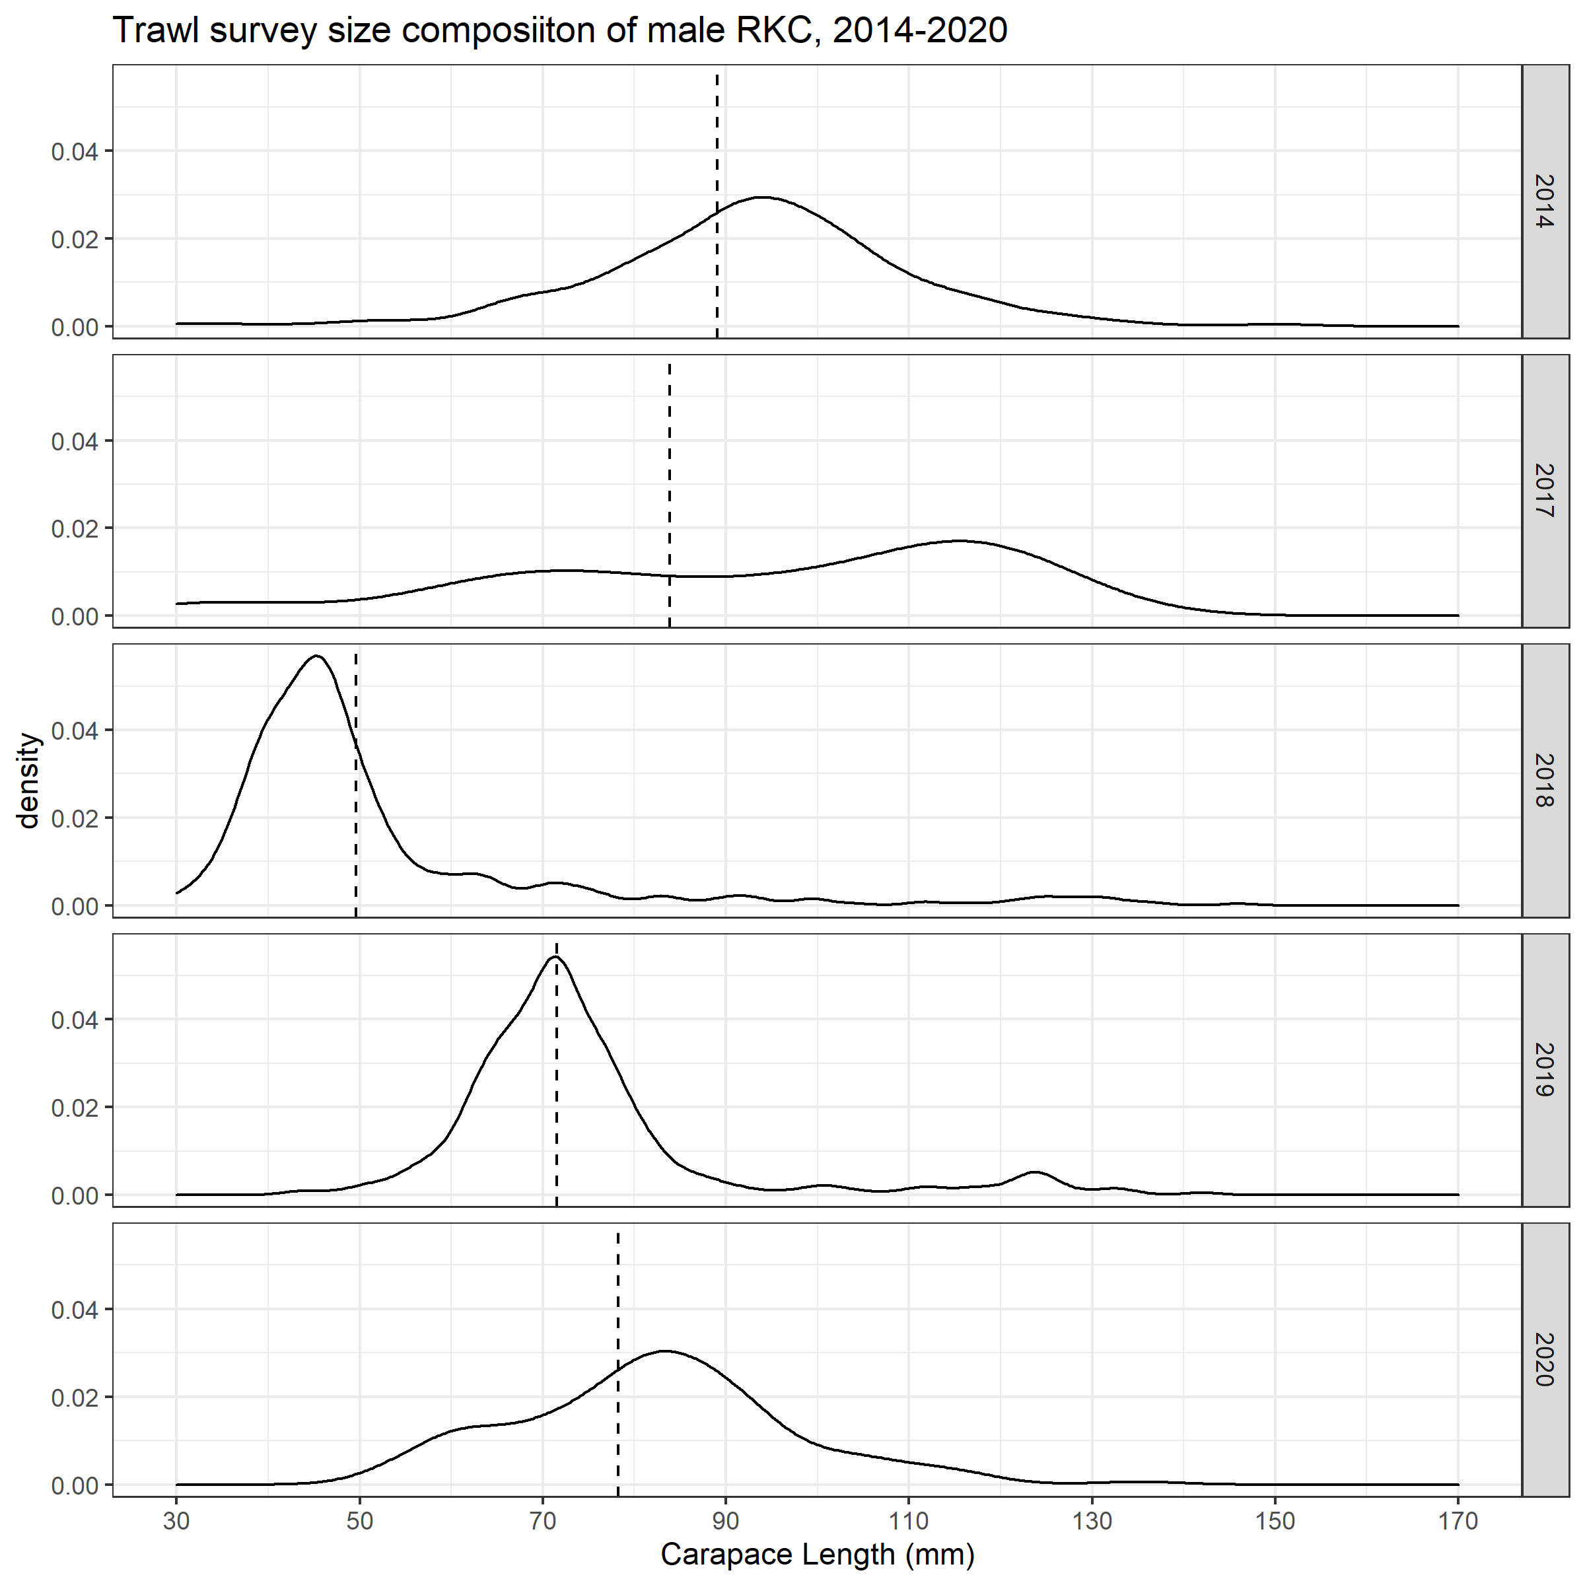
Male size and CPUE: Identifying trends across projects
TAGGING PROJECT
TRAWL SURVEYS
2012-2015 spring tagging project can be a proxy for the trawl survey
91.9 mm CL
5 and 10 mile transects – 45 pots each – set 2-3 times
92.8 mm CL
31,624 crab captured*
*Includes NSEDC tagging in eastern NS

Slide 9
Male size and CPUE: 2010-2015
Harvest is from one cohort that is captured in the 2011 trawl survey
CPUE climbs and peaks as cohort reaches legal size
CPUE decreases as cohort is harvested and ages
Cycle begins again with a new cohort

Slide 10
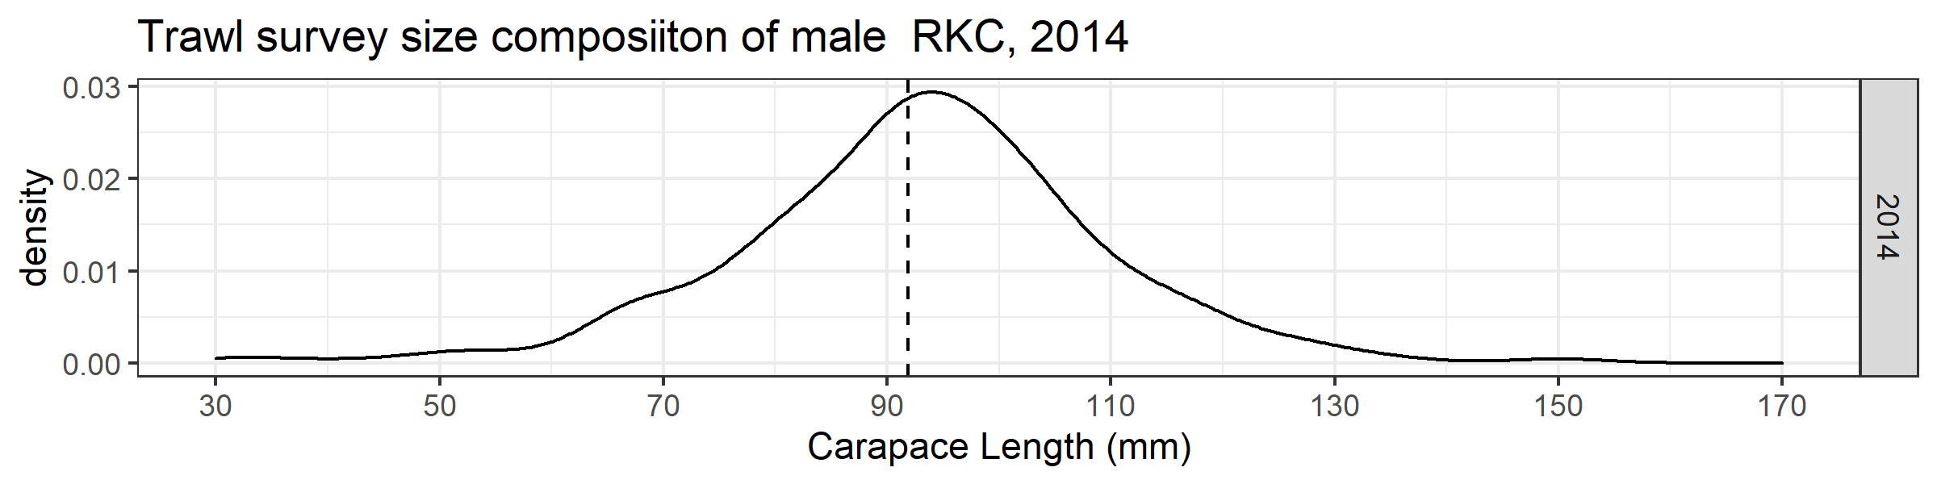
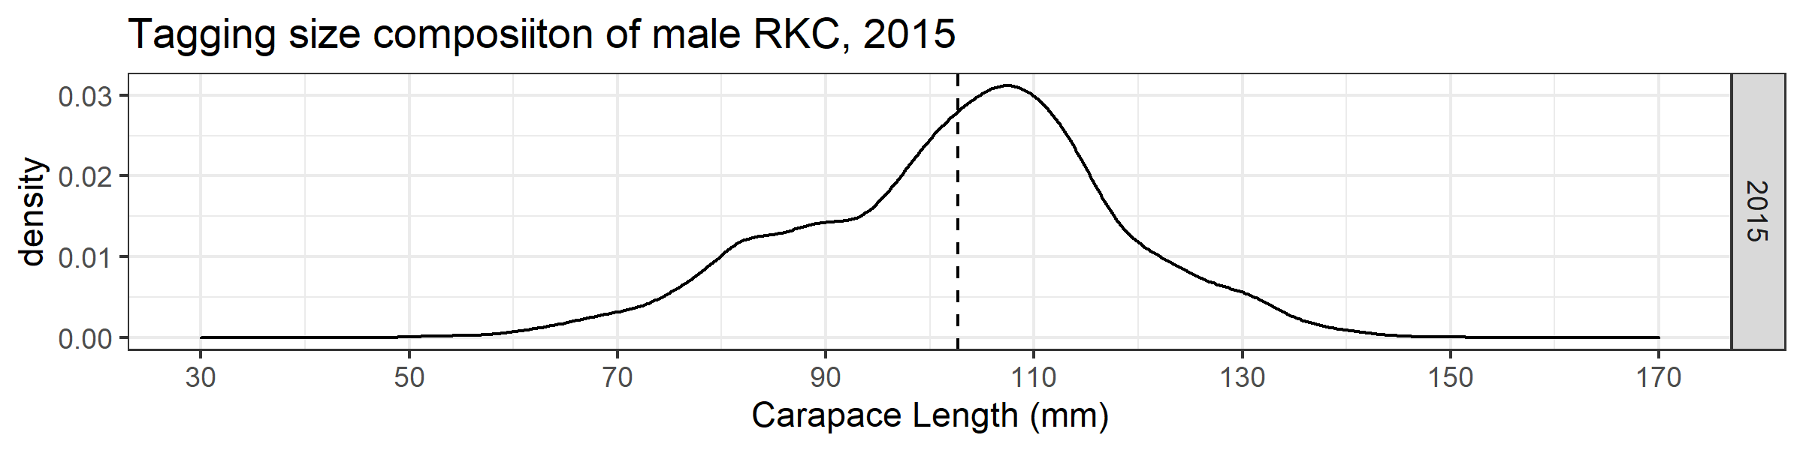
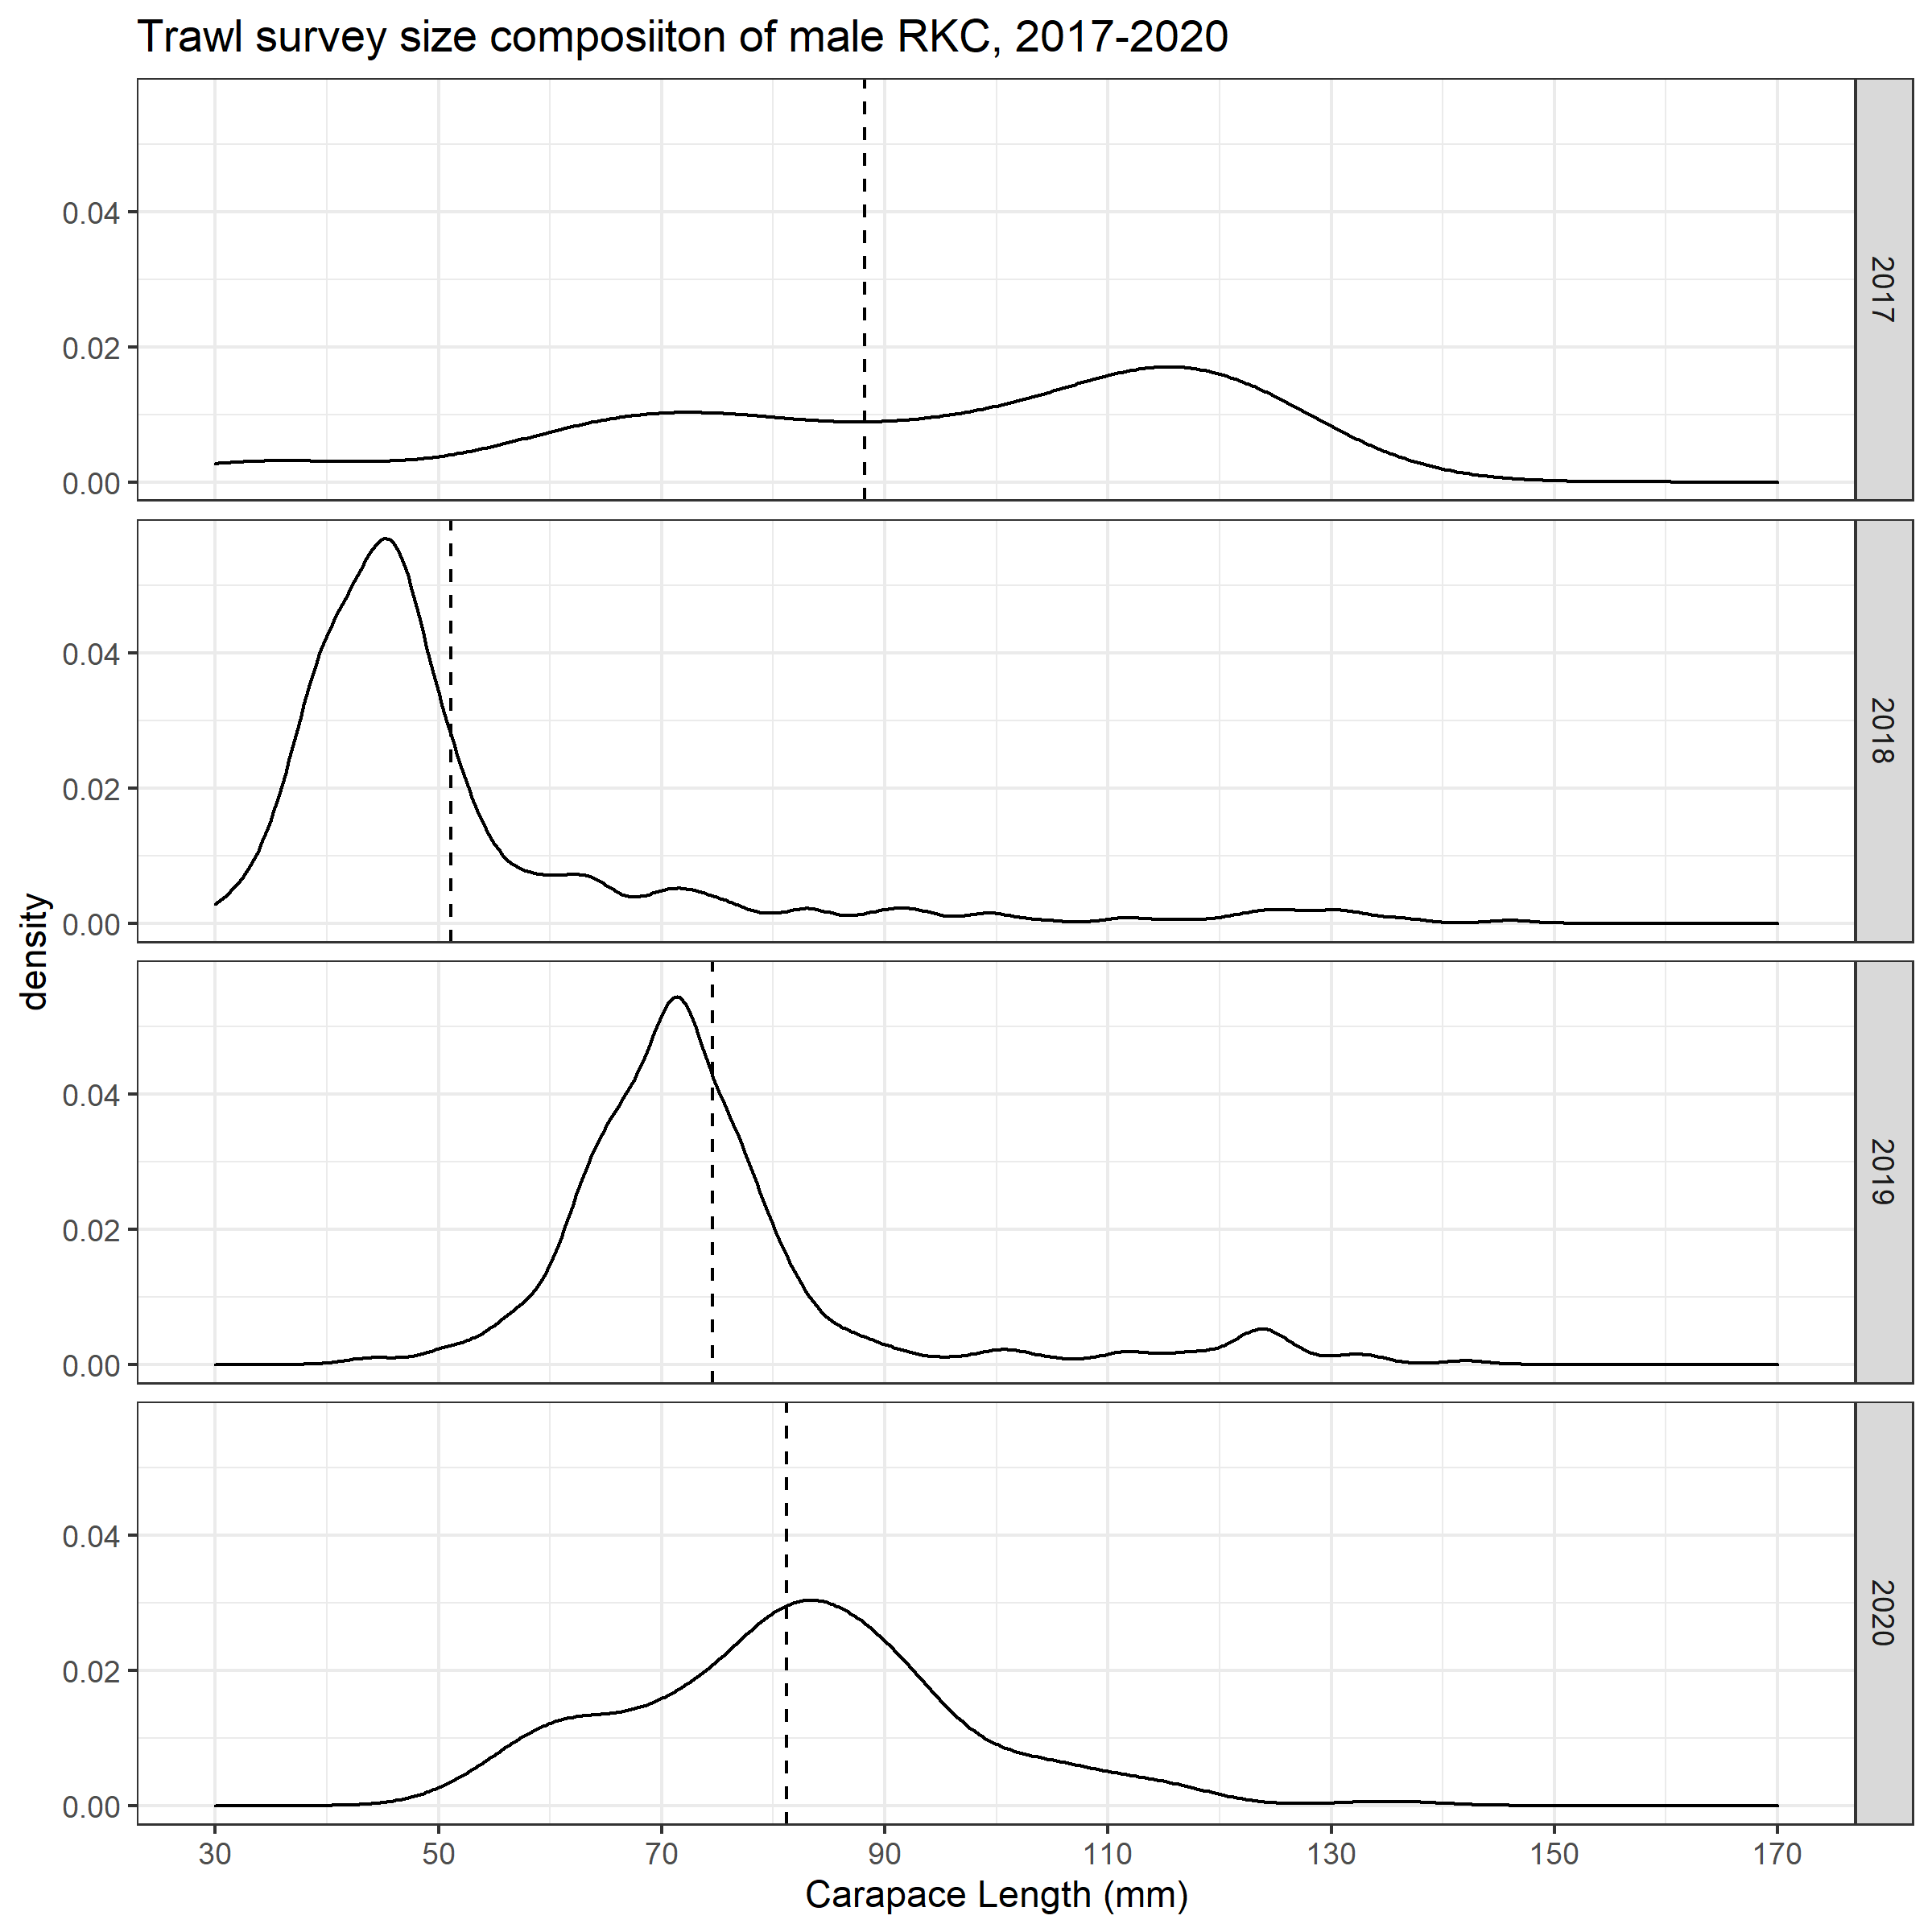
Male size and CPUE: 2014-2019
Harvest is from one cohort that is captured in the 2014 trawl survey
CPUE climbs and peaks as cohort reaches legal size
CPUE decreases as cohort is harvested and ages
Cycle begins again with a new cohort- 2021/2022?

Slide 11
Male size and CPUE: Moving Forward
Take-aways:
Appears a single cohort provides 1-3 years of commercial harvest
The timing to legal size of the next cohort affects CPUE
Can we use this pattern to help inform management decisions?
Could this topic be addressed in an MSE (Management Strategy Evaluation)?
Concerns:
Short time series at this point
Will patten persist into the future?
Commitment to conduct an annual trawl survey

Slide 12
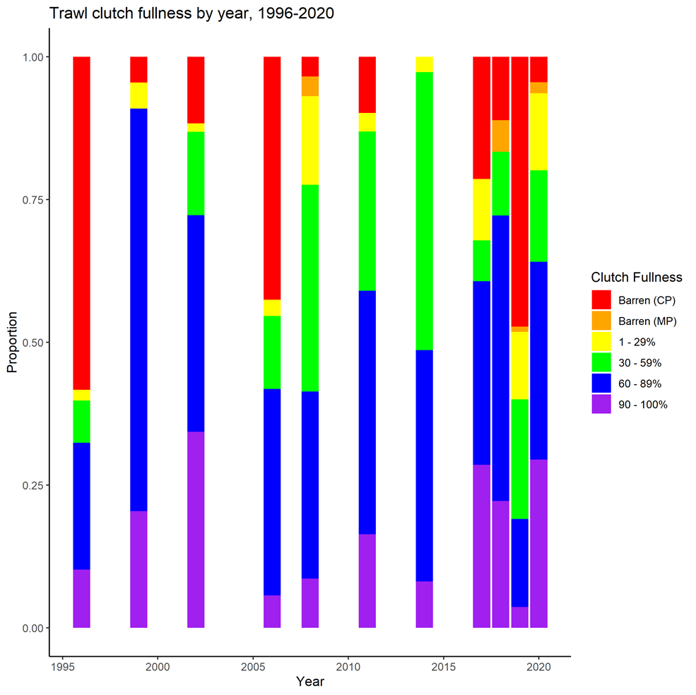
Female Clutch Fullness: The Issue
In 2019, the trawl survey detected a high proportion of no clutch/ small clutch females
In conjunction with few large males there was increased concern about the reproductive viability of the population
****Removed from data: crab less than 65 mm CL and listed as barren

Slide 13
Female Clutch Fullness: Clutch anomalies
50% mature --72-74 mm CL
Has been relatively consistent through time and over projects
Does not appear to be a change in the size at female reproductive maturity
Hypothesis: 65-75 mm CL size class is predominantly females and preponderance of small males (<75 mm CL) cause these clutch anomalies

Slide 14
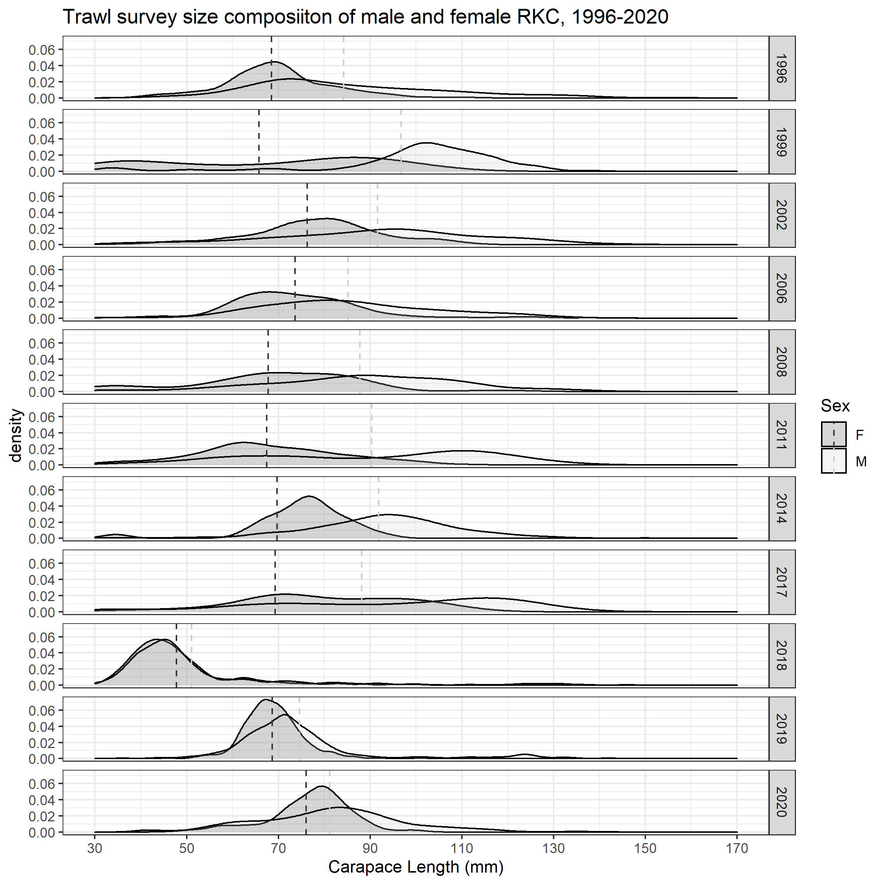

Female Clutch Fullness: We’ve Seen This Before
In 1996, 2006, and 2019 surveys crab cohort was 65-75 mm CL and predominantly female

Slide 15
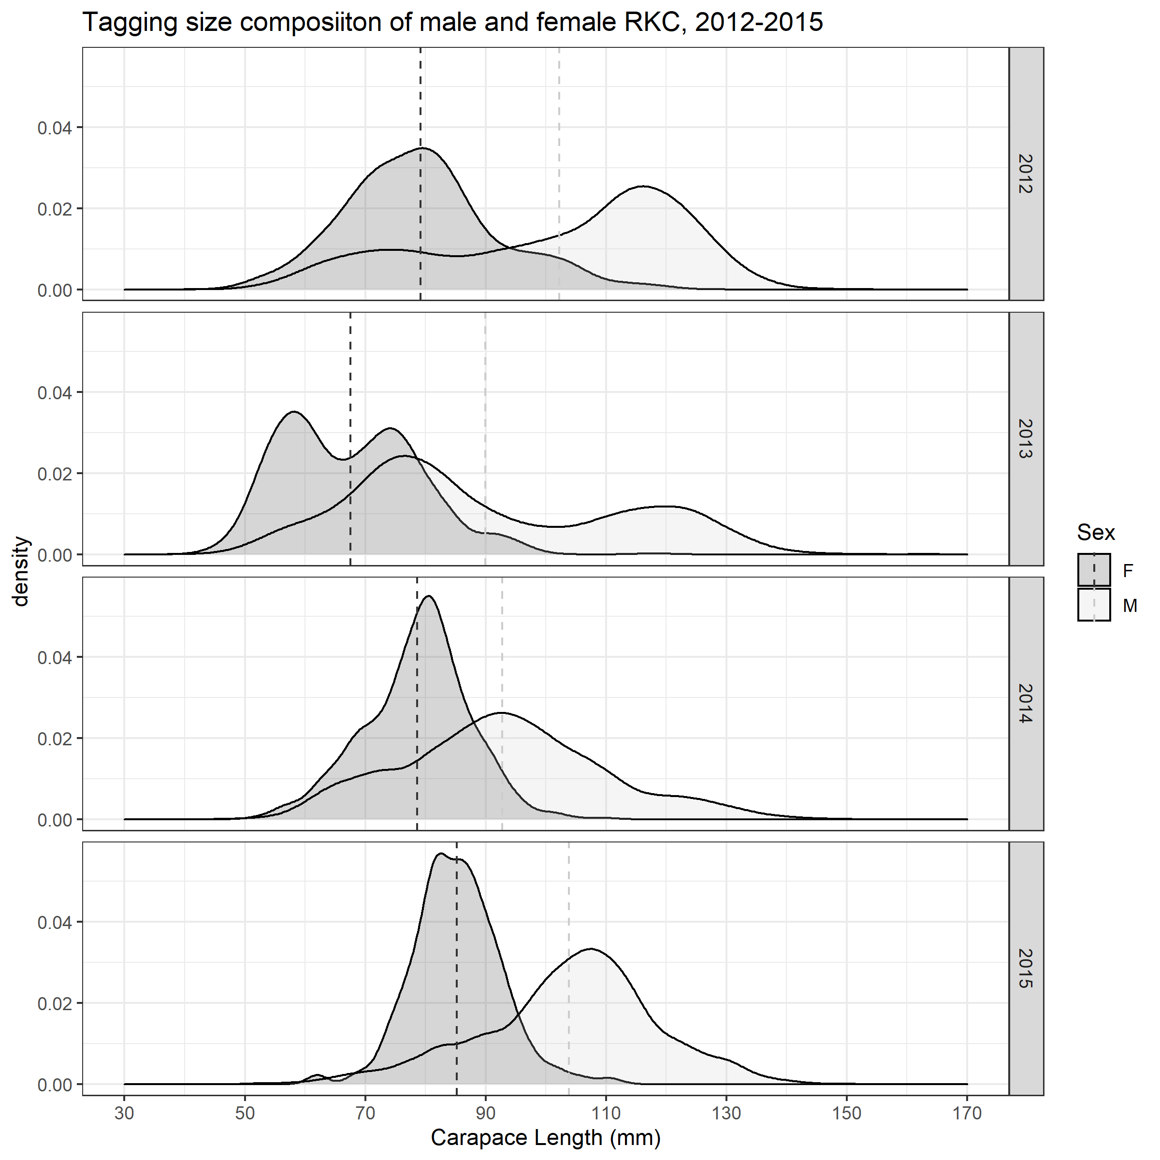
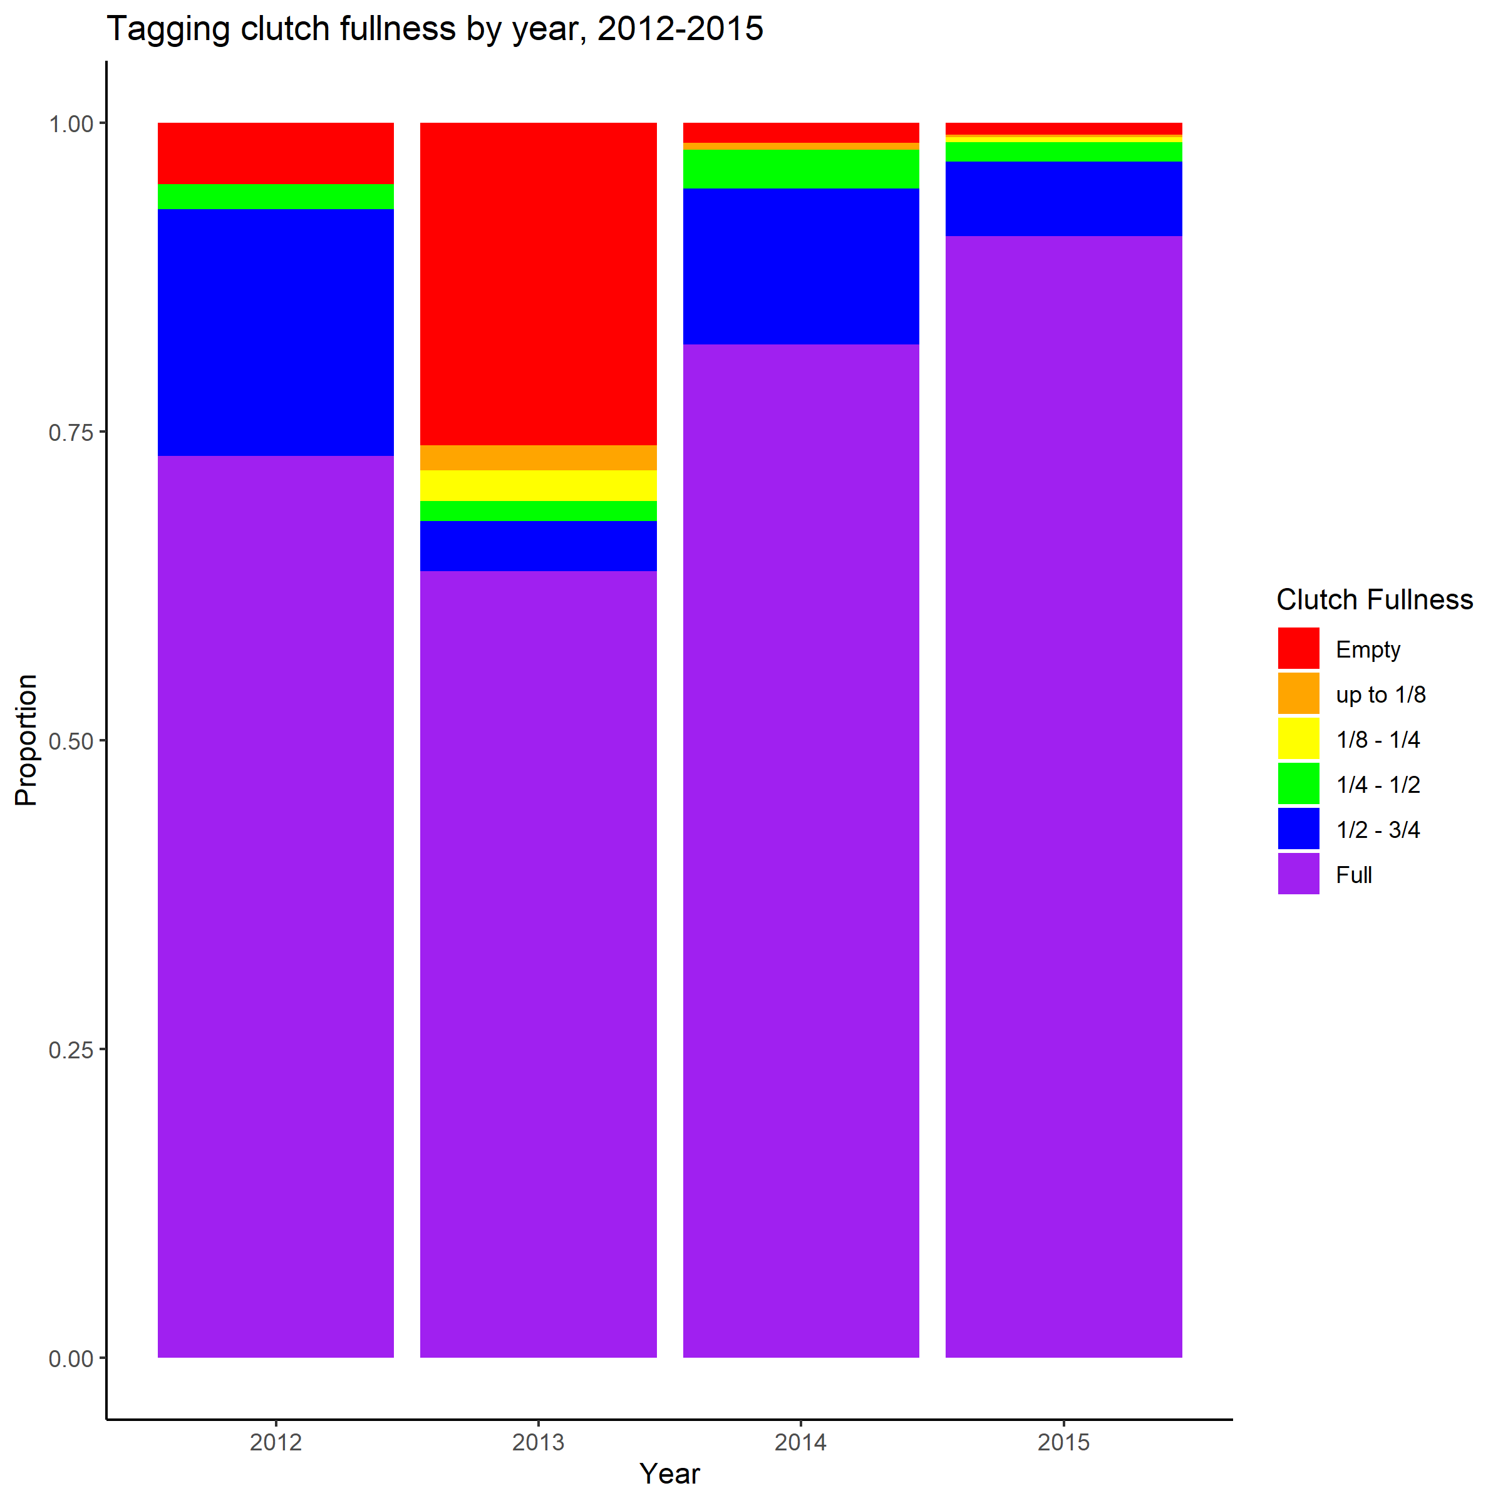
Female Clutch Fullness: Trend Identified in tagging data
Females 65-75 mm CL were also detected in tagging data in 2013 (no trawl survey that year)

Slide 16
Female Clutch Fullness: Trend does not persist
Empty clutches are gone the next year

Slide 17
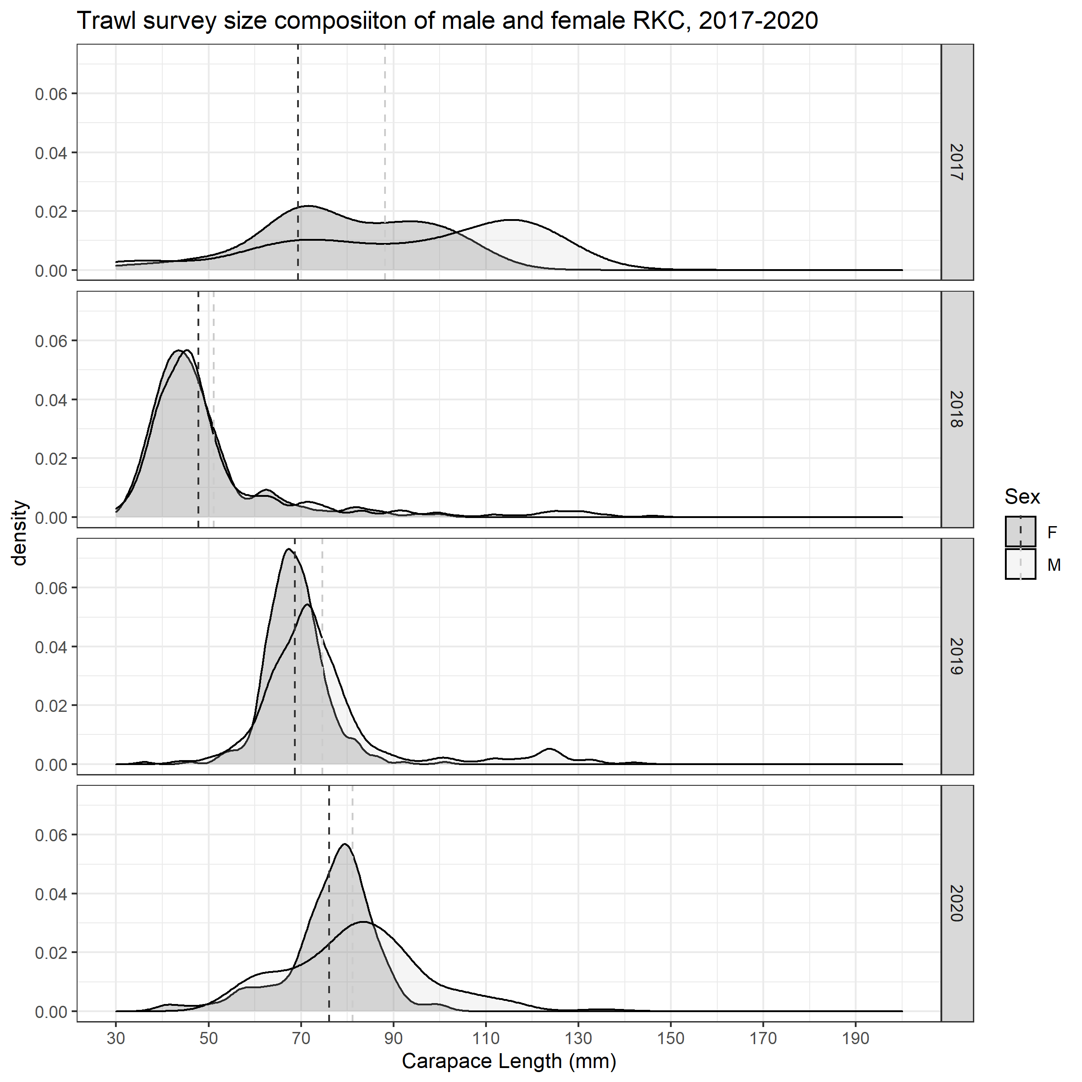
Female Clutch Fullness
In the next year, majority of female crab are greater than 75 mm CL and males of the same cohort are larger than the females
TRAWL
TAGGING

Slide 18
Female Clutch Fullness: Next Steps
What we are working on:
Embryo development
Number of fertilized eggs in a clutch
Live crab studies- Leah Zacher-NOAA
  Sent 25 females
What we don’t know:
Future effects of the clutch anomalies
Reproductive potential and what is needed to sustain the NSRKC population

Slide 19
Functional Maturity: The Issue
Functional maturity of NS male RKC is currently estimated from BBRKC and we believe mating occurs under the ice so grasping pairs are difficult to examine
Hypothesis: Functional maturity is less than 94 mm CL
Evidence:
Large males were still scarce in 2020, yet females egg clutches were predominantly 60-100% full
A cohort will support itself and once the males are predominantly larger than the cohort females, mating will occur

Slide 20
Functional Maturity: Evidence and research
Live crab study in Kodiak NOAA labs
2020- all crab molted to greater than 94 mm CL in late September/Early October 😐
Plan to try again next year with smaller crab…
Large males were not captured in the trawl yet clutches were predominantly 60-100% full
Evidence of sublegal molting in the fall!!!

Slide 21
Live crab research
Collaboration between NOAA-Kodiak and ADF&G
Males were <90 mm CL (n=14)
Females were <90 mm CL and mature (presence of eggs) (n=25)
Examine size of grasping males = functional maturity
Determine success of mating by male/female size
Examine egg development
Fecundity
Future work- seeking funding to continue the above examinations and add
Collect missing growth-per-molt data (64 - 73 mm and >124 mm CL)
Assess size dependent survival rates of male NSRKC in a 1-year laboratory holding study
Characterize size-and sex-specific movement patterns and habitat use of females and large (> 123 mm) and small (100 - 122 mm) male crab

Slide 22
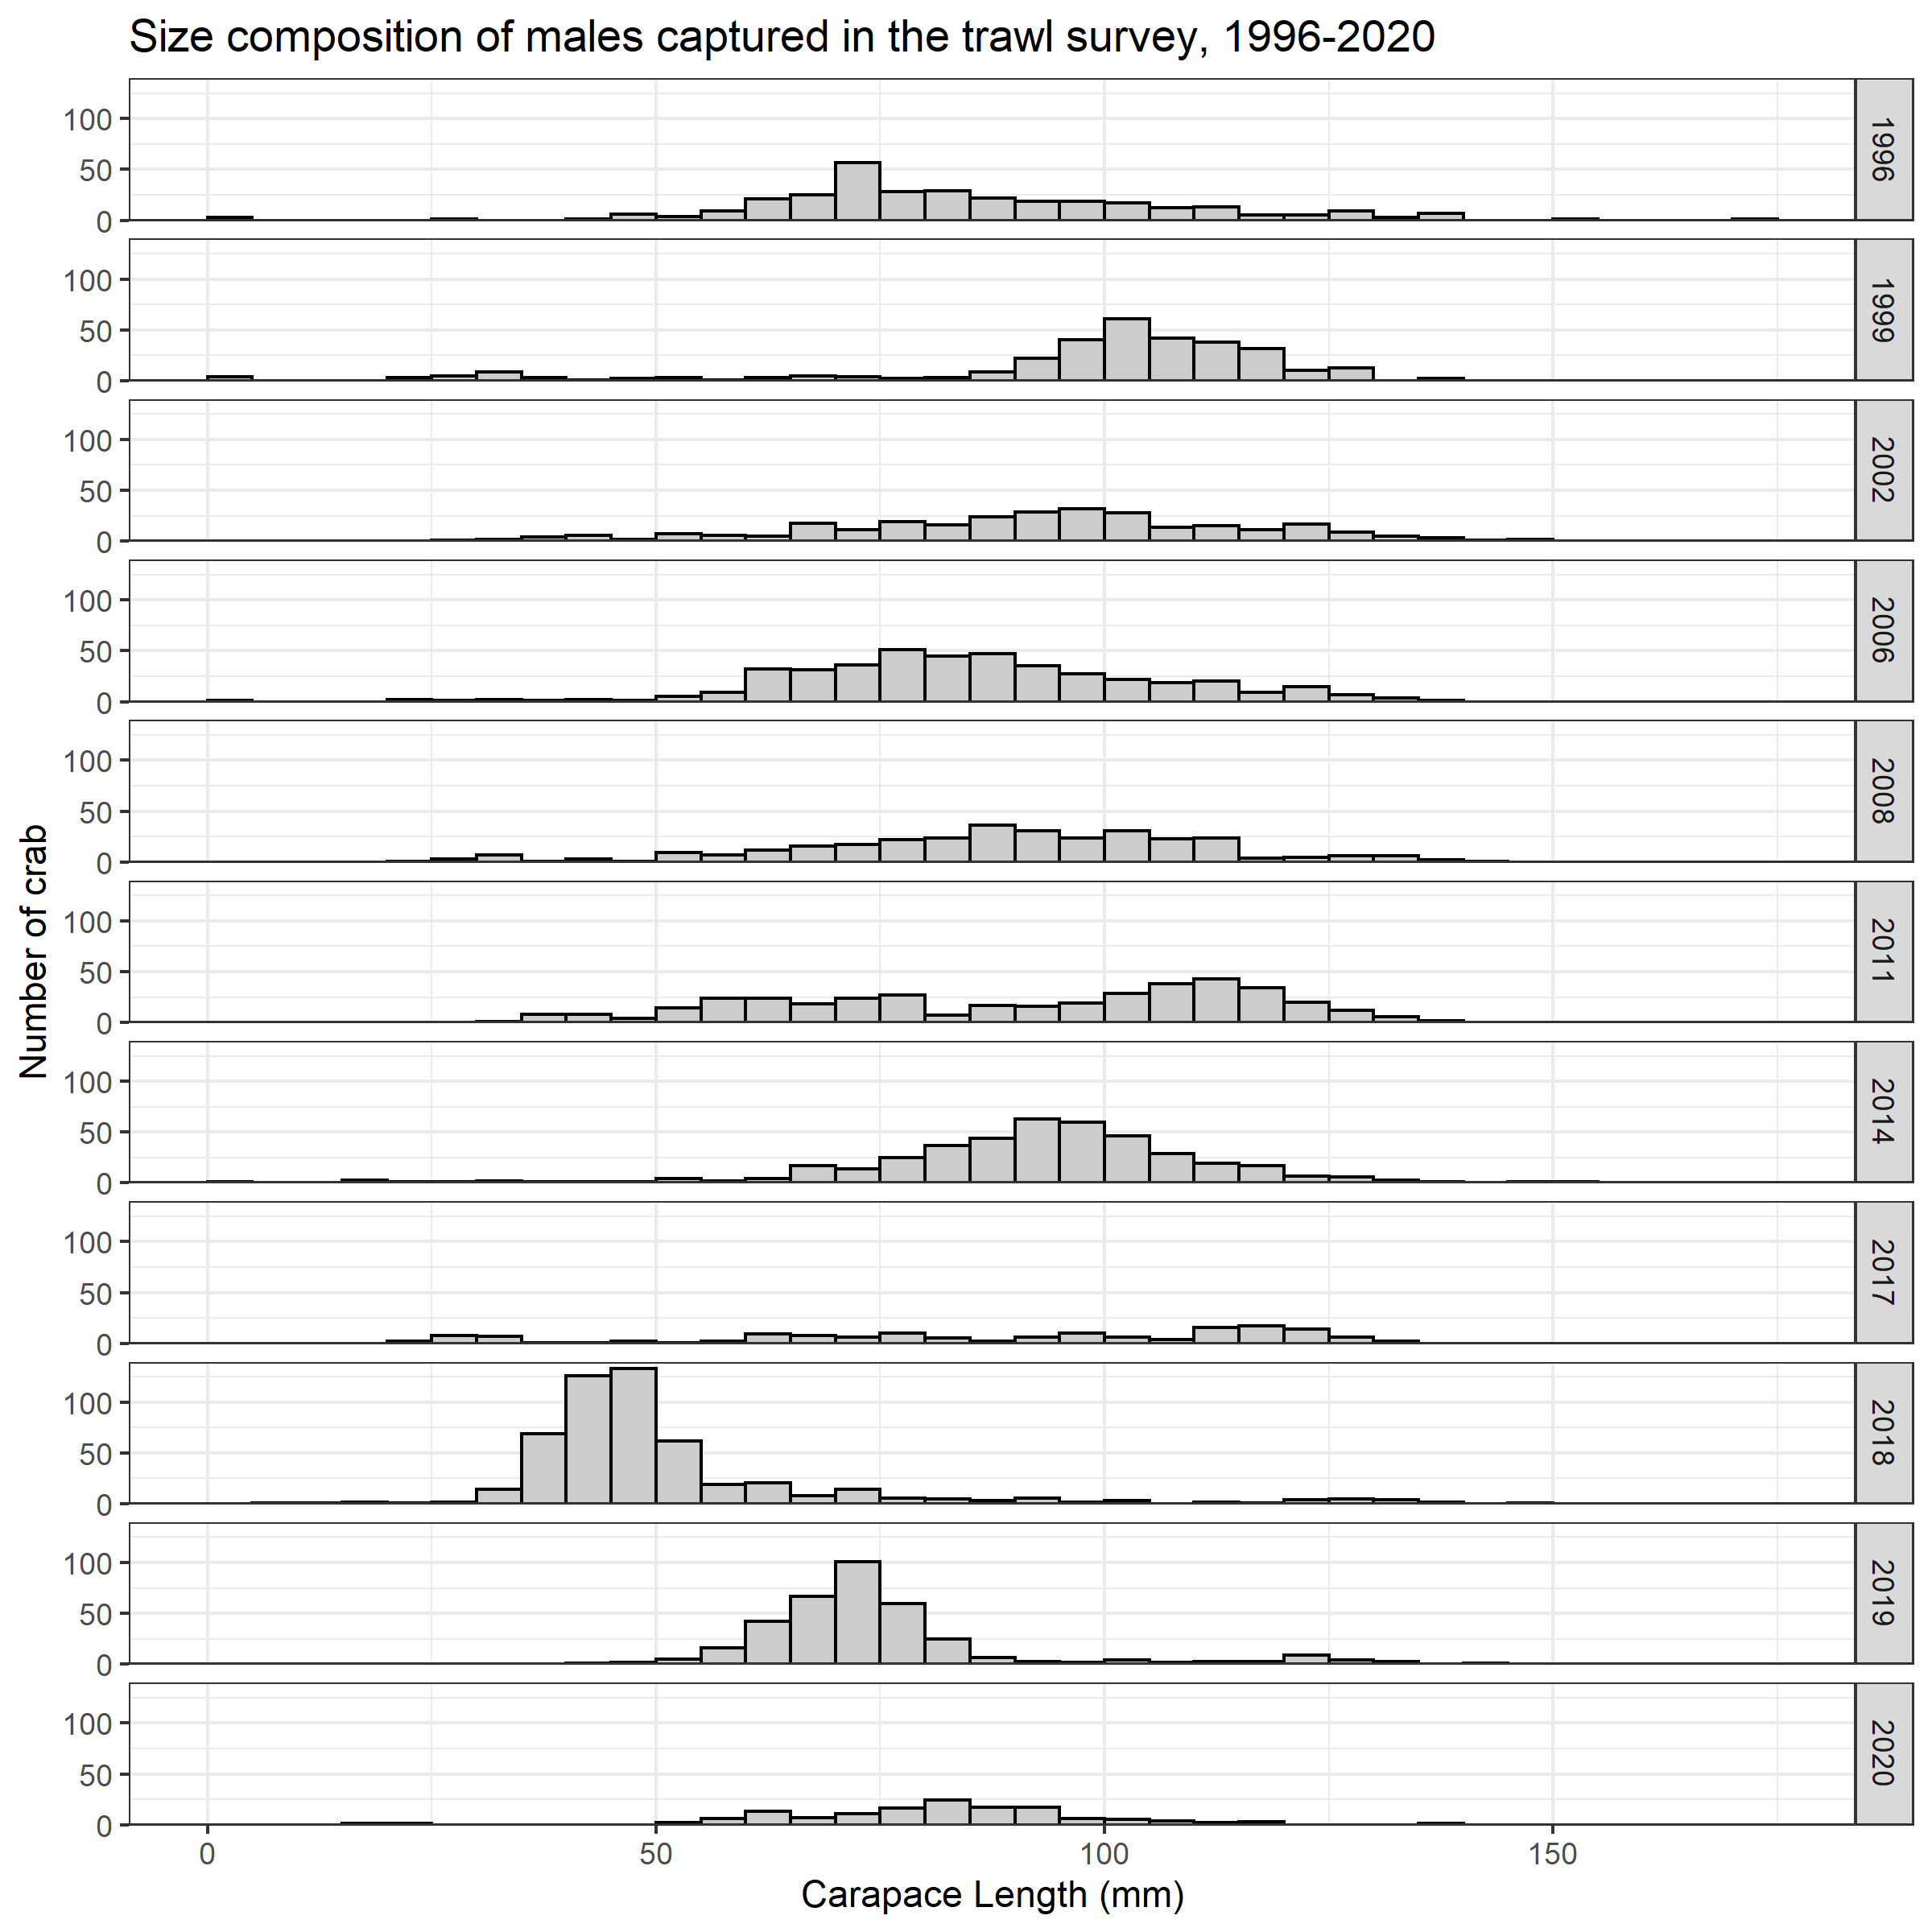
Locating Large males: The Issue
RKC >123 mm CL are rarer than expected in fisheries and trawl survey
Hypothesis: large crab in NS are in areas not fished or regularly assessed
Spaghetti tag recoveries since the 1980s but little fishery /research project- independent data
2020 Pilot study using pop-up satellite tags to detect crab movement without physical recovery
(Assistance from Kodiak ADF&G)

Slide 23
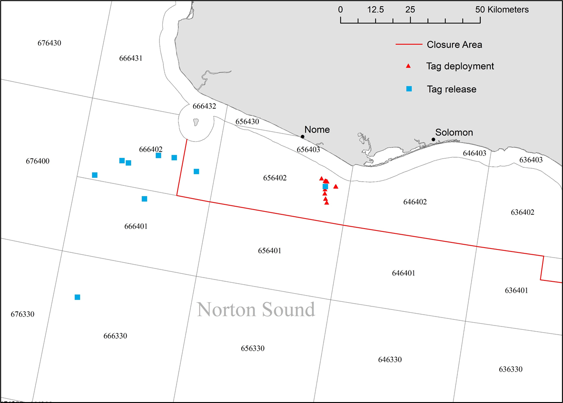
Locating Large Males
16 satellite tags deployed July 2020
  106 – 135 mm CL
  Tags were set to collect data for four months
9 tags popped up on predetermined date
  Oct 6 and Oct 7
  8 locations high confidence
SW most tag location is suspect
Will tag up to 140 crabs in spring 2021 (with ADF&G Kodiak and NOAA)
Preliminary location data from Andrew Nault – ADF&G

Slide 24

Thanks to our collaborators for helping us advance our understanding of NSRKC!
Questions?

