Slide 1
Norton Sound Red King Crab
SAFE 2021
Jan 11 2021
Crab Plan Team: Virtual
Toshihide “Hamachan” Hamazaki,
Jie Zheng
Alaska Department of Fish & Game
Division of Commercial Fisheries

Slide 2
NSRKC Stock Assessment Model
Modeling process
Available Data & model fit
5 months
Pot survey
Length
Natural
Mortality
Winter Harvest
& Discards
Winter fishery
Dec - May
NSRKC
SAFE Winter +Summer fishery
Feb 01
Abundance
July 01
Abundance
Summer fishery
Jun - Sept
Summer Harvest
& Discards
Length, CPUE
Molting, Growth &
Recruitment
Natural
Mortality
Trawl survey
Abundance, Length
Tag recovery
7 months

Slide 3
NSRKC Stock Assessment Model
Modeling process
Available Data & model fit
5 months
Length Prop
Pot survey
Natural
Mortality
Abundance
Trawl survey
ST. CPUE
Winter fishery
Dec - May
Feb 01
Abundance
July 01
Abundance
Summer fishery
Jun - Sept
Survey selectivity
=
Catch selectivity
Length Prop
Trawl Survey
Fishery: Retain
Discards
Molting, Growth
Recruitment
Natural
Mortality
7 months
Tag recovery

Slide 4
Assumptions
M = 0.18 for length class 1-6, higher mortality of classes 7 and 8
Same selectivity and catchability for New and Old Shells
Discards mortality = 0.2
Fishery harvests occur instantly:
  Winter fishery: Feb 01: Nov – May
  Summer fisher: July 01: Jun – Sept
Winter catch selectivity = winter pot survey selectivity

Slide 5
No Changes Fishery & Data since Sept 2020
Winter fishery 2020
  Commercial: Confidential
  Subsistence: 548 (retained)
Summer commercial fishery 2020
  6/25-9/03: 0
  No purchase by NSEDC. Open W. 167, catcher & seller only.
Bycatch: 0
Total retained harvest: Confidential mill. lb.
< ABC (0.22 mill. lb.)
All harvest data FINALIZED
Standardized CPUE NOT updated No data to update
ADF&G 2020 Summer trawl survey
  7/31-8/14: 1716.5 k, CV =0.27
Winter Commercial Retained length-shell Not collected
Tag recovery: No data to update
Changes in fishery regulation: Closed 164 E for Summer commercial fishery.

Slide 6
CPT Recommendation Sept 2020
Assessment Model 19.0 and compare it with GMACS Model 20.0
GMACS Model Comparison is in progress:
  Not ready for OFL (Discuss Later)
Model 19.0 for 2021 OFL-ABC
  Some changes in model outputs and estimates since Sept 2020:
CPT-SSC review and recommendations
  Mostly not current assessment model but exploration of data, and future model developments
  Presented and Discussed AFTER OFL

Slide 7
Some Changes Fishery & Data since Sept 2020
Proportion of legal sized crab by size class (Cleaned up observer and trawl data).
 | 64-73 | 74-83 | 84-93 | 94-103 | 104-113 | 114-123 | 124-133 | >133
Old | 0.0 | 0.0 | 0.0 | 0.12 | 0.80 | 1.00 | 1.00 | 1.00
New | 0.0 | 0.0 | 0.0 | 0.29 | 0.93 | 1.00 | 1.00 | 1.00
More legal (CW > 4.75 inch) crab per size class
  Higher legal crab biomass
  Higher OFL

Slide 8
OFL and ABC: Model 19.0
BMSY (1980-2021) 4.526 million lb or 2.053 k t
Projected MMB: 5.046 million lb or 2.29 k t
Tier 4a
FOFL = 0.18
Legal male biomass: 3.962 million lb or 1.80 kt
OFL(retained) = 0.59 million lb or 0.27 kt
ABC = 0.75*OFL = 0.474 million lb or 0.215 kt

Slide 9
Probability density of OFL and ABC: Model 19.0

Slide 10
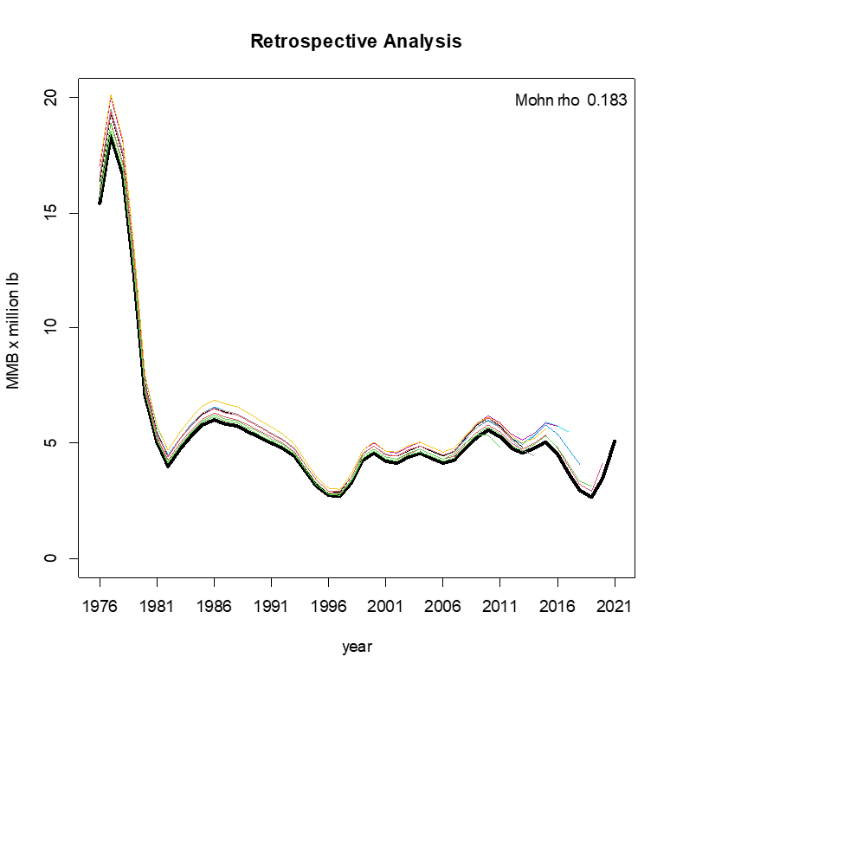
Retrospective to 10 years

Slide 11
Responses to SSC (Sept 2020)
•Bring forward OFL and ABC recommendations based on total catch rather than retained catch only.
Author reply: Author does not recommend Total Catch OFL
  NSRKC fishery observer survey is an ad hoc
  Survey objectives, design, protocol: Not intended to estimate total discards Observer survey is NOT representative (SAFE 2018)
  Program stability: No designate funding and staff
Observer survey may not be conducted every year.

Slide 12
Responses to SSC (Sept 2020)
Total OFL depends on choice of discards method
Model | 19.0 | 19.0a | 19.0b | 19.0c | 19.0d | 19.0e
Method |  | LNR | LNR2 | Sub | Sub2 | Prop
Likelihood Total | 324.5 | 325.9 | 325.8 | 329.0 | 327.2 | 325.5
Discards likelihood |  | 1.30 | 1.27 | 3.61 | 2.58 | 1.01
OFL.retained | 0.593 | 0.589 | 0.589 | 0.592 | 0.591 | 0.587
OFL.unretained | 0.039 | 0.039 | 0.039 | 0.041 | 0.039 | 0.039
OFL.total | 0.632 | 0.628 | 0.628 | 0.633 | 0.630 | 0.626
LNR: Discards CPUE*Effort (Effort: Total pot pull) LNR2: Adjusted
Sub: Total catch CPUE*Effort – Retained catch Sub2: Adjusted
Prop: Retained catch*(Discards/Retained)
Which method produce ACCURATE estimate?

Slide 13
Steps needed to set statistically sound discard estimates and total OFL
Design an observer survey program that can estimate total discards (Request experts assistance)
  Extend observer survey throughout season.
  Random selection of crab boats-crabbers
  How to capture discards by majority of crabbers whose boat were too small to have an observer?
Regulation change?
  Can crabbers refuse to have an observer?
  Do observers have legal grounds to be on boat?
Secure Program stability
  Dedicated and stable funding?
  Dedicated staff

Slide 14
Responses to CPT-SSC (Sept 2020)
•Bring forward a GMACS model (20.0) in the upcoming assessment, including a detailed comparison with the base model (19.0).
Author reply: GMACS is not ready to replace assessment model
Tag recovery likelihood is wrong (Cody)
GMACS can’t (?) have two retention curves from single fishery selectivity
  Winter Com and Subs fisheries assumed to use the same pot. Com can retain only legal crab, but Sub can retain any sizes.
GMACS estimates catch. Assessment model consider catch absolute.
GMACS can’t (?) enter 0 (zero) catch
Still figuring all inputs and outputs for comparison

Slide 15
NSRKC GMACS progress
Directly input model parameters from assessment model
  Annual recruitment
    GMACS: Male only model not assumed.
  Fishery catch and retention selectivity
    Still working on winter fishery selectivity (ad hoc dome shape), summer commercial (ad hoc 1 parameter logistic),
  Molting probability
  Initial size and length-shell proportion
    Still working
  Size transition matrix
  Size prop input sample size
Some GMACS model input are not created by Assessment model
  Selectivity model parameterization differs
  Fishing mortality: Still working: Assessment model does not calculate
  CVs,
  theta[1]……theta[n] : what are they?

Slide 16
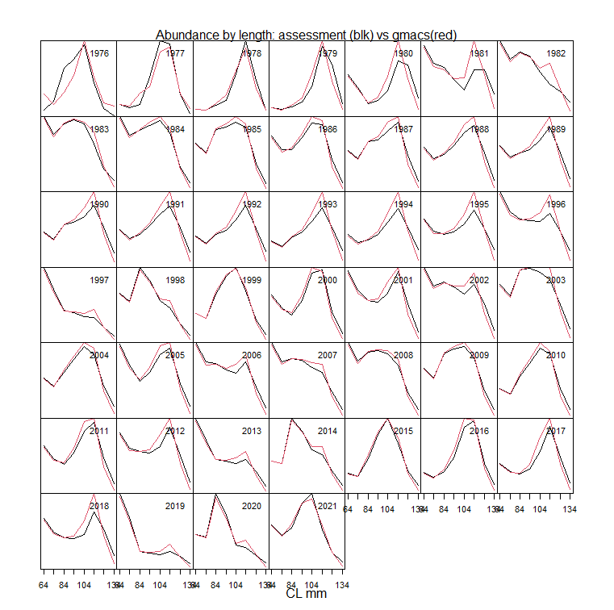
NSRKC GMACS Progress: Abundance by size

Slide 17
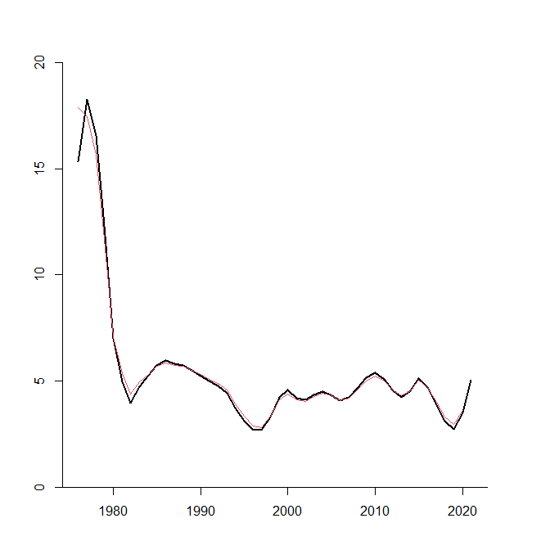
NSRKC GMACS Progress: MMB: Assessment vs GMACS

Slide 18
Responses to CPT-SSC (Sept 2020)
•Bring forward VAST modeling diagnostics, including spatial residuals. Bring forward a model run in the upcoming assessment that uses the VAST estimates.
Author reply: VAST model not working well with my PC.
  VAST Package installation error
  TMB – VAST model compilation error
  VAST model convergence error (Then how do I fix)
  VAST model outputs (Where are they, and how to read all outputs?)

Slide 19
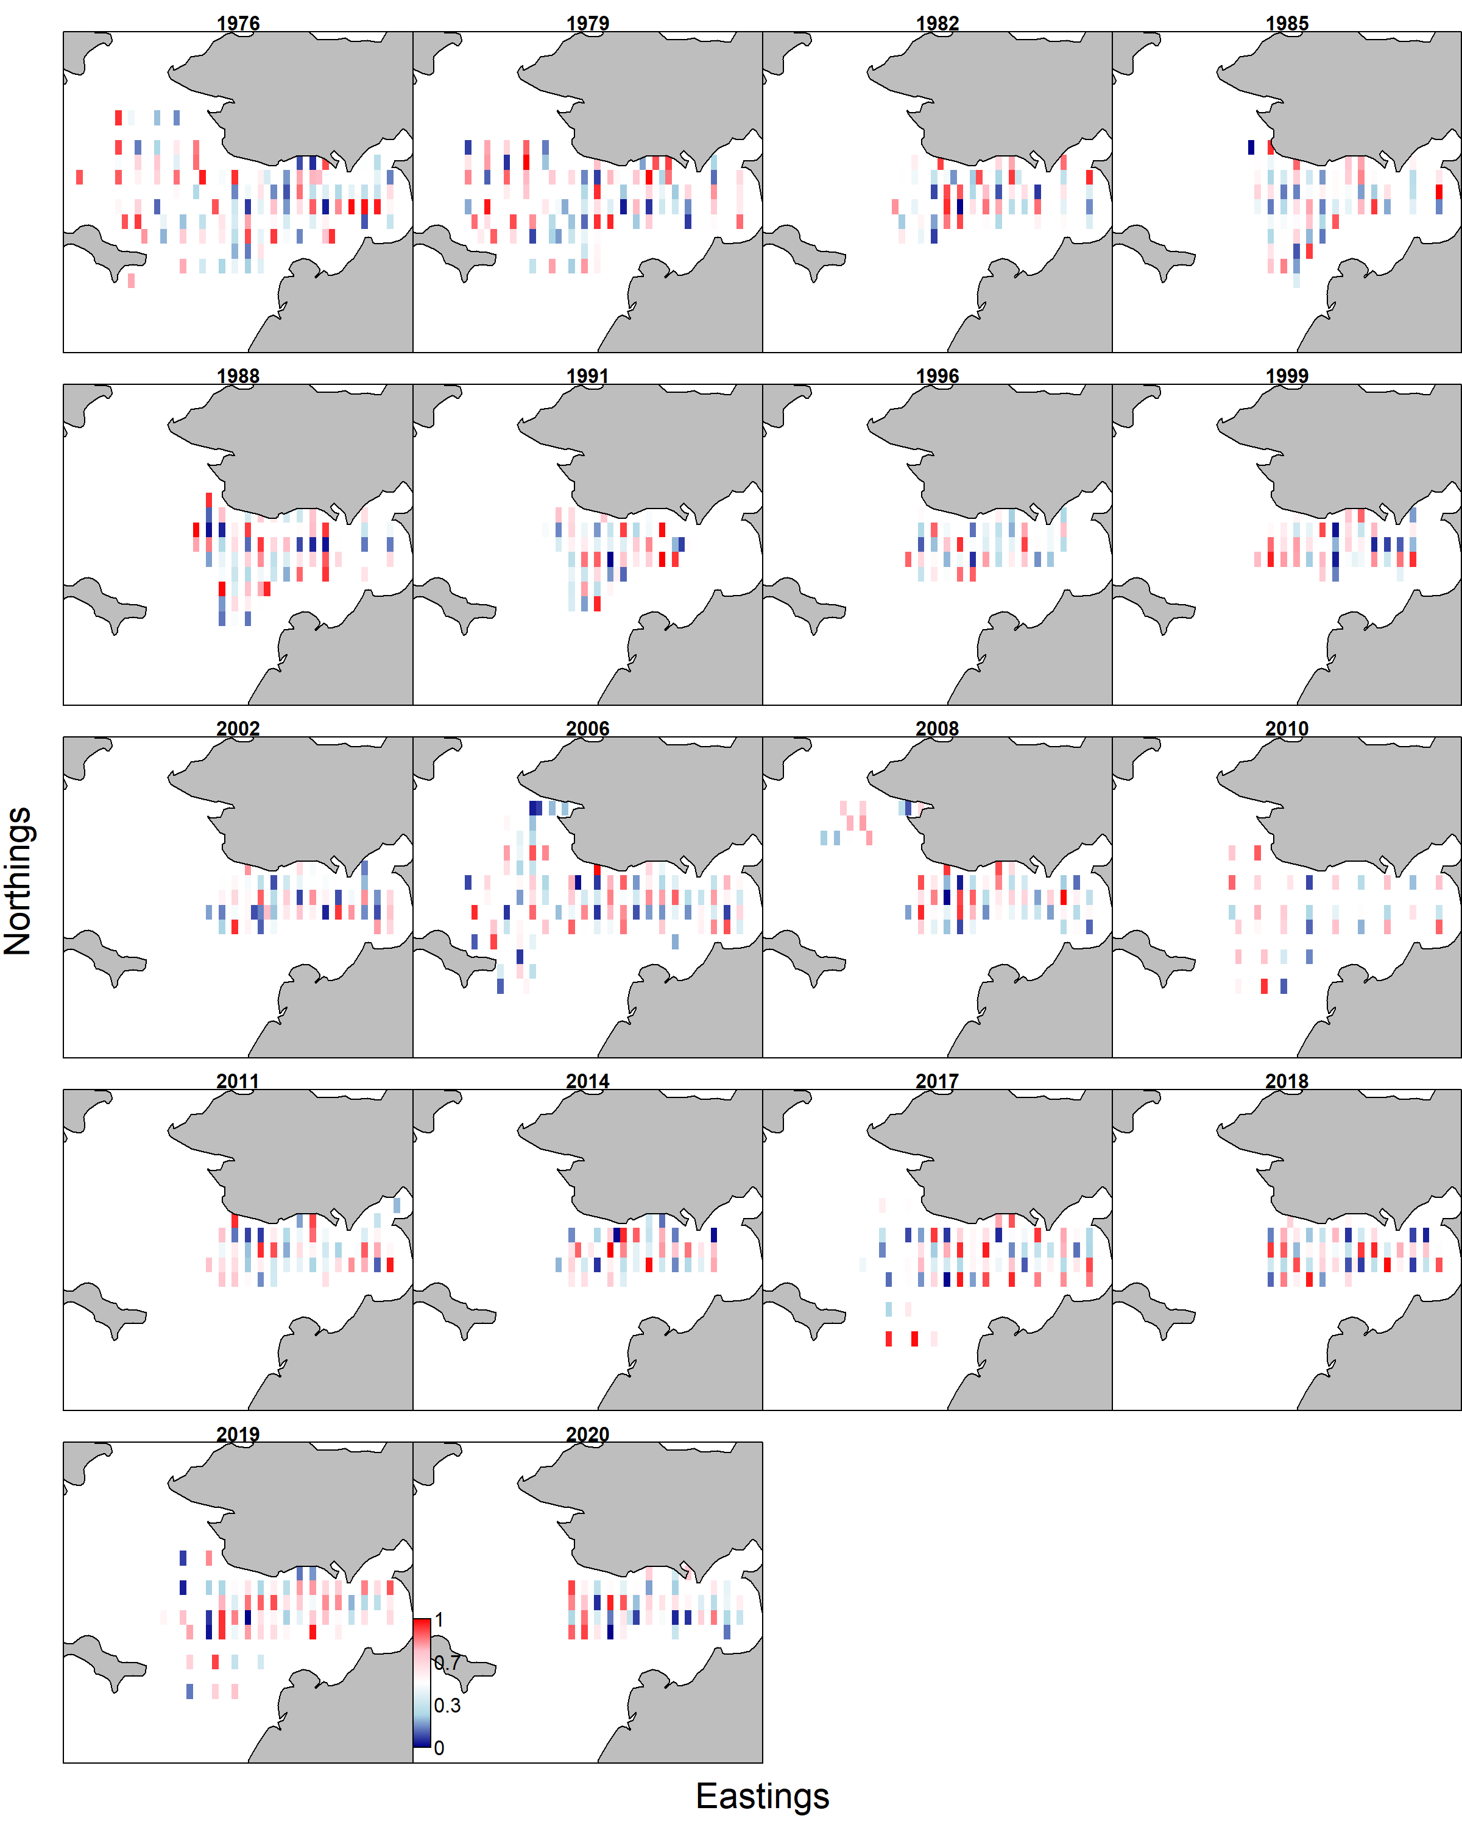
VAST model spatial residual

Slide 20
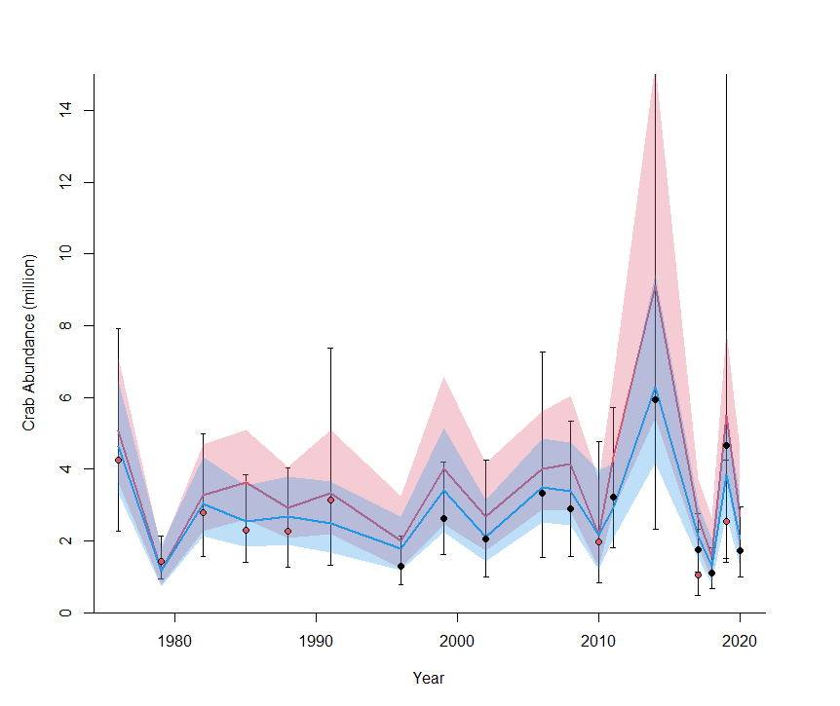
Responses to CPT-SSC (Sept 2020)
•Bring forward a model run in the upcoming assessment that uses the VAST estimates.
VAST based abundance are higher than trawl survey (abundance expanding to wider less frequently trawled area).
Higher abundance = higher OFL

Slide 21
Responses to CPT-SSC (Sept 2020)
•Bring forward a model run in the upcoming assessment that uses the VAST estimates.
Model 19.0 OFL
Trawl survey 0.59 mil lb
VAST: survey 0.76 mil lb
VAST: NS 1.03 mil lb
Black: Trawl survery
Green: VAST: Survey area
Red: VAST: Entire Norton Sound

Slide 22
Responses to CPT-SSC (Sept 2020)
•Bring forward VAST modeling diagnostics, including spatial residuals. Bring forward a model run in the upcoming assessment that uses the VAST estimates.
Author reply: VAST model not working well with my PC.
  VAST Package installation error
  TMB – VAST model compilation error
  VAST model convergence error (Then how do I fix)
  VAST model outputs (Where are they, and how to read all outputs?)

Slide 23
Responses to CPT-SSC (Sept 2020)
•Female red king crab: Size specific clutch fullness, measure of reproductive success, time series of average clutch fullness.
Author reply:
Average clutch fullness = ∑[% clutch full*#fecund female]/(Total fecund female)
NOAA code | NOAA Fullness | Assigned % | ADFG code | ADFG Fullness | Assigned %
2 | 0-1/8 | 6.25 | 3 | 1-29% | 15
3 | 1/8-1/4 | 18.75 | 4 | 30-59% | 45
4 | 1/4 – 1/2 | 27.5 | 5 | 60-89% | 75
5 | 1/2 – 3/4 | 62.5 | 6 | 90-100% | 95
6 | 3/4 – 1 | 87.5
7 | >1 | 100

Slide 24
Responses to CPT-SSC (Sept 2020)
Maturity
ADFG (1996 - 2002) | Immature: < 72mm CL and no egg Mature: ≥ 72mm CL or with egg
ADFG (2006 - 2020) | Immature: small abdominal flap Mature: oval-shaped abdominal flap full covered
NOAA (1976 – 1991) | Immature: NA Mature: NA
NOAA NBS (2010 – 2019) | Immature: NA Mature: NA
Clutch size
ADFG (1996 – 2020) | 1: Barren clean plepod, 2: Barren matted plepod 3: 1- 29% full, 4: 30-59% full, 5: 60-89% full, 6: 90-100% full
NOAA (1976 – 2019) | 0: Immature, 1: Barren clean plepod, 2: 1- 12.5% full, 3: 12.5 - 25% full, 4: 26-50% full, 5: 51-75% full, 6: 76-100% full, 7: > 100% full, 9: No data

Slide 25
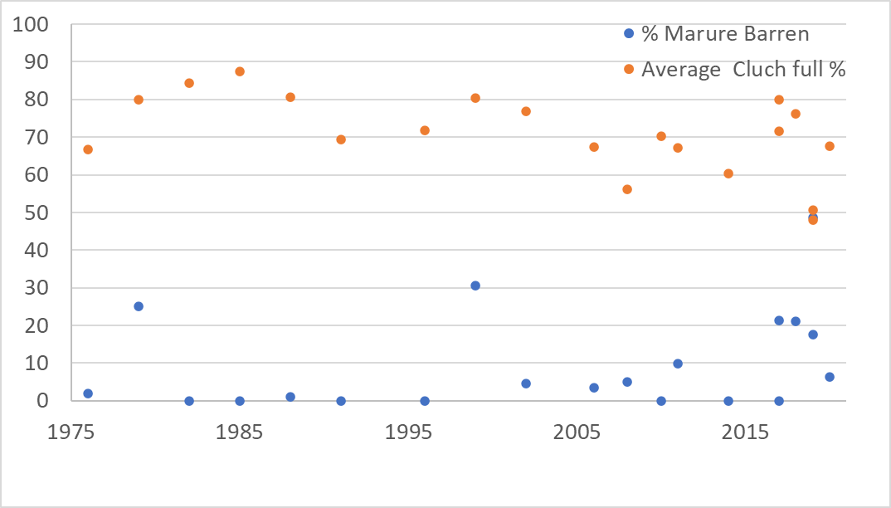
Responses to CPT-SSC (Sept 2020)
•Female red king crab: Size specific clutch fullness, measure of reproductive success, time series of average clutch fullness.

Slide 26
Responses to CPT-SSC (Sept 2020)
•Retrospective Analyses and Mohn’s Rho.
Author reply: Extended to past 10 years, using retention probability using 2021 data.

Slide 27
Responses to CPT-SSC (Sept 2020)
•Report annual lost pots data:
Author reply:
 | Commercial |  | Subsistence
Year | # of pots lost | # of fishermen fished | # of pots lost | # of households fished
2005–06 | ND | 1 | 50 | 67
2006–07 | ND | 8 | 132 | 116
2007–08 | ND | 9 | 6 | 108
2008–09 | ND | 7 | 8 | 70
2009–10 | 30 | 10 | 23 | 85
2010–11 | 3 | 5 | 8 | 95
2011–12 | 64 | 35 | 19 | 138
2012–13 | 23 | 26 | 4 | 104
2013–14 | 105 | 21 | 16 | 75
2014–15 | 104 | 44 | 16 | 107
2015–16 | 38 | 25 | 20 | 64
2016–17 | 201 | 43 | 11 | 109
2017–18 | 179 | 28 | 33 | 82
2018–19 | 32 | 6 | 59 | 60
2019–20 | 3 | conf | 33 | 50

Slide 28
Responses to CPT-SSC (Sept 2020)
•Report annual lost pots data: the proportion of pots lost in each fishery each year.
Author reply:
Total number of pots unknown
Winter commercial
Average pot pull per fish ticket: 9
Total pot = 9*total crabbers fished
% of lost pots: Ave 35% (6%- 71%)
Average winter com catch 1.5 (0.6-2.7) crab /pot/day
Winter fishing season: 120days
Lost pots catch crab all season: 180 (72-324)crab/pot/season
Total crab caught by lost pots: 230- 65,000 /year :
1%-39% of total crab caught by NS (summer + winter)
Does not include sublegal-female,
Does not include subsistence lost pots

Slide 29
Responses to CPT-SSC (Sept 2020)
•Incorporate LK/TK in management process, to locate large crab, changes of distribution and spatial pattern
Author reply:
LK/TK Task force (created by SSC and tasked to NSRKC LK/TK)
will not take NSRKC as a case study.
LK/TK Taskforce: Does not do research, possibly will give guidance and best practices for social science and Indigenous methods for doing LKTK research.

Slide 30
Responses to CPT-SSC (Sept 2020)
•Incorporate LK/TK in management process, to locate large crab, changes of distribution and spatial pattern
Author reply:
A team of TK/LK researchers who have expertise in planning and conducting the research needs to be identified.
2. A proposed research plan needs to be written and reviewed by the Taskforce.
3. The most importantly, funding source need to be identified and secured.

Slide 31
Responses to CPT-SSC (Sept 2020)
•Contact meta-analysis of male-size at maturity across red king crab stocks that occur at different temperatures. Contact Russian Scientists for Barents Sea RKC data.
Author reply:
Contacted several Russian and Norwegian scientists. But no response.
Size of transplanted RKC in Barents Sea are comparable to BBRKC though temp is similar to NSRKC. Don’t know how meta-analyses would help informing maturity size of NSRKC.

Slide 32
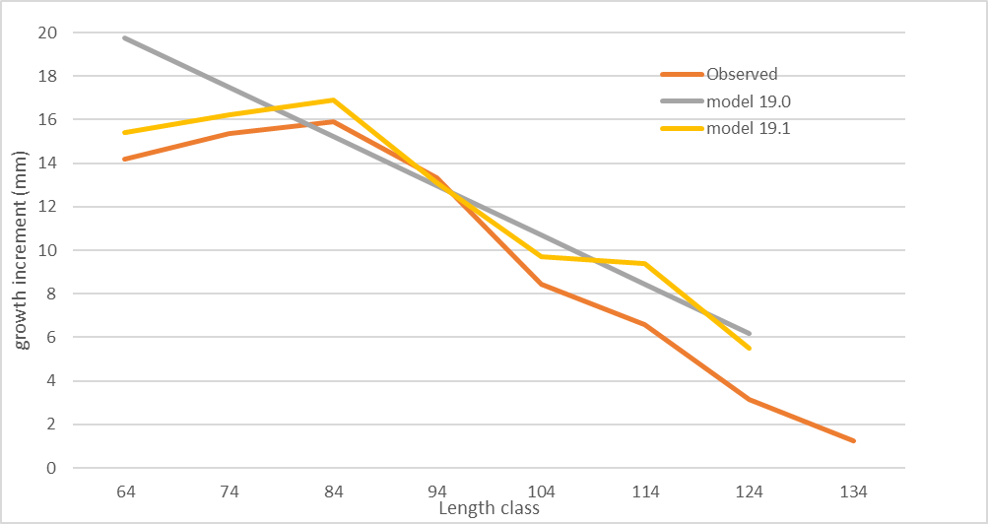
Responses to CPT-SSC (Sept 2020)
•Review of the growth matrix to determine if growth is overestimated in the model, .
Author reply:
Model overestimates growth. Individual size class growth model can correct smaller but not larger sizes.

Slide 33
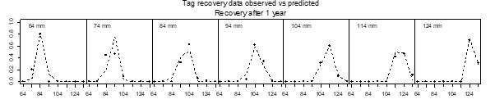
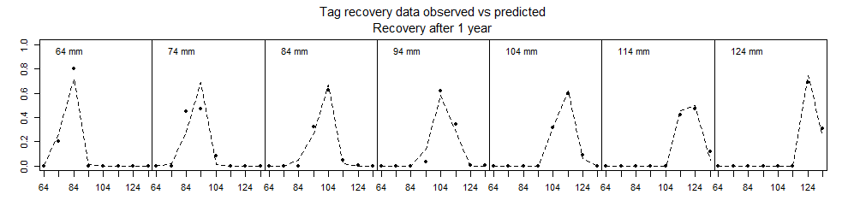
Responses to CPT-SSC (Sept 2020)
•Review of the growth matrix to determine if growth is overestimated in the model, .
Author reply:
Model fit to tag recovery looks good for larger crab.

Slide 34
Responses to CPT-SSC (Sept 2020)
•List Female data Inventory
Author reply:
Majority of data are.
Trawl survey abundance
CL size,
Clutch fullness,
Egg development, color.
Good enough to make a female model?

Slide 35
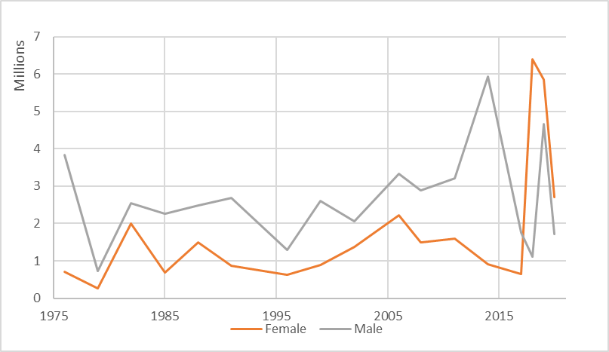
Responses to CPT-SSC (Sept 2020)
•Trawl survey male and female abundance

