Slide 1

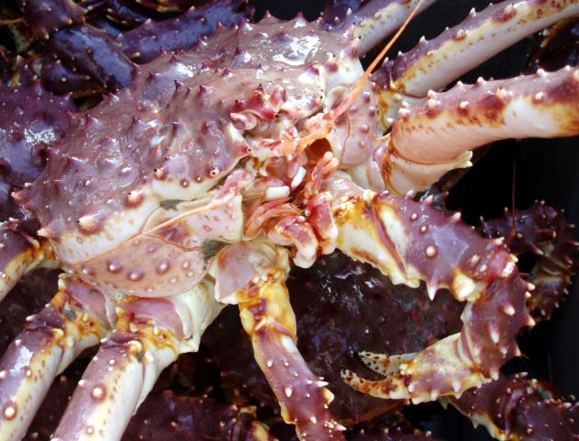
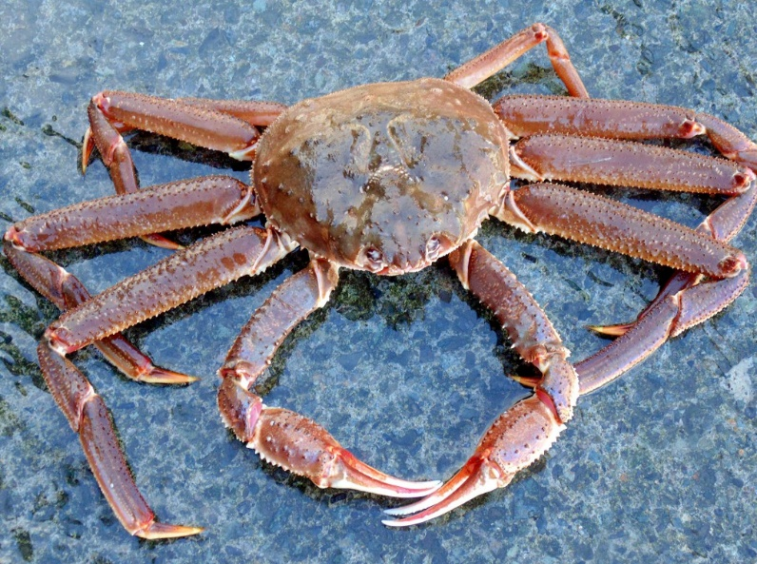
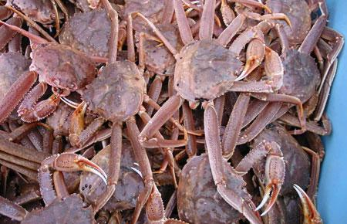
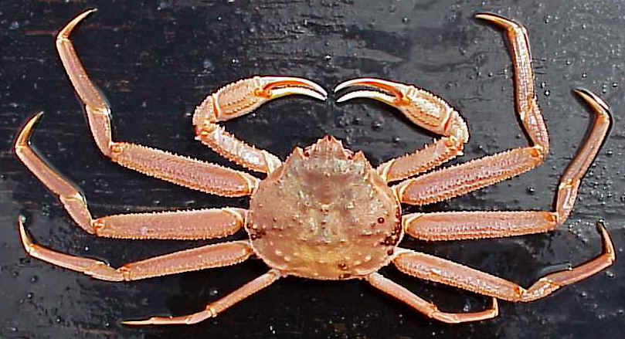
Shell condition and temperature-derived updates to the length-weight relationships for three eastern Bering Sea crab stocks
Jonathan Richar
Jon.richar@noaa.gov
Alaska Fisheries Science Center
Kodiak Laboratory

Slide 2
Importance of size-weight relationship
Used to calculate estimates of mature biomass for stock assessment/fishery management by stock/management area
Population status
OFL calculation

Slide 3
Background
Current S-W parameters based on work conducted in late 2000s as an update to initial work done primarily in 1970s/1980s (Chilton 2011)
Data from 2006 to 2011
  Relative to previous work, much larger sample sizes
  Amalgamated across years/shell condition
Complicating factors that might influence relationship were not accounted for

Slide 4
Objectives
Update size-weight relationships used to calculate biomass estimates
  Allowing for likely influencing factors
Red king crab, tanner crab, opilio crab
  Shell condition
    Older shells more dense, and tissue fill greater
Red king crab only
  Thermal regime of given survey year
    Influences metabolism, molt timing and tissue growth post-molt and prior to survey

Slide 5
Methods I
Up to date size-weight data
Collected randomly on the EBS summer bottom trawl survey
Clean (no/minimal epibionts), intact (no carapace cracks or missing/regenerating limbs)
Weight (g)
  Digital scale
Carapace size (CL/CW) to 0.1mm
  Vernier caliper (prior to 2016)
  Digital caliper (2016 to present)

Slide 6
Methods II
Stock specific data grouped based on variable of interest
Male Bristol Bay red king crab, EBS Bairdi, EBS opilio
  Shell condition
Male Bristol Bay red king crab ONLY
  New shell males grouped by warm/cold year, determined based on whether a late summer retow was conducted
  Cold years: 2000, 2006, 2007, 2008, 2009, 2010, 2011, 2012, 2017
  Warm years: 2001, 2002, 2003, 2004, 2005, 2013, 2014, 2015, 2016, 2018, 2019

Slide 7
Methods II cont.
 | N
Male BBRKC - NS | 1756
Male BBRKC - OS | 552
Male BBRKC - NS - cold | 1265
Male BBRKC - NS - warm | 491
Male Tanner crab - NS | 3314
Male Tanner crab - OS | 2064
Male Opilio crab - NS | 4531
Male Opilio crab - OS | 1979

Slide 8
Methods III
The size-weight relationship may be modelled as
  Weight (g) = a *(Carapace size (mm))^{b}
Parameters a and b estimated separately
  Iinear regression fitted to log-transformed size-weight data
  Parameter a is the intercept in log-scale
  Parameter b is the slope
Slopes compared
  T-tests: SC/temp against baseline
  Regression models: SC/SC, temp/temp
Biomass estimates calculated using final parameter estimates, and compared to baseline estimates to determine impact

Slide 9
Results

Slide 10
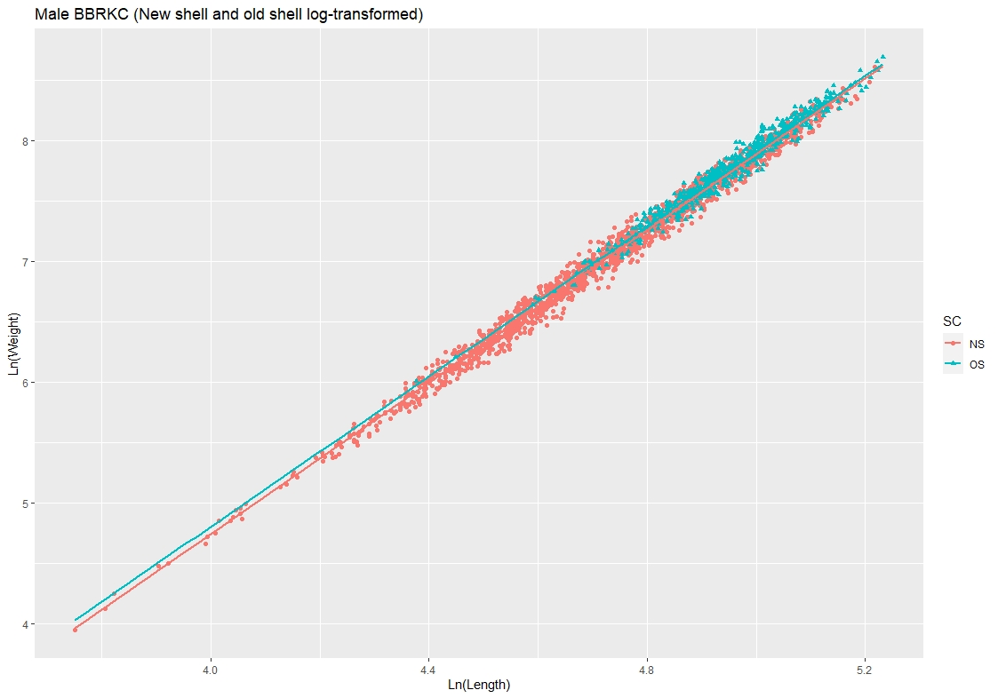
Male red king crab – shell condition
log(W_{OS}) = 0.000481 * CL^{3.111170}
R² = 0.97
Slope not significantly different from baseline
Slopes not different
From each other, though intercepts were
log(W_{NS}) = 0.00039 * CL^{3.147886}
R² = 0.99
Slope not significantly different from baseline

Slide 11
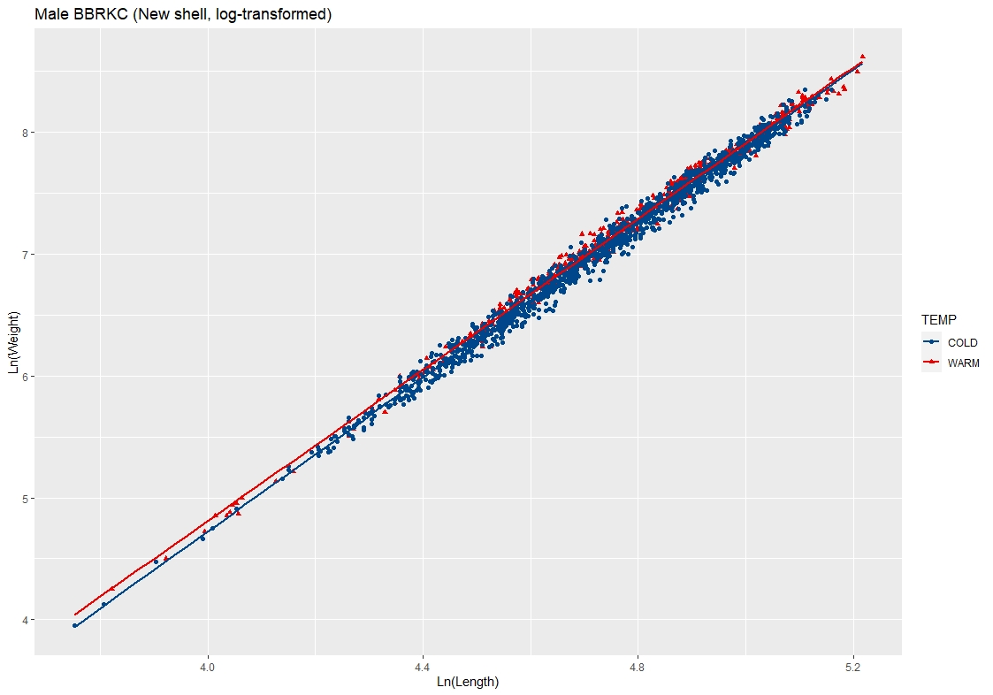
Male red king crab – NS - temperature
Log(W_{SC2warm}) = 0.000507 * CL^{3.099277}
Slope significantly different
R² = 0.99
Slopes differ from each other (p = 2e-16)
Log(W_{SC2cold}) = 0.000368 * CL^{3.157545}
Slope not significantly different
R² = 0.99

Slide 12
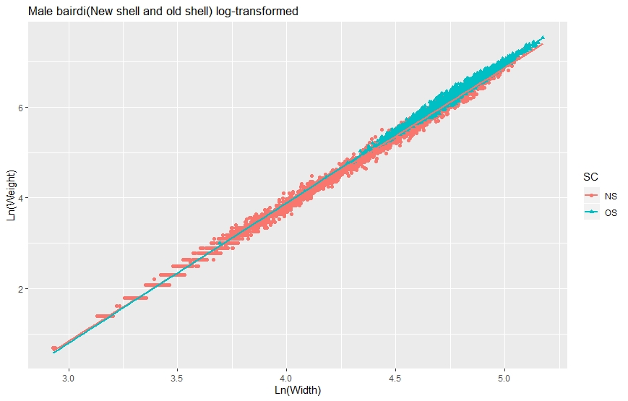
Male Bairdi crab – shell condition
Log(W_{OS}) = 0.000208 * CW^{3.091966}
Significantly different
R² = 0.98
Slopes and intercepts significantly different
Log(W_{NS}) = 0.000273 * CW^{3.014254}
Significantly different
R² = 0.99

Slide 13
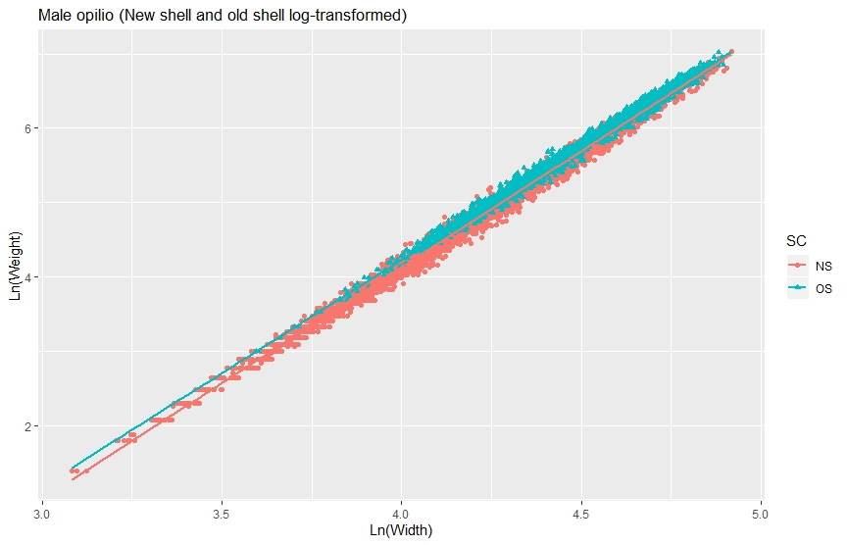
Male opilio crab – shell condition
Log(CW_{OS}) = 0.000343 * CW^{3.051748}
Significantly different from baseline
R² = 0.99
Slopes and intercepts significantly different
Log(CW_{NS}) = 0.000237 * CW^{3.119509}
Significantly different from baseline
R² = 0.99

Slide 14
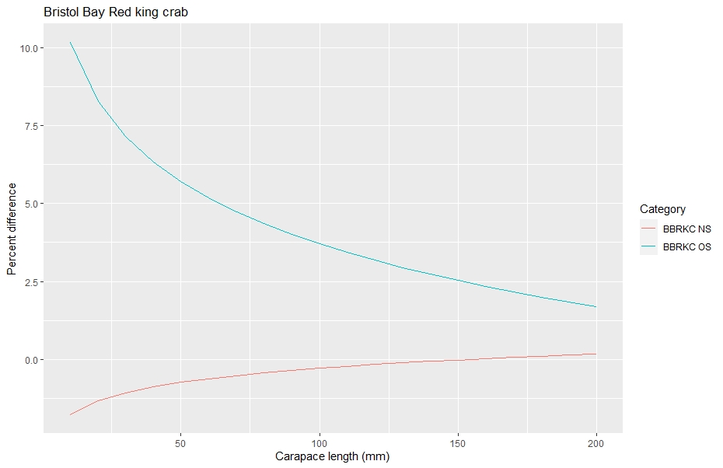
Calculated weight anomalies relative to current models
Notes:
Current size weight models are overestimating weight-at-size for new shell BBRKC, while underestimating weight at size for old shell. These issue are most prevalent at smaller sizes, and decline with size, particularly for old shell crab.

Slide 15
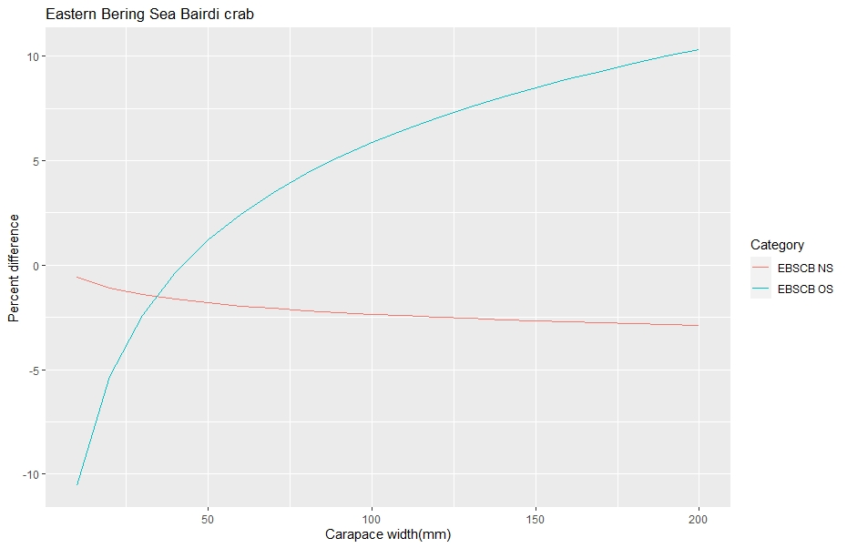
Anomalies II
Notes:
New shell weights overestimated using present models while old shell weights are underestimated, and both classes the problem worsens with increase in size

Slide 16
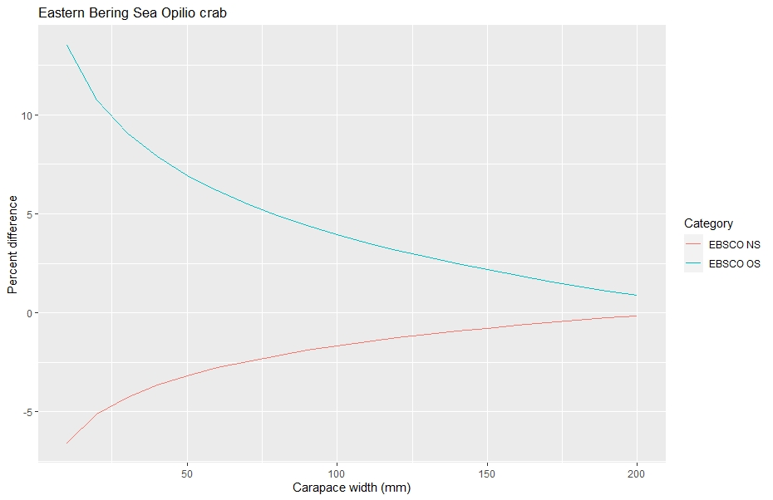
Anomalies III

Slide 17
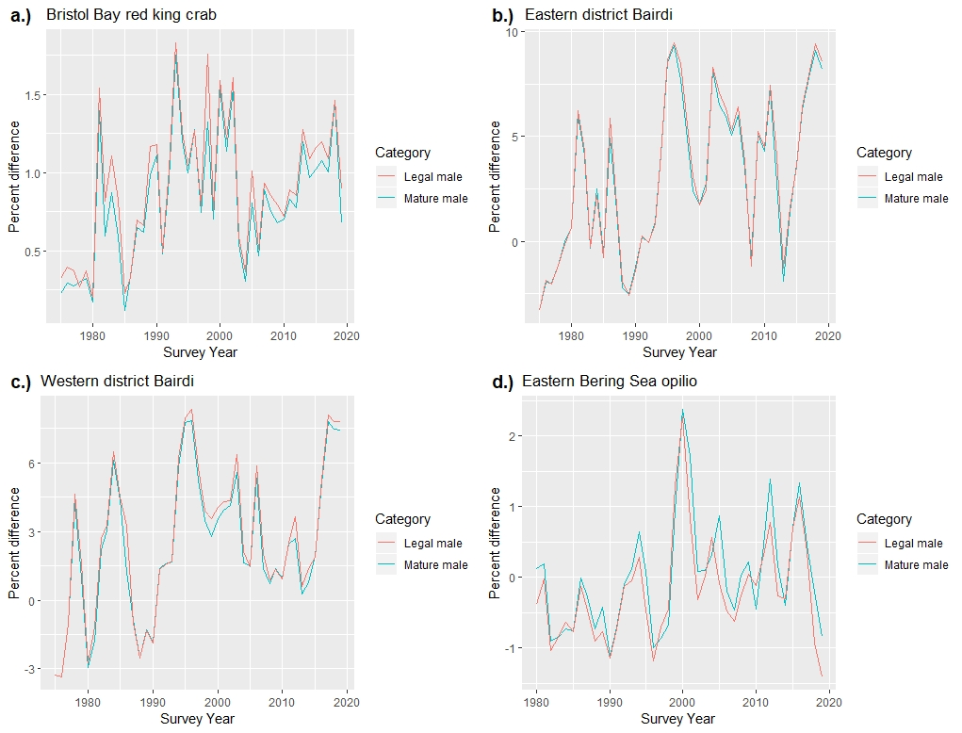
Time series biomass anomalies relative to baseline estimates

Slide 18
Conclusions
Shell-condition based size-weight models
  Limited impact on opilio, BBRKC
    Low priority refinement for these stocks
  Larger impact on Bairdi
    High priority refinement for this stock
Temperature-based size-weight model
  Findings suggest it might be appropriate to use “warm year” parameters to model size-weight relationships in new shell males
  Careful consideration/more work

Slide 19
What’s Next
Follow-up work to address blue king crab and females

Slide 20
Literature cited
Chilton, E.A. 2009. Updates to size-weight relationships of eastern Bering Sea commercial crab species. Presentation.
Chilton, E.A. 2011. Size-weight relationships of commercial crab in the eastern Bering Sea.

Slide 21

Questions?

