Slide 1

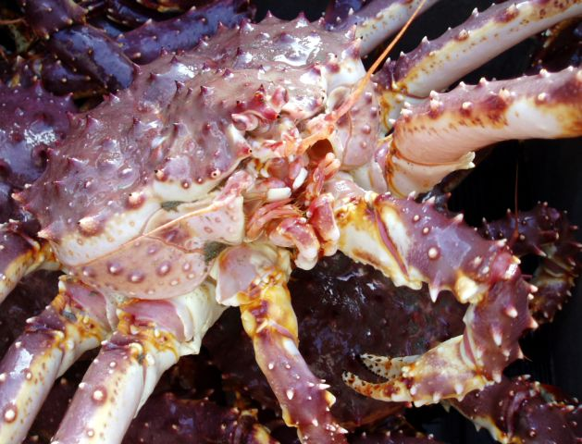
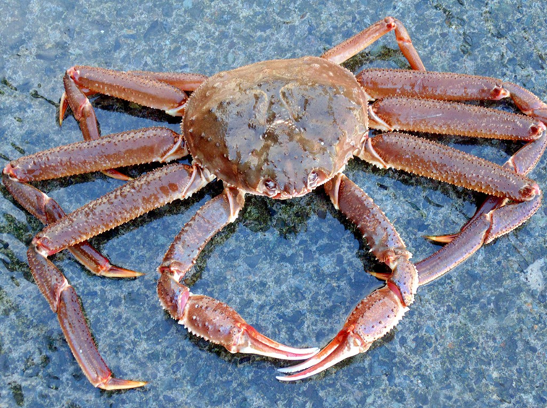
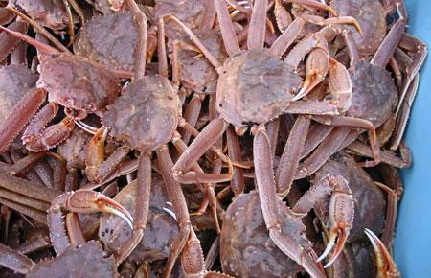
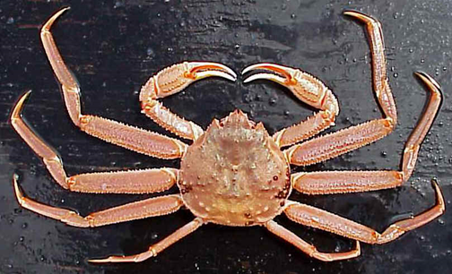
SAP - VAST update January 2021
Jonathan Richar
AFSC RACE Kodiak Lab
Jon.richar@noaa.gov
James Thorson
AFSC Seattle
james.thorson@noaa.gov

Slide 2
Major items from May 2020 meeting
1.) Example diagnostics from an accepted model (GAP)
  - Diagnostics from EBS-NBS yellowfin sole model will be presented
2.) Example diagnostics from a model that would not be accepted
  - Diagnostics from v.2020 NSRKC model are presented
3.) Develop a baseline for model rejection based on diagnostic output i.e. 50:50 pass/fail model
- BBRKC model proposed, with comparison to YFS and NRS models
4.) Explore/Refine model settings beyond the RACE standard used for 2020.
  - Multiple ObsModel/knot/covariate settings tested
5.) Residual diagnostics for VAST (Andre Punt’s recommendation RE: SAFS think tank)
  - DHARMa procedures implemented and diagnostics presented here
6.) Implement barrier method for SMBKC
  - Barrier method implemented and initial results presented here
Notes:
Quickly, I imagine everyone here is familiar with VAST, so in light of everything else I will be presenting I won’t be providing background on it today, but my copresenter Jim would be happy to answer any questions about it

Slide 3
Item 1: Accepted GAP VAST model: EBS-NBS Yellowfin sole
No VAST GAP model rejected outright on the basis of its diagnostics
  When not used, authors simply opted not to use VAST estimates at this time (Jason Conner, AFSC GAP, pers. Comm.)
EBS + NBS yellowfin sole model selected as a case study for accepted model
  ObsModel(2,1)
  All Omega/Epsilon parameters enabled
  Bias correction enabled
  Cold pool as environmental covariate
Presented side-by-side with the v.2020 BBRKC diagnostics presented last spring for comparison

Slide 4
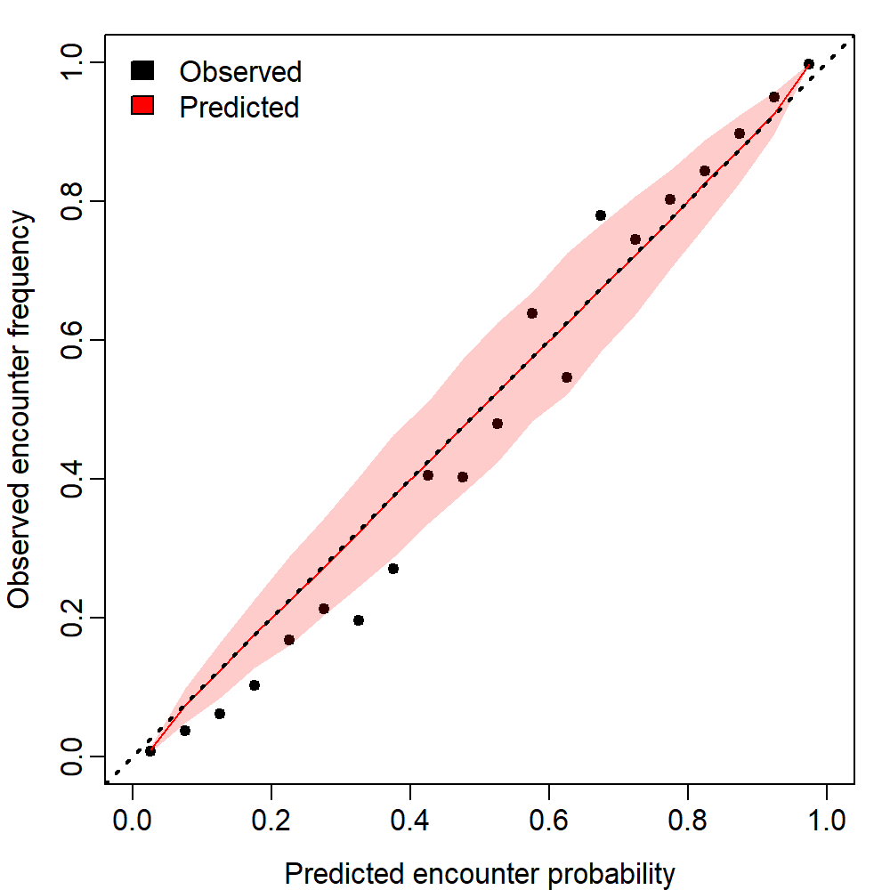

Encounter probability
YFS
BBRKC
Notes:
As a refresher, for the encounter probability plot, in an ideal world the encounter probabilities would fall along 1-to-1 line. If to the left, observed encounter frequencies were greater than predicted, and if to the right predicted encounter probabilities exceeded observed.
Here yellowfin sole and red king were quite comparable

Slide 5
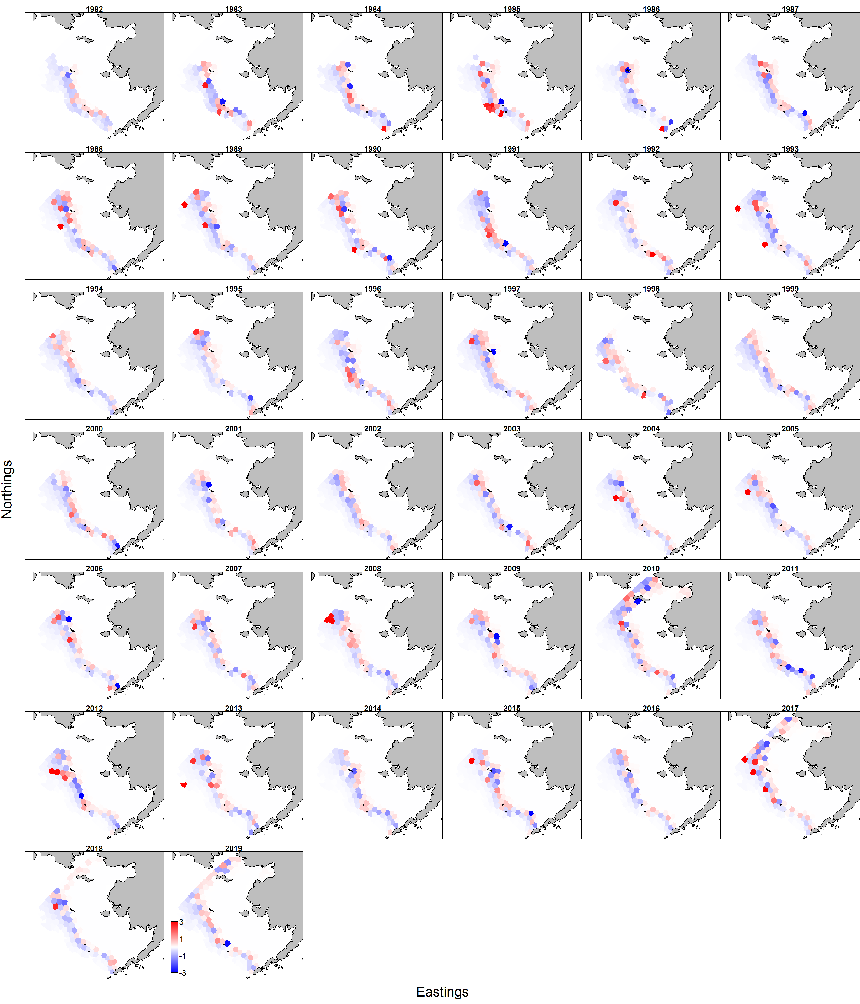
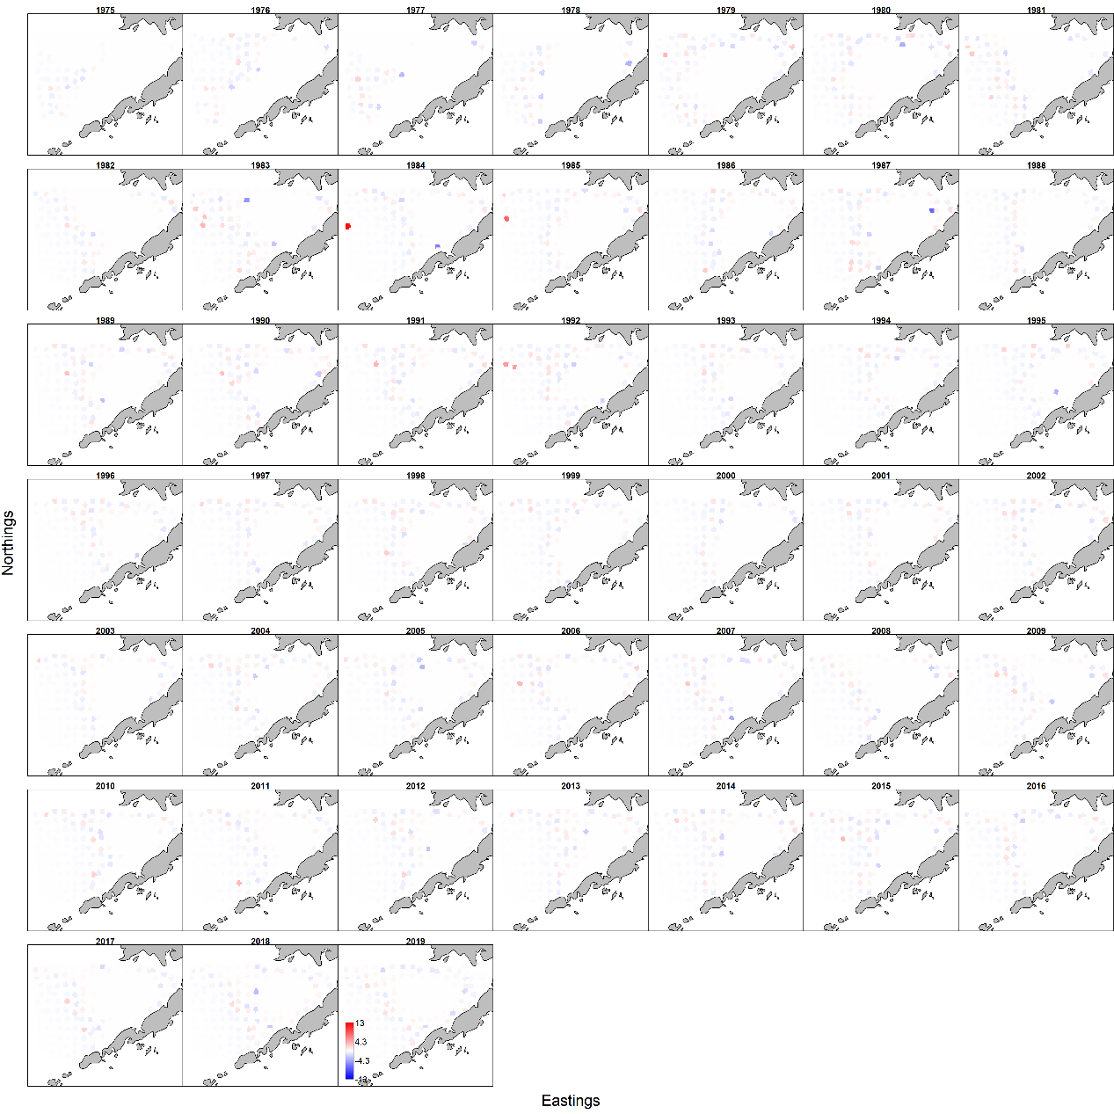
Spatial residuals – I (Encounter)
YFS
BBRKC
Notes:
Now spatial residuals, which are calculated as the difference between observations and predictions, standardized by the SD of the observations.
For the encounter component, residuals for the YFS model have a much narrower range than what is observed for RKC, although the great range for RKC results from a few extremes observed in the 1980s, and most residuals are comparable in scale between the two models. We can also see that VAST had more difficulty capturing encounter frequency in the Outer Domain, with a negative pattern being observable

Slide 6
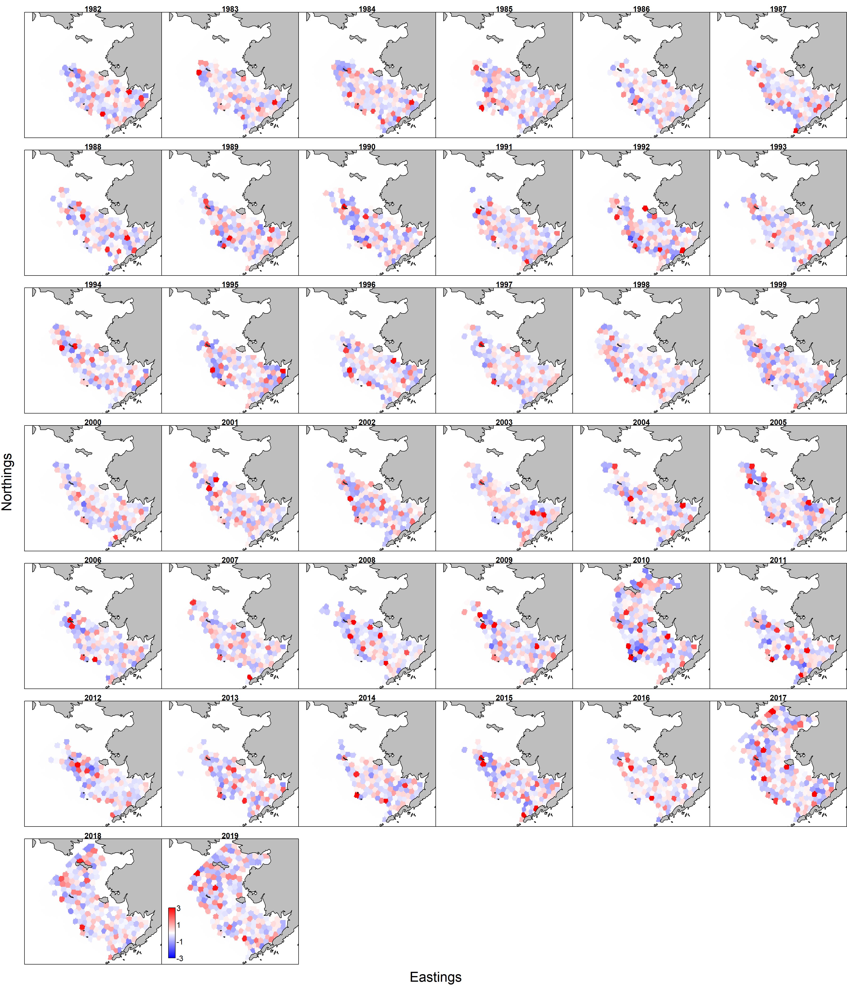
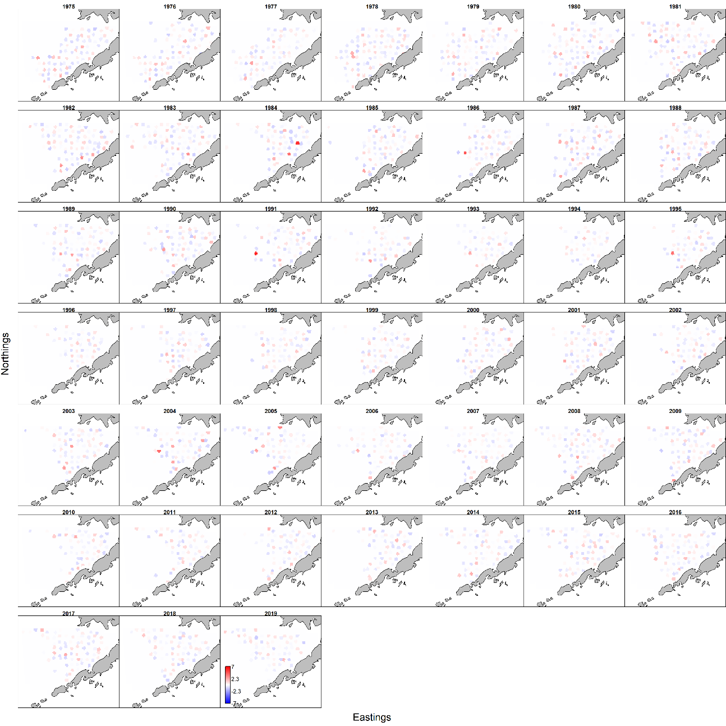
Spatial residuals – II (Catch rate)
YFS
BBRKC
Notes:
For the catch rate residuals, we again that the YFS model residuals have a lower range than what is observed for RKC, though again most residuals are in fact comparable.
Relative to the encounter residuals, catch residuals do not display any pronounced spatial trends.

Slide 7
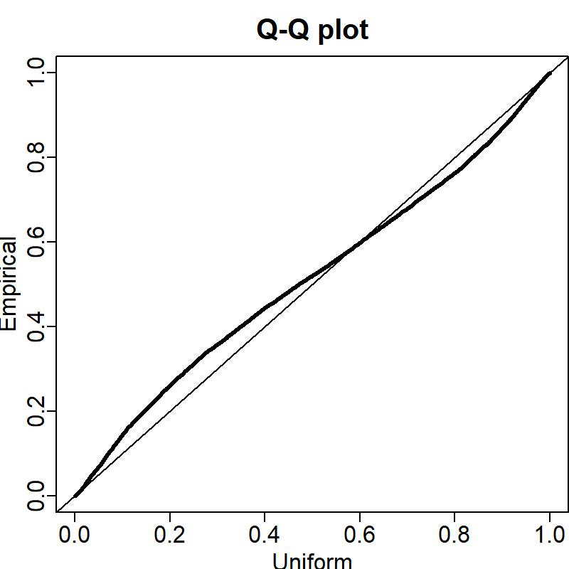
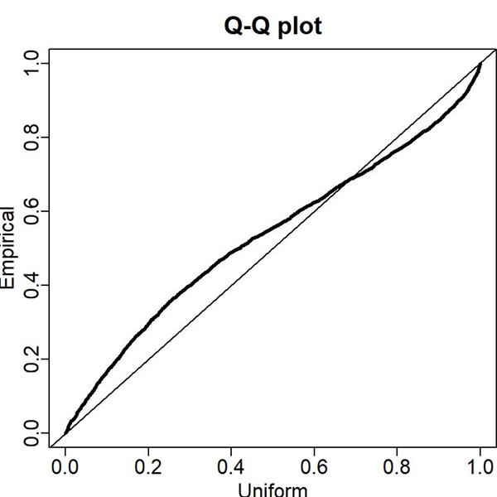
Positive catch rate Q-Q plots
YFS
BBRKC
Notes:
Now the catch rate QQ plot, which assesses whether the assumed observation distribution used for modeling catch rates was appropriate. The x-axis is the theoretical quantile and the y axis the sample quantile. In a perfect world, the black line will fall along the 1:1 line.
Here we see moderate deviations relative to the 1:1 line for YFS, indicating that, relative to the assumed distribution, there were more low/moderate catch rates in the data, and fewer high catch rate observations, with these being more pronounced in RKC

Slide 8
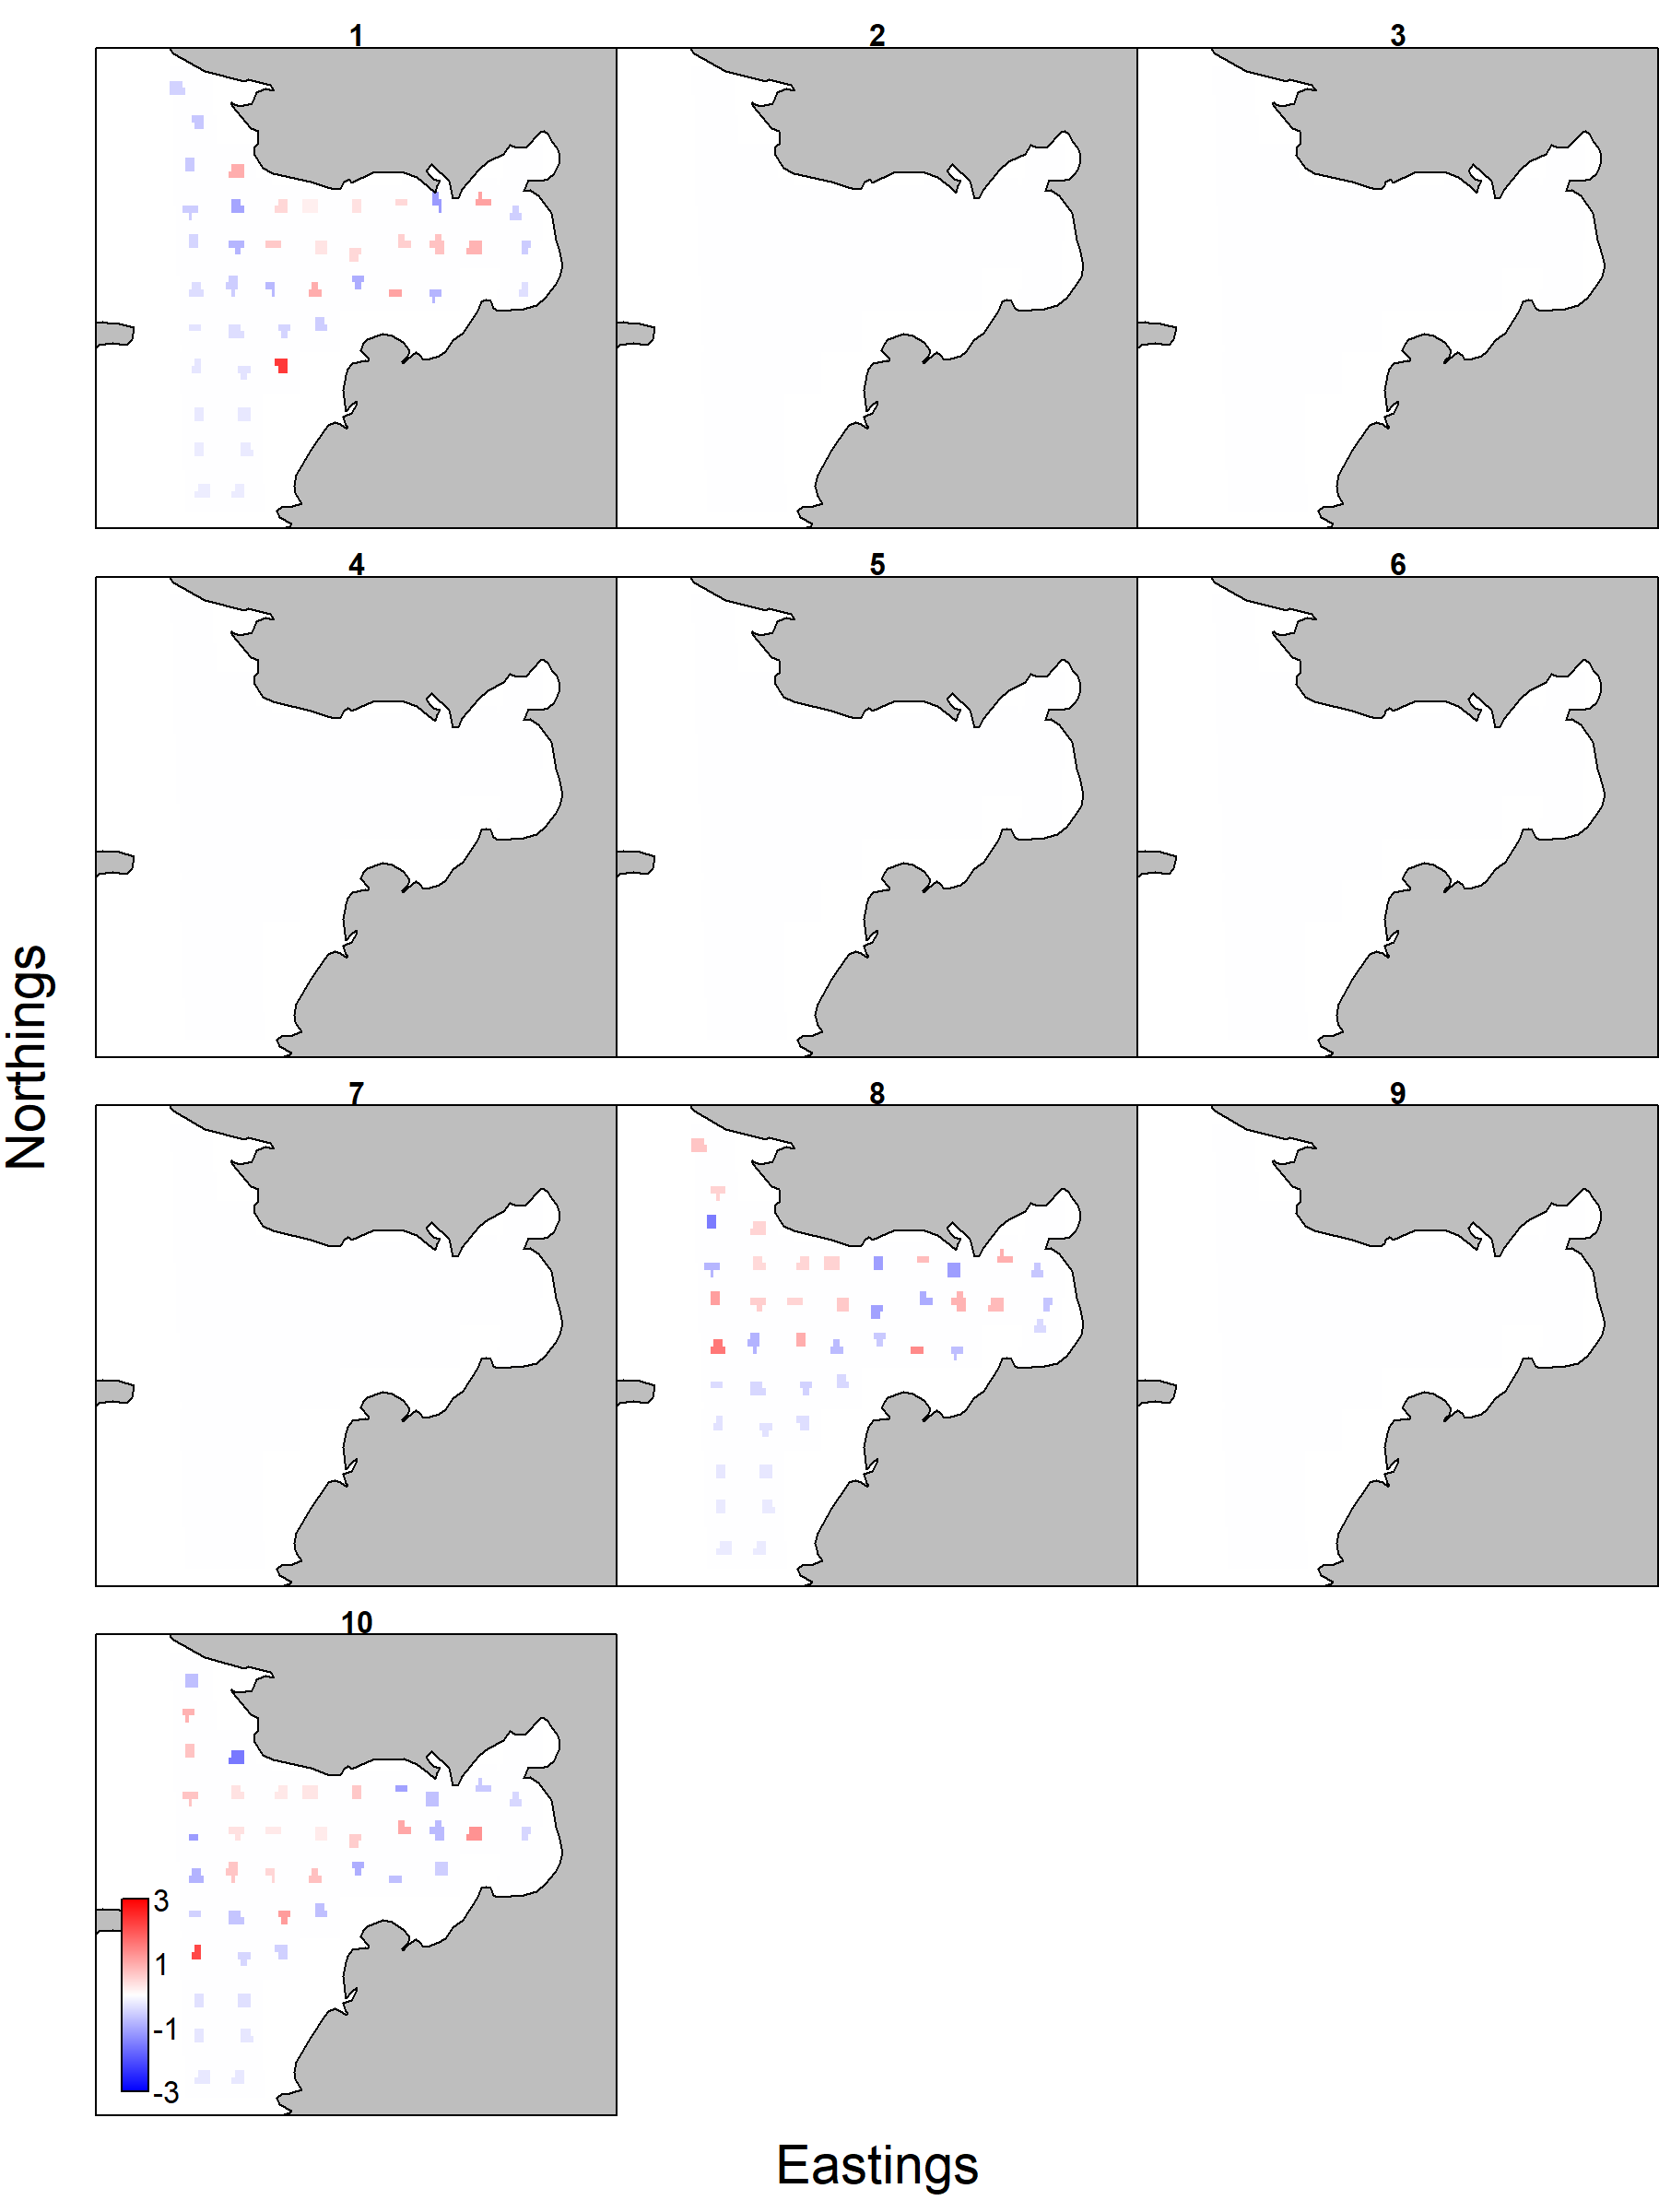
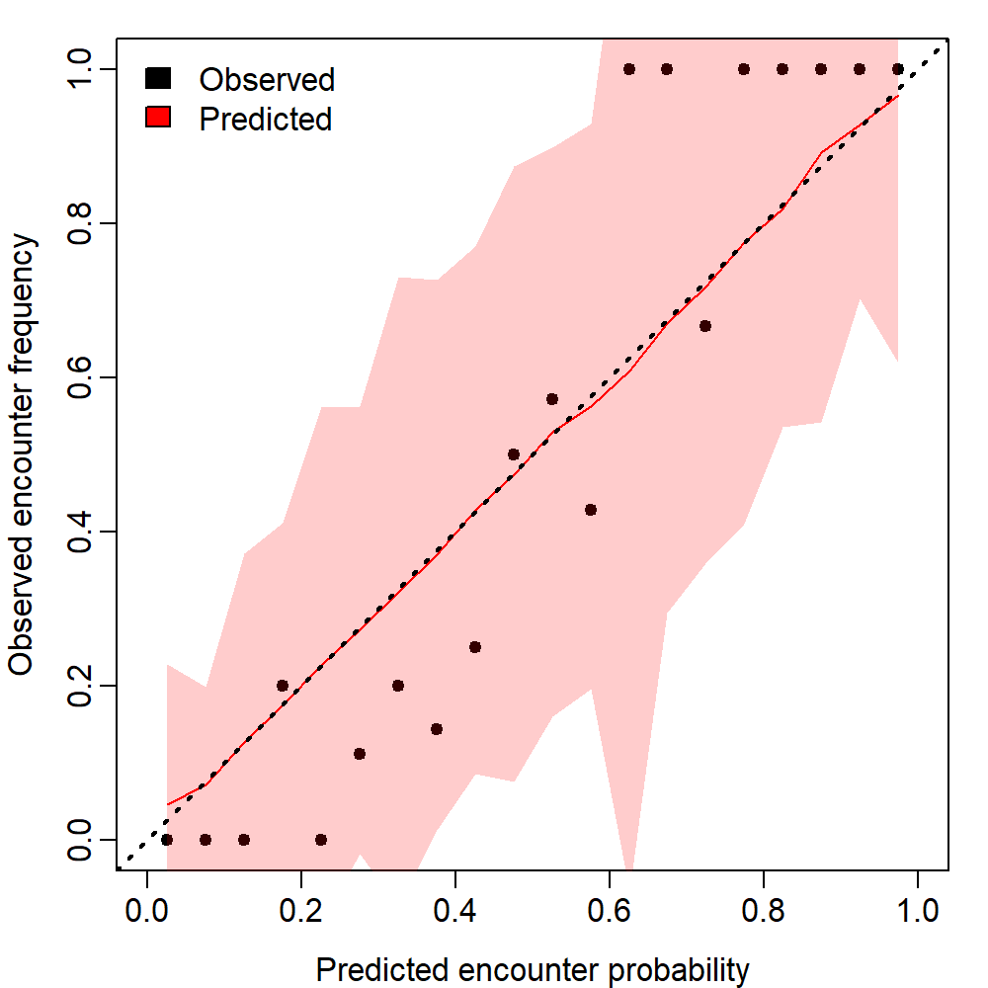
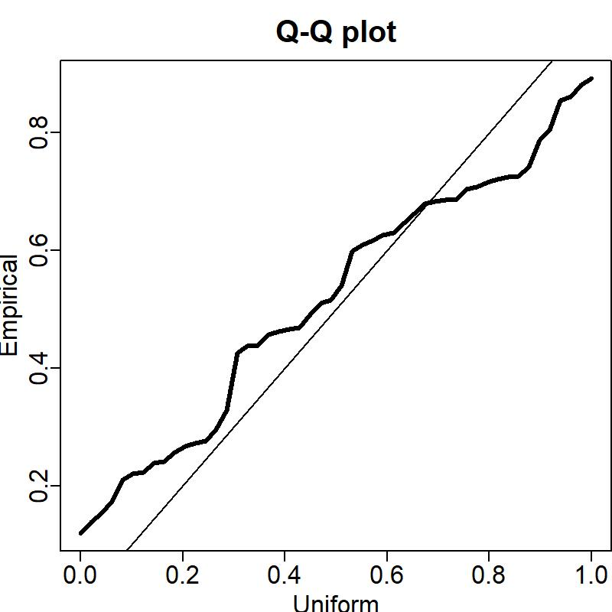
Item 2: a model that would not be accepted
Norton Sound Red King Crab v.2020
Notes:
I am still going over output from recent models, and trying to identify a less obvious model just on the wrong side of the accept/reject line, so for now my choice for a model that would not be accepted is the v.2020 model for NSRKC, which is arguably a little too obvious.

Slide 9
Item 3: Baseline for model rejection
At present VAST GAP do not have a “rejection standard”, and decision as to whether or not to use VAST output is left to the specific author.
SAP work here, with emphasis on use on an advisory basis, is ongoing.
Provisionally, I suggest the use of the BBRKC GE65 model, and associated diagnostics as the minimally acceptable/ 50:50 model
  Diagnostics fall between those for VAST models for yellowfin sole (YFS), and northern rock sole (NRS, which was not selected for use by the relevant author)

Slide 10
Convergence diagnostics
Internal convergence check: should not report evidence model is not converged
Hessians: positive-definite
Parameters: within bounds
Parameter SEs: ideally not large in magnitude compared to parameters, or if so limited in number of occurrences
Notes:
A quick note on diagnostics…beyond the graphics I will be showing, there are also model convergence diagnostics, which I will not be presenting, as an economy measure. To be accepted, a model should pass these, and all models used in this presentation did. These include…..

Slide 11
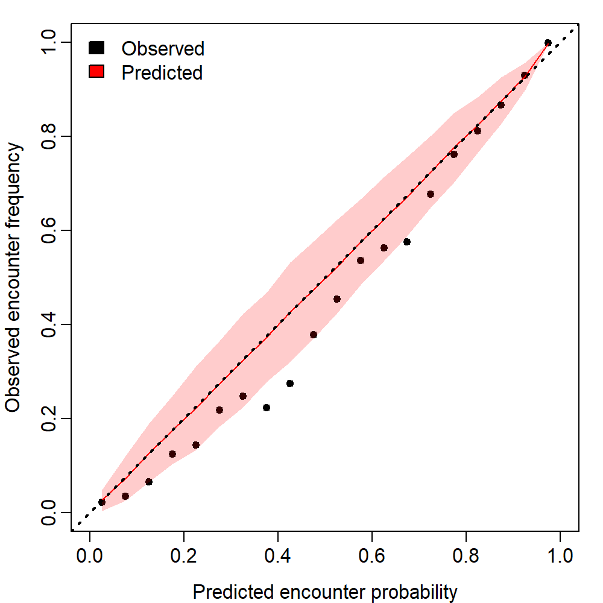
Encounter probability vs actual
YFS
BBRKC
NRS
Notes:
For the encounter probability plots we again see that RKC and YFS models are comparable…and are actually out performed here by the NRS model

Slide 12
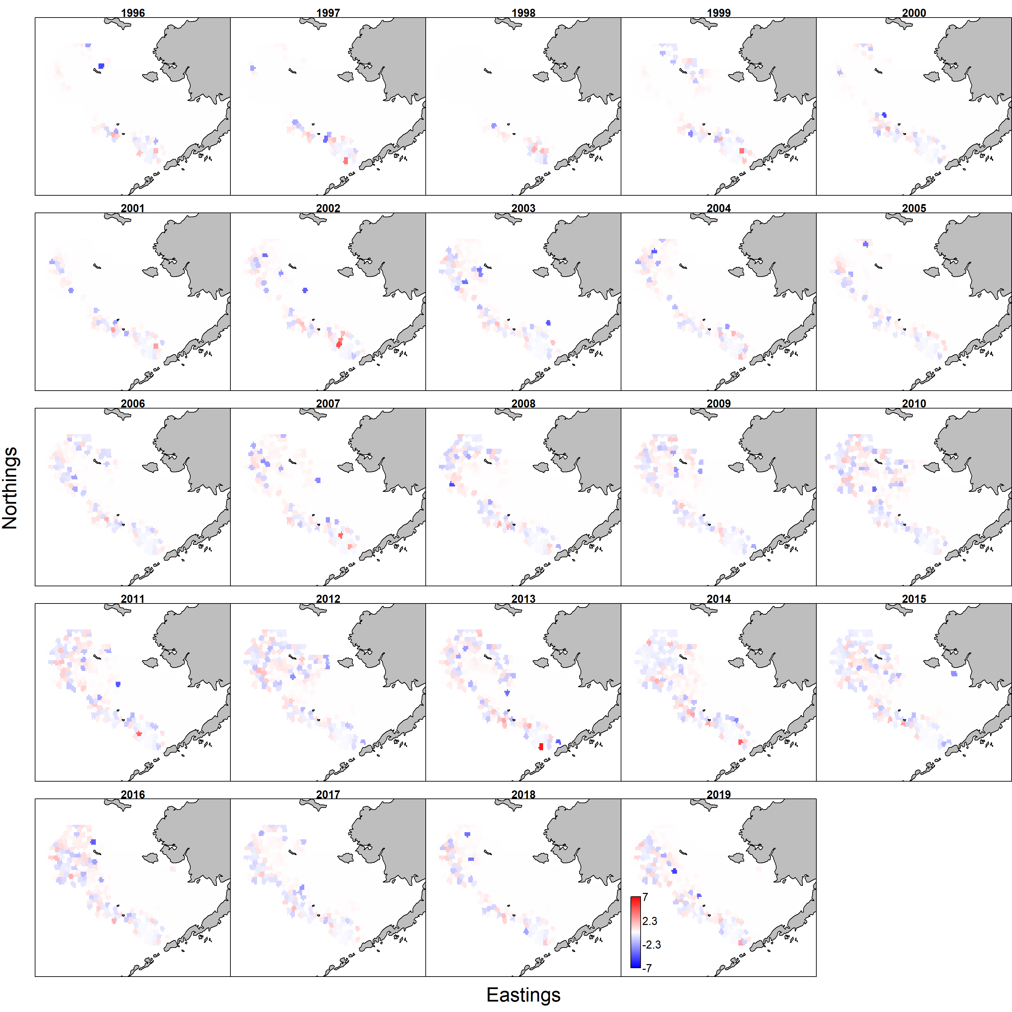
Encounter rate residuals
YFS
BBRKC
NRS
Notes:
Spatial residuals for BBRKC encounter rates are comparable with those for both YFS and NRS, with all three having some difficulty in regions outside of the species core habitat

Slide 13
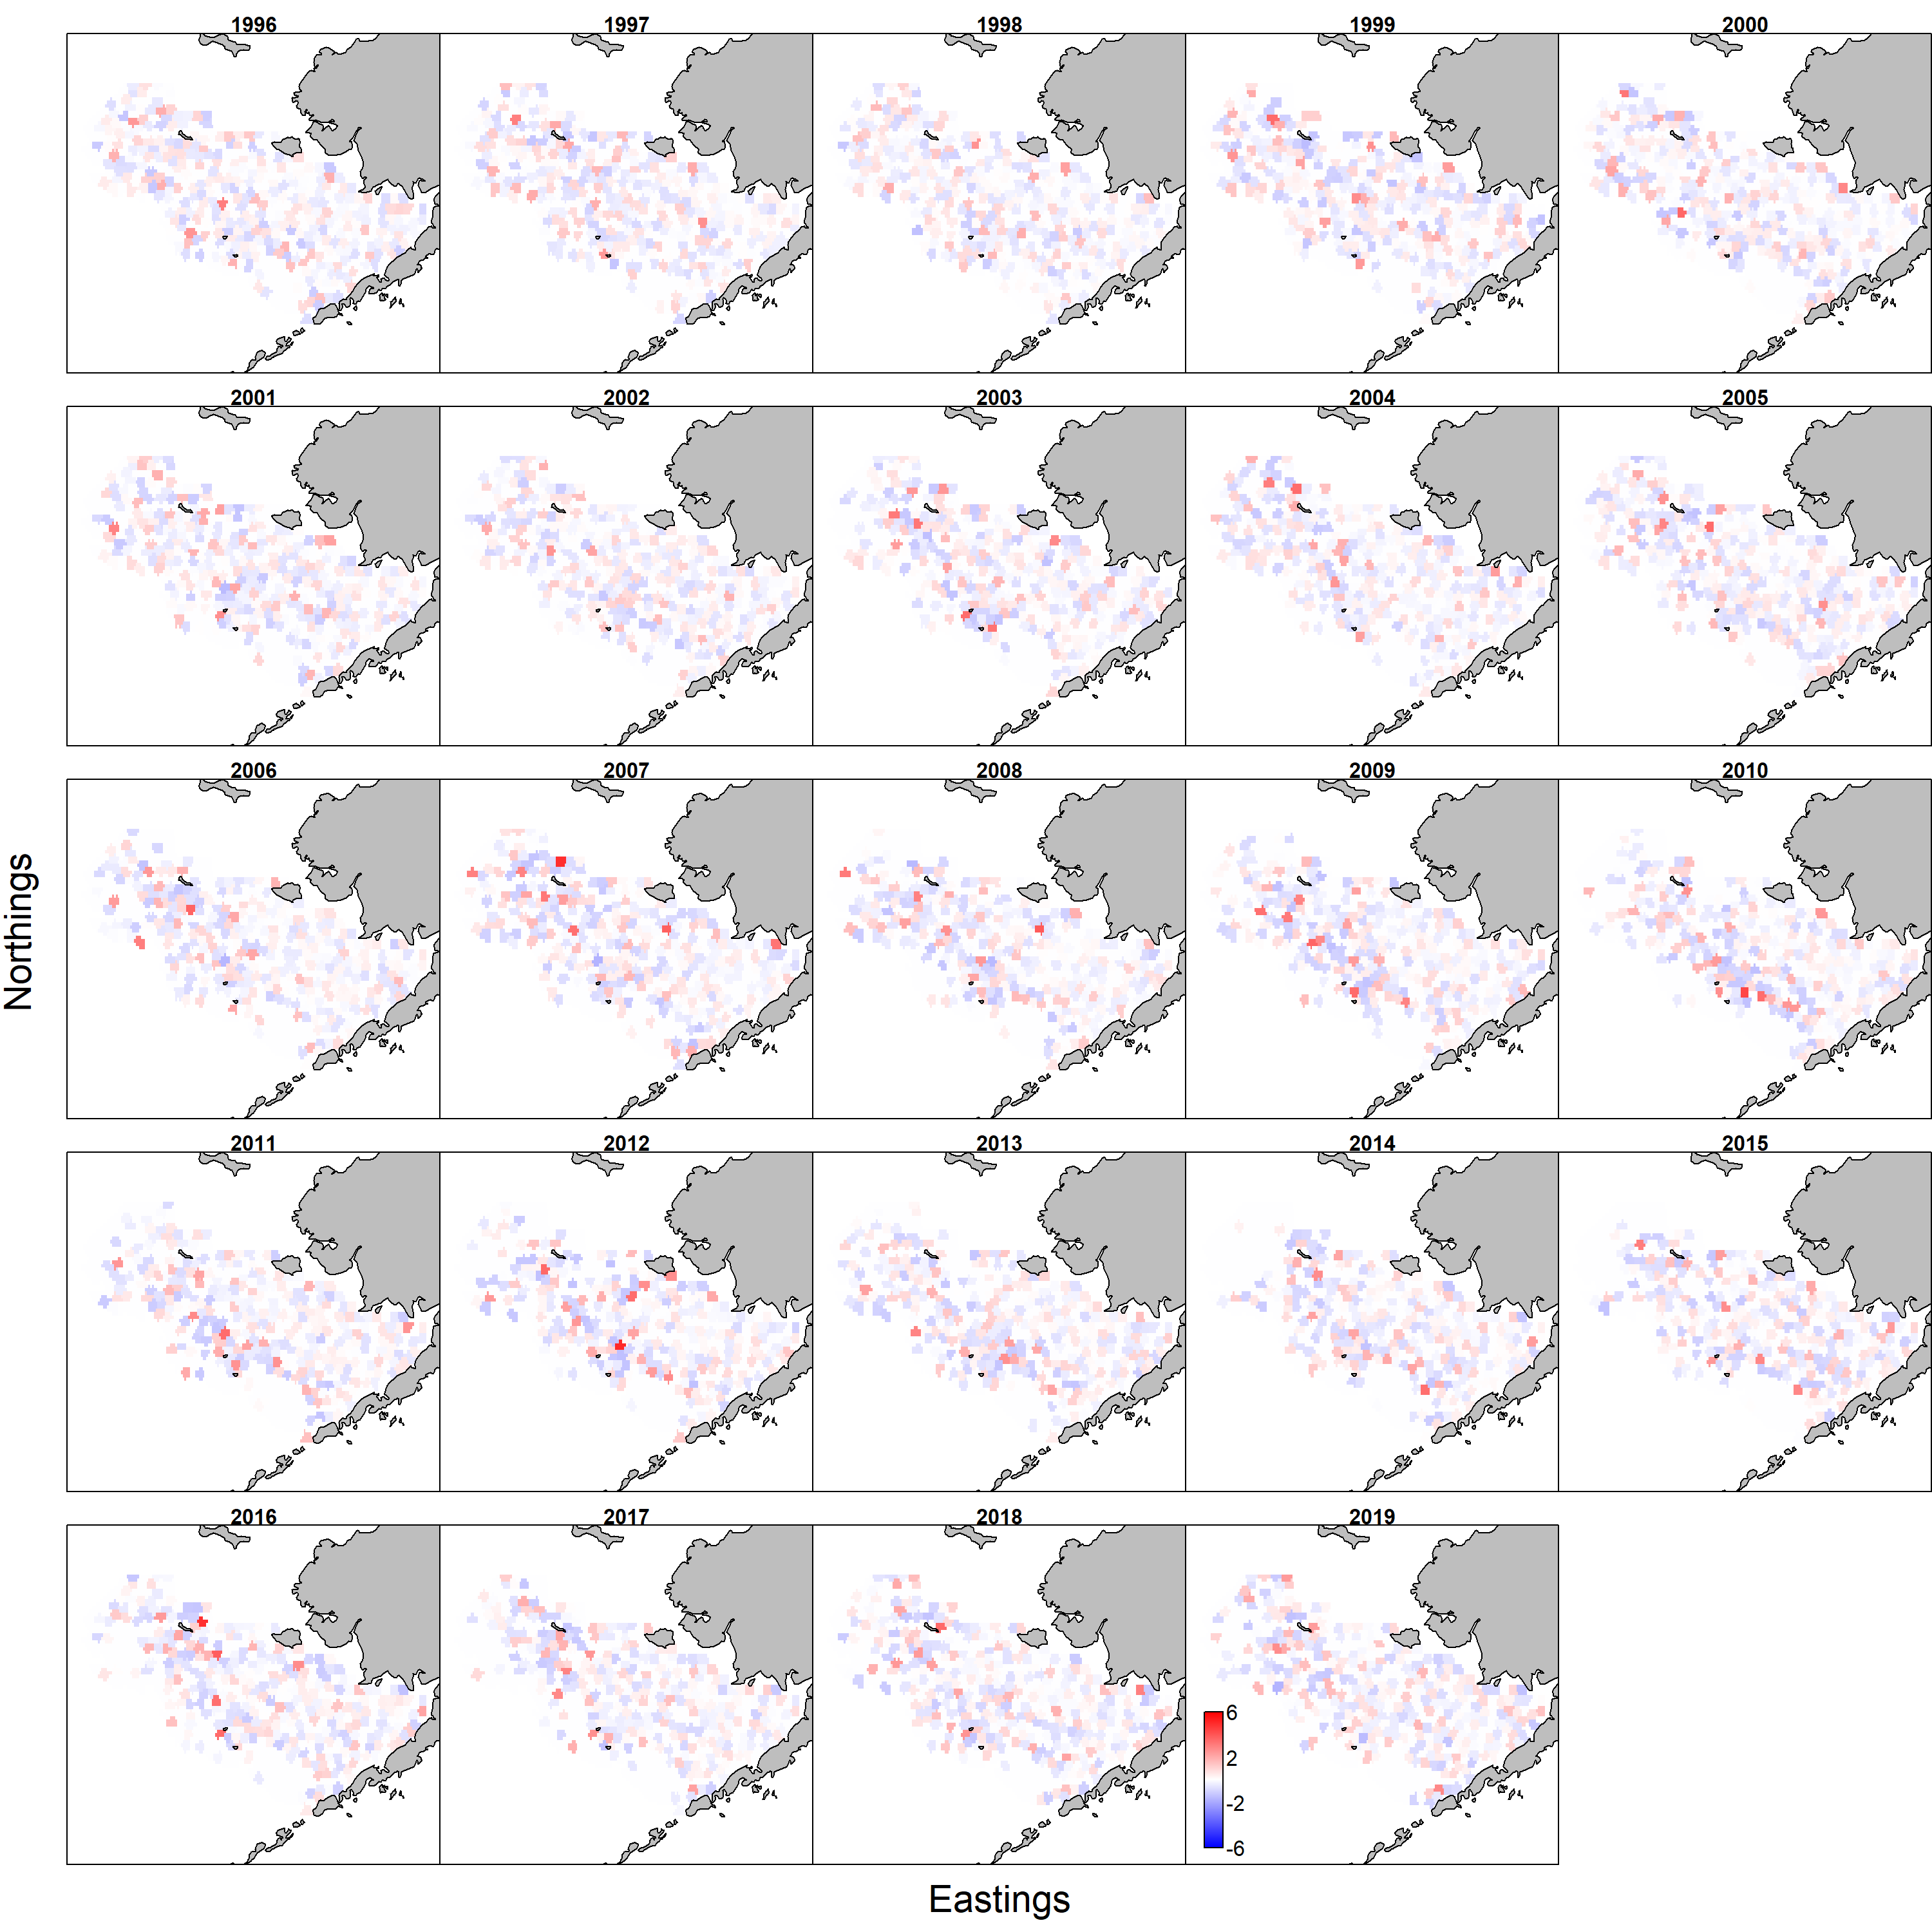
Catch rate residuals
YFS
BBRKC
NRS
Notes:
In terms of the catch rate spatial residuals, RKC are

Slide 14

Positive catch rate Q-Q plots
YFS
BBRKC
NRS

Slide 15
Item 4: VAST settings research

Slide 16
VAST Research update I
Testing new features incorporated in 2020 updates
  Diagnostics updated to use features of the R package DHARMa
    Recommendation of Cole Monnahan and Andrea Havron
    Diagnostics just described have been largely superceded
    Caveat that VAST developers are still working on how to interpret certain outputs in VAST context
  For SMBKC, Barrier method has been implemented, which allows for an intervening landmass to influence spatial correlation between two points.
Limited work on environmental covariates
  NBT

Slide 17
VAST Research update II
ObsModel settings
  Gamma model w/Poisson-link delta model - ObsModel(2,1)
  Lognormal - ObsModel(1,1)
  Lornormal (bias-corrected mean and Log-coefficient of variation as parameters - ObsModel(4,1))
  Compound-Poisson-Gamma - ObsModel (8,2)
  Tweedie – ObsModel (10,2)
  Only discussing Gamma and Lognormal today

Slide 18
VAST Research update III
#knots
  150-750 knots explored
  Today will only be presenting 250, 500 and 750 knot models
Stocks/classes modeled and discussed today
  St Matthew Blue king crab male biomass, GE90
  EBS Bairdi total male biomass
  EBS opilio mature male biomass
  Bristol Bay red king crab total (males + females) biomass GE65

Slide 19
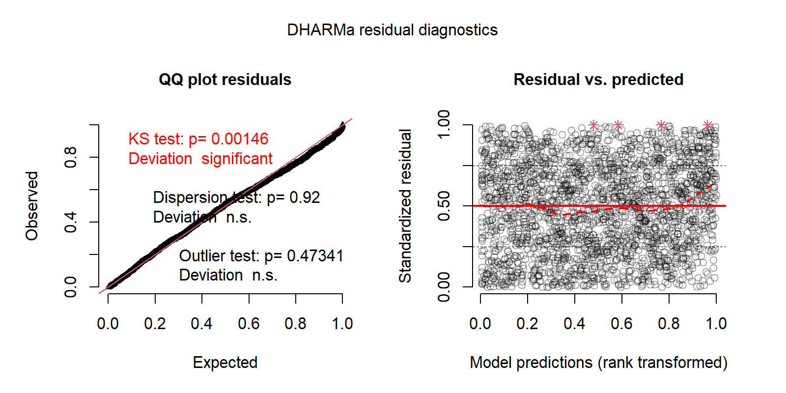
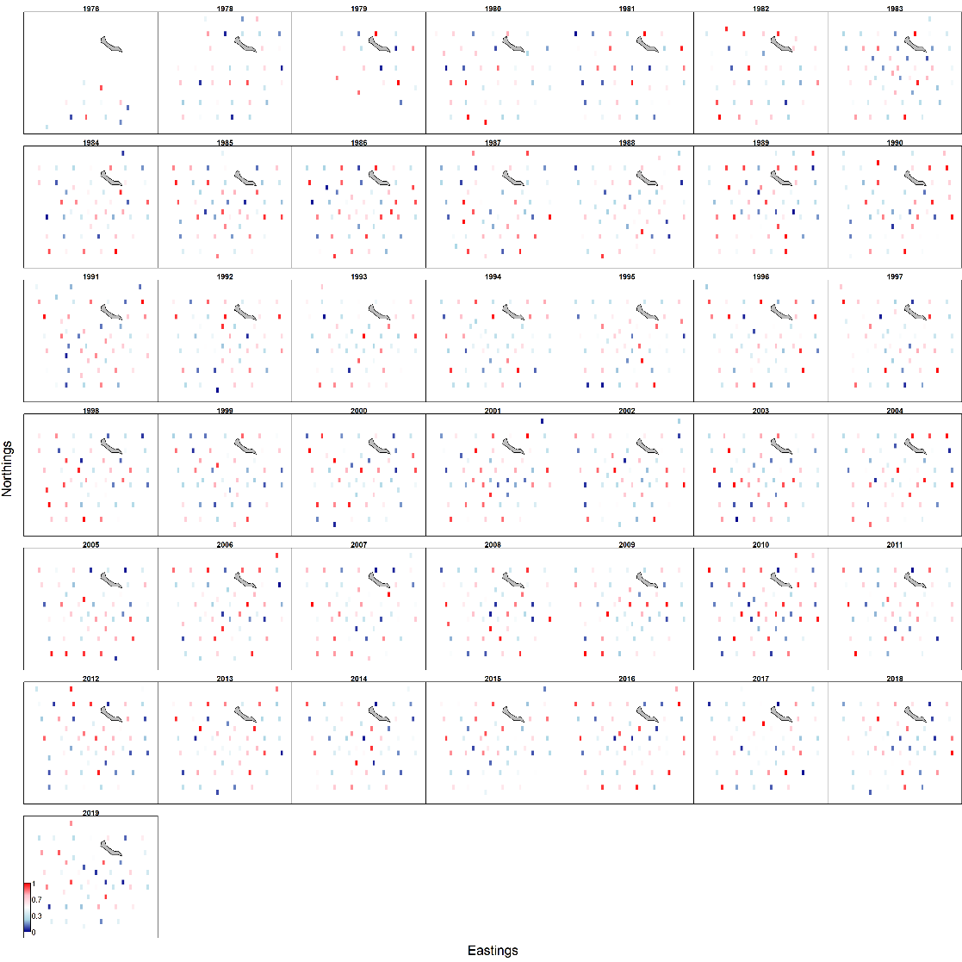
Item 5 - DHARMa residual diagnostics
Recommended by Cole Monnahan and Andrea Havron at SAFS seminar
New data simulated from the fitted model for each observation in original data
Residuals summarized as the probability density of the eCDF generated by simulation corresponding to the observed value
Output
  QQ-plot with relevant statistical tests
  Plot of how residuals vary with magnitude of the predictions
  Spatial map of quantile residuals
Notes:
Simulates new data from the fitted model for each observation.
For each observation, it then calculates the empirical cumulative density function for the simulated observations, which describes the possible values (and their probability) at the predictor combination of the observed value, assuming the fitted model is correct.
The residual is then defined as the value of the empirical density function at the value of the observed data, so a residual of 0 means that all simulated values are larger than the observed value, and a residual of 0.5 means half of the simulated values are larger than the observed value.

Slide 20
DHARMA cont.
Issues
  Output p-values are likely skewed, and not currently considered reliable
  Some question as to the interpretation of the p-values in context of VAST
Currently being investigated
P-values in presented diagnostics should be considered skeptically
Quantile residual maps are extremely difficult to read, and not presented here
  Spatial trends where observed were not what I would consider severe enough to reject models

Slide 21
Bristol Bay red king crab

Slide 22
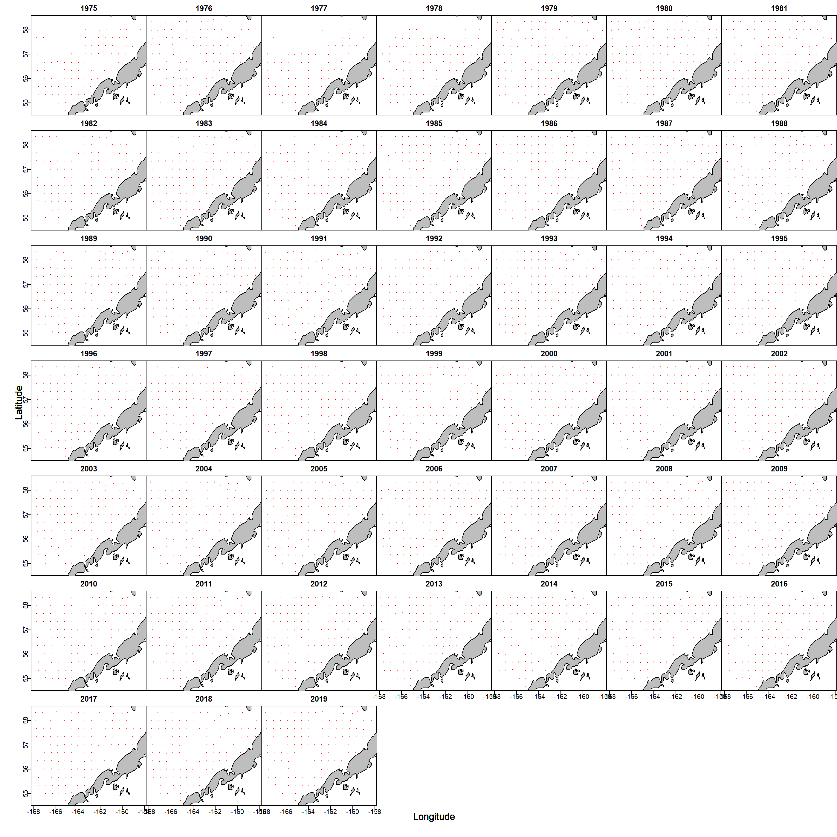
Data by year

Slide 23
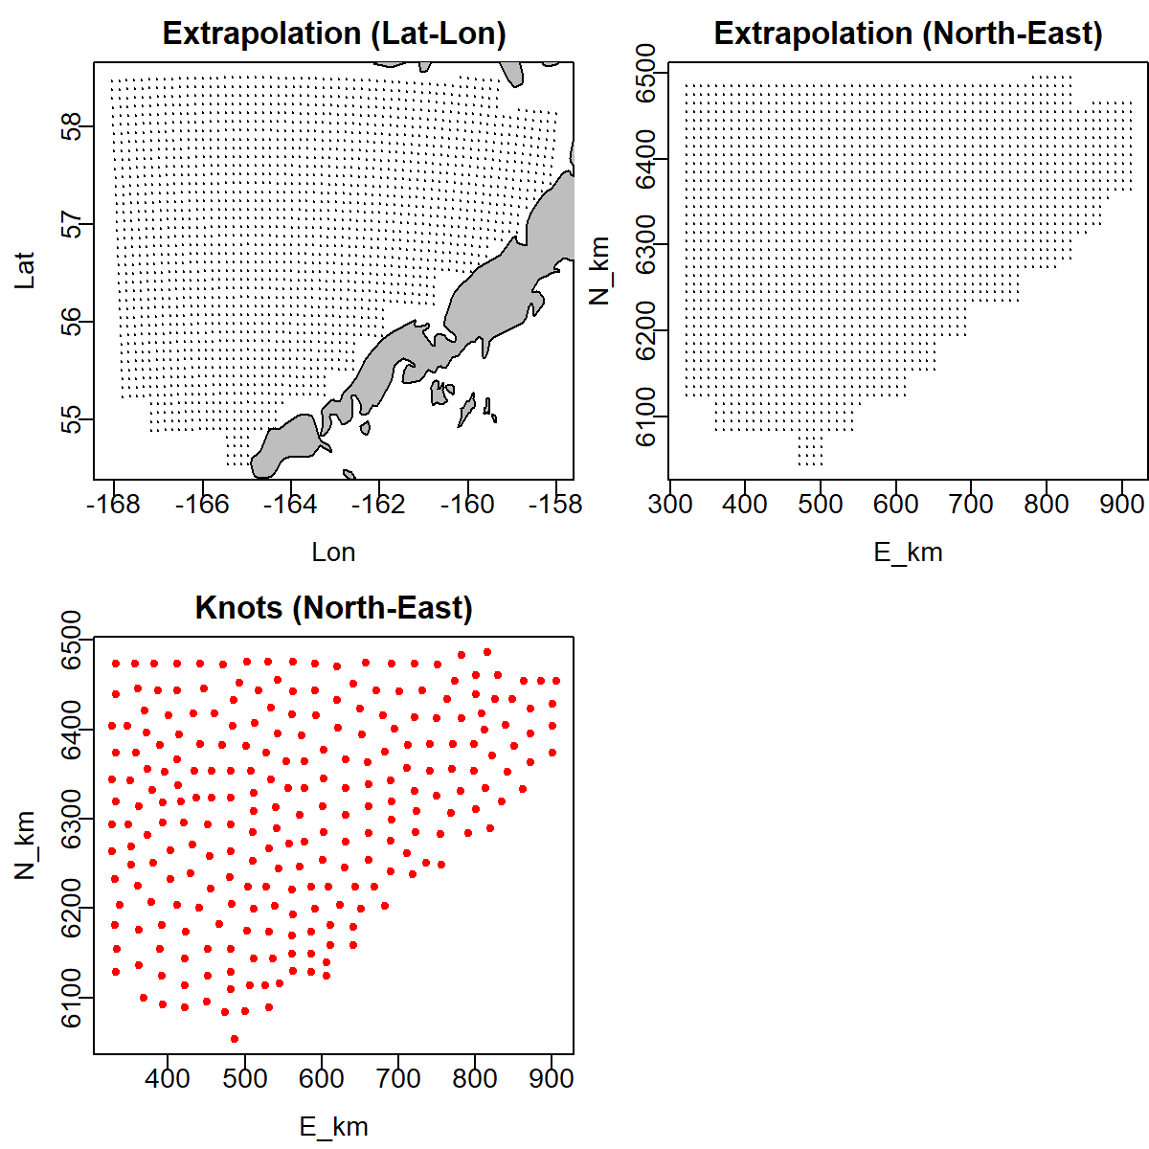
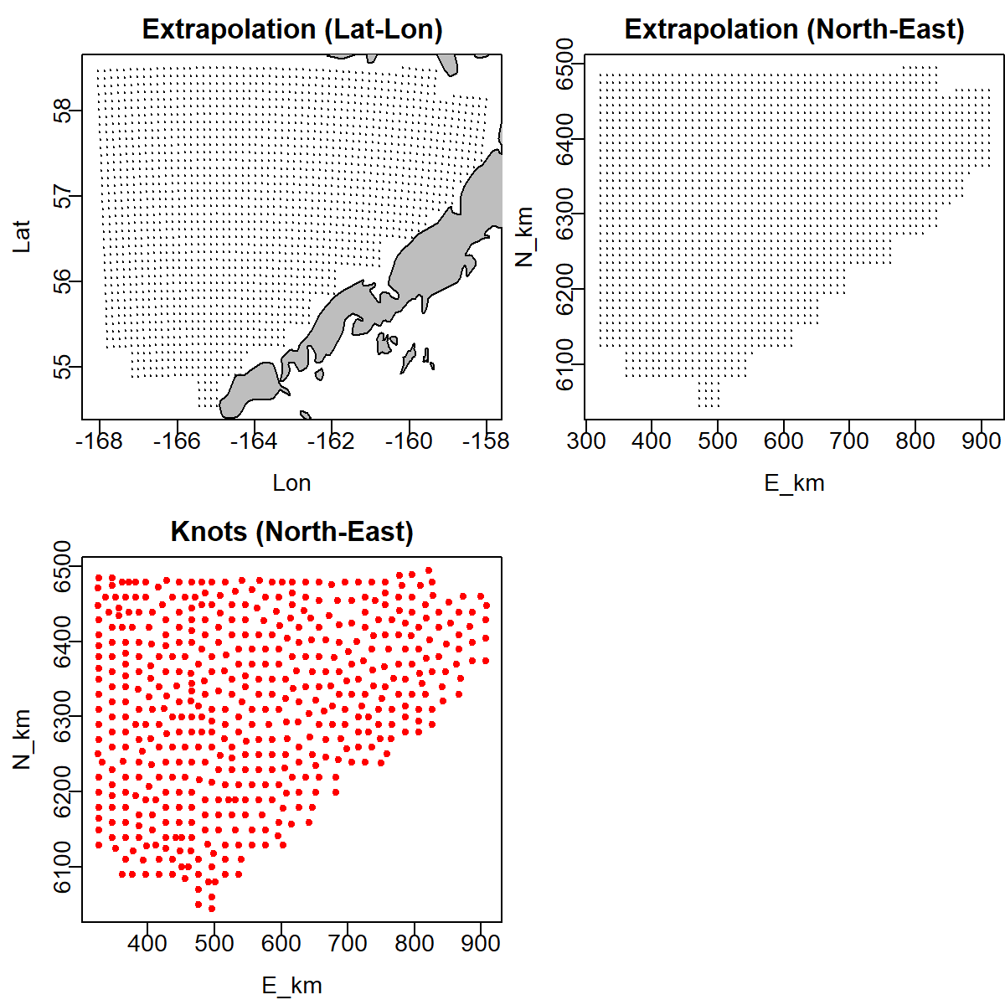
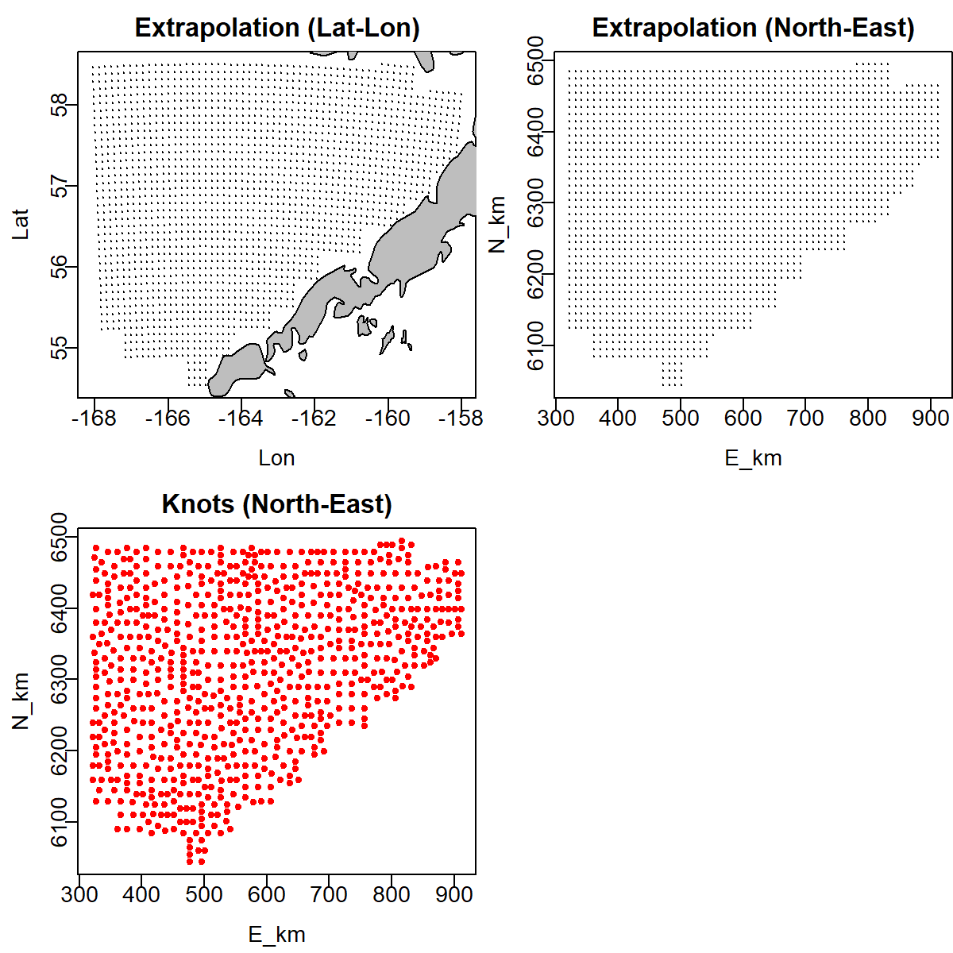
Extrapolation area/knots
250 knots
500 knots
750 knots
Notes:
All knot settings provided excellent coverage, to the point of saturating the extrapolation region

Slide 24
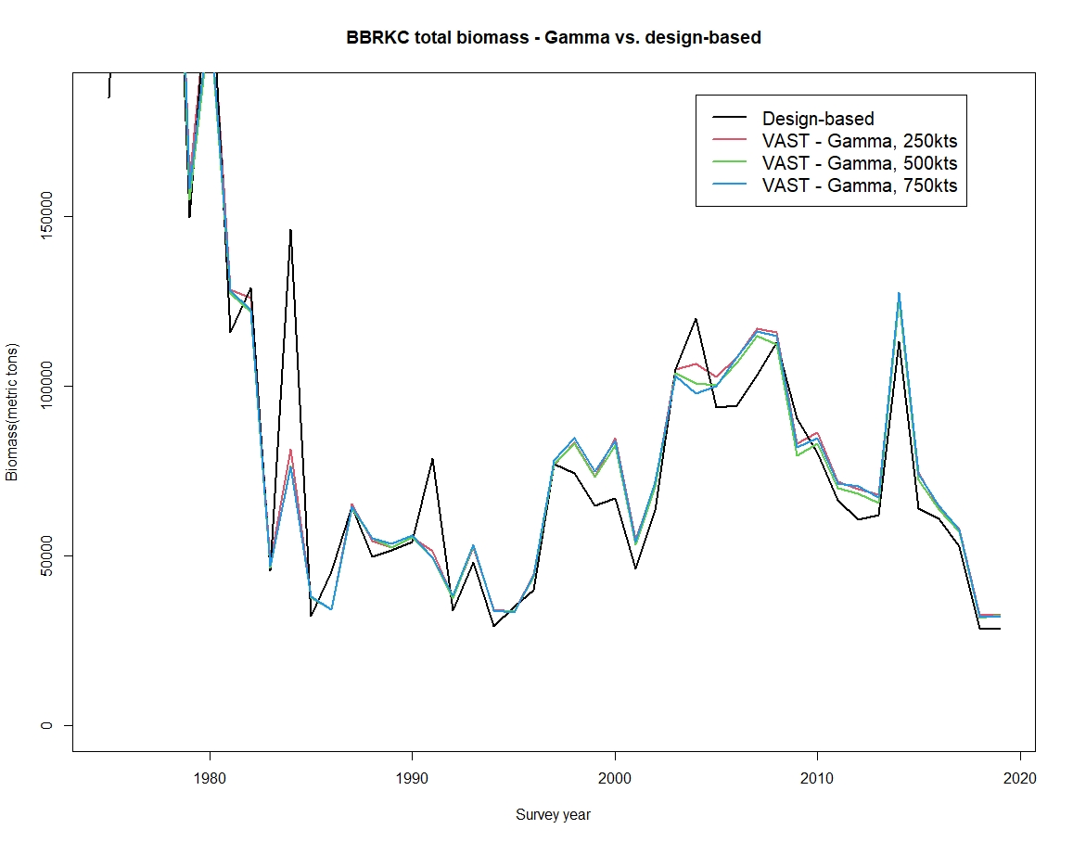
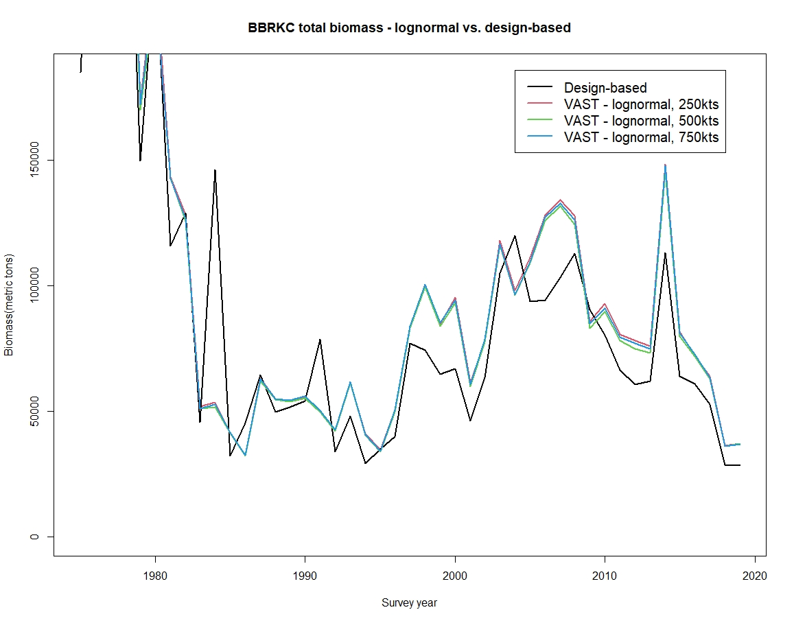
Biomass estimates
Gamma obs model
Lognormal obs model

Slide 25
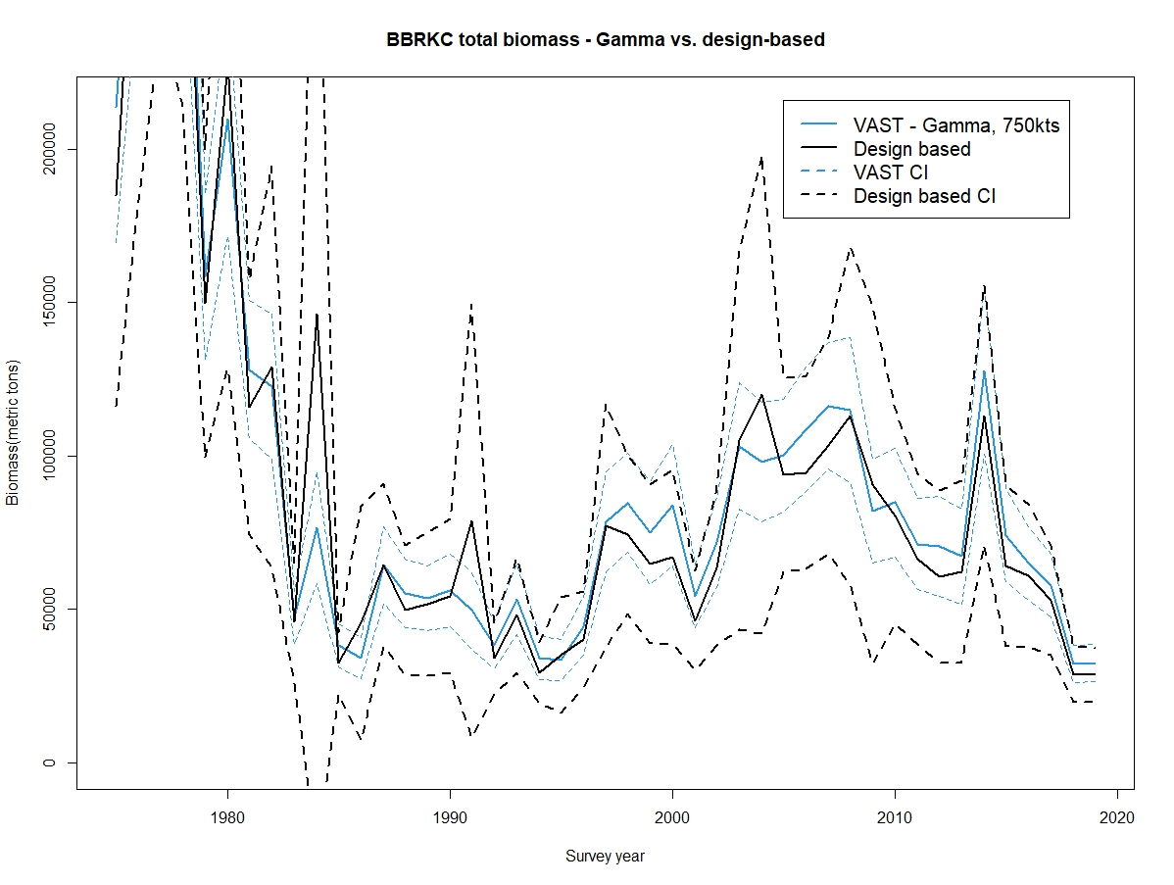
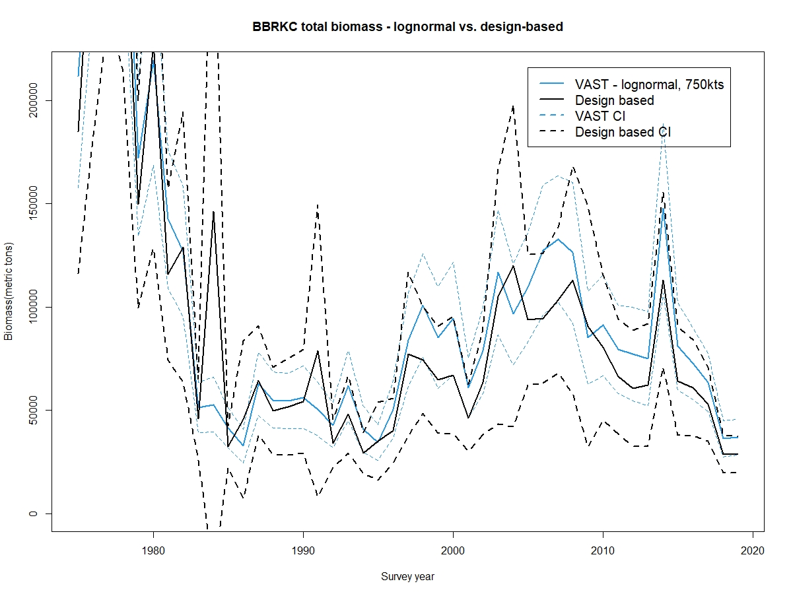
Biomass estimates w/ CIs
Gamma
Lognormal

Slide 26
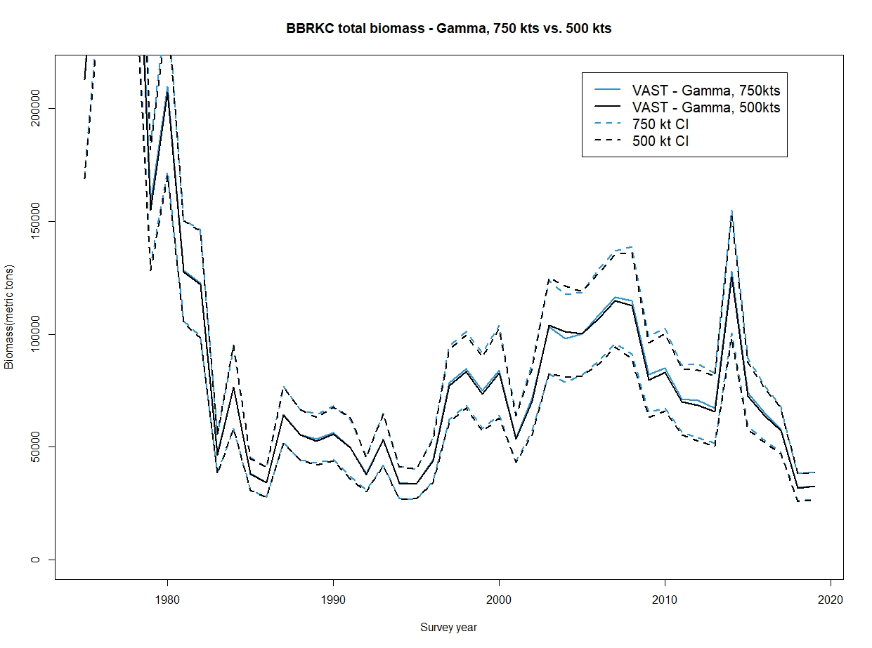
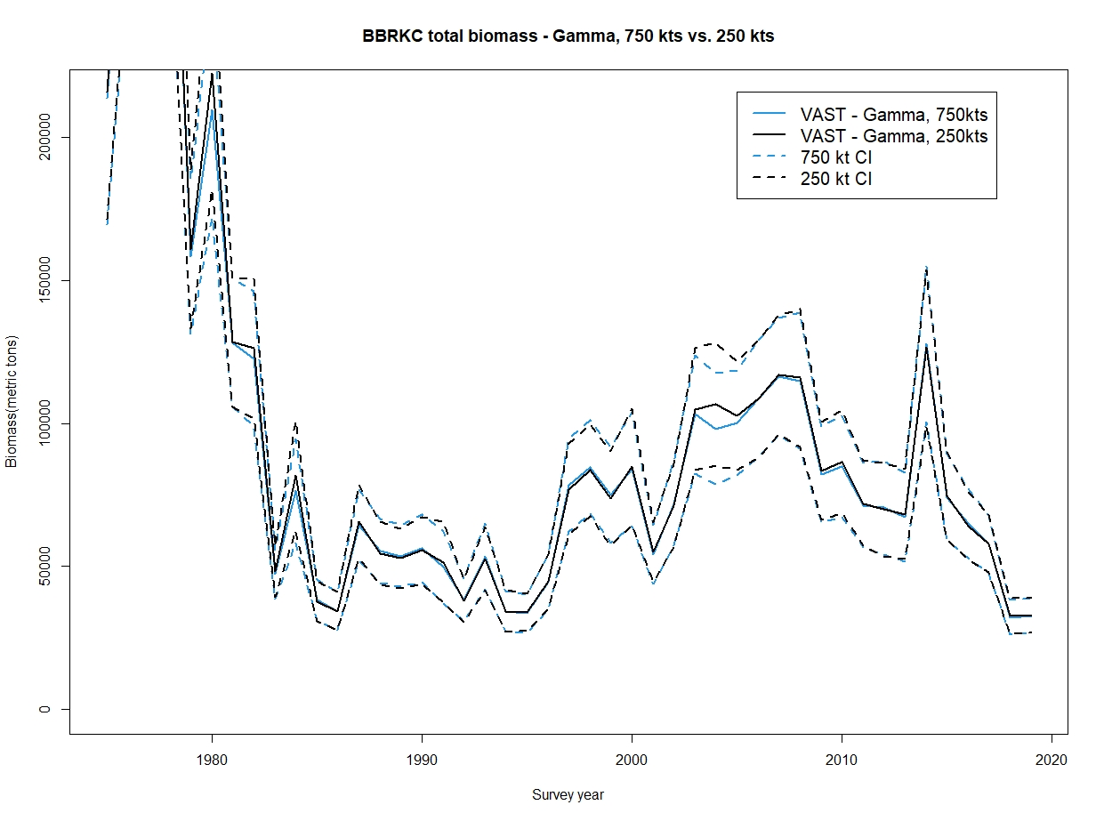
CI comparisons-Gamma obs model
750 vs 500 kts
750 vs 250 kts

Slide 27
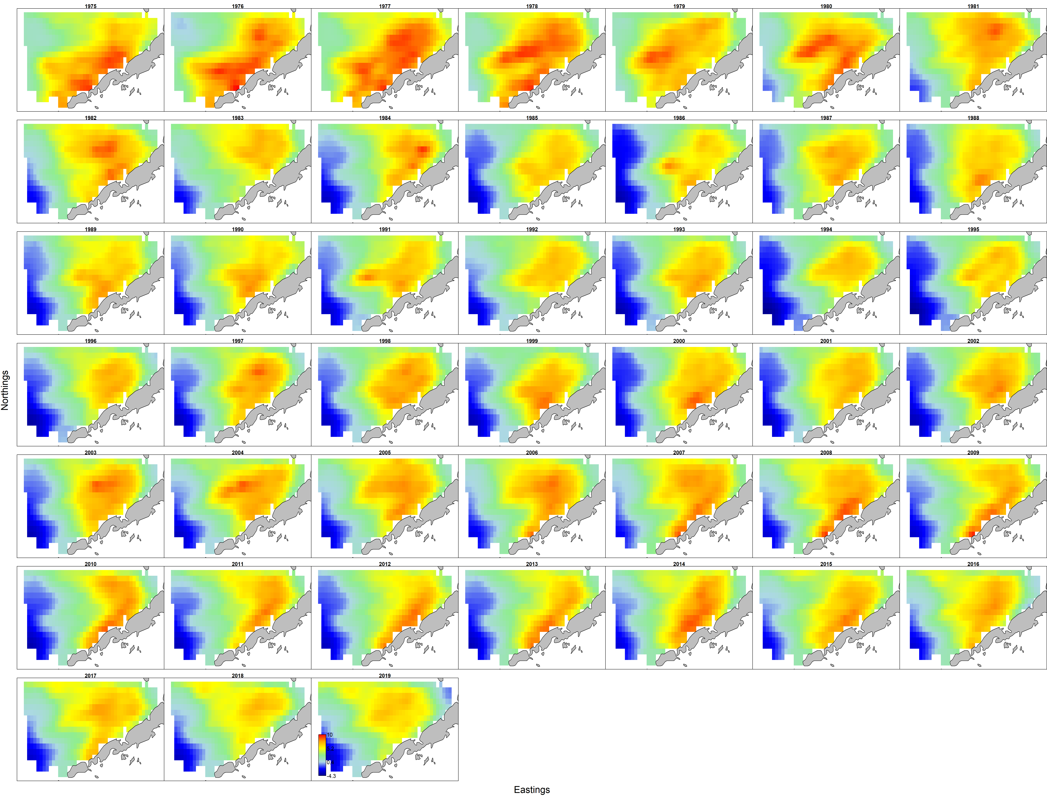
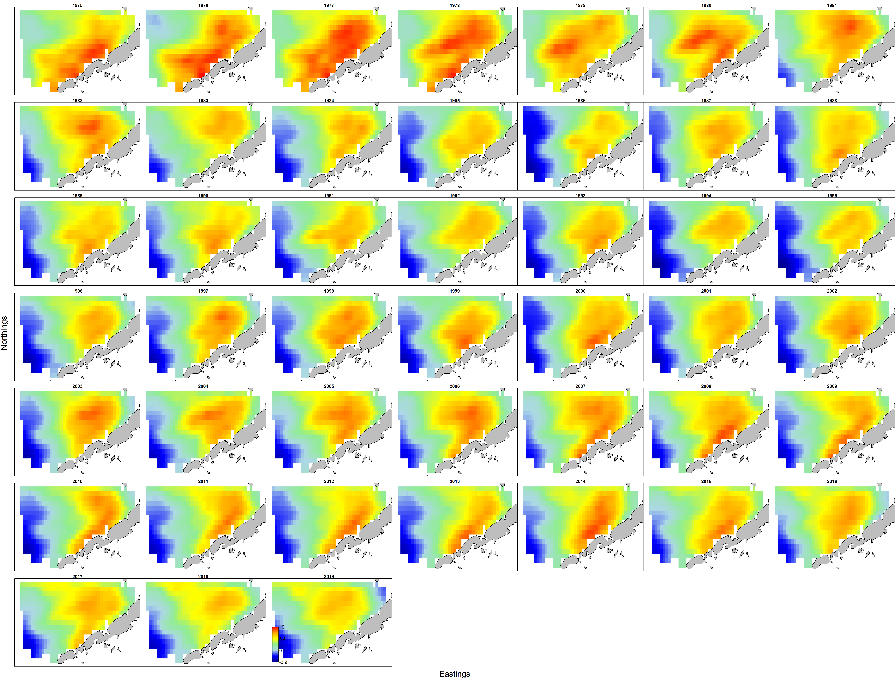
Density maps
750 knots - Gamma
750 knots - Lognormal

Slide 28
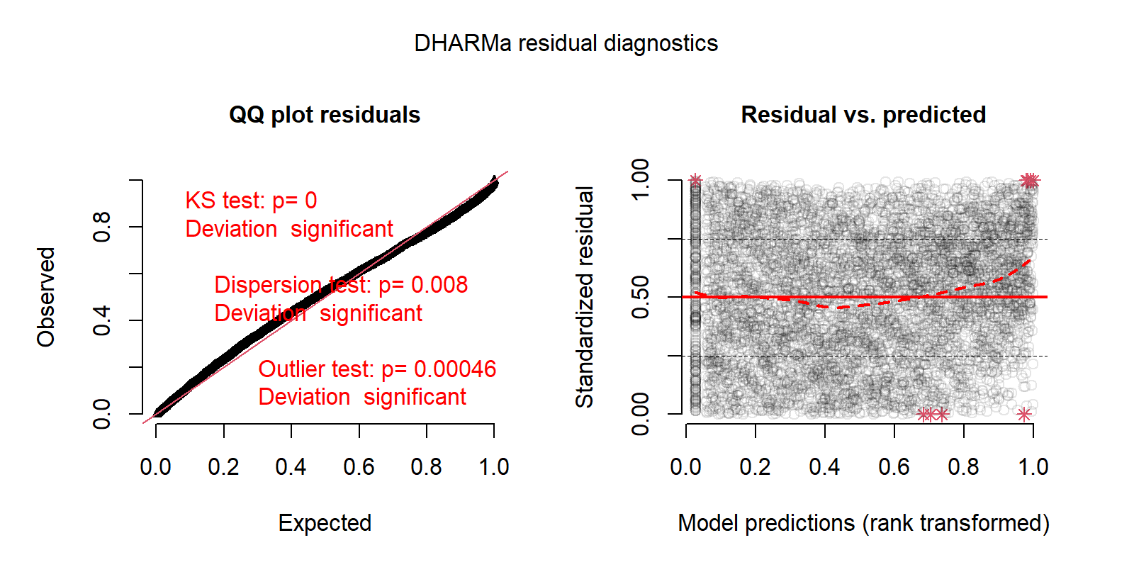


Quantile residuals - Gamma
250 knots
500 knots
750 knots

Slide 29
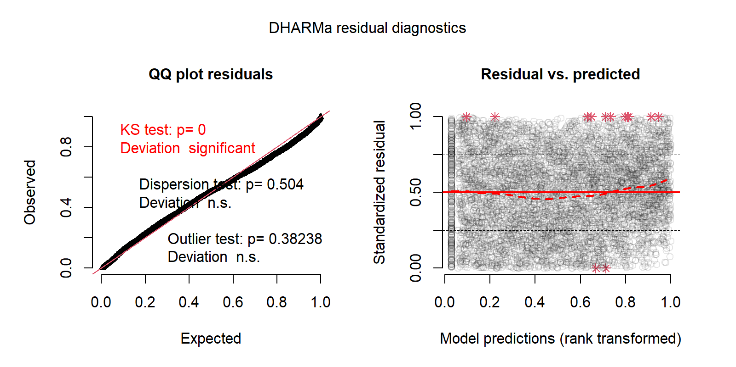
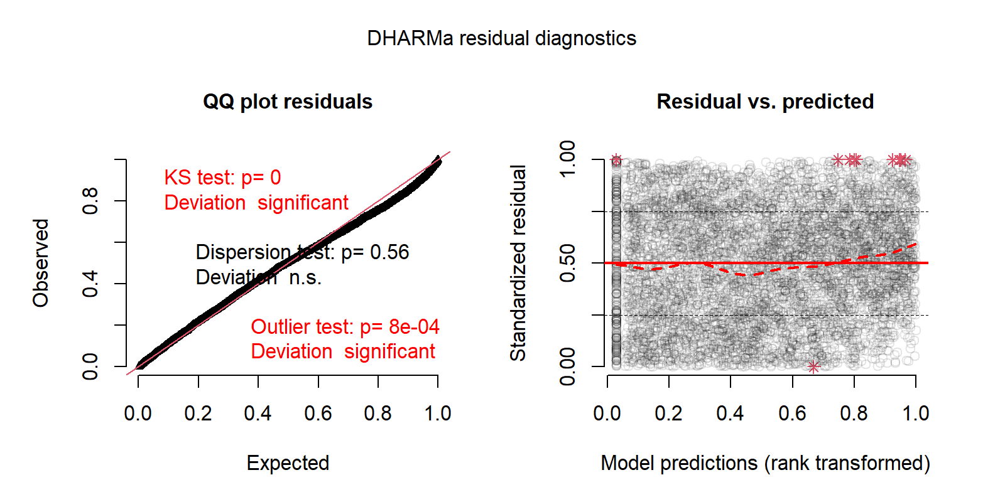
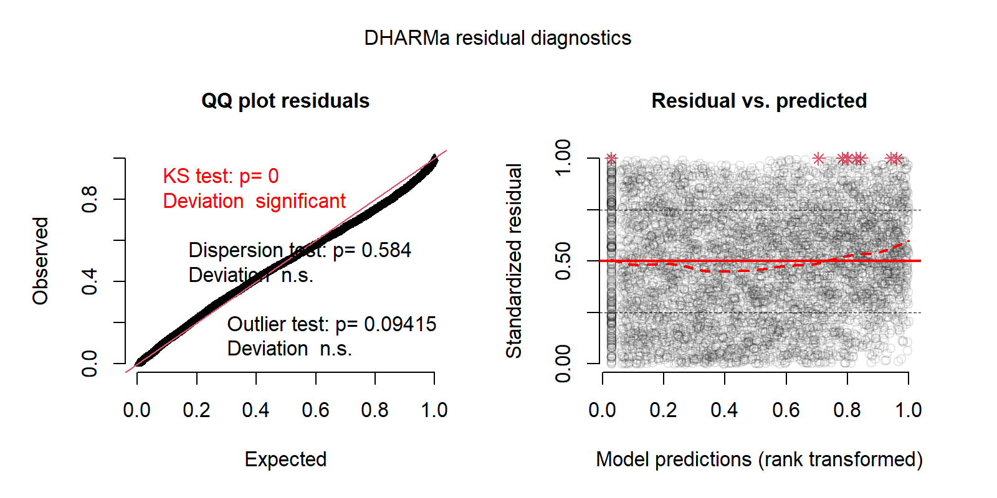
Quantile residuals - Lognormal
250 knots
500 knots
750 knots

Slide 30
Summary- BBRKC
A lognormal model using 250 or 750 knots appears to be the best choice for this stock based on DHARMa diagnostics
However Gamma models track area swept estimates more closely
With latter in mind, provisional recommendation would be to continue with Gamma models….for now.
#knots has very limited effects on Cis
  Suggest 500 kts as ceiling for this stock

Slide 31
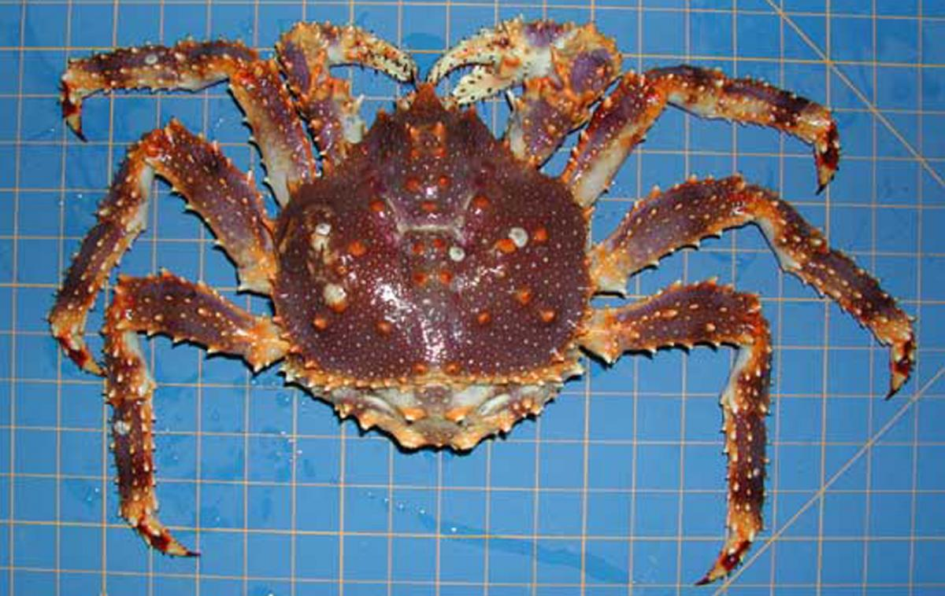
St Matthew Blue King Crab

Slide 32
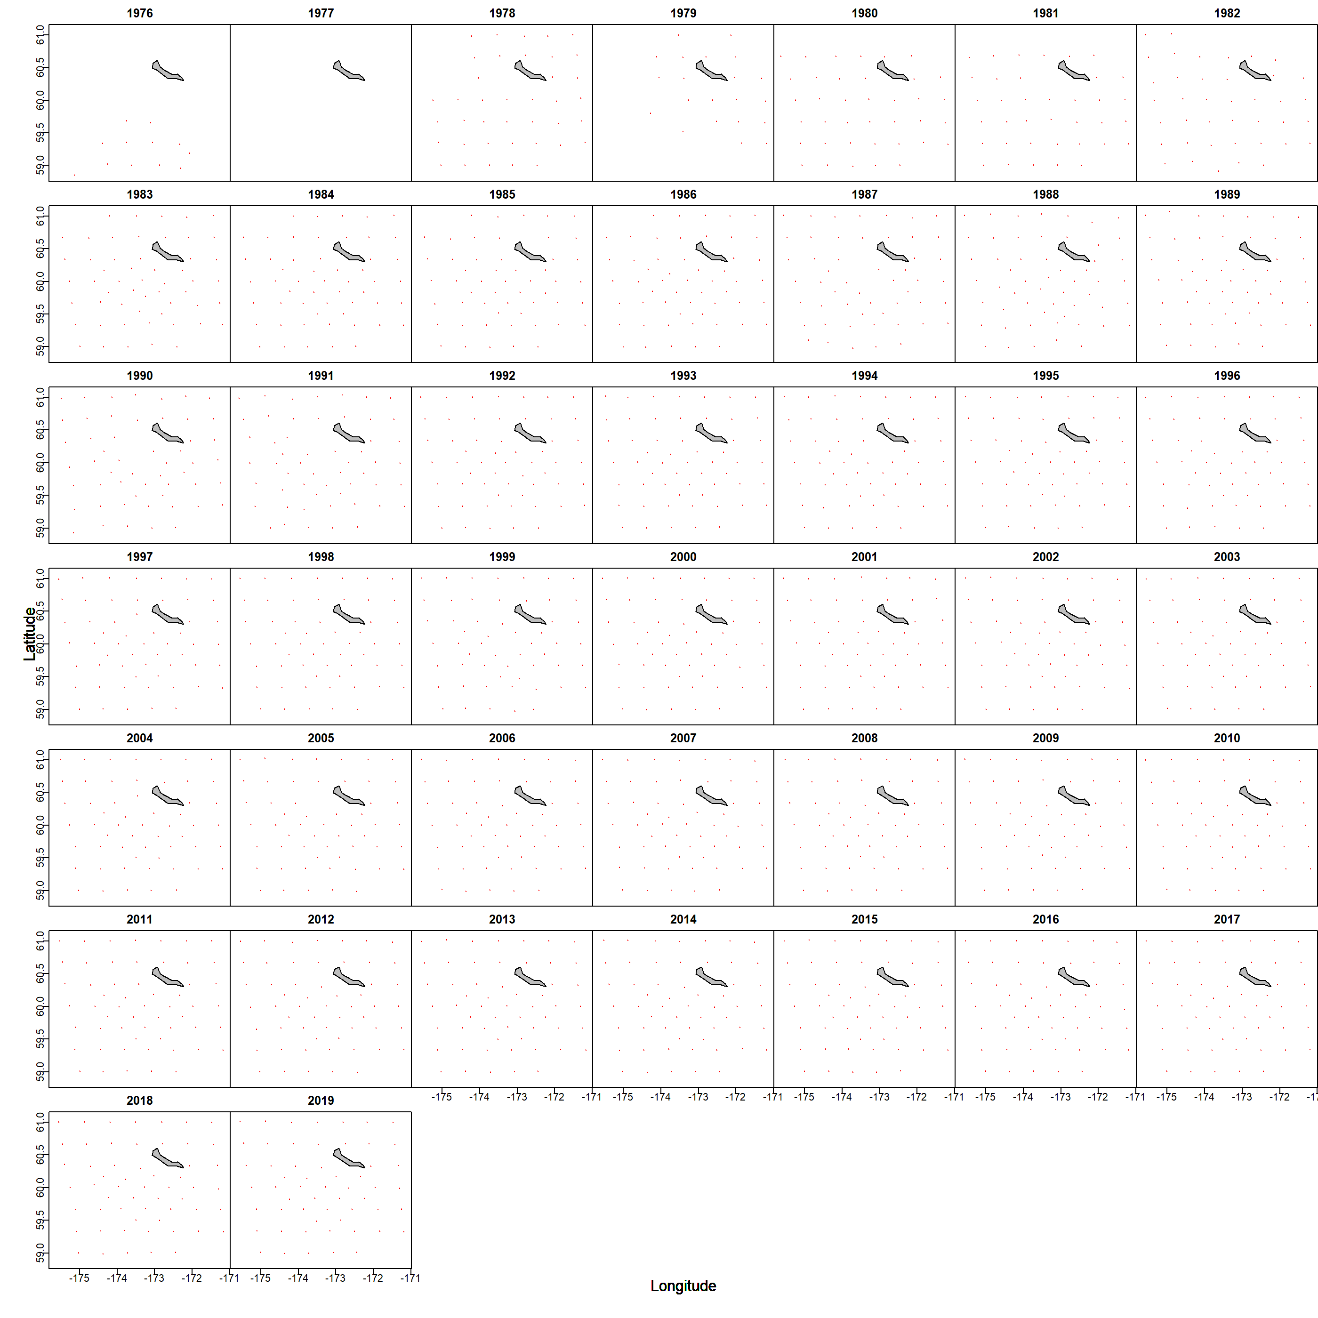
Data by year

Slide 33
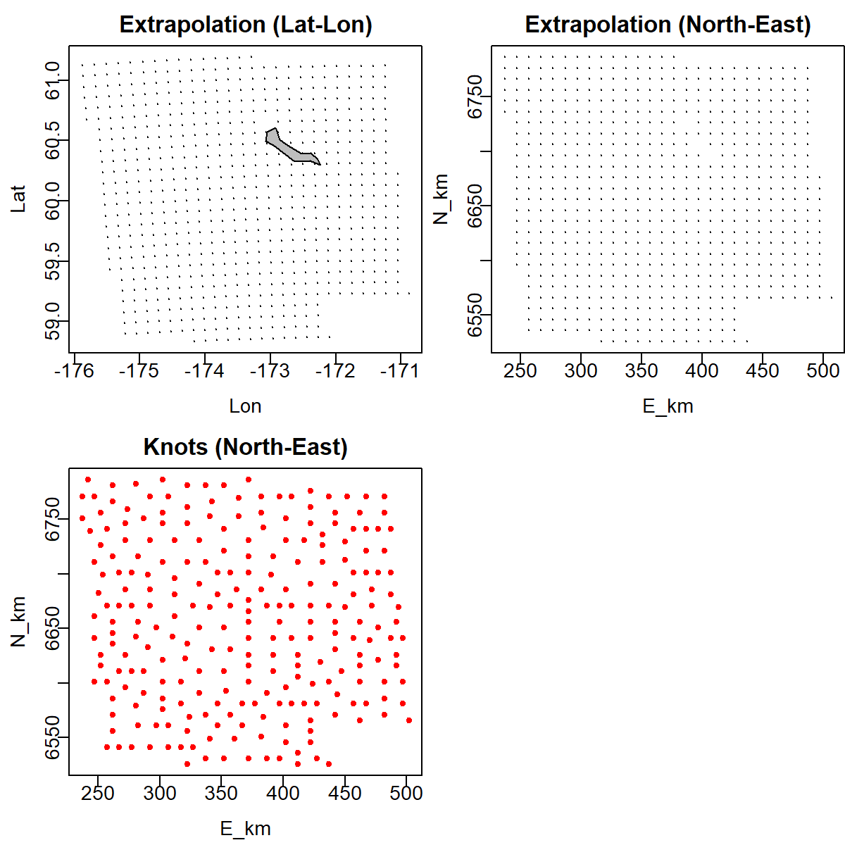
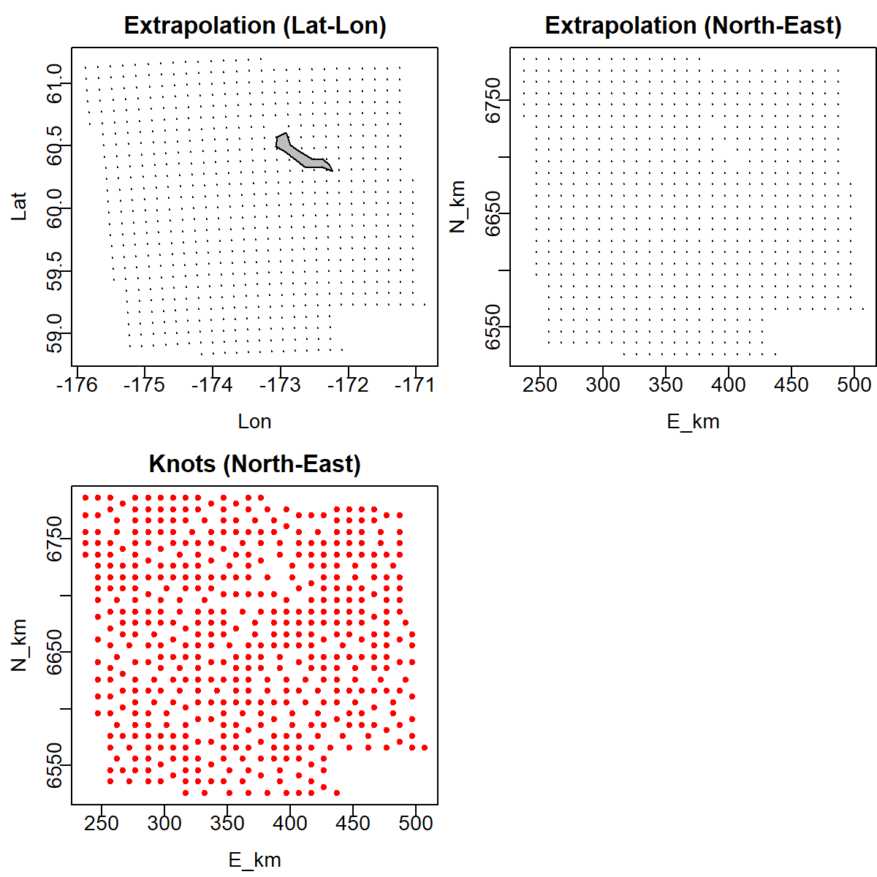
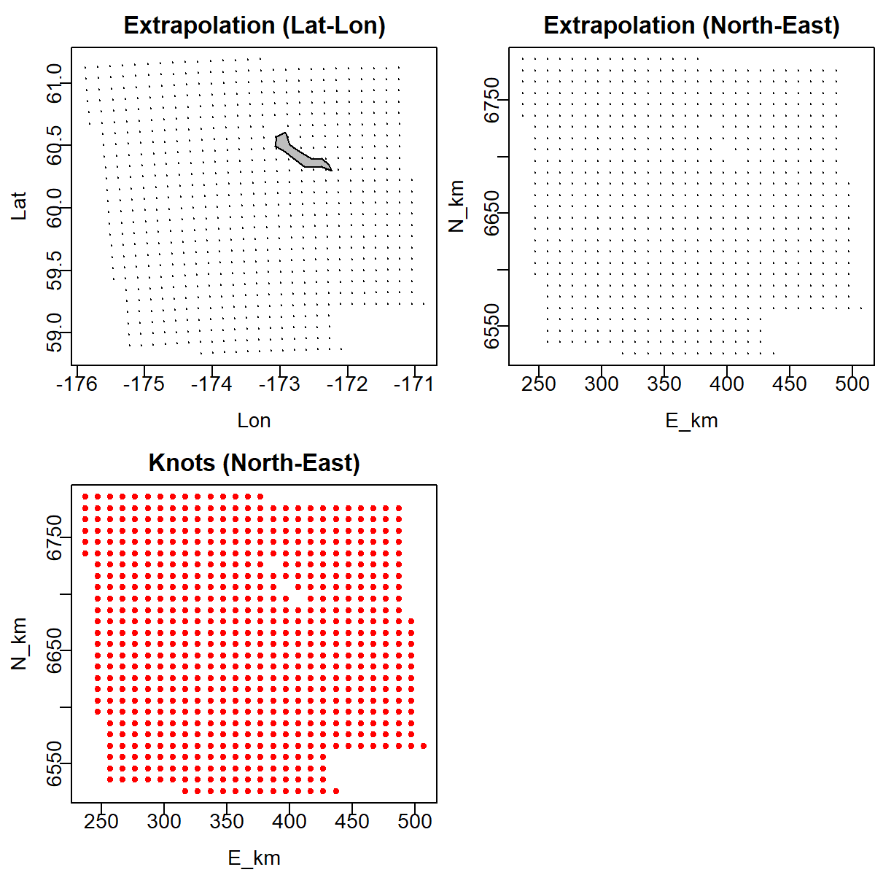
Extrapolation area/knots
250 knots
500 knots
750 knots

Slide 34
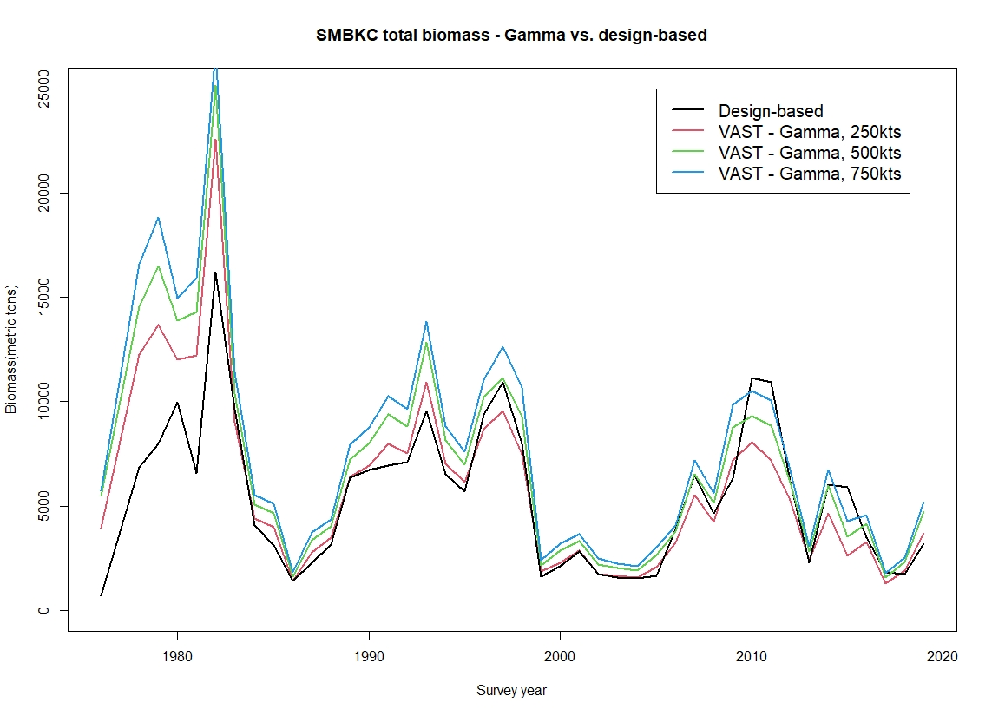
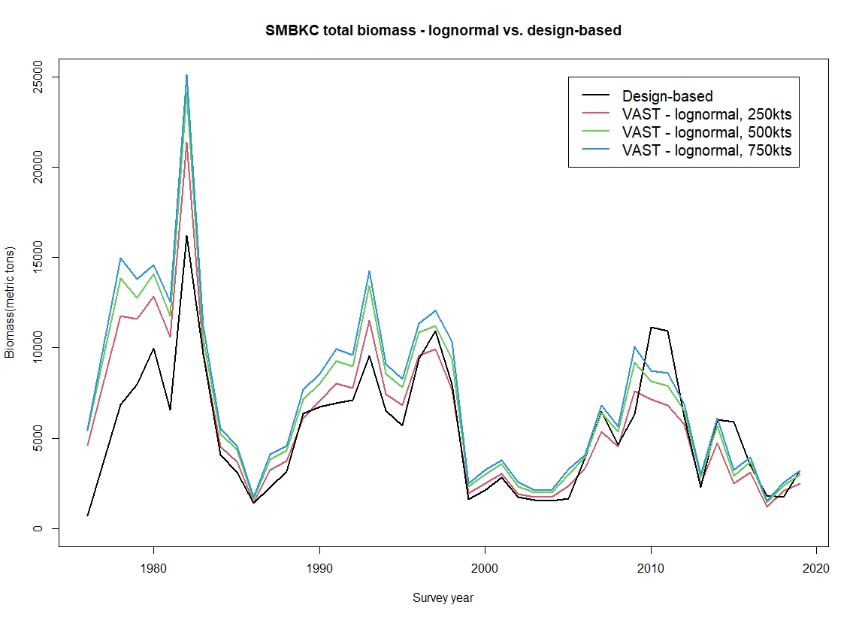
Biomass Estimates
Gamma obs model
Lognormal obs model

Slide 35
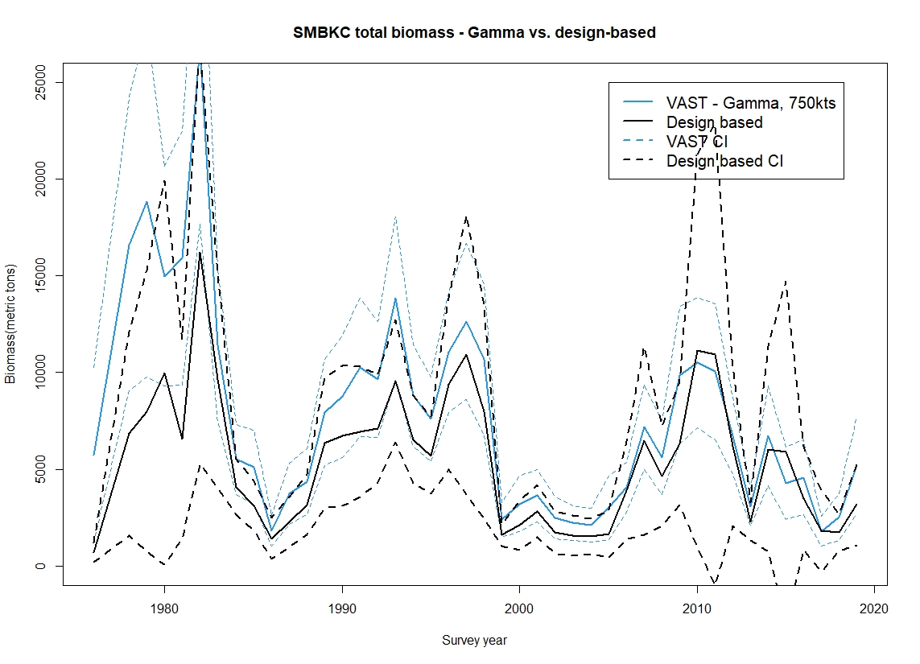

Biomass w/CIs
Gamma
Lognormal

Slide 36
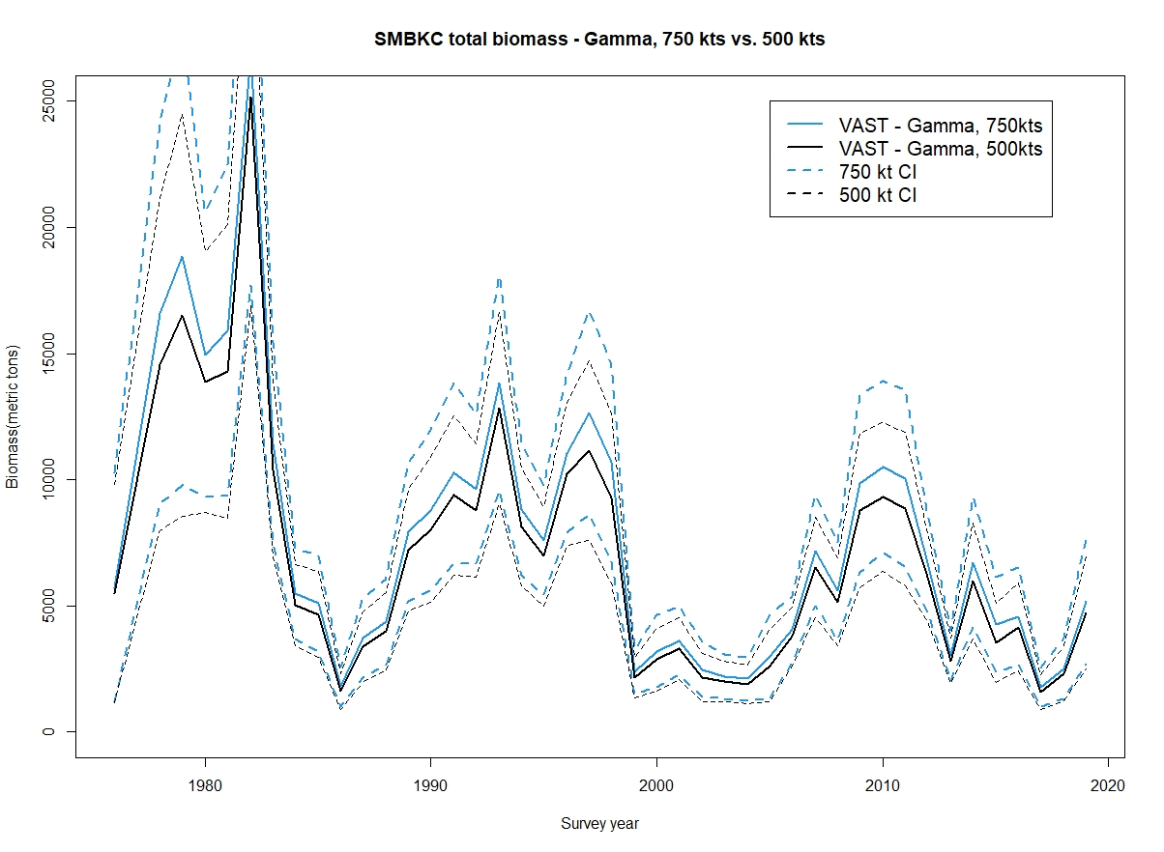
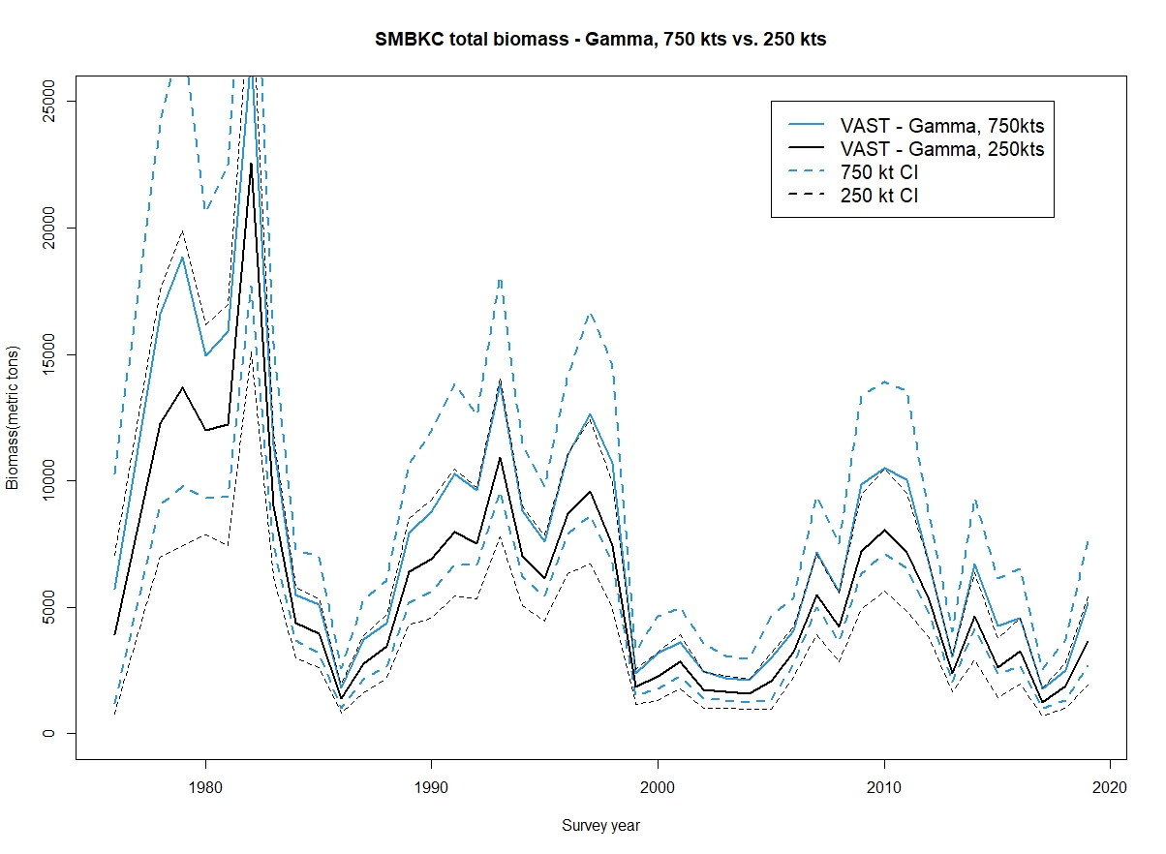
CI comparisons – Gamma obs model
750 vs 500 kts
750 vs 250 kts

Slide 37
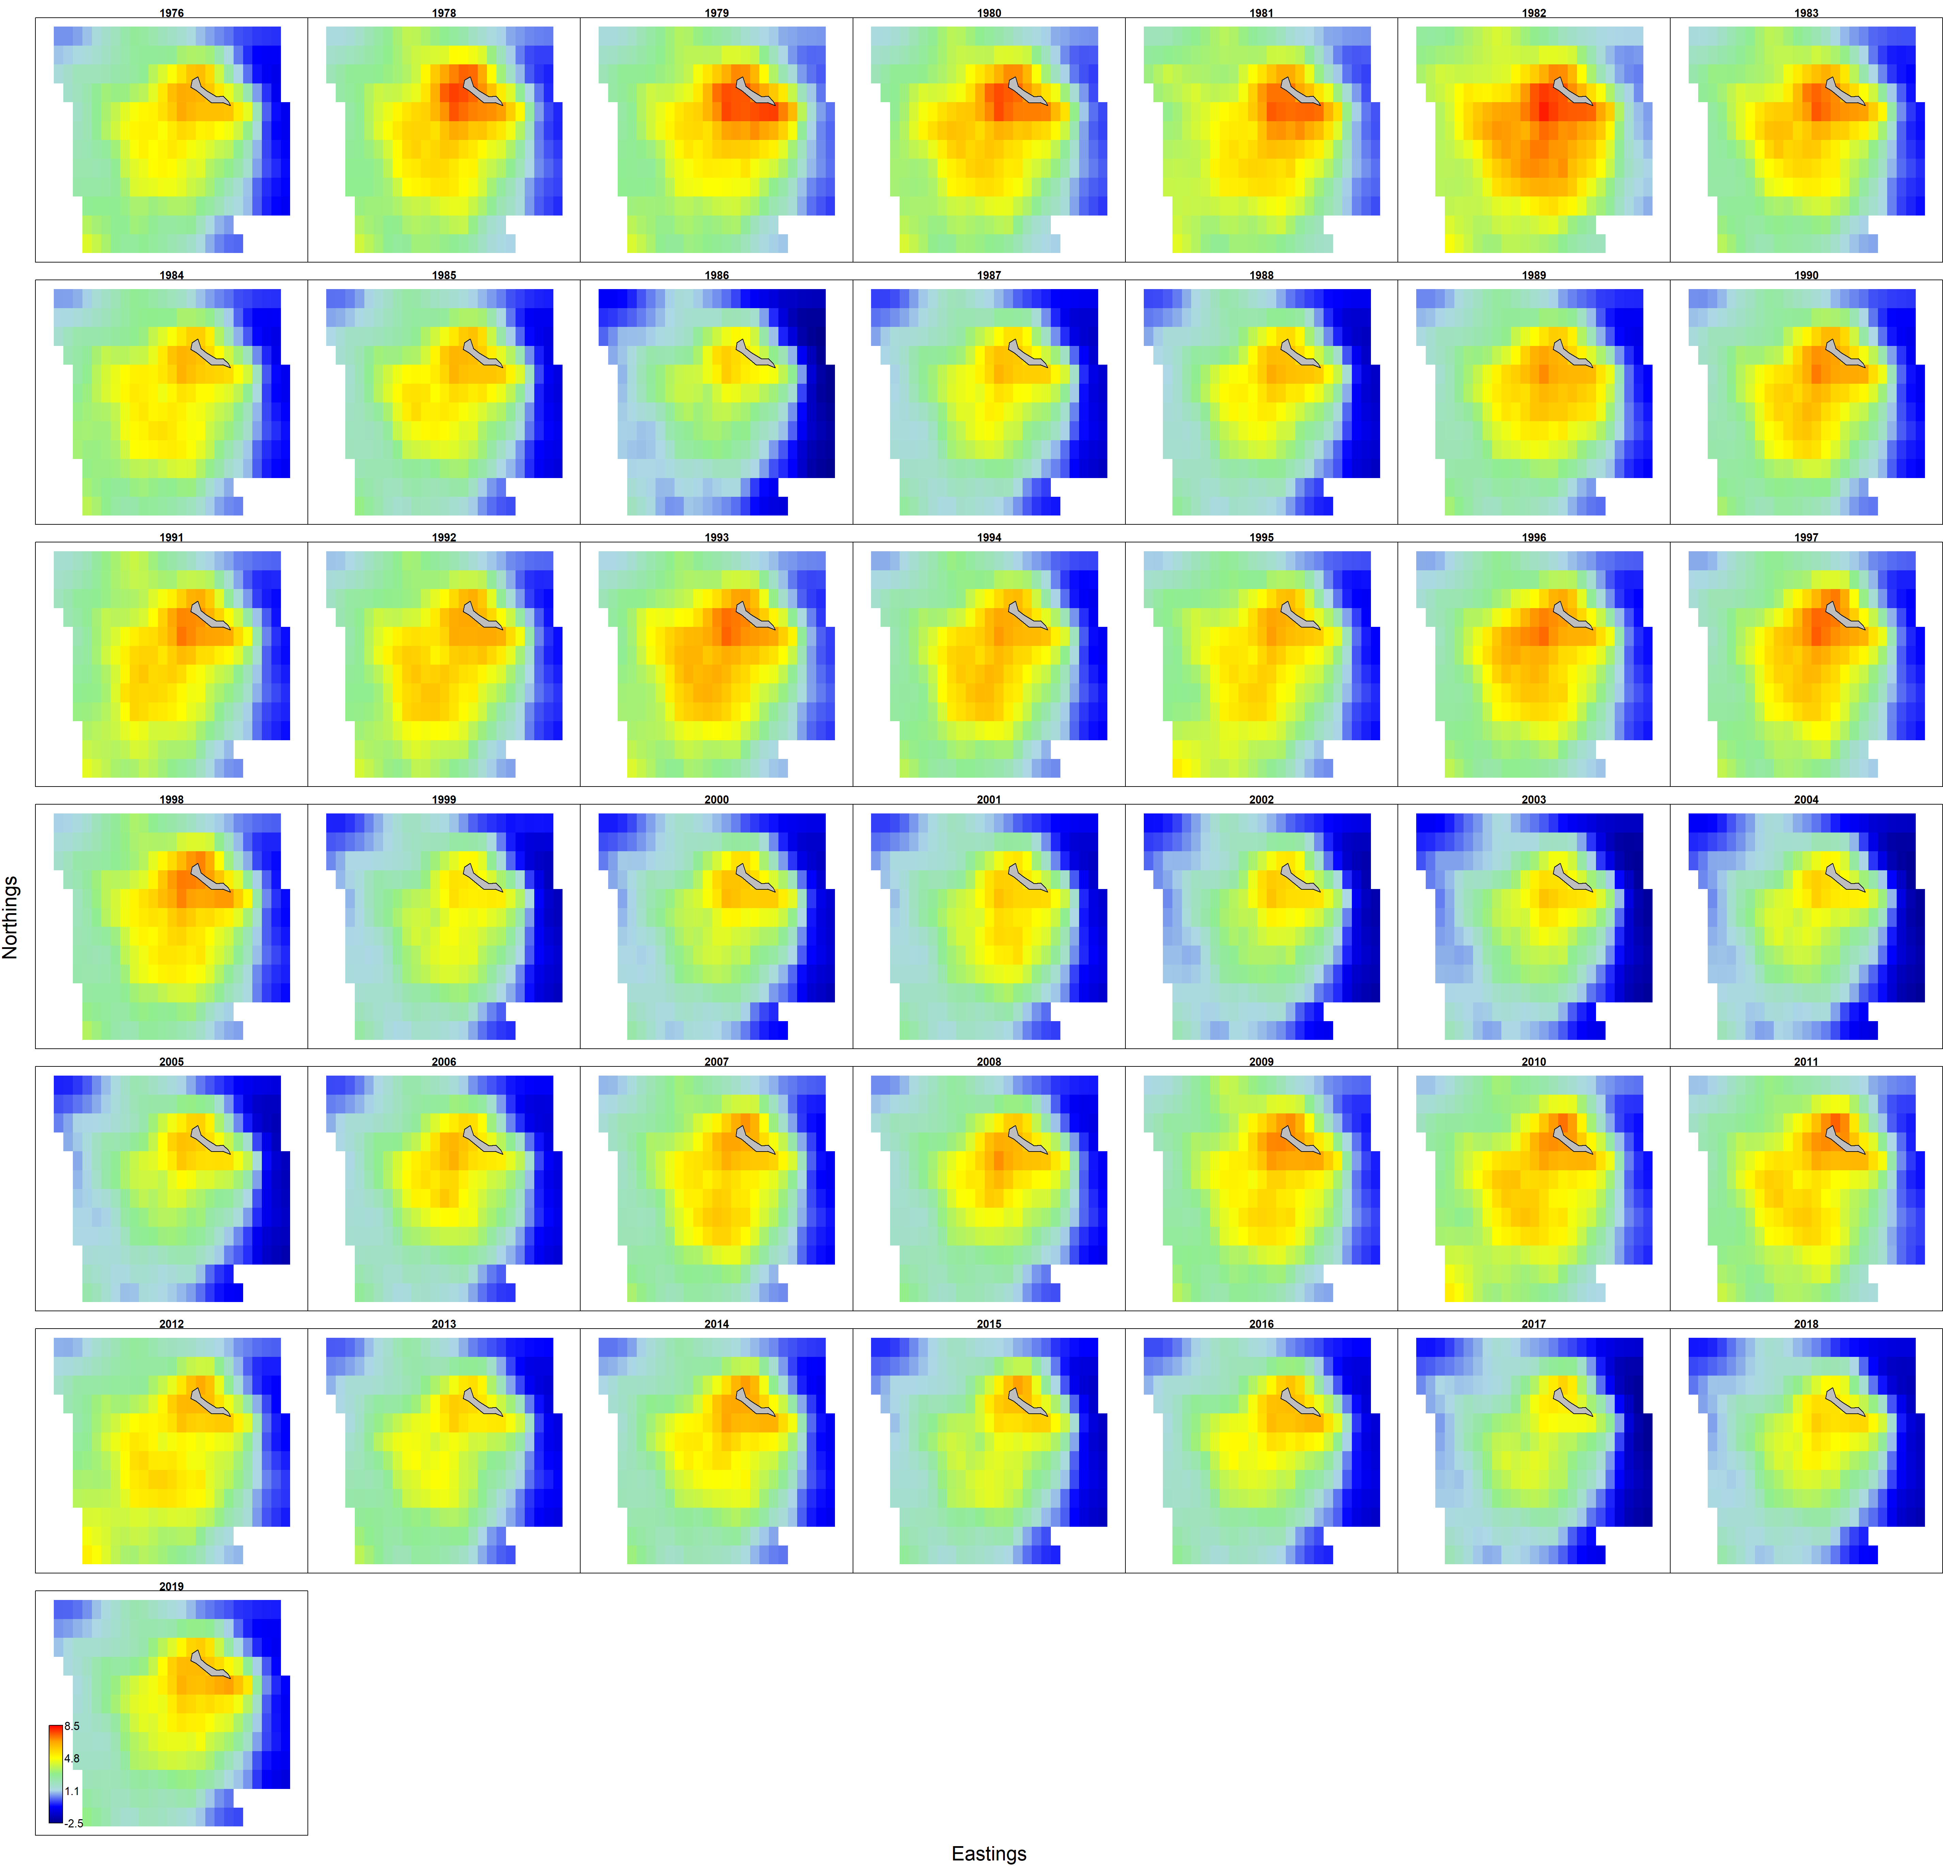
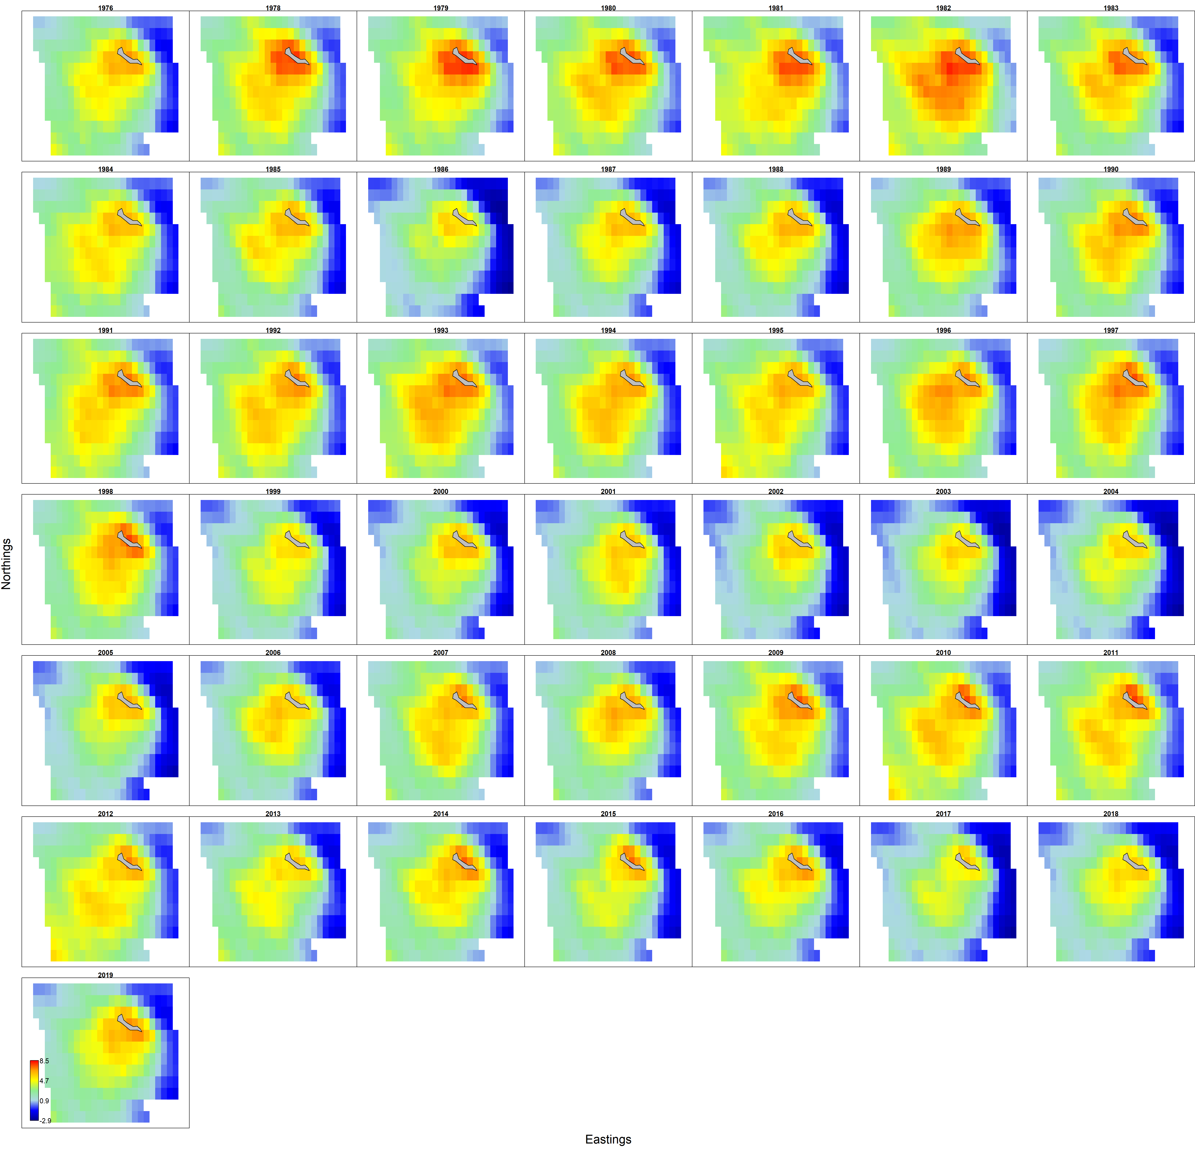
Barrier method
Gamma, 500 knot, Barrier
Gamma, 500 knot, standard

Slide 38
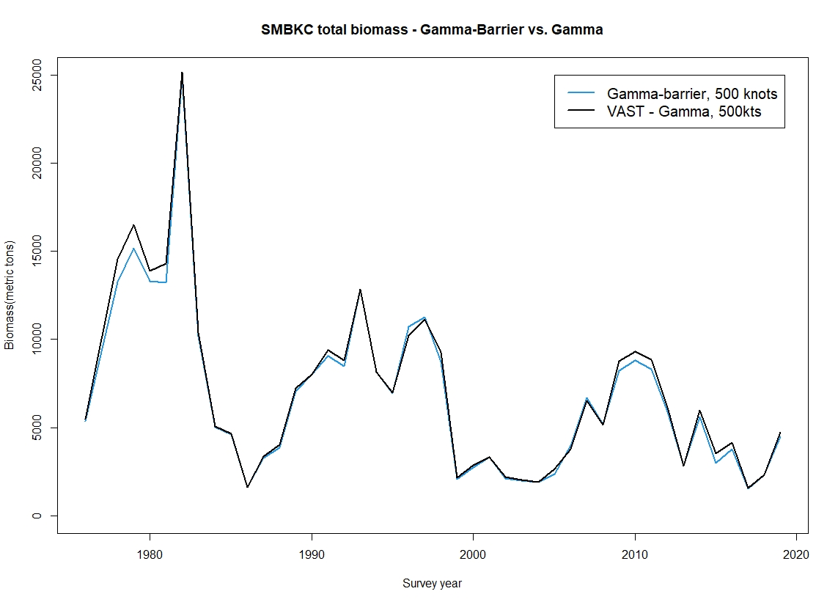
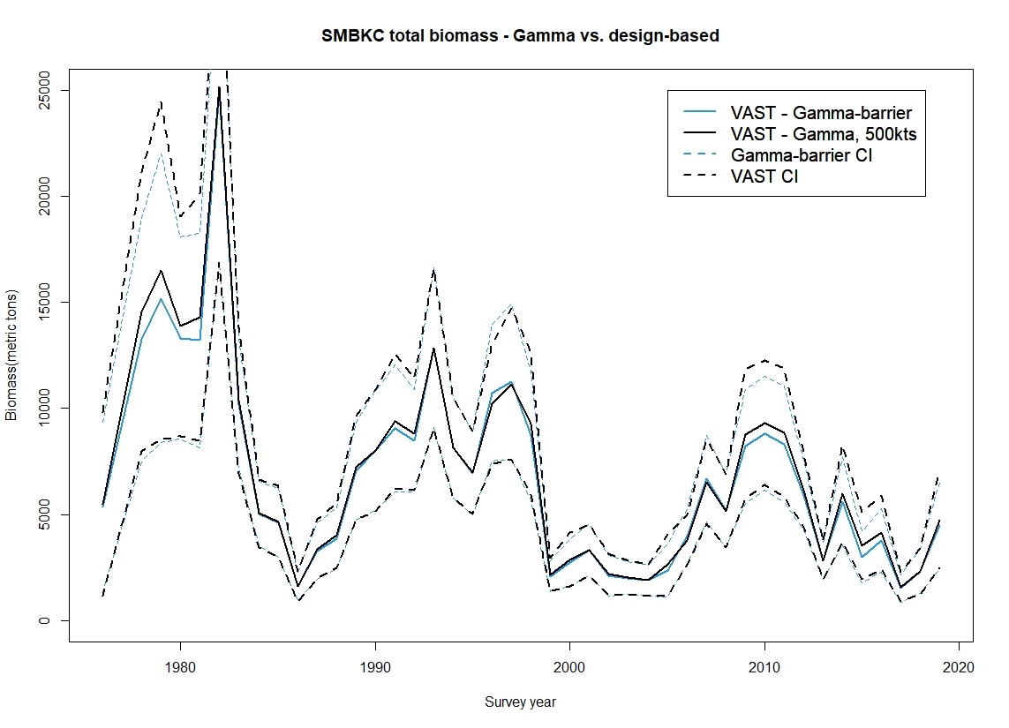
Barrier method – biomass estimates

Slide 39

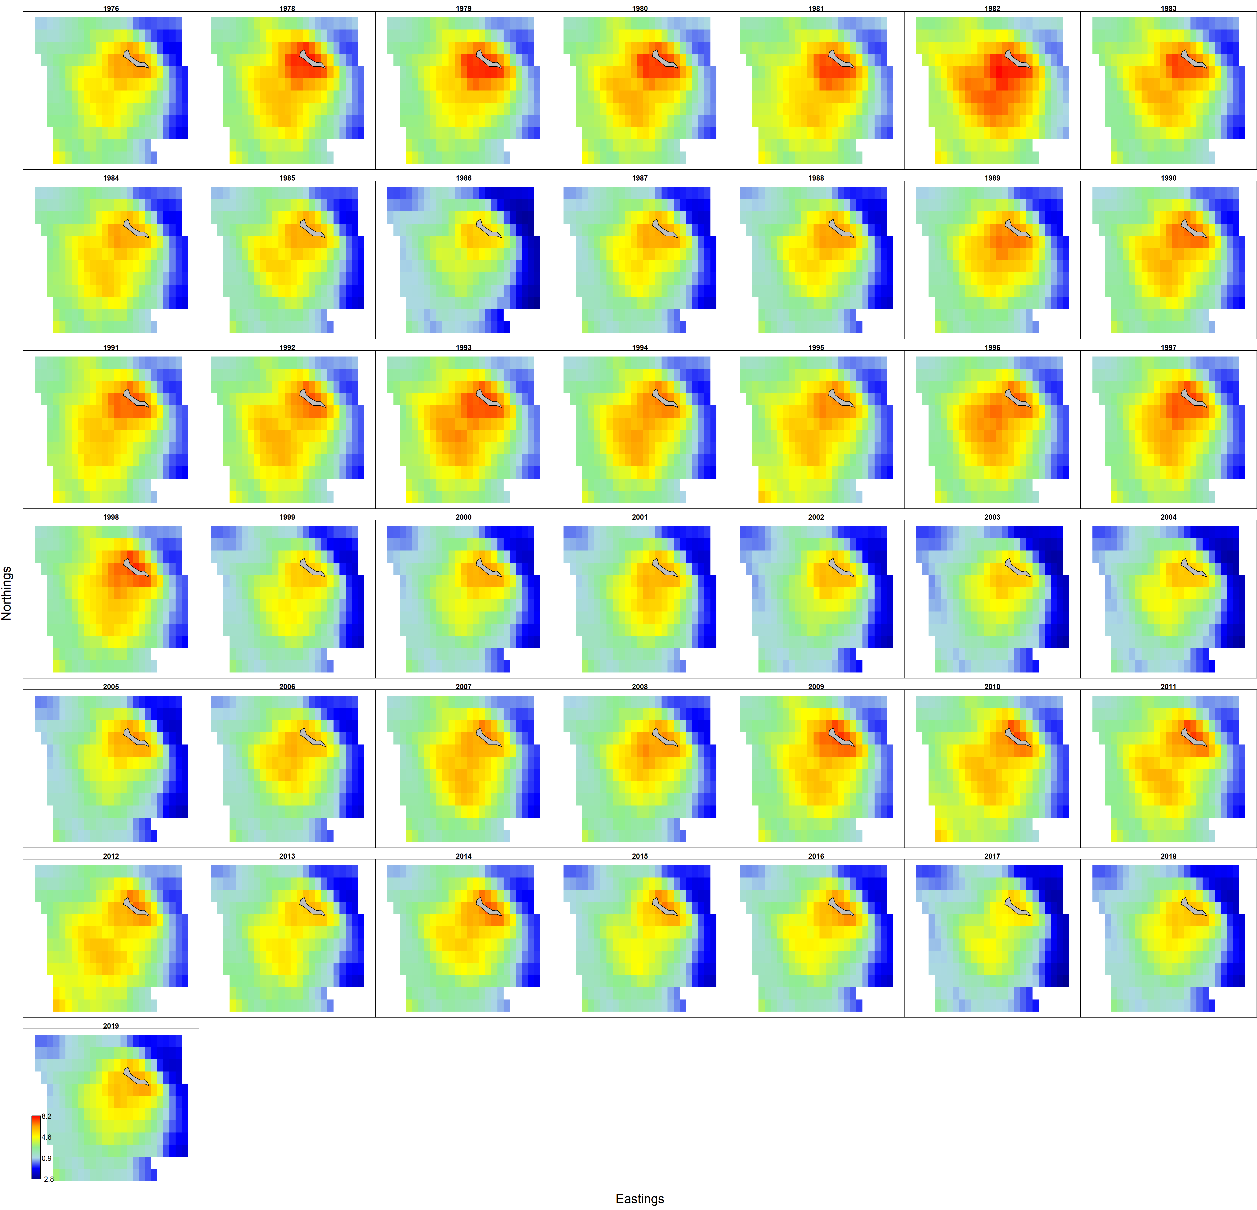
Density maps
750 knots - Gamma
750 knots - Lognormal

Slide 40



Quantile residuals - Gamma
250 knots
500 knots
750 knots

Slide 41



Quantile residuals - Lognormal
250 knots
500 knots
750 knots

Slide 42
Conclusions: SMBKC
Epsilon2 model component had to be disabled in all gamma models, and in lognormal models >250 knots
CI influenced by number of knots
  Discrepancies largely due to differences in estimate
Effects of barrier method are limited
  Primarily manifest as slight decrease in estimates
  CIs less affected
Gamma and log-normal models track design based estimates similarly
Log-normal appear to have better diagnostics
  Reliability
Provisionally suggest that Gamma may be most appropriate for this stock
  Still working on #knots

Slide 43

EBS Bairdi

Slide 44

Data by year

Slide 45



Extrapolation area/knots
250 knots
500 knots
750 knots

Slide 46


Biomass estimates
Gamma obs model
Lognormal obs model

Slide 47


Biomass w/CIs
Gamma obs model
Lognormal obs model

Slide 48


CI comparisons – Gamma obs model
750 vs 500 kts
750 vs 250 kts

Slide 49


Density maps
750 knots - Gamma
750 knots - Lognormal

Slide 50



Quantile residuals - Gamma
250 knots
500 knots
750 knots

Slide 51



Quantile residuals –Lognormal
250 knot
500 knot
750 knot

Slide 52
Bairdi summary
Model resolution had very limited effects on estimates
CIS essentially unaffected
Trade offs between the two model classes
  Gamma tracked design-based estimates better
  Lognormal model diagnostics seem marginally superior
    Reliability
  Both performed well modeling population spatial distributions
Gamma w/Poisson-link delta model w/500 kts is current recommendation

Slide 53
EBS opilio

Slide 54
Data by year

Slide 55
Extrapolation area/knots
250 knots
500 knots
750 knots

Slide 56


Biomass estimates
Gamma obs model
Lognormal obs model

Slide 57


Biomass w/CIs
Gamma
Lognormal

Slide 58


CI Comparisons – Gamma obs model
750 vs 500 kts
750 vs 250 kts

Slide 59


Density maps
750 knots - Gamma
750 knots - Lognormal

Slide 60


Quantile residuals
750 knots - Gamma
750 knots - Lognormal

Slide 61


Gamma model, NBT covariate
Density
Quantile residuals

Slide 62

Biomass – NBT covariate

Slide 63
Summary: opilio
For males at least
  Gamma model provides the superior diagnostics and tracked designed based much better
  Large knot number (750+) improves CI
  Effects of incorporating temperature as covariate were less than might be hoped
    Improved Cis
  Recommendation: Gamma model w/Poisson-link delta model, 750 knots and NBT as covariate.

Slide 64
Winter 2021
Females for all stocks
  Priority on BBRKC
Alternate grid square areas for extrapolation grid
Environmental covariates
  NBT: BBRKC, SMBKC, Bairdi
  Depth?
    NSRKC?

Slide 65
Recommendations
BBRKC GE65 TBM model as reference pass/fail
Model settings:
  Gamma w/Poisson-link delta model and 500-750 knots for all stocks
  Barrier method for SMBKC,
  Possible reversion to prior diagnostic outputs if current questions about DHARMA not answered by March
Model features:
  Improved visualization of spatial residuals
  Visualization of Barrier approach implementation.
Procedural
  Formation of ad hoc advisory/review team including at least two VAST GAP personnel to provide peer review of model outputs, and approve use
    March 1

Slide 66

Questions?

