Slide 1
Aleutian Islands golden king crab stock assessment
May 2021 Crab SAFE DRAFT REPORT
M.S.M. Siddeek^{1,} J. Zheng¹, C. Siddon¹, B. Daly², M.J. Westphal³, and L. Hulbert¹
Alaska Department of Fish and Game, Juneau¹, Kodiak², and Dutch Harbor³, Alaska
May 17, 2021

Slide 2
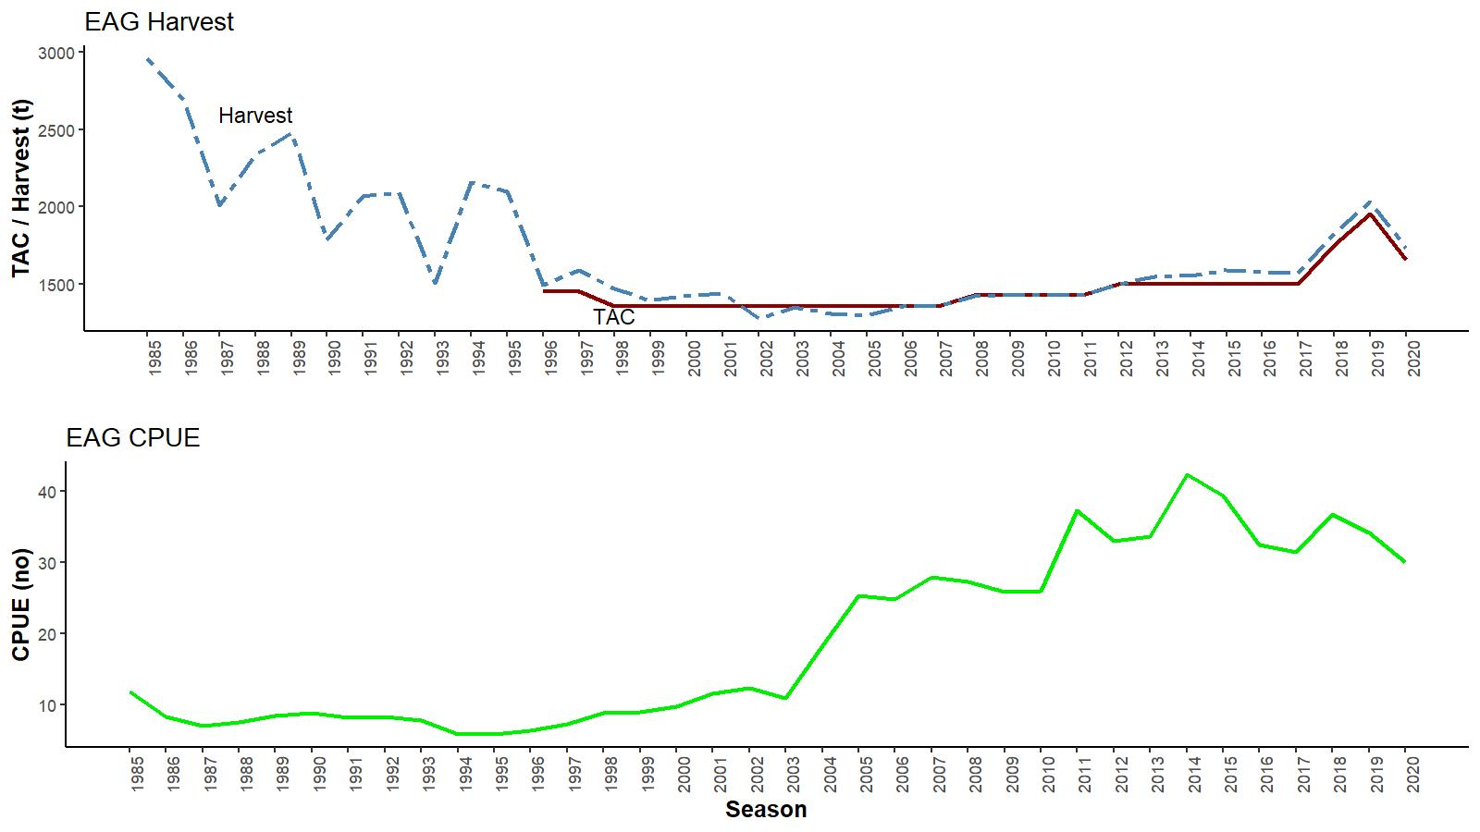
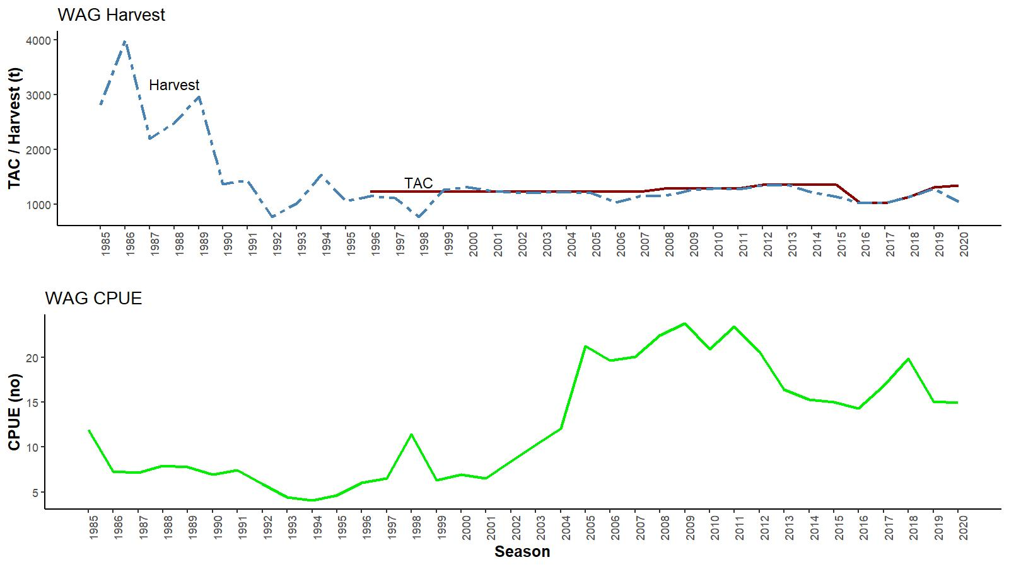
EAG
Catch (t) and CPUE
(number of crab per pot lift), 1985/86–2020/21
WAG
TACs :
2020/21:
(1) EAG: 3.650 million lbs
(2) WAG: 2.960 million lbs
*As of March 26, 2021, WAG fishery is ongoing (77%TAC harvested)

Slide 3
Topics
Responses to January 2021 CPT and February 20021 SSC comments
Methods:
- CPUE standardization
- Model choices
Results:
- CPUE standardization & diagnostics
- Model results & diagnostics
- Model recommendation, OFL, and ABC

Slide 4
Length based modeling approach
Integrated male-only length-based models fitted to fishery dependent catch, CPUE, and tagging data.
Constant M of 0.21yr⁻¹.
Projected the abundance from unfished equilibrium in 1960 to initialize the 1985 abundance.
4 main and 6 modified models for EAG and WAG.
Knife-edge maturity size of 111 mm CL for main models’ MMB calculation. Modified models have 116 mm CL maturity size/maturity curve.
Francis re-weighting method for Stage-2 effective sample sizes calculation for all models.

Slide 5
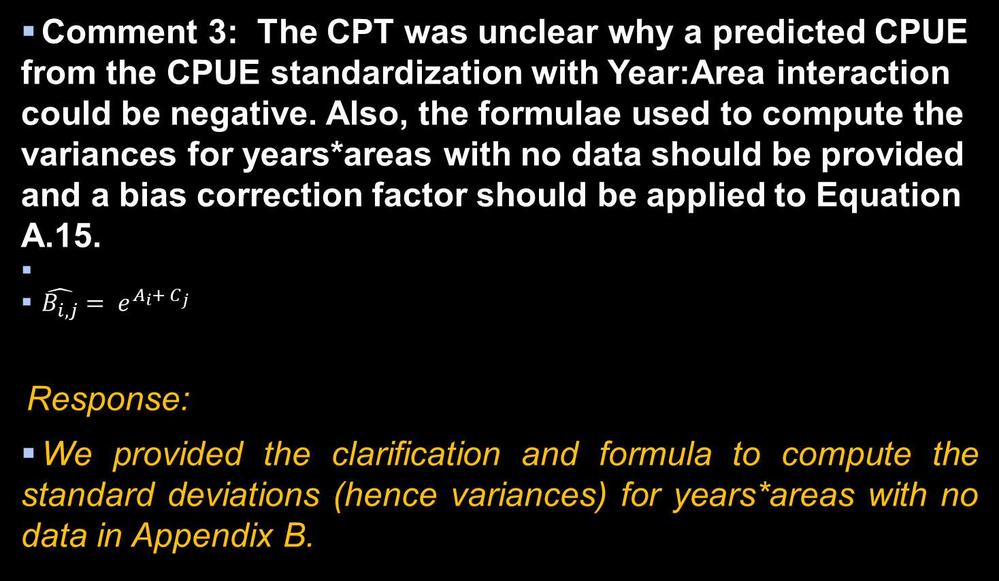
January 2021 CPT (selected) comments
Comment 3: The CPT was unclear why a predicted CPUE from the CPUE standardization with Year:Area interaction could be negative. Also, the formulae used to compute the variances for years*areas with no data should be provided and a bias correction factor should be applied to Equation A.15.
$\hat{B_{i, j}}= e^{A_{i}+ C_{j}}$
Response:
We provided the clarification and formula to compute the standard deviations (hence variances) for years*areas with no data in Appendix B.

Slide 6
January 2021 CPT comments continued
Comment 4: The analysts should consider a range of alternative standardization models for the EAG cooperative survey data (including that suggested by the SSC) and provide a rationale (including model fit, whether the analysis converged, etc.) for the selected model.
Response:
We provided a few alternative standardization models for EAG cooperative survey data and provided the rationale for the selected model in Appendix C. The limitations on time series of data and factor levels (for example, only a maximum of three vessels operate in EAG) prevent us exploring variants of the simple random slope model.

Slide 7
January 2021 CPT comments continued
Comment 6: Model results should be presented only for the best fit (lowest objective function). If a best fit model exhibits unusual features (e.g., outlying F estimates or parameters on bounds), this can often be rectified by implementing bounds or smoothing penalties on some of the parameters.
Response:
We detected some errors in input observer and fish ticket size measurement data for 2016–2019 and rectified them for current runs. This surprisingly eliminated multiple minima issues found earlier when jittering WAG parameter estimates.

Slide 8
January 2021 CPT comments continued
Comment 7: The runs used to create the retrospective plots should be checked as one run (1993 for WAG) appears to be a case where the minimizer has failed to converge.
Response:
The minimizer did not fail in the retrospective run. The 1993 MMB jump was the result of an increase in total catch removal in the model (Figure CPT2):

Slide 9
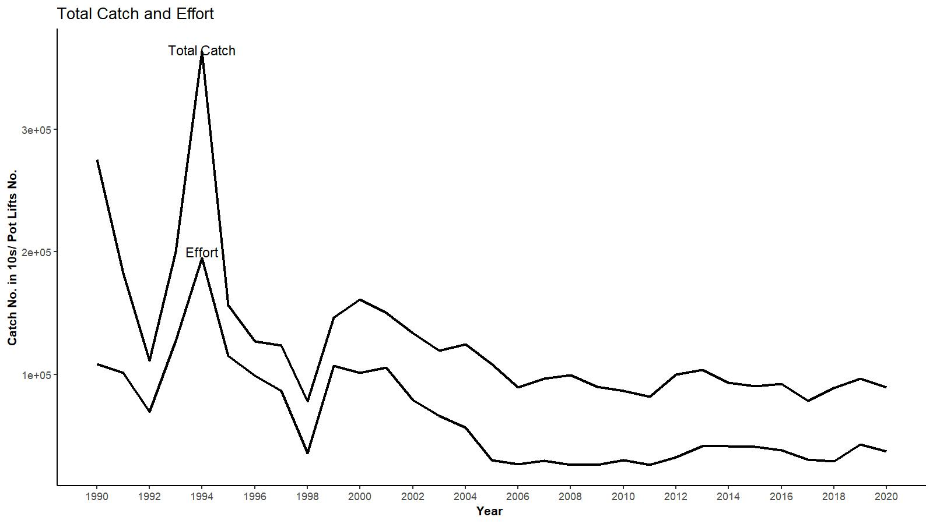
Figure CPT2. Estimated total catch (in 10s of crab) to the model size range (101 to 185+ mm CL) and effort (pot lifts) by year in WAG.

Slide 10
January 2021 CPT comments continued
Comment 8: Additional suggestions related to presentation:
c. Provide a figure that shows the size composition data for the fleet with time-varying selectivity in a vertical manner (e.g., Figure 12 in the snow crab assessment) to see changes in the data over time. This can be done using the R package ggridges.
Response: done (Figures 9 to 11 for EAG and 27 to 29 for WAG in the main text).
d. Additionally, a plot that shows the fits to the aggregate size-composition data would be useful.
Response: done (Figure CPT4). Cumulative size compositions of retained catch fitted well for all models but total catch fits slightly differ:

Slide 11
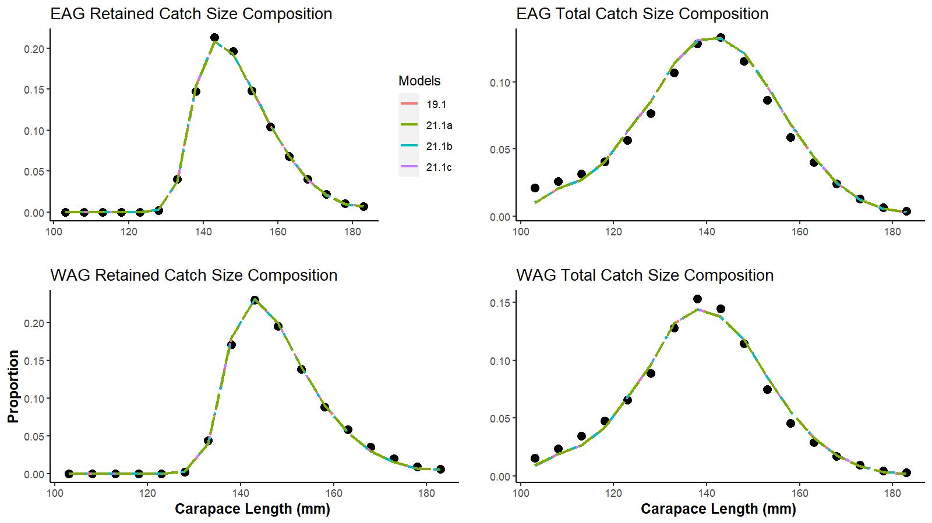
Figure CPT4. Cumulative size compositions vs. CL for retained catch (left panels) and total catch (right panels) for EAG (top) and WAG (bottom). Observed proportions are marked by solid circles and predicted proportions by different models’ (19.1, 21.1a, 21.1b, and 21.1c) are shown by different colored lines.

Slide 12
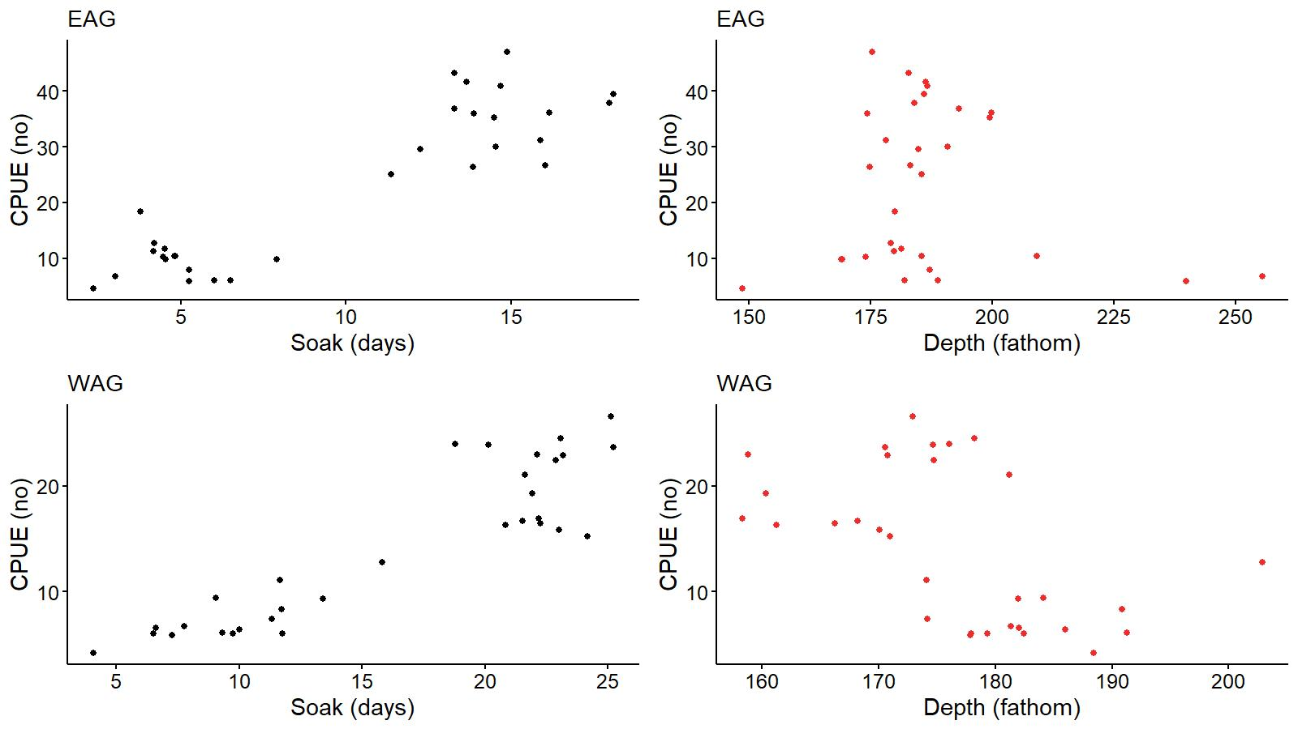
Comment 8: Additional suggestions related to presentation:
f. Also plot the data on CPUE vs. depth and CPUE vs. soak time to allow the underlying patterns to be identified.
Figure CPT5. Annual observer nominal legal male CPUE vs annual mean soak time and annual mean depth in EAG (top) and WAG (bottom).

Slide 13
Response to one of June 2020 SSC comments:
Comment 4: The SSC recommends that, if this approach [i.e., 0.7 Sigma approach] were used, the CV would be a better choice. This is because the standard deviations of high recruitments with the same CV might be higher than a cutoff and would result in reference points that are biased lower. The SSC also recommends exploring choosing a reasonable lag from the current year that would include most crabs that have recruited into the fishery. For example, if most crabs are observed by age 6, the 2020 assessment would use recruitments from 1987–2014, and the 2021 assessment would use 1987–2015, and so on.
Response:
1: CV provided mixed results for choosing an appropriate year range for different levels of CV (e.g., CV 100%: 1985–2011; CV 125%: 1984–2013; and CV 150%: 1984–2016). Furthermore, years in the selected ranges were non-contiguous. We provide the case for 150% CV cutoff level in Figure SSC1.
2: The fixed period 1987–2012 for mean number of recruit calculation used in the base model 19.1 considers an 8-year time lag from the terminal year, which appears to be the recruitment age for golden king crab. However, it is necessary to locate cut off points on both ends of the time range to choose an appropriate fixed period for mean recruit calculation. The method used in our selection process takes care of this.
.

Slide 14
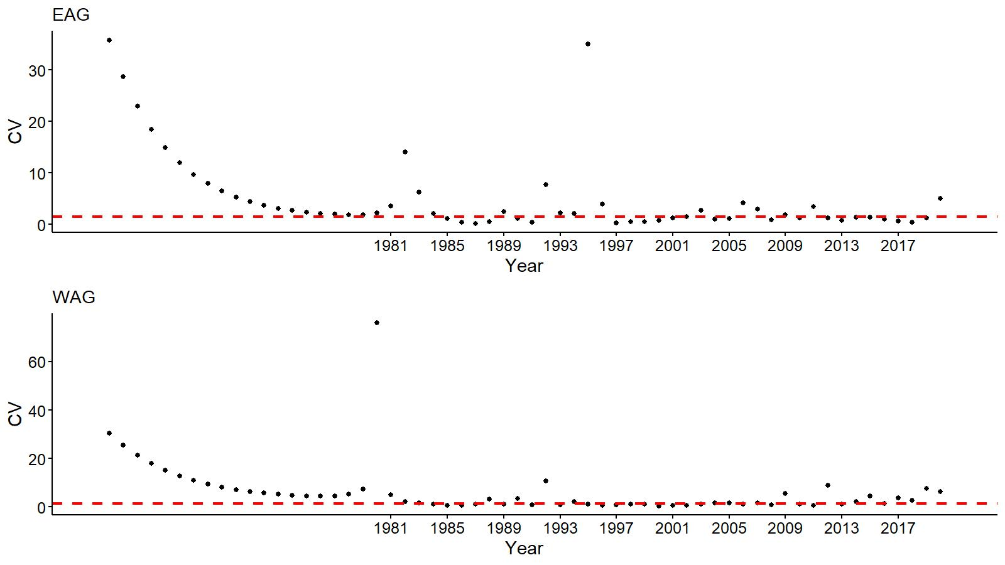
Figure SSC1. Coefficient of variation (CV) of recruit_dev vs. year for EAG (top) and WAG (bottom) for model 21.1a. A 150% CV cutoff (red) horizontal line is overlayed on each scatter plot.

Slide 15
February 2021 SSC (selected) comments
Comment 1: With respect to Model 21.1b (Same structure and data inputs as M21.1a, but with three-time blocks for selectivity (1960–2004, 2005–2015, and 2016+), the SSC agrees that justification will need to be provided as to why allowing time-varying selectivity based on these time blocks is appropriate, relative to other time-varying parameterizations.
Response:
The 1960–2004 block pertains to the pre-rationalization period, which was the feature of all models. In the model 21.1b, the post-rationalization period was divided into two: 2005–2015 and 2016+, to create two selectivity blocks based on observed different fishing patterns (reduced proportions in large size groups in Figure SSC2).

Slide 16
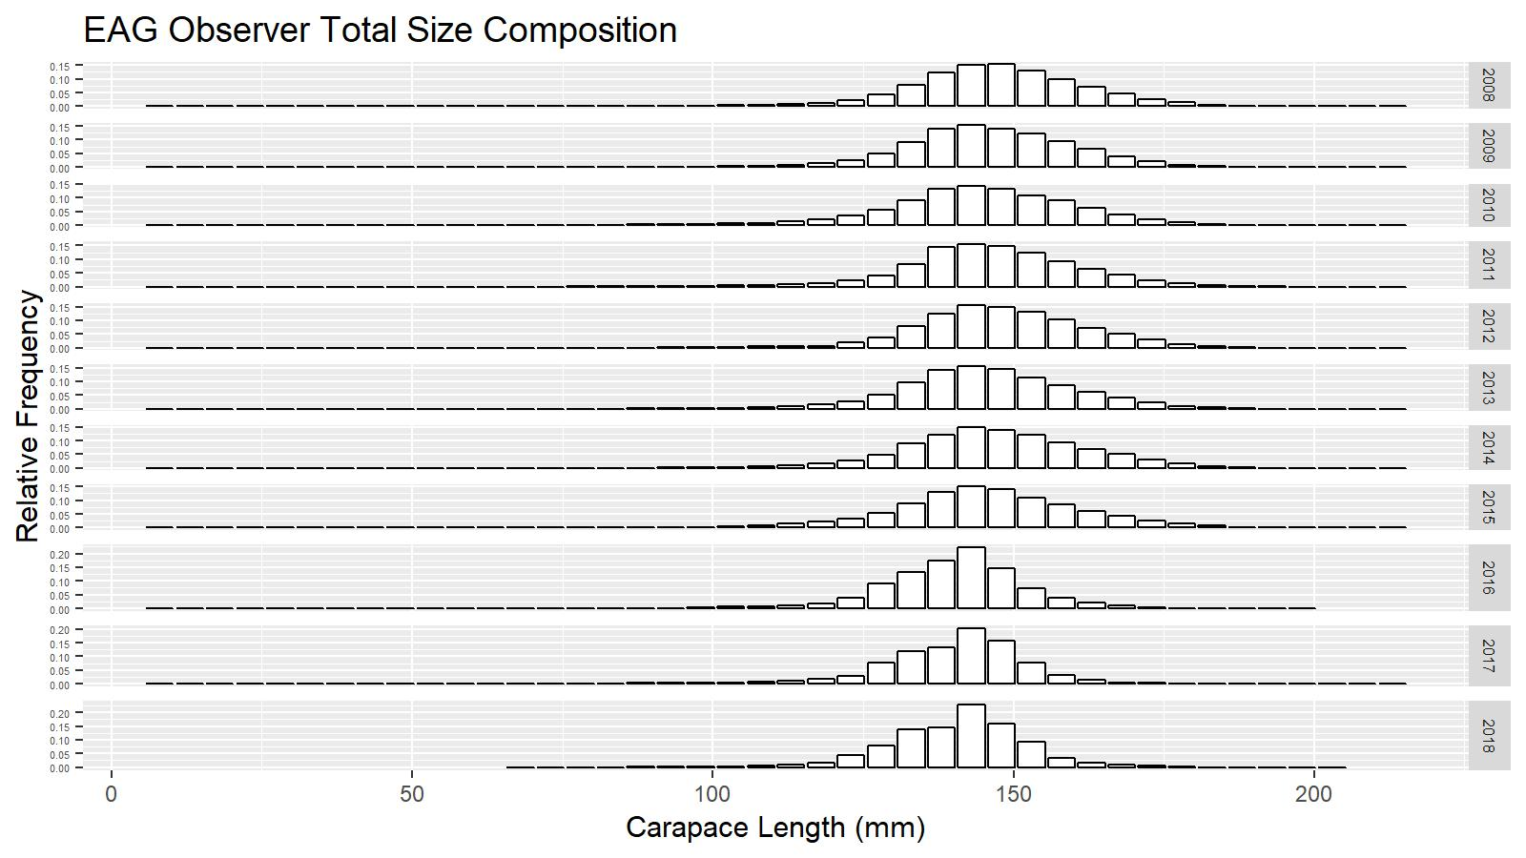
Figure SSC2. Observer total size composition for 2008–2018 in the EAG.

Slide 17
February 2021 SSC comments continued
Comment 4: The SSC would also like to reiterate its support for several previous suggestions:
1. Exploration of a single-area model, or possibly a two-area model with larval connectivity, for the AIGKC crab stock.
Response:
We modelled EAG and WAG stocks separately for several reasons:
(a) Fishery catch data (e.g., CPUE magnitude and CPUE temporal trends) suggest that the productivity is different between the two areas.

Slide 18
February 2021 SSC comments continued
(b) WAG has wider area of stock distribution compared to limited area distribution in EAG.
(c) The fishing areas are spatially separated with an area gap between EAG and WAG (Figure 8 in the main text). Regions of low fishery catch suggest that availability of suitable habitat may vary longitudinally.
(d) Tagging studies have shown little mixing between the two areas.
(e) Unlike other king crabs, golden king crab females carry large, yolk-rich, eggs, which hatch into lecithotrophic (non-feeding) larvae that do not require a pelagic distribution for encountering food items. Depth at larval release, the lecithotrophic nature of larvae, and swimming inactivity in lab studies implies benthic distributions, which may limit larval drift between areas, if horizontal current velocities are reduced at depth.

Slide 19
February 2021 SSC comments continued
(f) Integrating contrasting data in one single model may provide parameter estimates in between the two extremes which would not be applicable to either (Richards 1991; Schnute and Hilborn 1993).
(g) Area specific assessment is superior to a holistic approach for this stock because of patchy nature of golden king crab distribution.
(h) Alaska Board of Fisheries decided to manage the two areas with separate total allowable catches.
(i) Genetic analysis shows no significant differentiation between areas within the Aleutian Island population (Grant and Siddon 2018), thus there is no genetic support for subdividing this population; however, above listed factors support separate stock assessments in the two regions.

Slide 20
February 2021 SSC comments continued
b. Evaluation of whether catches of AIGKC caught in the NMFS Aleutian Island trawl survey could be utilized as an additional index of abundance.
Response: We have not looked at the NMFS trawl data for AIGKC catches. We will explore any feasibility of including AIGKC caught in the NMFS Aleutian Island trawl survey as an additional index of abundance in the future.

Slide 21
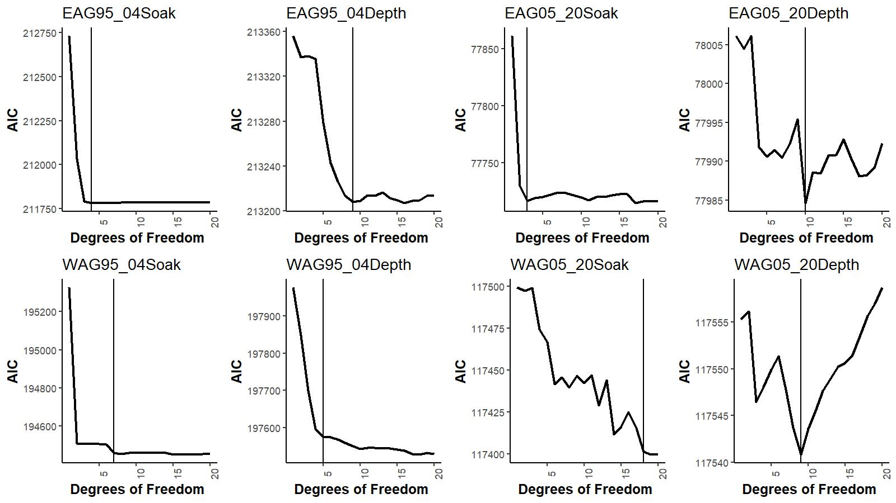
a. Observer CPUE index by non-interaction GLM model.
Figure B.1. AIC vs degrees of freedom for soak time and depth during pre- and post-rationalization periods for EAG (top) and WAG (bottom). Vertical lines identify the optimum degrees of freedom values chosen for CPUE standardization.

Slide 22
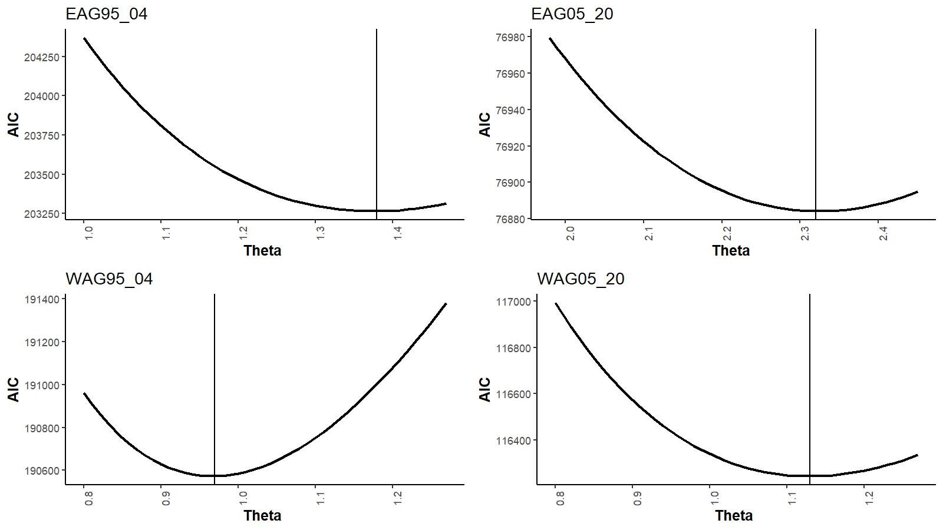
Observer CPUE index by non-interaction GLM model continued
Figure B.2. AIC vs theta (dispersion parameter) during pre- and post-rationalization periods for EAG (top) and WAG (bottom). Vertical lines identify the optimum theta values chosen for CPUE standardization.

Slide 23
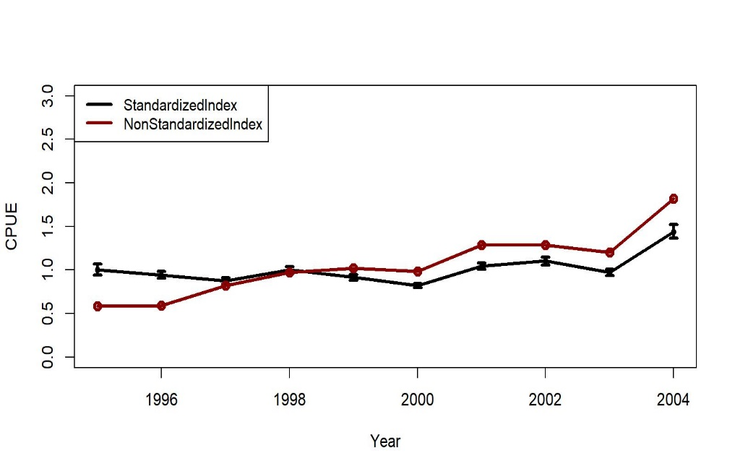
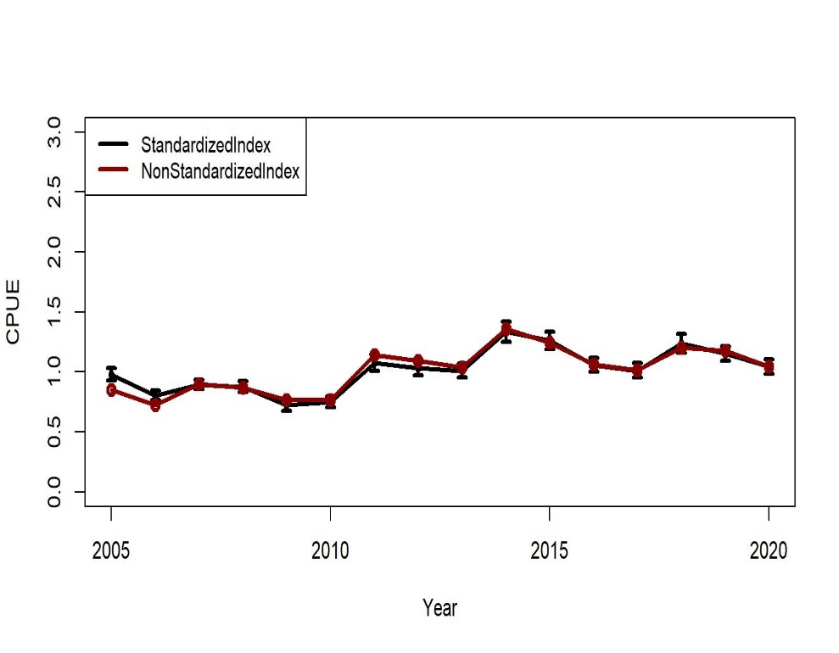
Trends in non-standardized and standardized CPUE indices with +/- 2 SE by GLM for EAG. Standardized indices: black line and non-standardized indices: red line.
1995/96 – 2004/05
2005/06 – 2020/21
Ln(CPUE) = Year + Captain+ Gear + ns(Soak, df=4) + Month,
family = NB (θ = 1.38)
Ln(CPUE) = Year + Captain + Gear + ns(Soak, df=3)
family = NB (θ = 2.32)

Slide 24
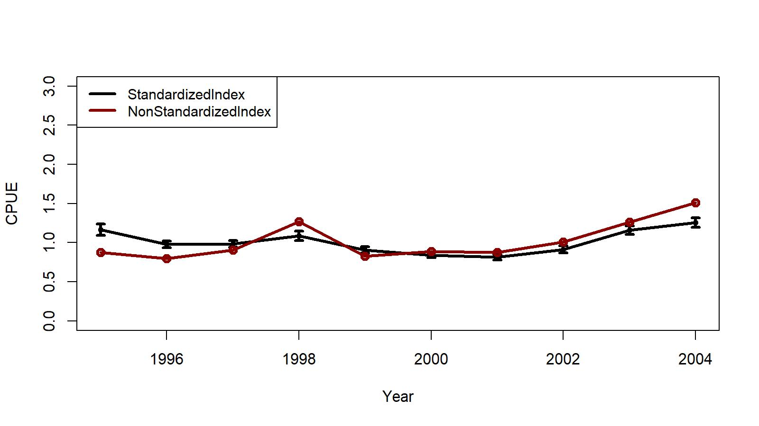
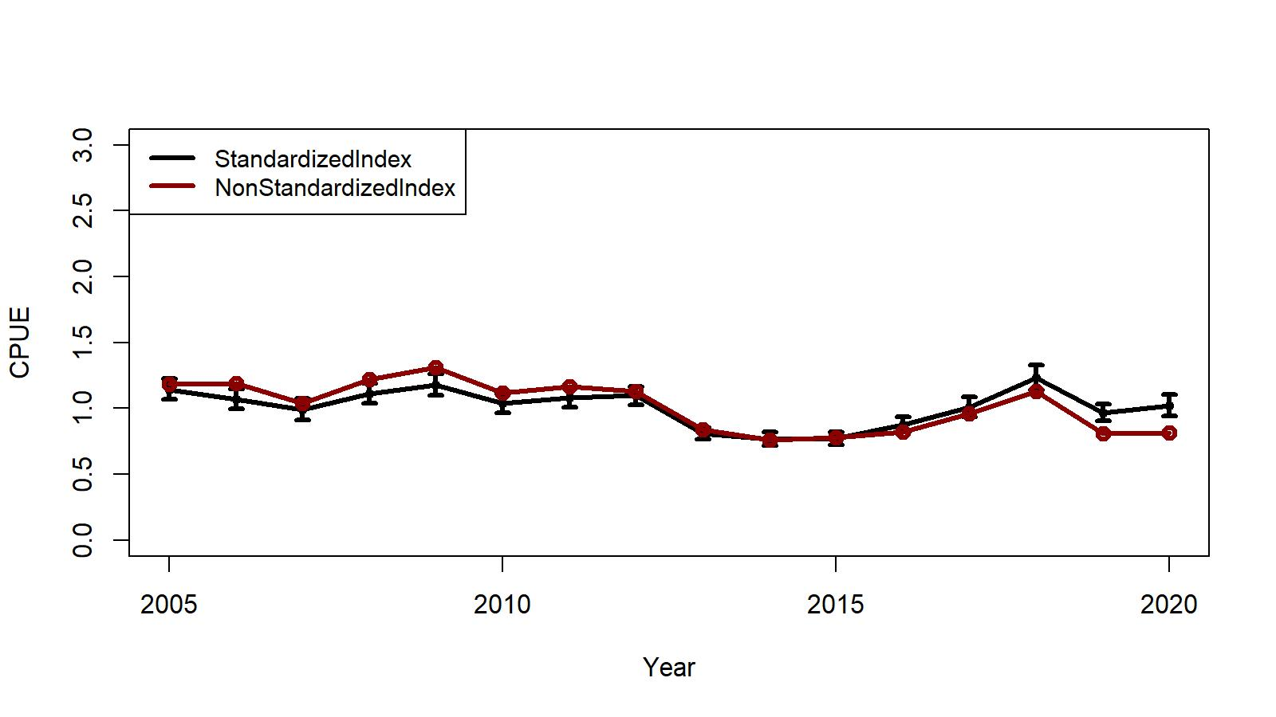
Trends in non-standardized and standardized CPUE indices with +/- 2 SE by GLM for WAG. Standardized indices: black line and non-standardized indices: red line.
1995/96 – 2004/05
2005/06 – 2020/21
Ln(CPUE) = Year + Captain+ ns(Soak, df=7) + Gear,
family = NB (θ = 0.97)
Ln(CPUE) = Year + Captain + Gear + ns(Soak, df=18)
family = NB (θ = 1.13)

Slide 25
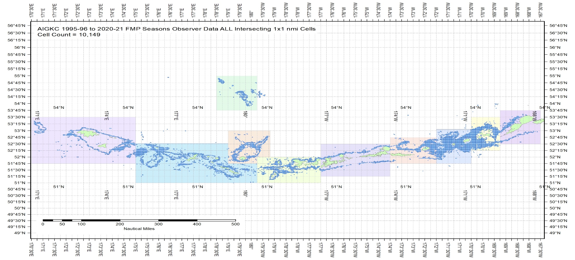
b. CPUE index considering Year:Area interaction GLM model.
Figure B.3. The 1995/96–2020/21 observer pot samples enmeshed in 10 blocks for the Aleutian Islands golden king crab. The blocks were determined from visually exploring each year’s pot distribution locations. The blocks contain observed patches of crab distribution during this period.

Slide 26
Table B.2. Sum of ever fished number of grids for each block. Blocks 1–4 belong to EAG and 5–10 to WAG.
Ever Fished:
AIGKC All Seasons | Block1 | Block2 | Block3 | Block4 | Block5 | Block6 | Block7 | Block8 | Block9 | Block10
1995/96–2020/21 - Sum of 1 nmi x1 nmi cells | 381 | 1402 | 1792 | 917 | 459 | 1028 | 796 | 2012 | 1021 | 334

Slide 27

Observer CPUE index by the Year:Area interaction GLM: Final model for EAG (CPUE index for assessment model 21.1c)
Final selection by stepCPUE:
$\ln\left(CPUE\right)= Gear+Captain+ns\left(Soak, 4\right)+Year:Area$ (B.10)
for the 1995/96–2004/05 period [θ=1.38, $R^{2}=0.2235$]
$\ln\left(CPUE\right)= Vessel+Gear+ns\left(Soak, 3\right)+Year:Area$ (B.11)
for the 2005/06–2020/21 period [$=2.32, R^{2}=0.1169$].

Slide 28

Observer CPUE index by the Year:Area interaction GLM: Final model for WAG (CPUE index for assessment model 21.1c)
$\ln\left(CPUE\right)= Vessel+ns\left(Soak, 7\right)+Gear+Year:Area$ (B.12)
for the 1995/96–2004/05 period [θ=0.97, $R^{2}=0.1719$]
$\ln\left(CPUE\right)=Gear+Year:Area+ns(Soak,18)$ (B.13)
for the 2005/06–2020/21 period [$=1.13, R^{2}=0.0818, Soak forced in$].

Slide 29

Block-scale analysis:
${CPUE}_{ij}= e^{{YB}_{ij}+ σ_{ij}^{2}/2}$ (B.14)
$B_{ij}= N_{ever, j }{CPUE}_{ij}$ (B.15)
Filled the $B_{ij}$ index gaps by fitting $\ln\left({\hat{B}}_{i, j}\right)= A_{i}+ C_{j}$ (B.16)
where $B_{i, j}$is the index of biomass for year i and block j, A_{i} is a year factor, and C_{j} is a block factor.
R code for model prediction:
library(MASS)
glm.fit<- glm(log(B_{ij})~Year_{i} + Block_{j}, data=Bindex)
where “Bindex” contains available B_{ij},Year_{i}, and Block_{j} column values.
To predict the missing biomass index Y:
Y<- predict.glm (glm.fit, BindexFillpredict, se.fit=TRUE)
where the new data frame “BindexFillpredict” contains Year_{i} and Block_{j} column values for which B_{ij} indices are needed and contains an empty B_{ij} column for fill in.
Bias correction was made to each predicted biomass index by $B_{i, j}= e^{{\hat{Y}}_{i, j}+ σ_{ij}^{2}/2}$

Slide 30

Block-scale analysis:
The standard error for each year and area combination:
Let covariance matrix of the fitted “glm.fit” be Σ and
Coefficients for linear combination of a set of predictors in a vector form as C,
the standard error of prediction for that combination is $\sqrt{C′ΣC}$ , where $C′$ is the transpose of vector $C$.
Annual biomass index,$B_{i}$,
$B_{i}= \sum_{j}{B_{ij}}$ (B.17)
$Var \left(B_{i}\right)= \sum_{j}{{N_{ever, j}}^{2} var({CPUE}_{i, j})}$ (B.18)
Rescaled the $B_{i}$ indices by the geometric mean of $B_{i}$as CPUE_{i} index.
Standard error of CPUE_{i}
$\sqrt{\frac{Var(B_{i})}{{\left(B_{i}\right)}^{2}}}$ (B.19)

Slide 31
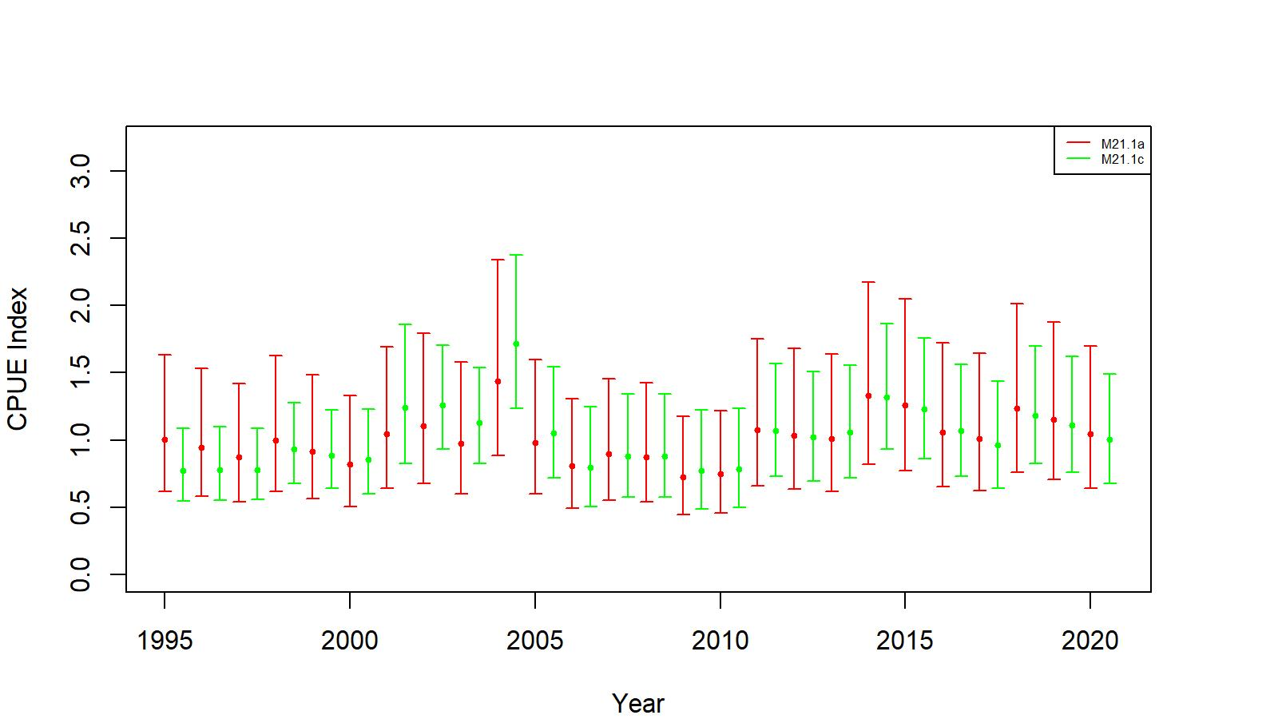
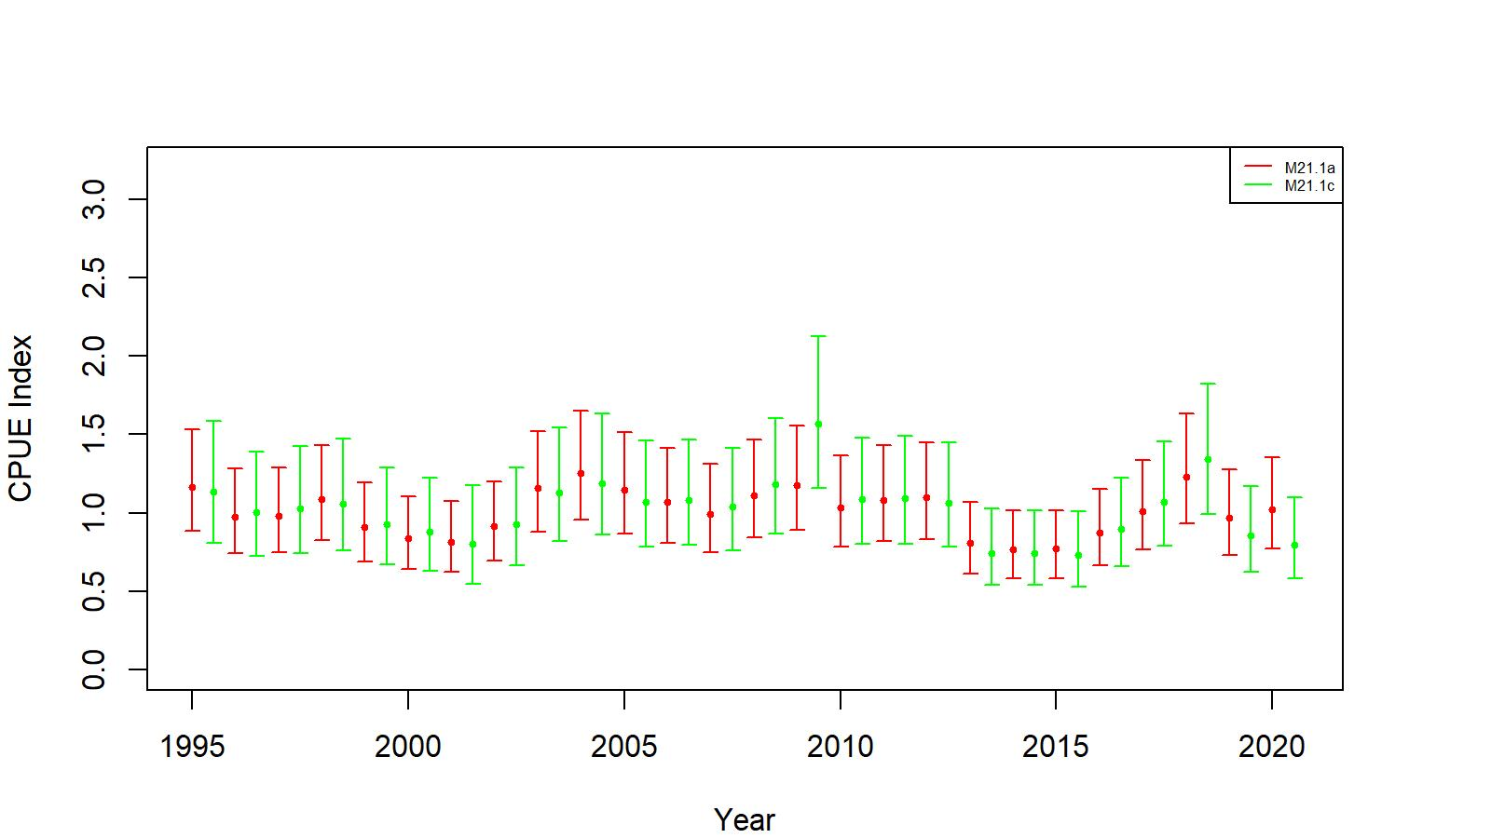
Comparison of observer CPUE indices between no interaction and Year:Area interaction GLM fits. left: EAG, right: WAG
Comparison of standardized CPUE indices with +/- 2 SE between no interaction (red line, 21.1a) and Year:Area interaction (green line, 21.1c) models for EAG. Model estimated additional constant variance was included.
Comparison of standardized CPUE indices with +/- 2 SE between no interaction (red line, 21.1a) and Year:Area interaction (green line, 21.1c) models for WAG. Model estimated additional constant variance was included.

Slide 32
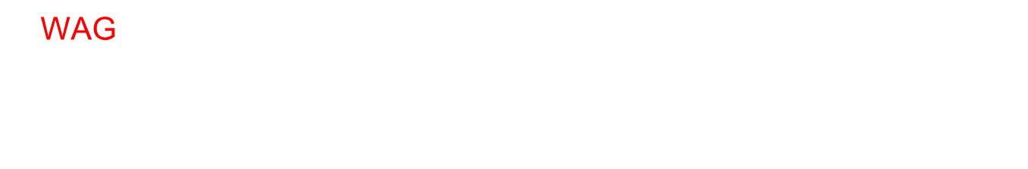
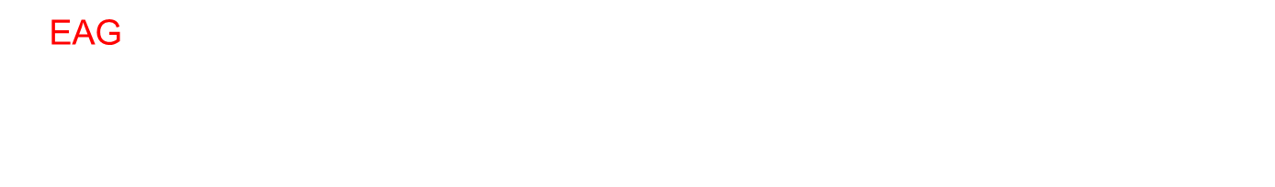
c. Commercial fishery CPUE index by NB GLM:
EAG:
$\ln\left(CPUE\right)= Year+Vessel+Month$ (B.20)
for the 1985/86–1998/99 period [θ=10.40, $R^{2}=0.3327$]
WAG:
$\ln\left(CPUE\right)= Year+Vessel+Area$ (B.21)
for the 1985/86–1998/99 period [θ=6.67, $R^{2}=0.3569$]

Slide 33
Appendix C. Cooperative survey CPUE standardization
27,122 cleaned up records from 2015–2019 surveys.
Created new columns: VesString and VesStringPot
CPUE standardization models:
1. Fixed effects model:
Sum Catch= Y + VesselStringPot + ns(Depth, df=10) + Block + ns(Soak, df=3) (C.1)
family= negative binomial (θ=2.32) , R² = 0.6088 (Soak forced in).
2. Random effects model 1:
Sum Catch = Y + ns(Depth, df=10) +ns(Soak, df=3) + (1|Vessel/VesStringPot)+(1|Block/VesselString) family= negative binomial (θ=2.32) (C.2)
3. Random effects model 2:
Sum Catch = Y + ns(Depth, df=10) + ns(Soak, df=3) + (1|Block/VesselString) (C.3)
family= negative binomial (θ=2.32).

Slide 34
Cooperative survey CPUE standardization continued
Model selection:
1. The random intercept model 1 resulted in a singular fit (i.e., Vessel and VesStringPot:Vessel group variances were (very close to) zero) - rejected.
2. Comparison of the random intercept model 2 (C.3) with that of the fixed effects model (C.1) by the Hausman’s (1978) model selection test resulted in rejecting the null hypothesis that random effect model is consistent with the data (Chi Square = 1124.4, df = 18, p < 2.2e⁻¹⁶). However, we based our selection of random effects model 2 on the sampling design (i.e., multi-level sampling) implemented in data collection.

Slide 35
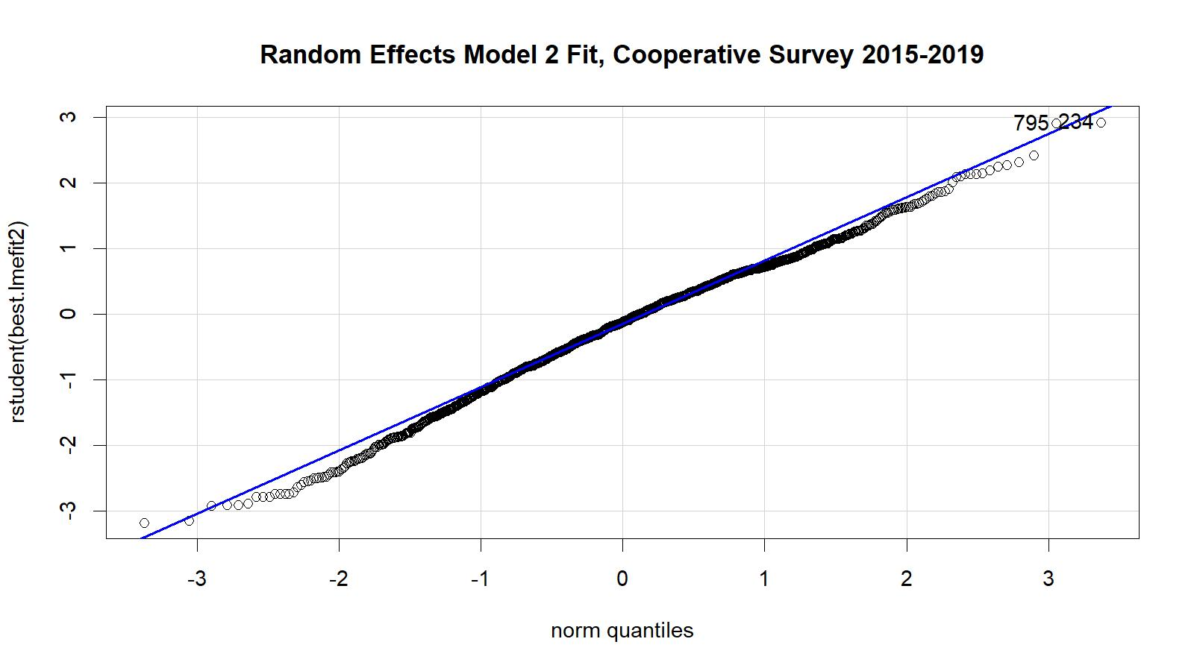
Fig. C4. Studentized residual plot for the mixed random effects model fit. The 2015–2019 EAG data were used.

Slide 36

Cooperative survey CPUE indices
Bias corrected predicted yearly CPUE,
$${CPUE}_{i}= e^{Mean\left(ln(predicted {CPUE}_{i})\right)}\left(1+Var[\ln\left(predicted {CPUE}_{i}\right)]/2\right)$$
We standardized the ${CPUE}_{i}$ by the geometric mean of ${CPUE}_{i}$ over 2015-19 to obtain annual CPUE indices for input to assessment models.
95% confidence intervals of ${CPUE}_{i}$ were estimated as
$$\left(standardized {CPUE}_{i}∗ e^{−2∗\sqrt{Var\left[\ln\left(predicted {CPUE}_{i}\right)]/n\right]}}, standardized {CPUE}_{i}∗ e^{+2∗\sqrt{Var\left[\ln\left(predicted {CPUE}_{i}\right)]/n\right]}}\right)$$
where n is the number of predicted CPUEs in a year.

Slide 37
Table C.3. The cooperative survey expected legal size male standardized CPUE indices,
standard errors (SE), and lower- and upper- 95% confidence limits, EAG
2015–2019 data.
Year | Predicted CPUE index | SE | Lower Limit | Upper Limit | Sample size
2015 | 1.11164 | 0.02666 | 0.60593 | 2.03943 | 335
2016 | 0.94664 | 0.02656 | 0.51610 | 1.73636 | 304
2017 | 1.10698 | 0.04148 | 0.58576 | 2.09200 | 206
2018 | 1.17588 | 0.03565 | 0.62952 | 2.19642 | 199
2019 | 0.73004 | 0.03749 | 0.38940 | 1.36867 | 289

Slide 38
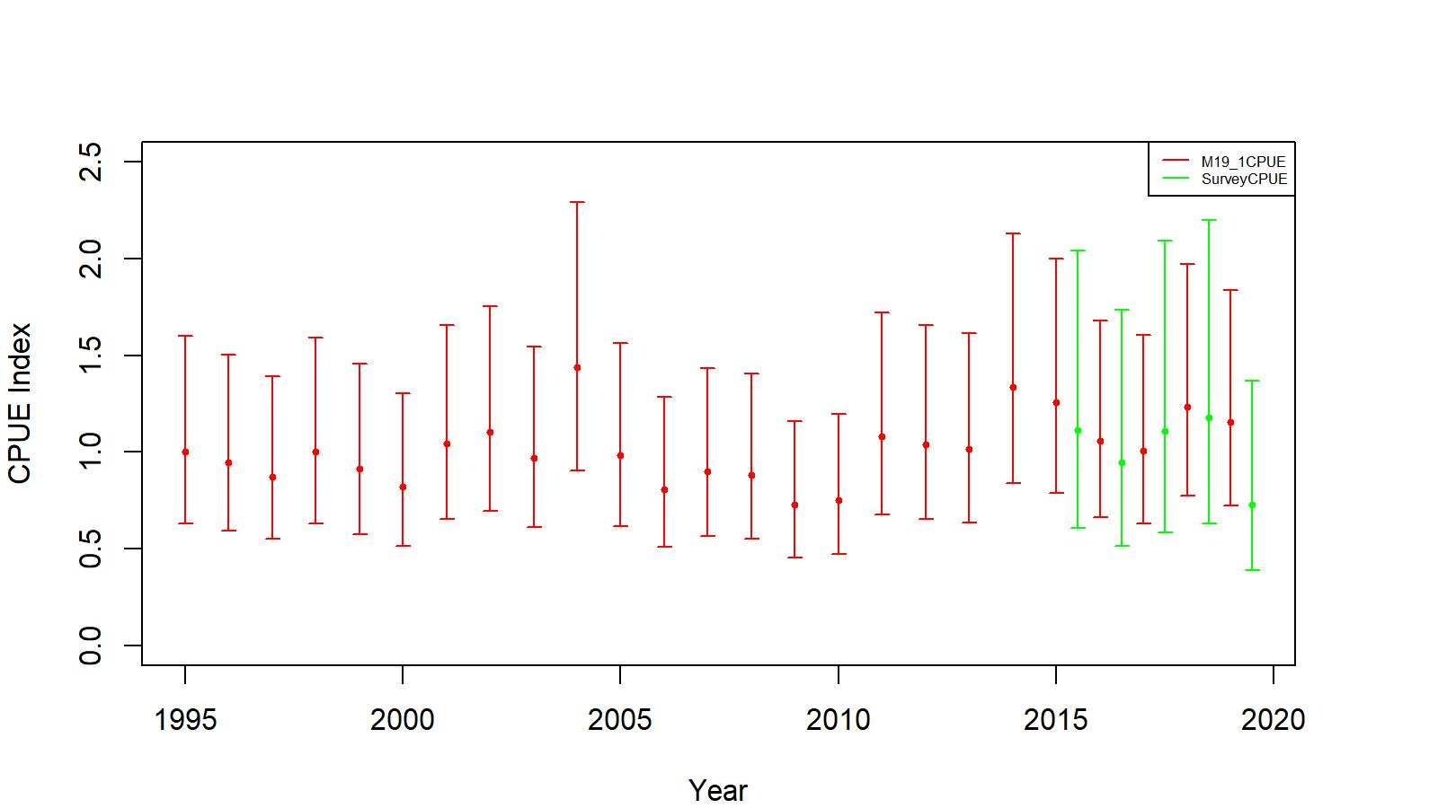
Figure C.5. Comparison of cooperative survey random effects model 2 CPUE indices (green) and observer non interaction factor model CPUE indices (red, 19.1) for EAG. The confidence limits are determined with ±2SE. Model estimated additional standard error was added to SE.

Slide 39
Table T1. Features of all models, EAG and WAG
Model | CPUE Data Type and Maturity Option | Period for Mean Number of Recruit Calculation for (a) Initial Equilibrium Abundance and (b) Reference Points Estimations and Remarks
19.1 (accepted model in May 2019, implemented with up to 2020/21 data) | Observer data from 1995/96–2020/21 Fish ticket data from 1985/86–1998/99; Observer and fish ticket CPUE standardization by negative binomial model; a knife-edge minimum maturity size of 111 mm CL. | 1987–2012; CPT/SSC suggested base model.
21.1a | 19.1+ | 1987–2017; CPT/SSC suggested model.
21.1b | 21.1a+ three total selectivity periods (1960–2004; 2005–2015; 2016+). | CPT/SSC suggested model.
21.1c | 21.1a+ the observer CPUE data standardized including Year:Area interactions. | CPT/SSC suggested model.
21.1a1 | 21.1a+ a knife-edge minimum maturity size of 116 mm CL. | Authors proposed additional model.
21.1a2 | 21.1a+ maturity curve. | Authors proposed additional model.
21.1b1 | 21.1b+ a knife-edge minimum maturity size of 116 mm CL. | Authors proposed additional model.
21.1b2 | 21.1b+ maturity curve. | Authors proposed additional model.
21.1c1 | 21.1c+ a knife-edge minimum maturity size of 116 mm CL. | Authors proposed additional model.
21.1c2 | 21.1c+ maturity curve. | Authors proposed additional model.

Slide 40
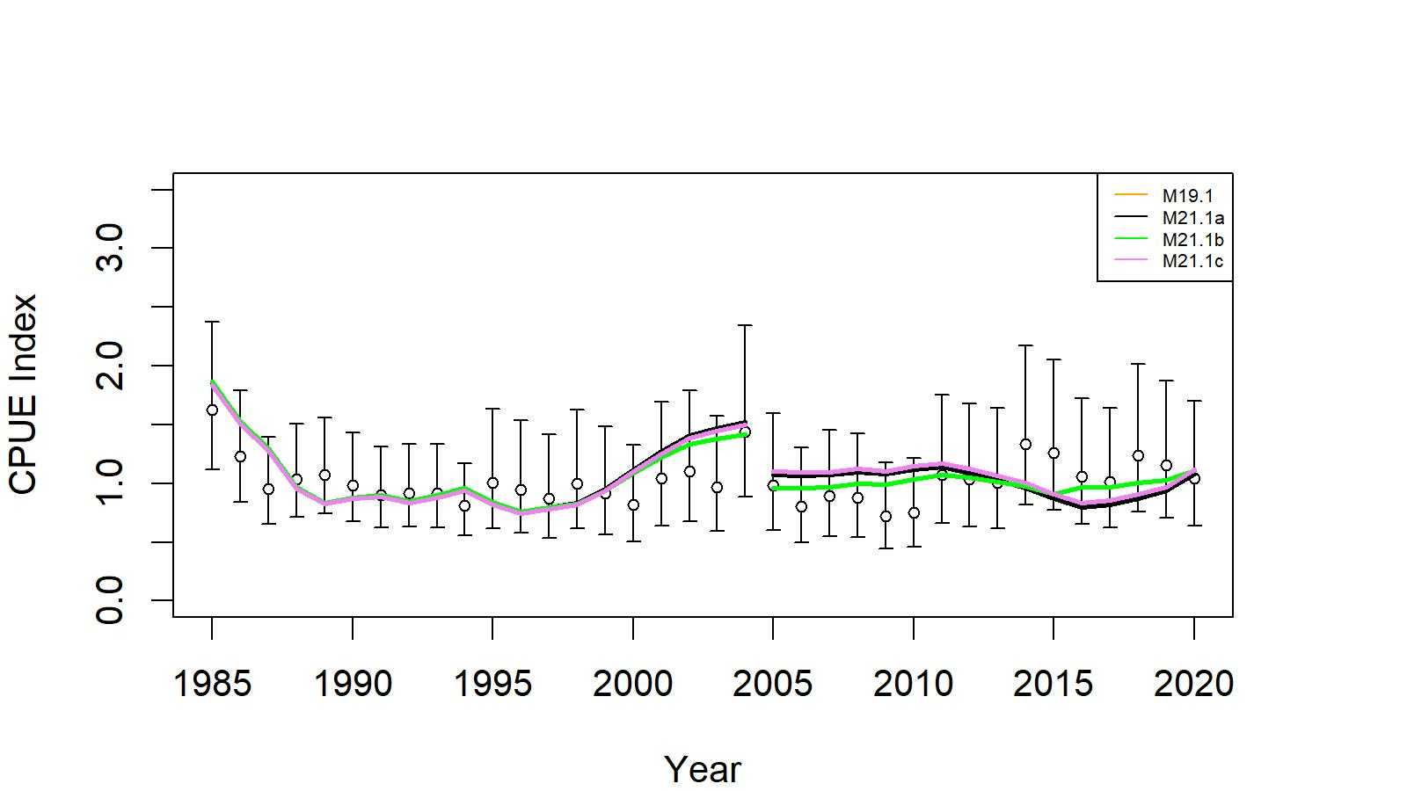
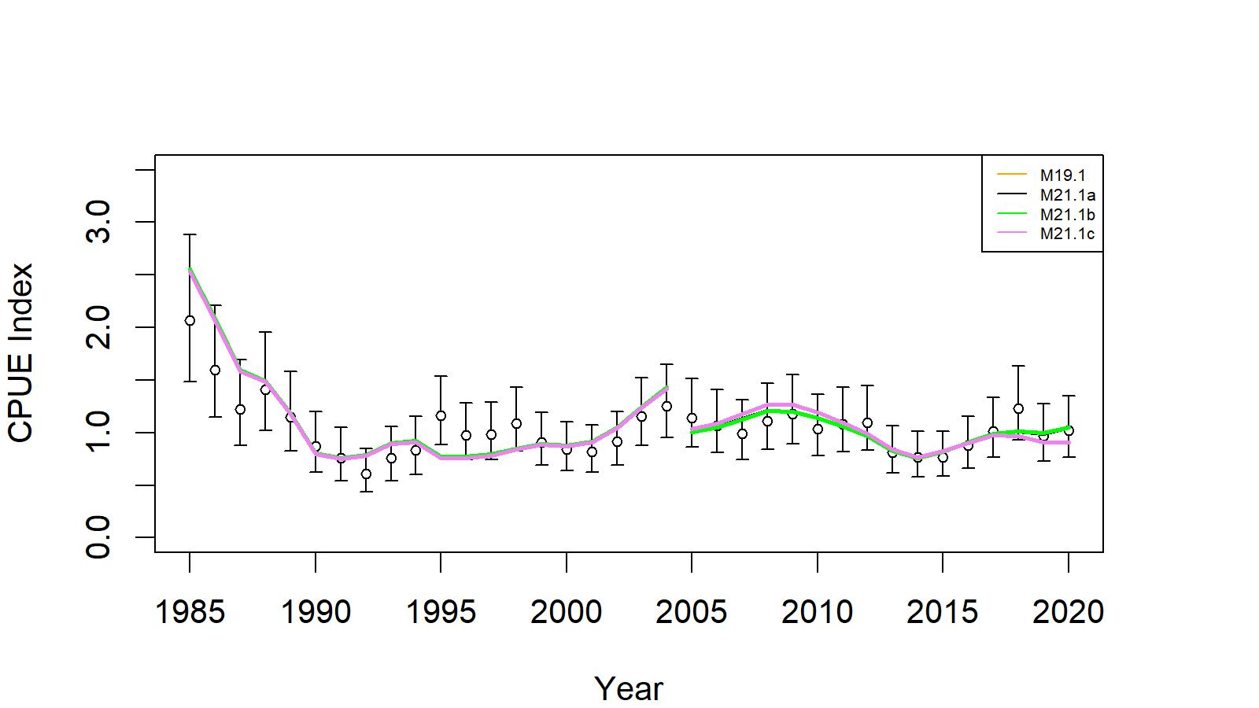
Results
EAG
WAG
Figs. 24 and 41. Comparison of input CPUE indices [with +/- 2 SE for model 19.1 (black circles)] with predicted CPUE indices (colored solid lines) by 19.1, 20.1a, 21.1b, and 21.1c for EAG and WAG, 1985/86–2020/21. Model estimated additional standard error was added to each input standard error.

Slide 41
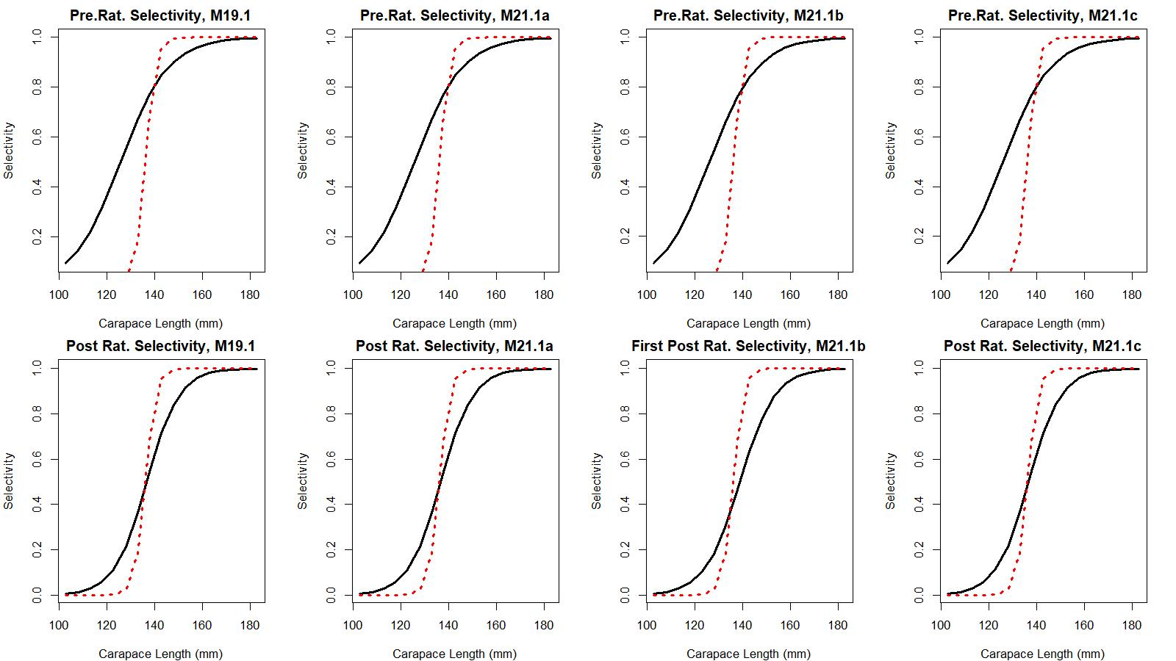
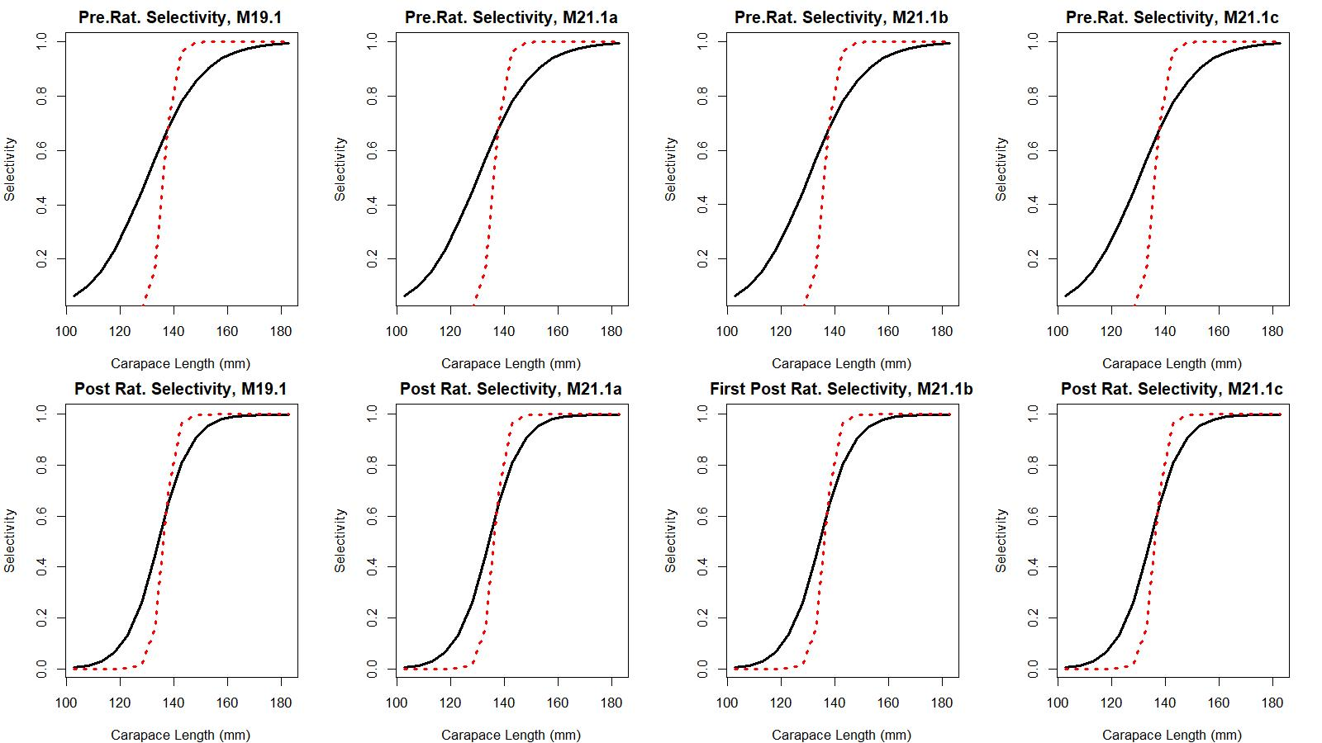
Figs. 12a and 30a. Estimated total (black solid line) and retained selectivity (red dotted line) for pre- and post- rationalization periods for models 19.1, 21.1a, 21.1b, and 21.1c fits to EAG and WAG data.
EAG
WAG

Slide 42
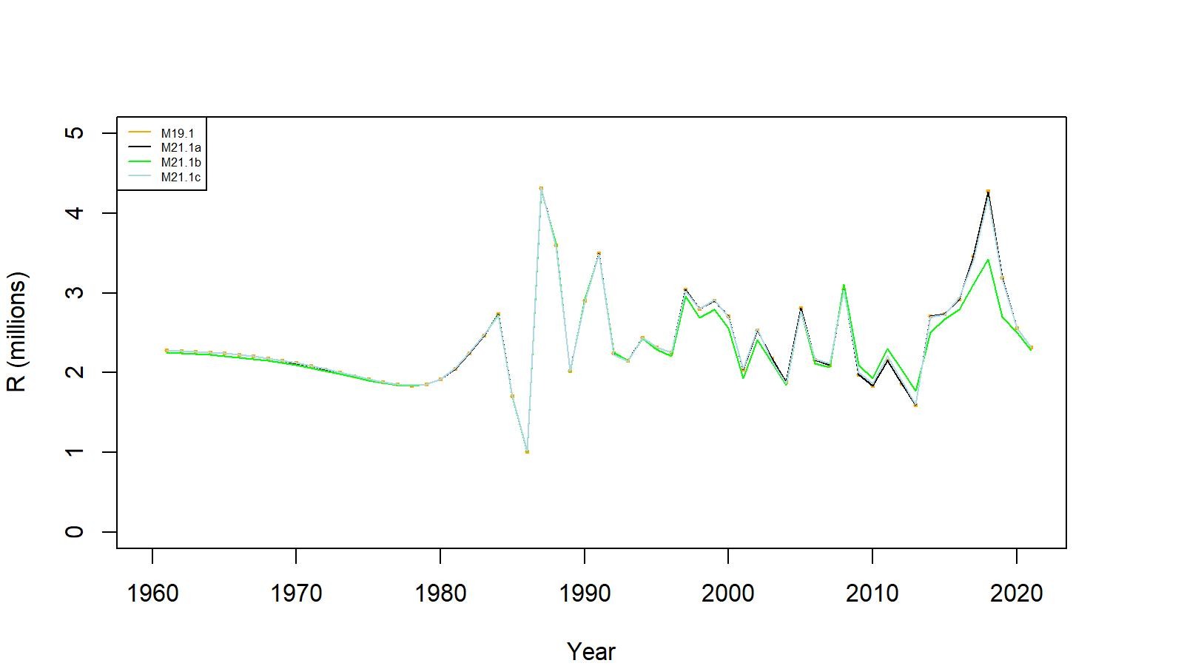
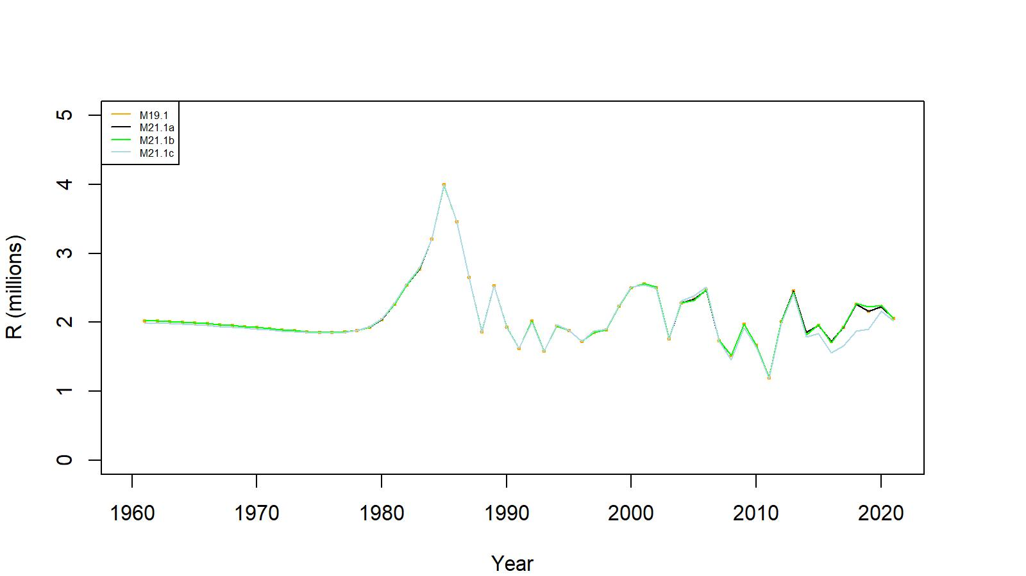
Figs. 14 & 32 . Estimated number of male recruits (crab size ≥ 101 mm CL) for 19.1, 21.1a, 21.1b, and 21.1c model fits to EAG and WAG data, 1961–2021.
EAG
WAG

Slide 43
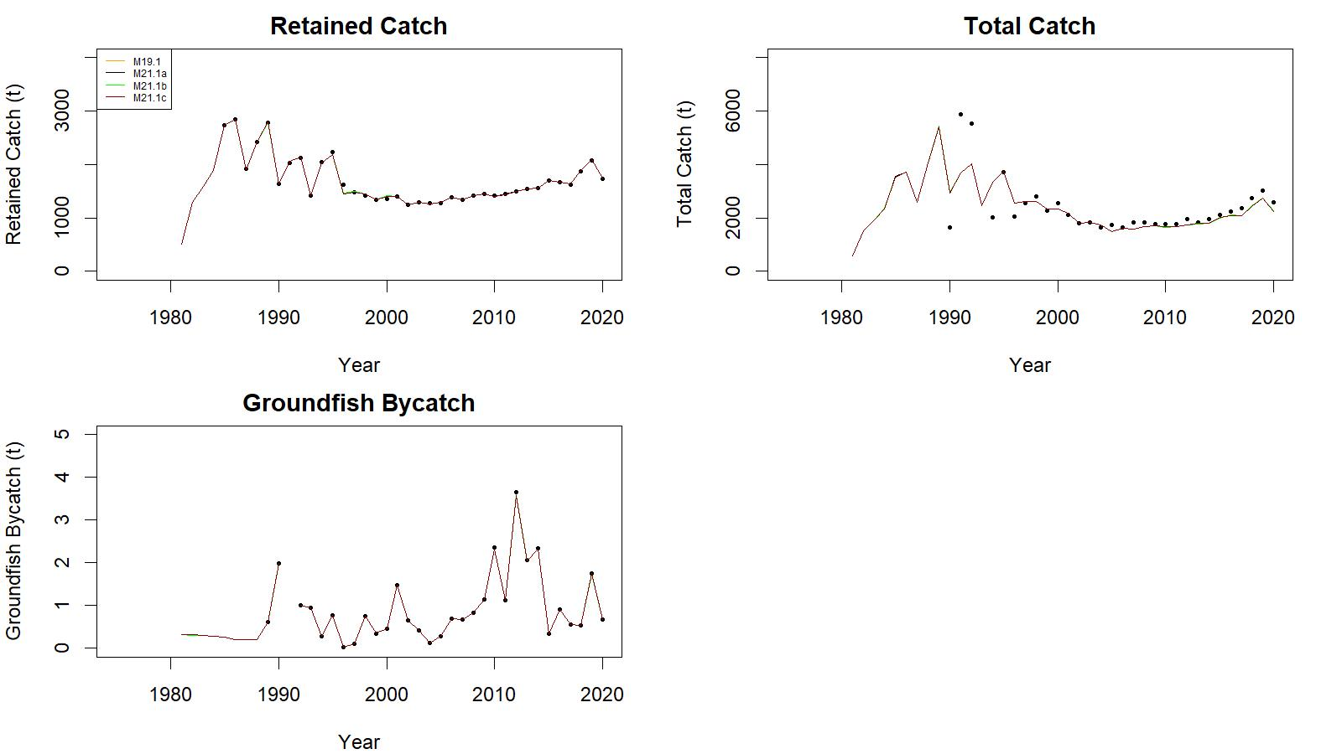
Fig. 17. Observed (open circle) vs. predicted (solid line) retained catch (top left), total catch (top right in), and groundfish bycatch (bottom left) of golden king crab for 19.1, 21.1a, 21.1b, and 21.1c model fits in EAG, 1981/82–2020/21.
.

Slide 44
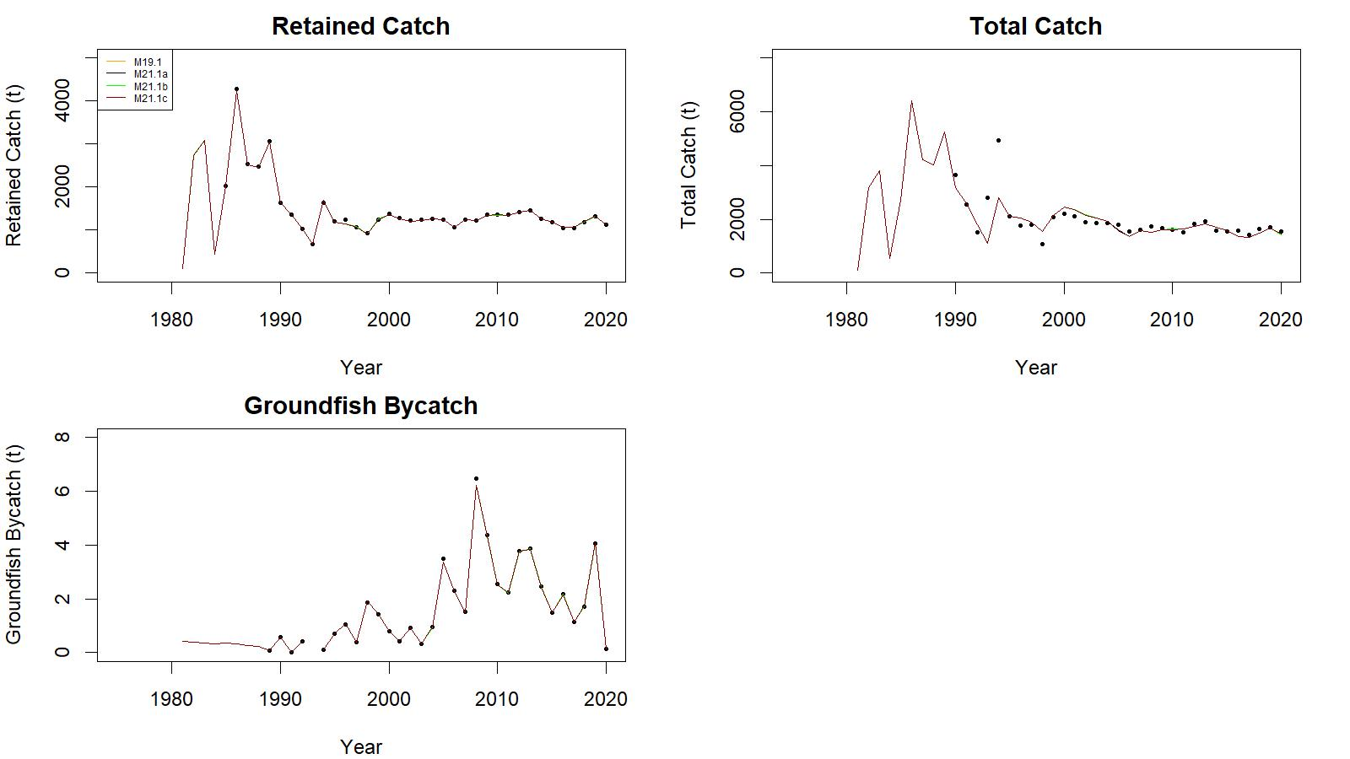
Fig. 35. . Observed (open circle) vs. predicted (solid line) retained catch (top left), total catch (top right in), and groundfish bycatch (bottom left) of golden king crab for 19.1, 21.1a, 21.1b, and 21.1c model fits in WAG, 1981/82–2020/21.
.

Slide 45
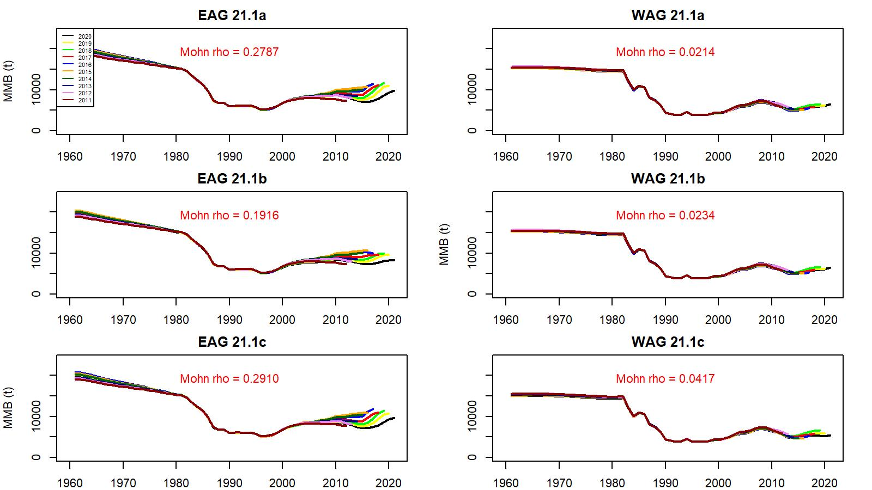
Fig. 23. Retrospective fits of MMB by the model following removal of terminal year data under models 21.1a, 21.1b, and 21.1c for golden king crab in the EAG (left) and WAG (right), 1960/61–2020/21.

Slide 46
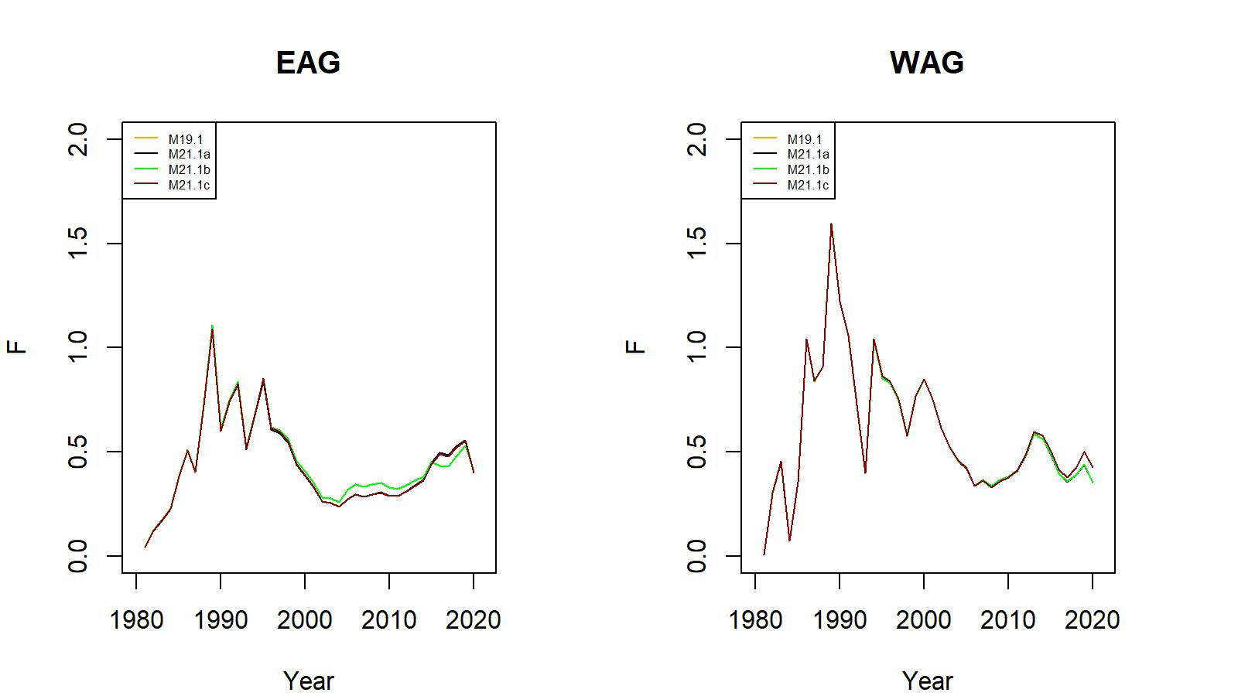
Fig. 25. Trends in pot fishery full selection total fishing mortality for 19.1, 21.1a, 21.1b, and 21.1c model fits to EAG (left) and WAG (right) data, 1981/82–2020/21.

Slide 47
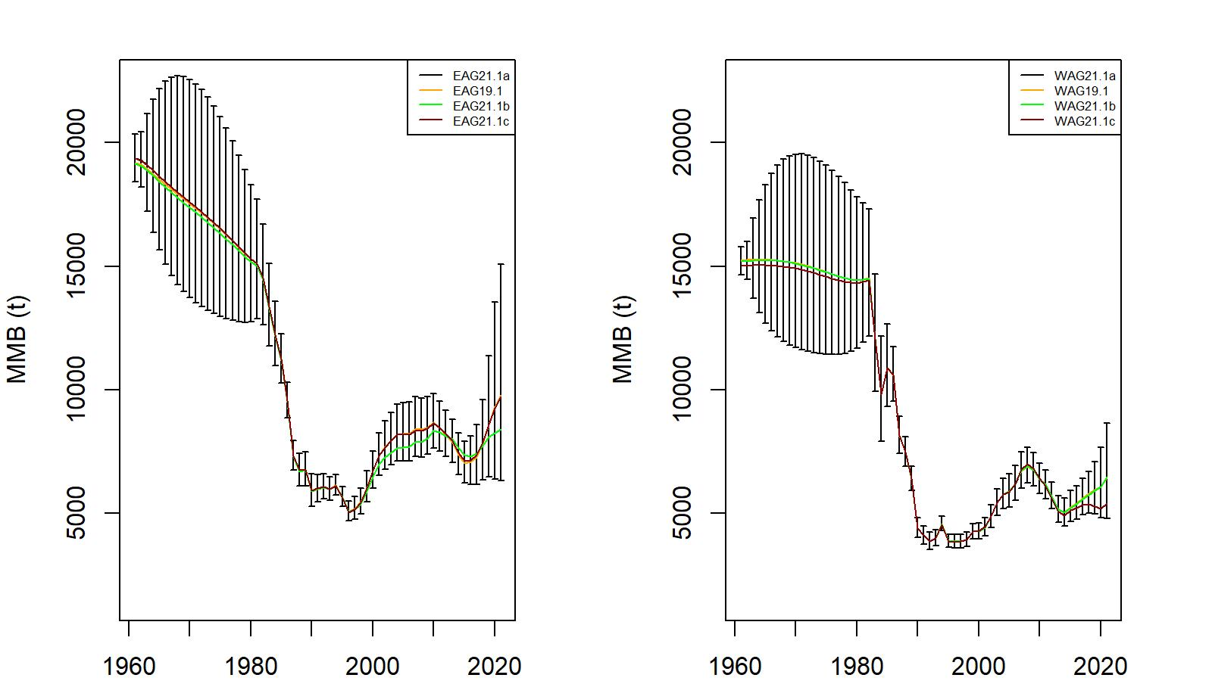
Fig. 26. Trends in golden king crab mature male biomass for 19.1, 21.1a, 21.1b, and 21.1c model fits to EAG (left) and WAG (right) data, 1960/61–2020/21. Model 21.1a estimate has two standard error confidence limits.. Year 2020 refers to 2019/20 fishing season.

Slide 48
Table 12. Negative log-likelihood values of the fits for models 19.1, 21.1a, 21.1b, and 21.1c for golden king crab in the EAG.
Likelihood Component | Model 19.1 | Model 21.1a | Model 21.1b | Model 21.1c | 21.1a-19.1 | 21.1b-19.1 | 21.1c-19.1
Number of free parameters | 152 | 152 | 154 | 152
Retlencomp | -1334.9600 | -1334.9600 | -1325.3100 | -1331.1500 | 0 | 9.65 | 3.81
Totallencomp | -1486.6000 | -1486.6000 | -1481.4000 | -1487.0300 | 0 | 5.2 | -0.43
Observer cpue | 0.1376 | 0.1441 | -6.5913 | -6.3306 | 0.0065 | -6.7289 | -6.4682
RetdcatchB | 7.6797 | 7.6795 | 7.5856 | 7.8838 | -0.0002 | -0.0941 | 0.2041
TotalcatchB | 23.7070 | 23.7071 | 23.5424 | 23.7389 | 0.00010 | -0.1646 | 0.0319
GdiscdcatchB | 0.0003 | 0.0003 | 0.0003 | 0.0003 | 0 | 0 | 0
Rec_dev | 6.8557 | 6.8548 | 5.7315 | 6.6954 | -0.0009 | -1.1242 | -0.1603
Pot F_dev | 0.0128 | 0.0128 | 0.0120 | 0.0128 | 0 | -0.0008 | 0
Gbyc_F_dev | 0.0267 | 0.0267 | 0.0261 | 0.0265 | 0 | -0.0006 | -0.0002
Tag | 2692.6000 | 2692.6000 | 2692.9000 | 2692.5700 | 0 | 0.3 | -0.03
Fishery cpue | -3.5625 | -3.5628 | -3.3106 | -3.2839 | -0.0003 | 0.2519 | 0.2786
RetcatchN | 0.0062 | 0.0062 | 0.0058 | 0.0061 | 0 | -0.0004 | -0.00010
Total | -94.0875 | -94.0851 | -86.8140 | -96.8547 | 0.0024 | 7.2735 | -2.7672

Slide 49
Table 23. Negative log-likelihood values of the fits for models 19.1, 21.1a, 21.1b, and 21.1c for golden king crab in the WAG.
Likelihood Component | Model 19.1 | Model 21.1a | Model 21.1b | Model 21.1c | 21.1a-19.1 | 21.1b-19.1 | 21.1c-19.1
Number of free parameters | 152 | 152 | 154 | 152
Retlencomp | -1300.4500 | -1300.4200 | -1301.3600 | -1301.5800 | 0.03 | -0.91 | -1.13
Totallencomp | -1606.4100 | -1606.4300 | -1607.5300 | -1612.6400 | -0.02 | -1.12 | -6.23
Observer cpue | -14.6181 | -14.6180 | -14.6192 | -10.6439 | 0.00010 | -0.0011 | 3.9742
RetdcatchB | 5.0494 | 5.0493 | 5.0588 | 5.2239 | -0.0001 | 0.0094 | 0.1745
TotalcatchB | 45.3462 | 45.3465 | 45.4377 | 45.4480 | 0.0003 | 0.0915 | 0.1018
GdiscdcatchB | 0.0014 | 0.0014 | 0.0014 | 0.0013 | 0 | 0 | -0.0001
Rec_dev | 4.4273 | 4.4274 | 4.4465 | 4.8170 | 0.00010 | 0.0192 | 0.3897
Pot F_dev | 0.0266 | 0.0266 | 0.0266 | 0.0265 | 0 | 0 | -0.00010
Gbyc_F_dev | 0.0435 | 0.0435 | 0.0435 | 0.0436 | 0 | 0 | 0.0001
Tag | 2694.9900 | 2694.9900 | 2695.0400 | 2695.1300 | 0 | 0.05 | 0.14
Fishery cpue | -5.4124 | -5.4131 | -5.3625 | -5.5391 | -0.0007 | 0.0499 | -0.1267
RetcatchN | 0.0024 | 0.0024 | 0.0024 | 0.0019 | 0 | 0 | -0.0005
Total | -177.0030 | -177.0010 | -178.8120 | -179.7090 | 0.002 | -1.809 | -2.706

Slide 50
Stock status, reference biomass, OFL fishing mortality, OFL (total catch), and ABC for various models for EAG.
Biomass, OFL, and ABC are in 1000t. Current MMB = MMB on 15 Feb. 2022.
EAG:
Model | Tier | MMB_{35%} | Current MMB | MMB/ MMB_{35%} | F_{OFL} | Recruitment Years to Define MMB_{35%} | F_{35%} | OFL | ABC (P*=0.49) | ABC (0.75*OFL)
EAG19.1 | 3a | 6.69585 | 8.72217 | 1.30 | 0.61 | 1987–2012 | 0.61 | 2.935086 | 2.918135 | 2.201314
EAG21.1a | 3a | 6.76171 | 8.71756 | 1.29 | 0.61 | 1987–2017 | 0.61 | 2.932993 | 2.916042 | 2.199745
EAG21.1b | 3a | 6.64877 | 7.69293 | 1.16 | 0.56 | 1987–2017 | 0.56 | 2.515111 | 2.502109 | 1.886333
EAG21.1c | 3a | 6.75540 | 8.66857 | 1.28 | 0.61 | 1987–2017 | 0.61 | 2.918103 | 2.903490 | 2.188577
EAG21.1a1 | 3a | 6.51066 | 8.39605 | 1.29 | 0.55 | 1987–2017 | 0.55 | 2.701414 | 2.685591 | 2.026060
EAG21.1a2 | 3a | 5.92744 | 7.27904 | 1.23 | 0.48 | 1987–2017 | 0.48 | 2.417822 | 2.403729 | 1.813367
EAG21.1b1 | 3a | 6.44179 | 7.36860 | 1.14 | 0.50 | 1987–2017 | 0.50 | 2.296729 | 2.284992 | 1.722546
EAG21.1b2 | 3a | 5.86418 | 6.40658 | 1.09 | 0.44 | 1987–2017 | 0.44 | 2.067846 | 2.057141 | 1.550884
EAG21.1c1 | 3a | 6.56279 | 8.38248 | 1.28 | 0.54 | 1987–2017 | 0.54 | 2.648313 | 2.635166 | 1.986235
EAG21.1c2 | 3a | 5.92153 | 7.23736 | 1.22 | 0.48 | 1987–2017 | 0.48 | 2.405558 | 2.393397 | 1.804168

Slide 51
Stock status, reference biomass, OFL fishing mortality, OFL (total catch), and ABC for various models for WAG.
Biomass, OFL, and ABC are in 1000t. Current MMB = MMB on 15 Feb. 2022.
WAG:
Model | Tier | MMB_{35%} | Current MMB | MMB / MMB_{35%} | F_{OFL} | Recruitment Years to Define MMB_{35%} | F_{35%} | OFL | ABC (P*=0.49) | ABC (0.75*OFL)
WAG19.1 | 3a | 5.29998 | 6.09902 | 1.15 | 0.57 | 1987–2012 | 0.57 | 1.884520 | 1.877668 | 1.413390
WAG21.1a | 3a | 5.28969 | 6.09798 | 1.15 | 0.57 | 1987–2017 | 0.57 | 1.884023 | 1.877172 | 1.413017
WAG21.1b | 3a | 5.27901 | 6.13891 | 1.16 | 0.57 | 1987–2017 | 0.57 | 1.891769 | 1.884480 | 1.418827
WAG21.1c | 3a | 5.22569 | 5.37973 | 1.03 | 0.57 | 1987–2017 | 0.57 | 1.553061 | 1.546571 | 1.164796
WAG21.1a1 | 3a | 5.14652 | 5.78336 | 1.12 | 0.50 | 1987–2017 | 0.50 | 1.697025 | 1.690875 | 1.272768
WAG21.1a2 | 3a | 4.67050 | 5.03845 | 1.08 | 0.44 | 1987–2017 | 0.44 | 1.528387 | 1.522805 | 1.146290
WAG21.1b1 | 3a | 5.13443 | 5.82280 | 1.13 | 0.50 | 1987–2017 | 0.50 | 1.704275 | 1.697558 | 1.278206
WAG21.1b2 | 3a | 4.65828 | 5.06458 | 1.09 | 0.44 | 1987–2017 | 0.44 | 1.534941 | 1.529012 | 1.151206
WAG21.1c1Ver2 | 3a | 4.57997 | 5.02675 | 1.10 | 0.51 | 1993–1997 | 0.51 | 1.422027 | 1.416168 | 1.066520
WAG21.1c2Ver2 | 3a | 4.14813 | 4.37926 | 1.06 | 0.45 | 1993–1997 | 0.45 | 1.283679 | 1.278425 | 0.962759

Slide 52
Status and catch specifications for the entire Aleutian Islands fisheries (1000 t)
Year | MSST | Biomass (MMB) | TAC | Retained Catch | Total Catchª | OFL | ABC^{b}
2017/18 | 6.044 | 14.205 | 2.515 | 2.585 | 2.942 | 6.048 | 4.536
2018/19 | 5.880 | 17.848 | 2.883 | 2.965 | 3.355 | 5.514 | 4.136
2019/20 | 5.915 | 16.386 | 3.257 | 3.319 | 3.735 | 5.249 | 3.937
2020/21^{d} | 5.998^{d,c} | 16.215^{d,c} | 2.999 | 2.770^{c} | 3.148^{c} | 4.798 | 3.599
2020/21e | 6.026 | 16.207
2020/21^{f} | 5.964 | 14.871
2020/21^{g} | 5.991 | 15.124
2021/22^{d} |  | 14.821 |  |  |  | 4.796 | 3.615
2021/22e |  | 14.816 |  |  |  | 4.817 | 3.613
2021/22^{f} |  | 13.832 |  |  |  | 4.407 | 3.305
2021/22^{g} |  | 14.048 |  |  |  | 4.471 | 3.353

Slide 53
Status and catch specifications for the entire Aleutian Islands fisheries (million lb)
Year | MSST | Biomass (MMB) | TAC | Retained Catch | Total Catchª | OFL | ABC^{b}
2017/18 | 13.325 | 31.315 | 5.545 | 5.699 | 6.487 | 13.333 | 10.000
2018/19 | 12.964 | 39.348 | 6.356 | 6.536 | 7.396 | 12.157 | 9.118
2019/20 | 13.041 | 36.124 | 7.180 | 7.317 | 8.234 | 11.572 | 8.679
2020/21^{d} | 13.223^{d,c} | 35.748^{d,c} | 6.610 | 6.107^{c} | 6.940^{c} | 10.579 | 7.934
2020/21e | 13.284 | 35.730
2020/21^{f} | 13.148 | 32.784
2020/21^{g} | 13.207 | 33.341
2021/22^{d} |  | 32.675 |  |  |  | 10.573 | 7.969
2021/22e |  | 32.662 |  |  |  | 10.620 | 7.965
2021/22^{f} |  | 30.494 |  |  |  | 9.715 | 7.287
2021/22^{g} |  | 30.971 |  |  |  | 9.857 | 7.393
Total retained catch plus estimated bycatch mortality of discarded bycatch during crab fisheries and groundfish fisheries.
25% buffer was applied to total catch OFL to determine ABC.
WAG fishery was still being prosecuted when the assessment was conducted.
Model 19.1(base model)
Model 21.1a.
Model 21.1b.
Model 21.1c.

Slide 54
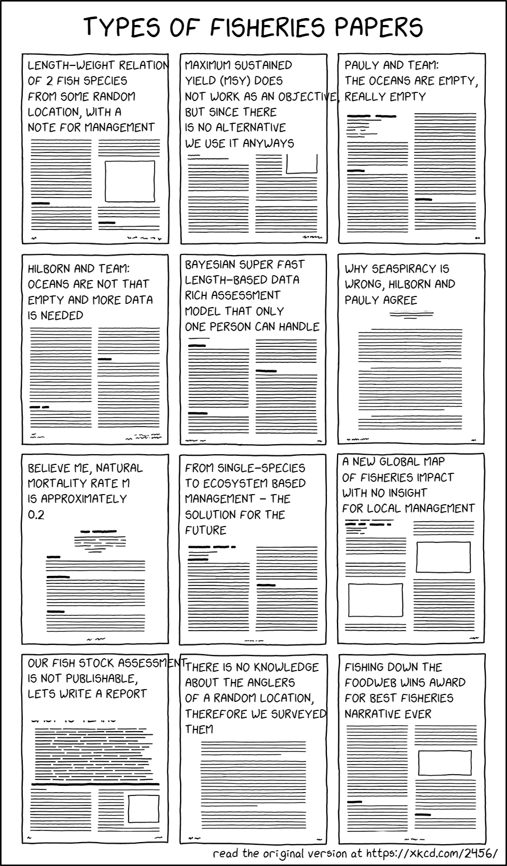

Thank you

Slide 55
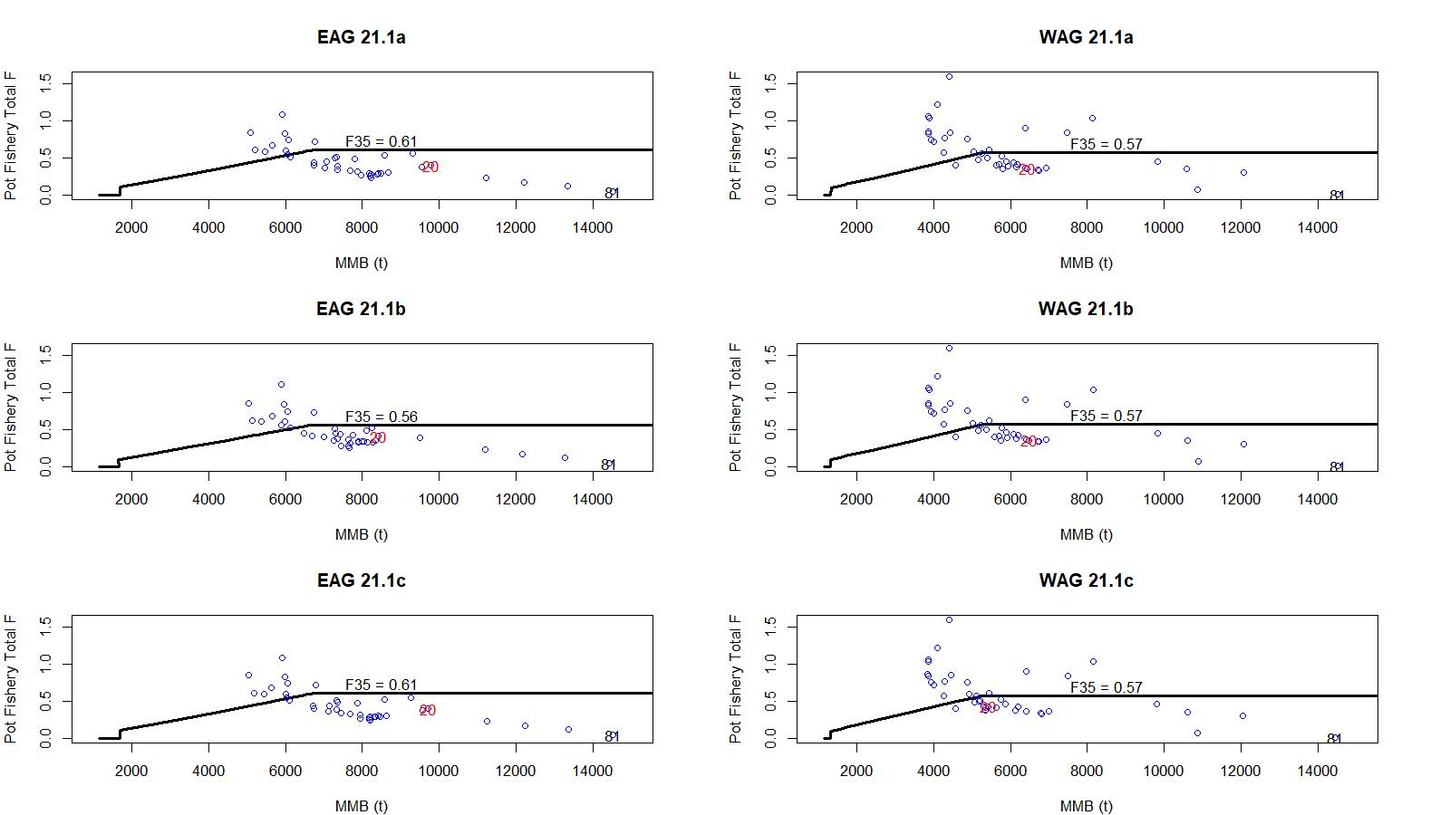
Figure 42. F vs MMB trends superimposed with F35 lines: EAG & WAG

Slide 56
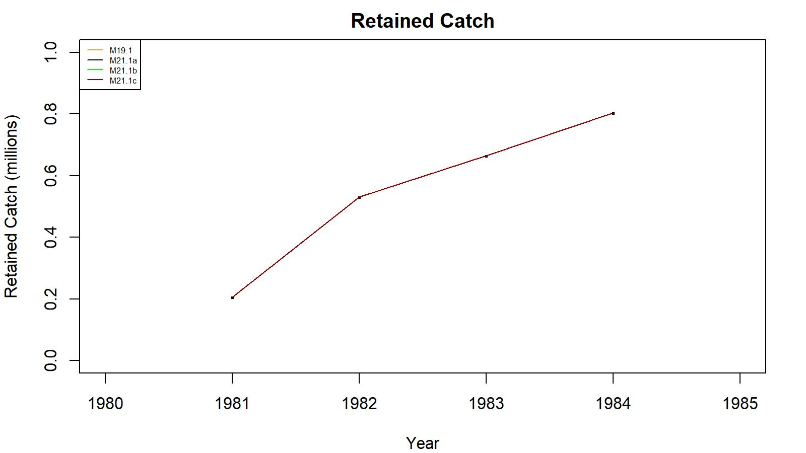
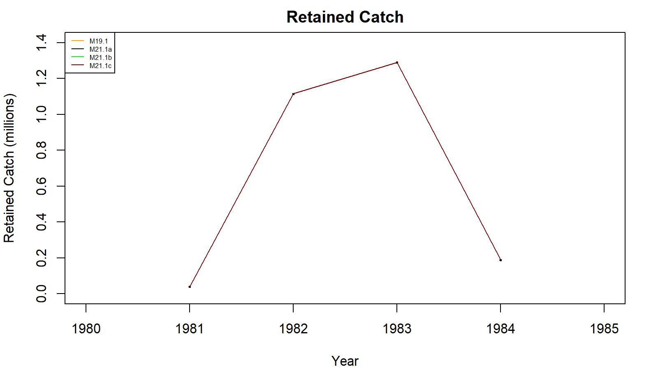
1981-84 retained catch fit: EAG: Fig. 18; WAG: Fig. 36. Models 19.1, 21.1a, 21.1b, and 21.1c
EAG
WAG

Slide 57
Size comp.: EAG: Figs. 9a, 10a, & 11; WAG: Figs. 27a, 28a, and 29 for model 21.1a.
Groundfish Discard
Retained
Total
EAG
WAG

Slide 58
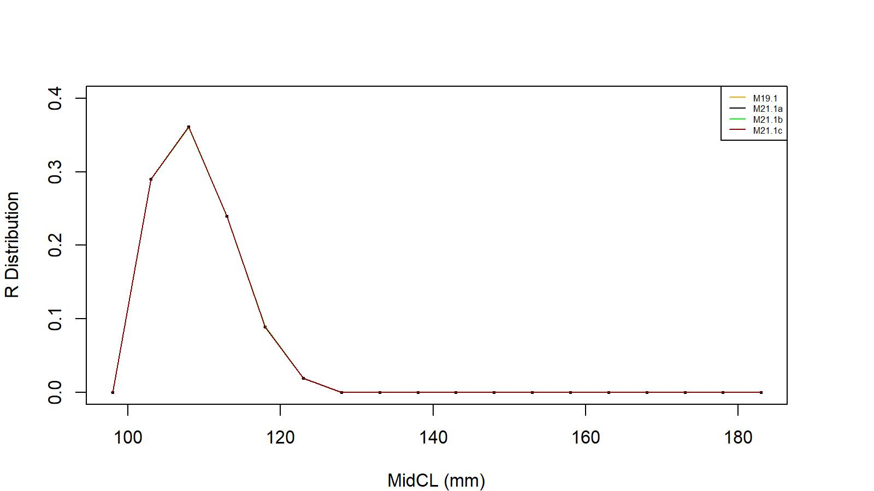
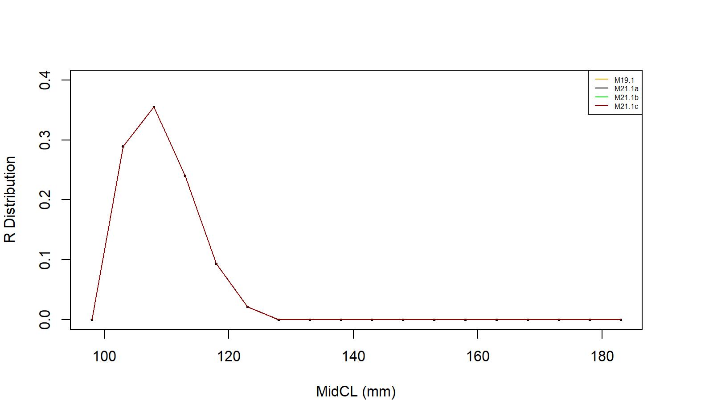
Recruit size distribution.: EAG: Fig. 15; WAG: Fig. 33. models 19.1, 21.1a, 21.1b, and 21.1c
EAG
WAG

Slide 59
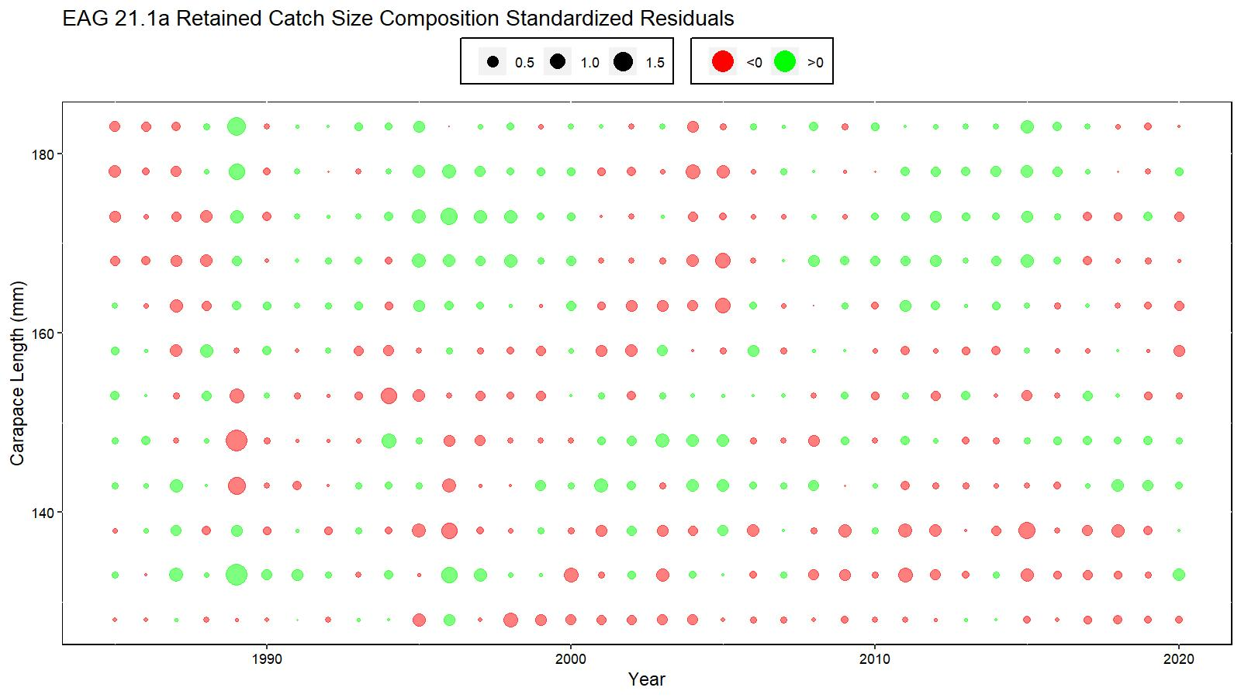
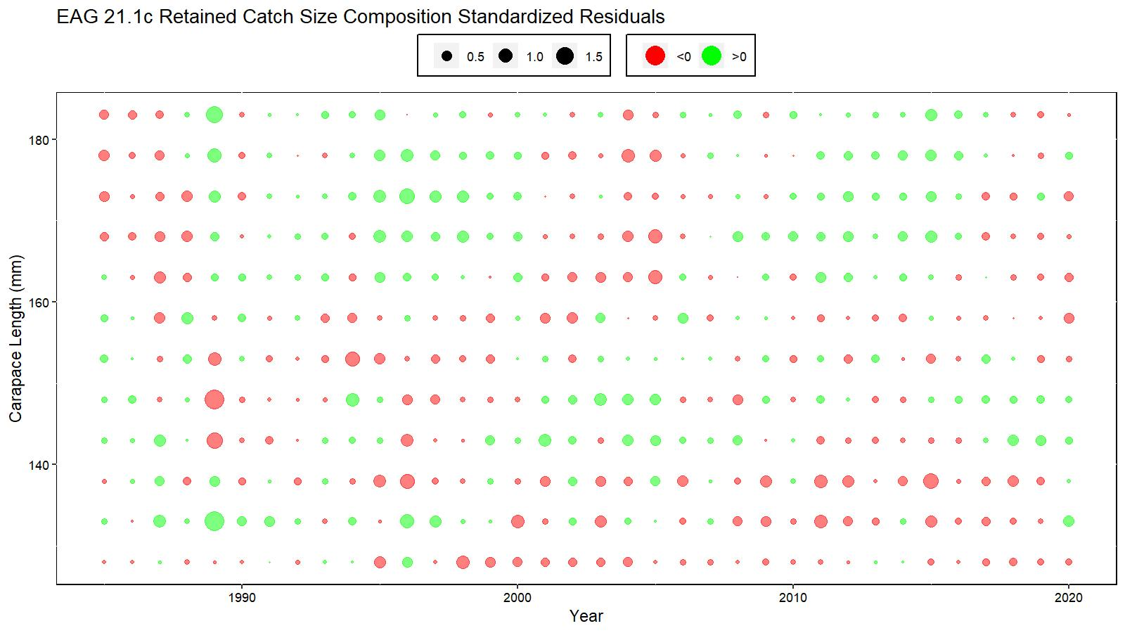
Figs. 19 & 20. Retained Catch residual bubble plots for EAG
Model 21.1a
Model 21.1c

Slide 60
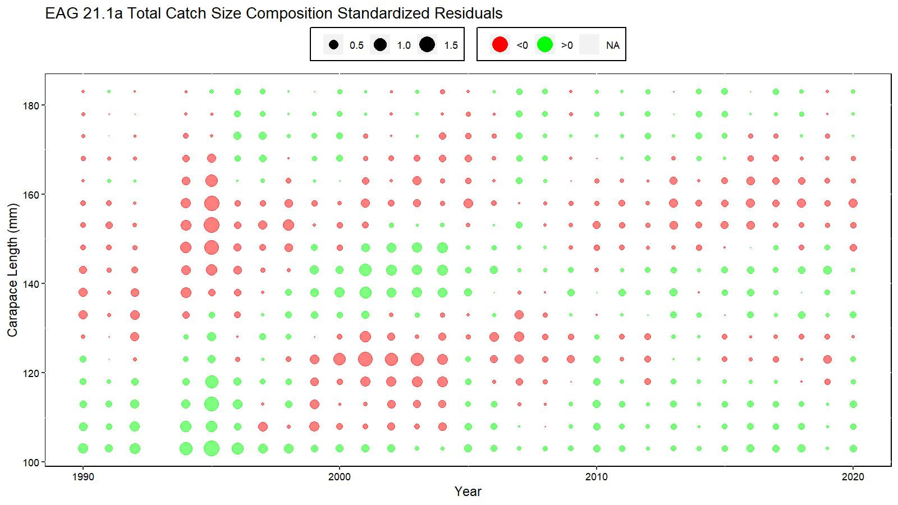
Figs. 21 & 22. Total Catch residual bubble plots for EAG
Model 21.1a
Model 21.1c

Slide 61
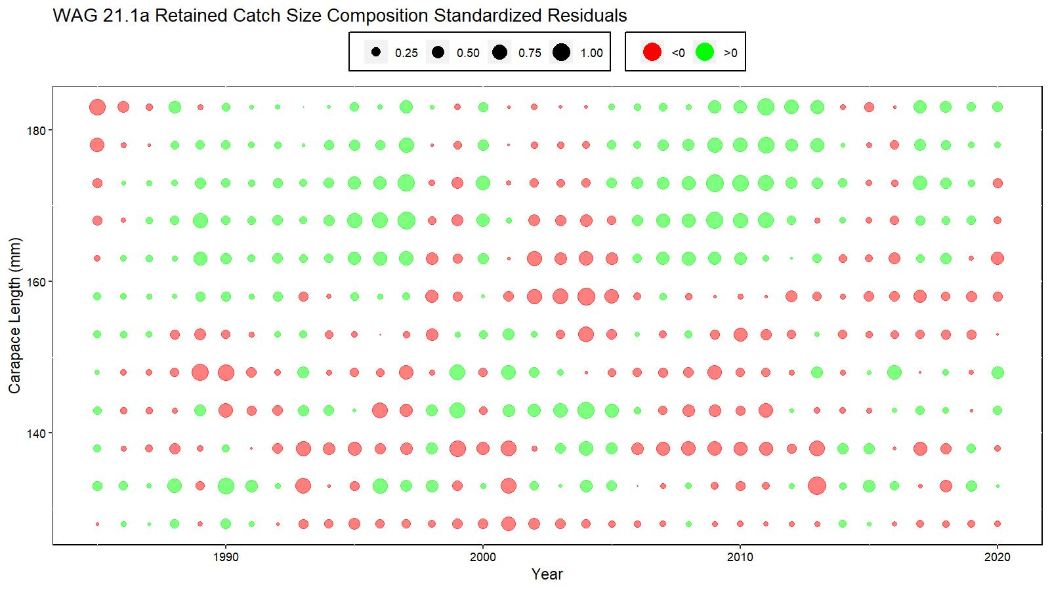
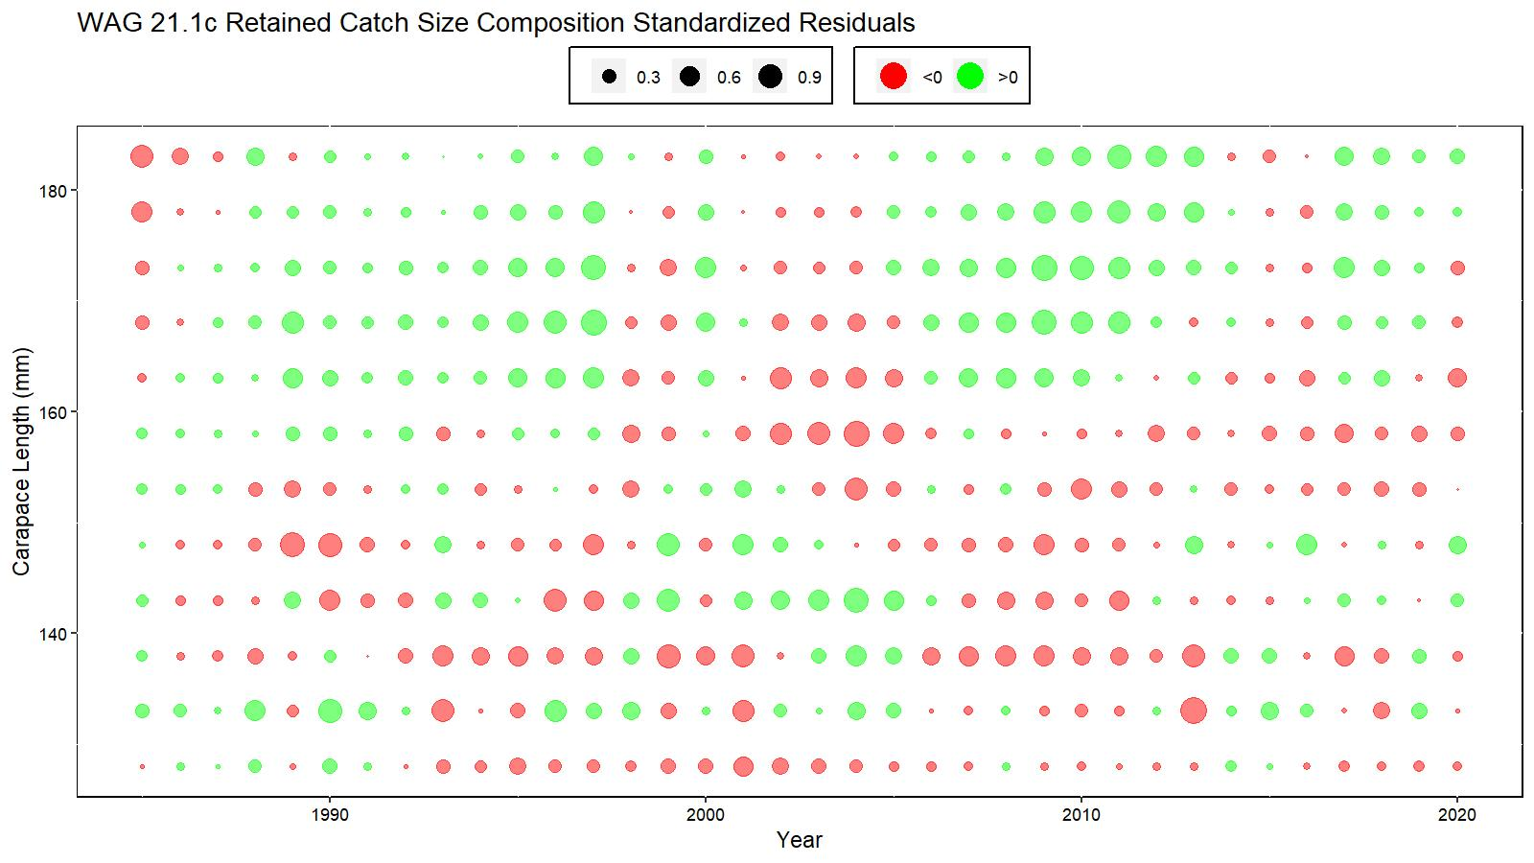
Figs. 37 & 38. Retained Catch residual bubble plots for WAG
Model 21.1a
Model 21.1c

Slide 62
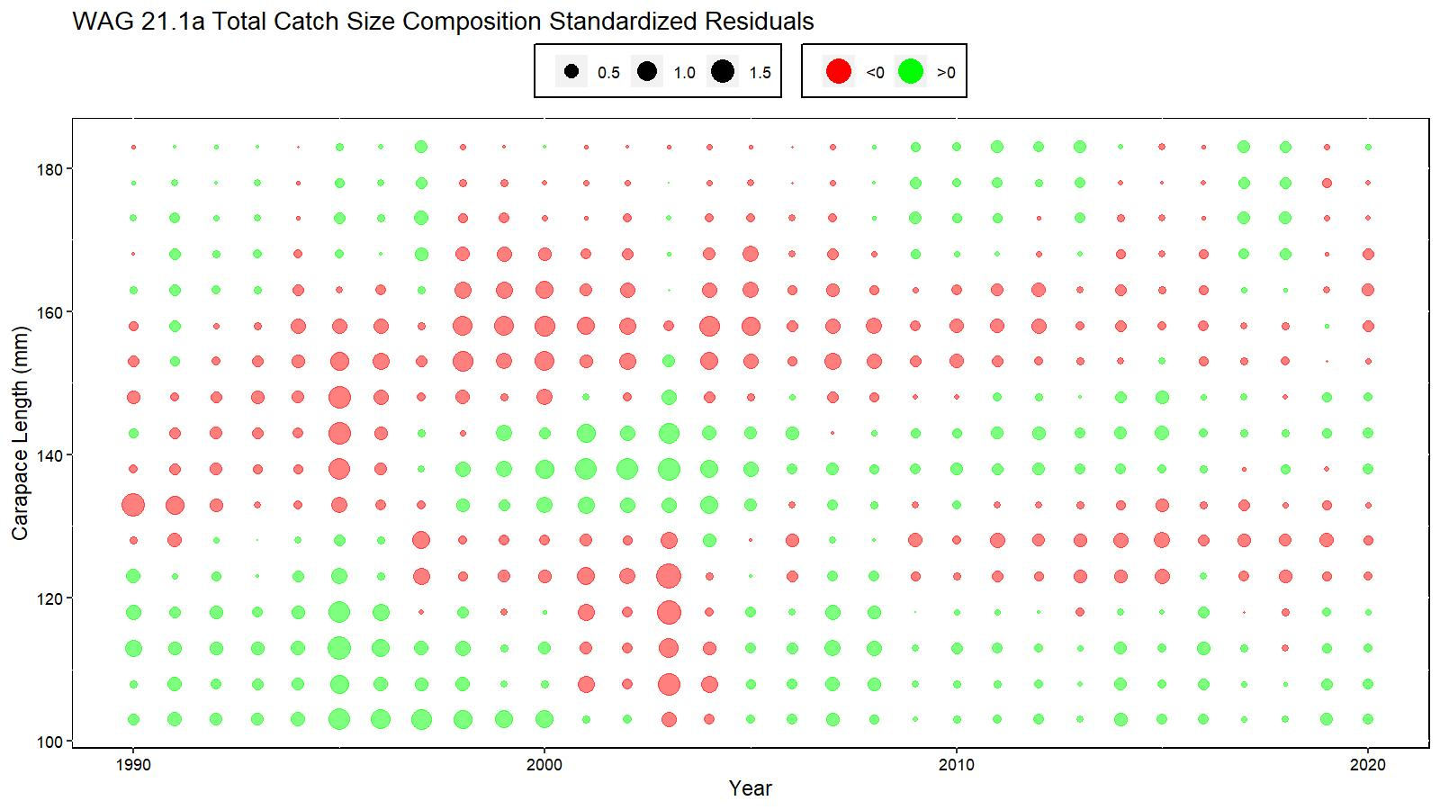
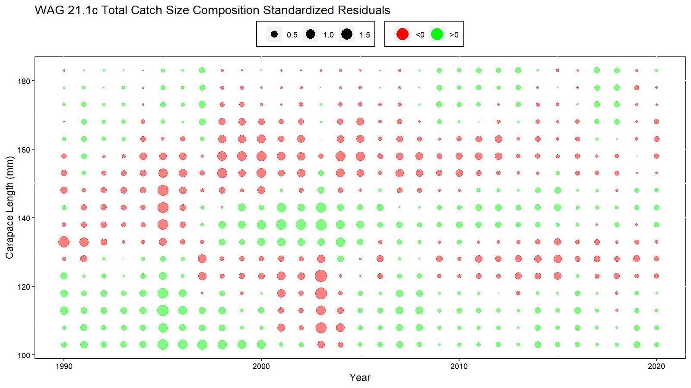
Figs. 39 & 40. Total Catch residual bubble plots for WAG
Model 21.1a
Model 21.1c

