Slide 1
Evaluation of recruitment estimates in the Bering Sea/Aleutian Islands Blackspotted/Rougheye rockfish assessment, and their management implications
Paul Spencer and Jim Ianelli
Alaska Fisheries Science Center

Slide 2
Sawtooth pattern in recent BSAI ABCs
ABC recommendations for the year following an off year (black points) are based on uncertain year class strengths (black points)
The ABC recommendations are often downgraded when full assessments (with new data) occur (red points)

Slide 3
Outline
Review of data and models from the 2018 assessment, with some additional graphs
Management implications of uncertain estimates of year class strength
Evaluate the effect of three modeling recommendations from the BSAI Plan Team
Evaluate retrospective patterns in exploratory models
Recommendations for November 2020 assessment

Slide 4
Background
For AI portion of the stock assess with age-structured model:
  Strong conflict between biomass index and composition data
  2018 models
    18.1 -- McAllister-Ianelli weighting, relatively more emphasis on fitting age/length comps, worse fit to biomass index
    18.2 – Francis weighting, relatively less emphasis on fitting age/length comps, better fit to biomass index (recommended by authors)
  “Missing” older fish, higher levels of younger fish (both fishery and survey)

Slide 5
Decline in older/larger fish in recent years from AI survey
Also increase in smaller/younger fish

Slide 6
Decline in estimated survey number of older fish
Decline from 2012-2014
Age group | Rate of decline
21-25 | 87%
26-30 | 82%
31-35 | 72%
36-40 | 74%
40+ | 52%

Slide 7
Same pattern in the fishery data
Proportional compositions for each year scaled to the extrapolated number from the Observer program

Slide 8
Mismatch in data vs model total mortality
Cohort-specific mortality rates from the 2018 model are smaller than those estimated directly from survey data (via catch curves).
The model does not have a mechanism for explaining less than expected number of older fish in recent years.

Slide 9
Conflict between composition data and survey biomass trend
A Tier 5 model would show a decreasing trending in the last decade
Adding the composition degrades the fit to the biomass trend, indicating the data conflict
Model 18.1 – McAllister-Ianelli weighting
Model 18.2 – Francis weighting
Better fit to the survey biomass with Francis weighting

Slide 10
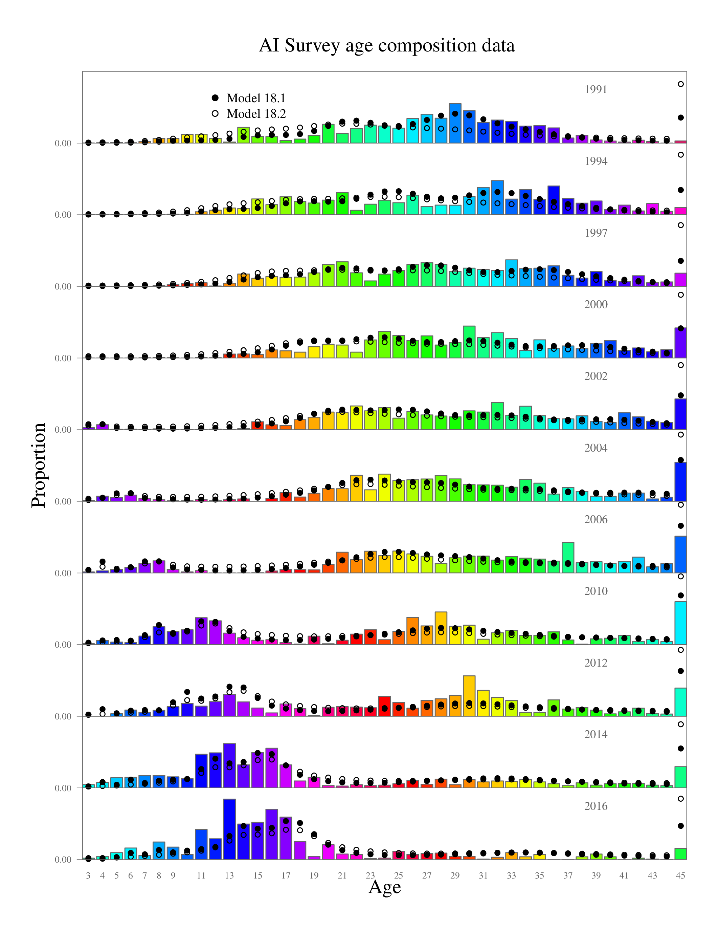
Data conflict illustrated in the 2018 models
Model 18.1 degrades the fit to the survey biomass data in order to fit the composition data better
Differences in the composition fits between 18.1 and 18.2
appear relatively small

Slide 11
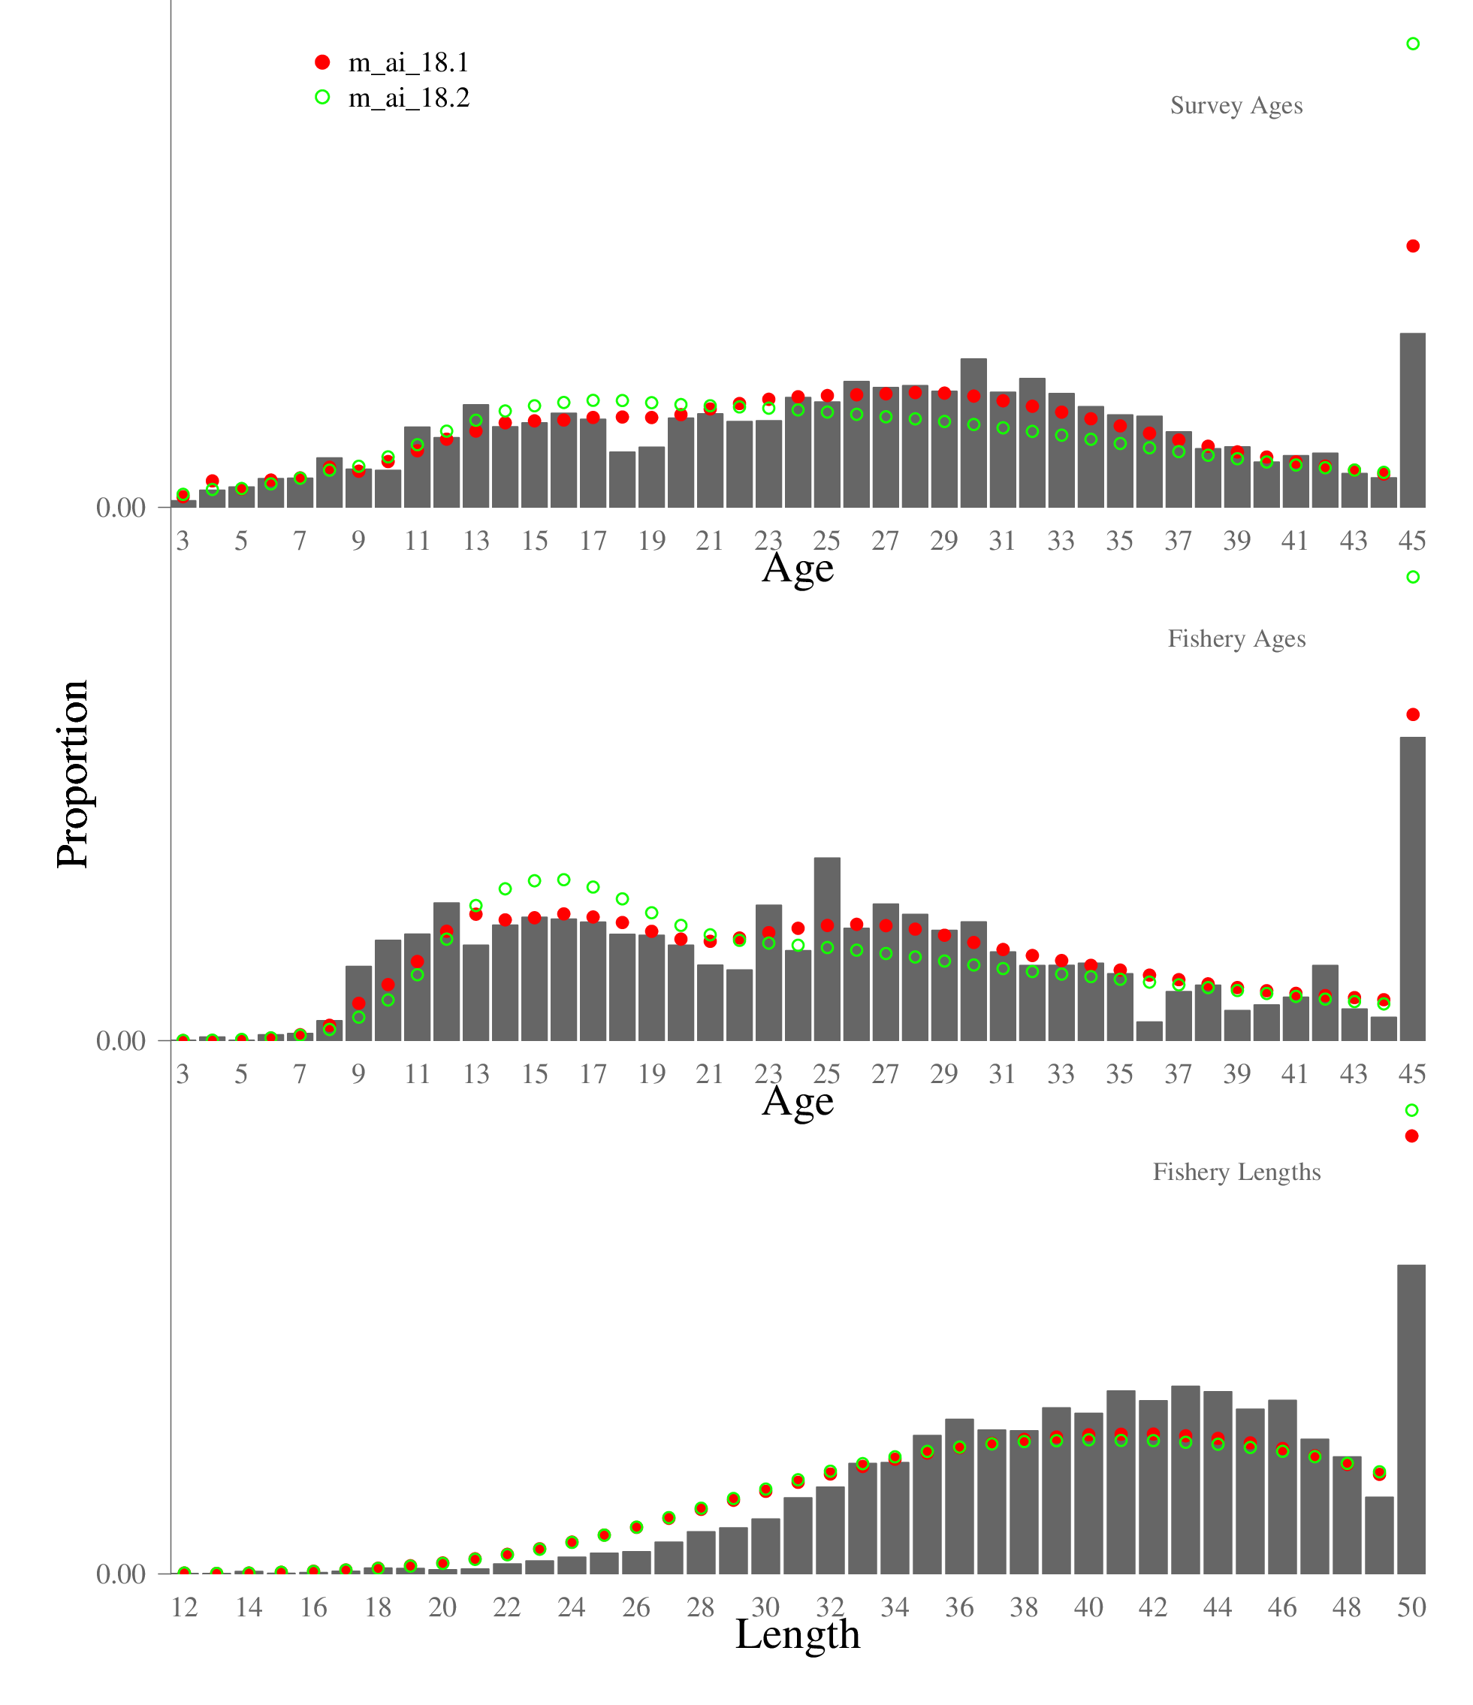
Data conflict illustrated in the 2018 models
Root Mean Squared Errors

Slide 12
Concentration of estimated stock into a small number of year classes (Model 18.1)
Model 18.1 achieves the fits to the composition data by having strong recruitments in recent years (for year classes that have low survey selectivity).
For Model 18.1:
2002 year class is 19% of 2018 biomass
2002, 1998, and 1999 year classes are 37% of the total biomass

Slide 13
Mismatch in recent biomass trends
Overall decreasing trend in the AI survey biomass trend, yet the 2018 population model shows a strong increase in recent total biomass (i.e., a factor of 4 since ~ 2000)
From the 2018 presentation: “Models that do not downweight the age and length composition data suggest the total biomass is ~ 3- 4 times the current survey biomass, and composed mostly of young fish partially selected by the survey. With the new survey biomass estimates and composition data, this seems increasingly implausible.”

Slide 14
Recruitment variability, and retrospective bias
There is more variability in estimated year class strength than those estimated from Model 18.1
Model 18.1
Some key year classes
2002 year class:
1.7 M (2008 peel)
22.5 M (2012 peel)
12.4 M (2014 peel)
19.4 M (2018 peel)
1998 Year class:
33 M (2010 peel),
7.8 M (2018 peel)

Slide 15
Recruitment variability, and retrospective bias

Slide 16
Changes in magnitude in year-class estimates between assessments
For example, the estimate of the 1998 year class has declined from 23.1 million in the 2014 assessment to 7.8 million in the 2018 assessment (also, some recent year classes were estimated as very large in the 2018 assessment)
These observations were a factor in recommending the Francis weighting in the 2018 assessment (along with decline in older fish)

Slide 17
Management implications – large inter-assessment changes in ABC
Annual BSAI ABC increases
2020: 28% (from 2019)
2021*: 27% (from 2020)
As these young fish in Model 18.1 increase in age and grow larger, they become more selected by the fishery and the
ABC increases.
Estimated population for 2018
*From 2019 partial assessment

Slide 18
Management Implications
Given the retrospective pattern, it is likely that estimates of year classes currently estimated as large (and fueling the rapid increase in ABC) may be revised downward with new data
Without a definitive increase in the survey biomass estimates or more reliable estimates of year class strength, the large percentage increases in ABC may not be warranted for a long-lived stock that has exhibited less than expected older fish in recent surveys and fishery catch

Slide 19
Model Explorations
Suggested modeling topics from the BSAI Plan Team
  Update the aging error index
  Larger bounds on natural mortality prior distribution
  Dome-shaped survey selectivity

Slide 20
Updated ageing error index
Based on estimation procedure in Punt et al. (2008); https://github.com/nwfsc-assess/nwfscAgeingError
Likelihood-based method, estimates the mean and standard deviation of read ages for each reader
Applied to 2,341 double-reads of BSAI blackspotted/rougheye rockfish sampled from 1986-2017

Slide 21
Effect of updated ageing error index
With more ageing error, model is able to estimated larger recruitments for some year classes because these would be “smeared out” in the observed data

Slide 22
Updated natural mortality prior distribution
Based on research by Then et al. (2015), accessed via online app developed by Jason Cope http://barefootecologist.com.au/shiny_m.html)
Used 3 life-history models based on t_{max}, which Then et al. recommend over methods based on growth parameters
Oldest age for BSAI blackspotted/rougheye is 121 years, we considered values of 100,125,150
Mean and standard deviation of M prior was set to 0.045 and 0.1, respectively. 2018 assessment had 0.03 and 0.05
Consistent with assessment of British Columbia blackspotted/rougheye rockfish, who used a range of 0.035 – 0.055

Slide 23
Effect of updated M prior distribution
Population abundance is scale larger to compensate for larger M. Higher survey biomass in 1990s. Estimate of M is 0.092, which seems implausibly large.

Slide 24
Dome-shaped survey selectivity
Used modified double normal equation:

Slide 25
Effect of dome-shaped selectivity
Lower recruitment than 2018 model. Higher total biomass and survey biomass prior to 2010, smaller afterwards. Relatively minor differences.

Slide 26
Summary of the effect of model changes
The issues present in model 18.1 (i.e., estimated large year classes based on limited data, a rapidly increasing population based on strong year classes of young fish not completely observed in the survey, and a poor residual pattern in the fit to the survey biomass estimates) have not been resolved by these exploratory model alternatives.
For example, none of these exploratory models fit the large survey biomass estimates in 2000, 2002, and 2012.

Slide 27
Retrospective pattern of exploratory models
Model Name | Differences from Model 18.1
ae_m_McIan | Updated ageing error, updated natural mortality prior distribution, updated McAllister-Ianelli data weights
ae_m_Francis | Updated ageing error, updated natural mortality prior distribution, updated Francis data weights
ae_m_drop14 | Updated ageing error, updated natural mortality prior distribution, set most recent 14 year classes to the estimated mean recruitment, same weights as model ae_m_Francis
For model ae_m_drop14, most year classes are estimated as
Most recent 14 year classes estimated as
This model was motivated by cases where we do not use recruitment estimates that
we think are unreliable.

Slide 28
Retrospective pattern of exploratory models – still strong
McAllister-Ianelli Francis drop14

Slide 29
Summary of concerns/observations (partial)
Drop in abundance of older fish
Mismatch in data vs model total mortality
Poor residual pattern for the AI survey biomass
Mismatch in model biomass vs survey biomass trend
Changes in magnitude of year class estimates
Large inter-assessment changes in ABC
Population shifts younger, and estimated to be concentrated in a small number of age classes
Positive retrospective bias in recruitment

Slide 30
Summary of observations regarding data weighting
Data-weighting procedures that give relatively stronger emphasis to fitting the composition data can produce slightly better fits to these data. However, these cases also have
1) Degraded fits to the biomass trend data
2) Stronger retrospective bias in recruitment patterns
3) Large estimates of recruitment for recent year classes with low selectivity
4) Large interannual variability in projected ABCs

Slide 31
Data weighting considerations
In our view, we should not base our management and projected harvest specifications on recruitment estimates with large uncertainty
Co-author and internal reviewers have commented on similarities with sablefish assessment (loss of older fish, increased younger fish, large and unreliable estimates of recent year classes)
A useful precedent is sablefish management (although the methodology for data weighting differs)

Slide 32
Data weighting considerations
The model results and management specifications depend on the choice for data-weighting
How much weight do we want to give the biomass trend, and how much to the composition data?
None of the procedures considered here completely drops data from the assessment.
The Francis weighting procedure is the most commonly used data-weighting method in U.S. west coast assessments, and has a theoretical foundation that accounts for the correlations within each given year of composition data (which reduces the amount of informative data)
Other data-weighting approaches could be considered (i.e., Dirichlet)

Slide 33
Recommendations for November 2020 assessment
Use the updated ageing error matrix
Updated natural mortality prior distribution (either M set at 0.045, or with an informative prior)
Francis weighting for the composition data

