Slide 1
Catch Timeseries Standardization update
Benjamin Daly and Tyler Jackson
Alaska Department of Fish and Game
May 2021 Crab Plan Team meeting

Slide 2
Why is this needed?
Past approach: append most recent data to historical timeseries
  The problem: Confusion about historical data and catch expansions, unknown how historical estimates were generated....they were done “by hand”
  Institutional knowledge about details of past calculations lost with individuals retiring, moving on, etc.... now what?
Current approach: increased transparency
Streamlined raw data files pulled from databases annually
Full data timeseries supplied each year
Well annotated code for data filtering and catch expansions
  GitHub repository: https://github.com/commfish/adfg_crab_observer
Outputs match current stock assessment data requests, flexibility to change with shifting assessment needs
*Likely that new timeseries will differ from what has been used in the past*

Slide 3
Challenges
Historical fishery effort: difficulty in parsing out between snow and Tanner fisheries
  Lots of overlap (incidental retention), derby-style fishery very fast
  Fish tickets record the retained catch and effort, and act as an invoice for the vessel. Effort data depend on the accuracy of the information reported by the captain. Fish tickets also do not distinguish between incidental catch and directed catch, which can make it difficult to assign effort to the appropriate fishery. ...... Pre-2005 years
  Pengilly timeseries: manually apportioned historical (pre-2005) effort using raw fishing tickets... Mostly an issue with Tanner crab
    No documentation
    Doing this again, from scratch, would be very time consuming and would likely not yield better estimates of historical effort (Doug had the most institutional knowledge)
  More recent (post-2005) years is a non-issue: fish ticket reports have directed-incidental breakdowns by fishing trip
Changes in fishery management
  CDQ fisheries managed separately for some years: make sure the are grouped
  Shifting management boundaries: freeze most current boundaries? Shift over time?

Slide 4
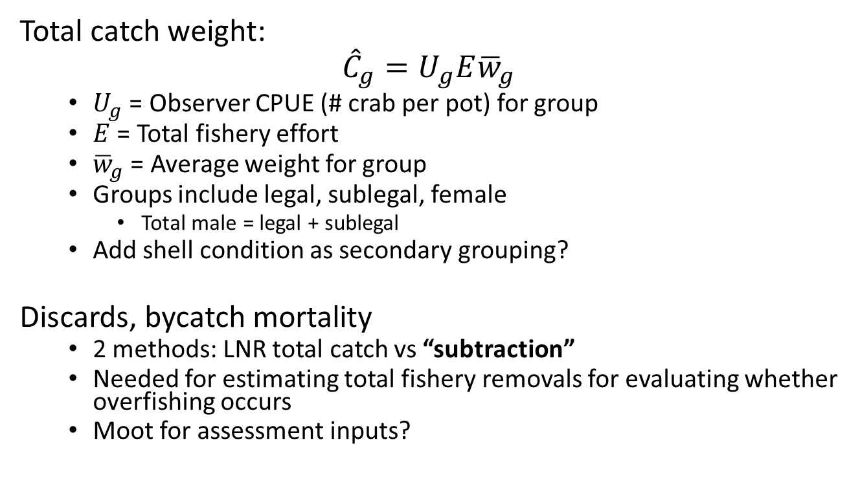
Catch Expansions
Total catch weight:
$${{\hat{C}}_{g}=U}_{g}E{\overline{w}}_{g}$$
  $U_{g}$ = Observer CPUE (# crab per pot) for group
  $E$ = Total fishery effort
  ${\overline{w}}_{g}$ = Average weight for group
  Groups include legal, sublegal, female
    Total male = legal + sublegal
  Add shell condition as secondary grouping?
Discards, bycatch mortality
  2 methods: LNR total catch vs “subtraction”
  Needed for estimating total fishery removals for evaluating whether overfishing occurs
  Moot for assessment inputs?

Slide 5
Start of timeseries
Observer program initiated for BSAI crab ~1990 originally to monitor compliance of fishery regulations and collect data for in-season management
  Collection procedures were evolving in the early years: shifting fishery operations, manager data needs, assessment needs, etc
1995 considered first year observer program became more settled, protocols standardized
  1995 first year where observer data was entered into a database instead of being kept in spreadsheets and word documents
  To avoid some of the potential errors and lack of documentation, propose starting timeseries for observer data in 1995
    Model scenario where total catch starts at 1995

Slide 6
Start of timeseries
CPT Jan 2020 recommendation:
All stock assessment authors evaluate the impact of the revised post-1995 total catch time series by including these data in the base model from last year’s assessment for consideration at the May CPT meeting. If the results are deemed acceptable, the revised time series should then be used all other model configurations being considered.
SSC Feb 2020 recommendation:
It was reported that ADF&G is currently recalculating time series of total catch using standardized methods. The SSC supports this effort and supports the CPT recommendation to use the 1995 start date for revising the catch time series. This start date corresponds to the standardization of data collection and storage methods. Modeling efforts may still use catch data prior to 1995. The SSC also supports the CPT recommendation that each assessment should evaluate the impact to the current base model of shifting to these new catch time series.

Slide 7
BBRKC
Data summarization 1990 – 2019/20 available on GitHub & sent to Jie
  Total retained catch
  Total catch (total male (i.e., legal + sublegal), female)
  Total bycatch in Tanner fishery (total male, female)
  Size composition
    Retained catch - dockside
    Directed fishery (males and females) - observer
    Tanner fishery (males and females) - observer
Directed fisheries include all IFQ, CDQ, and test fisheries for RKC in Bristol Bay
Bycatch in Tanner fishery restricted to east of 166°W
  Historical data estimates restricted to east of 163°W
  No Tanner fishing east of 163°W since 1996
  “Pengilly effort timeseries” tuned to E/W 166°W

Slide 8
Snow crab
Still in progress: very close
Combined all primary and CDQ fisheries
Total catch
  Female
  Male: total male vs separate subLeg + Leg categories? More accurate ave wts?
  Flexibility to do both?
Bycatch
  Tanner: calculate separately for east/west 166 vs All EBS?
    ave_wts impacted if calculated separately vs pooled
  BBRKC
  SMBKC
  PIBKC, PIRKC, PIGKC

Slide 9
Tanner
Still in progress
Directed fishery: east/west 166 for full timeseries
Bycatch
  East: BBRKC
  West: snow, SMBKC, PIRKC, PIBKC

Slide 10
Other stocks in the queue
SMBKC
PIRKC
PIBKC
PIGKC
*AIGKC*

Slide 11
Variance Estimation
SSC Feb 2020:
The SSC further supports looking at variance estimates for catch data from the program to help inform effort/resources to spend on it, and what sample sizes are necessary to achieve adequate precision. The SSC recommends that the program consult the catch accounting staff at the AKRO and the observer staff at AFSC who have years of experience analyzing catch variances.

Slide 12
Variance Estimation
Update: Will take a deeper dive into this once big-3 timeseries are completed.
Some thoughts:
  Total catch estimator is based on simple random sample
    Compute simple design based or bootstrap variance?
  Gaeuman (2014) used ratio estimator – assumes observers randomly sample pots, not usually the case, either systematic or stratified by string(s)
  Boyle et al. (1997) and Burt and Barnard (2003) used stratified estimators – survey vessel, vessel type
  NMFS groundfish uses post-stratification based on gear, vessel type, location – our total catch estimators are not based a stratified design
Cursory examination of snow crab observer CPUE resulted in very low CVs (1-2%) (sample sizes are very large) – are estimates that low useful in assessment?
Each assessment currently assumes a CV on catch – what are these currently based on?

Slide 13
Update: no 2021 ADF&G SMBKC pot survey
ADF&G did not receive any bids by fishing vessels to conduct the 2021 SMBKC pot survey
Will attempt the survey in 2022
  Timing: ~ 21 days in Aug/Sept
Notes:
The 2018 pot survey had large influence on stock status and overfished determination

