Slide 1
Incorporating BSFRF side-by-side catchability studies in the
Tanner crab assessment
William Stockhausen
Alaska Fisheries Science Center
May 2021

Slide 2
Introduction
BSFRF and NMFS conducted joint catchability studies focused on Tanner crab
  2013-2018
  side-by-side (SBS) tows (paired hauls)
    simultaneous start
    0.5 nmi separation
    same tow direction
BSFRF
  modified Nephrops trawl assumed* to capture ALL crab in gear path
  5-minute tow
  net equipped with mensuration gear to determine area swept
NMFS
  standard EBS 83-112 bottom trawl gear
  standard 30-minute tow
  standard net mensuration gear to determine area swept
footropes
83-112
Nephrops

Slide 3
Two approaches to estimating NMFS survey catchability
Using survey-level aggregated data
  uses design-based survey abundance by 5-mm size bins
  conceptually simpler
  aggregation loses side-by-side information
  can’t extend analysis beyond SBS study years
Using side-by-side (paired haul) data
  provides haul-specific information
  can incorporate environmental covariates
  allows extension beyond study years

Slide 4
Introduction
BSFRF and NMFS conducted joint catchability studies focused on Tanner crab
  2013-2018
  side-by-side (SBS) tows (paired hauls)
    simultaneous start
    0.5 nmi separation
    same tow direction
BSFRF
  modified Nephrops trawl assumed* to capture ALL crab in gear path
  5-minute tow
  net equipped with mensuration gear to determine area swept
NMFS
  standard EBS 83-112 bottom trawl gear
  standard 30-minute tow
  standard net mensuration gear to determine area swept
footropes
83-112
Nephrops

Slide 5
SBS Study Areas
2015
2013
2016
2014
2017

Slide 6





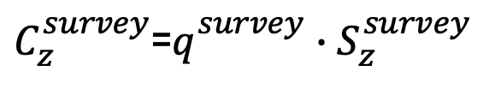
Survey-level relationships: catchability and availability
$$N_{z}^{survey}=A_{z}^{survey}∙C_{z}^{survey}∙N_{z}^{population}$$
$C_{z}^{survey}$=$q_{}^{survey}∙S_{z}^{survey}$
NMFS EBS ($A_{z}^{NMFS EBS}≡1$):
$$N_{z}^{NMFS EBS}= 1 ∙C_{z}^{NMFS EBS}∙N_{z}^{EBS}$$
BSFRF SBS ($C_{z}^{BSFRF SBS}≡1$):
$$N_{z}^{BSFRF SBS}=A_{z}^{SBS}∙ 1 ∙N_{z}^{EBS}$$
NMFS SBS:
$$N_{z}^{NMFS SBS}=A_{z}^{SBS} ∙C_{z}^{NMFS EBS}∙N_{z}^{EBS}$$
Notes:
For any particular year a SBS study occurred.

Slide 7





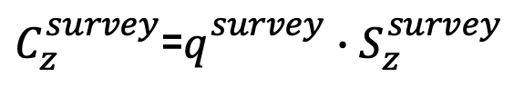
Survey-level relationships: catchability and availability
$$N_{z}^{survey}=A_{z}^{survey}∙C_{z}^{survey}∙N_{z}^{population}$$
$C_{z}^{survey}$=$q_{}^{survey}∙S_{z}^{survey}$
population abundance
NMFS EBS ($A_{z}^{NMFS EBS}≡1$):
$$N_{z}^{NMFS EBS}= 1 ∙C_{z}^{NMFS EBS}∙N_{z}^{EBS}$$
BSFRF SBS ($C_{z}^{BSFRF SBS}≡1$):
$$N_{z}^{BSFRF SBS}=A_{z}^{SBS}∙ 1 ∙N_{z}^{EBS}$$
NMFS SBS:
$$N_{z}^{NMFS SBS}=A_{z}^{SBS} ∙C_{z}^{NMFS EBS}∙N_{z}^{EBS}$$
Notes:
For any particular year a SBS study occurred.

Slide 8
Survey-level relationships: catchability and availability
$$N_{z}^{survey}=A_{z}^{survey}∙C_{z}^{survey}∙N_{z}^{population}$$
$C_{z}^{survey}$=$q_{}^{survey}∙S_{z}^{survey}$
survey catchability
NMFS EBS ($A_{z}^{NMFS EBS}≡1$):
$$N_{z}^{NMFS EBS}= 1 ∙C_{z}^{NMFS EBS}∙N_{z}^{EBS}$$
BSFRF SBS ($C_{z}^{BSFRF SBS}≡1$):
$$N_{z}^{BSFRF SBS}=A_{z}^{SBS}∙ 1 ∙N_{z}^{EBS}$$
NMFS SBS:
$$N_{z}^{NMFS SBS}=A_{z}^{SBS} ∙C_{z}^{NMFS EBS}∙N_{z}^{EBS}$$
Notes:
For any particular year a SBS study occurred.

Slide 9
Survey-level relationships: catchability and availability
$$N_{z}^{survey}=A_{z}^{survey}∙C_{z}^{survey}∙N_{z}^{population}$$
$C_{z}^{survey}$=$q_{}^{survey}∙S_{z}^{survey}$
availability to survey
NMFS EBS ($A_{z}^{NMFS EBS}≡1$):
$$N_{z}^{NMFS EBS}= 1 ∙C_{z}^{NMFS EBS}∙N_{z}^{EBS}$$
BSFRF SBS ($C_{z}^{BSFRF SBS}≡1$):
$$N_{z}^{BSFRF SBS}=A_{z}^{SBS}∙ 1 ∙N_{z}^{EBS}$$
NMFS SBS:
$$N_{z}^{NMFS SBS}=A_{z}^{SBS} ∙C_{z}^{NMFS EBS}∙N_{z}^{EBS}$$
Notes:
For any particular year a SBS study occurred.

Slide 10
Survey-level relationships: catchability and availability
$$N_{z}^{survey}=A_{z}^{survey}∙C_{z}^{survey}∙N_{z}^{population}$$
$C_{z}^{survey}$=$q_{}^{survey}∙S_{z}^{survey}$
survey abundance
NMFS EBS ($A_{z}^{NMFS EBS}≡1$):
$$N_{z}^{NMFS EBS}= 1 ∙C_{z}^{NMFS EBS}∙N_{z}^{EBS}$$
BSFRF SBS ($C_{z}^{BSFRF SBS}≡1$):
$$N_{z}^{BSFRF SBS}=A_{z}^{SBS}∙ 1 ∙N_{z}^{EBS}$$
NMFS SBS:
$$N_{z}^{NMFS SBS}=A_{z}^{SBS} ∙C_{z}^{NMFS EBS}∙N_{z}^{EBS}$$
Notes:
For any particular year a SBS study occurred.

Slide 11
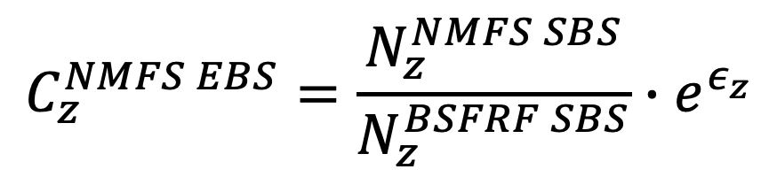
Survey-level relationships: catchability estimation
$$C_{z}^{NMFS EBS}=\frac{N_{z}^{NMFS SBS}}{N_{z}^{BSFRF SBS}}∙e^{ε_{z}}$$
Can be estimated outside assessment model
Notes:
For any particular year a SBS study occurred.

Slide 12
SBS catchability studies: number of crab caught
2016
2014
2013
2015
2017

Slide 13
SBS catchability studies: area-swept abundance
2016
2014
2013
2015
2017

Slide 14
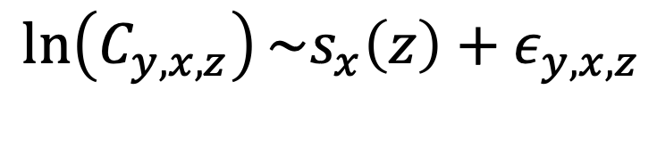
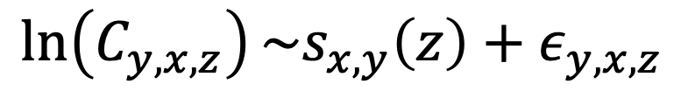
Statistical modeling
smooth function of size
Annual models
$$\ln\left(C_{y,x,z}\right)\sim s_{x,y}\left(z\right)+ε_{y,x,z}$$
smooth function of size
Global model
$$\ln\left(C_{y,x,z}\right)\sim s_{x}\left(z\right)+ε_{y,x,z}$$
data weighted by total number of individuals at size
estimated using “gam” function in R package mgcv
Notes:
For any particular year a SBS study occurred.

Slide 15
Catchability estimated from empirical catchability
females
males
Notes:
For any particular year a SBS study occurred.

Slide 16
Notes:
For any particular year a SBS study occurred.

Slide 17
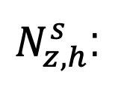
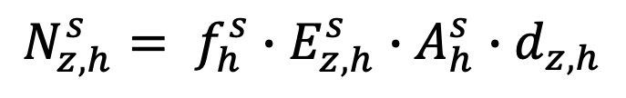
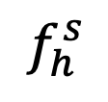



Haul-level relationships
Numbers caught and measured on paired-haul h by survey s
$$N_{z,h}^{s}= f_{h}^{s}∙E_{z,h}^{s}∙A_{h}^{s}∙d_{z,h}$$
$$d_{z,h}$$
: local density of crabs of size z
number of crabs of size z
caught and measured
$$A_{h}^{s}$$
: area swept
$N_{z,h}^{s}$:
$$E_{z,h}^{s}$$
: trawl efficiency
$$f_{h}^{s}$$
: fraction sampled
Notes:
For any particular year a SBS study occurred.

Slide 18
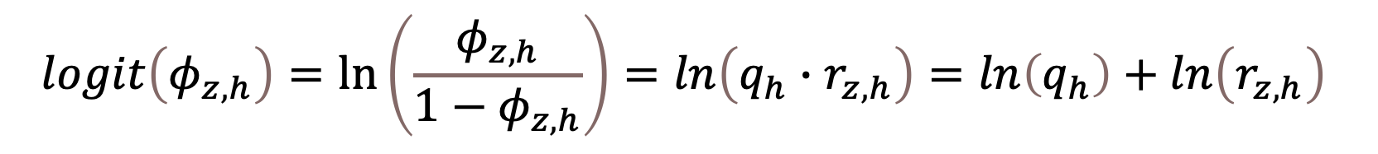
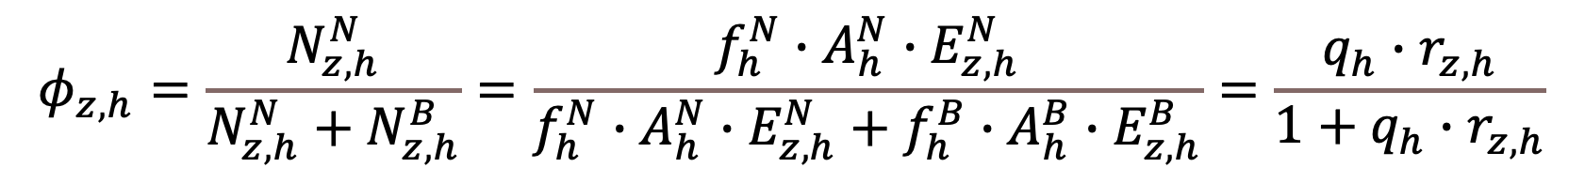
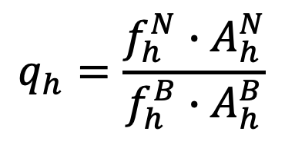
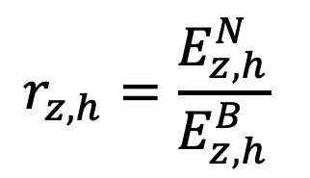


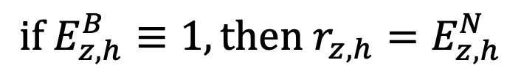
Haul-level relationships
$$φ_{z,h}=\frac{N_{z,h}^{N}}{N_{z,h}^{N}+N_{z,h}^{B}}=\frac{f_{h}^{N}∙A_{h}^{N}∙E_{z,h}^{N}}{f_{h}^{N}∙A_{h}^{N}∙E_{z,h}^{N}+f_{h}^{B}∙A_{h}^{B}∙E_{z,h}^{B}}=\frac{q_{h}∙r_{z,h}}{1+q_{h}∙r_{z,h}}$$
$$N_{z,h}^{N}$$
: # crab caught in NMFS haul
$$N_{z,h}^{B}$$
: # crab caught in BSFRF haul
$$r_{z,h}=\frac{E_{z,h}^{N}}{E_{z,h}^{B}}$$
$$q_{h}=\frac{f_{h}^{N}∙A_{h}^{N}}{f_{h}^{B}∙A_{h}^{B}}$$
a known value
$$logit\left(φ_{z,h}\right)=\ln\left(\frac{φ_{z,h}}{1−φ_{z,h}}\right)=ln\left(q_{h}∙r_{z,h}\right)=ln\left(q_{h}\right)+ln\left(r_{z,h}\right)$$
$$\text{if} E_{z,h}^{B}≡1, \text{then} r_{z,h}=E_{z,h}^{N}$$
Notes:
For any particular year a SBS study occurred.

Slide 19
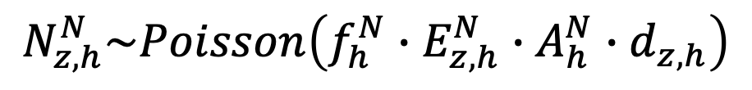
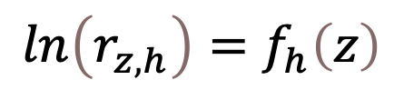
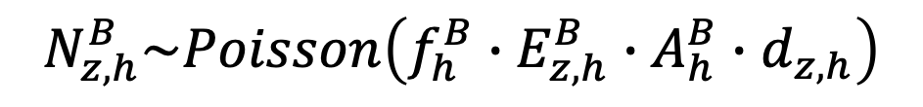
Statistical modeling
Assumptions
$$N_{z,h}^{N}\sim Poisson\left(f_{h}^{N}∙E_{z,h}^{N}∙A_{h}^{N}∙d_{z,h}\right)$$
$$N_{z,h}^{B}\sim Poisson\left(f_{h}^{B}∙E_{z,h}^{B}∙A_{h}^{B}∙d_{z,h}\right)$$
Then
$$Pr\left(N_{z,h}^{N}|N_{z,h}^{N}+N_{z,h}^{B}\right)=B\left(N_{z,h}^{N}+N_{z,h}^{B},{\tilde{φ}}_{z,h}\right)$$
Which can be fit with GLMs of the type
$$logit\left(φ_{z,h}\right)−ln\left(q_{h}\right)=f_{h}\left(z\right)+ω_{h,z}; ω_{h,z}\sim N\left(0,σ^{2}(h,z)\right)$$
Why? Because
$$ln\left(r_{z,h}\right)=f_{h}\left(z\right)$$
!
Notes:
For any particular year a SBS study occurred.

Slide 20
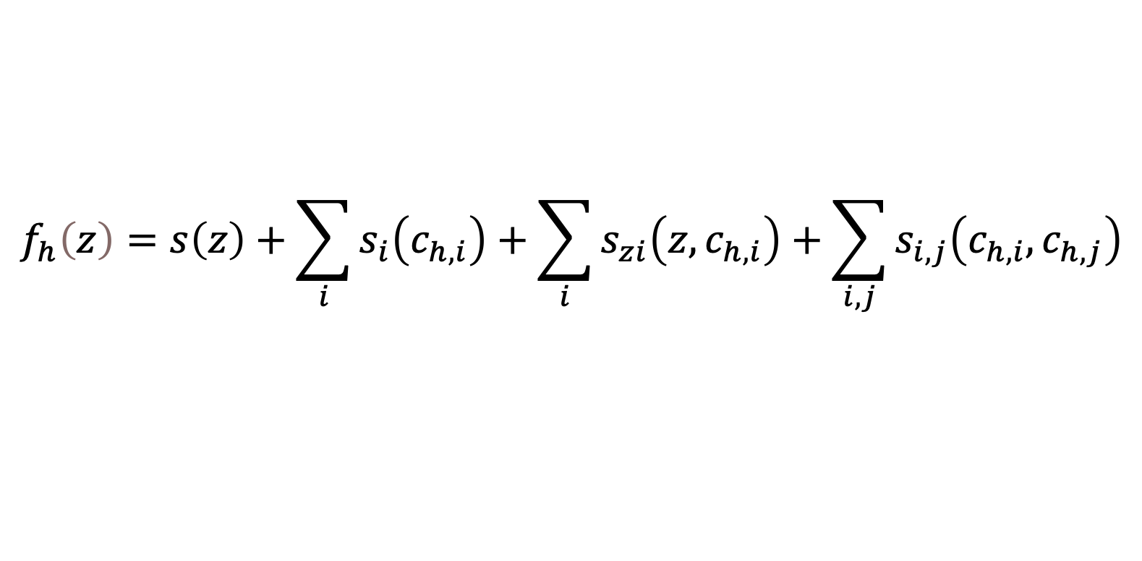
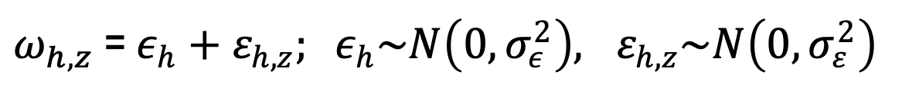

Statistical modeling
Fixed effects model
$$f_{h}\left(z\right)=s\left(z\right)+\sum_{i}{s_{i}\left(c_{h,i}\right)}+\sum_{i}{s_{zi}\left(z,c_{h,i}\right)}+\sum_{i,j}{s_{i,j}\left(c_{h,i},c_{h,j}\right)}$$
where
$$c_{h,i}$$
are potential haul-level environmental covariates
tow depth
bottom temperature
mean sediment grain size
sediment sorting coefficient
Error model
$ω_{h,z}$ = $ε_{h}+ε_{h,z}; ε_{h}\sim N\left(0,σ_{ε}^{2}\right), ε_{h,z}\sim N\left(0,σ_{ε}^{2}\right)$
haul-level
random effect
Notes:
For any particular year a SBS study occurred.

Slide 21
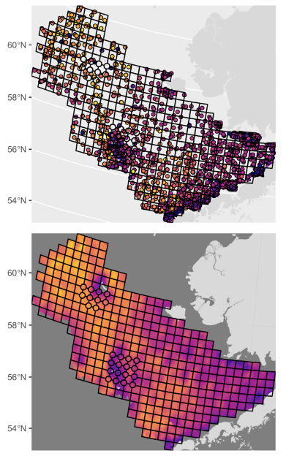
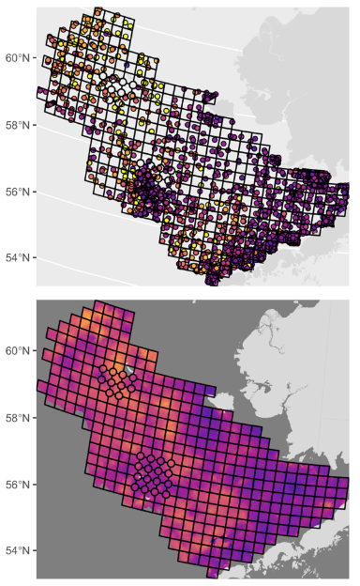


Sediment Characteristics
Data obtained from dbSEABED
Created rasters using ArcGIS Empirical Bayes co-Kriging
Extrapolated sediment characteristics at each paired-haul location
Notes:
For any particular year a SBS study occurred.

Slide 22
Quality control checks (1)
Censored data in black
Histogram of “q” values
Notes:
Hauls with q outside the acceptable limits ($[\frac{1}{3},3]∙q_{nom}$) (in black) were dropped. Colors indicate year of survey. Symbols at the top and bottom of each plot represent values of log(R) at +$∞$ and -$∞$, respectively.

Slide 23
Quality control checks (2)
observations with < 5 individuals dropped
final data used
Notes:
Subset of observed values of log(R) to be fit. Observations with < 5 total individuals were removed, as were hauls with q outside the acceptable limits ($[\frac{1}{3},3]∙q_{nom}$). Colors indicate year of survey. Symbol area reflects the total number of individuals captured. Symbols at the top and bottom of each plot represent values of log(R) at +$∞$ and -$∞$, respectively.

Slide 24
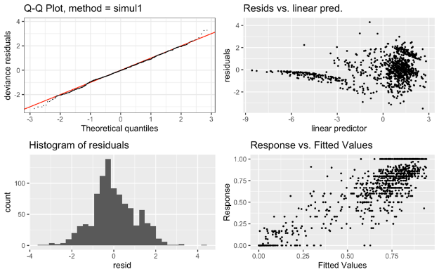
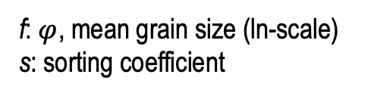
Results from best model: males
Method: REML Optimizer: outer newton
full convergence after 22 iterations.
Gradient range [-0.001232008,0.007510317]
(score 1533.706 & scale 1).
Hessian positive definite, eigenvalue range [2.109921e-05,32.51288].
Model rank = 314 / 314
Basis dimension (k) checking results. Low p-value (k-index<1) may
indicate that k is too low, especially if edf is close to k'.
k' edf k-index p-value
ti(z) 4.000 3.923 1.00 0.55
ti(d) 4.000 1.110 0.98 0.28
ti(f) 4.000 0.914 1.00 0.39
ti(z,d) 16.000 4.710 0.98 0.21
ti(z,t) 16.000 2.610 1.02 0.81
ti(z,f) 16.000 7.335 0.98 0.20
ti(z,s) 16.000 1.522 1.02 0.71
ti(d,s) 16.000 2.513 1.10 1.00
ti(t,s) 16.000 1.654 1.08 1.00
ti(f,s) 16.000 0.858 1.11 1.00
s(h) 189.000 99.648 NA NA
z: size
d: haul depth
t: temperature
f: $φ$, mean grain size (ln-scale)
s: sorting coefficient
Notes:
Males

Slide 25
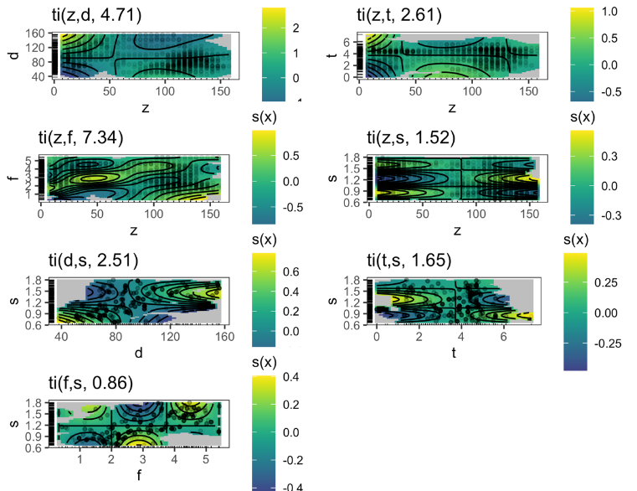
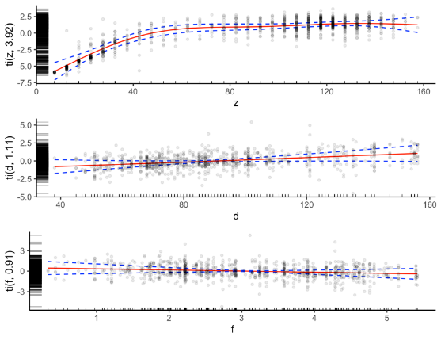
Estimated smooth functions: males
2-d smooths
size
bottom depth
phi
Notes:
For any particular year a SBS study occurred.

Slide 26
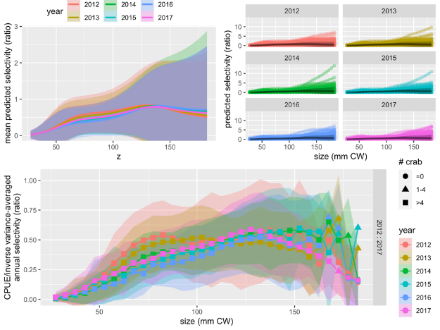
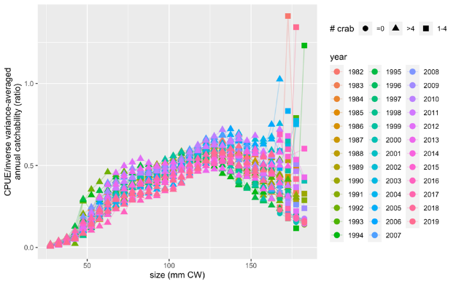
Estimated haul-level efficiencies and annual catchability: males
All years
Notes:
Predicted NMFS survey male catchability for 2012-2017. Upper row: unweighted mean and 95% confidence intervals (left); individual haul-level estimates (right). Lower row: Inverse-variance weighted estimates of annual NMFS survey catchability, with 95% confidence intervals.

Slide 27
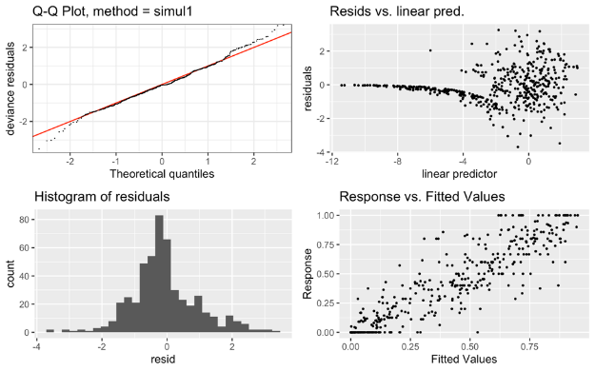
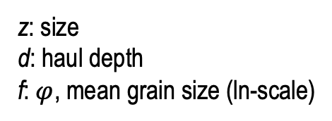
Results from best model: females
Method: REML Optimizer: outer newton
full convergence after 7 iterations.
Gradient range [-2.203405e-07,1.33785e-07]
(score 820.9957 & scale 1).
Hessian positive definite, eigenvalue range [0.2495432,23.32384].
Model rank = 175 / 175
Basis dimension (k) checking results. Low p-value (k-index<1) may
indicate that k is too low, especially if edf is close to k'.
k' edf k-index p-value
ti(z) 4.00 3.82 0.99 0.48
ti(d) 4.00 1.11 1.13 1.00
ti(z,d) 16.00 6.44 1.06 0.96
ti(z,f) 16.00 7.92 1.08 0.98
s(h) 134.00 76.86 NA NA
z: size
d: haul depth
f: $φ$, mean grain size (ln-scale)
Notes:
For any particular year a SBS study occurred.

Slide 28
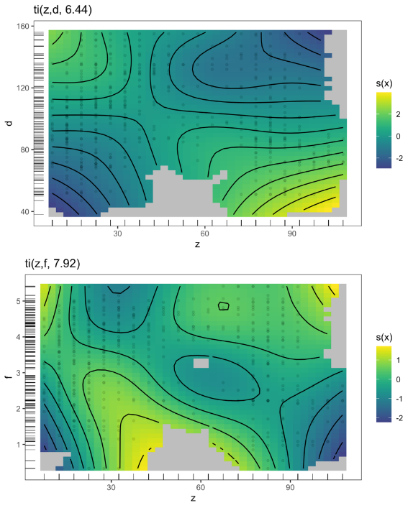
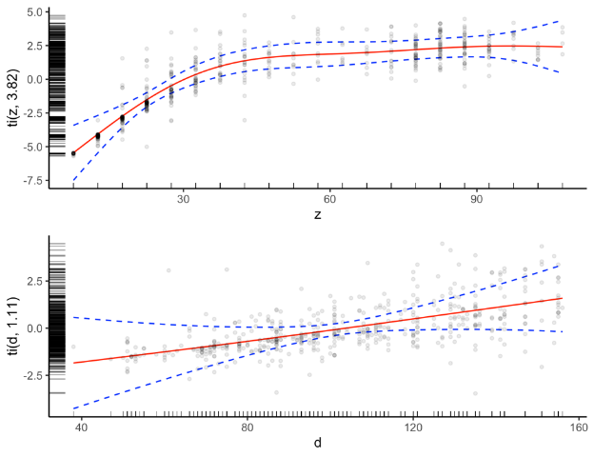
Estimated smooth functions: females
Notes:
For any particular year a SBS study occurred.

Slide 29
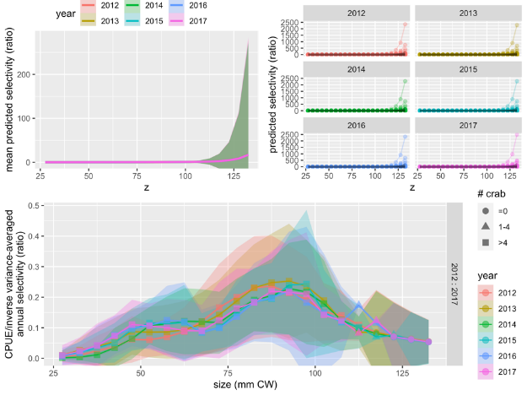
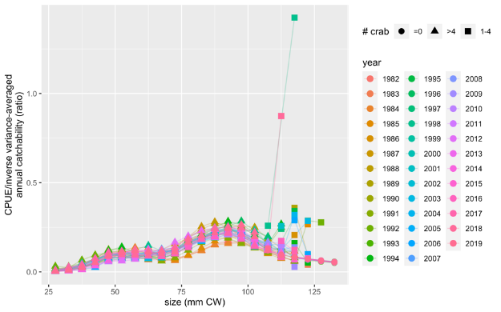
Estimated haul-level efficiencies and annual catchability: females
All years
Notes:
Predicted NMFS survey female catchability for 2012-2017. Upper row: unweighted mean and 95% confidence intervals (left); individual haul-level estimates (right). Lower row: Inverse-variance weighted estimates of annual NMFS survey catchability, with 95% confidence intervals.

Slide 30
Summary
Little information at largest crab sizes
  > 150 mm CW males, > 125 mm CW females
Aggregated analysis suggests survey catchability is asymptotic
  large uncertainty at largest sizes
  annual estimates seems unreliable
Haul-level analysis suggests survey catchability is dome-shaped
  large uncertainty at largest sizes
  incorporates spatial covariates
    concerns: extrapolation beyond observed values (needs to be quantified)
  allows estimation of annual catchability curves for 1982+
  other statistical models?: negative binomial, different random effects structure
Best application to assessment?
  as assumed values?
  as data?
Notes:
For any particular year a SBS study occurred.

Slide 31
Notes:
For any particular year a SBS study occurred.

Slide 32
Other approaches: Somerton and Otto (1999) Underbag Experiment
estimated “net efficiency” for Tanner (and snow) crab
fit ascending, descending logistic curves
  crab captured entering net through mouth
  crab captured entering through mesh underneath
Notes:
For any particular year a SBS study occurred.

Slide 33
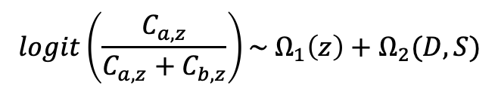

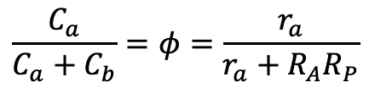
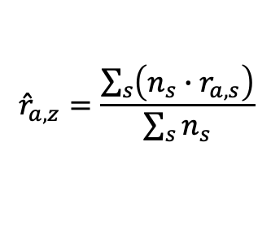
Somerton et al (2013): NMFS/BSFRF SBS Study
footropes
snow crab targeted
estimated ”relative net efficiency” of NMFS gear to BSFRF gear
83-112
$$\frac{C_{a}}{C_{a}+C_{b}}=φ=\frac{r_{a}}{r_{a}+R_{A}R_{P}}$$
nephrops
$$logit\left(φ\right)=\log\left(r_{a}\right)−log⁡(R_{A}R_{P})$$
$$logit\left(\frac{C_{a,z}}{C_{a,z}+C_{b,z}}\right)\sim Ω_{1}\left(z\right)+Ω_{2}(D,S)$$
at each SBS station
$$r_{a,z}=exp⁡[Ω_{1}\left(z\right)+Ω_{2}\left(D,S\right)+\log\left(R_{A}R_{P}\right)]$$
average for all EBS
$${\hat{r}}_{a,z}=\frac{\sum_{s}{\left(n_{s}∙r_{a,s}\right)}}{\sum_{s}{n_{s}}}$$
2010
92 stations
Notes:
For any particular year a SBS study occurred.

Slide 34
Somerton et al., 2013 for snow crab (cont.)
weighted r_{a} expanded to EBS stations
unweighted average r_{a} over SBS stations
environmental covariates
Notes:
For any particular year a SBS study occurred.

Slide 35
Kotwicki et al. (2017): Return to NMFS/BSFRF SBS Study
used 2010 SBS data for snow crab
estimated ”selectivity ratio” of BSFRF gear to NMFS gear
proportion NMFS
selectivity ratio
catch comparison ratio
Notes:
For any particular year a SBS study occurred.

