Slide 1
Crab SAFE: Economic Status Report 2020
Presented by:
Brian Garber-Yonts
Alaska Fisheries Science Center
Economics and Social Science Research Program
January 12, 2021

Slide 2

2020 Crab Economic SAFE Overview
Executive Summary (SAFE Report extract)
Economic Status and Trends
  Economic output
    TACs, landings, ex-vessel and finished product volume
    Ex-vessel and first wholesale revenue and average prices
  Income and employment
  Operating costs and Income Statement (New)
  Quota Market and Holdings
  Fishing capacity and effort
  International trade
Notes:
Exec sum to be reshaped into reportcards?

Slide 3
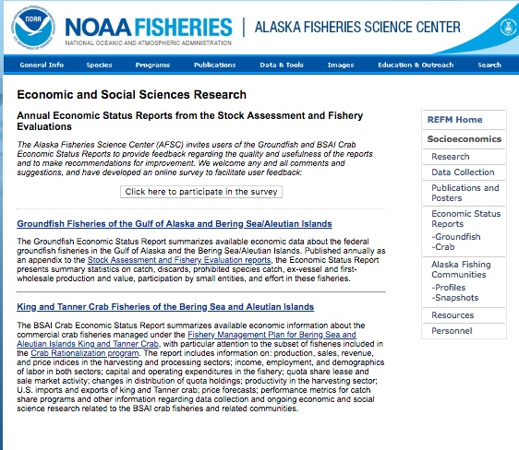
Economic SAFE availability
https://www.afsc.noaa.gov/REFM/Socioeconomics/SAFE/default.php

Slide 4
SSC Comments
…recommends that [net earnings] be developed for the processing sector as well. The SSC also recommends that the Crab SAFE include report card indices that parallel those in the groundfish SAFE. The SSC notes that these indices do not need to be the same as those of the groundfish SAFE but should be informative about the current performance of the crab fisheries relative to past performance. The SSC also recommends that data presented in the Crab Economic SAFE tables be available for download by the public, similar to the data in the Groundfish SAFE.”
  Very limited cost data available for crab processors.
  Report card indices will de developed for May CPT meeting
  New! Executive Summary data available online via AKFIN: https://reports.psmfc.org/akfin

Slide 5
SSC Comments
“The upcoming crab SAFE analysis of the extent of quota leasing, the degree to which quota is being fished by leaseholders rather than quota owners, and how ownership patterns have changed over time should include a disaggregation to the community level where possible. This would allow time series tracking of the flow of ownership among communities and analysis of trends (e.g., quota moving from smaller to larger communities over time). Vessel ownership by community should be similarly tracked on an annual basis in the SAFE document to allow the identification of trends, as should the number of reductions in the amount of employment throughout the fisheries noted (e.g., the number of crew positions decreasing by 10%).”
  Ownership decomposition still in development; spatial disaggregation of results will be addressed as possible.

Slide 6
SSC Comments
“It should be clarified that an increase in price does not mitigate all community impacts of the decrease in vessel and processing activity that would accompany such a large decrease in TAC…
SSC suggests that information on average daily and total seasonal wages be provided by community and tracked over time. Similarly, clarification is needed on the relationship between the attribution of a decrease of 33% in processing hours in 2016 compared to the previous year to “the decrease in TACs across all stocks” and the decrease in median processing wages seen that was stated “as most likely due to increased efficiencies in processing procedures and a resultant decrease in overtime pay.”
”
  Crab processing labor statistics generally cannot be disaggregated to community level due to confidentiality limits.

Slide 7
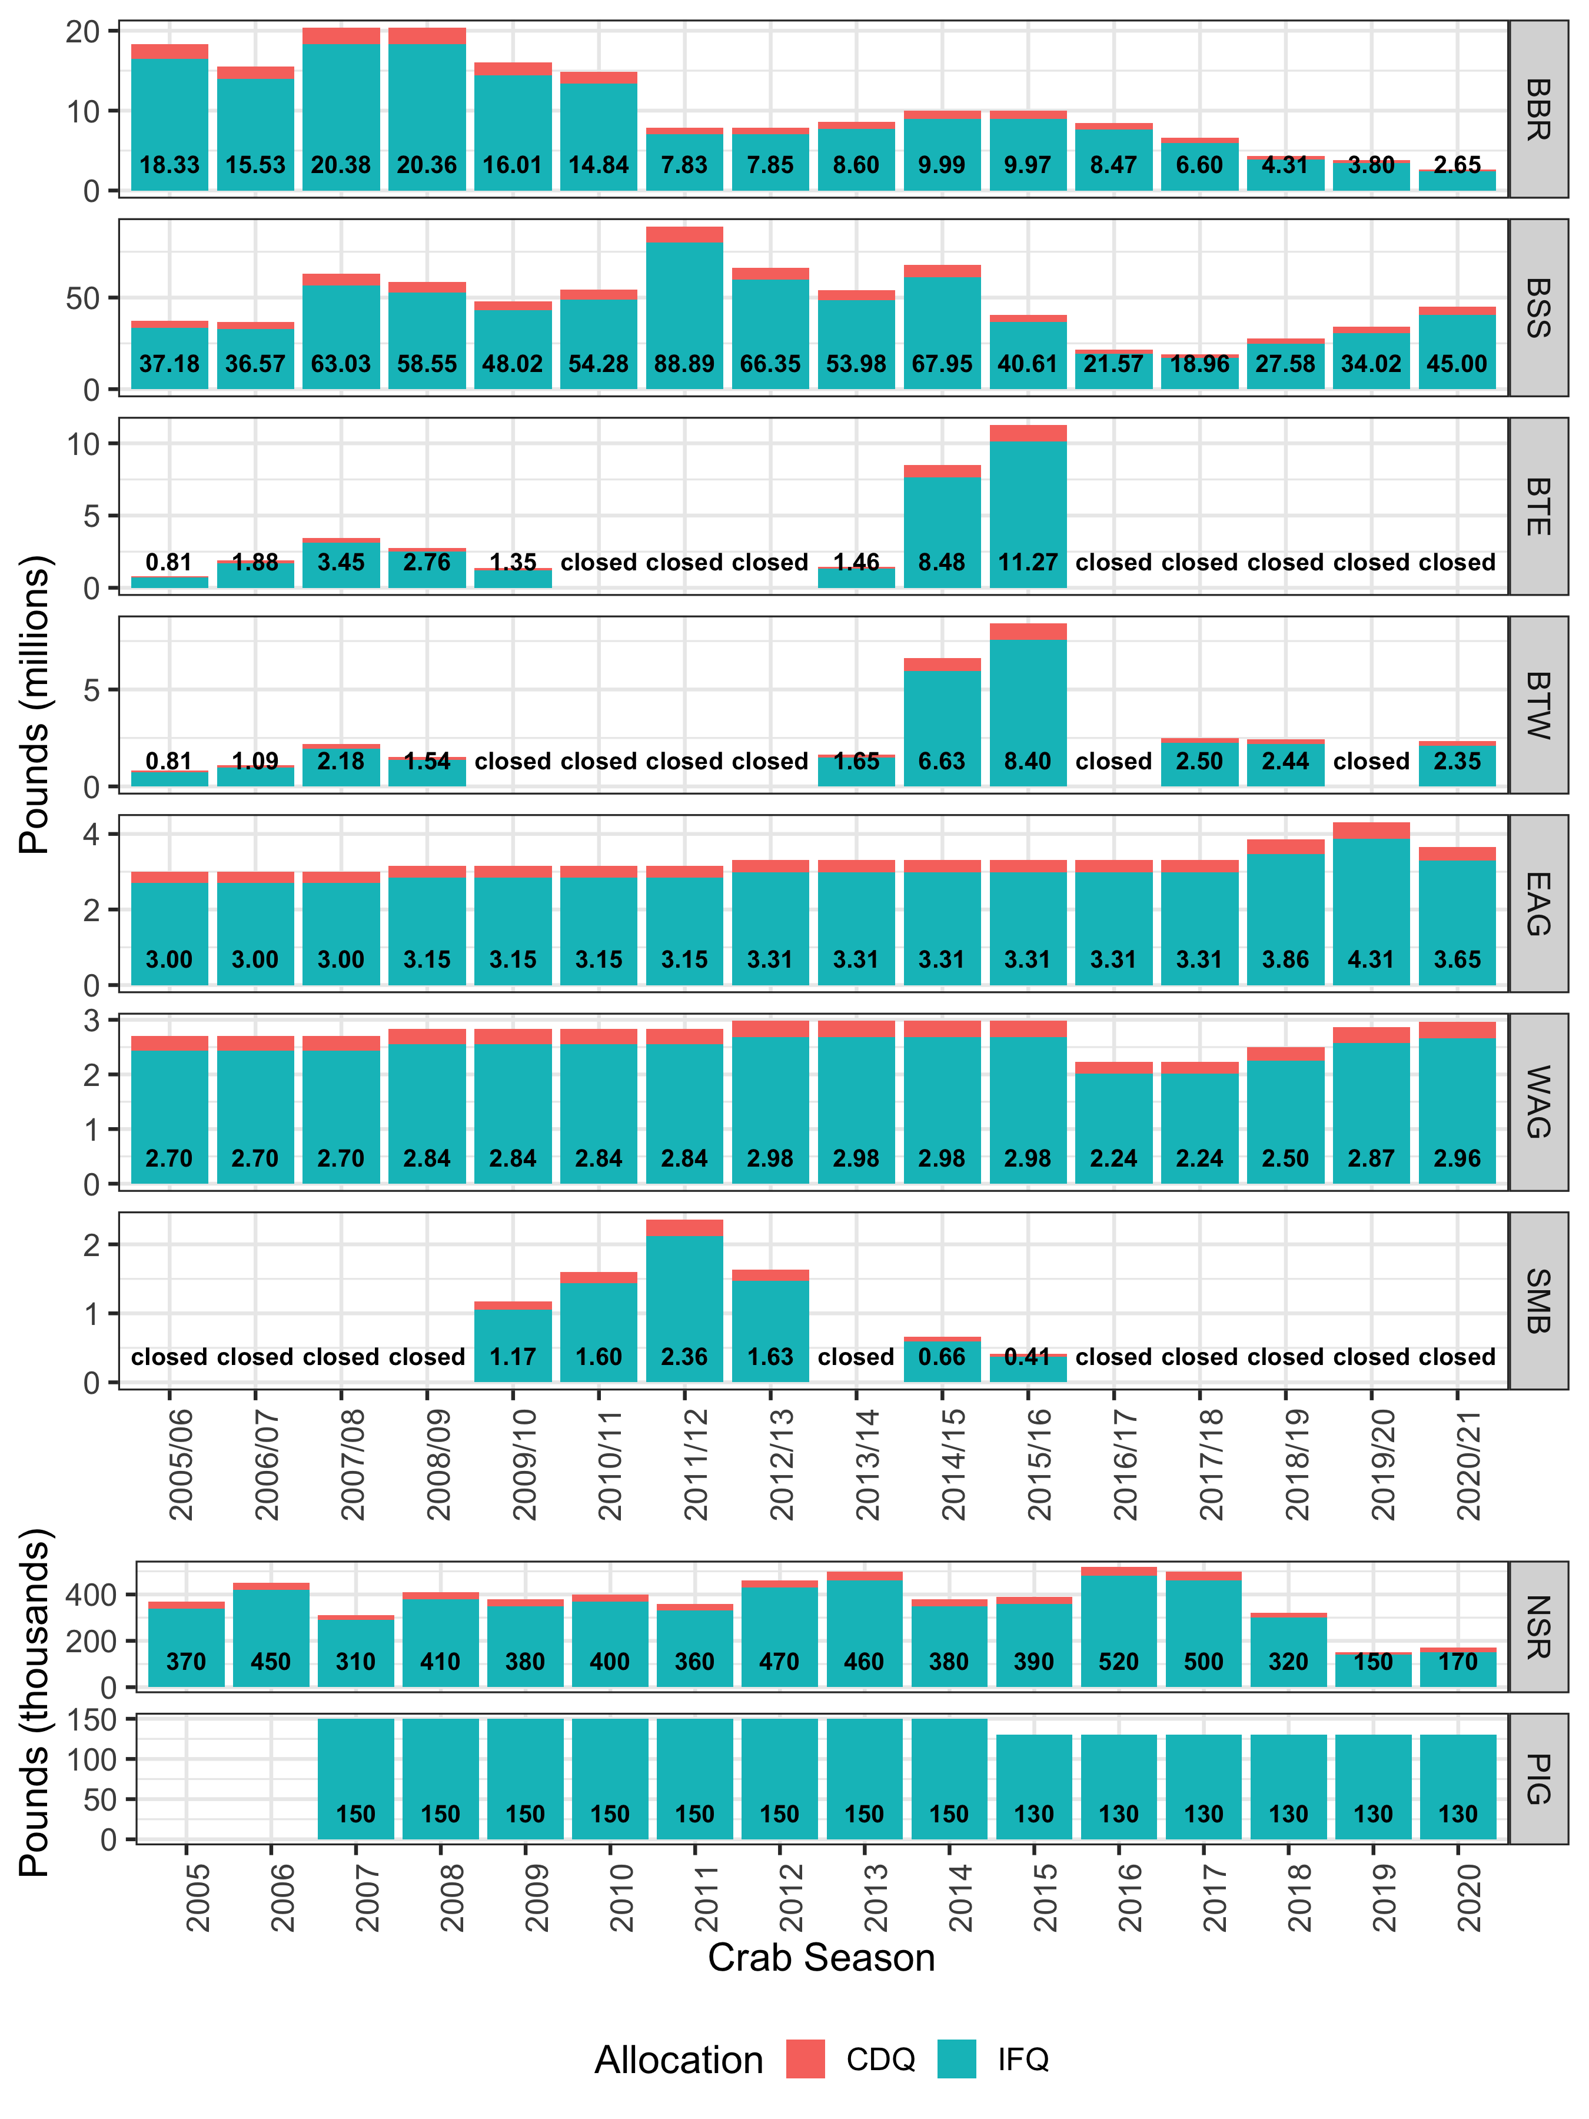
TAC 2005/06 – 2020/21

Slide 8
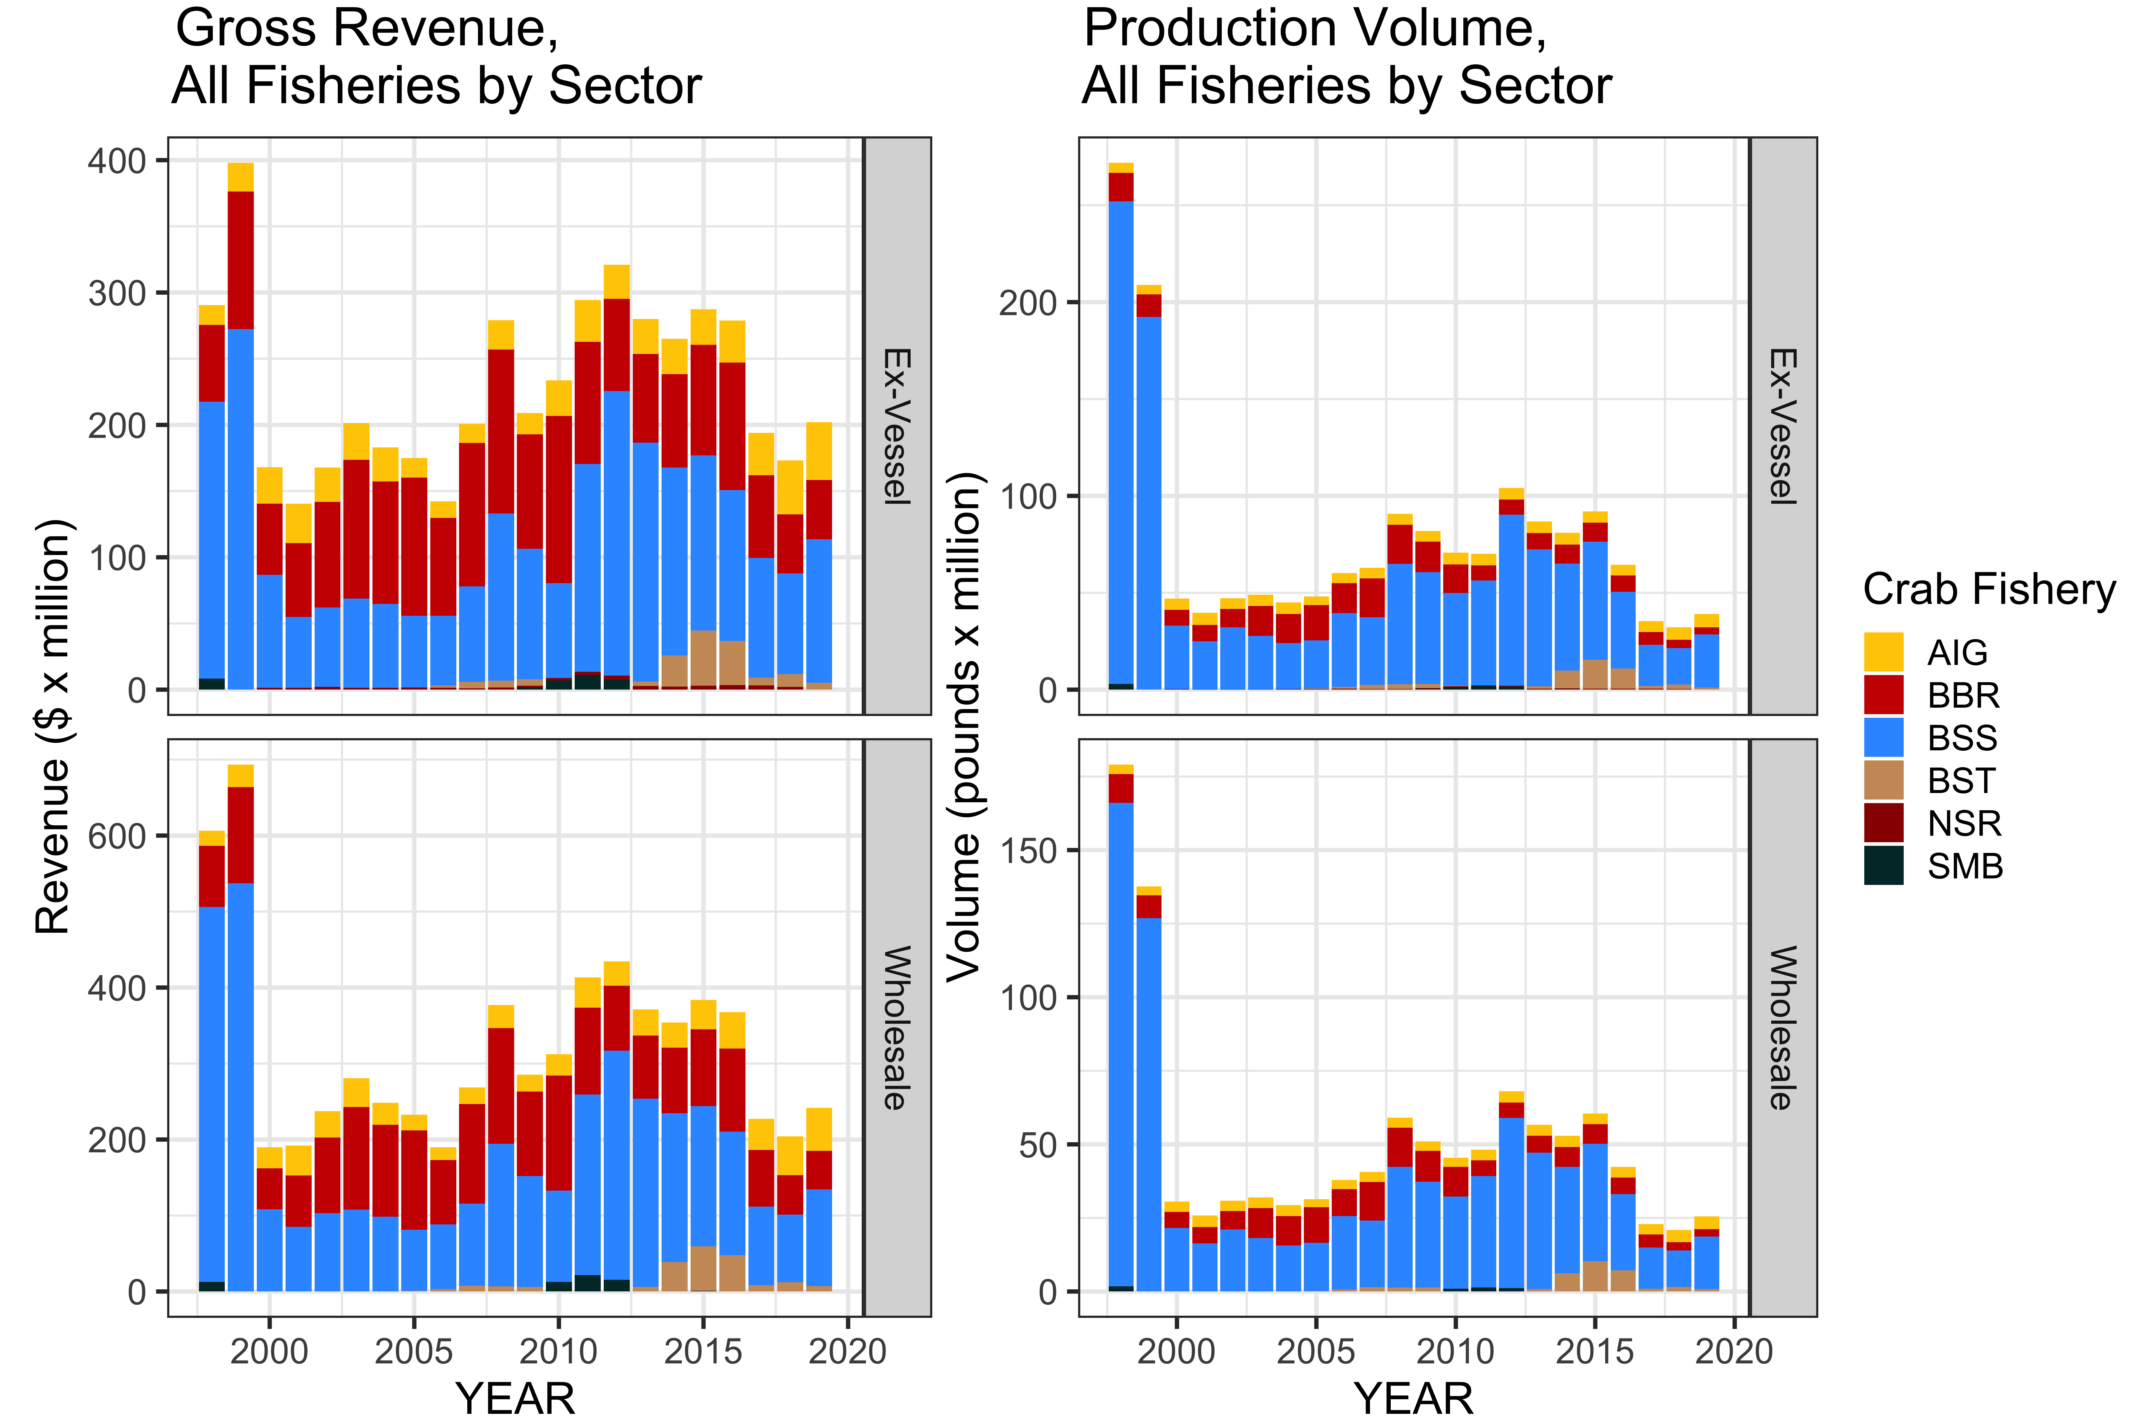
2019 Production & Value

Slide 9
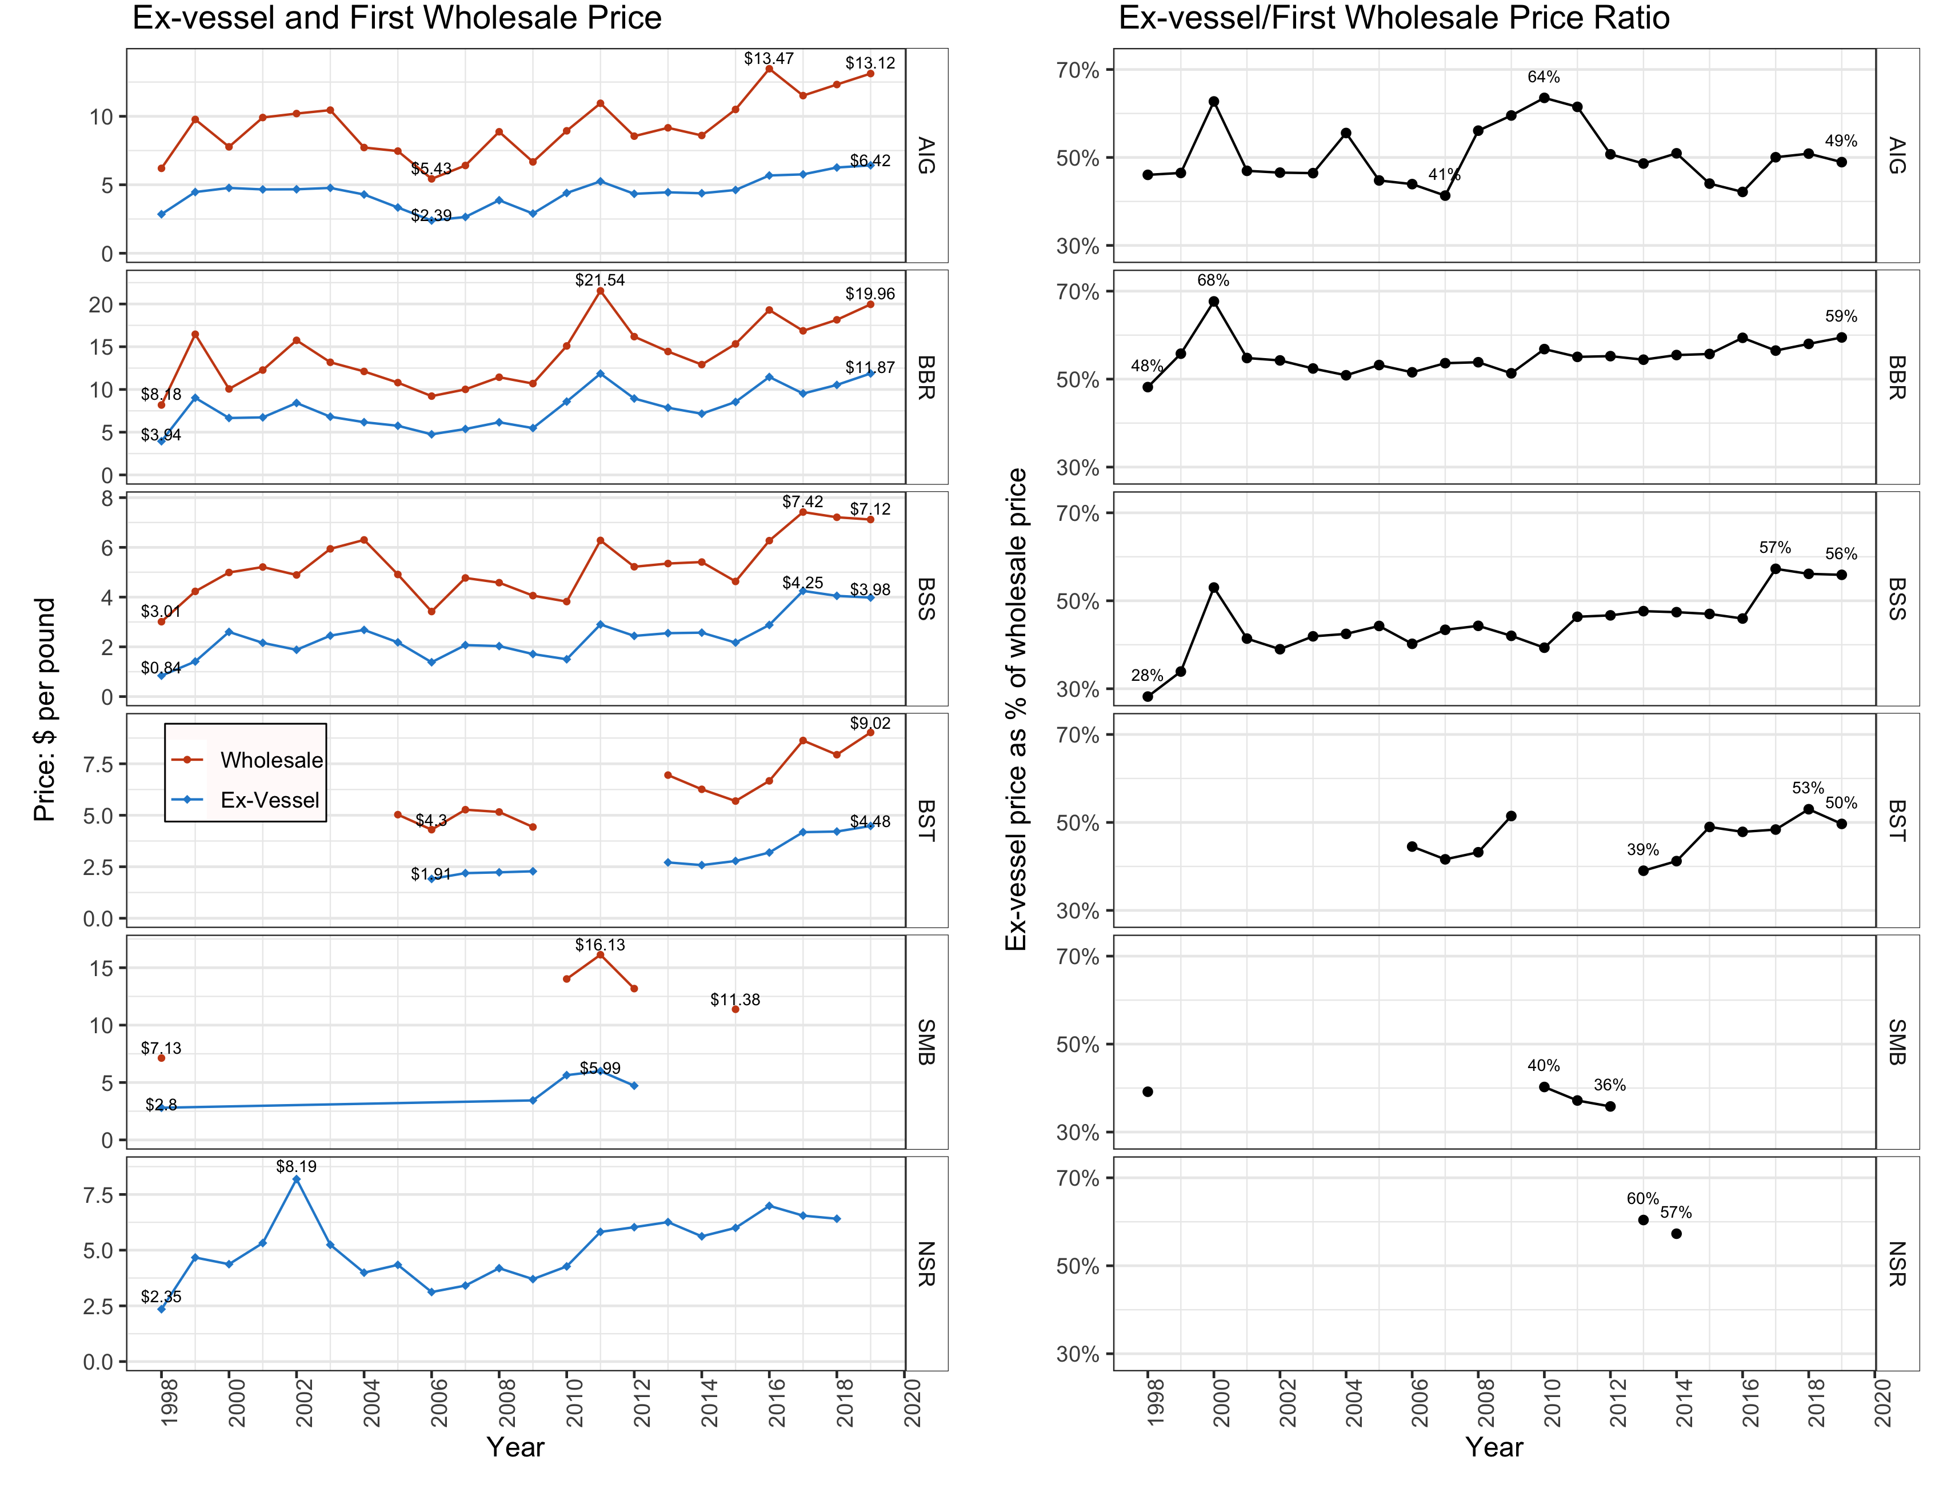
2019 Ex-vessel & Wholesale Price
Notes:
Price ratios: generally stable, but slight upward trend over long term, although BSS trending down in <3 years
Stability is result of arbitration, coop management
Doesn’t control for affiliated sales (AIG particlularly vert integrated)
Should be particular focus for further development

Slide 10
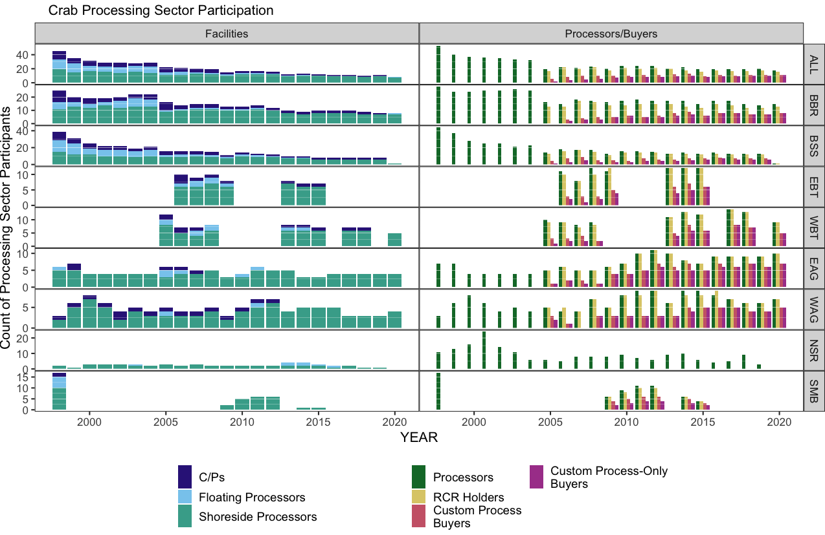
2019 Processing Capacity
Notes:
Only 12 active plants, from 17 5 years ago

Slide 11
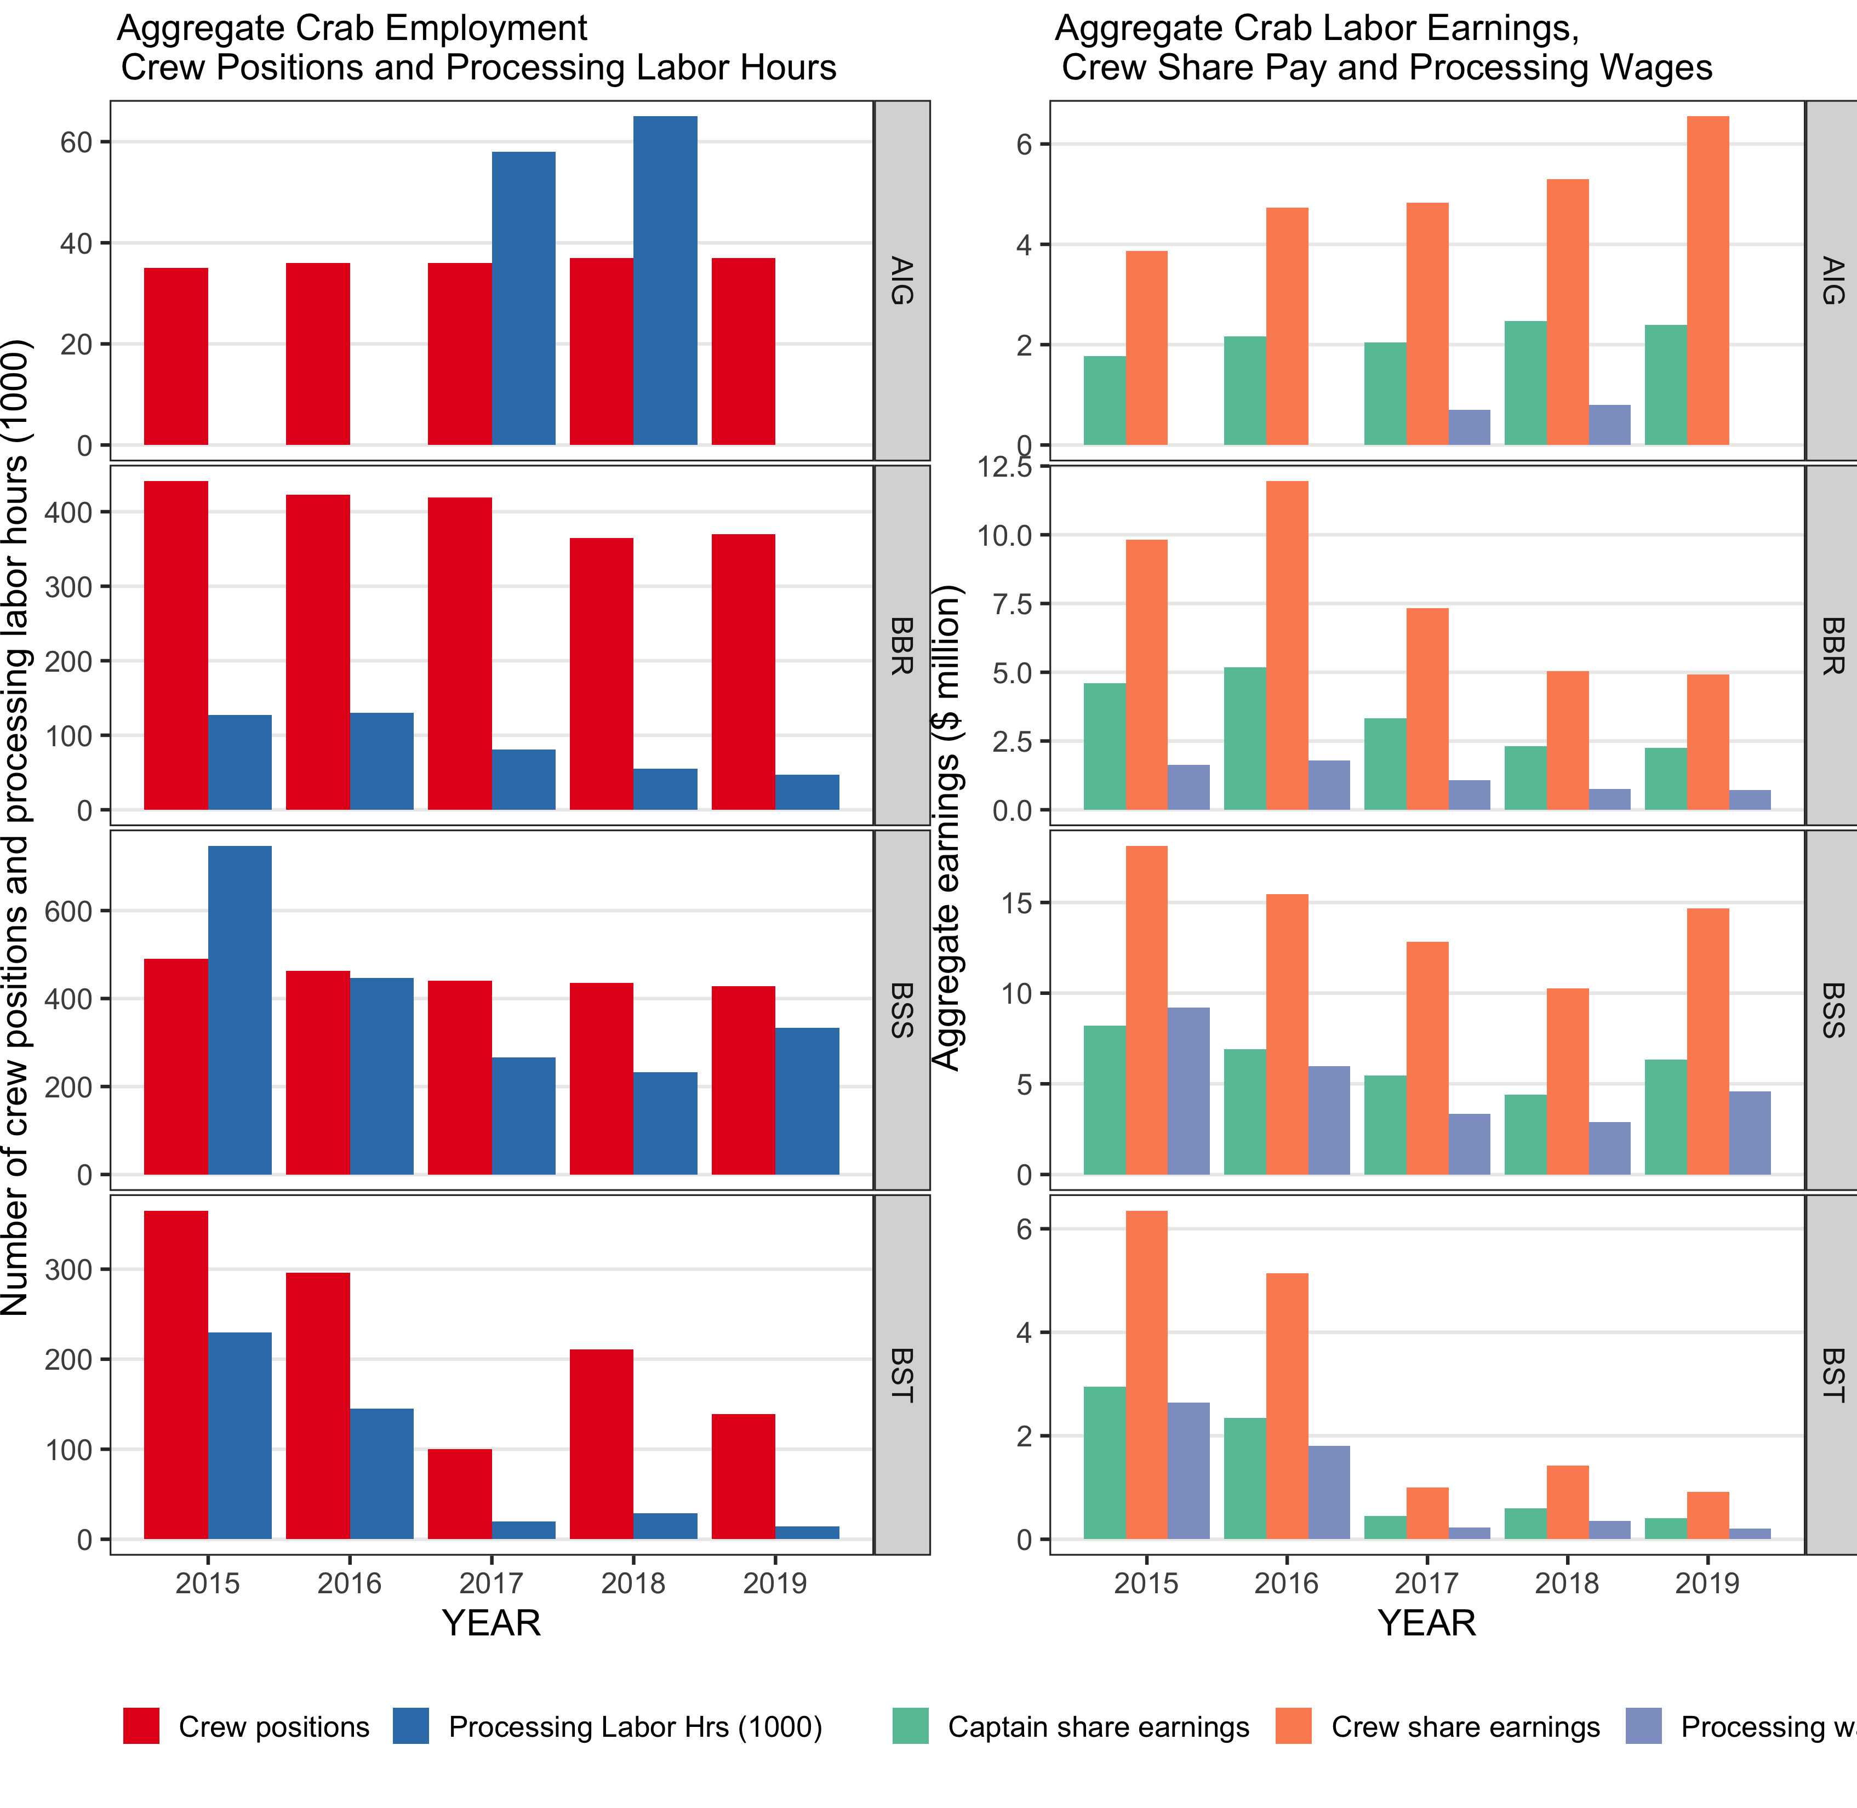
2019 Employment & Income (CR program)

Slide 12
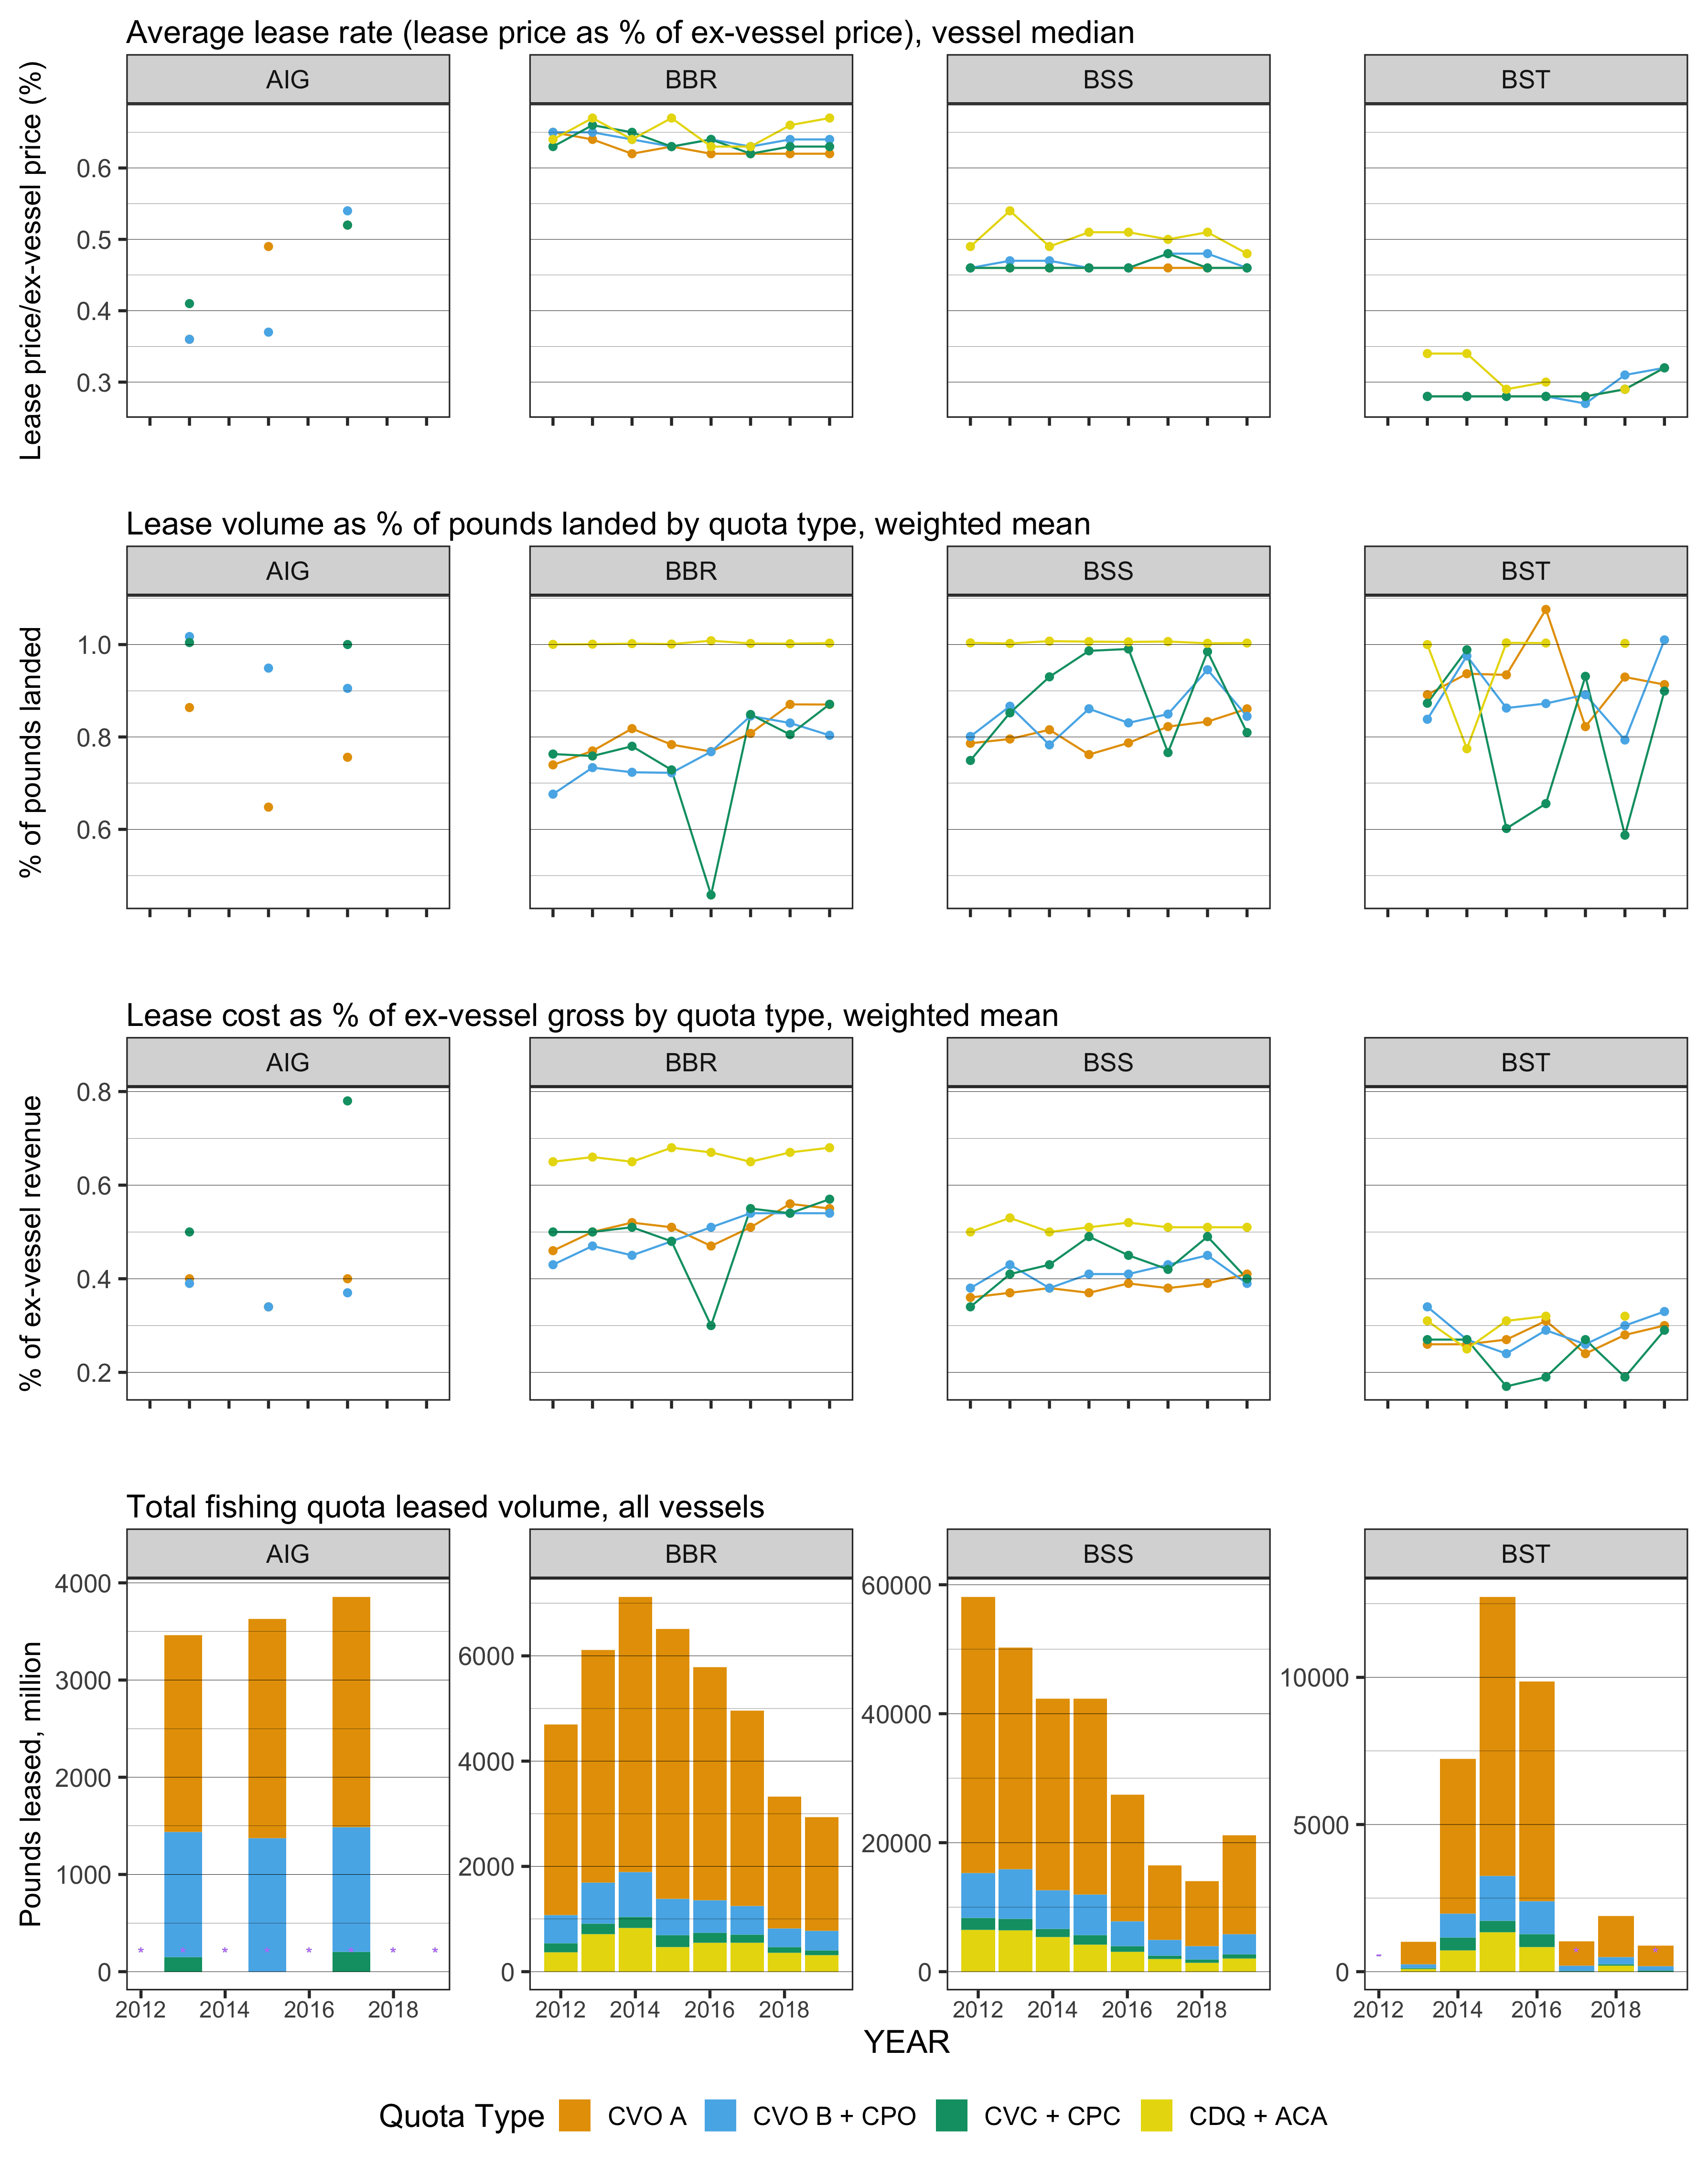
IFQ Lease Activity and Rates
  BBR CVO A: 62-63%
  BSS CVO A: 46%
  Over all QS:
    81-88% Leased
    39-42% Gross

Slide 13
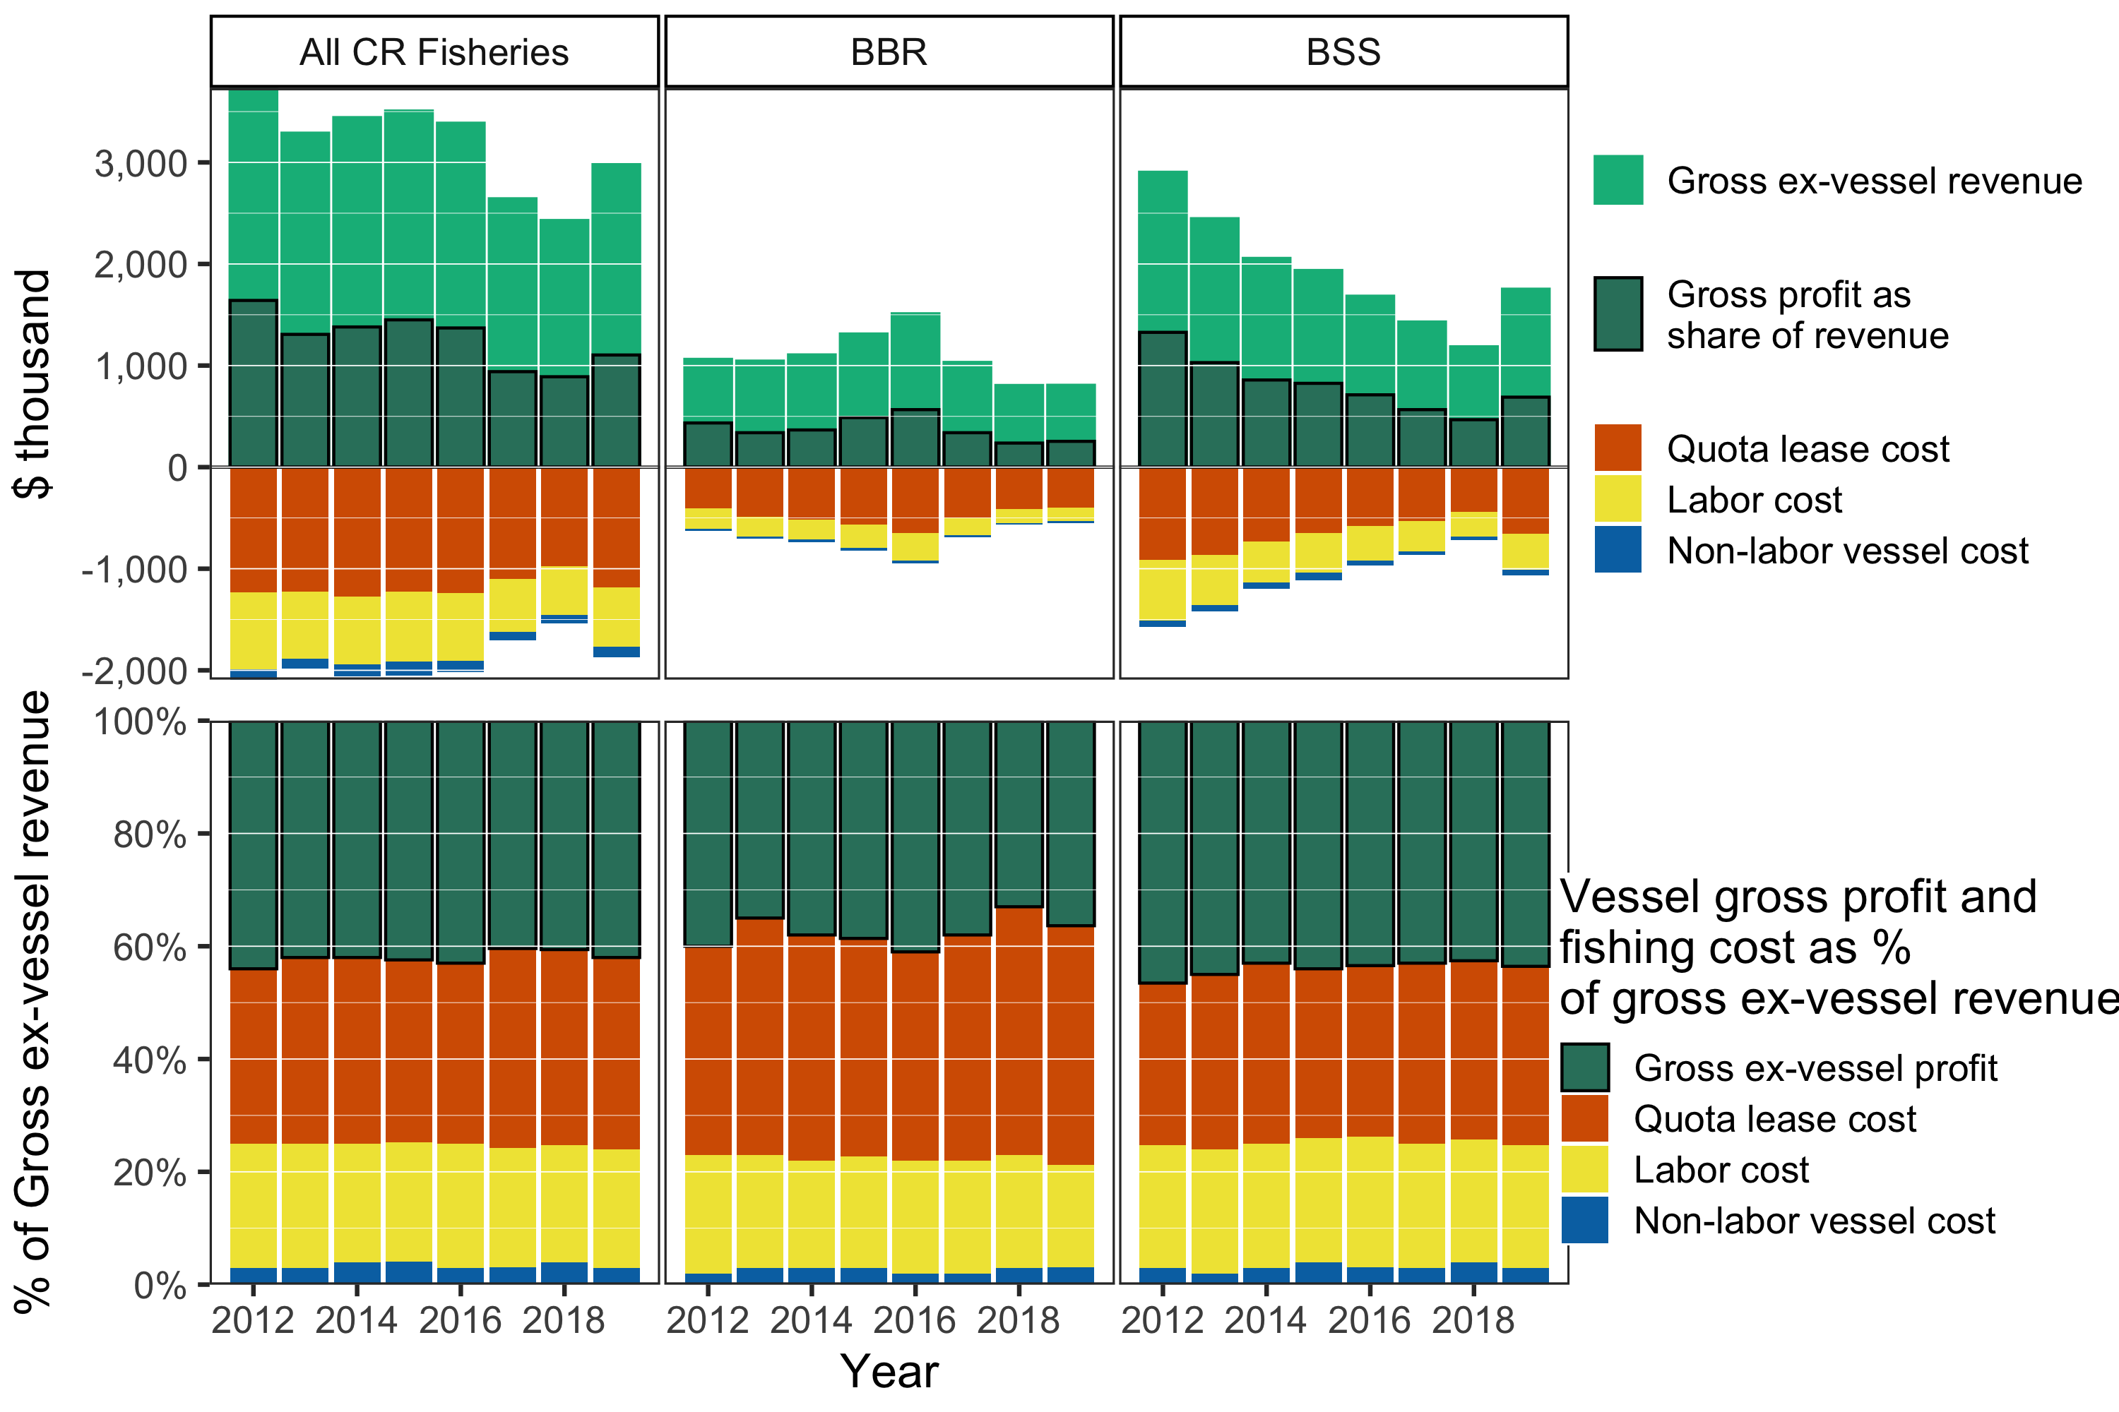
Vessel Income Statement

Slide 14
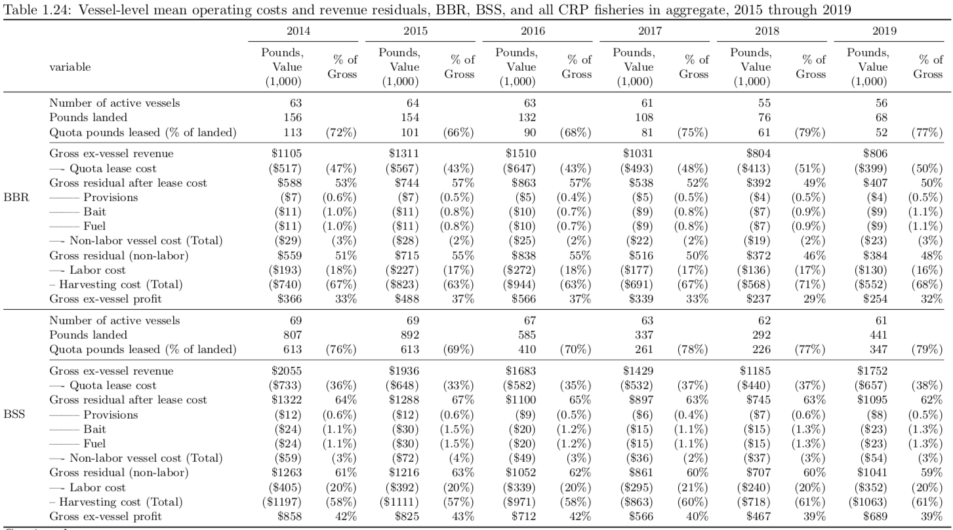
Vessel Income Statement

Slide 15
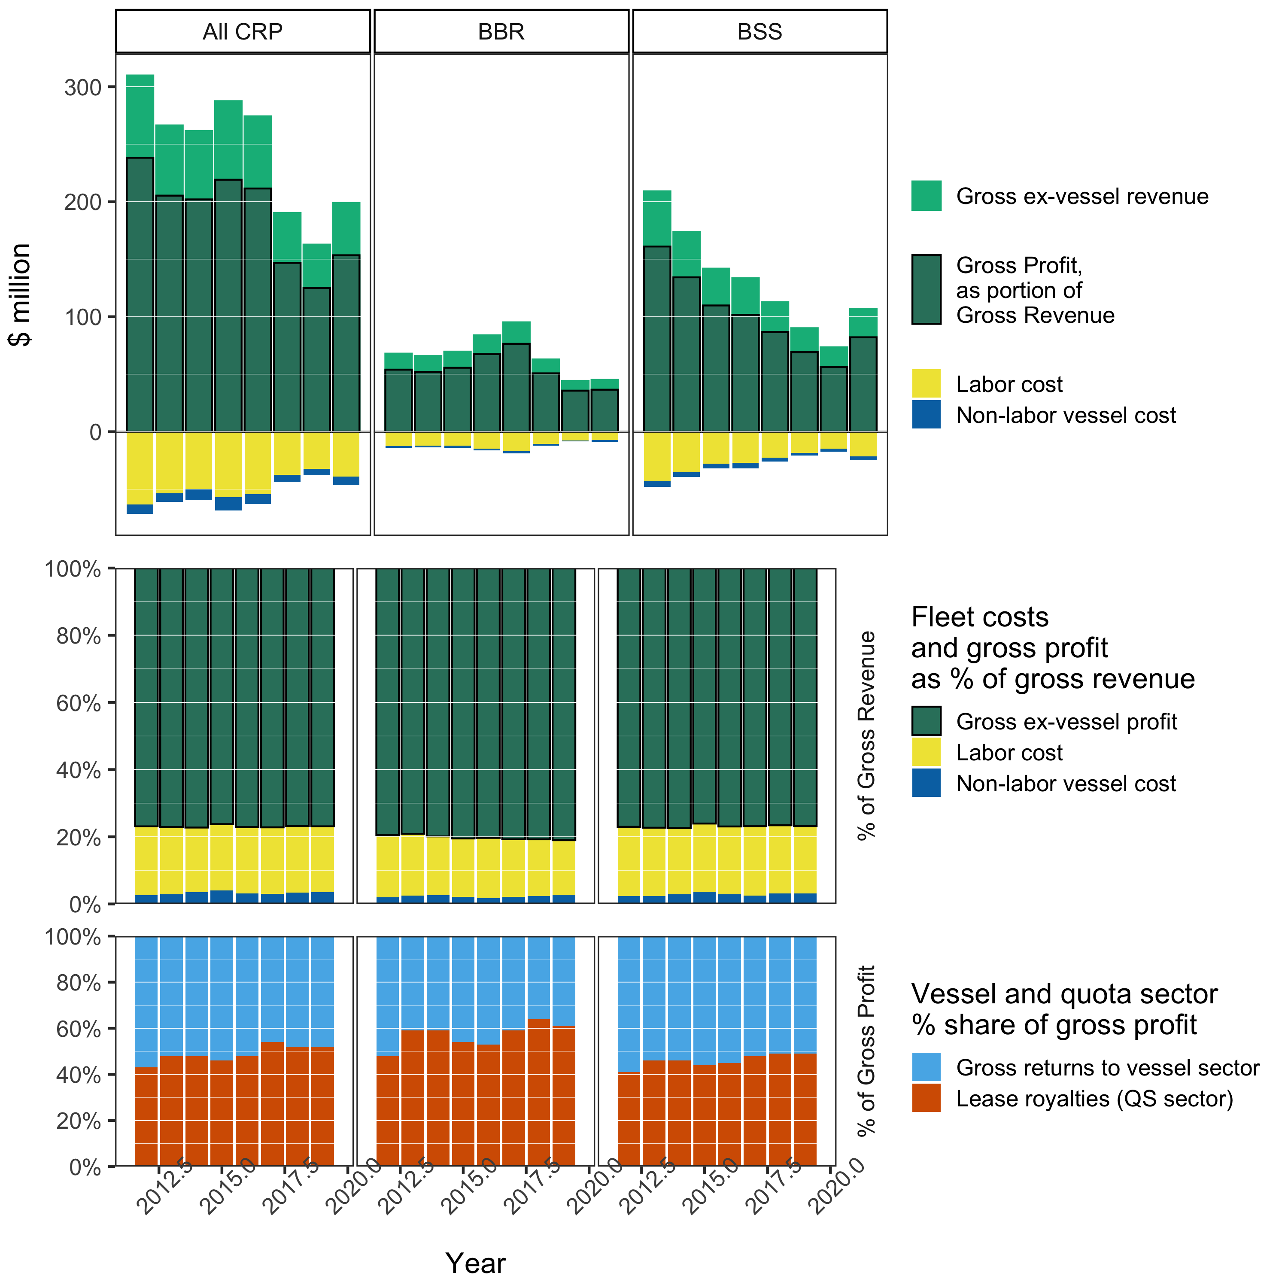
Fleet Income Statement
Notes:
Cost accounting limited to fuel, provisions, and bait; capital maintenance and investment, overhead, other business costs not included, hence gross profit
Quota costs are transfer rather than economic cost

Slide 16
Discussion
Priorities for 2020 SAFE:
Report card metrics, ESP integration
Price forecasts & current-year estimates
Demographics (Community chapter)
Processing sector income analysis
Council EDR Review

Slide 17
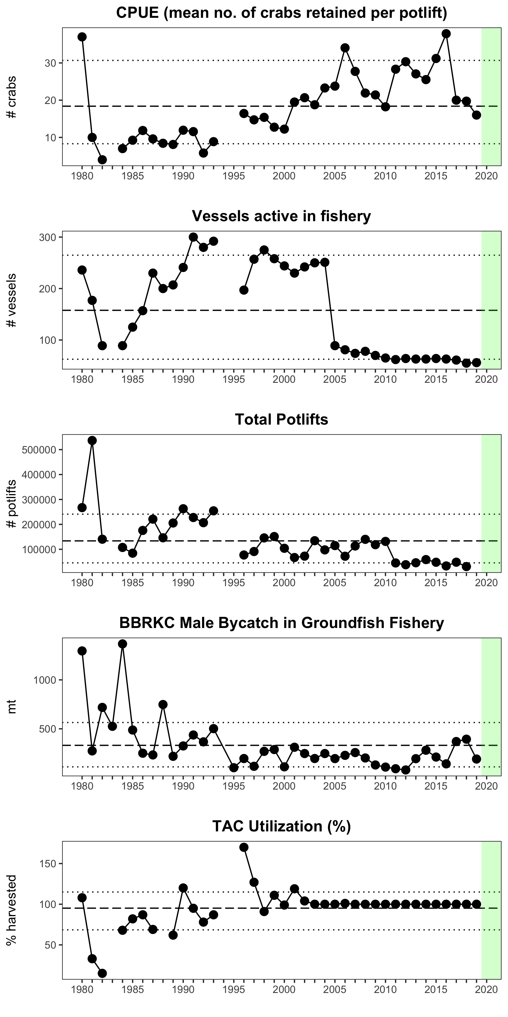
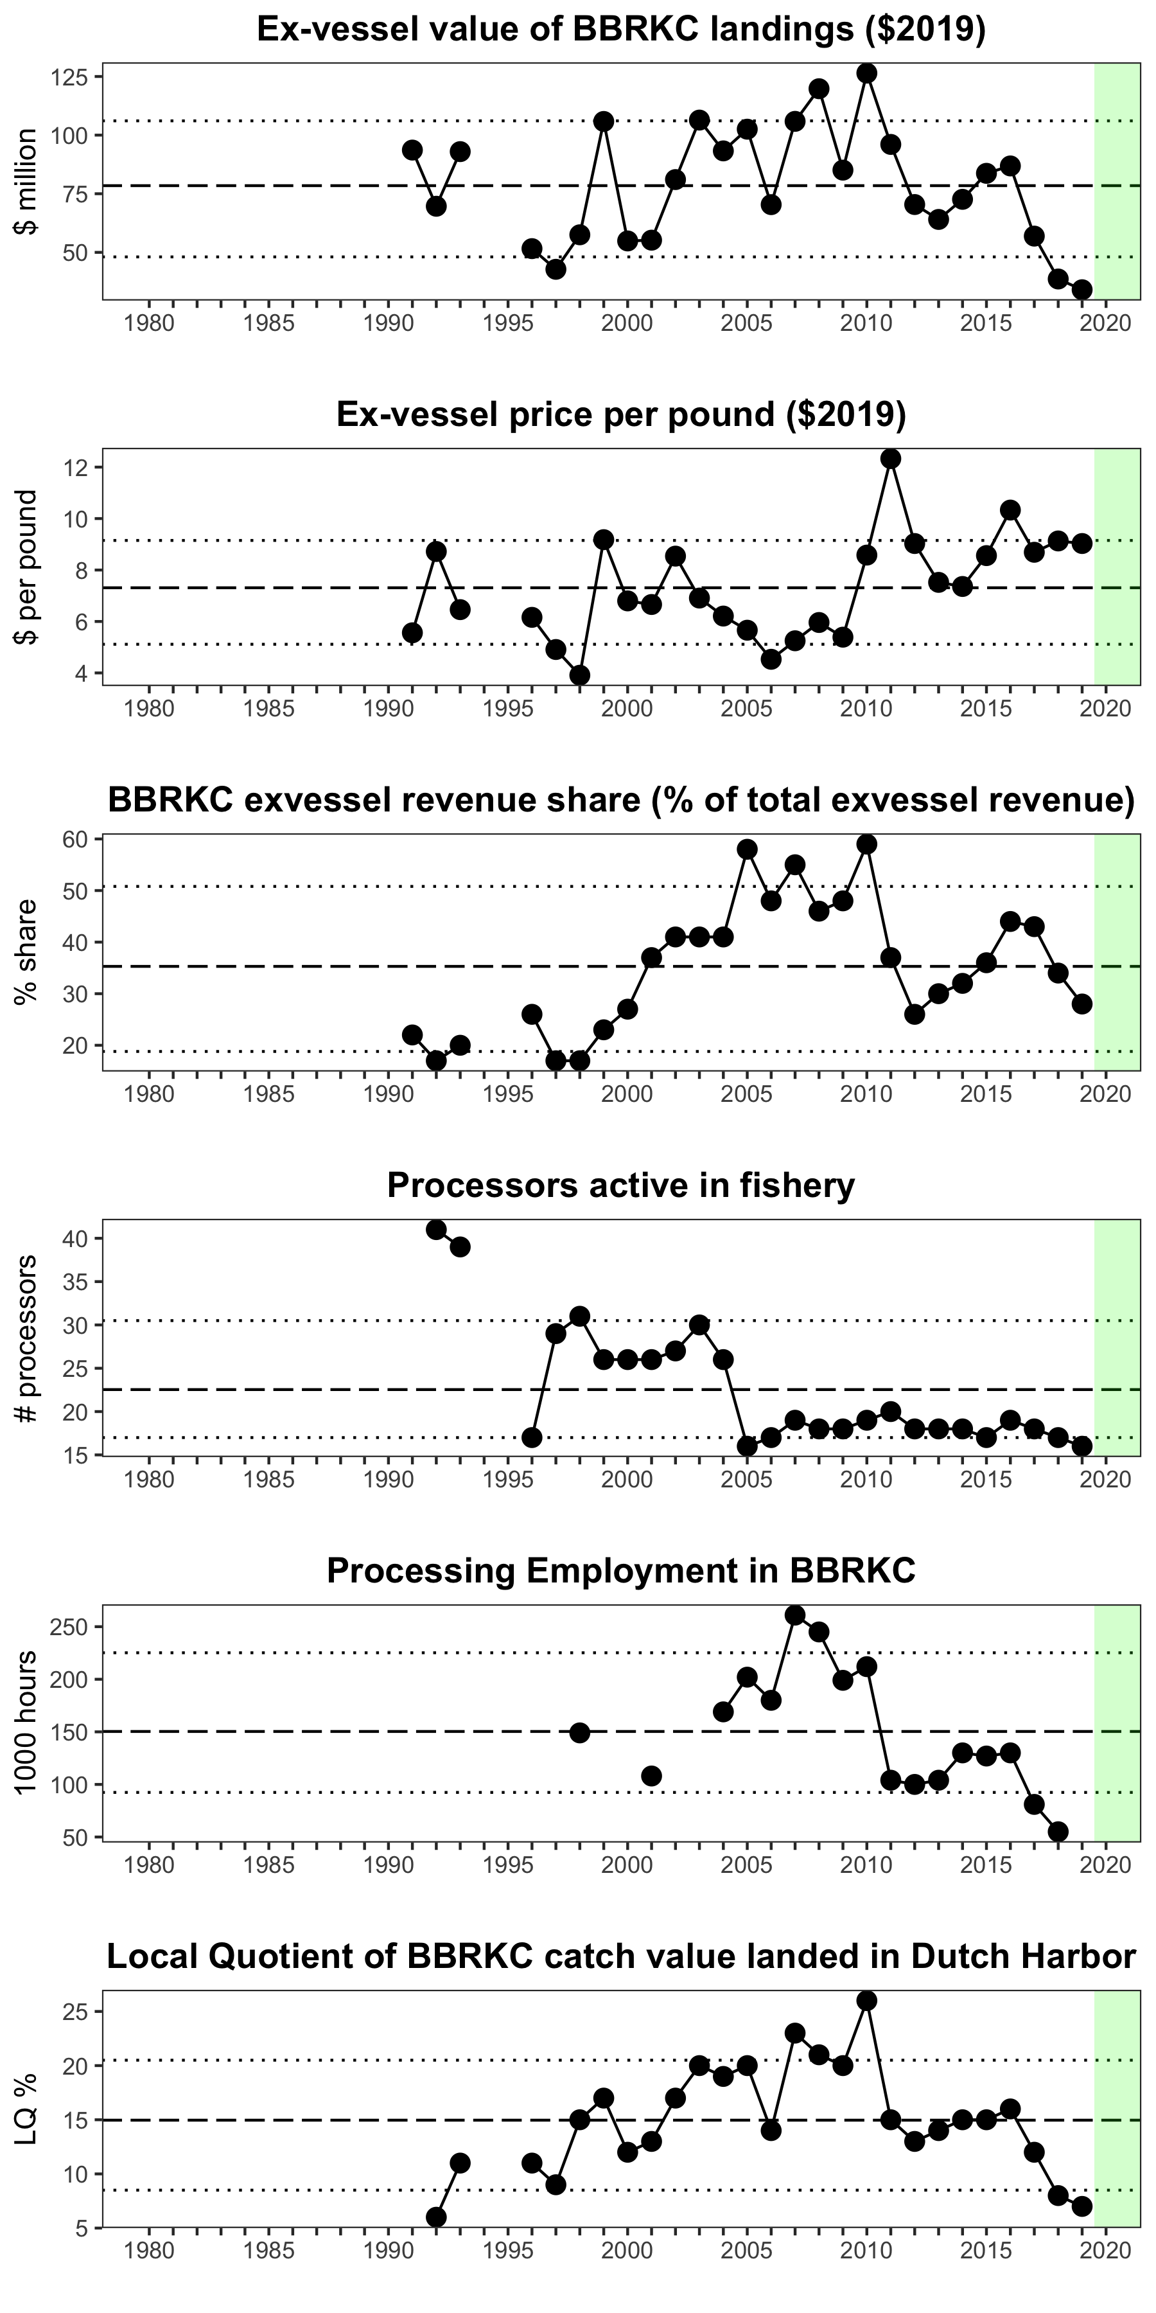
ESPs
Candidate metrics

