Slide 1
An exploration of assessment methods for EBS snow crab
Addressing retrospective patterns through consideration of time-variation
Cody Szuwalski
May 17, 2021
Crab Plan Team

Slide 2
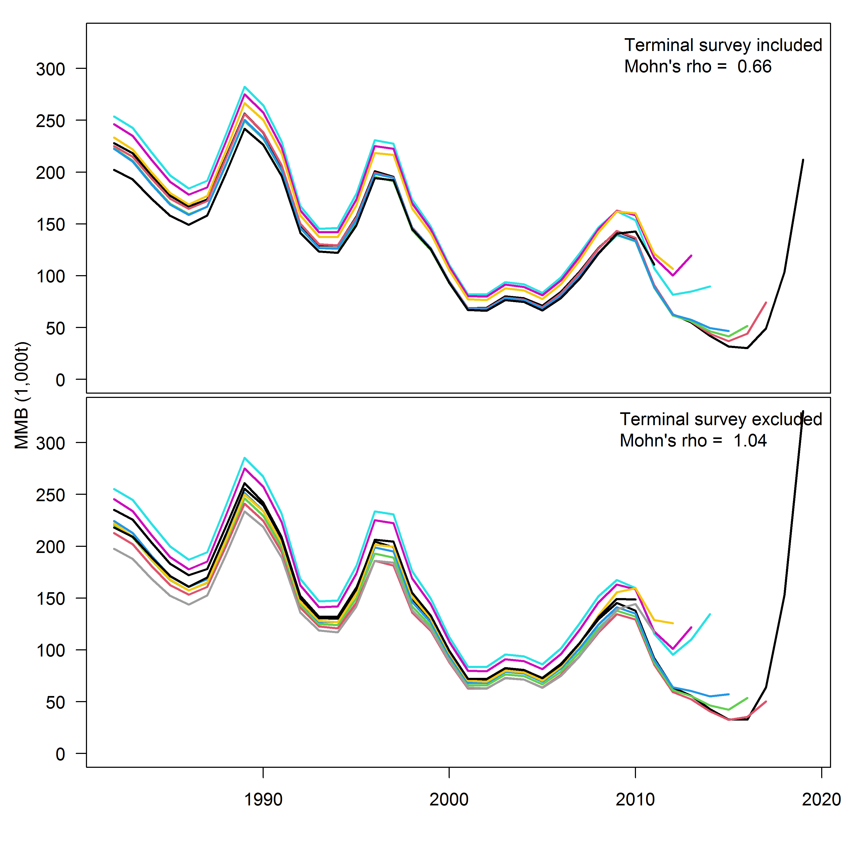
Retrospective
Recruitment
Tier 3.5
‘Empirics’
How can we address retrospective patterns?

Slide 3
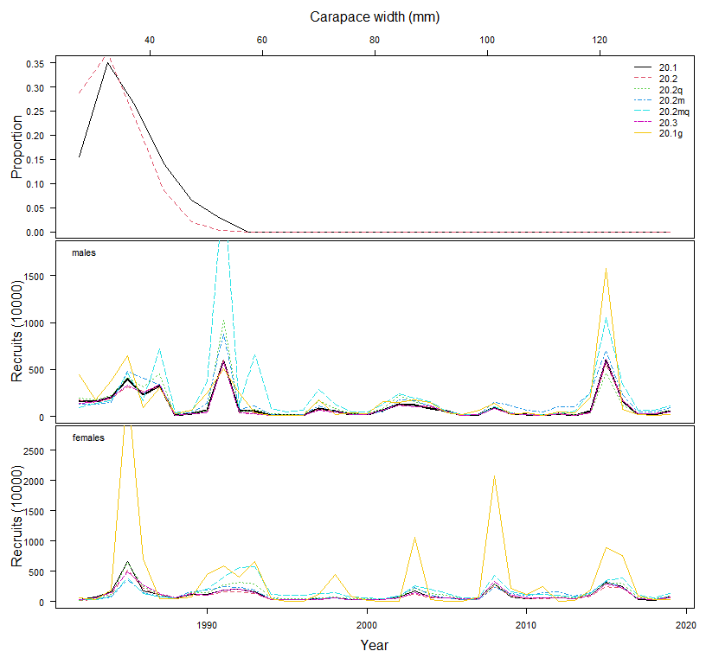
Retrospective
Recruitment
Tier 3.5
‘Empirics’
How big of a 2015 recruitment is plausible?

Slide 4
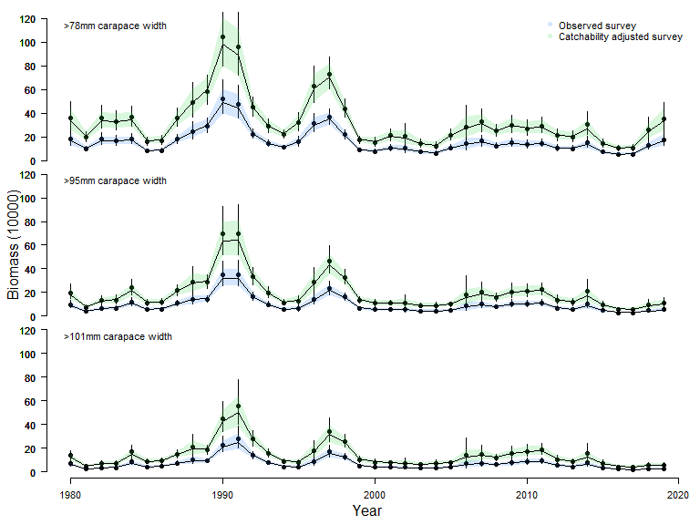
Retrospective
Recruitment
Tier 3.5
‘Empirics’
Ways to address retrospective patterns
Post hoc adjustments (e.g. increased buffers)
Additional model structure (e.g. time-varying M)
Survey-based management (e.g. Tier 4 methods)

Slide 5
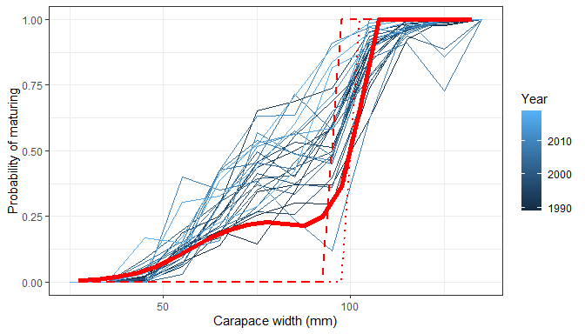
Retrospective
Recruitment
Tier 3.5
‘Empirics’
What do we know?
Mature biomass
Growth
Fishery selectivity
Natural mortality
Maturity
Survey selectivity

Slide 6
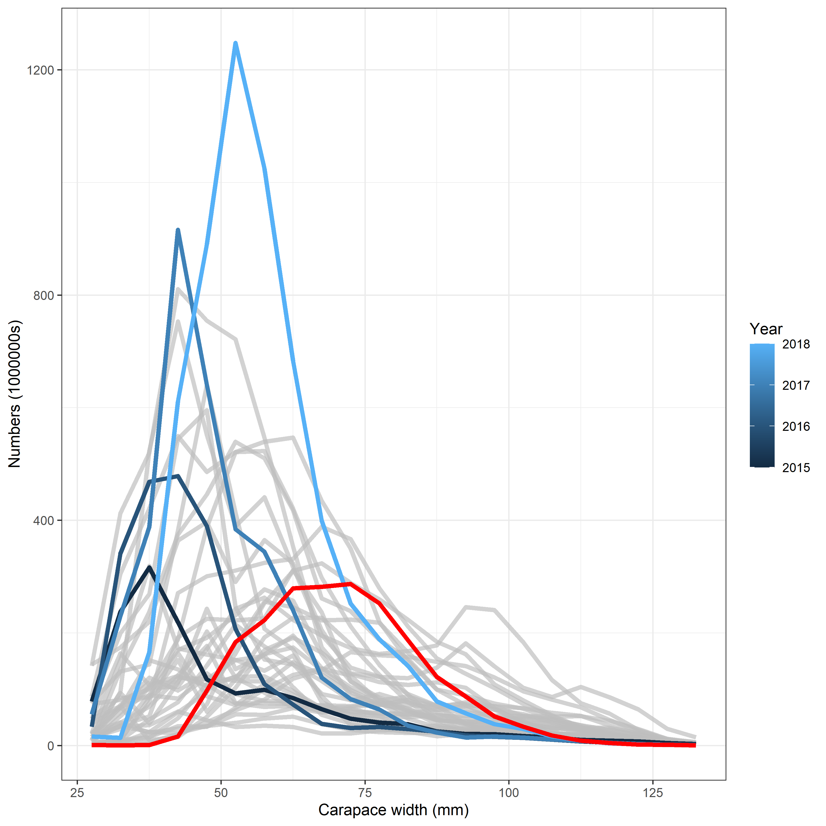
SSC comment: Generally, the SSC accepts a new model when it represents an improvement over the previous model. There are some improvements and advantages with the author-preferred GMACS model relative to the status quo model, but there are also some unresolved problems. Beyond improved fits to the data, one of the most important evaluation criteria is biological plausibility of the results, and a new modeling framework is only as good as the plausibility of the results. The SSC noted that it seems unlikely that the stock is 4x larger than last year’s estimate, while lacking new survey data to support that conclusion.
The estimated MMB for the author preferred model in 2019 was 167 kt; in 2020 it was 276.7 kt (a ~65% increase). Model 20.3 did have a larger change than this, but it was not the author-preferred model. The changes in the author-preferred model were consistent with changes observed in the stock when similarly sized recruitments entered the population. The numbers at length in the survey from 2015-2018 consistently suggested a cohort larger than has ever been observed. However, the survey data from 2019 suggested a decline in numbers across all size classes. Even with that decline, the remaining numbers at length were comparable to the cohort that supported >100 kt catches in the late 1990s at a similar point in its development (see the 1996 numbers at length and compare that to the retained catches in 1997).

Slide 7
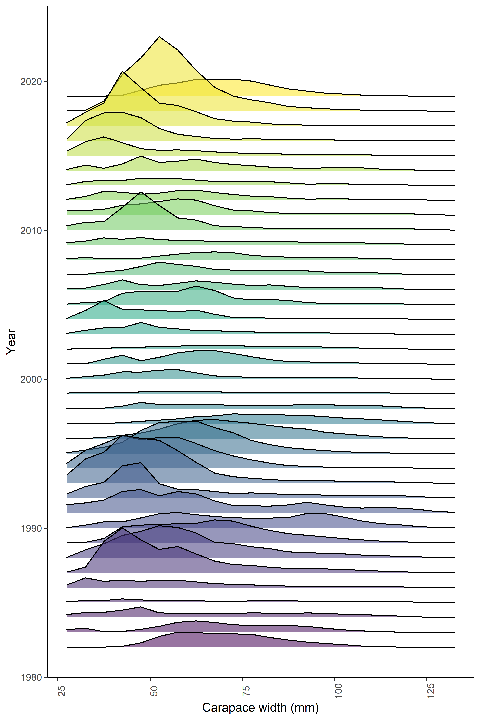
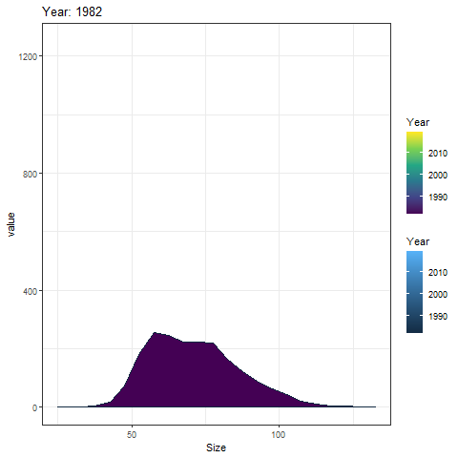

Slide 8
SSC comment: Despite this change in scale, there is still a very large positive retrospective pattern which is puzzling because one would expect this positive bias to be reduced if the previous model was overestimating stock size. The SSC recommends further efforts to reduce the large retrospective pattern in future models, perhaps through time-varying catchability, natural mortality changes, or different selectivity functions.
Author response: The retrospective patterns exist in both the status quo and GMACS model (see the SAFE from 2019 in which the retrospective pattern from the status quo model had a Mohn’s rho of 0.54-0.48). Time-varying catchability and natural mortality are explored below in the status quo model and result in smaller retrospective patterns, but produce different management advice. Implementing any new time-varying process in an assessment with a retrospective pattern will improve the retrospective pattern, but management advice can be drastically in error if the incorrect process is allowed to vary (Szuwalski et al., 2019). Consequently, an understanding of what process is time-varying is recommended before implementation of time-variation in integrated assessments.

Slide 9
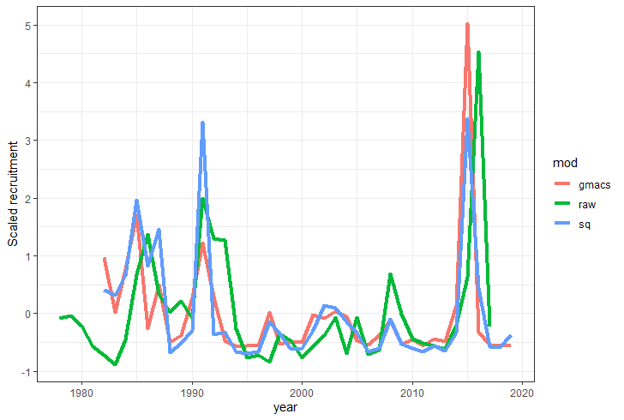
SSC comments: The author and CPT had concerns with how recruitment variability is controlled in Model 20.2, which does not appear to have been resolved with the extremely large estimated 2015 year class in the author’s preferred model. The GMACS model (20.2) seemed to fit some of the data slightly better, most particularly the MMB survey data in the terminal years, but the SSC considered the recruitment deviation problem too big to ignore. Until a resolution is reached on how to appropriately control recruitment estimates, the author provided a sensitivity to each of the 2018 and 2019 survey data points. This sensitivity revealed that the model responded differently to each survey and showed that under either survey scenario, Model 20.2 was still providing higher estimates of MMB compared to the status quo model (20.1).
Large estimates of recruitment from the GMACS model compared to the status quo are primarily a result of poor fits of the status quo model to the survey data. An example is presented here in which the status quo model is forced to fit the survey data in the terminal years by inputting smaller CVs. This results in estimates of recruitment similar to GMACS (though not quite as large) and an estimated OFL of 175 kt. The 2015 cohort was on track to be the largest ever recorded based on the observations of numbers at length from 2015 to 2018. However, the survey data in 2019 showed a substantially reduced cohort across most size classes. It is unclear whether this reduction was a result of a mortality event or changes in catchability.

Slide 10
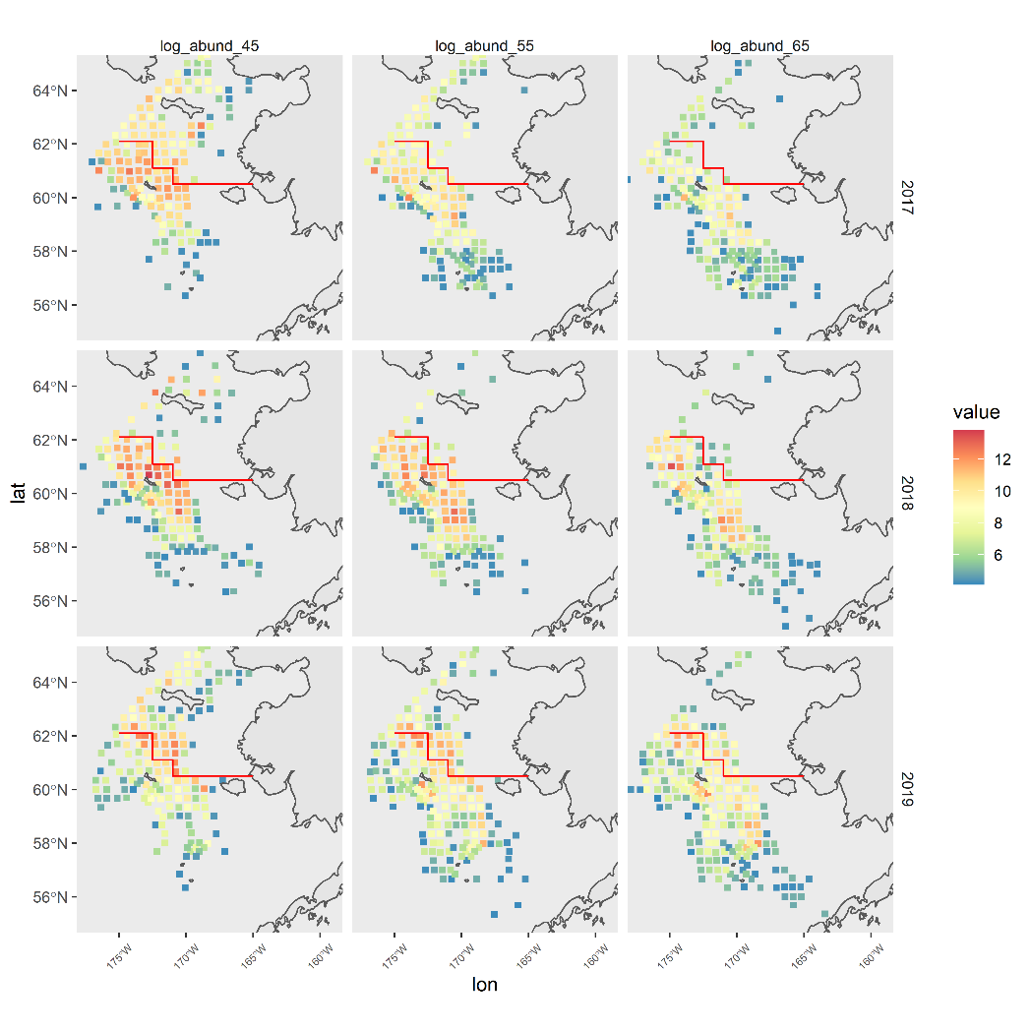

Slide 11
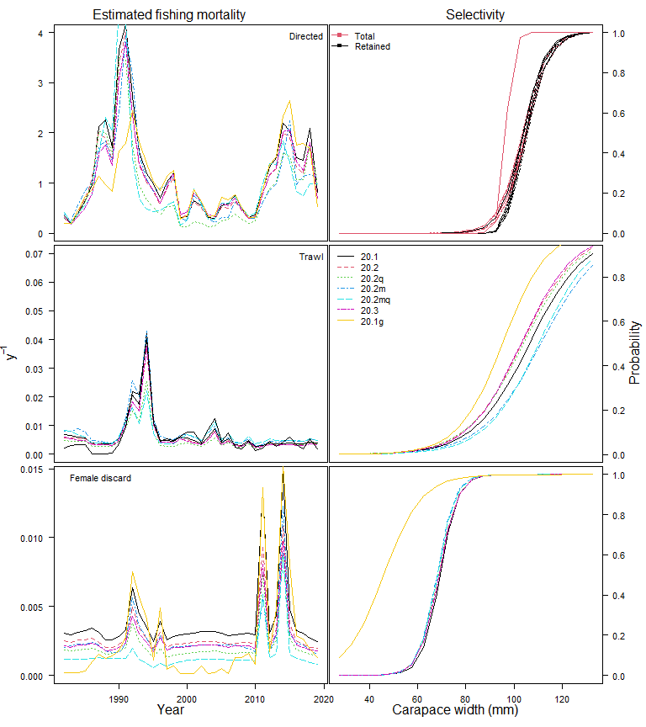
SSC comments: Another feature of the author-preferred GMACS model is extremely high fully-selected fishing mortality in some years that would imply that 95 - 98% of fully-available large crab would have been harvested, which does not seem logistically possible.
Author response: This is actually a feature of the status quo model, not GMACS. Fishing mortality estimates from GMACS in the period over which those high exploitation rates occur in the status quo model are much lower. This is one of the reasons GMACS was the author-preferred model in 2020.

Slide 12
SSC comments: The SSC requests the authors provide a biological rationale, if there is one, for differences in the sex ratio of recruitment.
Author response: Differences in growth, different spatial distributions, differences in time-variation in other processes like maturity are all possible reasons this might occur.

Slide 13
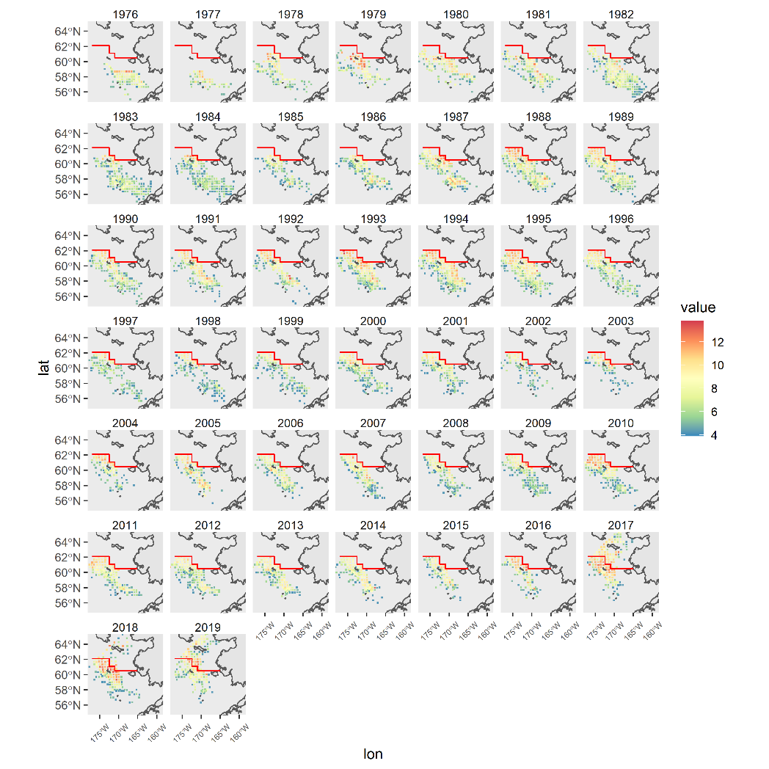
Males
(45<carapace<55mm)

Slide 14
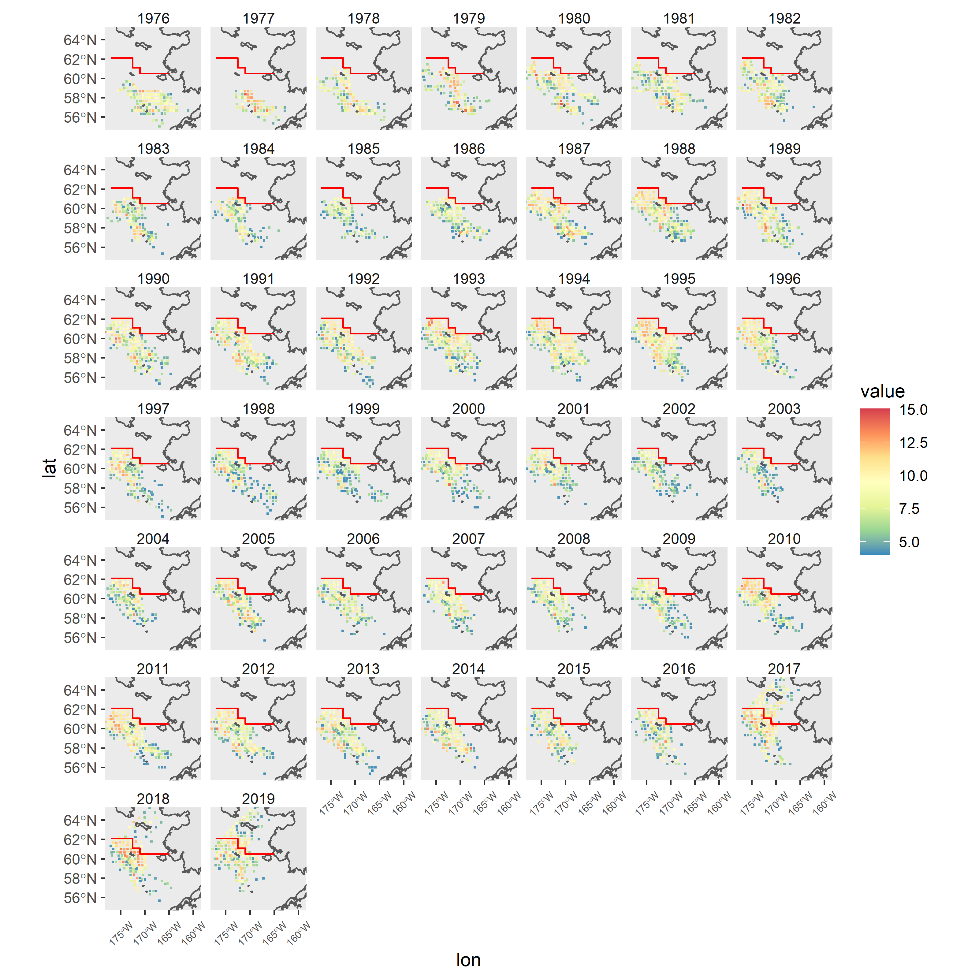
Females (45<carapace<55mm)

Slide 15
SSC comments: The SSC requests the authors provide a biological rationale, if there is one, for differences in the sex ratio of recruitment.
Author response: Differences in growth, different spatial distributions, differences in time-variation in other processes like maturity are all possible reasons this might occur. All of that said, females do not enter either the federal or state harvest control rules. Given the numerous uncertainties in attempting to estimate mature male biomass, adding another source of uncertainty by forcing males to be linked to females does not seem sensible given the outcomes, which include even larger retrospective patterns than currently observed in the status quo and GMACS models.

Slide 16
SSC comments: As with all assessments, the estimation of natural mortality is a challenge for snow crab. The SSC recommends that the authors consider examining the web-based Barefoot Ecologist tool to develop a natural mortality prior distribution for snow crab.
Author response: The methods used to calculate a prior for natural mortality in the 2020 assessment were the same methods used by the Barefoot Ecologist when maximum age is available.

Slide 17
SSC: comments: VAST modeling for the bottom trawl survey was postponed this year and the SSC would like to see it move forward as model-based indices may help add robustness to future missing survey data or a potential change in spatial distribution into the northern Bering Sea.
Author response: A run with VAST indices is included this year. The estimates from VAST are markedly different in some years and, while CVs are smaller in many years, in other years they are much larger. It is not difficult to perform another run with a VAST-derived index each year, but understanding whether or not the outcomes are sensible when large differences appear is less easy. Given the number of other issues with the snow crab assessment, this should be a low priority.

Slide 18

GMACS is superior to the status quo model,
BUT it still has retrospective patterns,
which is a problem.
Or, in haiku form:
New beats status quo
But retrospective pattern
Problem not solved yet

Slide 19
What to do about retrospective patterns?
1) incorporate more model structure to allow the necessary flexibility to fit the data (e.g. allow a process to vary over time that was not previously varying over time),
2) perform post hoc adjustments of the management quantities based on the magnitude of retrospective patterns (similar to what the CPT suggested by increasing the buffer to 50% for the ABC in 2020),
3) use a survey-based index of abundance or biomass to set the OFL (similar to the Tier 4 harvest control rules).

Slide 20
What to do about retrospective patterns?
1) incorporate more model structure to allow the necessary flexibility to fit the data (e.g. allow a process to vary over time that was not previously varying over time),
2) perform post hoc adjustments of the management quantities based on the magnitude of retrospective patterns (similar to what the CPT suggested by increasing the buffer to 50% for the ABC in 2020),
3) use a survey-based index of abundance or biomass to set the OFL (similar to the Tier 4 harvest control rules).

Slide 21
Tier 3 assessment models :
  20.1 – Last year’s accepted model (status quo) fit to last year’s data
  20.1g – Last year’s GMACS model fit to last year’s data
  20.2 – Last year’s accepted model (status quo) fit to last year’s data with down-weighted size composition data (all weights equal 100, rather than 200)
  20.2q – 20.2 + time-varying survey catchability from 1989-present
  20.2m – 20.2 + time-varying natural mortality for mature males and females
  20.2qm – 20.2 + time-varying survey catchability from 1989-present and time-varying natural mortality for mature males and females
  20.2v – 20.2 + VAST survey estimates

Slide 22
Model overview
July 1
Survey
Logistic selectivity in 2 ‘eras’
Linked to BSFRF data
Size composition and biomass index
7.5/12 M
Directed fishery
Non-directed fishery
Mating
4.5/12 M
Molting
Growth
Recruitment

Slide 23
Model overview
Survey
Mature males, immature for both sexes, mature females
Estimated with a prior
7.5/12 M
Directed fishery
Non-directed fishery
Mating
4.5/12 M
Molting
Growth
Recruitment

Slide 24
Model overview
Survey
7.5/12 M
Directed fishery
Logistic selectivity
Retention selectivity
Discard mortality equal to 30%
Fit to:
Retained length comps
Total length comps
Retained biomass
Male and female discard biomass
Non-directed fishery
Mating
4.5/12 M
Molting
Growth
Recruitment

Slide 25
Model overview
Survey
7.5/12 M
Directed fishery
Non-directed fishery
Logistic selectivity
Discard mortality equal to 80%
Mating
4.5/12 M
Molting
Growth
Recruitment

Slide 26
Model overview
Survey
7.5/12 M
Directed fishery
Non-directed fishery
Mating
Freely estimated maturity curves
February 15
4.5/12 M
Molting
Growth
Recruitment

Slide 27
Model overview
Survey
7.5/12 M
Directed fishery
Non-directed fishery
Mating
4.5/12 M
Molting
All immature crab assumed to molt
Terminal molt to maturity
Growth
Recruitment

Slide 28
Model overview
Survey
7.5/12 M
Directed fishery
Non-directed fishery
Mating
4.5/12 M
Molting
Growth
Linear growth in GMACS; kinked growth curve for females in SQ
Recruitment

Slide 29
Key changes in model structure in GMACS
Fishing mortality
  Definitions of ‘total mortality’ and how female mortality is treated are different between models
Growth
  Both sexes linear in GMACS
  Male linear, female kinked in SQ
BSFRF availability
  All year/sex combinations of BSFRF data have a freely estimated availability curve in GMACS (not so in status quo model)
Recruitment
  GMACS estimates a yearly recruitment and a parameter that divides that recruitment between sexes
  SQ estimates separate recruitment deviations for both sexes with smoothing penalties on devs
Natural mortality
  Immature natural mortality combined in status quo; separated in GMACS

Slide 30
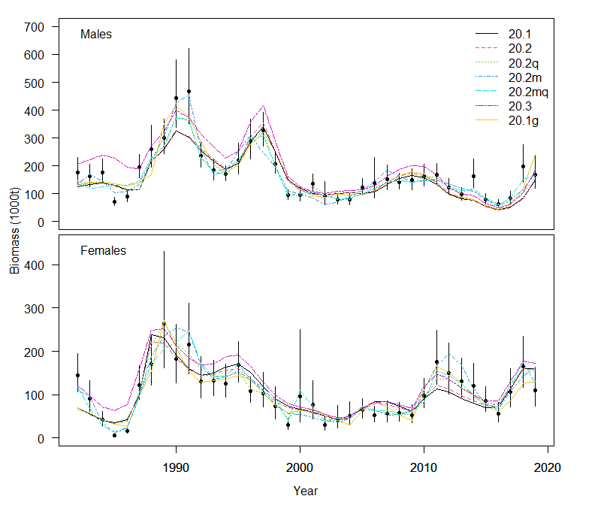

Slide 31
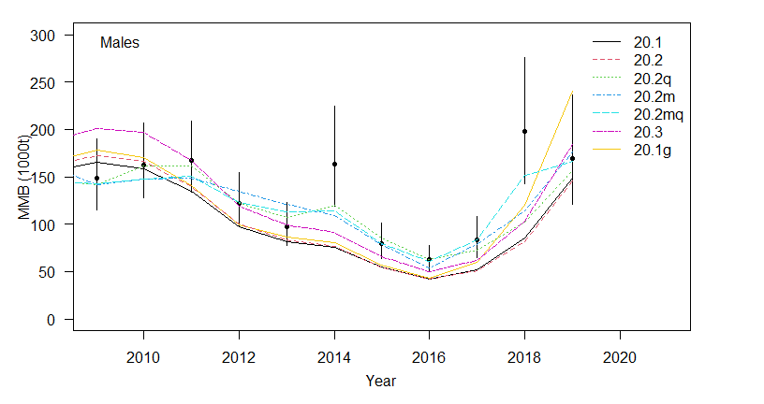

Slide 32
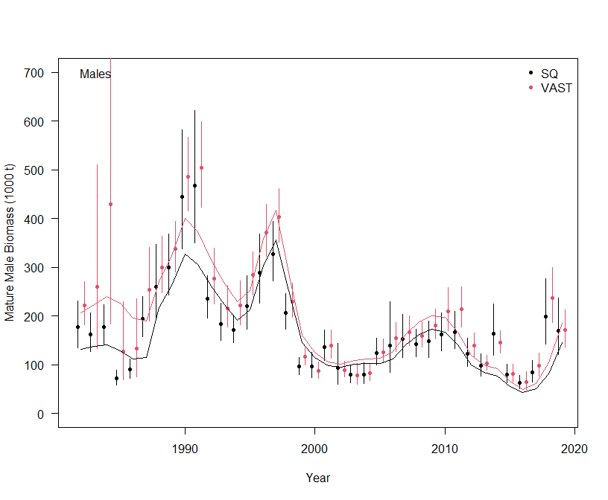

Slide 33
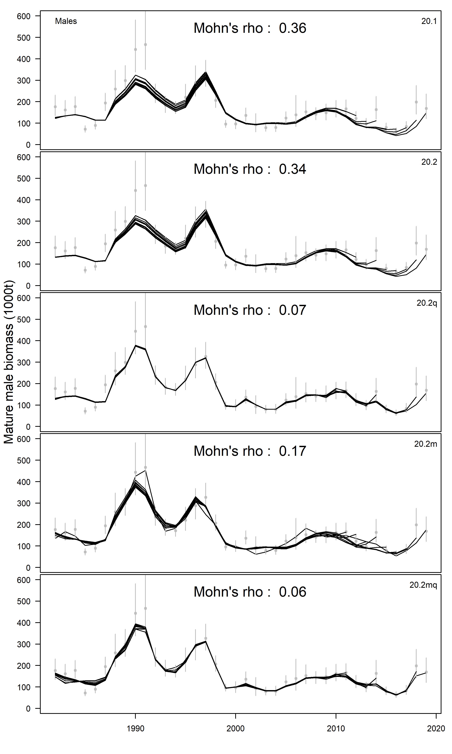
20.1
Adding more flexibility to the model reduces retrospective patterns, as expected.
However, it’s not clear that a bigger reduction in the retrospective pattern should be taken as an indication of the appropriate process varying.
20.2
20.2q
20.2m
20.2mq

Slide 34
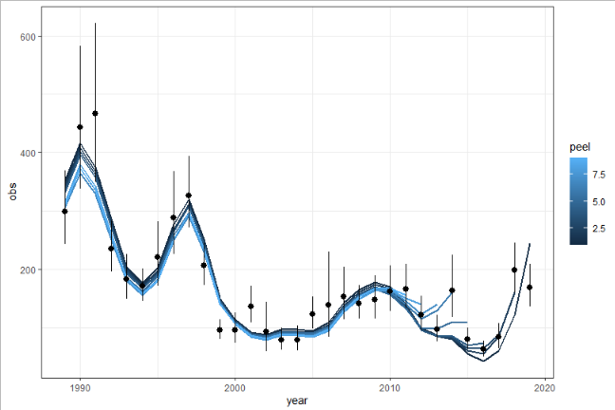
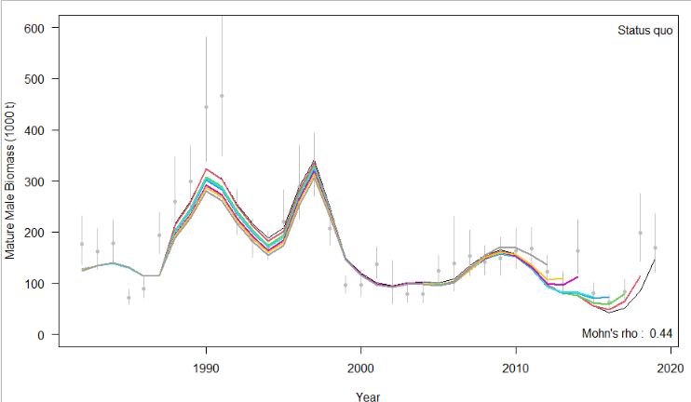

Slide 35
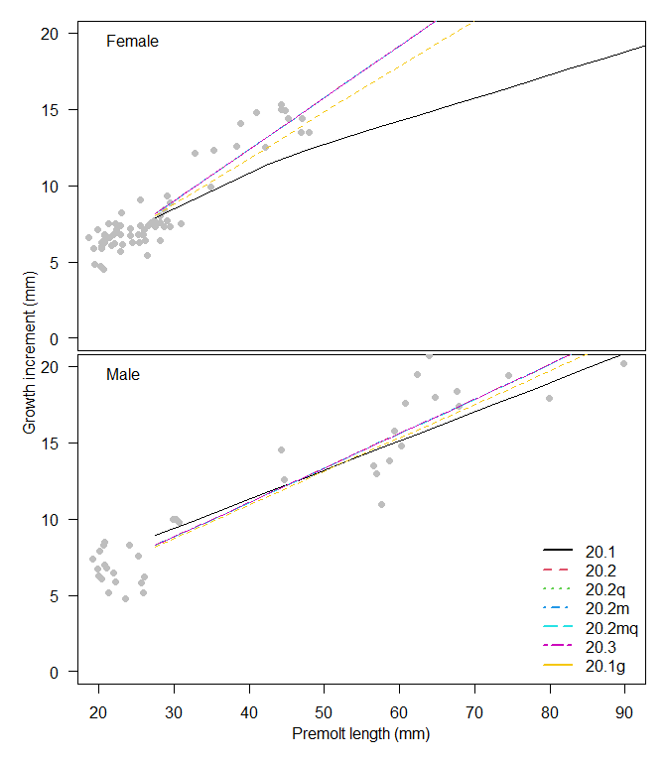

Slide 36
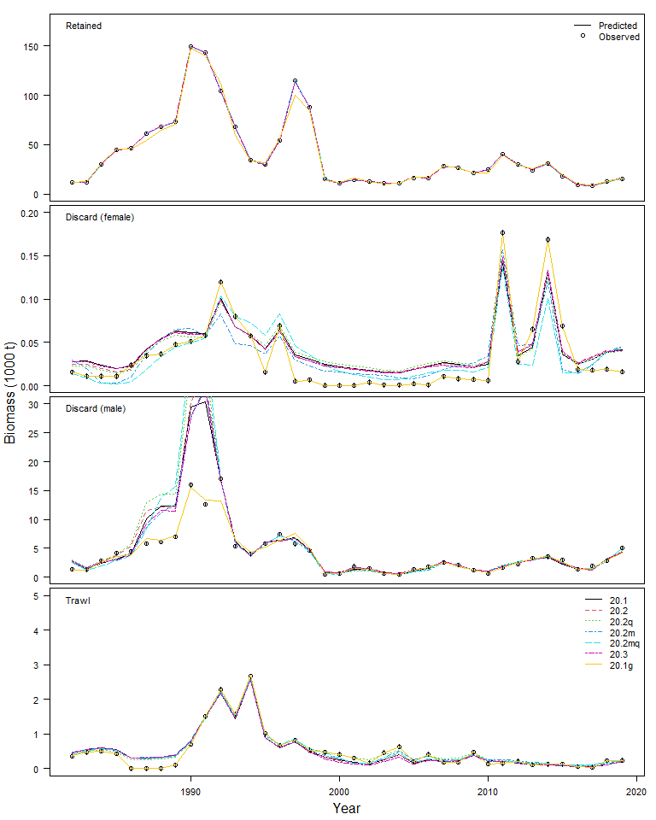

Slide 37
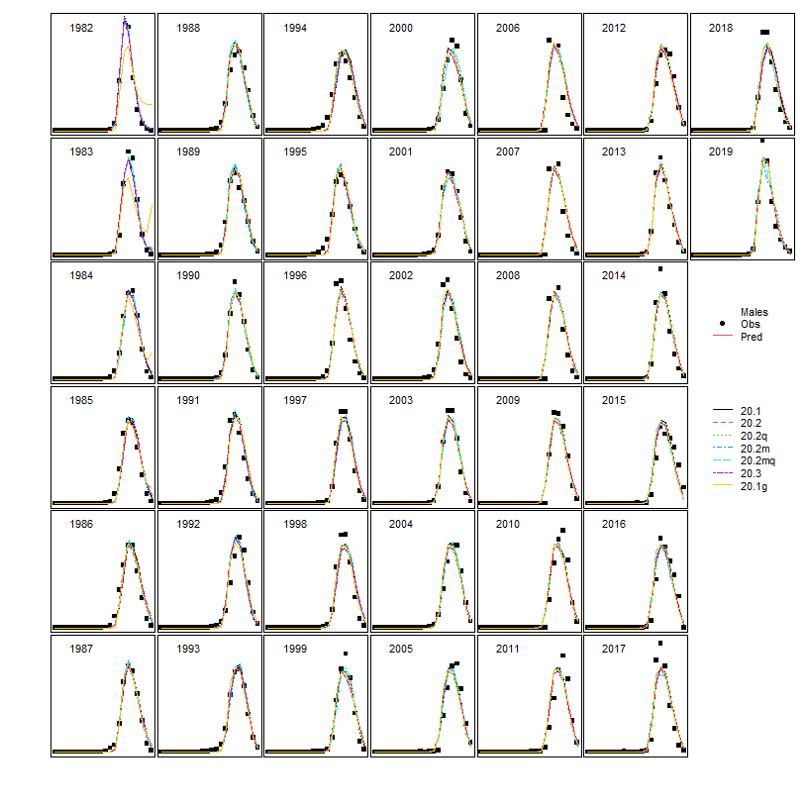
Model fits to retained catch size composition data

Slide 38
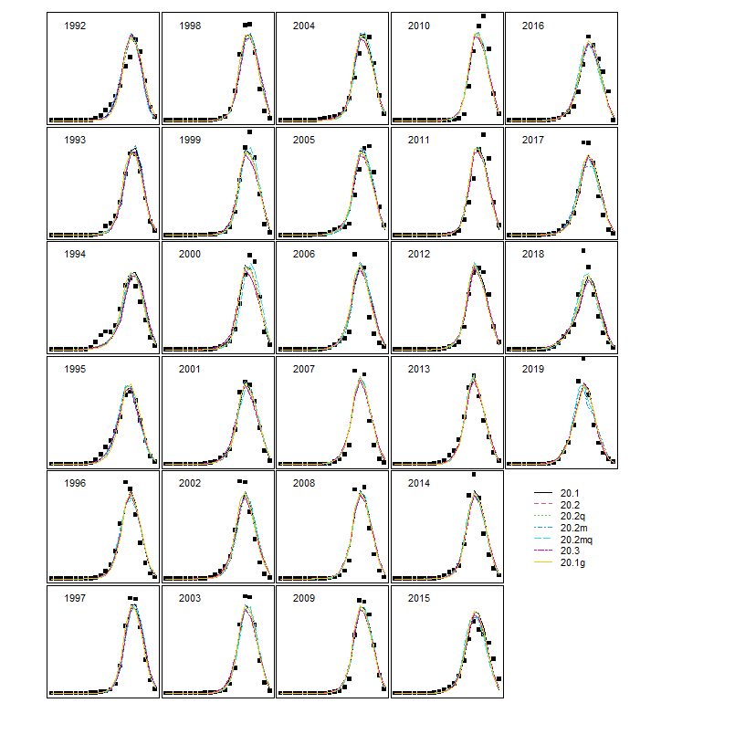
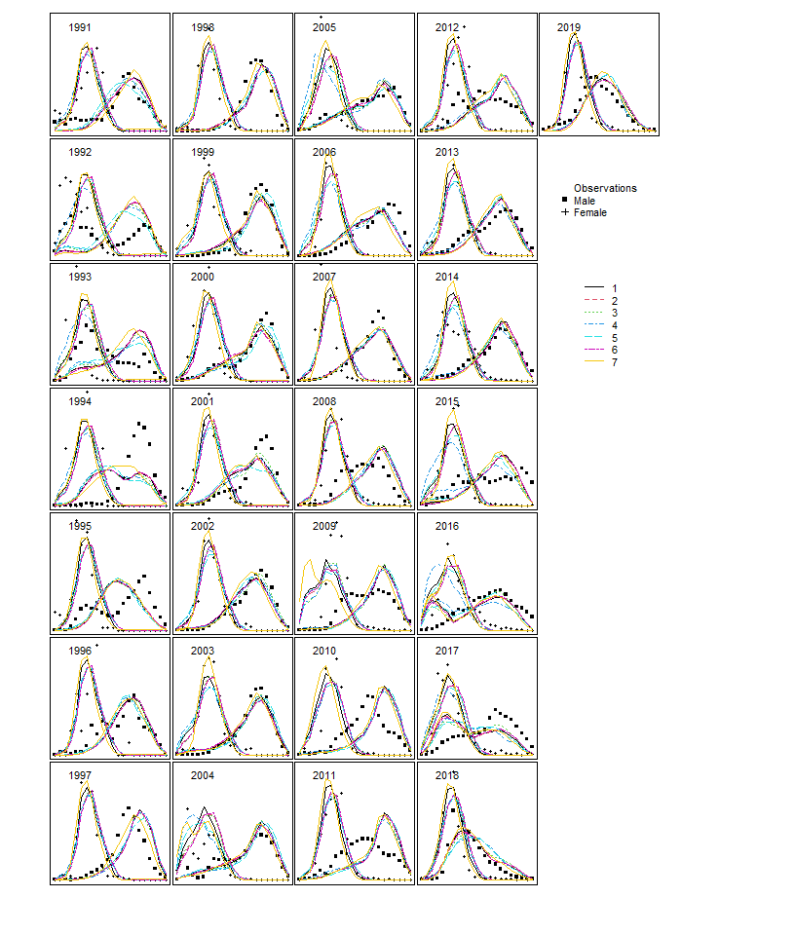
Model fits to total catch size composition data
Model fits to trawl catch size composition data

Slide 39
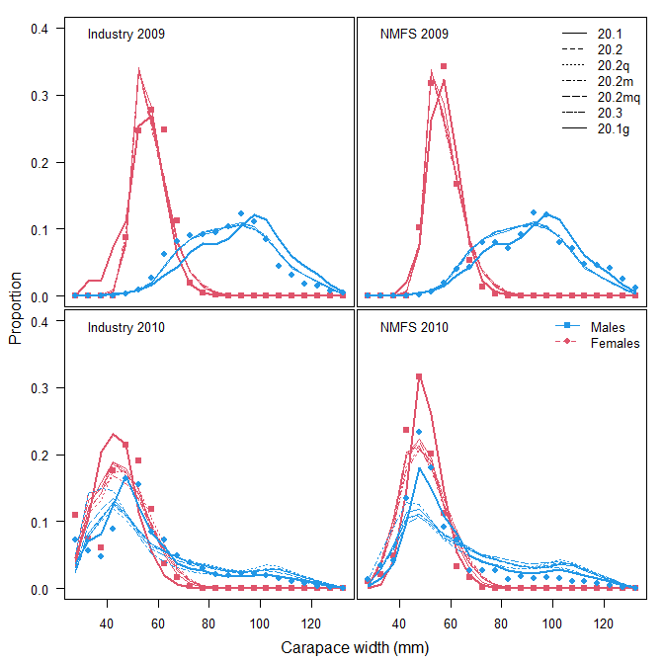
Model fits to size composition data from
summer survey experiments (2009 & 2010)

Slide 40
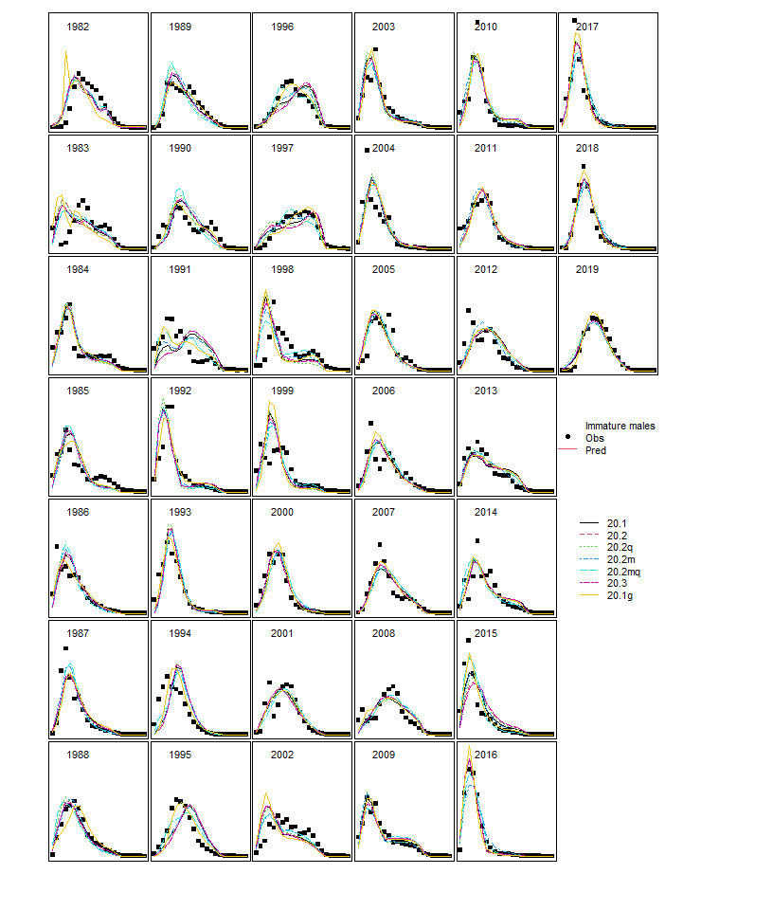
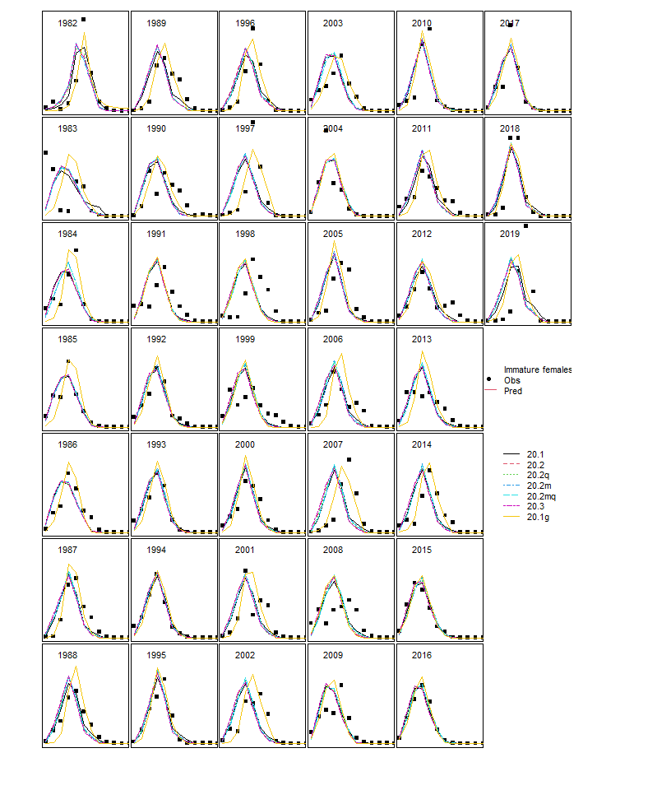

Slide 41
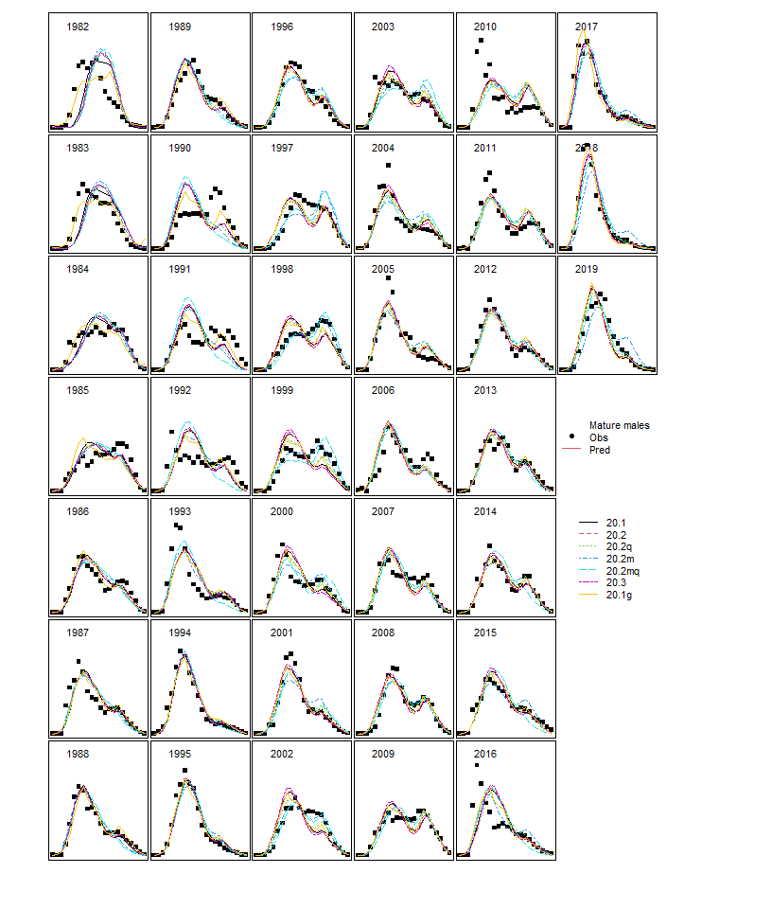
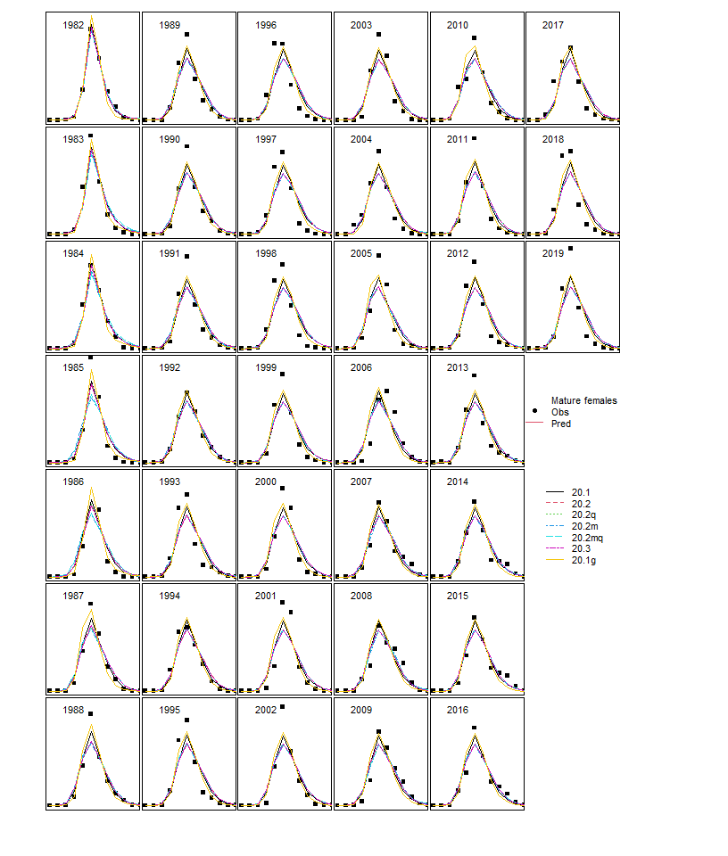

Slide 42
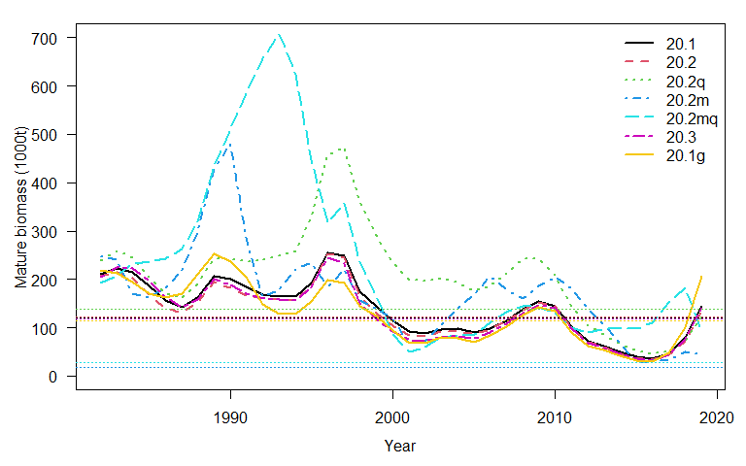

Slide 43
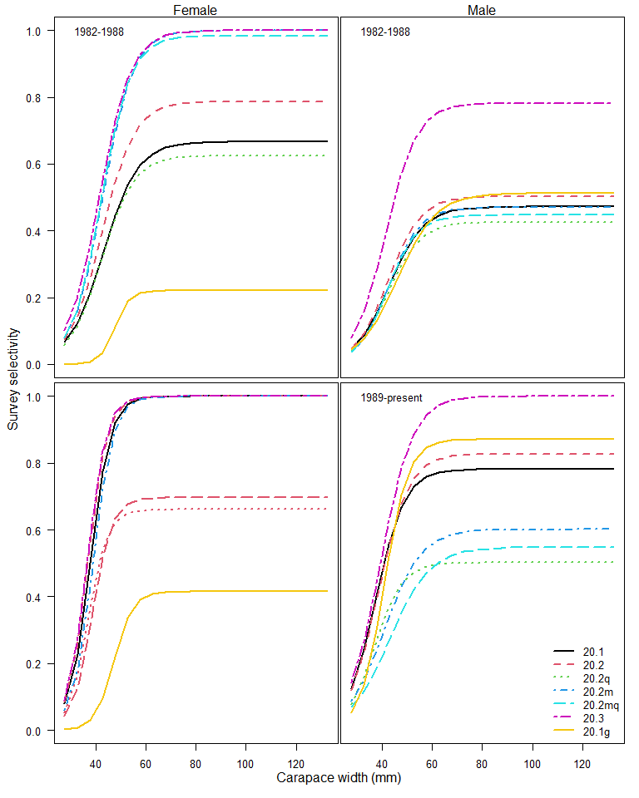
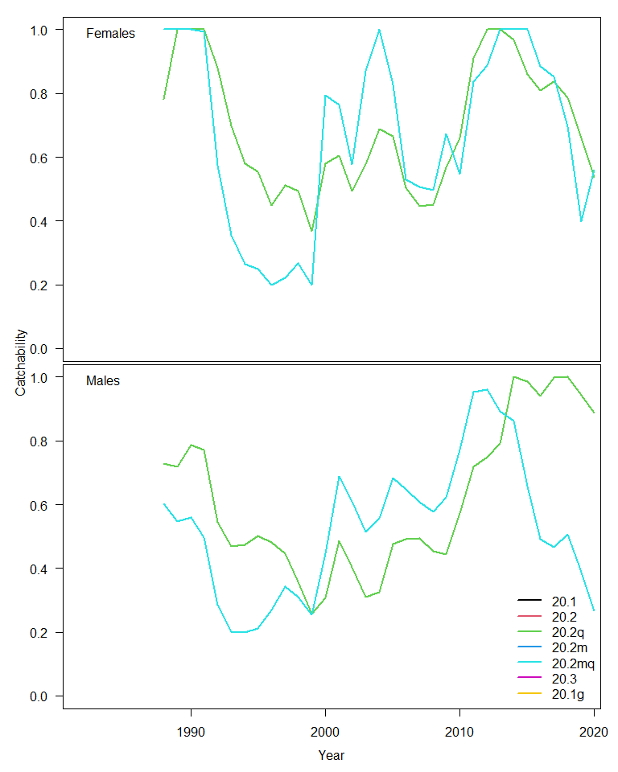

Slide 44
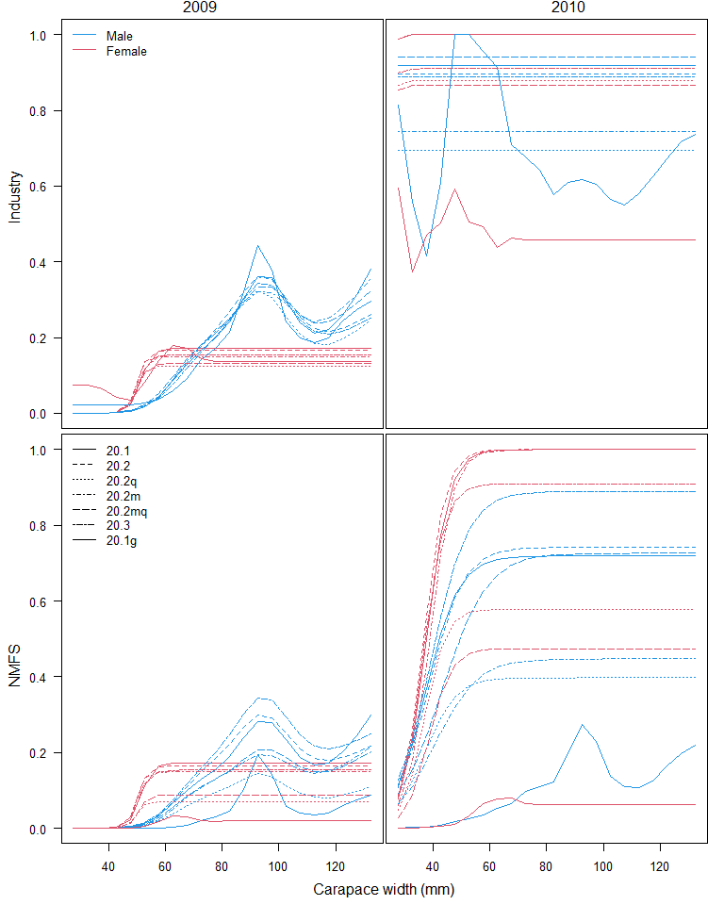

Slide 45
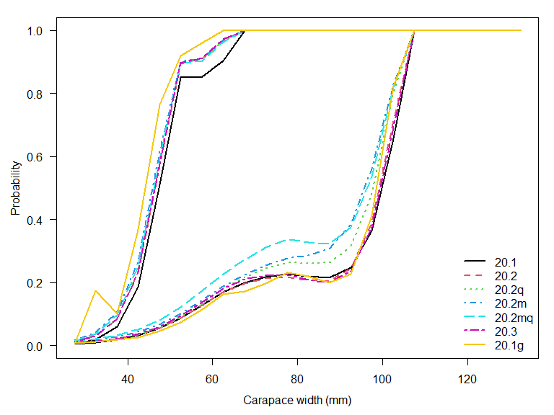

Slide 48
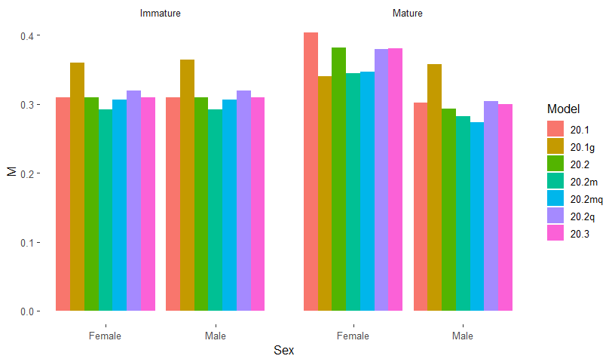

Slide 49
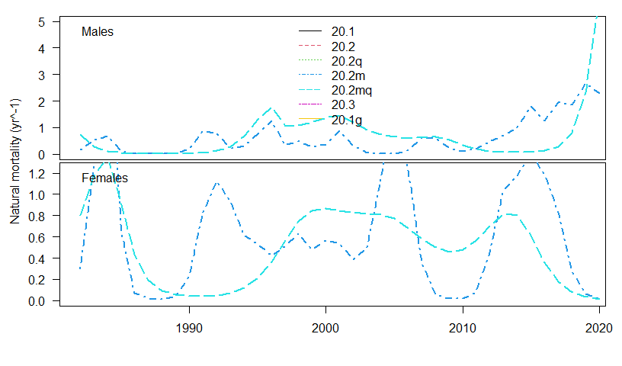

Slide 50
Model | MMB | B35 | F35 | FOFL | OFL | M | avg_rec
20.1 | 144.11 | 120.46 | 1.59 | 1.59 | 95.25 | 0.30 | 109.70
20.2 | 133.51 | 121.47 | 1.23 | 1.23 | 88.90 | 0.29 | 103.91
20.2q | 121.61 | 137.56 | 1.94 | 1.94 | 77.08 | 0.30 | 132.86
20.2m | 43.29 | 17.85 | 6.29 | 6.29 | 70.88 | 0.17 | 152.61
20.2mq | 92.20 | 28.06 | 12.46 | 1.86 | 14.72 | 0.75 | 241.96
20.3 | 140.88 | 118.13 | 1.26 | 1.26 | 95.37 | 0.30 | 104.45
20.1g | 207.19 | 113.66 | 1.65 | 1.65 | 184.91 | 0.36 | 169.96
If the smoothness penalty for model 20.2m is increased, the OFL drops to 12 kt.

Slide 51
Not particularly helpful…
Adding time variation produced:
  Instable models
  Drastically different management advice
  Variation in M and q that were not easily interpretable or particularly believable
  Perhaps I should have estimated time variation in immature M as well
  Trying an index for catchability similar to what Buck has done might be useful (but that’s also only 1 part of ‘catchability’ for snow crab)

Slide 52
Needs for management
Where are we?
  A good estimate of terminal year biomass
Where do we want to be?
  Management targets for biomass and fishing mortality that will get us there

Slide 53
Tier 1-3 definitions
‘reliable estimates of B,BMSY, and FMSY’
Tier 4 definitions
‘stocks where essential life history, recruitment information and understanding are insufficient to achieve Tier 3’
We know a lot about snow crab life history and recruitment, but assessment estimates of terminal year MMB are not reliable because of retrospective patterns.

Slide 54
Tier 3 does not say that the reliable estimate of B has to come from a stock assessment.
 | Tier 3 | Tier 4 | Tier 3.5?
MMB | Assessment | Survey | Survey
FMSY | SBPR | Natural mortality | SBPR
MSY | SBPR | Average survey | SBPR

Slide 55
Tier 3.5?
MMB: Random effects model (adjusted by catchability?)
FMSY: F35% from spawning biomass per recruit performed in a population dynamics model based on observed data on population processes
BMSY: Average of MMB over the history of the fishery (up for discussion)

Slide 56
What metric for mature male biomass?
Currently the currency of management is ‘morphometric’ maturity
This includes all large clawed males regardless of carapace width.
This results in high F35% because a large fraction of the morphometrically mature males are protected by the fishery selectivity.
If the reproductively important animals are really only the larger males, using morphometric maturity
Test >78mm, >95mm, >101mm

Slide 57
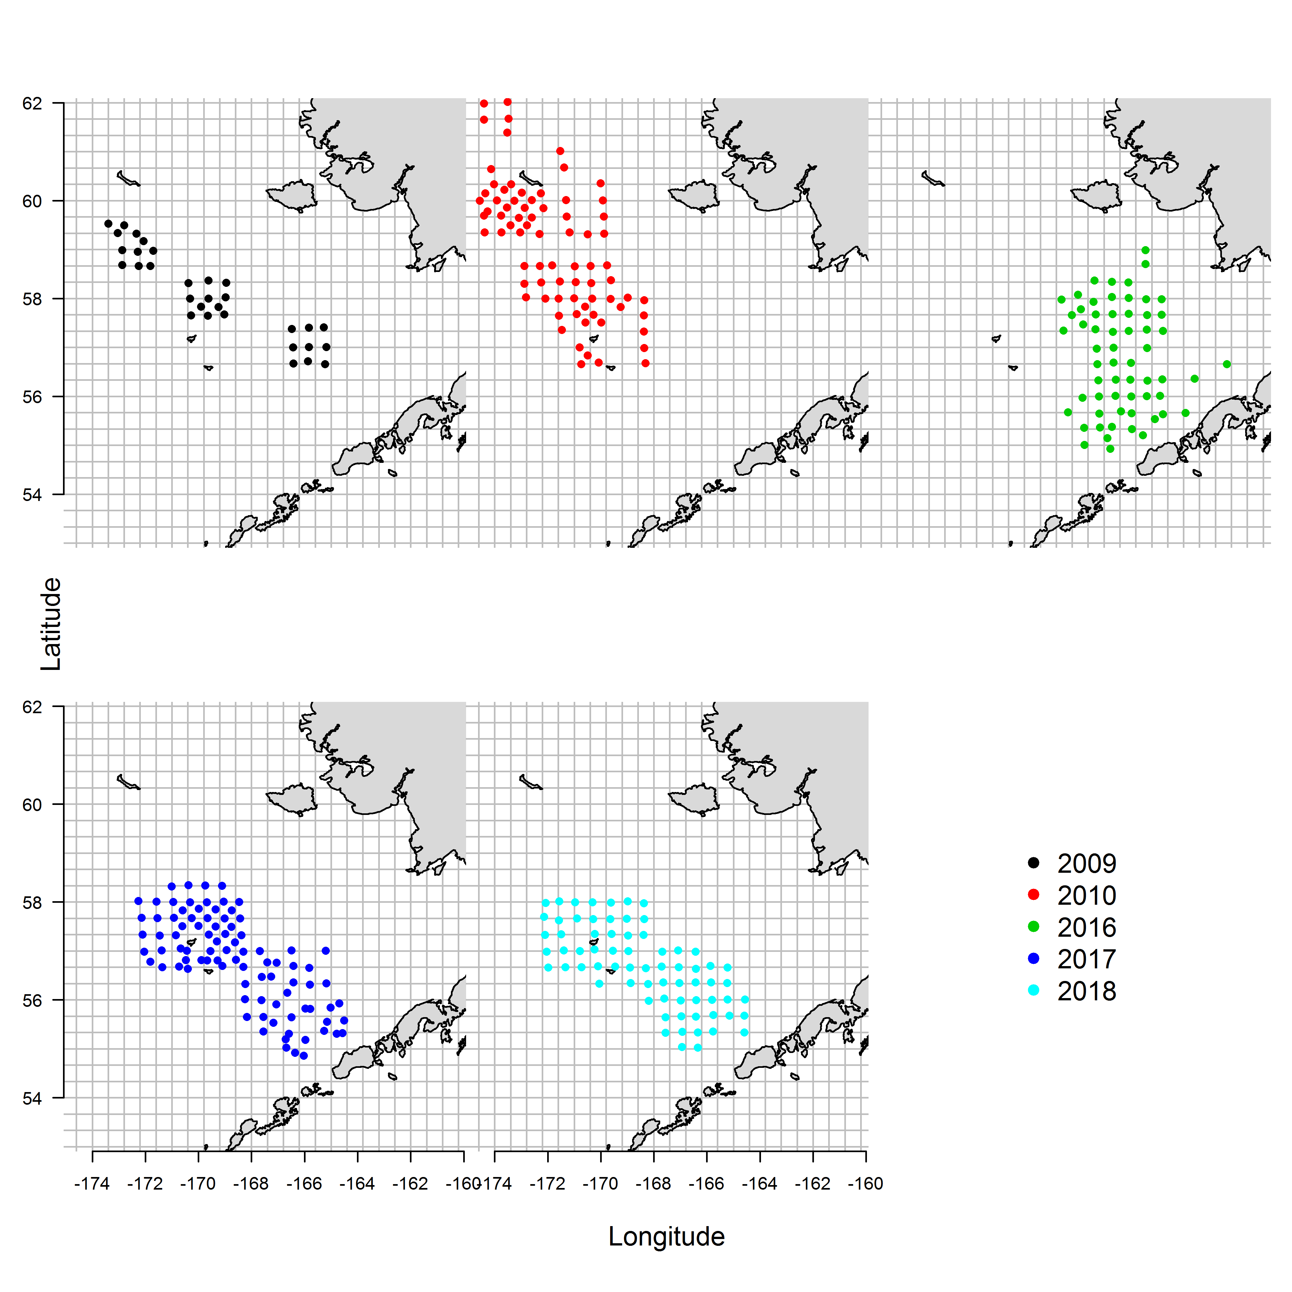
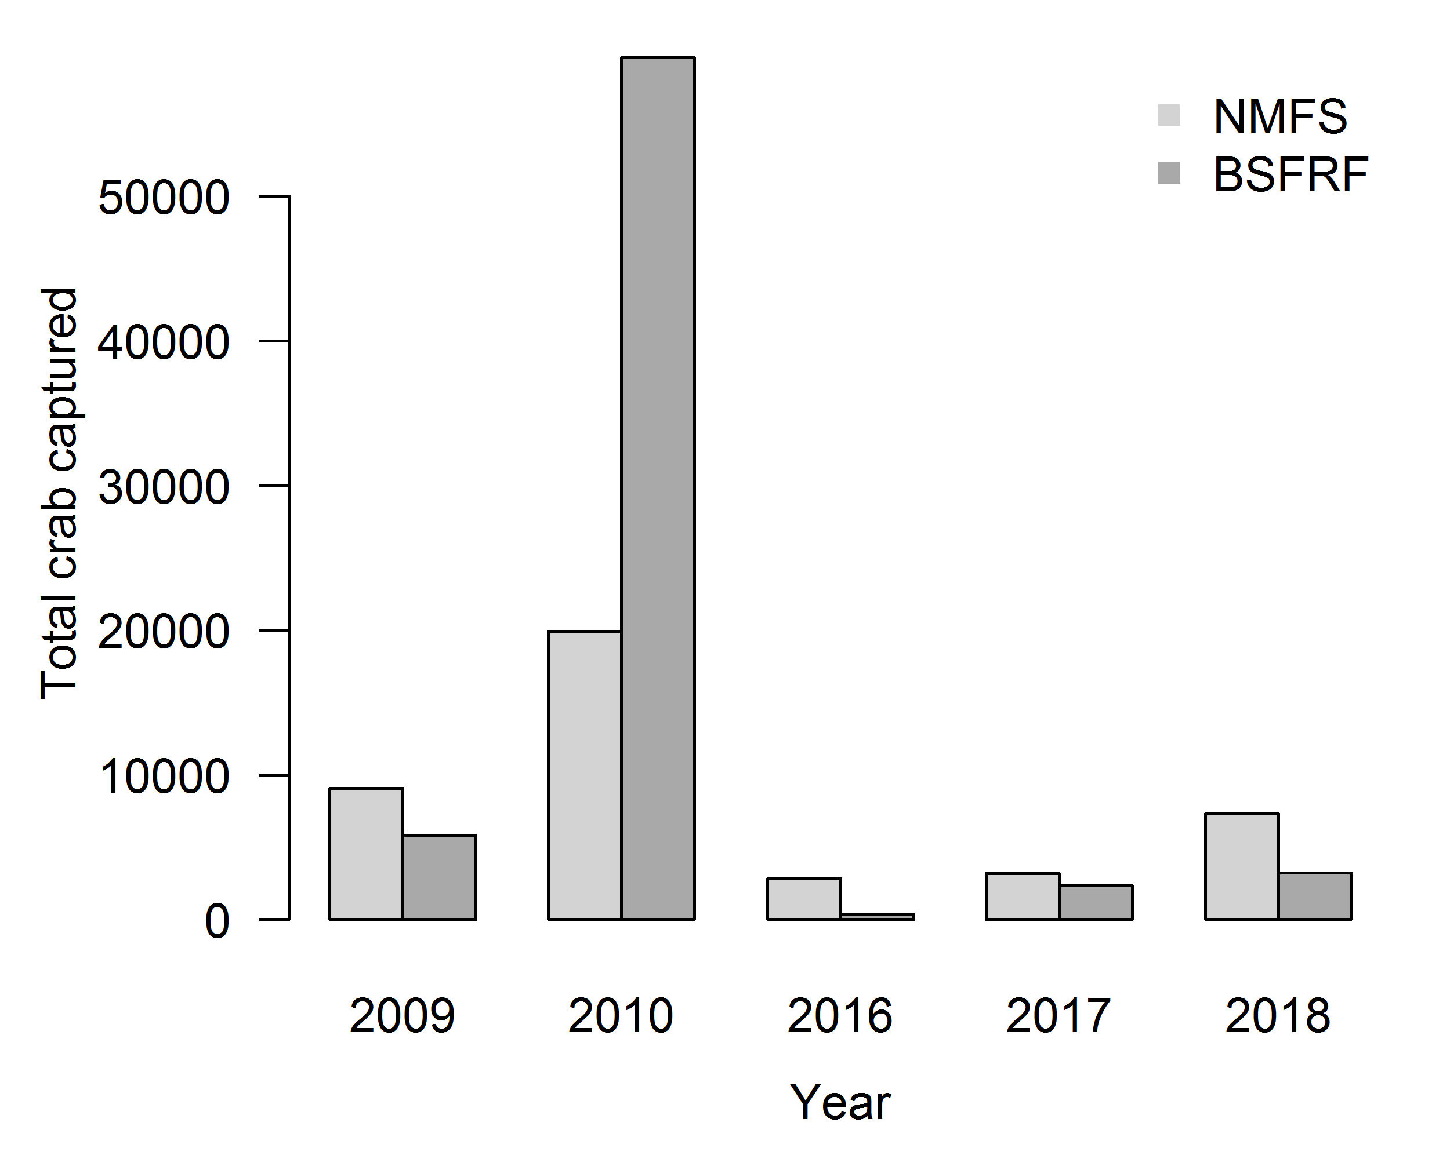

Slide 58
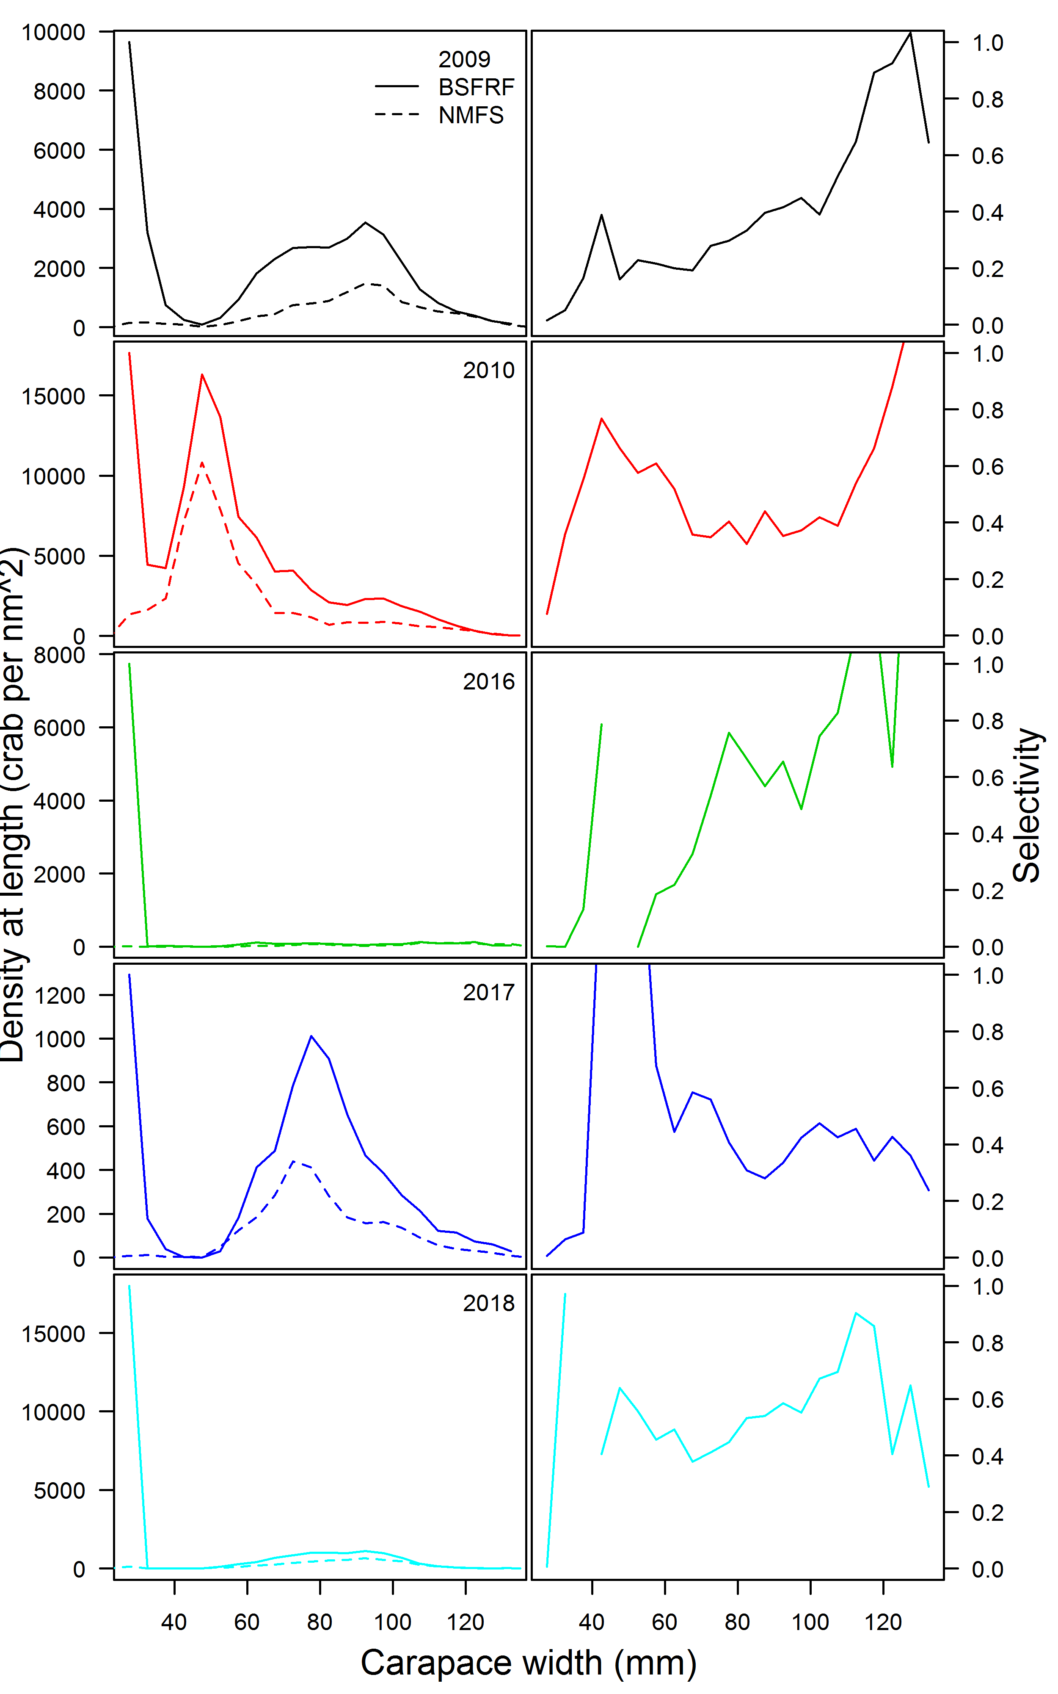
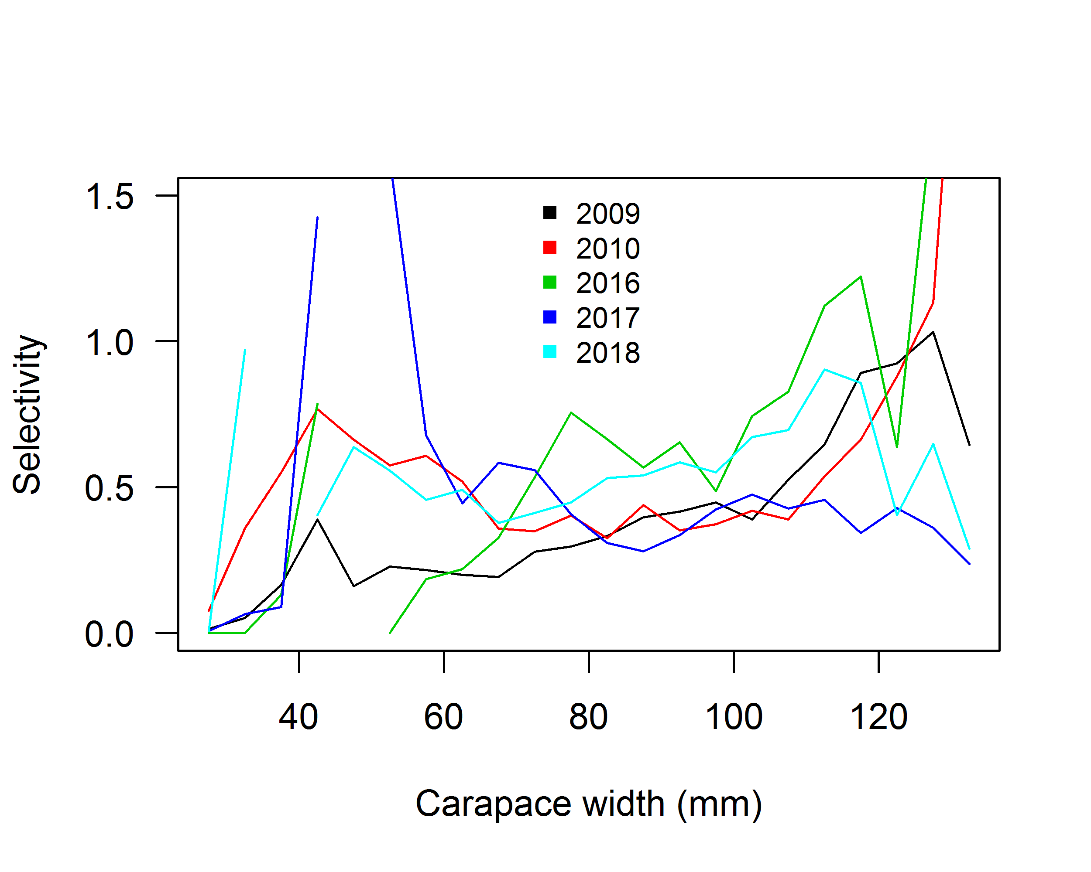

Slide 60
Proxy for FMSY
Information on population processes are needed to specify the population dynamics model:
Growth
Maturity
Fishery selectivity
Natural mortality
Comparison of the estimates from the assessment to the ‘empirical’ estimates of each process

Slide 61
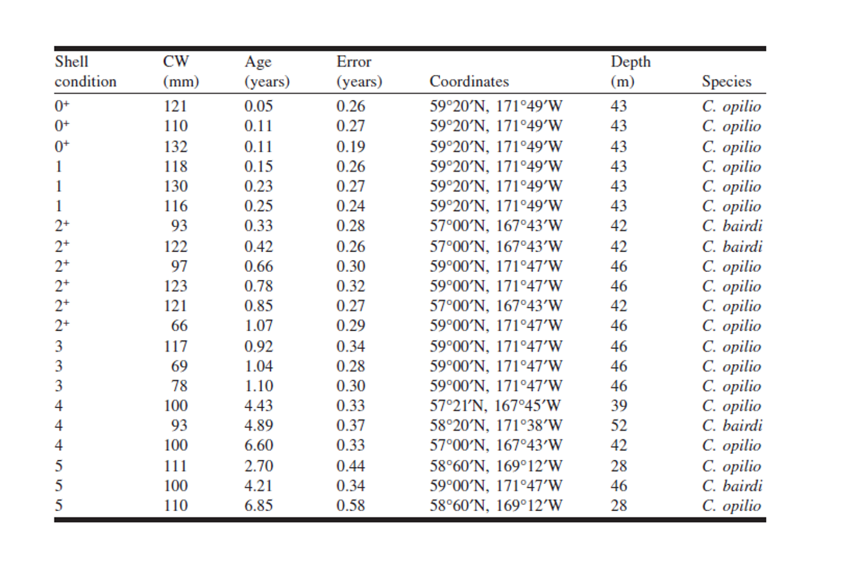
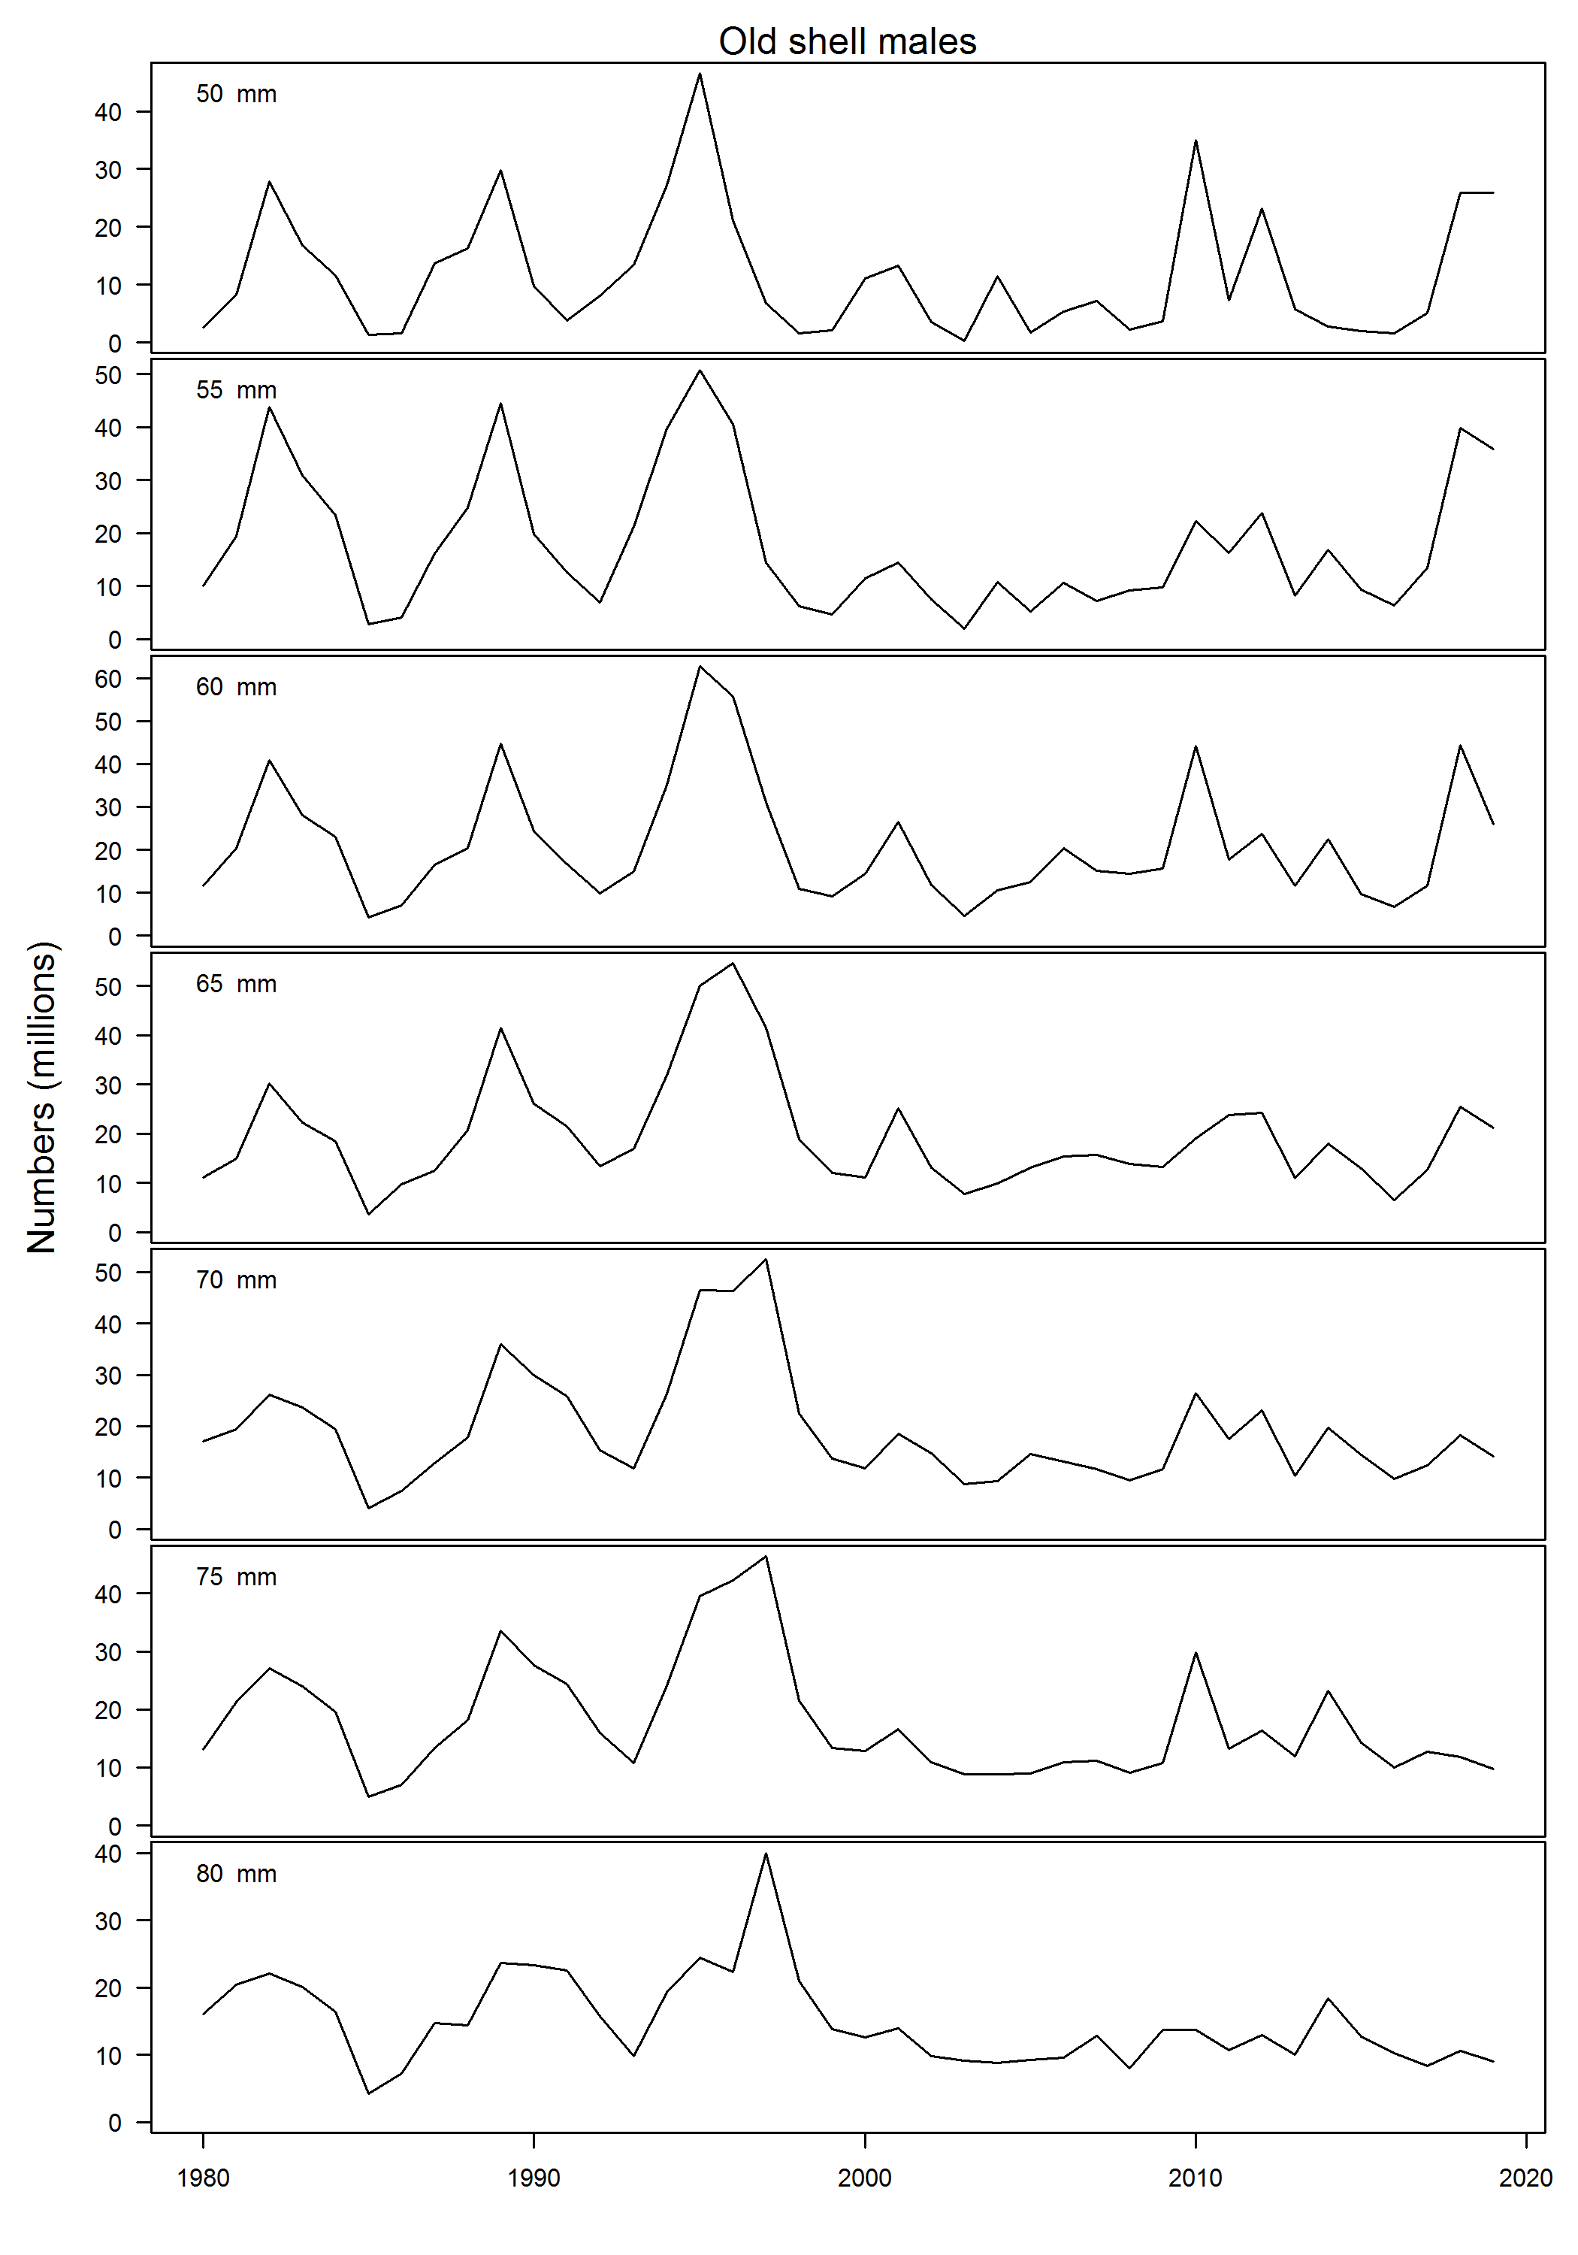
Assumed maximum age of 20 years

Slide 62
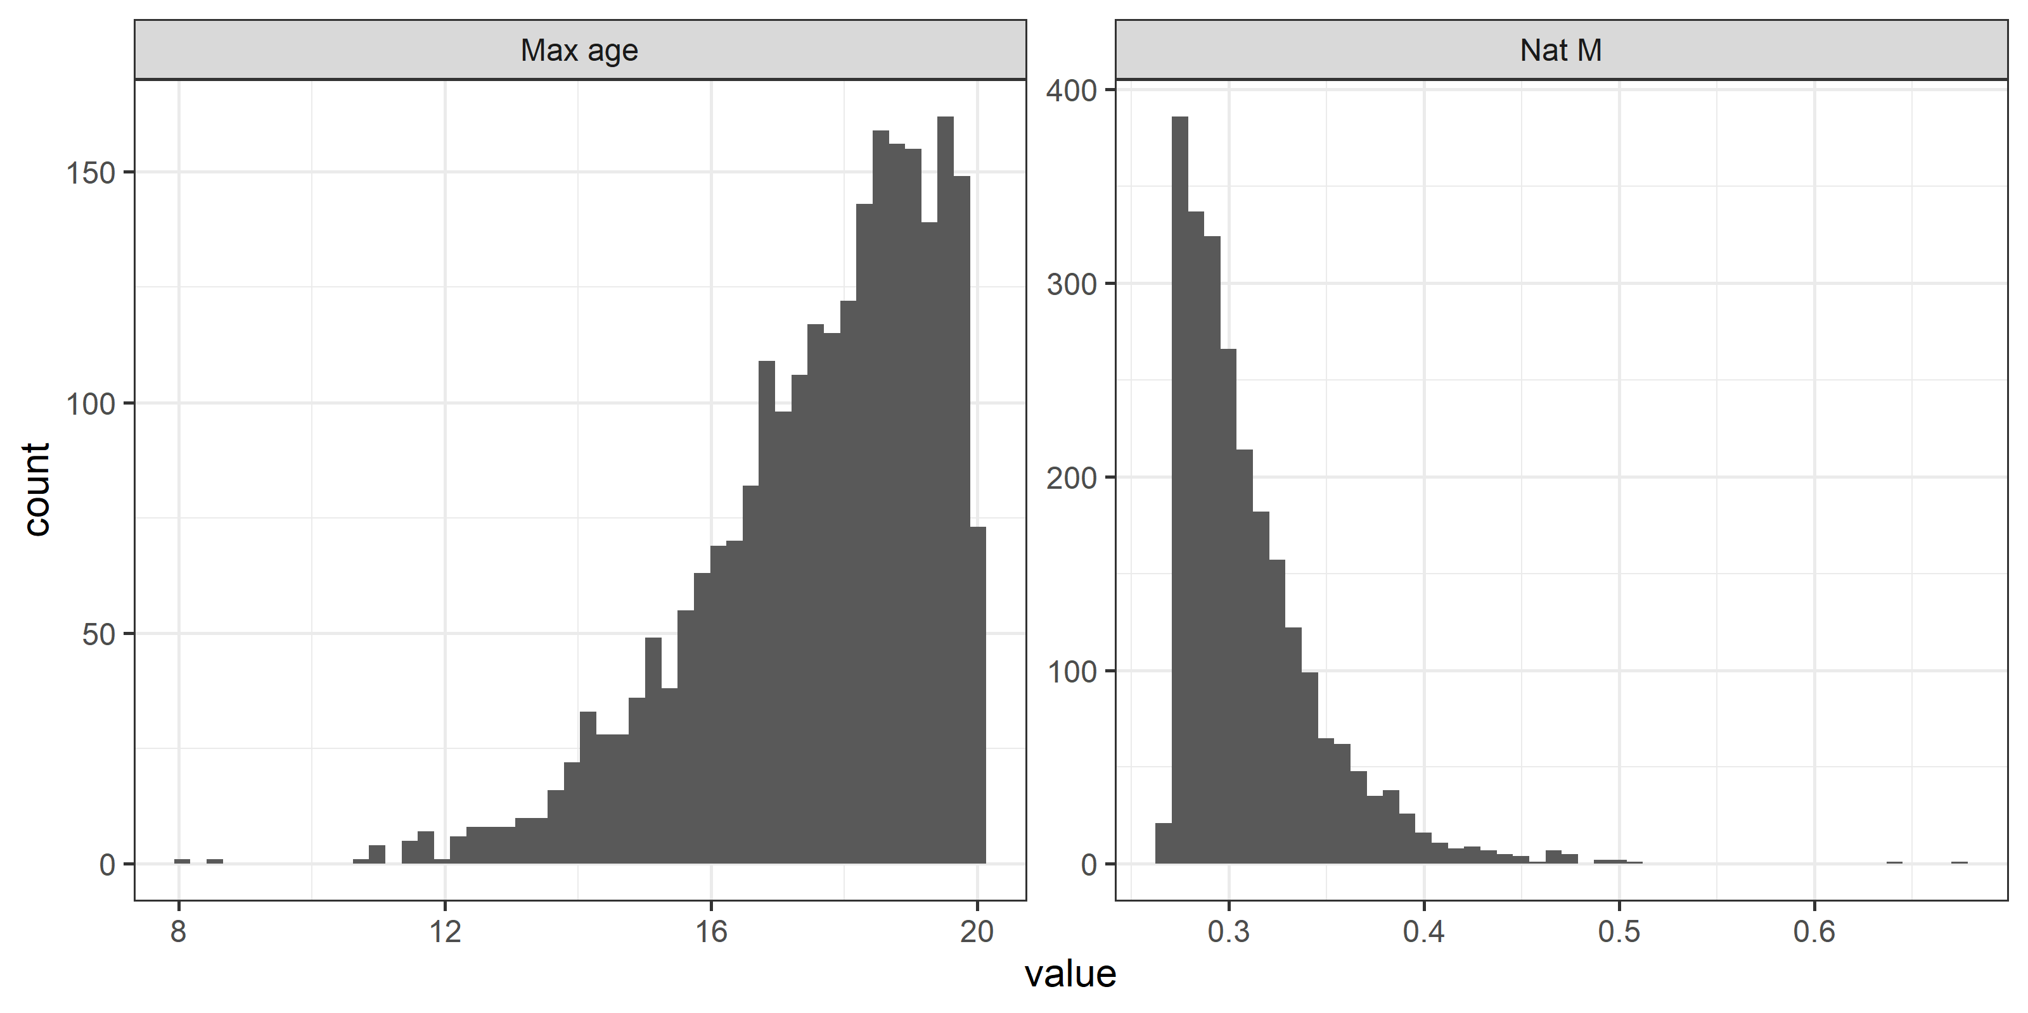
Input distribution of maximum age and resulting distribution of natural mortality calculating using Then et al. 2016’s methodology.

Slide 63
Blue lines are the proportion of new shell crab in a given year and size class that were mature based on chela height.
This represents the probability of maturing IF shell condition is a perfect proxy for time since molt, which we know it is not.

Slide 64
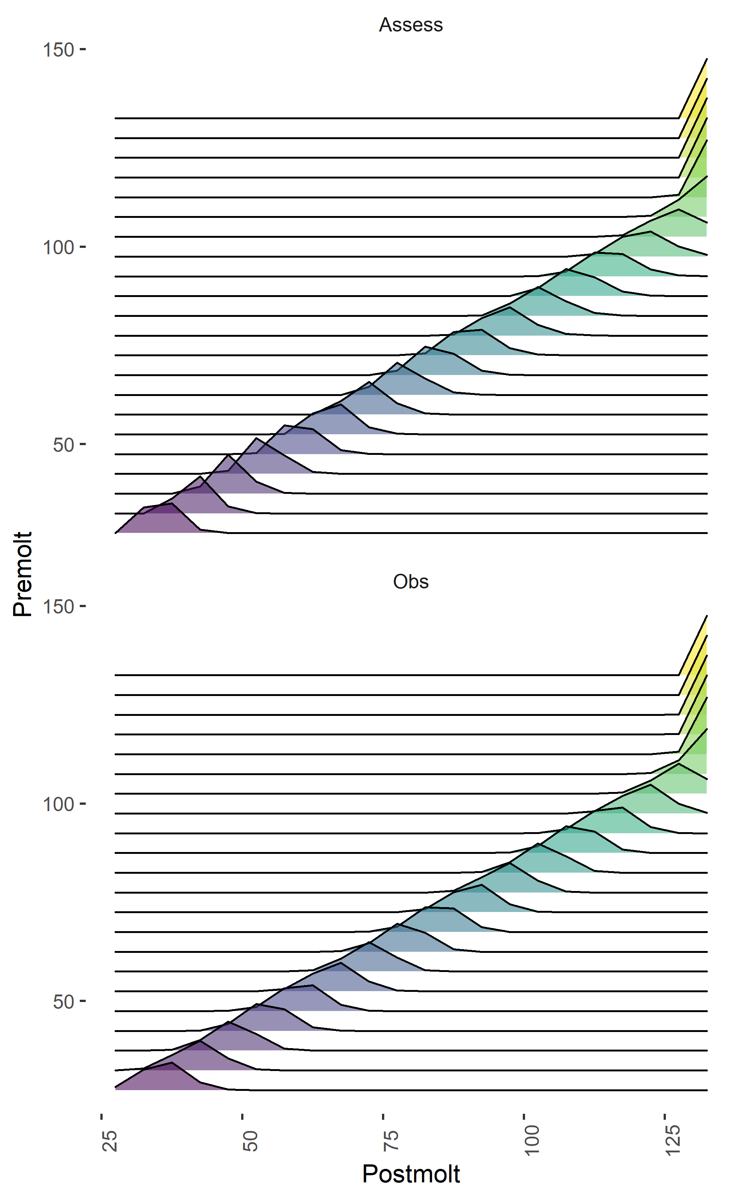
Generating size transition matrices
Subsample growth data—draw 15 data points 1000 times
Fit linear growth models predicting postmolt carapace width from premolt width
Renormalized discretized normal distribution for variation in growth per molt (standard deviation set to 4 mm to get close to assessment)
Size transition matrices produced look very similar to those from the assessment

Slide 65
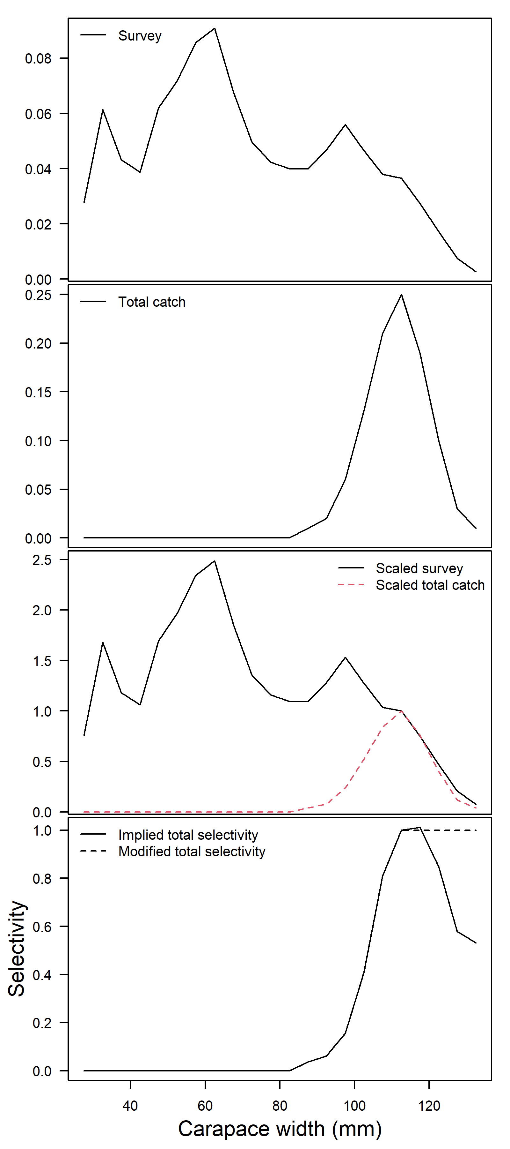
How to calculate ‘empirical’ selectivity?
Start with total survey male numbers at length and total catch size composition in a given year.
Assume that the maximum of the total catch size composition is the first size class at which the fishery selectivity is equal to 1.
Scale the total survey male numbers at length and the total catch size composition such that the composition data both equal 1 in the size class identified in #2.
Divide the scaled total size composition from #3 by the scaled total survey male size composition data from #3 to get an implied selectivity.

Slide 66
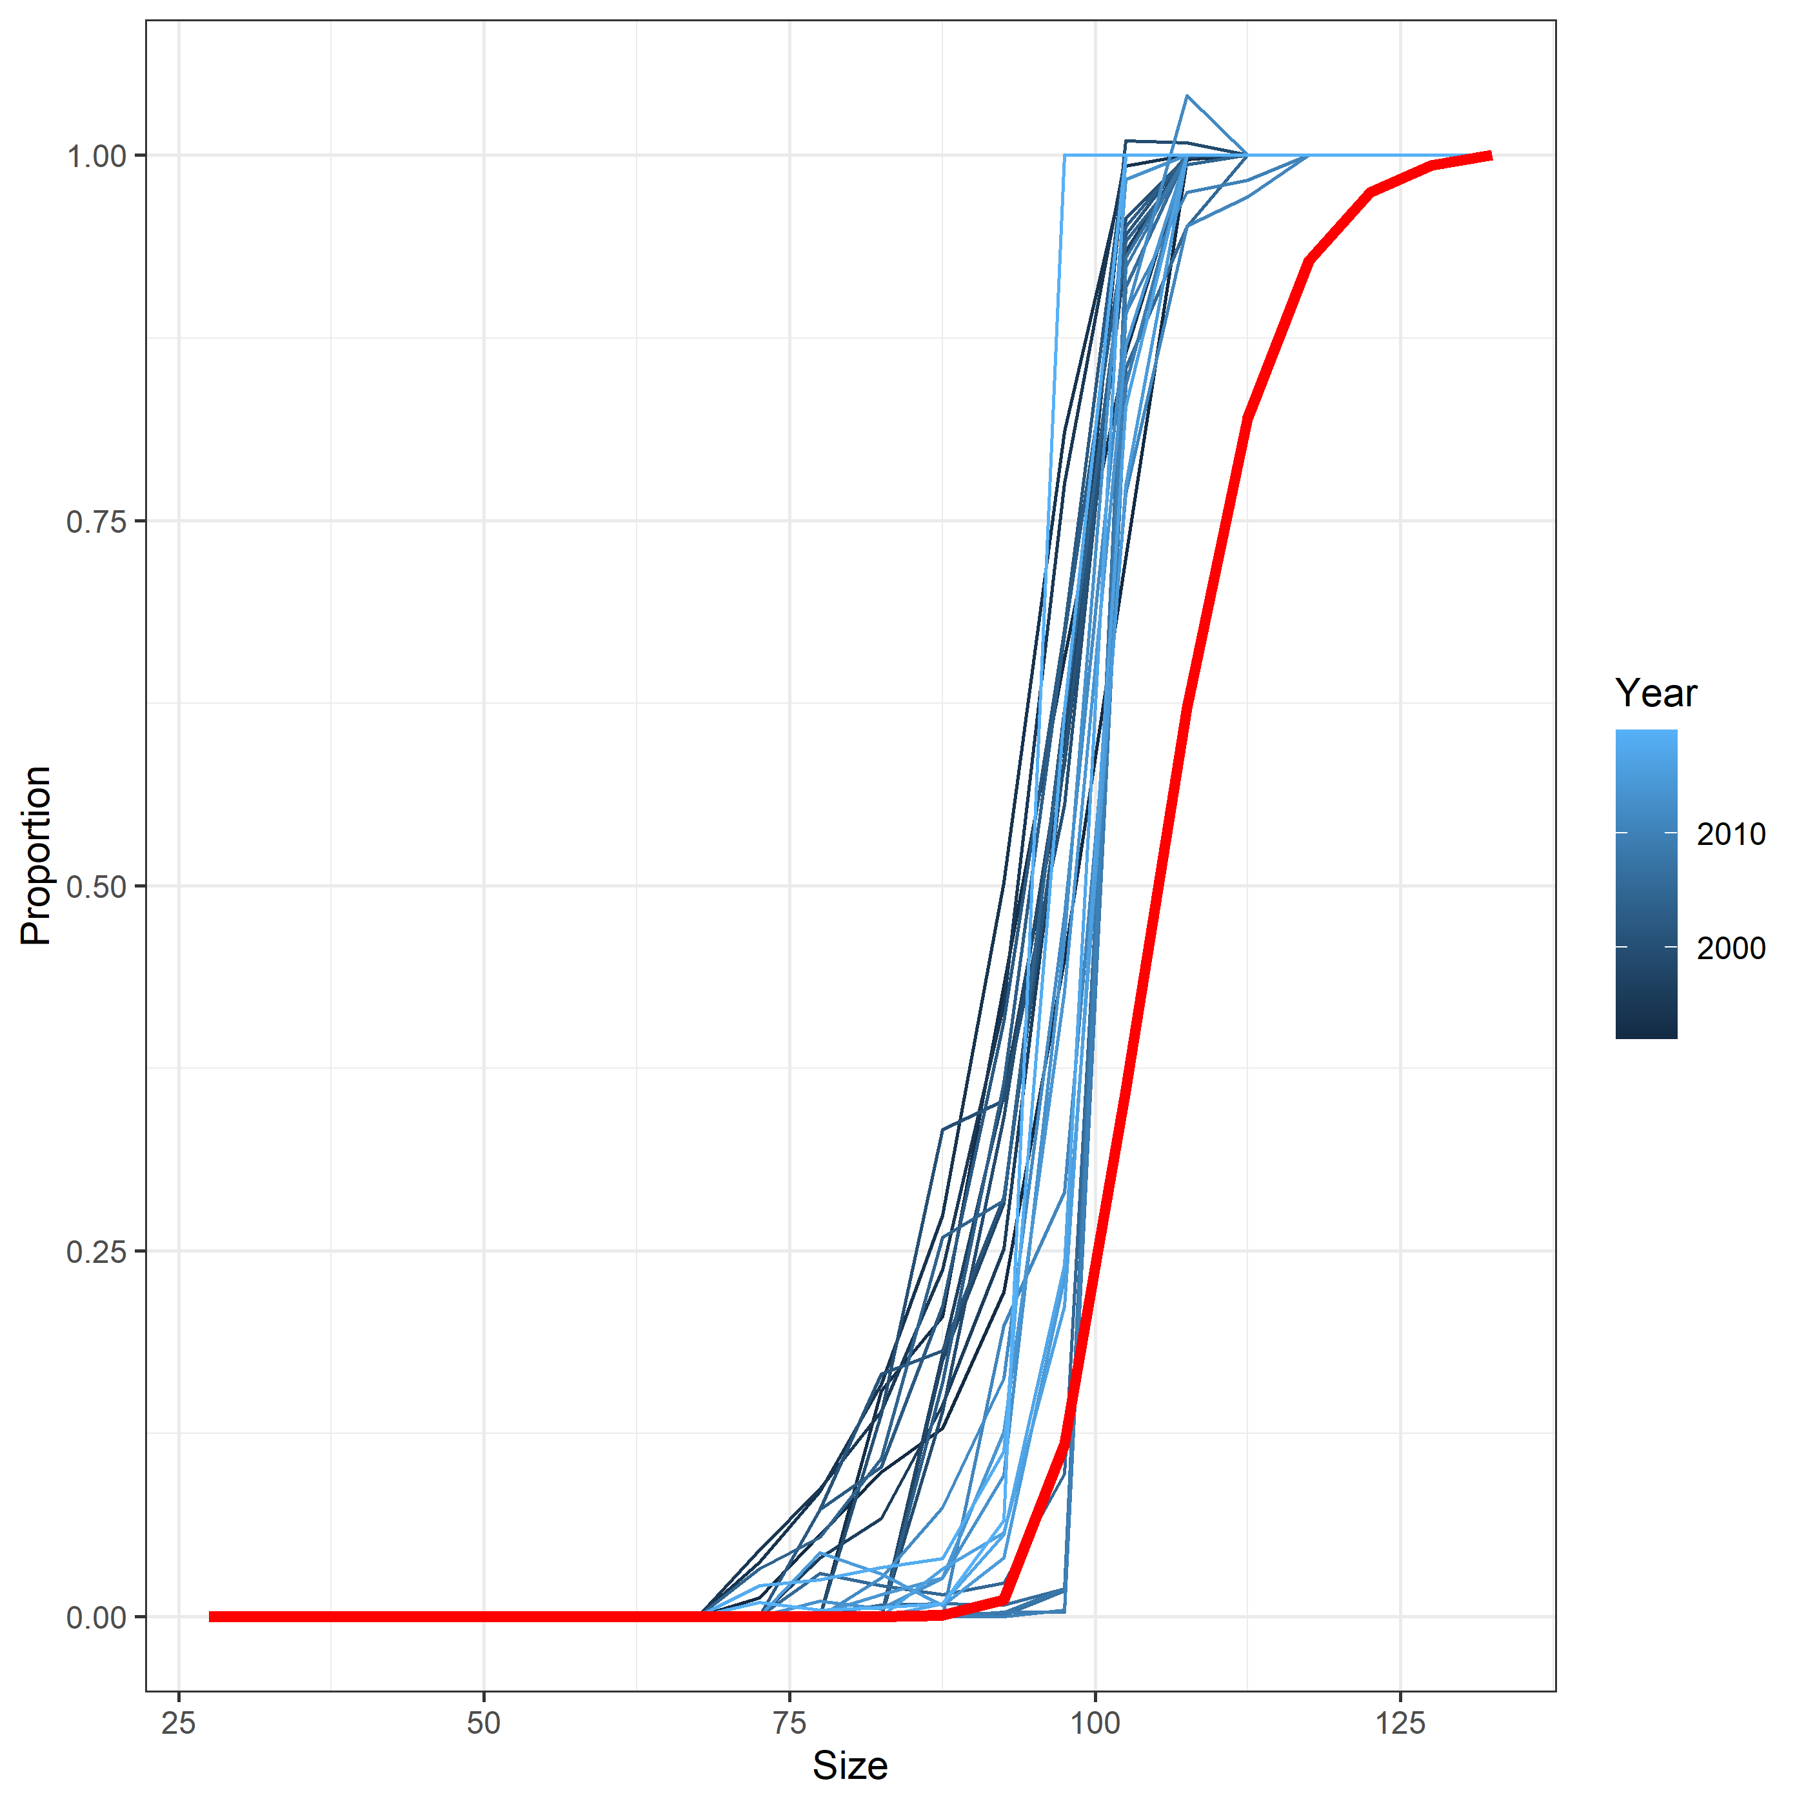
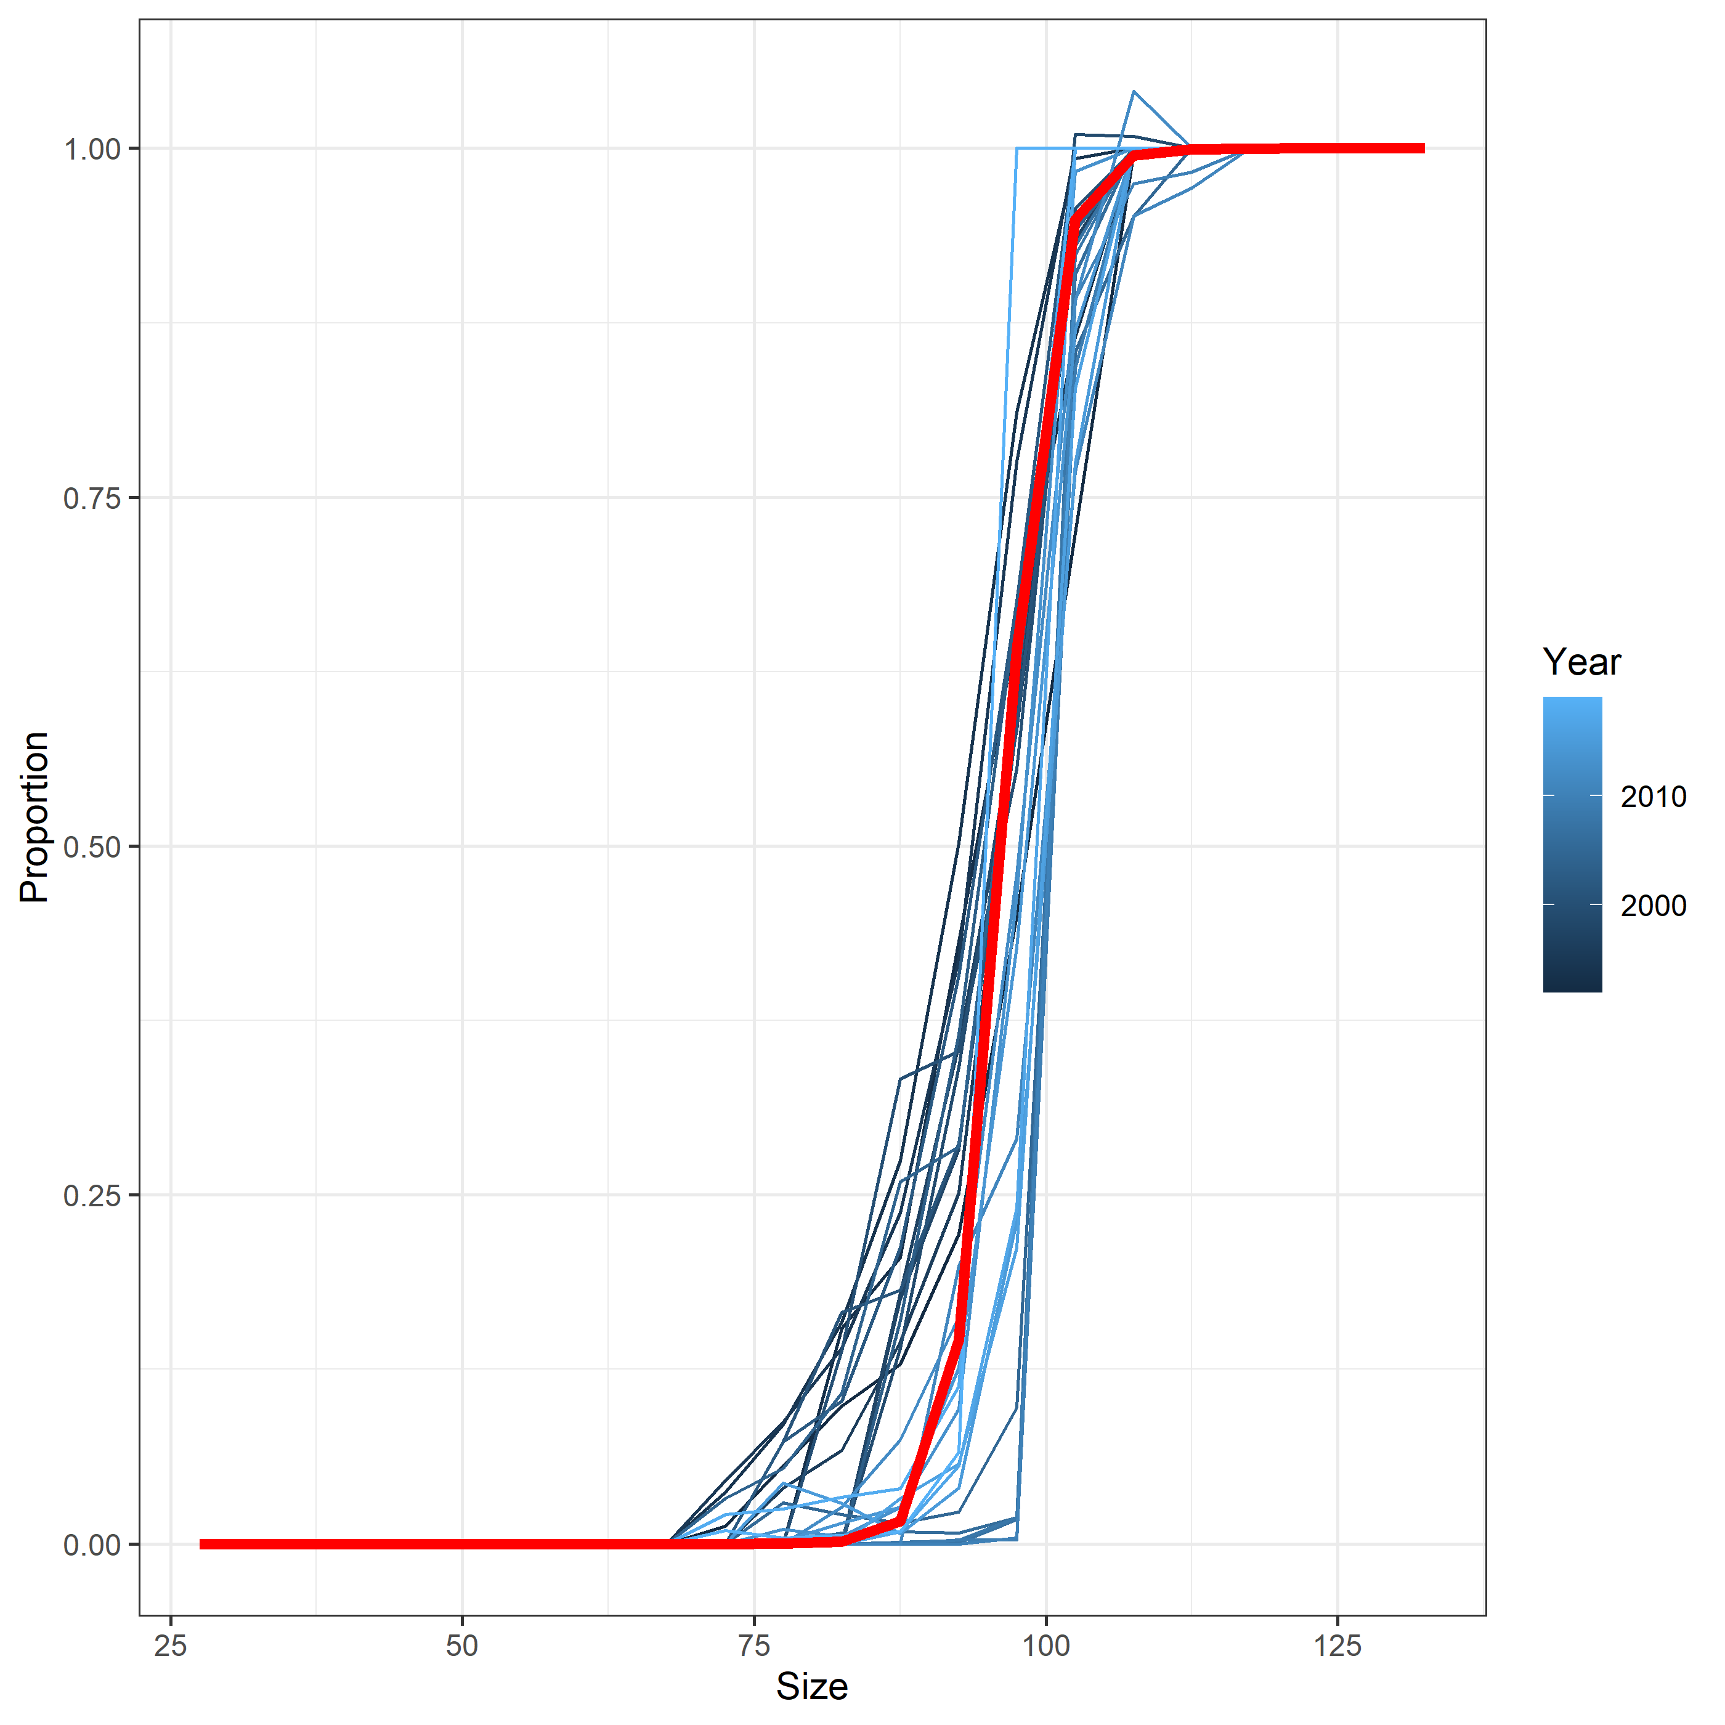
Total selectivity
Retained selectivity
Retained selectivity

Slide 67
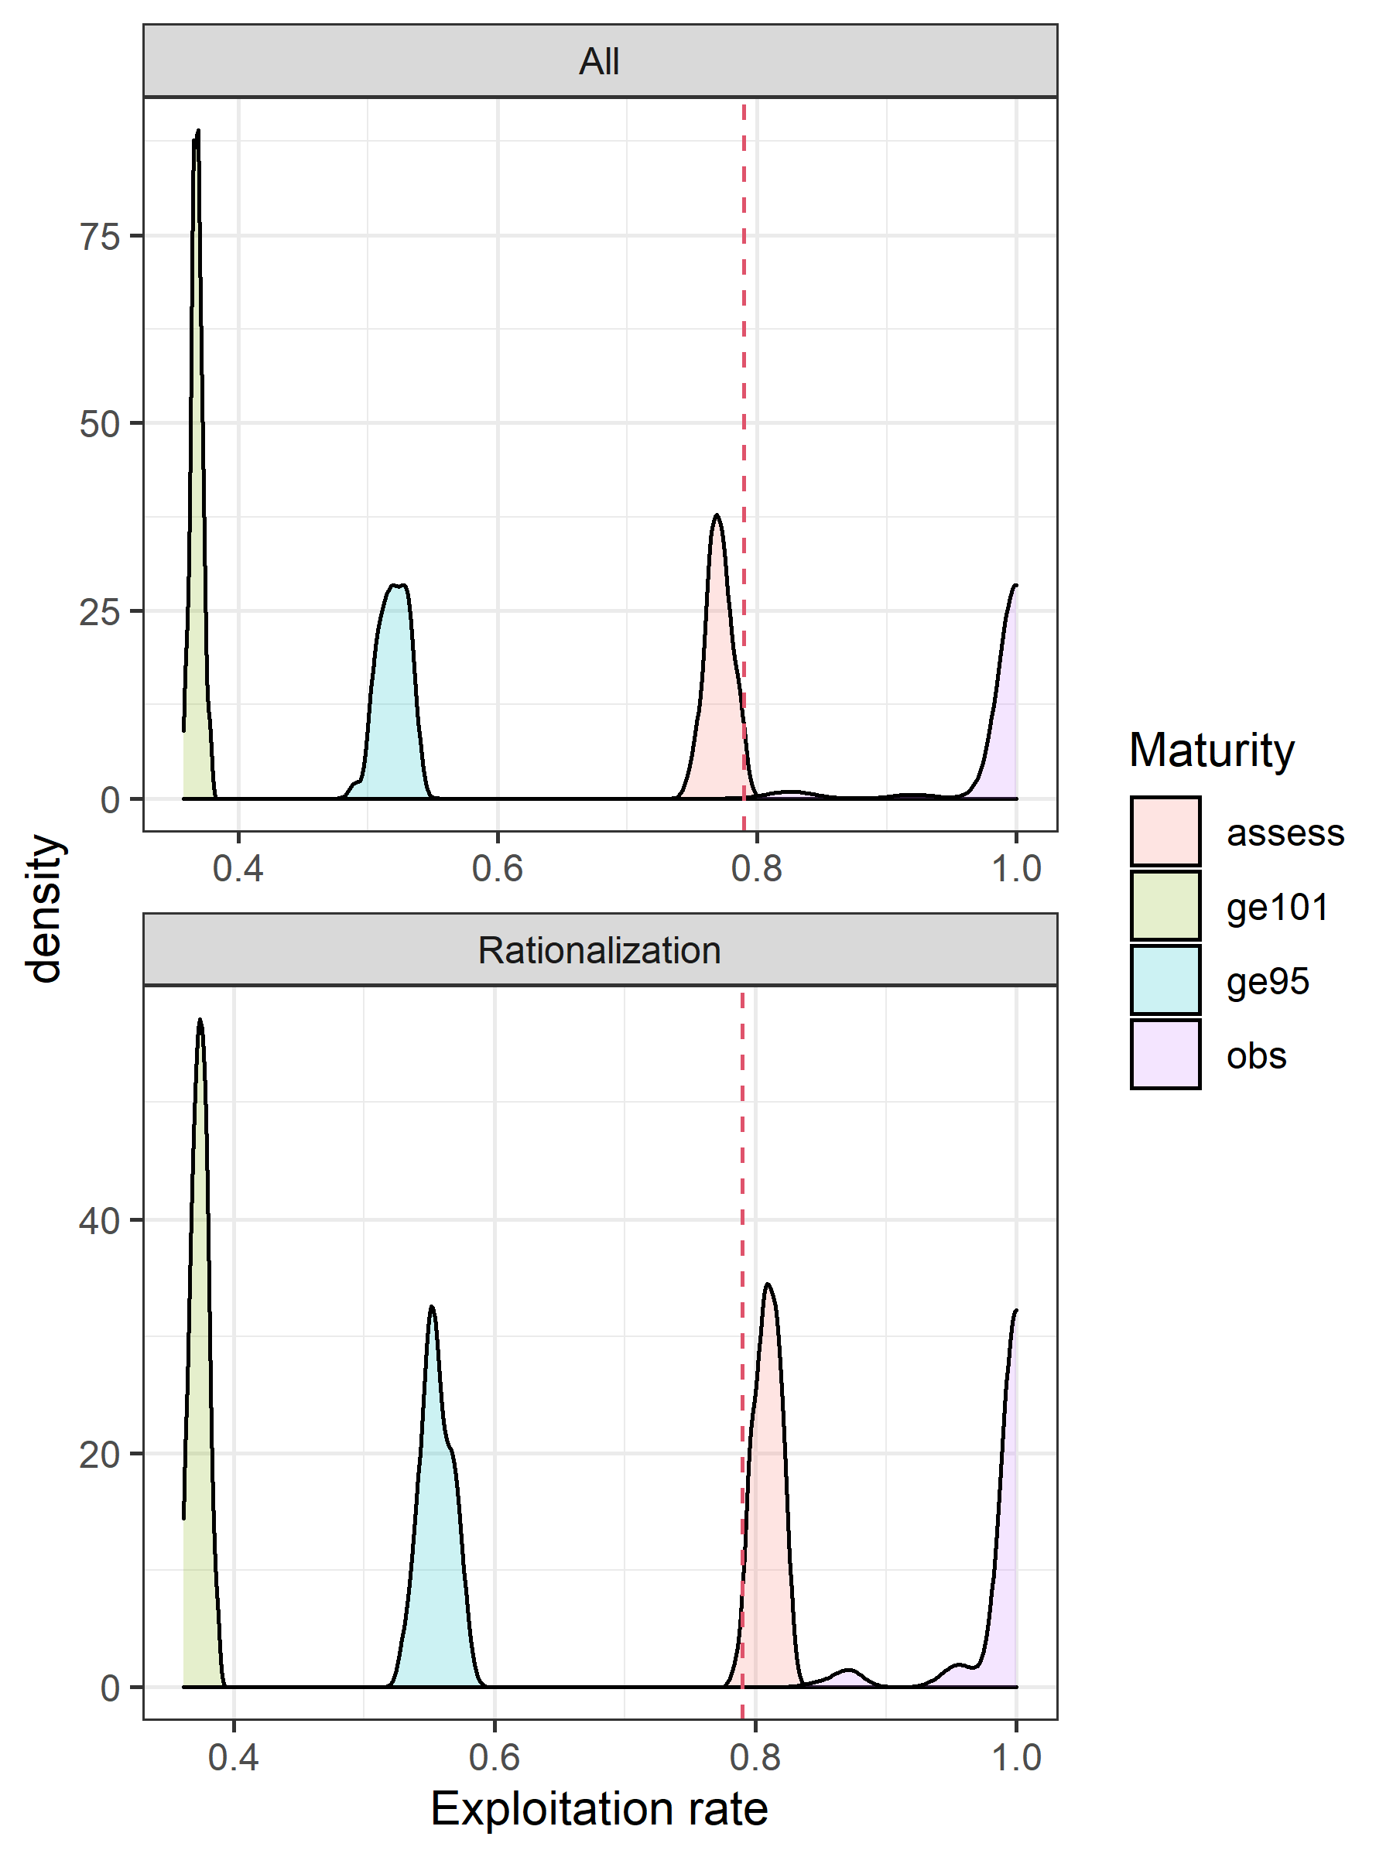
Calculating distributions of F35%
Multiple estimates for each population process
Monte Carlo methods
Draw from available estimates:
  Retained and total fishery selectivity
  Size transition matrix
  Probability of maturing at size
  Natural mortality
Insert into population dynamics function
Order of impacts on calculated F35%:
  Probability of maturing
  Fishery selectivity
  Growth or M
F35% from the assessment is close to the estimates using assessment derived quantities
Using ‘observed’ maturity suggests the fishery can take all males selected in the fishery

Slide 68
 | MMB | BMSY | Status | F35 | FOFL | OFL
78mm | 175 | 162.9 | 1.07 | 1.64 | 1.64 | 119.2
95mm | 54.5 | 98.04 | 0.56 | 0.81 | 0.41 | 15.52
101mm | 28.9 | 71.32 | 0.41 | 0.47 | 0.16 | 3.56
78mm_q | 350 | 325.9 | 1.07 | 1.64 | 1.64 | 238.4
95mm_q | 109 | 196.1 | 0.56 | 0.81 | 0.41 | 31.05
101mm_q | 57.8 | 142.6 | 0.41 | 0.47 | 0.16 | 7.13
Model | MMB | B35 | F35 | FOFL | OFL
20.1 | 144.11 | 120.46 | 1.59 | 1.59 | 95.25
20.2 | 133.51 | 121.47 | 1.23 | 1.23 | 88.90
20.1g | 207.19 | 113.66 | 1.65 | 1.65 | 184.91

Slide 69
What do we know?

Slide 70
How big of a 2015 recruitment is plausible?
Really big, BUT ‘something’ happened.
Observed for 4 years
Raw numbers of the smallest animals fully selected in the fishery (~50mm) were two times as large as ever observed.

Slide 71
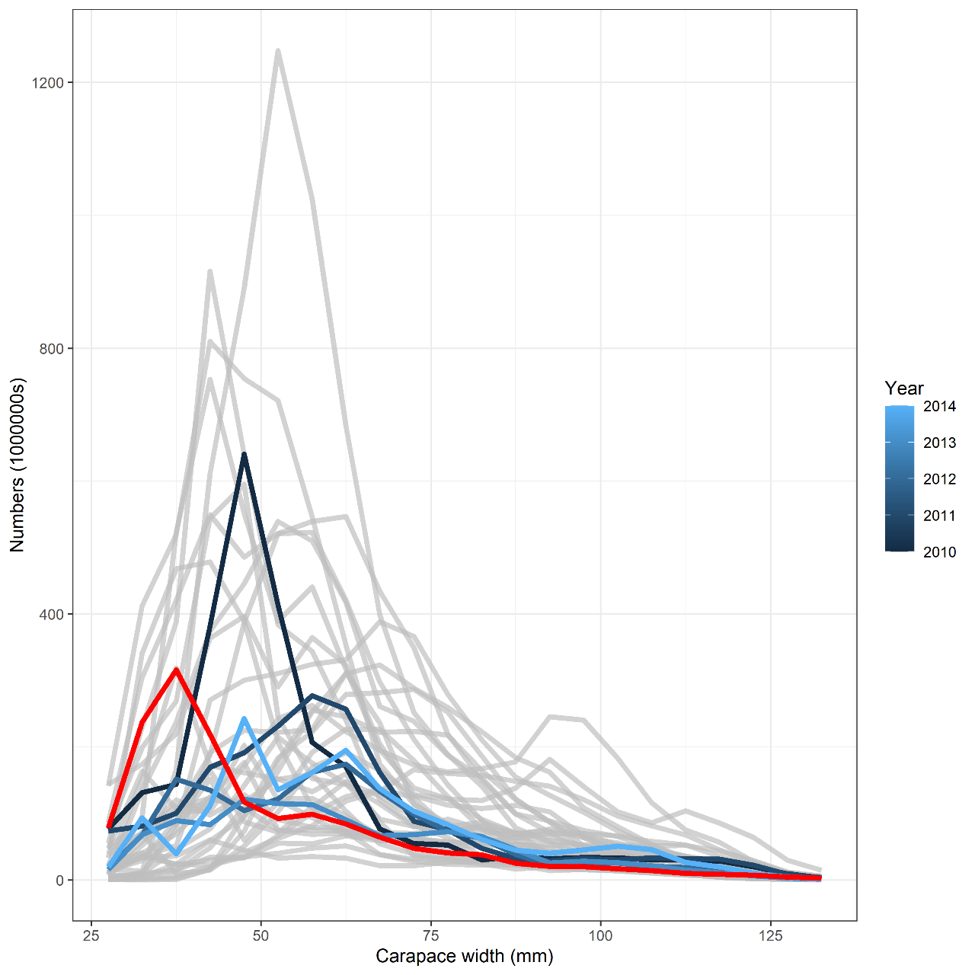
Natural mortality likely varies over time

Slide 72
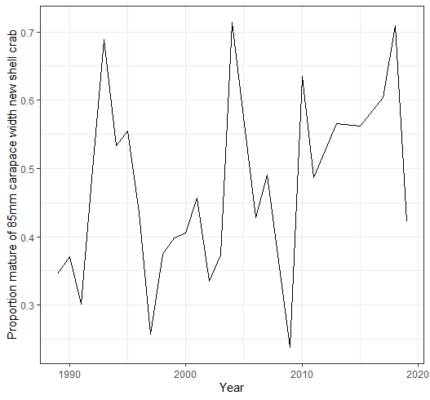
Probability of maturing likely varies over time

Slide 73
Catchability is likely varying over time
NBS flux
Sediment type
(Somerton et al., 2013)

Slide 74
Fishery selectivity is likely varying over time
Total selectivity
Retained selectivity

Slide 75
Is the yearly variability in the survey biomass more influenced by processes related to the survey or related to variation in population processes?

Slide 76
Model | Pro | Con
Integrated assessment | Data sources fit simultaneously, uncertainty propagated Continuity of management | Retrospective patterns Lacking data to inform multiple time-varying processes Mis-specified models likely do not provide appropriate estimates of population processes
Tier 3.5 | Agnostic to time-variation in population processes Accounts for uncertainty via MC | Does not consider covariance between processes

Slide 77
Recommendations
Hard to defend the time-varying models
GMACS (20.1g) and status quo (20.2) + time-varying fishery selectivity and explore post hoc adjustments for retrospective patterns
Tier 3.5 + consideration of fishery selectivity

Slide 78
(pause for discussion)

Slide 79
Assessment related considerations | Population dynamics considerations | Environmental ecosystem consideration | Fishery Performance considerations
Level 3: Major concerns | Level 4: Extreme concern | Level 1: no increased concerns | Level 2: Substantially increased concerns
Assessment considerations
Retrospective patterns
Missing survey data
Poor model fits
Population dynamics considerations
Largest recruitment ever seen
Time-variation in natural mortality, maturity, fishery selectivity, survey catchability, maturity
Ecosystem considerations
Not sure what would be included
Fishery performance
CPUEs on a general decline, but somewhat up this year over last
High discards
Spatial displacement of the fishery

Slide 80
Fishery dynamics

Slide 81
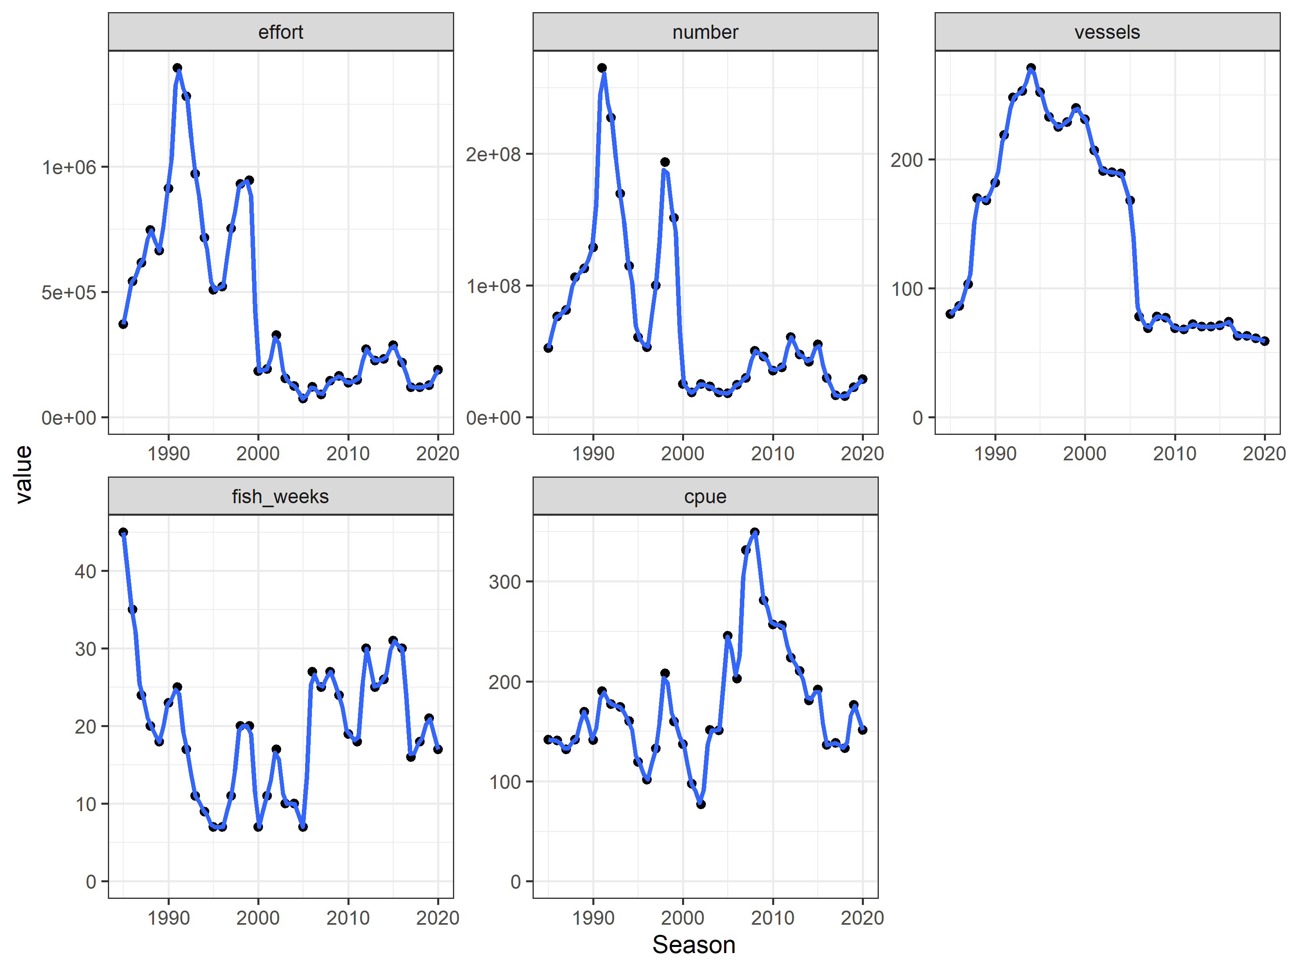

Slide 82


Slide 83


Slide 84


Slide 85


1997
2020

Slide 86
What might the opilio fishery look like in the future?
Fishery dynamics—where and when do fishers fish?
Ice edge dynamics—how will the disappearance of sea ice impact timing and distribution of the fishery?
Processing—will there be incentive to open processing facilities farther north?
For a given fleet size, CPUE, and effort, how long would it take to catch a given TAC?

Slide 87


