Slide 1


2022 EFH 5-Year Review Plan
NMFS Alaska Region &
Alaska Fisheries Science Center
Gretchen Harrington, Habitat Conservation Division
Ned Laman, Alaska Fisheries Science Center
Jodi Pirtle, Habitat Conservation Division
Molly Zaleski, Habitat Conservation Division
John V. Olson, Habitat Conservation Division
Megan Mackey, Sustainable Fisheries Division

Slide 2

Council’s EFH Roadmap - 10 Components
We have prioritized the six EFH components in bold:
EFH descriptions and identification (and MAPS!)
Fishing activities that may adversely affect EFH
Non-MSA fishing activities that may adversely affect EFH
Non-fishing activities that may adversely affect EFH
Cumulative impacts analysis
EFH conservation and enhancement recommendations
Prey species list and locations
Habitat Areas of Particular Concern (HAPC) identification
Research and information needs
Review EFH every 5 years.
This information will be presented to the Council in a summary report in June 2022 (T).
If the Council chooses to update its FMPs, FMP amendments will be prepared along with the appropriate analytical documents through the normal Council process.

Slide 3

Timeline - Work to date
2022 EFH 5-Year Review Proposed Approach
Progress on Species Distribution Models for SSC input
Present EFH 5 year review plan to SSC
April 2019
June 2020
April 2021
April 2020
September 2020
2022 EFH 5-Year Review Proposed Approach Update to Council
Progress on Species Distribution Models for Groundfish Plan Teams

Slide 4

Timeline - Future Planning
SSC review Review of C 1
Council Review of EFH Summary Report
Council Initial Review
October 2021
June 2022
October 2022
February 2022
Jun-Nov 2022
December 2022
SSC Review of
C 2
FMP Amendment & NEPA
Council FInal Action

Slide 5

ADVANCING ESSENTIAL FISH HABITAT DESCRIPTIONS AND MAPS
FOR THE 2022 5-YEAR REVIEW
NED LAMAN¹, JODI PIRTLE², JIM THORSON³
¹ Groundfish Assessment Program (GAP), Alaska Fisheries Science Center (AFSC), Seattle, WA
² Habitat Conservation Division (HCD), NMFS Alaska Region, Juneau, AK
³ Habitat and Ecological Processes Research (HEPR) Program, AFSC, Seattle, WA

Slide 6
EFH Descriptions and Identification
EFH Definition: “those waters and substrate necessary to fish for spawning, feeding, or growth to maturity” (Magnuson-Stevens Act)
Component 1: EFH descriptions and identification
  FMP text and tables
  FMP maps based on species distribution models (SDM) established in 2017 and refined in 2022
EFH information levels
  Level 1 (distribution)
  Level 2 (habitat-related densities or abundance)
  Level 3 (habitat-related growth, reproduction, or survival rates)
  Level 4 (production rates by habitat)
In development for 2022 EFH 5-year Review:
  New EFH Level 2
    Groundfishes and Crabs in GOA, BSAI, and Arctic FMPs
  New EFH Level 3
    Groundfishes in GOA, BSAI, and Arctic FMPs

Slide 7
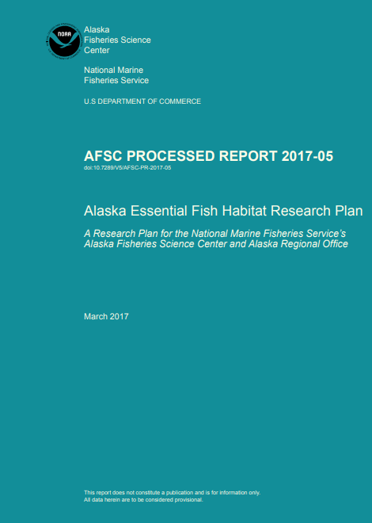
EFH RESEARCH
EFH research objectives to be accomplished by the next EFH 5-year Review (2022):
Develop EFH Level 1 information (distribution) for life stages and areas where missing.
Raise EFH level from Level 1 or 2 (habitat-related density or abundance) to Level 3 (habitat-related growth, reproduction, or survival rates).

Slide 8

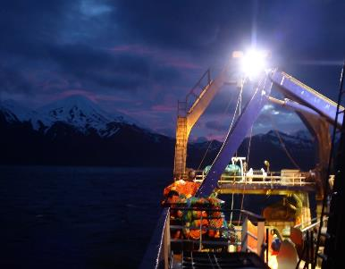
CONTRIBUTORS / AFFILIATIONS
Cheryl Barnes^{1,2,3}, Christina Conrath⁴, Louise Copeman^{5,6}, Alison Deary⁷, Georgina Gibson⁸, Gretchen Harrington¹, Jeremy Harris⁹, Tom Hurst⁵, Ben Laurel⁵, Jennifer Marsh^{1,10}, Franz Mueter¹⁰, Chris Rooper¹¹, S. Kalei Shotwell¹², William Stockhausen¹³
¹ HCD, NMFS Alaska Region, Juneau, AK
² HEPR Program, AFSC, Seattle, WA
³ University of Washington, Seattle, WA
⁴ GAP, AFSC, Kodiak, AK
⁵ Fisheries Behavioral Ecology Program, AFSC, Newport, OR
⁶ Oregon State University (OSU), Newport, OR
⁷ Recruitment Processes Program, AFSC, Seattle, WA
⁸ University of Alaska Fairbanks (UAF), Fairbanks, AK
⁹ GAP, AFSC, Seattle, WA
¹⁰ UAF, Juneau, AK
¹¹ Department of Fisheries and Oceans, Nanaimo, BC, Canada
¹² Resource Ecology and Fisheries Management (REFM), AFSC, Juneau, AK
¹³ REFM, AFSC, Seattle, WA
2020 EFH Discussion Paper: https://meetings.npfmc.org/Meeting/Details/2045

Slide 9
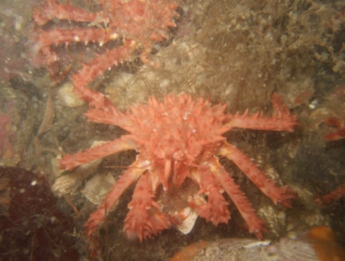
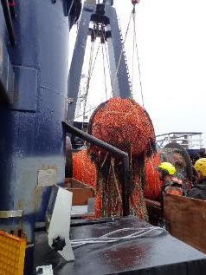
OUTLINE
New Ensemble Models and EFH Maps
Advancing EFH for Groundfishes and Crabs in Alaska (Laman et al.)
New Stock-specific EFH Tools
First Model-based Arctic EFH (Marsh et al.)
Juvenile Walleye Pollock Thermal Habitat (Laurel et al.)
Individual-based Models to Advance EFH (Shotwell et al.)

Slide 10
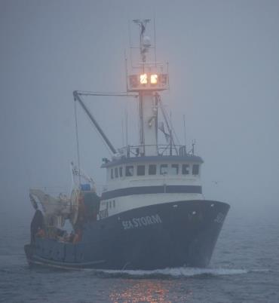
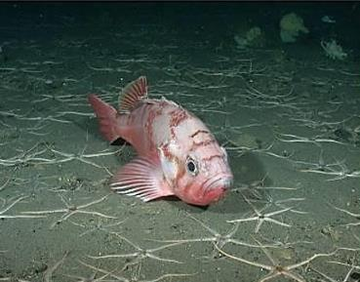
ADVANCING EFH FOR NORTH PACIFIC SPECIES IN ALASKA
(Laman, Pirtle, Harris, Rooper, Hurst, Conrath)
Since the 2017 EFH Review:
5 bottom trawl survey years added (2015-19)
Updated terrain and ROMS covariates
Updated life stages and maturity schedules
Refined methodology (numerical abundance, ensemble)
Skill testing among constituent SDMs
Advancing EFH Levels
  All models EFH Level 2 (abundance)
  Introduce EFH Level 3 (vital rates)

Slide 11
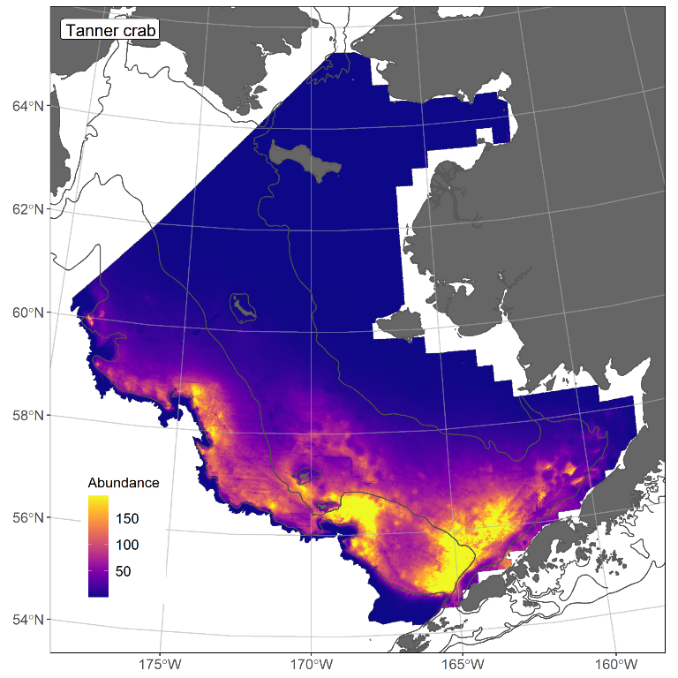
SOUTHERN TANNER CRAB
ENSEMBLE-PREDICTED ABUNDANCE
Abundance predicted from 1982-2019 catches
Cross-validation Spearman’s rank correlation (0.64)
Covariate effects: geographic position, depth, sediment grain size

Slide 12
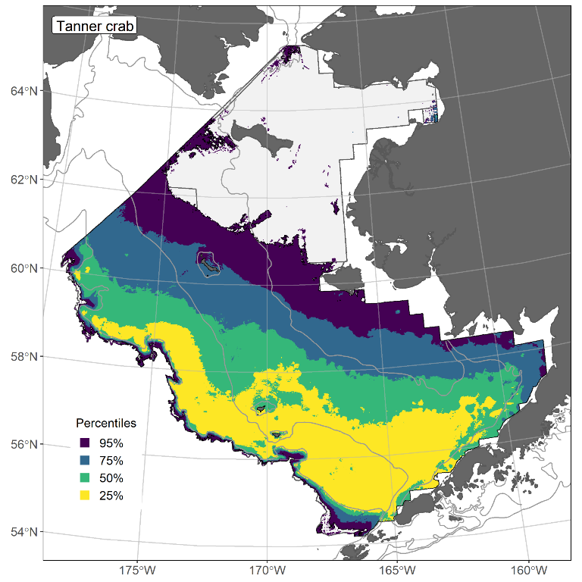
SOUTHERN TANNER CRAB
EFH MAP AND PERCENTILES
EFH (upper 95%) all of the colored area (purple)
Other EFH Percentiles:
75% = “Principal EFH Area” (blue); 50% = “Core EFH Area” (green); 25% = “EFH Hot Spots” (yellow)
Core EFH Area used in 2017 Fishing Effects Analysis (EFH Component 2)

Slide 13
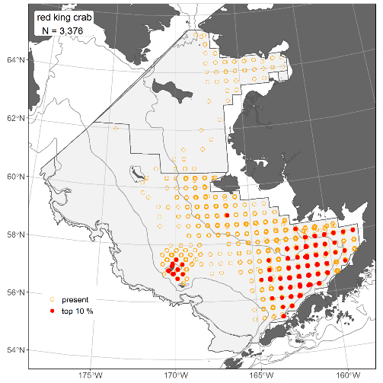
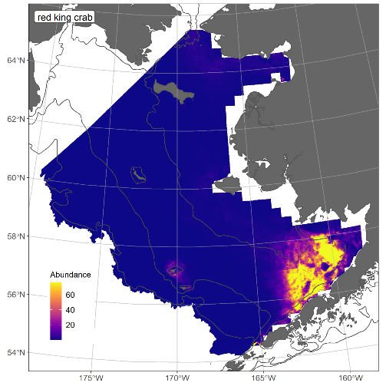
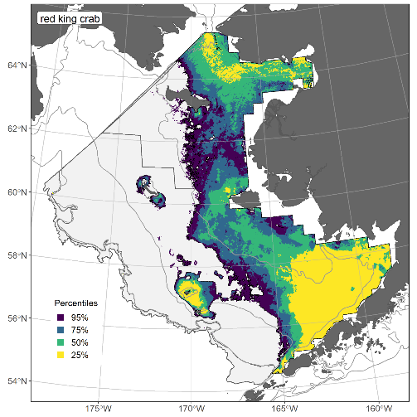
RED KING CRAB: HABITAT-RELATED, LEVEL 2 EFH
(Laman et al.)
Spearman’s Rank R² = 0.42
Constituent SDMs = MaxEnt and negative-binomial GAM
Main Effects: Tidal maximum current, geographic position, bottom depth, and sediment grain size = 82% of covariate contribution

Slide 14
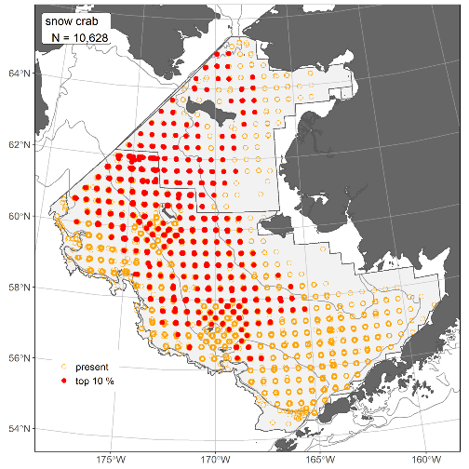
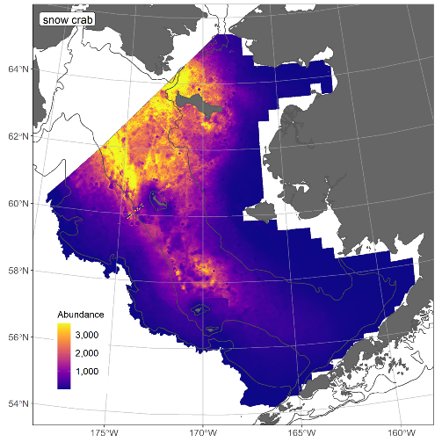
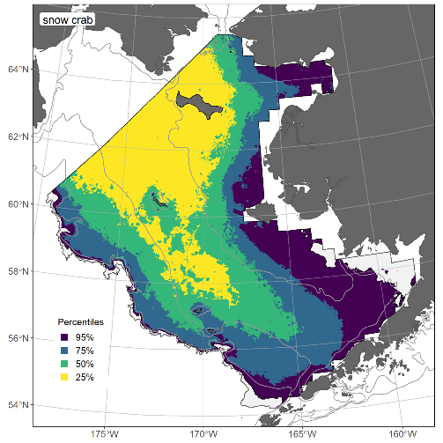
SNOW CRAB: HABITAT-RELATED, LEVEL 2 EFH
(Laman et al.)
Spearman’s Rank R² = 0.71
Constituent SDMs = MaxEnt and negative-binomial GAM
Main Effects: Geographic position, bottom temperature, and bottom depth = 80% of covariate contribution

Slide 15
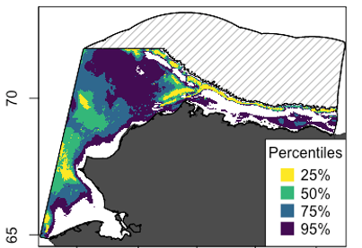
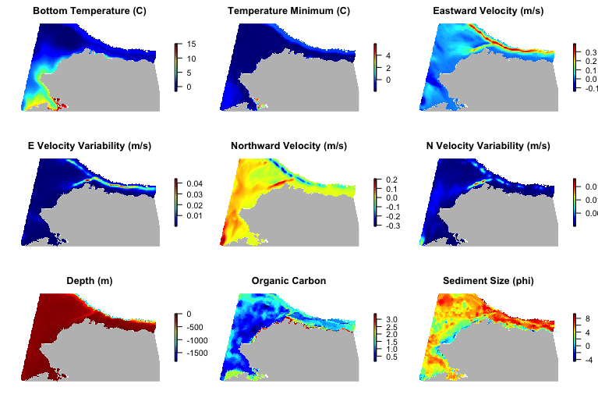
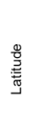


FIRST U.S. ARCTIC MODEL-BASED EFH
(Marsh, Mueter, Pirtle, Harris)
Snow Crab EFH Maps
Species Distribution Model Covariates
Mature Males
Mature Females

Slide 16
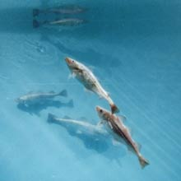
EFH LEVEL 3 – HABITAT-RELATED VITAL RATES
Addressing EFH Level 3 for groundfish the first time
Objective 2 of 2017 Alaska EFH Research Plan
Unified approach among projects
Laman et al. GOA and BSAI subset of species
Marsh et al. Arctic species
Laurel et al. GOA walleye pollock
Shotwell et al. GOA Pacific cod and sablefish

Slide 17
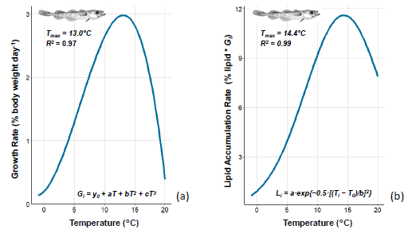
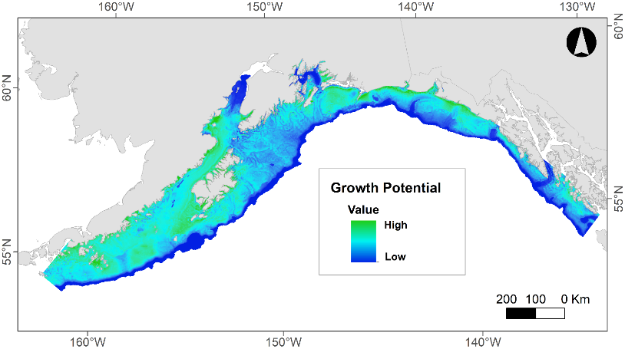
THERMAL HABITAT FOR JUVENILE WALLEYE POLLOCK (Laurel, Copeman, Hurst, Pirtle, Gibson, Harris)
Early juvenile stage pollock (40-120 mm)
Laboratory studies established temperature-dependent growth and condition rates for summer and energy loss rate for winter
EFH Level 3 map is the product of summer growth rate and an SDM
Habitat-related growth potential
Growth rate f(temperature)

Slide 18
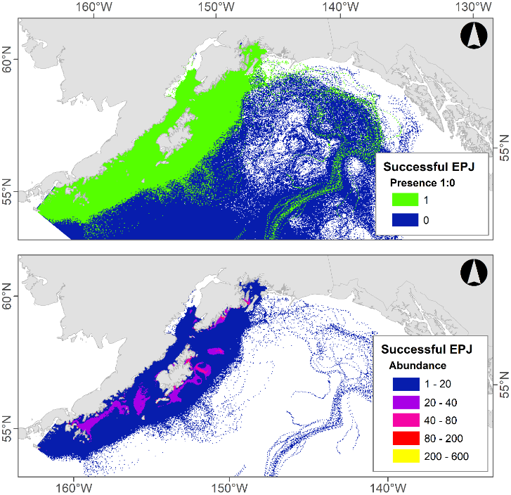
Individual-based Models (IBMs) to Describe and Map EFH
(Shotwell, Stockhausen, Gibson, Pirtle, Deary, Rooper)
Fig. 1
EFH Level 1: Initial IBM run will create the presence/absence map – life stage trajectory of survivors (Fig. 1).
EFH Level 2: Model trajectories are post-processed with spatially-explicit spawning biomass information to create the relative abundance map (similar to Fig. 2).
Fig. 2
EFH Level 3: Trajectories are further post-processed with vital rates to create maps of habitat-related survival and growth potential.
Pacific cod successful epipelagic juveniles

Slide 19
SSC MINUTES JUNE 2020 AND APRIL 2021
SSC suggested consideration of ensemble methods that weight EFH prediction across candidate SDMs with similar out-of-sample predictive performance. (June 2020)
SSC supported continued exploration of alternative SDM approaches across species, regions, and life stages (e.g., GAMs and MaxEnt models). (June 2020)
SSC supported the following: Response variable of numerical abundance with area swept (effort) as an offset in the SDM; Out-of-sample skill testing for arbitrating among candidate SDMs; Cross-validation through repeated sampling of testing and training datasets; Use of the complementary log-log (cloglog) link to relate abundance to occurrence, which facilitates skill testing; Use of RMSE for skill testing. (June 2020)
SSC supported research permitting description of Level 3 EFH. (June 2020)
SSC noted the immense progress in EFH modeling and hopes that these analyses will be considered in stock assessments and analyses supporting stock assessments, particularly habitat suitability and how it may pertain to recruitment and spawning locations. (June 2020)
Overall, the SSC is supportive of the use of this package of products for the advancement of EFH in the 2022 cycle, which will advance the objectives of the Alaska EFH research plan and lead to improved definitions of EFH in the BSAI, GOA, and Arctic. (April 2021)
The SSC considers consultation with assessment authors to be a critical link in evaluating model configuration and output, and was pleased to hear the EFH team was involving assessment authors early in the EFH review process. (April 2021)

Slide 20
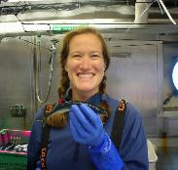
Opportunities for Involvement in EFH Review
Molly Zaleski, Habitat Conservation Division, NMFS Alaska Region, Juneau, AK
Process for the EFH 5-Year Review
Review Partners
Items for Review
  Components 1 and 7 (Prey) in the current Crab FMP
  New Component 1 model results and EFH maps

Slide 21
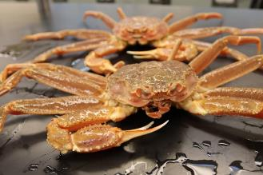
Review Process
For Stock Assessment Authors:
Stock-specific EFH information in the FMPs
Components 1 and 7:
  1: habitat descriptions and locations (text and maps)
  7: prey species list and habitat (text and tables)
Stock Authors
  Review and recommend updates to current FMP EFH text, tables, and maps (EFH Components 1 and 7)
  Review new species model results and EFH maps (EFH Component 1) and provide feedback
AKRO and NPFMC revise FMPs with new EFH information

Slide 22
Review Process
For Stock Assessment Authors:
Brief Instructions
Google Drive folder system
Materials are organized by species
AKRO will manage the process
What is provided?
Documents with Crab FMP text, tables, and maps
New EFH Component 1 information
  New species model results
  New species EFH maps

Slide 23
Partners: Stock Authors and Experts
Species | Authors | Experts
Red King Crab | Buck Stockhausen
Blue King Crab | Cody Szuwalski
Golden King Crab | Ben Daly and Shareef Siddeek
Snow Crab | Cody Szuwalski and Jie Zheng
Tanner Crab | Buck Stockhausen and Katie Palof
Your
Recommendations

Slide 24
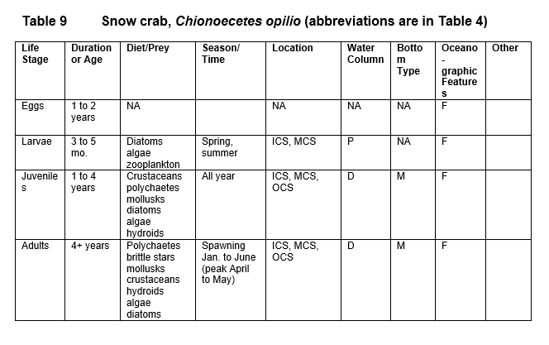
Items For Review
BSAI Crab FMP – Appendix F BSAI Crab EFH text
Section 2 – Habitat Descriptions for each species
  Life History and General Distribution
  Relevant Trophic Information
  Habitat and Biological Associations

Slide 25
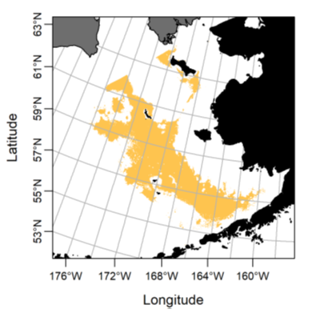
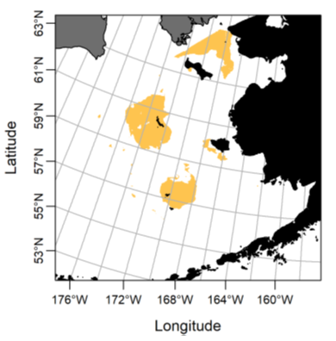
Items For Review
BSAI Crab FMP – Appendix F BSAI Crab EFH text
Section 2 – Habitat Descriptions for each species
Section 3.1 – EFH Text Descriptions
Section 3.2 – EFH Maps
Blue King Crab:
Spring
Winter

Slide 26
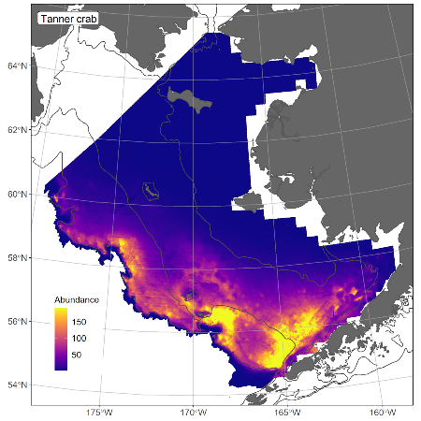
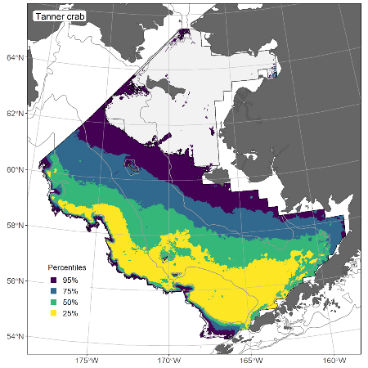
Items For Review
New Component 1 model results and EFH maps
Species draft tech memo chapters
Species model results, maps, and EFH maps
Tanner Crab:
New Model Results (summer)
EFH Map (with percentiles)

Slide 27
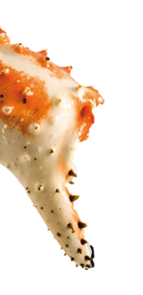
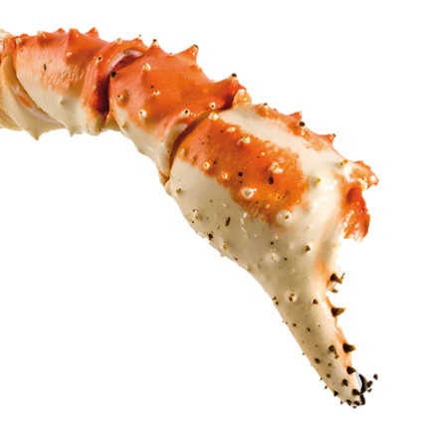
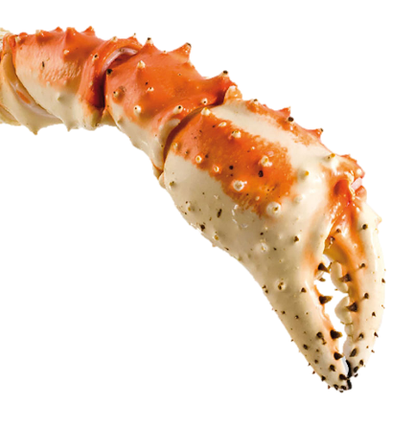
Your Role
What will you do?
Recommend a stock expert to partner with the stock author(s) for each species and life history stage
Review and recommend updates to current FMP text and tables
Review and provide input on the new species model results and EFH maps
Complete reviews by September 1, 2021

Slide 28
Thank You
Molly Zaleski
Send stock expert partnership recommendations to:
molly.zaleski@noaa.gov

Slide 29

2. Evaluation of the Effects of Fishing
JOHN V. OLSON, Habitat Conservation Division, NMFS Alaska Region, Anchorage, AK
Fishing Effects Model Description
Method to Evaluate the Effects of Fishing on EFH
Refining Gear Impact Estimates

Slide 30
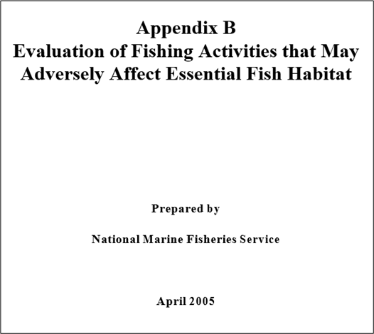


2. Evaluation of the Effects of Fishing
During the 2015 EFH cycle, the NPFMC requested several updates to the LEI model to make the input parameters more intuitive and to draw on the best available data. In response to their requests, the Fishing Effects (FE) model was developed. It is based on interaction between habitat impact and recovery, which depend on the amount of fishing effort, the types of gear used, habitat sensitivity, and substrate. The FE model updates the LEI model in the following ways:
The FE model is cast in a discrete time framework
The FE model implements sub-annual (monthly) tracking of fishing impacts and habitat disturbance.
The FE model draws on the spatially explicit Catch in Areas (CIA) database to use the best available spatial data of fishing locations.
The FE model incorporates the extensive literature (Grabowski et al 2014) to estimate susceptibility and recovery dynamics.

Slide 31
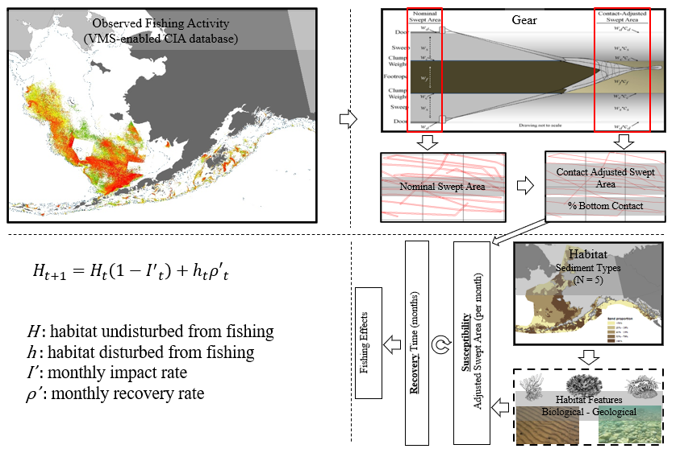
Fishing Effects Model Overview

Slide 32
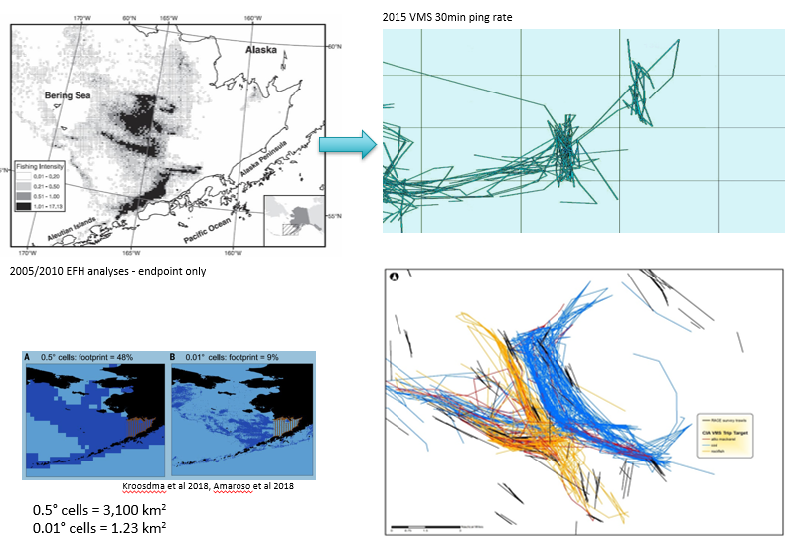
Using VMS to Increase Spatial Resolution

Slide 33
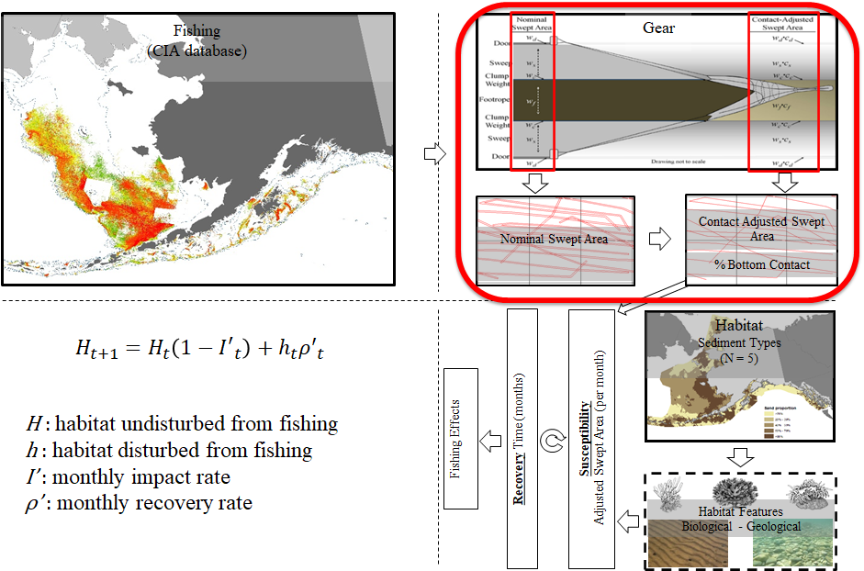
FE - Gear Descriptions & Bottom Contact

Slide 34
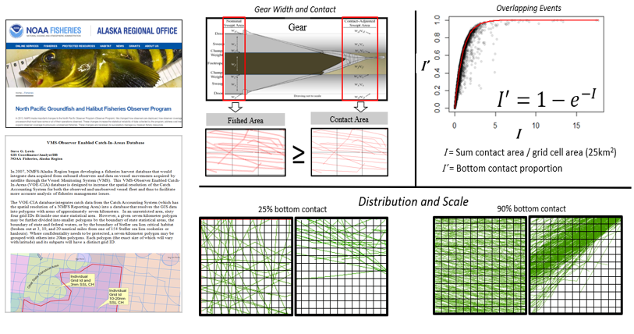
Defining Fishing Gear Footprint

Slide 35
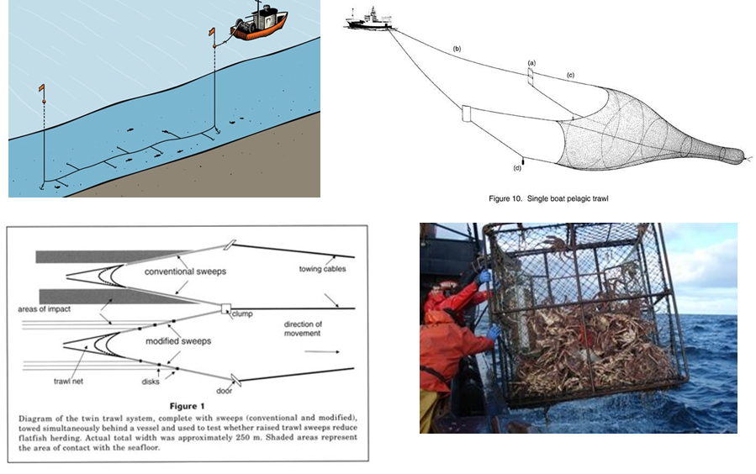
Bottom Contact Adjustment

Slide 36
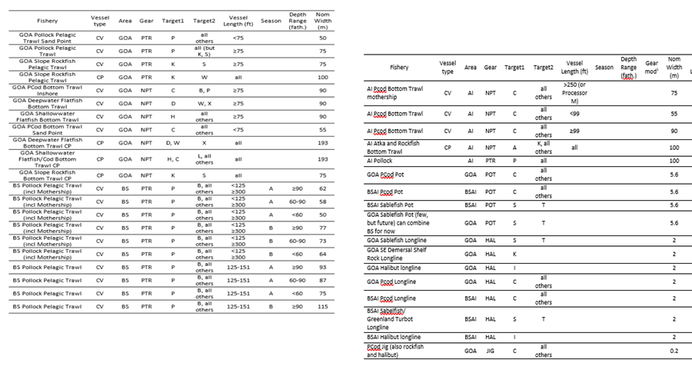
Gear Descriptions by Vessel Class, Target

Slide 37
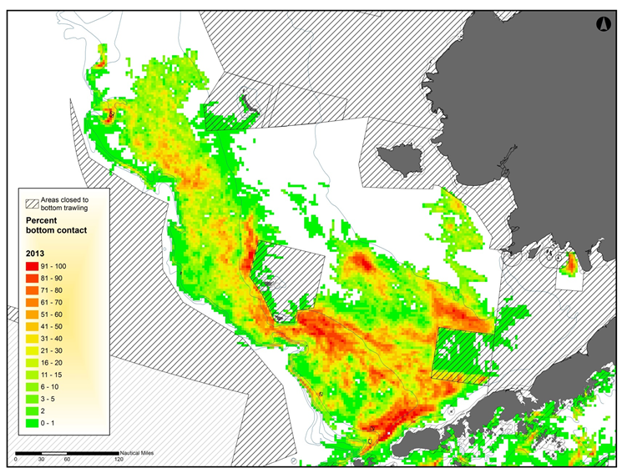
Initial Bottom Contact Percentages

Slide 38
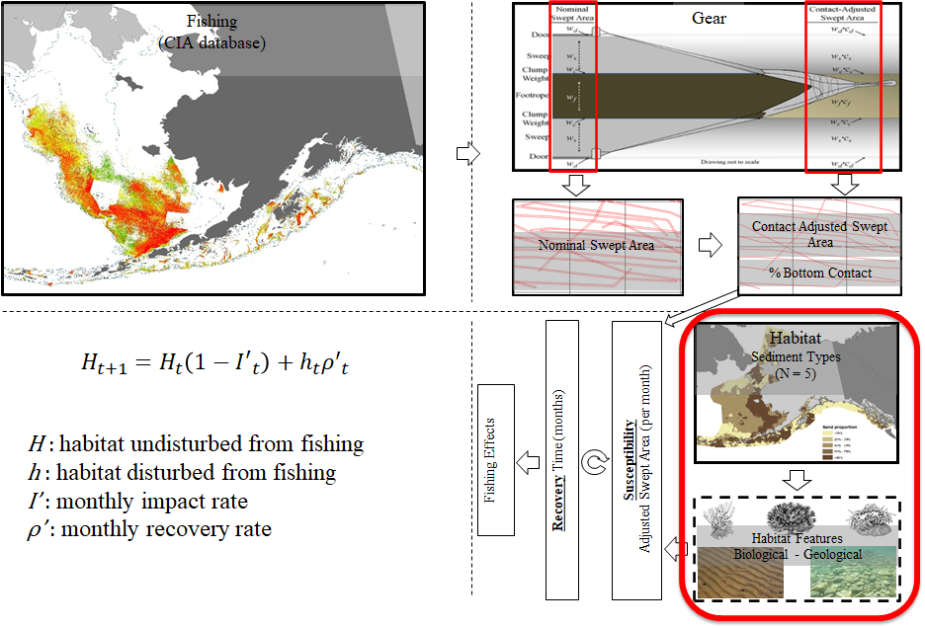
FE - Habitat Features

Slide 39
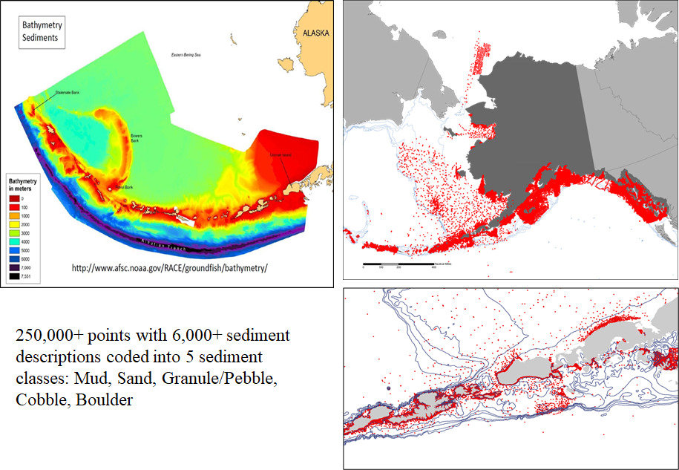
Bathymetry & Sediment

Slide 40
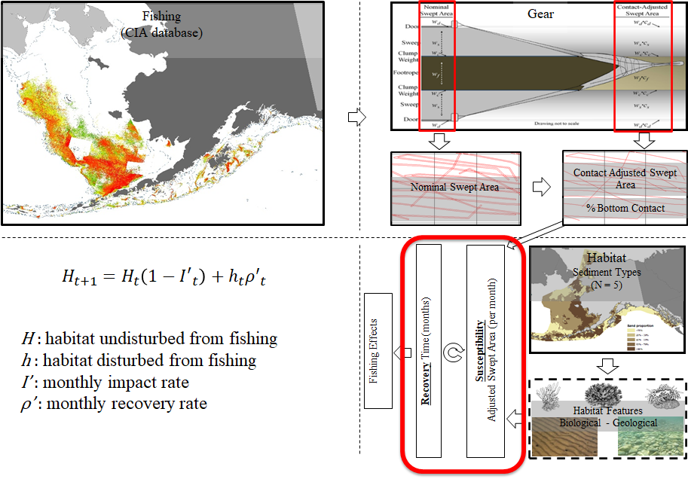
FE - Susceptibility & Recovery Dynamics

Slide 41
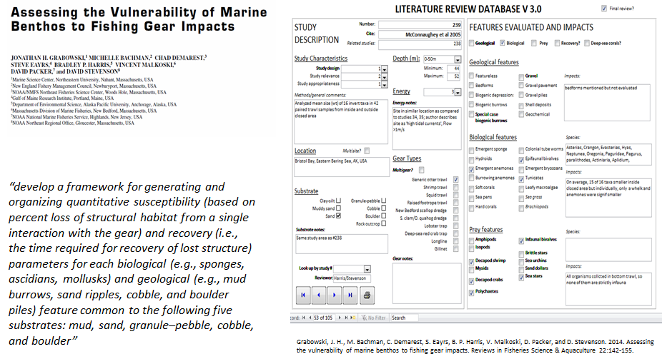
Framework for Literature Review

Slide 42
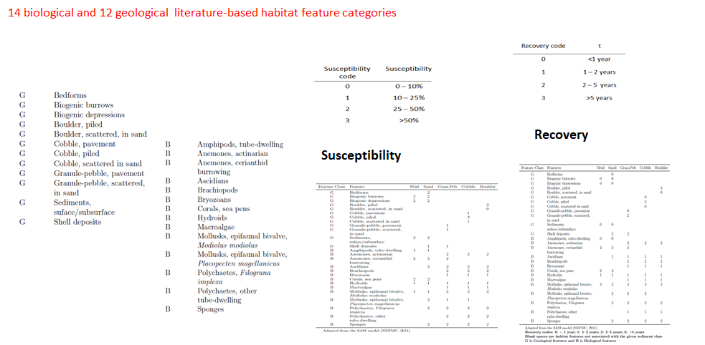
Classification of Habitat Features

Slide 43
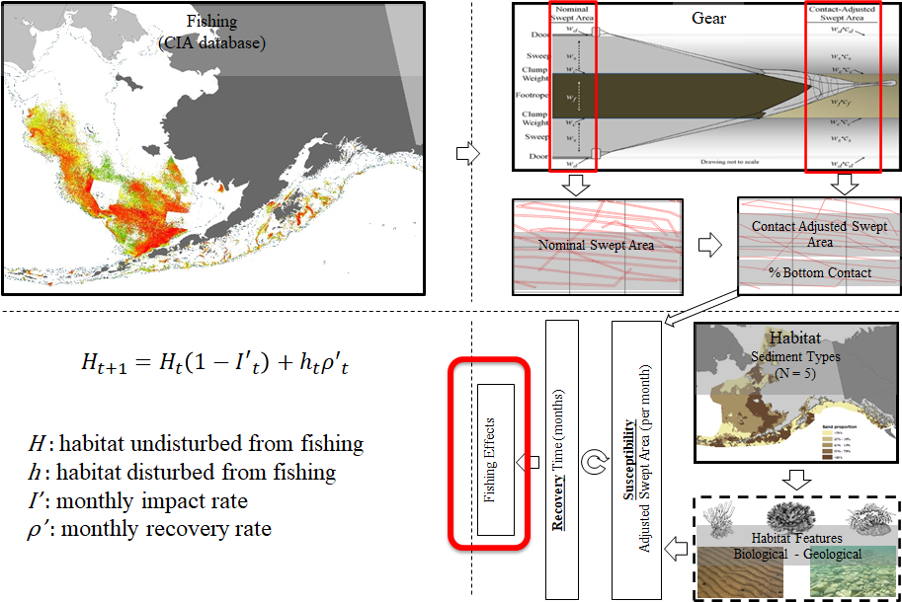
FE Output - Habitat Reduction

Slide 44
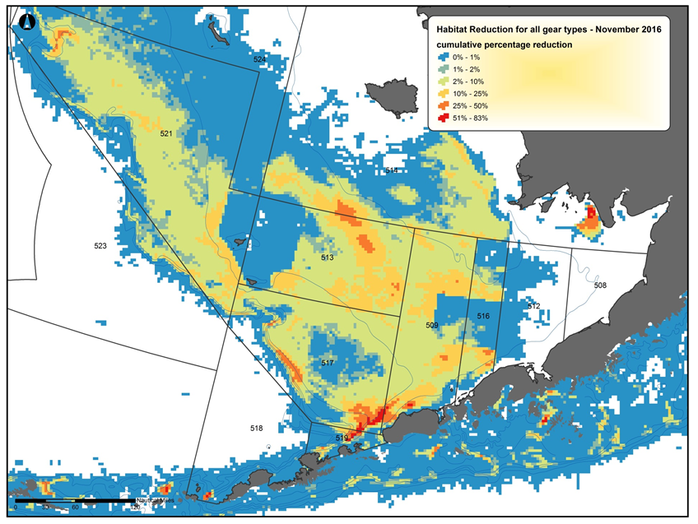
Cumulative Habitat Reduction

Slide 45

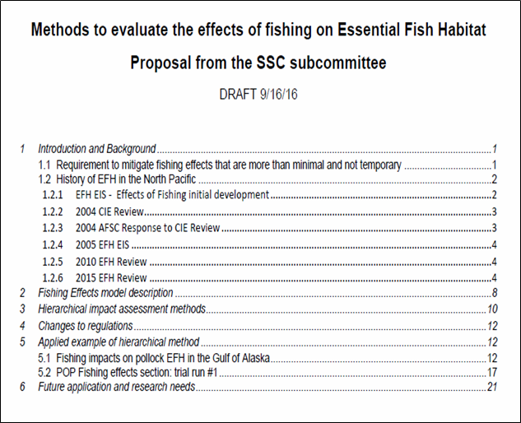
Stock Author Review Process

Slide 46
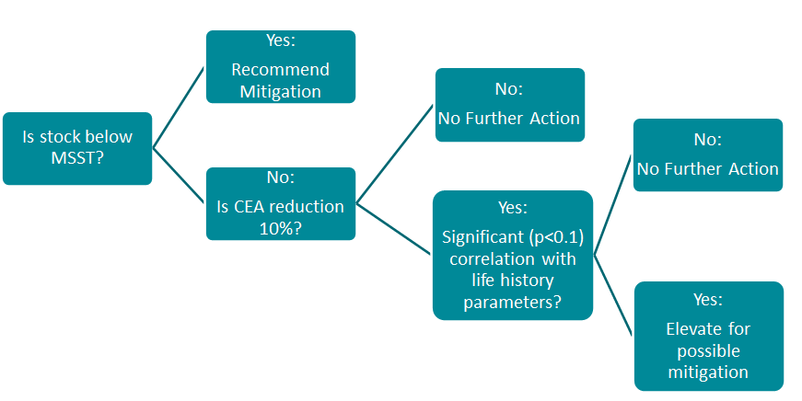
Assessment Methodology

Slide 47
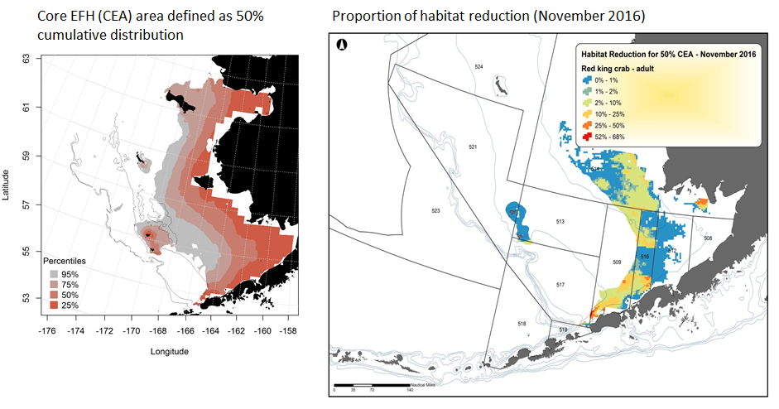
Bering Sea RKC Core EFH & FE Output (2017)

Slide 48
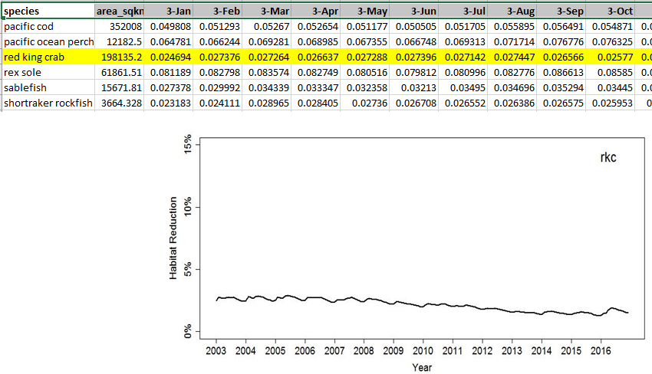
Habitat Reduction Time Series - RKC CEA

Slide 49

RKC Stock Author Review

Slide 50

Summary of Stock Author Evaluations - BSAI Crab

Slide 51

2017 FE Review & 2022 Workplan

Slide 52

Refining Longline and Pot Interactions

Slide 53

Longline Interactions

Slide 54

Pot Interactions

Slide 55

Camera System Under Development

Slide 56

8. Habitat Areas of Particular Concern (HAPC)
Megan Mackey, Sustainable Fisheries Division, NMFS Alaska Region, Juneau, AK
HAPC Overview
HAPC Process
Timelines
Current HAPCs

Slide 57
Councils & HAPC’s
Nationally, Councils have consistently used the four HAPC considerations (50 CFR 600.815(a)(8)) as an underlying basis for identifying HAPCs.
  the importance of the ecological function provided by the habitat;
  the extent to which the habitat is sensitive to human-induced environmental degradation;
  whether and to what extent development activities are or will be stressing the habitat; and
  the rarity of the habitat type.
However, each Council has approached the designation process differently.
  For example, some Councils designated discrete geographic areas as HAPCs, while others designated habitat types as HAPCs (e.g. estuaries) without specifying geographic boundaries.
NPFMC chose to identify HAPC as sites.
Notes:
57

Slide 58
HAPC - Alaska Region
Off Alaska, HAPCs are specific geographic sites.
NPFMC HAPC Process – Detailed in Appendix J of the EFH EIS
  The process may occur on a 5 year schedule or on a schedule established by the Council, if additional habitat protection is warranted.
  Process will be initiated when the Council sets priorities and issues a request for HAPC proposals.
In April 2021, the Council said it intends to consider the utility of a HAPC nomination process after receiving the summary report for the EFH 5-year review in June 2022.
Notes:
58

Slide 59
HAPC Process - Steps
Call for Proposals
Evaluation of Proposals
Draft Alternatives and Analysis
Draft NEPA document
Final NEPA document
FMP Amendment and Rulemaking (if needed)
Notes:
59

Slide 60

HAPC Process - Overview
Council Identifies HAPC Priority
  Council identifies priority management issue or issues.
  Criteria to evaluate the HAPC proposals will be reviewed by the Council and the Scientific and Statistical Committee (SSC) prior to the request for proposals.
Call for HAPC Proposals Initiated.
  A Call for Proposals is:
    Announced during a Council meeting;
    Published in the Federal Register:
    Advertised in the Council newsletter.
  Scientific and technical information such as habitat, fishery distributions, and economic data is made available simultaneously.
Any member of the public (NGOs, industry, local communities, government agencies, scientific and educational institutions) may nominate a site for designation as a HAPC by
submitting a proposal.
Notes:
60

Slide 61



HAPC Proposal Contents
Name, address, and affiliation.
Title for the HAPC proposal.
Brief, concise description.
Identify the habitat and FMP species that the HAPC proposal is intended to protect.
Statement of purpose and need.
Describe whether and how the proposed HAPC addresses the four considerations set out in the final EFH regulations.
Define the specific objectives.
Propose solutions to achieve these objectives.
Establish methods of measuring progress towards those objectives.
Define expected benefits of the proposed HAPC; provide supporting information/data, if possible.
Identify the fisheries, sectors, stakeholders, and communities to be affected by establishing the proposed HAPC [Who would benefit from the proposal; who would it harm?] and any information you can provide on socioeconomic costs.
Clear geographic delineation for the proposed HAPC (written latitude and longitude reference point and delineation on an appropriately scaled NOAA chart).
Best available information and sources of such information to support the objectives for the proposed HAPC (citations for common information or copies of uncommon information).
Notes:
61

Slide 62

HAPC – Initial Proposal Review
Initial Proposal Screening
  Council staff screen proposals to determine consistency with priorities, HAPC criteria, and general adequacy.
  Staff present a preliminary report of the screening results to the Council.
  The Council determines which of the proposals will be forwarded for the next review step: scientific, socioeconomic, and enforcement review.
Proposal Modifications during Review
  The Council may modify proposed HAPC sites and management measures and request additional stakeholder input and technical review before designating a site as HAPC.
Notes:
62

Slide 63



HAPC – Plan Team (Scientific) Review
The Council refers selected proposals to the plan teams. Plan teams evaluate the proposals for ecological merit.
To Facilitate Review & Provide Consistency:
  Tables and forms assist in review to decide whether areas meet the regulatory considerations and the Council’s priorities.
  GIS analysis depicts each HAPC proposal area along with sorted abundance/presence, fishing effort, bycatch, etc…
Notes:
63

Slide 64

HAPC – Additional Reviews
Socioeconomic Review
  The Magnuson-Stevens Act states that EFH measures are to minimize impacts on EFH “to the extent practicable,” thus, socio-economic considerations have to be balanced against expected ecological benefits at the earliest point in the development of measures.
  Identifies which fishing communities have potential to be affected and the effects on those communities such as employment, fishing and processing sectors earnings, and related infrastructure, to the extent that such information is readily available to the public.
Management and Enforcement Review
  HAPC Requirements
  Scale, Location, and Restrictions
  Collaboration with fisherman, NOAA ENF, and vessel observers to identify realistic solutions.
Notes:
64

Slide 65

HAPC - Council Assessment and Selection
Staff will provide the Council with a summary of the ecological, socioeconomic, and enforcement reviews.
The Council will select which proposal or proposals will go forward for analysis for possible HAPC designation.
The Council may modify the proposed HAPC sites and management measures.
The Council may obtain additional technical reviews as needed from scientific, socioeconomic, and management experts.
The Council may set up a stakeholder process, as appropriate, to obtain additional input on proposals.
Notes:
65

Slide 66
HAPC – Outcomes
Each proposal received and/or considered by the Council has one of three possible outcomes:
The proposal can be accepted.
The proposal can be used to identify an area or topic requiring more research.
  Council would initiate request to NMFS or other.
The proposal can be rejected.
Notes:
66

Slide 67
HAPC Timeline – 2009 HAPC Call for Proposals
Should Council decide HAPC action is necessary, the process needs to fit within the Council schedule and Plan Team availability.
Longer timeline accommodates more detailed analysis and review of a broader call for HAPC priorities.
Example
JUN 2009 | Council Identifies HAPC Priorities Call for HAPC Proposals initiated by FR Notice
AUG 2009 | Proposal Period Closes
OCT 2009 | Initial HAPC Proposals Summary to Council Council decision as to which ideas should be forwarded for Plan Team review
NOV – MAR 2010 | Plan Team Review of HAPC ideas Preliminary Enforcement and Socioeconomic Reviews
APR 2010 | Plan Team, ENF, Socio-Eco Review Summaries to Council Council finalizes HAPC Alternatives for Analysis
MAY - SEPT 2010 | Analysis of Alternatives
OCT 2010 | Initial Review
DEC 2010 | Final Review
Notes:
67

Slide 68


Current HAPC Areas:
Skate Egg Sites

Slide 69
Current HAPC Areas: 2005 HAPC Coral Areas

Slide 70



170°0'0"E
175°0'0"E
180°0'0"
175°0'0"W
°
Aleutian Islands Habitat Conservation Area Open to Bottom Trawling
Aleutian Islands Coral Garden Marine Reserves Bowers Ridge Habitat Conservation Zone
50°0'0"N
55°0'0"N
Areas shown in yellow represent the Aleutian Islands EEZ and would be closed to bottom trawling (279,114 nm²)
Areas shown in green would remain open to bottom trawling (12,423 nm²)
Areas shown in red would be closed to all bottom-tending fishing gear (110 nm²)
Areas shown in purple would be closed to mobile bottom-tending fishing gear (5,286 nm²)
45°0'0"N
543
542 ₅₄₁
50°0'0"N
0
25 50 75 100
Nautical Miles
175°0'0"E
180°0'0"
175°0'0"W
170°0'0"W

Slide 71

170°0'0"E
175°0'0"E
180°0'0"
175°0'0"W
°
Open to Bottom Trawling
Aleutian Islands Coral Garden Marine Reserves Bowers Ridge Habitat Conservation Zone
55°0'0"N
50°0'0"N
Areas shown in green would remain open to bottom trawling (12,423 nm²)
Areas shown in red would be closed to all bottom-tending fishing gear (110 nm²)
Areas shown in purple would be closed to mobile bottom-tending fishing gear (5,286 nm²)
0
20
40
60
80
Nautical Miles
50°0'0"N
180°0'0"
175°0'0"W
170°0'0"W

Slide 72

180°0'0"
°
Aleutian Islands Coral Garden Marine Reserves
Areas shown in red would be closed to all bottom-tending fishing gear (110 nm²)
0
5
10
15
20
Nautical Miles

Slide 73



135°0'0"W
°
Primnoa Coral Marine Reserves
Areas shown in blue would be closed to all bottom-tending fishing gear (13.5 nm²)
0
5
10 15 20
Nautical Miles
140°0'0"W
135°0'0"W

Slide 74

170°0'0"W
165°0'0"W
160°0'0"W
155°0'0"W
150°0'0"W
145°0'0"W
140°0'0"W
°
60°0'0"N
60°0'0"N
55°0'0"N
55°0'0"N
Gulf of Alaska Slope Habitat Conservation Areas
Areas shown in orange would be closed to bottom trawling (2,086 nm²)
50°0'0"N
50°0'0"N
0 25 50 75 100
Nautical Miles
165°0'0"W
160°0'0"W
155°0'0"W
150°0'0"W
145°0'0"W

Slide 75


165°0'0"E
170°0'0"E
175°0'0"E
180°0'0"
175°0'0"W
170°0'0"W
165°0'0"W
160°0'0"W
155°0'0"W
150°0'0"W
145°0'0"W
140°0'0"W
135°0'0"W
130°0'0"W
°
65°0'0"N
60°0'0"N
60°0'0"N
55°0'0"N
55°0'0"N
50°0'0"N
Alaska Seamount Marine Reserves
50°0'0"N
45°0'0"N
Areas shown in brown would be closed to all bottom-tending fishing gear (5,329 nm²)
0
50 100 150 200
Nautical Miles
45°0'0"N
175°0'0"W
170°0'0"W
165°0'0"W
160°0'0"W
155°0'0"W
150°0'0"W
145°0'0"W
140°0'0"W

Slide 76
Crab Plan Team Actions
Review current FMP text descriptions and tables (component 1);
Review new SDM results, EFH maps, and habitat information (component 1);
Review current FMP prey habitat text and tables (component 7);
Review Fishing Effects model with updated fishing data and new maps when available (component 2);
Consider providing information for the Council to considered in determining whether to initiate a HAPC proposal process in June 2022 (component 8).

Slide 77
GRETCHEN HARRINGTON
GRETCHEN.HARRINGTON@NOAA.GOV
NED LAMAN
NED.LAMAN@NOAA.GOV
JODI PIRTLE
JODI.PIRTLE@NOAA.GOV
MOLLY ZALESKI
MOLLY.ZALESKI@NOAA.GOV
JOHN V. OLSON
JOHN.V.OLSON@NOAA.GOV
MEGAN MACKEY
MEGAN.MACKEY@NOAA.GOV
THANK YOU!
QUESTIONS?

