Slide 1
Economic Status of the Groundfish Fisheries off Alaska, 2019
Alaska Fisheries Science Center
Presented by:
Ben Fissel
AFSC Economics and Social Sciences Research Program (ESSRP)
Sept. 08, 2019

Slide 2
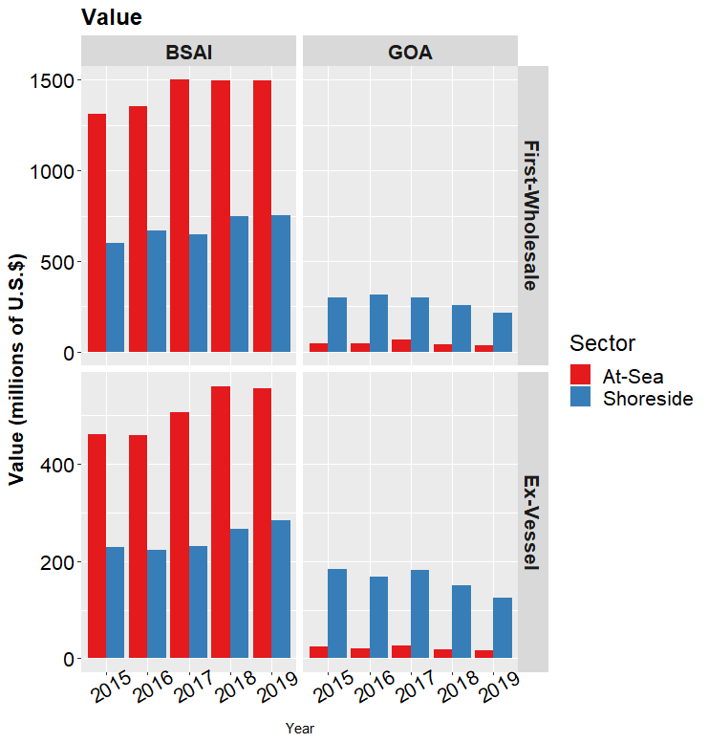
Alaska’s Groundfish Fisheries in 2019
Total catch: 2.18 million t
(decreased 2%)
Aggregate ex-vessel value
stable/increasing in BSAI decreased in GOA.
Wholesale value:
$2.50 billion (down 3%)
Ex-vessel value:
$980.8 million (down 3%)
Percent change adjusted for inflation.
Values in figure nominal (not adjusted for inflation)
Notes:
Total catch decreased across Alaska as a whole. With a slight decrease in BSAI catch and a more precipitous drop in catch in the Gulf. The decrease in catch contributed to a decreases in both ex-vessel value and first wholesale value. 2019 first-wholesale value was $2.5 mill in 2019 down 3% and similarly for ex-vessel value down 3% to $981 million. Similar to catch the decrease in value was more pronounced in the Gulf.

Slide 3
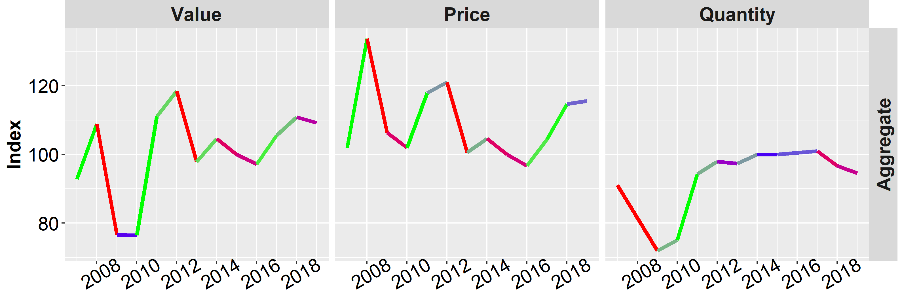
Alaska’s Groundfish Fisheries in 2019
Alaska Ex-vessel Economic Indices
In the aggregate:
Value decreased and volume (catch) decreases were the dominant factor while prices were more stable
Notes:
This figure here shows how aggregate price and volumes interacted to create value in Alaska as a whole. In 2019 prices were relatively stable and the drop in value was really driven more by the decrease in volume.
Whitefish prices leveled off after increasing for two years but remained strong.
The drop in volume was driven mainly by Pacific cod and Atka. Pollock volume was fairly level in aggregate with a decrease in the gulf and increase in the BSAI. Flatfish catch was also fairly stable. Rockfish and sablefish catch increased.
While the was some increase in prices for pollock and cod, prices for other species (Atka, flat, rockfish, sablfish) dropped. The net result was fairly level price for Alaska as a whole.

Slide 4
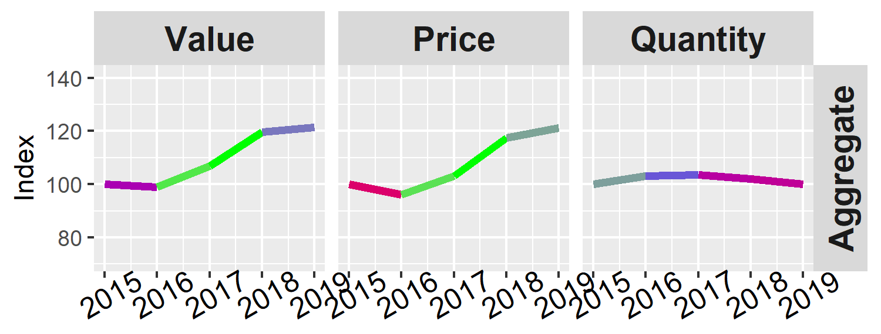
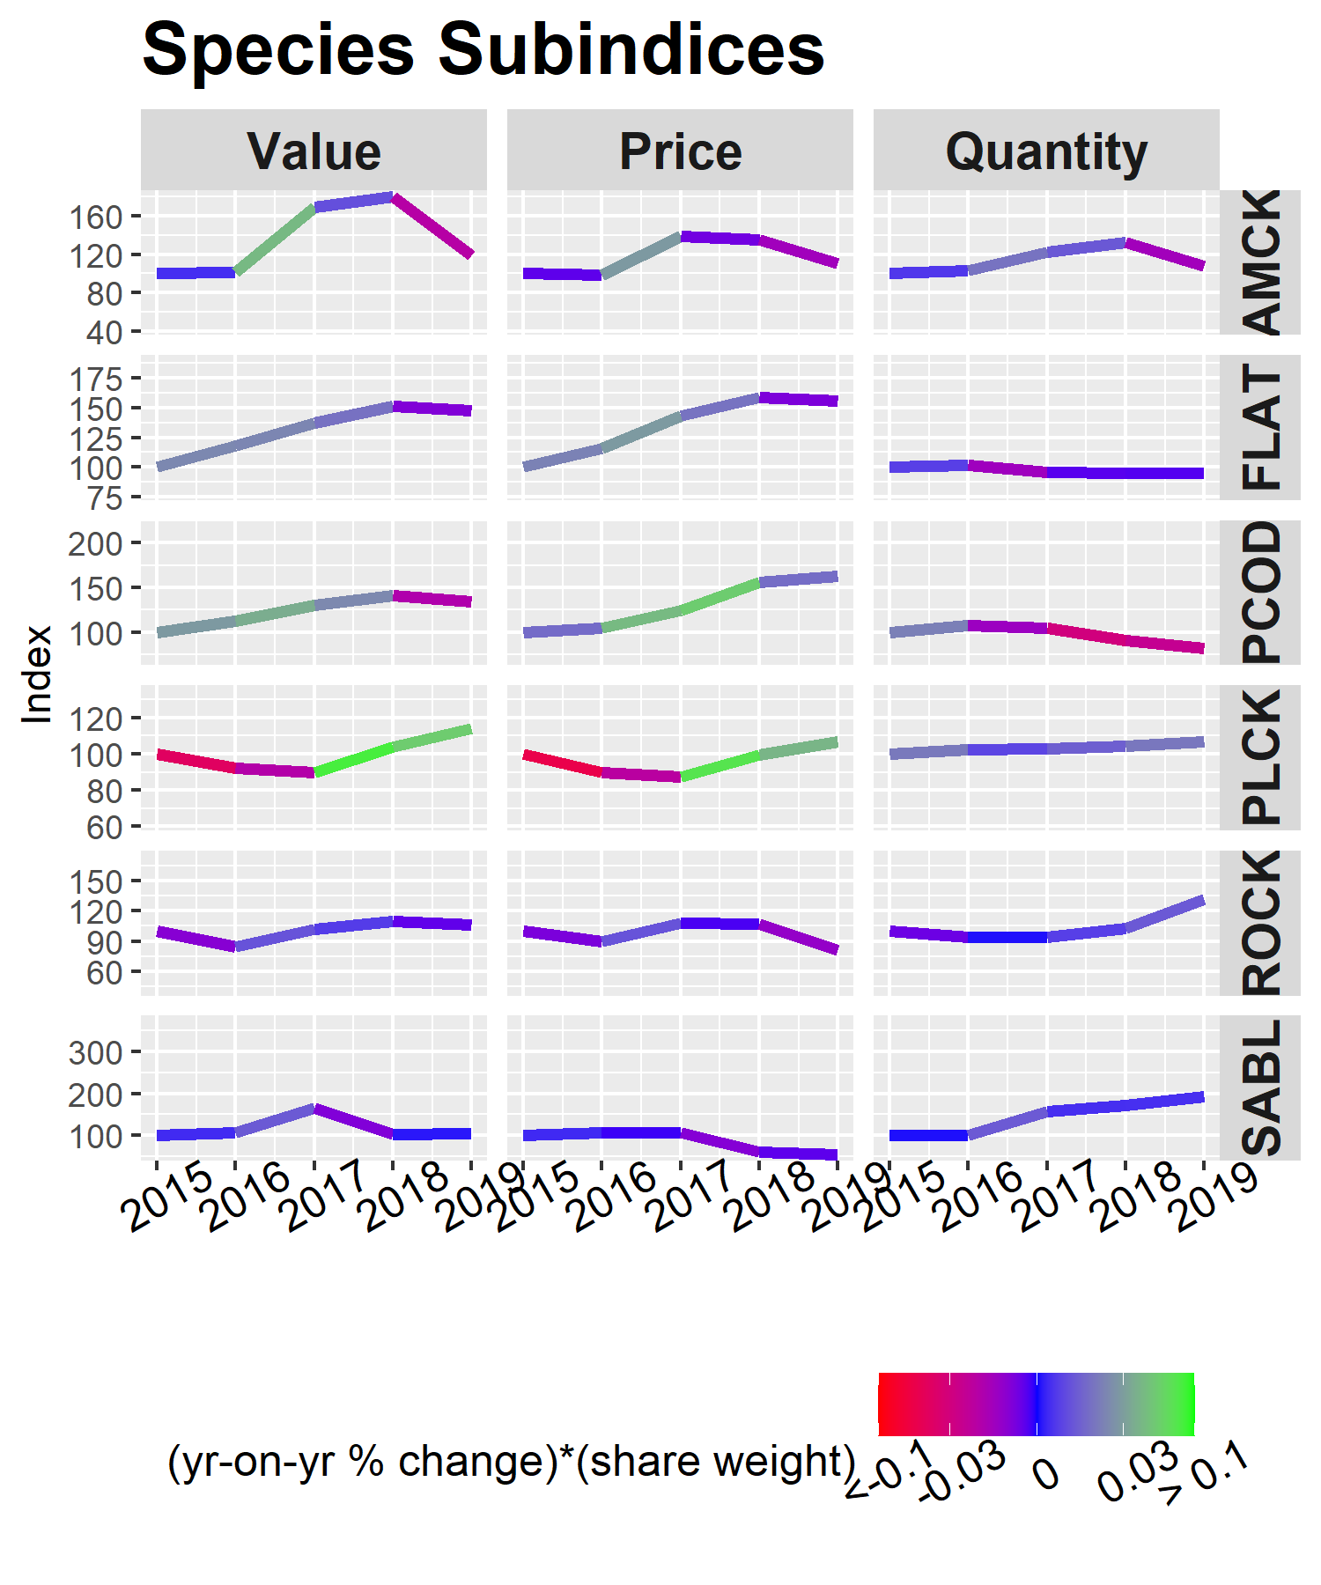
Species
BSAI Ex-vessel
Economic Indices
Value increased:
  Pollock
Value decreased:
  Atka
  Pacific cod
Value stable
  Rockfish
  Flatfish
  Sablefish
Indices are nominal (not adjusted for inflation)
Notes:
In the BSAI the drop in volume was less prominent driven mostly by pcod and Atka.
Prices increase for pollock and pacific cod but fell or remained stable for the remaining species.
Value dropped for Atka (combined effect of falling prices and volume). Value increased for pollock mostly because of increase in prices.

Slide 5
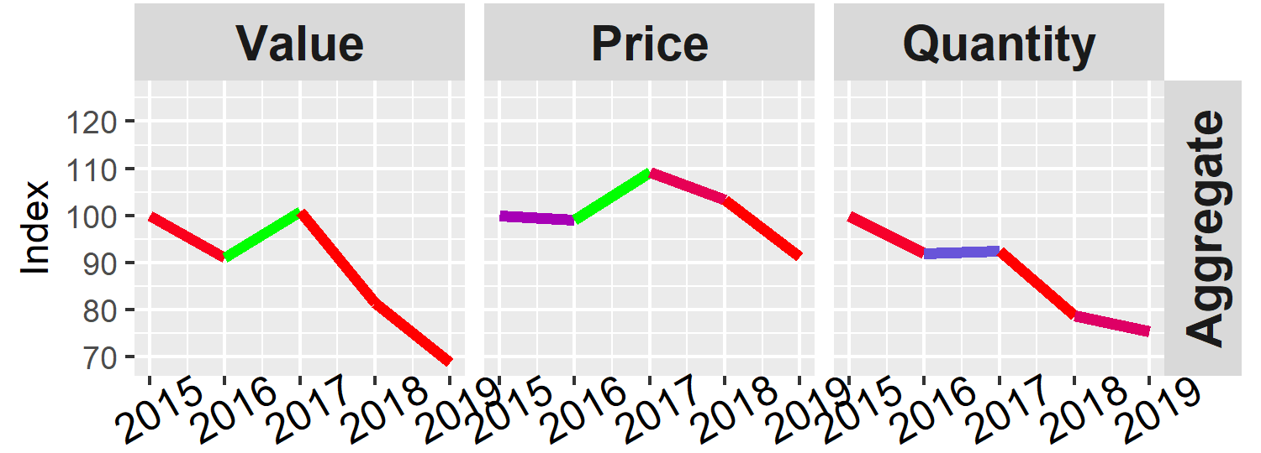
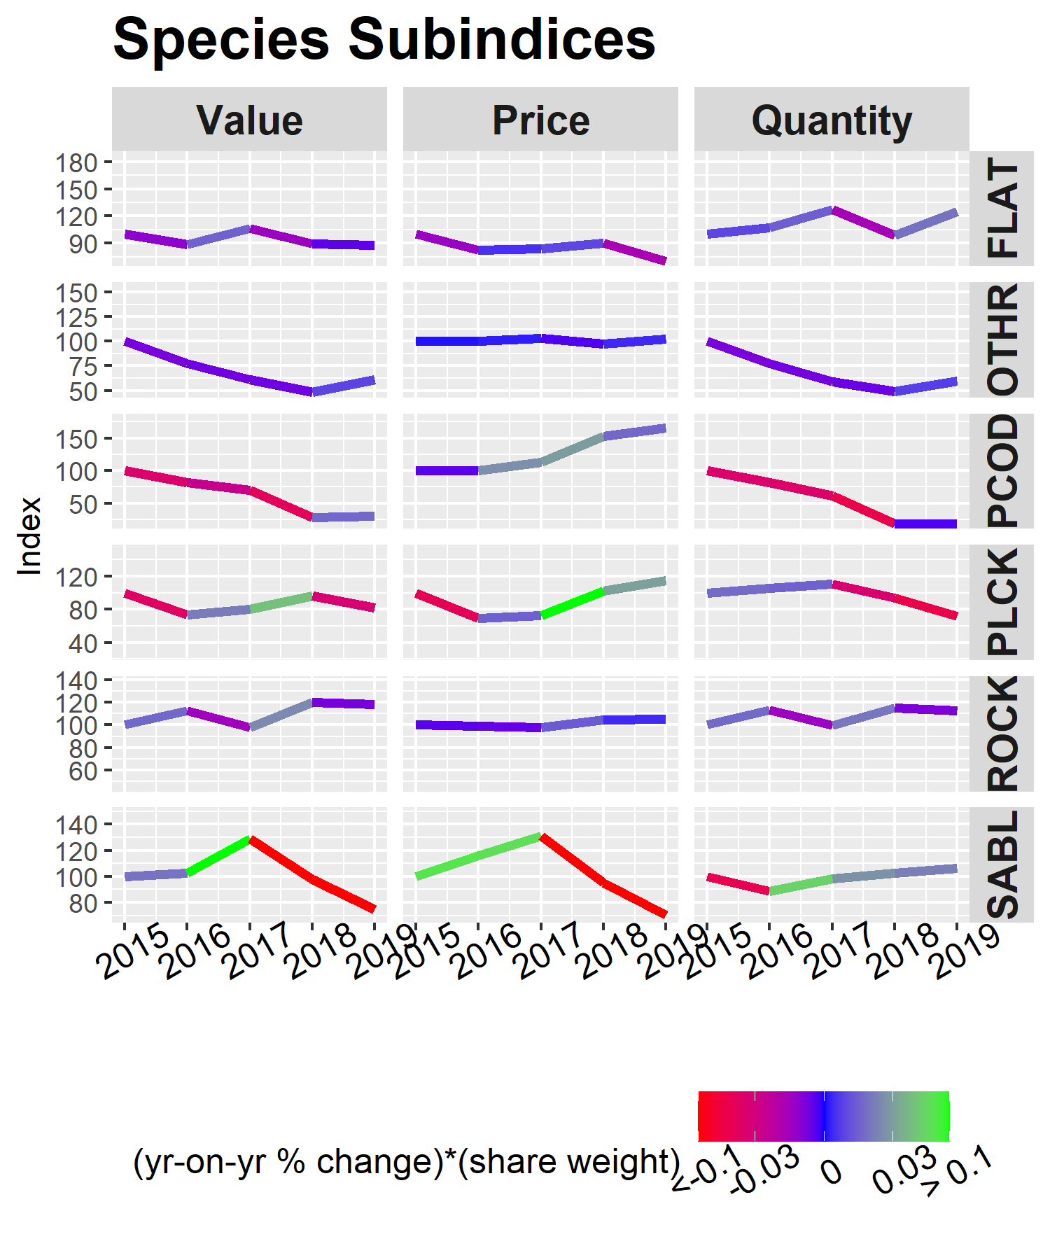
Species
GOA Ex-vessel
Economic Indices
Value decreases:
  Pollock
  Sablefish
Value stable:
  Pacific cod
  Rockfish
  Flatfish
Indices are nominal (not adjusted for inflation)
Notes:
Value dropped substantially in 2019 in the Gulf. This was drive by both drop in catch volume (largely from pollock though Pacific cod catches remained low) as well as a drop in prices driven largely by the drop in the sablefish price (though flatfish prices fell as well)

Slide 6
Economic Status Report, 2019: Content of the Sept. Draft
Executive Summary: 2019 highlights
Economic Data Tables
    Next slide
Economic Indices – figures and tables only
  Summary indices of value, catch/production, and price by region, at-sea/shoreside, species, gear, product type.

Slide 7
Economic Data Tables
All Alaska Summary Tables 1 – 10 | Catch (total and retained) Summarized discards and PSC Ex-vessel value 1st wholesale production and revenue Vessel counts
Bering Sea and Aleutian Islands Tables 11 – 26 | Ex-vessel: Retained catch, prices and value (with specific flatfish and rockfish species). Retained catch by target. Value metrics by fleet 1st wholesale: Production, prices, and value (with specific flatfish and rockfish species). Production value metrics by processor group Effort: Vessel counts, average length, tonnage, CV and CP fishing weeks, CV and CP crew weeks.
Gulf of Alaska Tables 27 - 42
Pacific halibut Tables H1 – H10 | Catch PSC Ex-vessel value, price 1st wholesale production, value and price Effort: vessel counts, vessel days, crew days

Slide 8
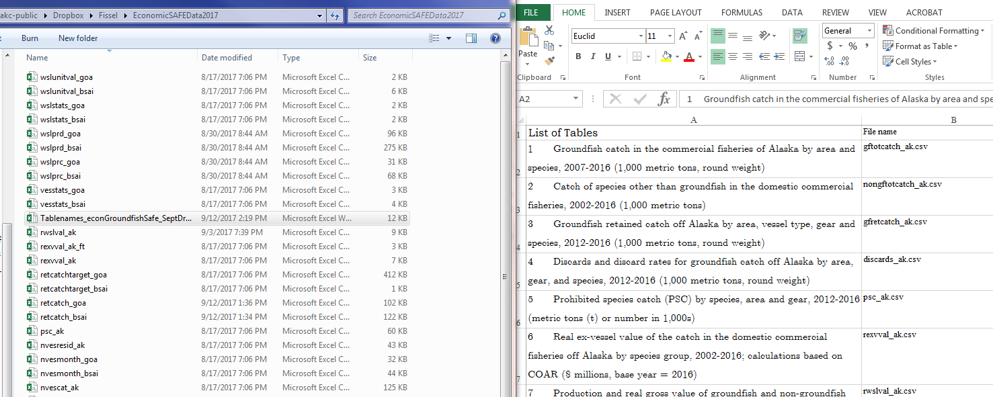
Where to find the data I need?
\\nmfs\akc-public\Dropbox\Fissel\EconomicSAFEData2020
TableInventory_econGroundfishSafe.csv matches table names to file names.
Currently only accessible to AFSC.
The data will be moved to and accessible through the website by November.

Slide 9
Economic Status Report, 2019:
Additional Final Draft Content (Nov.)
Report Card Metrics
Plan Team Reports
Wholesale and ex-vessel price projections
Market Profiles
Amendment 80 Economic Data Report
Gulf Trawl Economic Data Report
Amendment 91 Economic Data Report
Year-to-date catches and production.
Recent and ongoing ESSRP research and publications
New or revised content in RED
Catch share performance metrics and Community Participation moved outside of Econ SAFE

Slide 10
Ex-vessel price projections
Uses unadjusted fish ticket information through part of the year to estimate an (adjusted) annual ex-vessel price.
2020 now-casts for pollock, cod, and sablefish from last year preformed well compared to realized price (within approx. $0.01/lb)
Attempt to expand to include other shoreside fisheries: halibut, POP, and arrowtooth.
Year-to-date information on catch and production
Only limited economic information is available mid-year. Comprehensive collection of revenues reported at the end of the year through COAR.
Throughout this year we’ve developed routines for reporting year-to-date information based on available data.
Plan to report cumulative year-to-date catch and production information.

Slide 11
Responding to COVID-19
ESSRP is providing S&T and leadership information on the progress of catch and production as well as other COVID related impacts to markets.
National working group is analyzing trade impacts since COVID.
  To some extent volumes and value can shift to other time periods so month to month comparisons may ultimately be misleading.
  Large value decreases in both exports and imports of fresh product. Shelf stable products (e.g., frozen) are generally doing better.
  Large shift from food service sector to retail. Previously 70% food service 30% retail, now this has flipped.
  Alaska, the region with the largest export values over the baseline Jan-May period saw a 5% decline.
Notes:
Some of the largest decreases were seen in fresh exports of some East coast fresh shellfish particularly lobster and scallops. For Alaska products there were some early decreases in exports of cod and pollock surimi.
The value of seafood exports in Jan-May 2020 declined 16% from 2015-2019 baseline values with the largest declines occurring in May 2020 (20% from baseline values).
Exports of fresh product declined from baseline values by 37% overall beginning with a 58% reduction in Feb and then going to a 36% reduction in May. Exports of frozen product also declined but not as precipitously as fresh with an overall decrease of 12%.

Slide 12
GPT Species Economic Performance Report
Economic Performance Reports:
  BSAI: pollock, Pacific cod (ESP), flatfish complex (yellowfin sole, rock sole, flathead, arrowtooth) , rockfish (Pac. ocean perch, northern rockfish), Atka mackerel.
  GOA: pollock (ESP), Pacfic cod (ESP), flatfish (arrowtooth), rockfish (Pac. ocean perch, northern rockfish).
  Combined: sablefish (ESP).
EPRs will be revised to incorporate new data and discuss updated market conditions. (completed early-mid Oct.)
GPT can give feedback/discuss:
  EPR in the ESP.
Notes:
The ESP has been in the sablefish assessment for a few years now.
GOA pcod and pollock ESPs are new. The section isn’t just the EPR plugged into the EPR. Socio-econ section of the ESP give a terse overview stats, briefly discusses economic features and metrics provided for ESP. Stronger focus on communities and community metrics (largely provided by Sarah W.). Less discussion of market conditions, global context, and historical context.
Still trying to find the balance and where/how socio-econ info will best fit in and inform the ESP.

Slide 13
Economic Status Report, 2019
The Economic Status Report serves many purposes. Among them is to provide information to the Plan Team.
Economic data for 2019 are still being finalized and validated (typically price and value).
We invite feedback -- Ben.Fissel@noaa.gov

