Slide 1
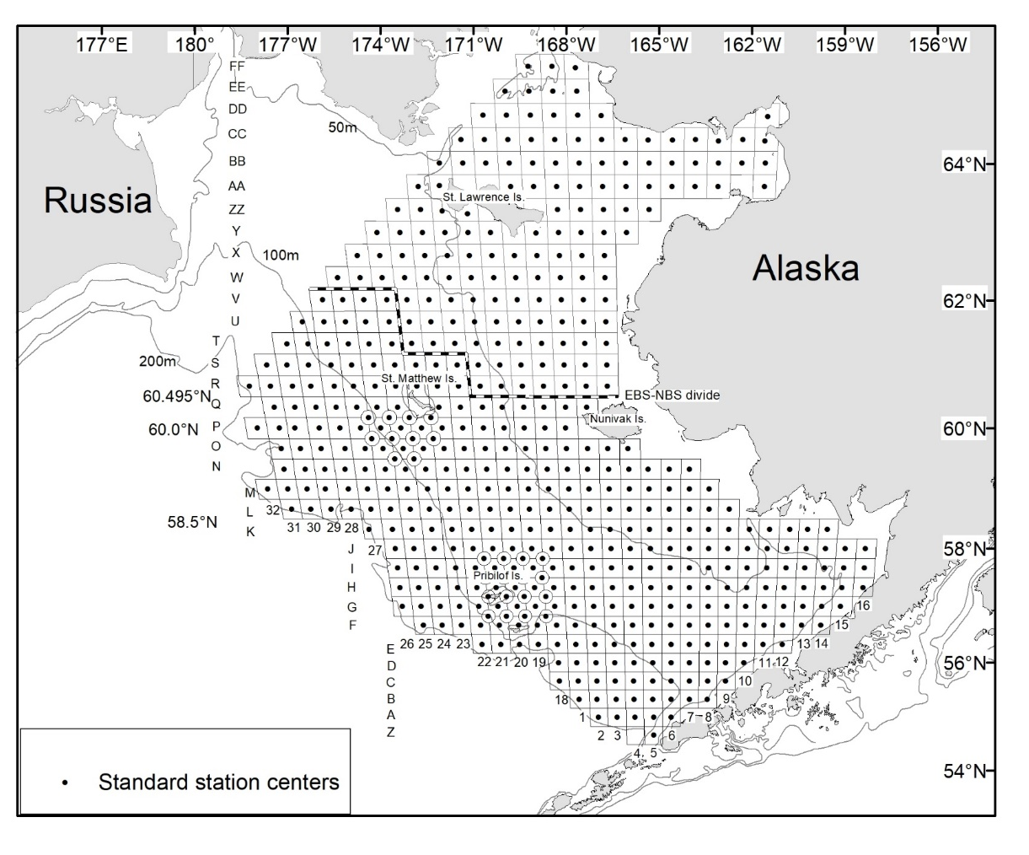
2021 Summer Survey and
Data Availability
Mike Litzow, Erin Fedewa, Jon Richar
Shellfish assessment program, AFSC

Slide 2
The plan
Full EBS/NBS survey
  Vesteraalen 25 May – 25 August
  Alaska Knight 28 May – 28 August (delayed 6 days from original plan)

Slide 3
Special projects
Bristol Bay red king crab tagging
Opilio radiometric aging
Opilio condition
Shell condition error evaluation
Observer program training specimens
Tanner / opilio carapace widths & chela heights
Blue/red king crab, Tanner weights
Live Tanner and opilio: lipid/condition and acidification captive studies
Pilot studies: bin/table subsampling comparison, 15 vs 30 min. tows

Slide 4
Data availability
Event | Usual timing | Timing this year | Notes
Survey effort data available | August 10 | August 15 | Due to survey delay
Area-swept estimates uploaded to AKFIN | August 15 (5 days to produce) | August 17 (2 days to produce) | Will calculate 2021 values without recalculating the rest of the time series
Female BBRKC estimates uploaded to AKFIN (if retows necessary) | N/A | August 22 | Can produce in one day after effort data are obtained
VAST estimates to stock assessment authors | August 20 | August 25

Slide 5
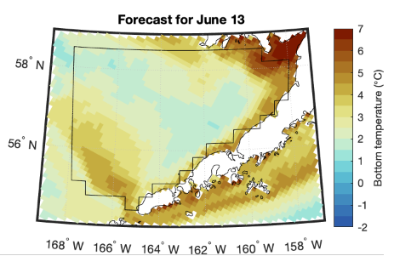
Bristol Bay retow
K. Kearney and K. Aydin
ROMS (Bering10K) forecasts for Bristol Bay on June 13th: 2021 looking very average, though colder than average bottom temperatures over the inner domain
Notes:
Figure shows the results of the Bering10K persistence forecast for June 13th, the mid-point for sampling BB in the EBS BT timeseries. Forecasts were calculated specifically for the BBRKC management area polygon to assess for potential retow conditions
**June 13th forecasts suggest cold pool will extend well into BB during 2021 June sampling on EBS BT survey.

Slide 6

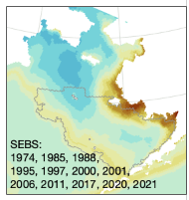
Bristol Bay retow possible?
K. Kearney and K. Aydin
Bottom temperatures forecast to be similar to retow years 2011, 2017
Retow Survey Year | Avg BB Bottom Temperature
2000 | 2.23°C
2006 | 2.43°C
2007 | 2.14°C
2008 | 1.65°C
2009 | 1.44°C
2010 | 1.77°C
2011 | 2.84°C
2012 | 1.22°C
2017 | 2.83°C
2021 Forecast | 2.79°C
Notes:
2021 temperature conditions in the SEBS are expected to be similar to those in 4 other re-tow years, suggesting that a re-tow in 2021 is possible. The table on the right shows average bottom temperatures in Bristol Bay for all re-tow years since 2000, with 2021 forecasted mean bottom temperature for Bristol Bay in the final column.

Slide 7
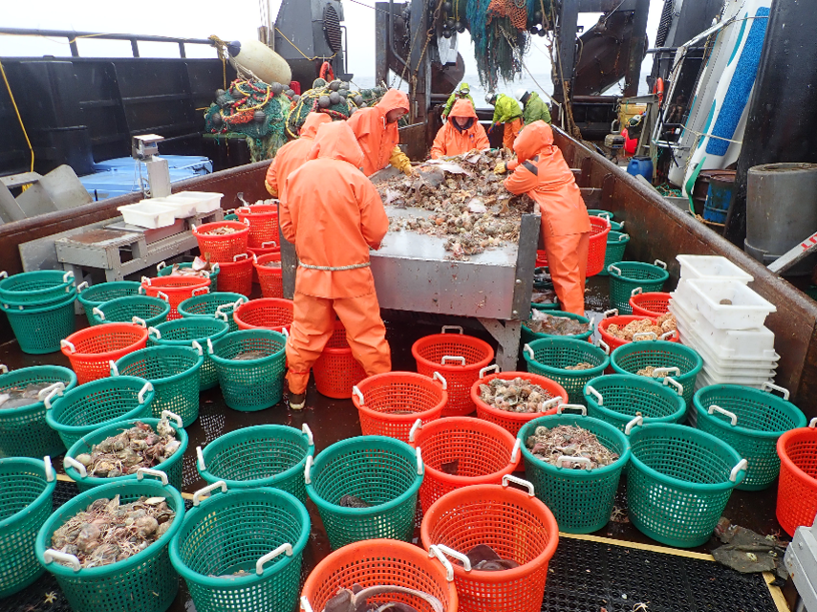
Questions

