Slide 1
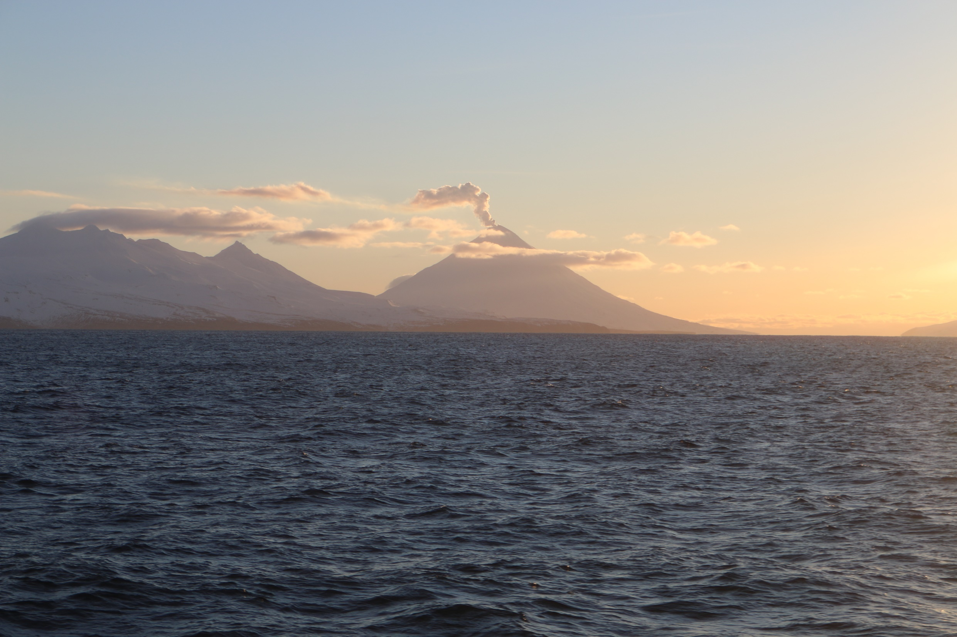

2020 winter acoustic-trawl survey of the Bogoslof Island area
Denise McKelvey & MACE Program
Alaska Fisheries Science Center
19–23 February 2020
NOAA ship Oscar Dyson

Slide 2
Bogoslof Island area AT survey: February 2020
Central Bering Sea Specific area

Slide 3
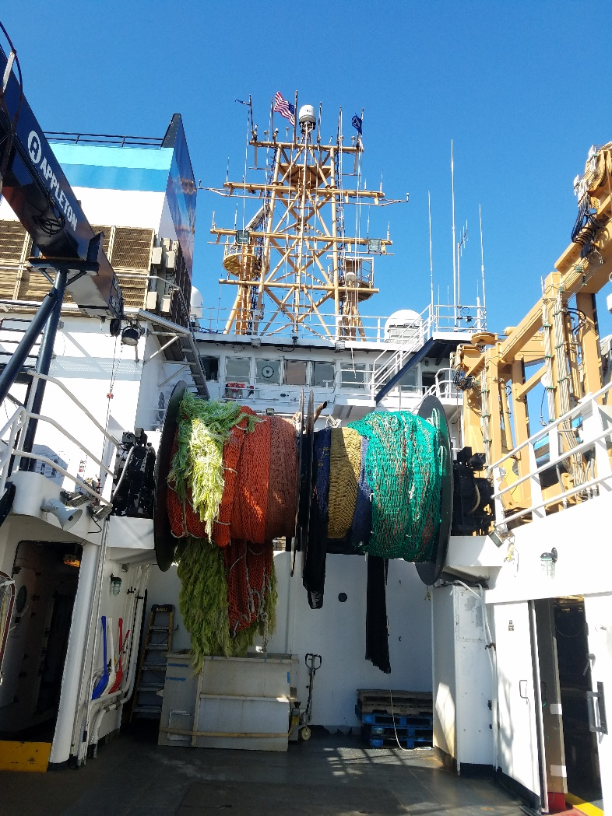
Midwater nets:
Central Bering Sea Specific area
AWT and LFS

Slide 4
Midwater nets:
Central Bering Sea Specific area
AWT and LFS
0.5 inch
codend liner
30 m (avg)
Vertical opening

Slide 5
Midwater nets:
Central Bering Sea Specific area
AWT and LFS
0.5 inch
codend liner
30 m (avg)
Vertical opening
1/8 inch
codend liner
17 m (avg)
Vertical opening

Slide 6
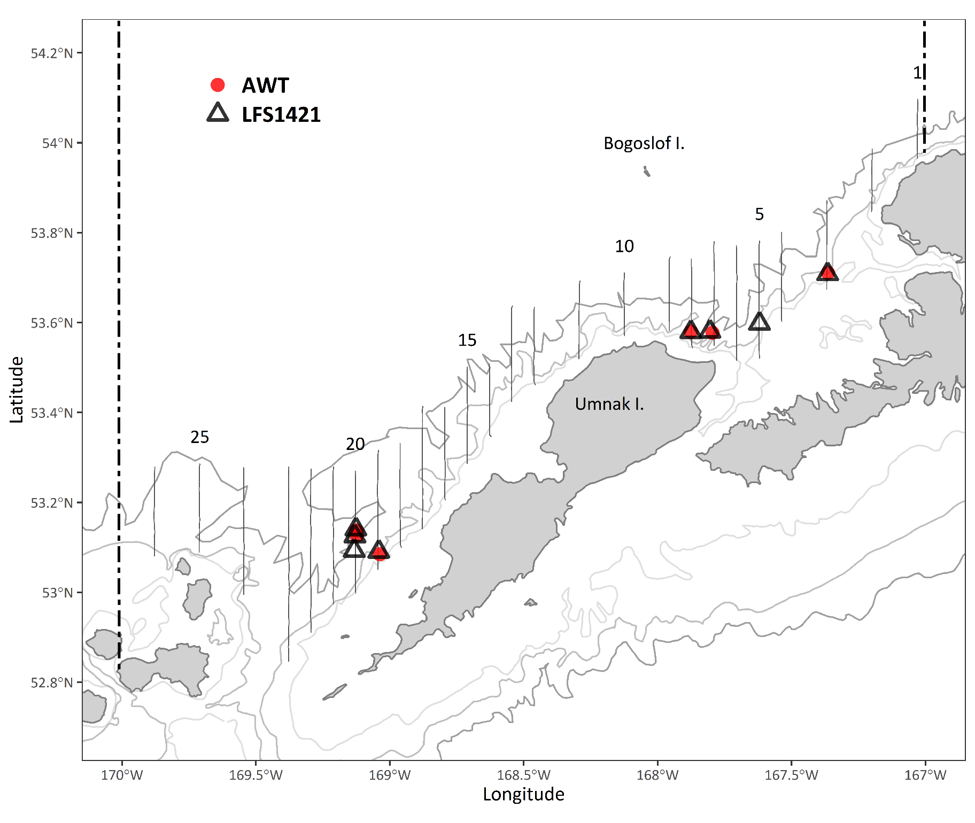

Slide 7
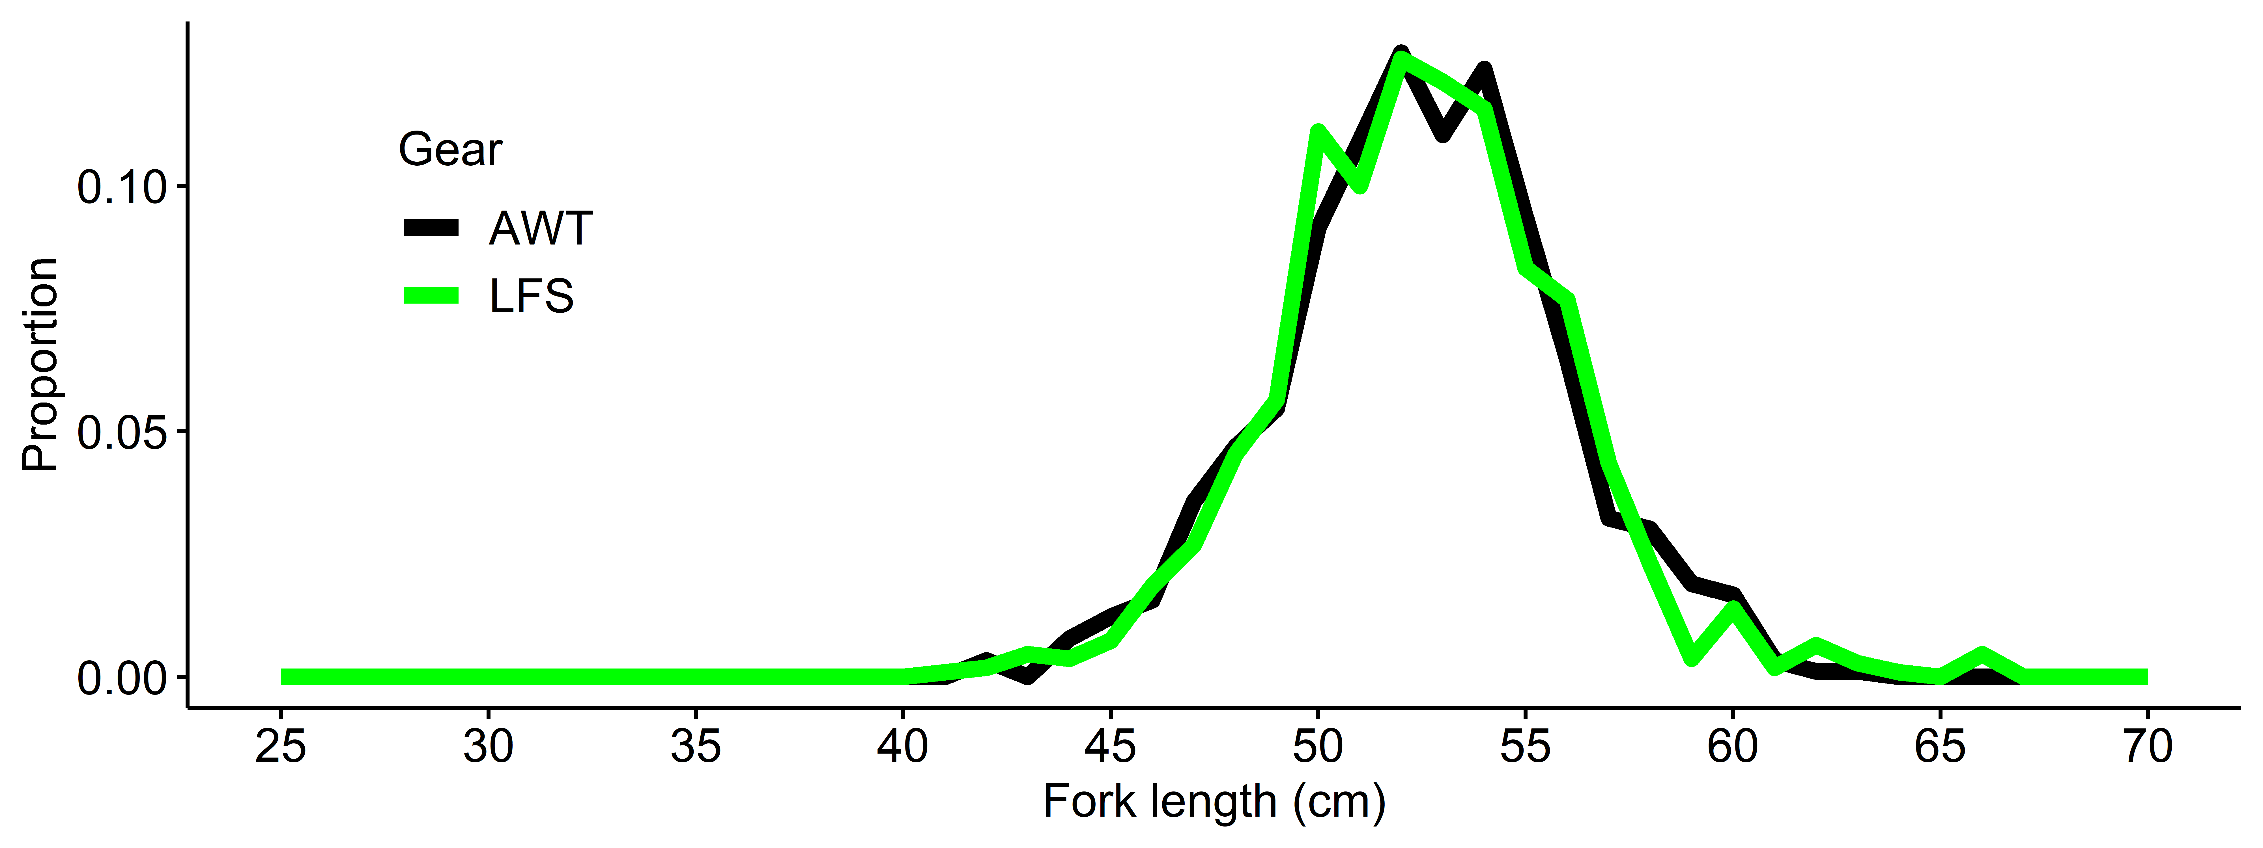
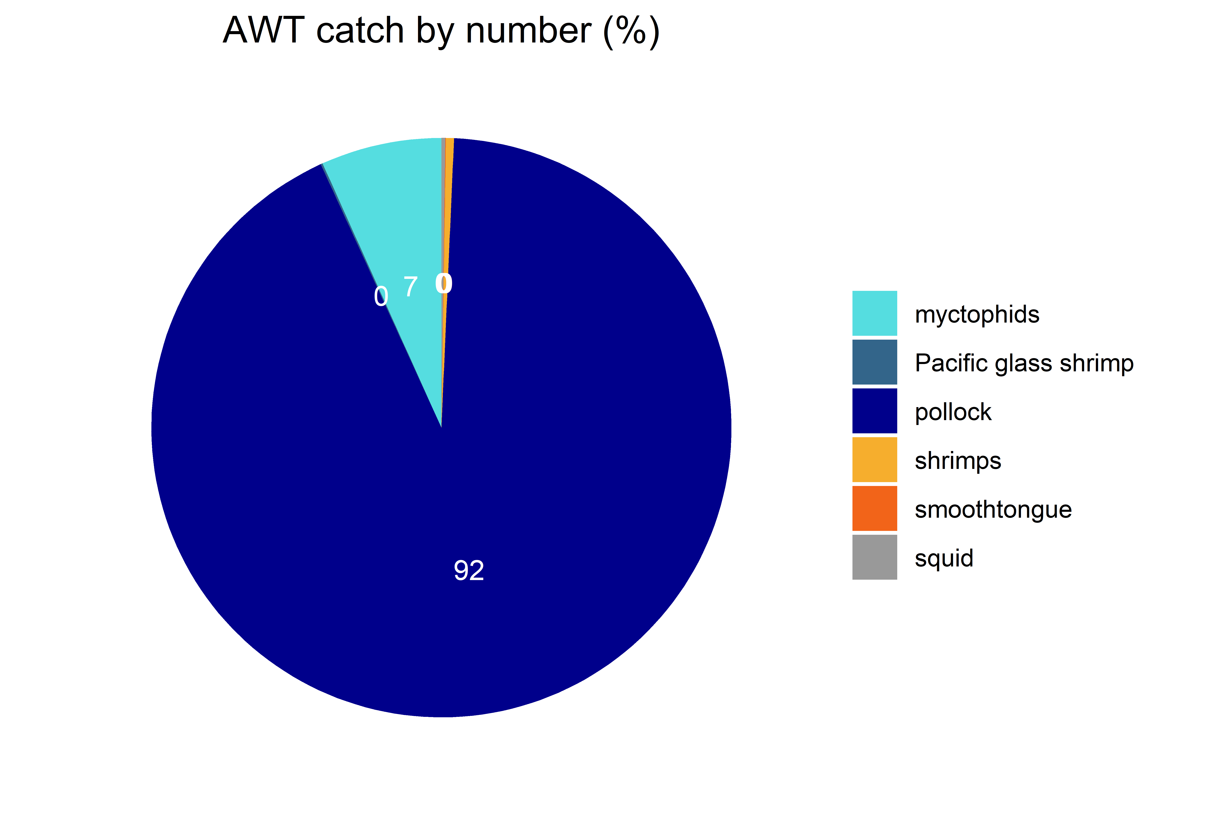
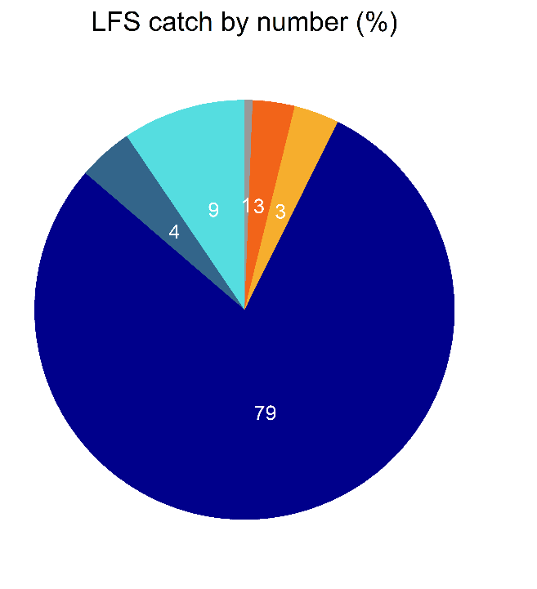
4 pairs (pairs #1 and #4 removed)

Slide 9
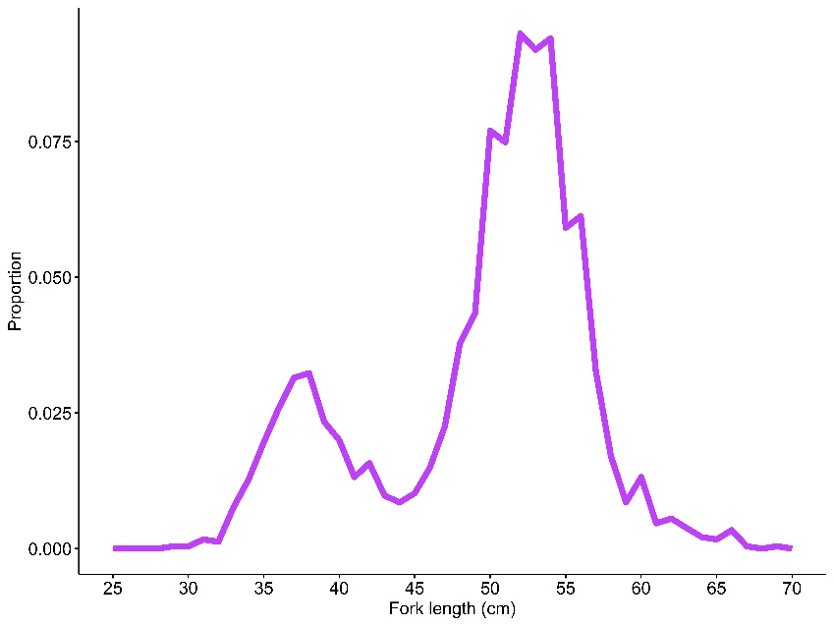

Slide 10
Umnak
Samalga

Slide 11
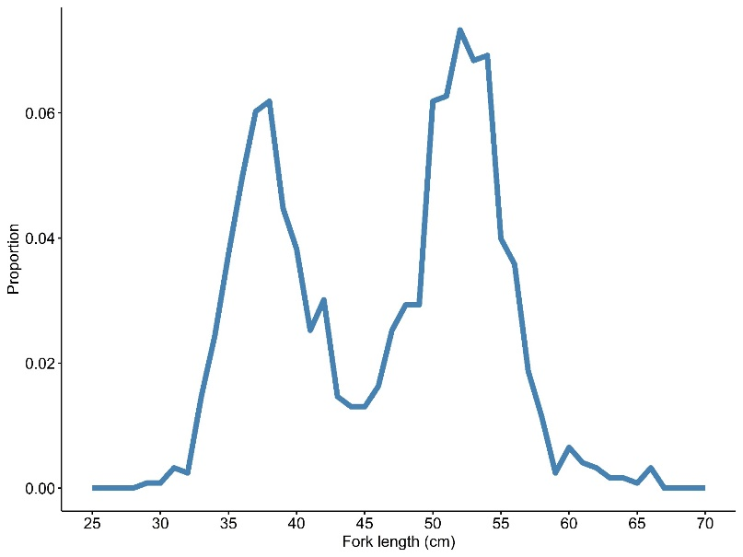
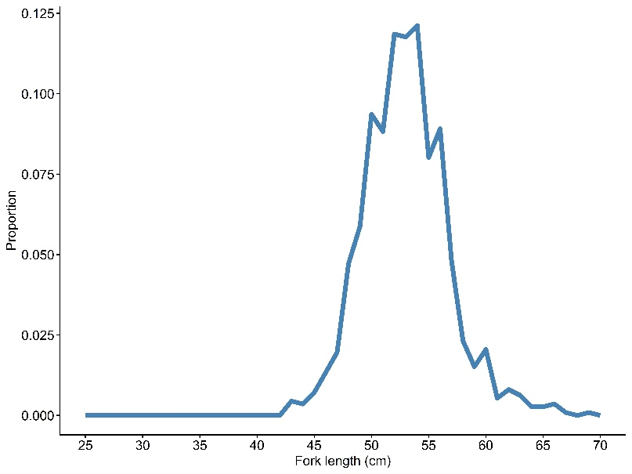
Umnak
Samalga

Slide 12
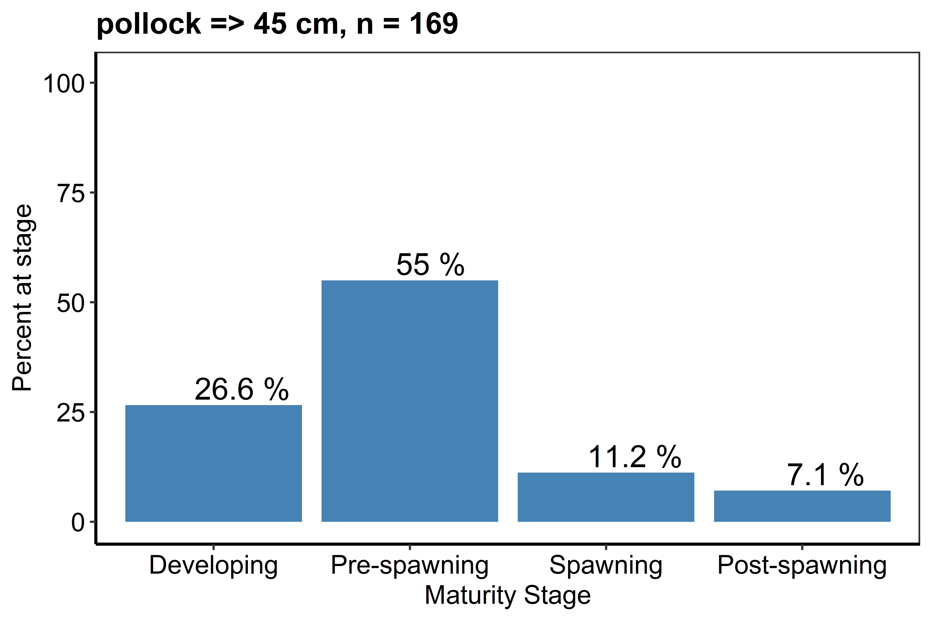
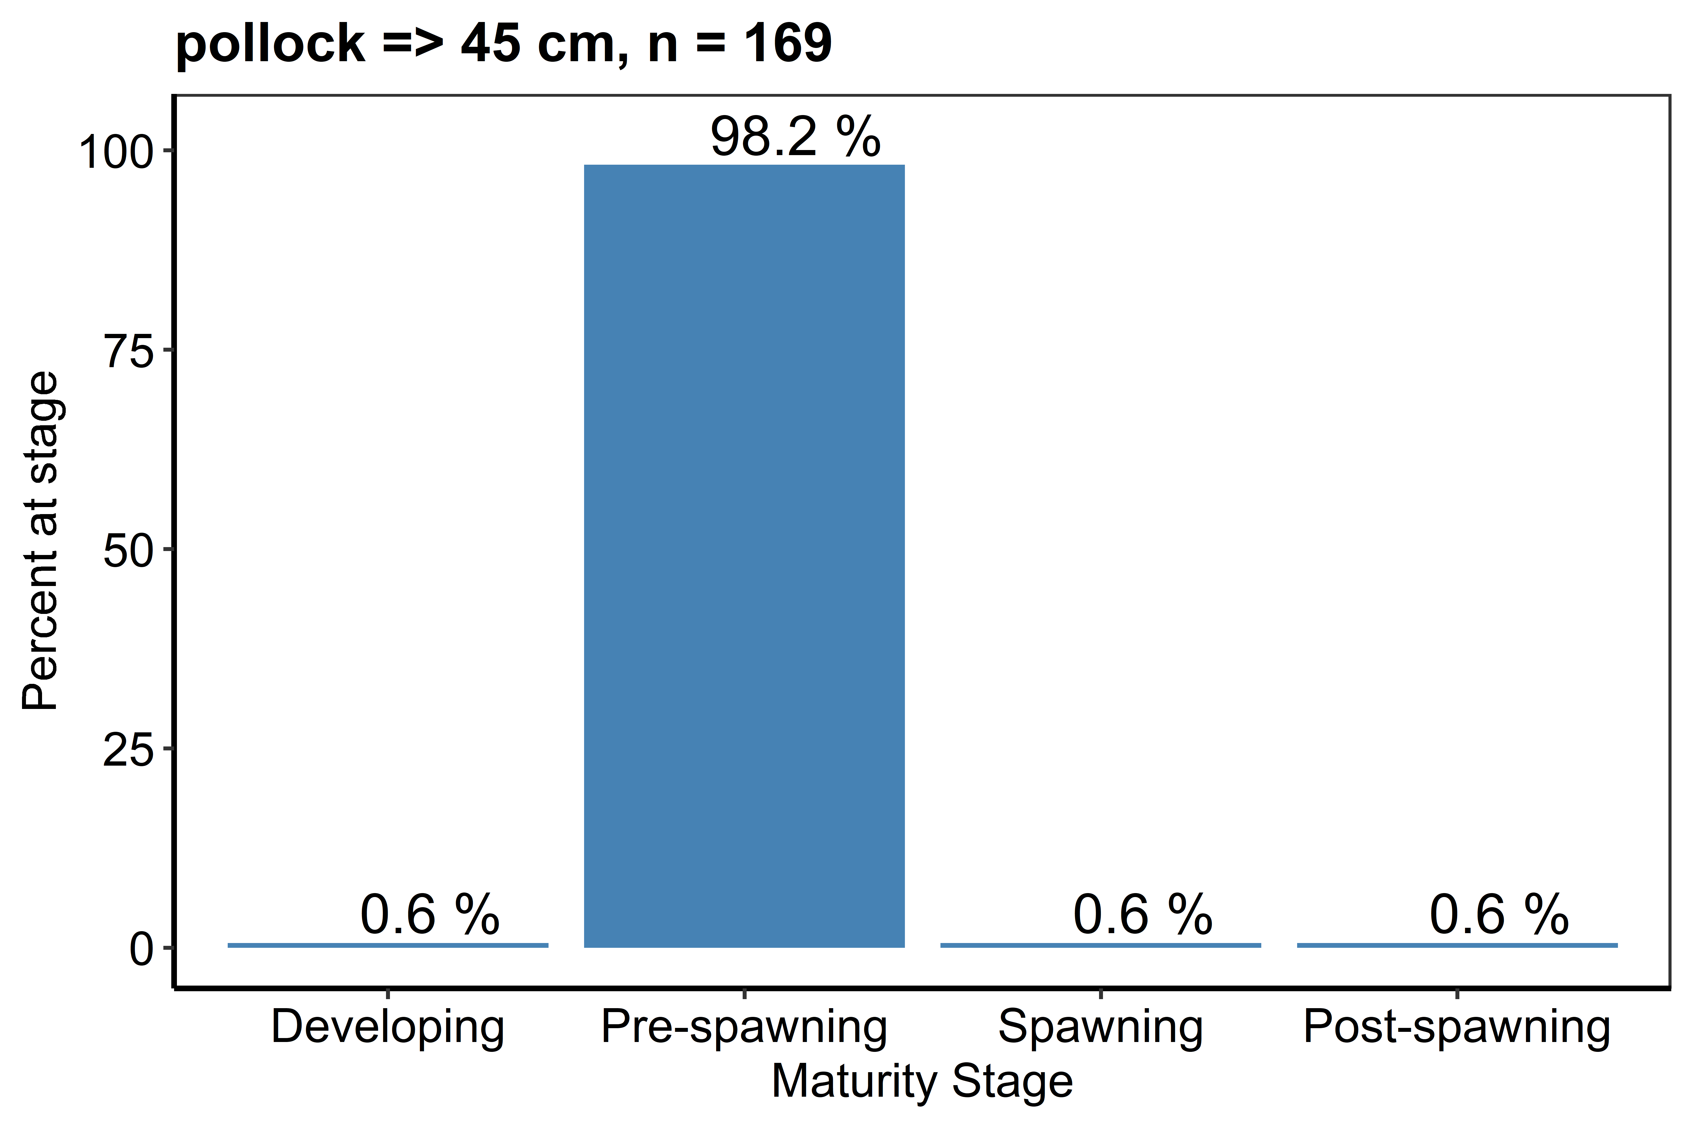
Umnak
Samalga

Slide 13
Umnak
Samalga
2018
82%

Slide 14
Bogoslof Island area AT survey: February 2020
2
30 thousand t/nm

Slide 15
Bogoslof Island area AT survey: February 2020
350 million fish
345 thousand t

Slide 16
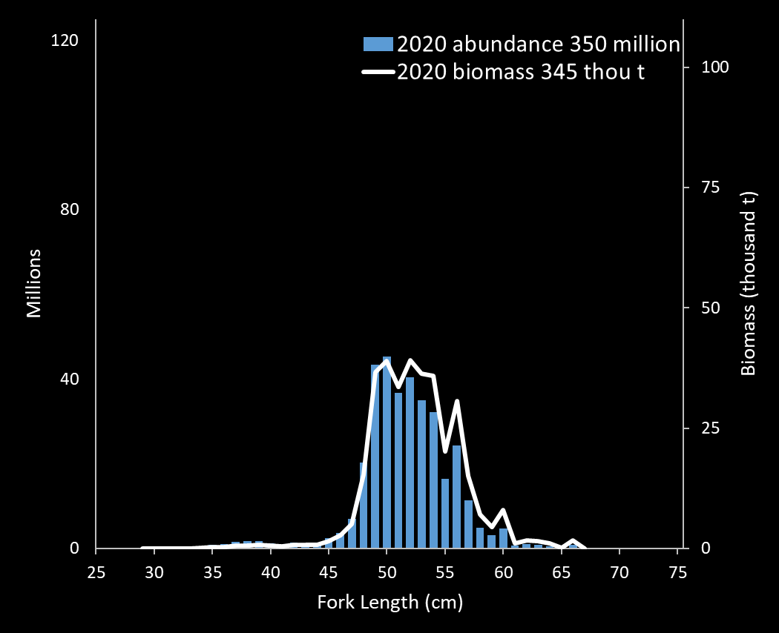
2020 population at length

Slide 17
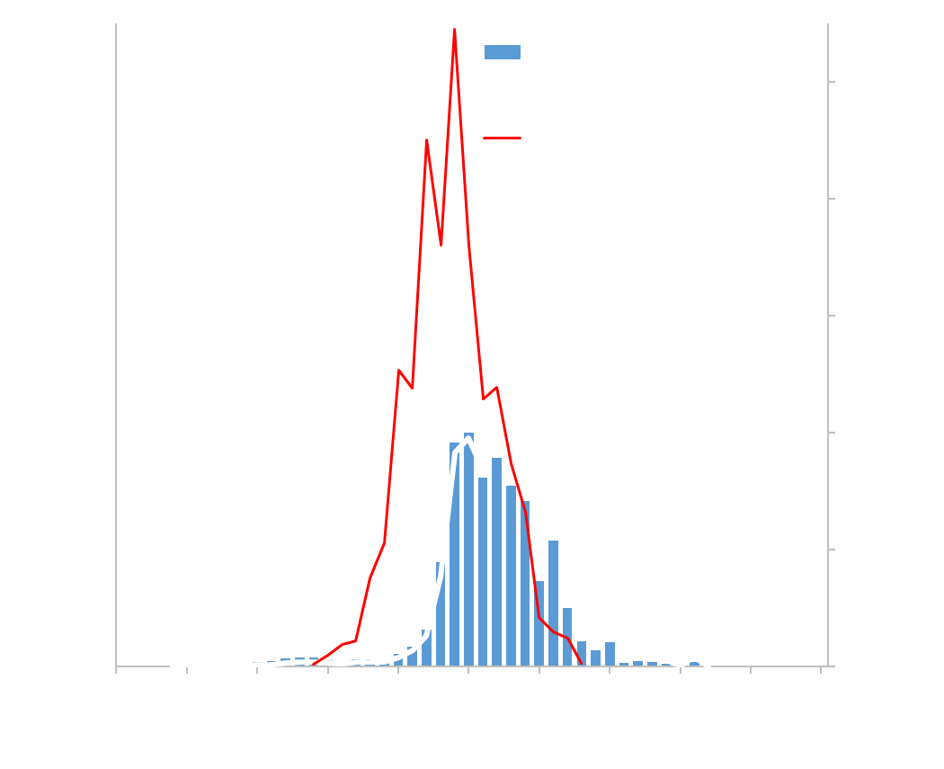
2018-2020 population at length

Slide 18
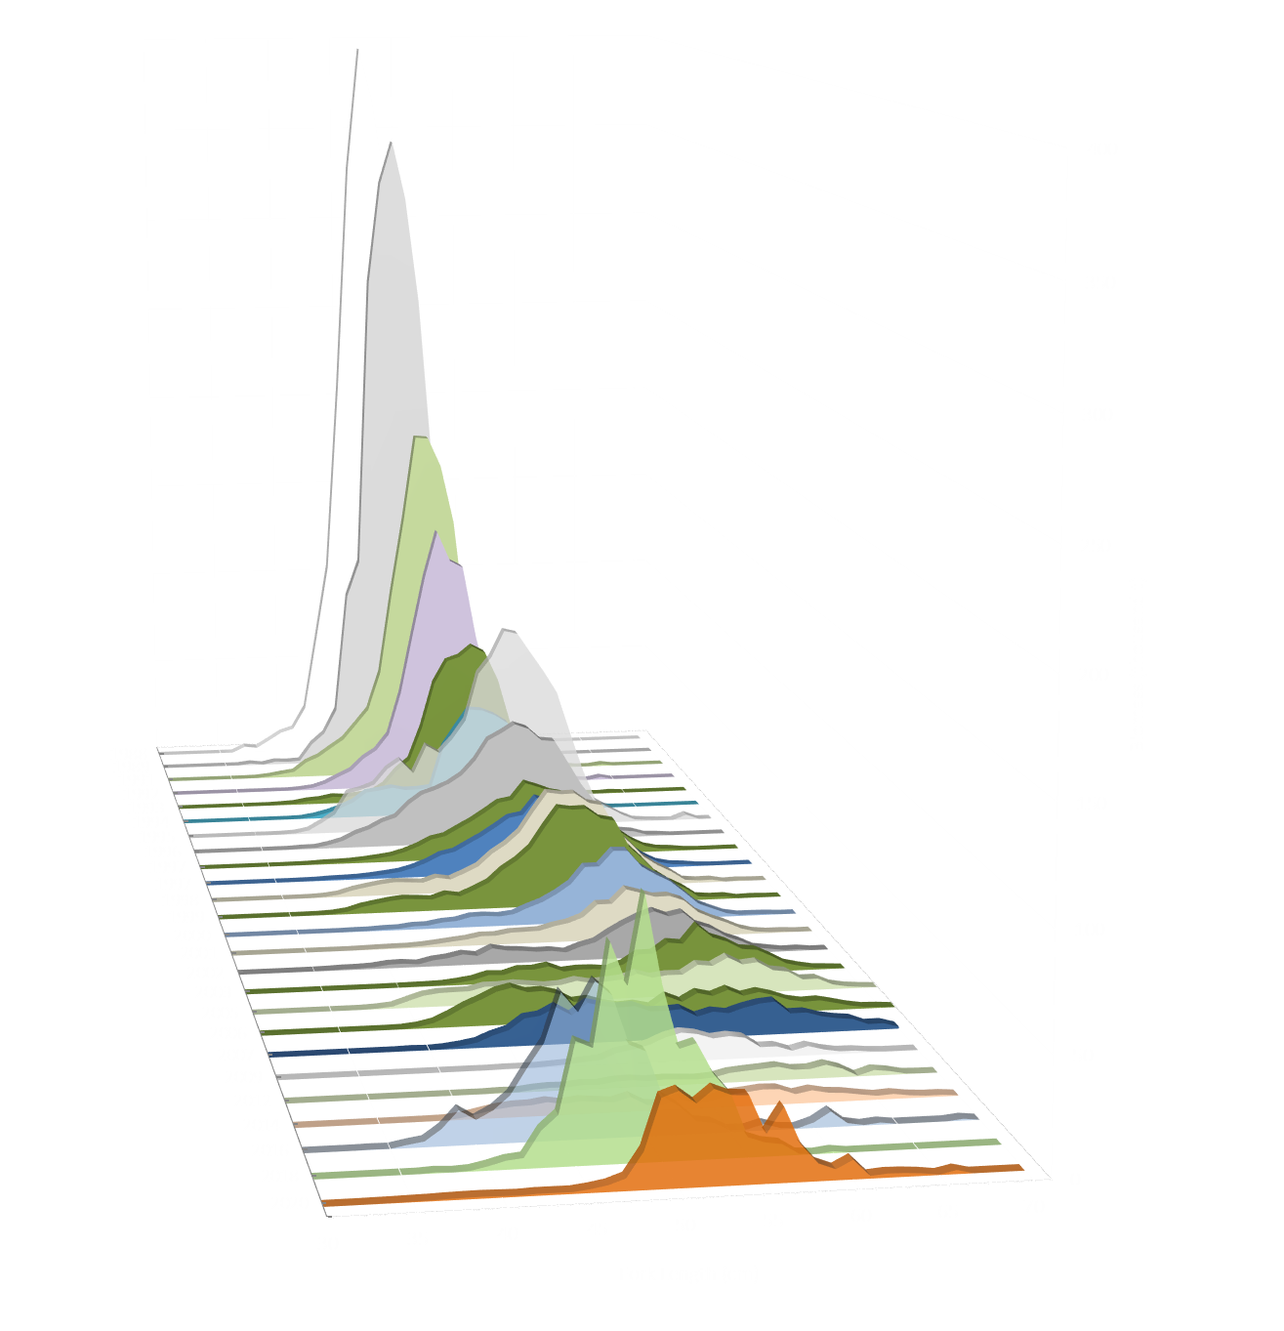
Historical
biomass
at length

Slide 19
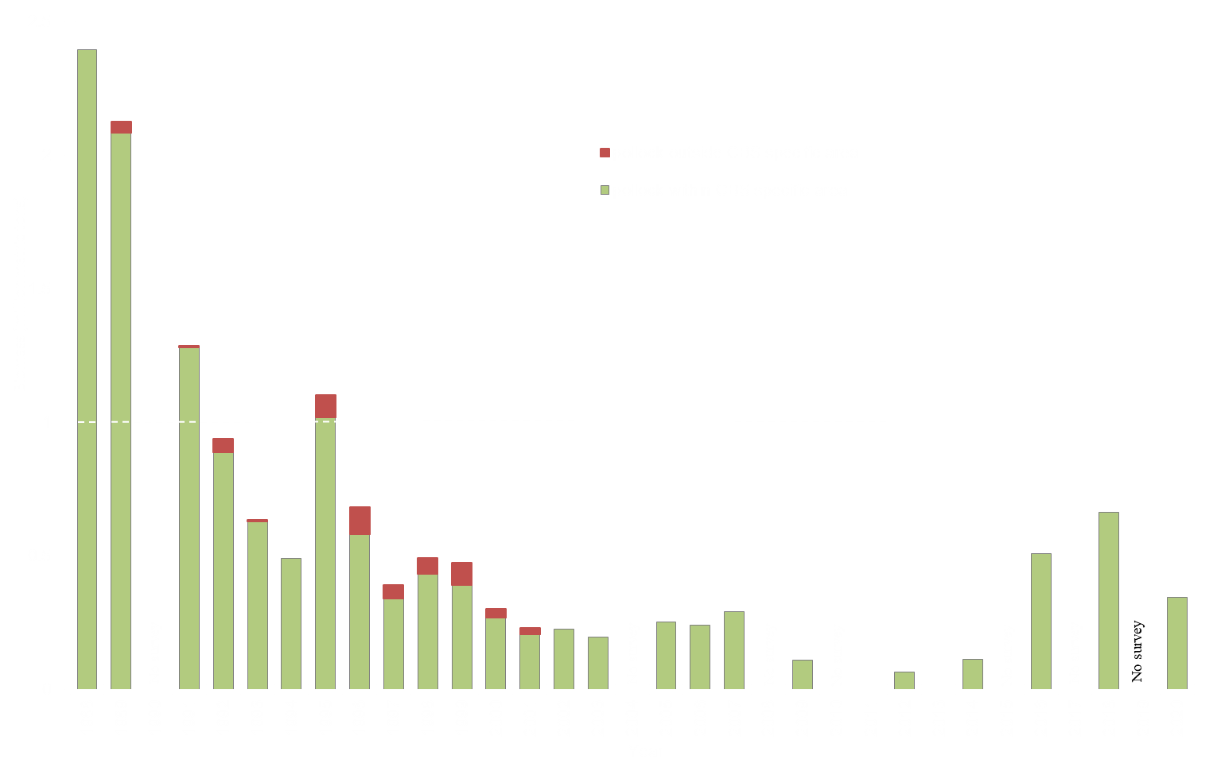
1 million tons (60% of 1.67 million tons)

Slide 20
Bogoslof Island area AT survey: 2020
Analysis improvements include:
Nearest haul
Not just pollock
Net selectivity

Slide 21
Bogoslof Island area AT survey: 2020
Analysis improvements include:
Nearest haul
Not just pollock
Net selectivity
Historically:
Pooled length distributions
Just pollock
No net selectivity

Slide 22
2020 Analysis changes :
Biomass t
Nearest haul
Not just pollock
Net selectivity
345 thousand t

Slide 23
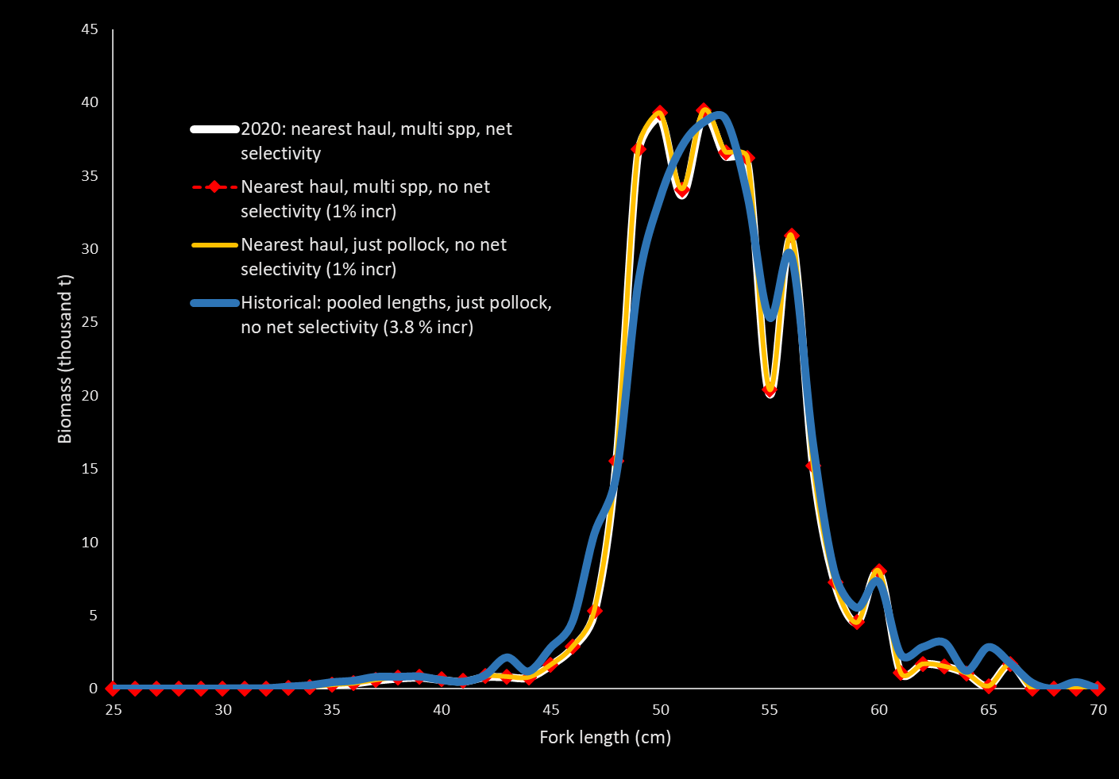
2020 Analysis changes :
Biomass t
Nearest haul
Not just pollock
Net selectivity
345 thousand t

Slide 24
Summary
We found the LFS net to be an asset during our February cruise in that it was easier to deploy and retrieve in rough weather, and it is comparable to the AWT for catching adult pollock
Most female pollock were pre-spawning suggesting survey timing was good
Pollock were concentrated in the Samalga region
Improved analysis includes:
Nearest-haul approach allowing us to account for other species contributing to the backscatter, and Net selectivity corrections
Pollock abundance was estimated at 350 million fish, with the biomass at 345 thousand t
2020 biomass 48 % decrease from 2018
Next Bogoslof survey is planned for 2022

Slide 25
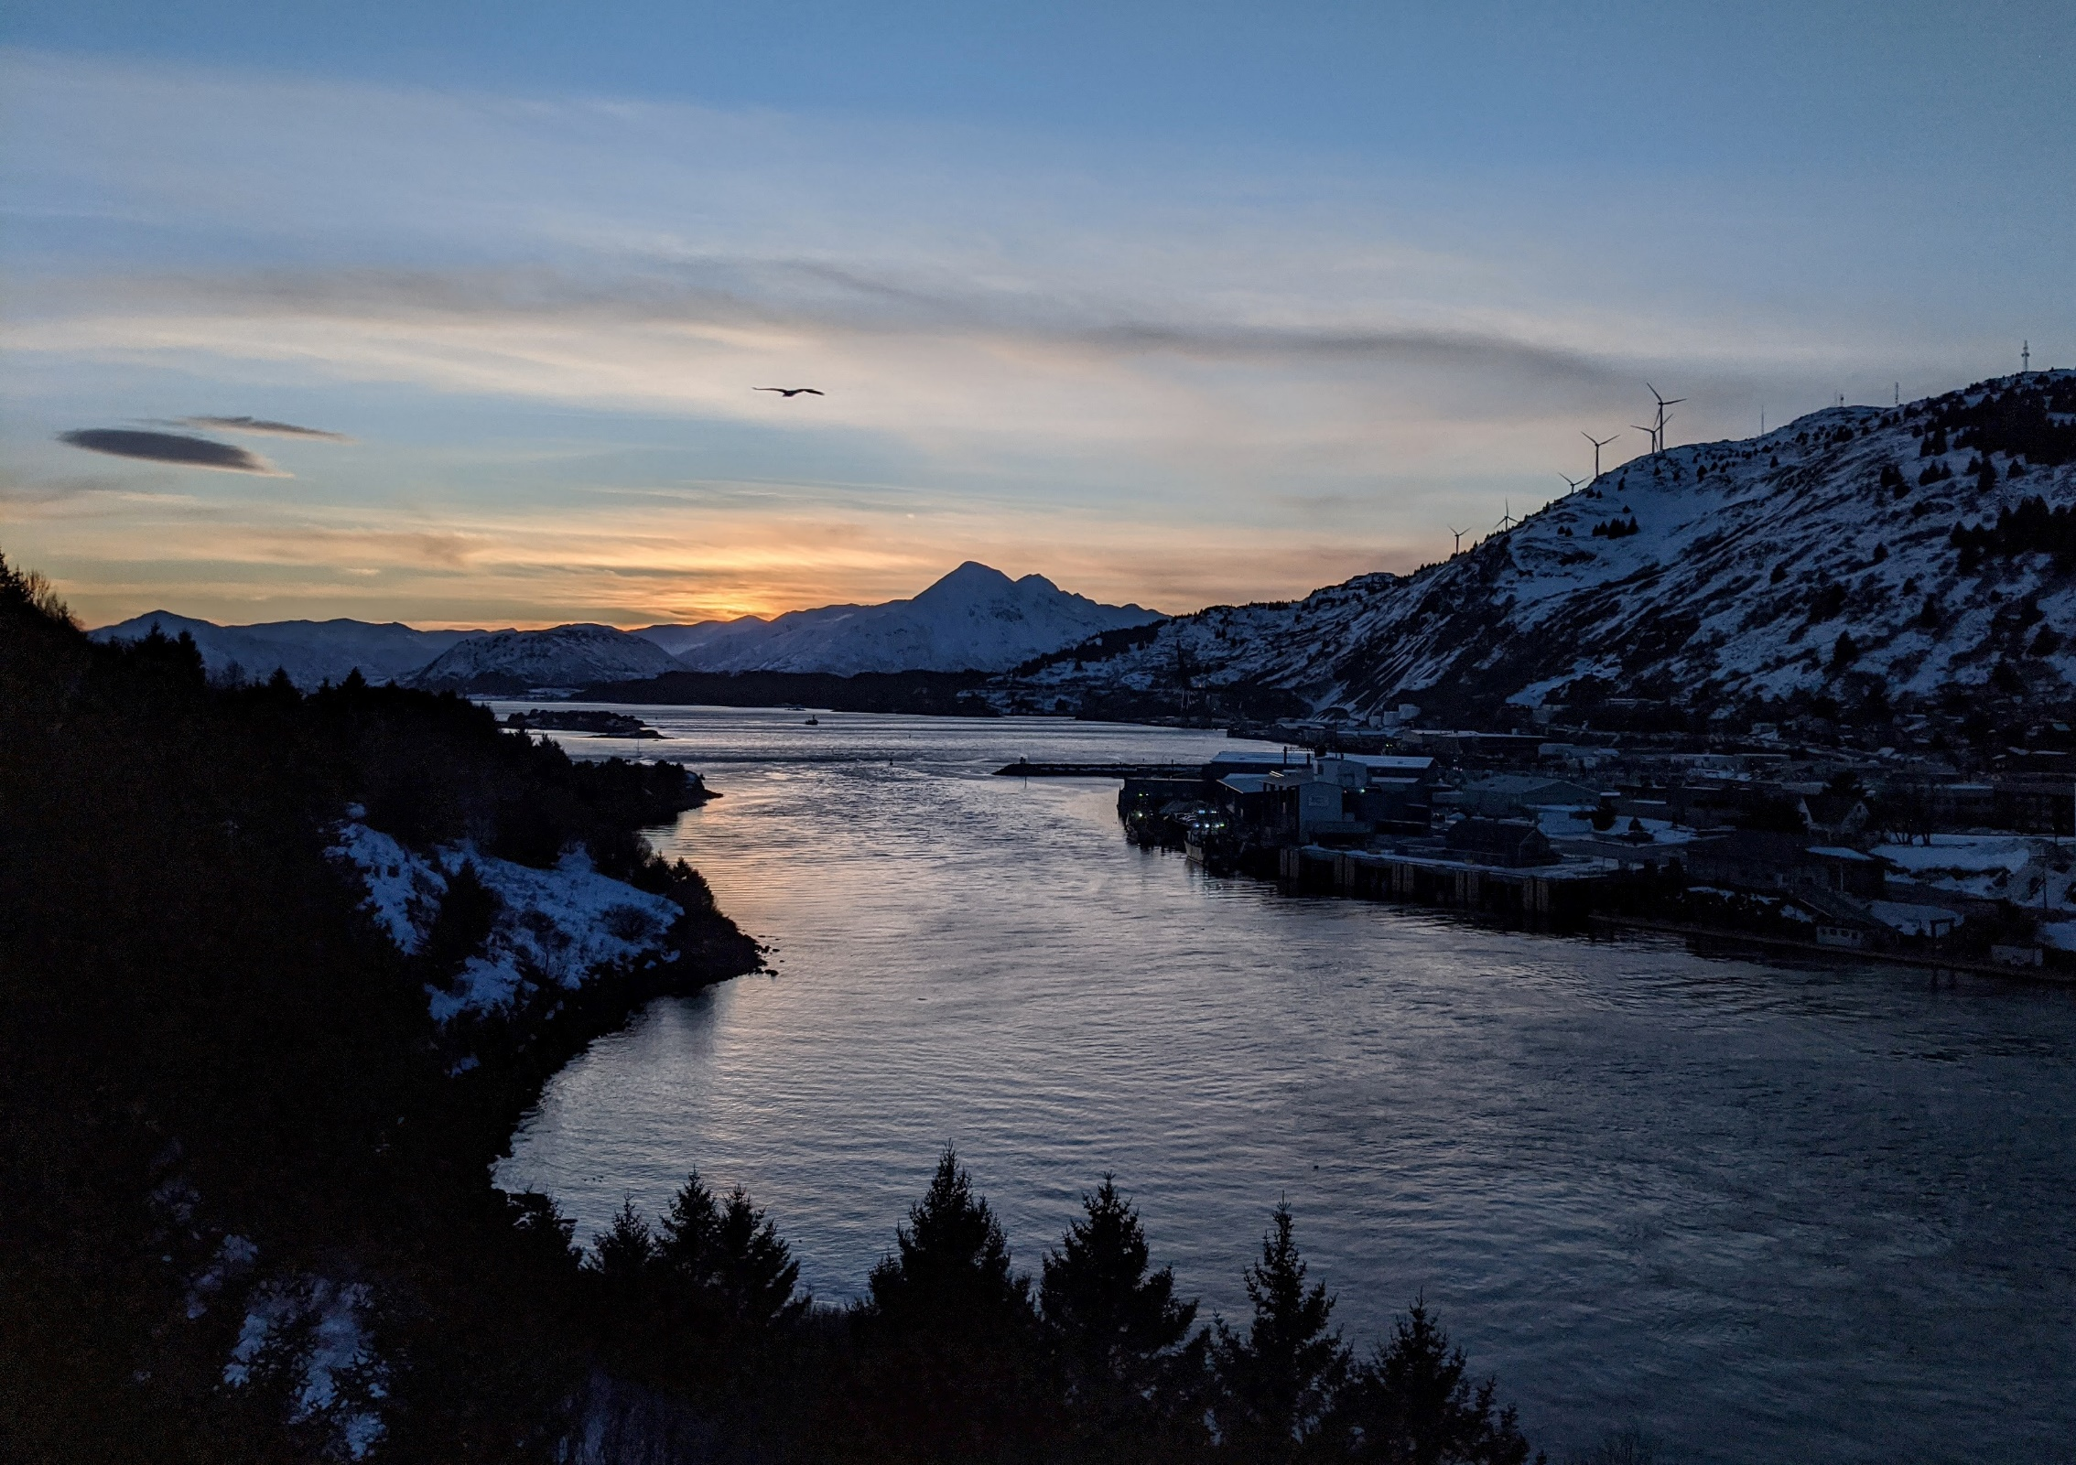
Questions??
Photo by Matthew Phillips

Slide 26
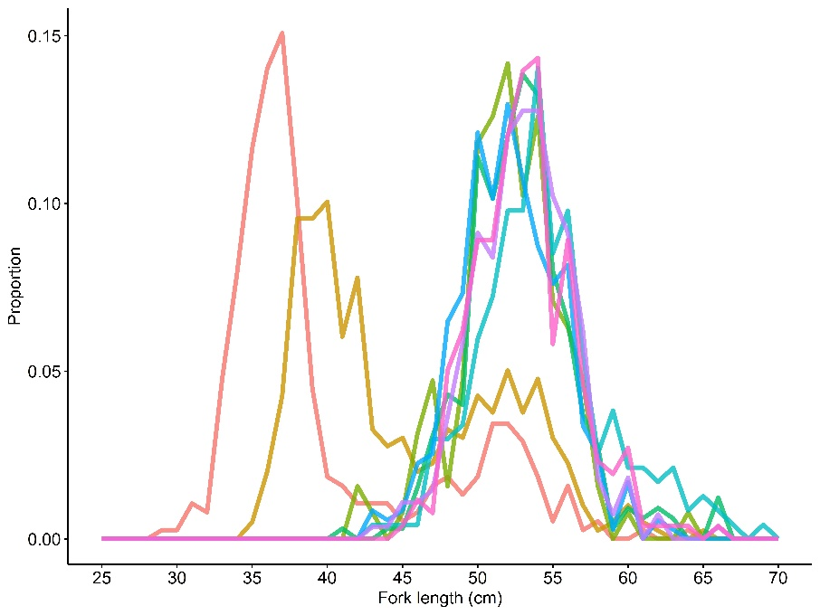
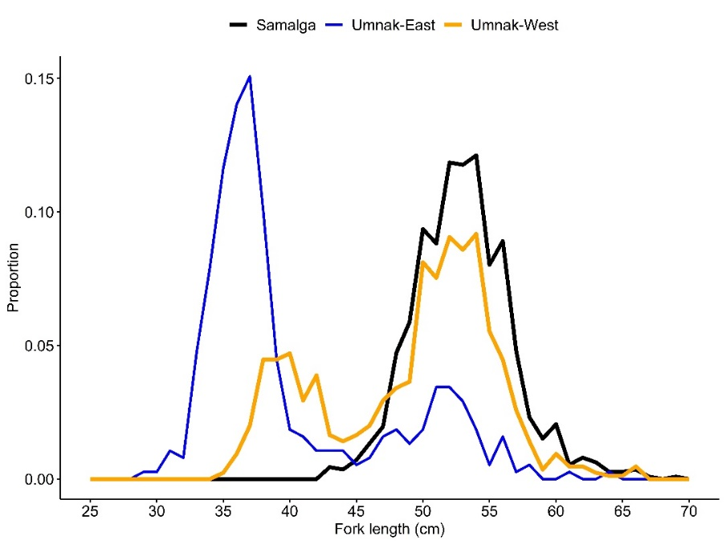
2020
Nearest haul uses individual length samples for single interval
Historically
Pooled length samples applied across broad area

Slide 27
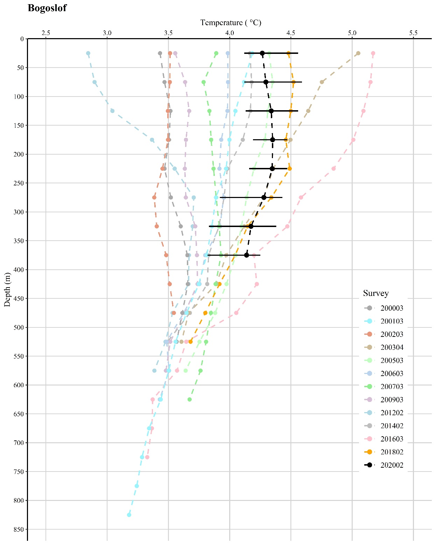

Slide 28
