Slide 1
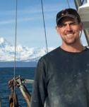
Research Priorities
2021
Triennial Review and Recommendations
Jim Armstrong

Slide 2
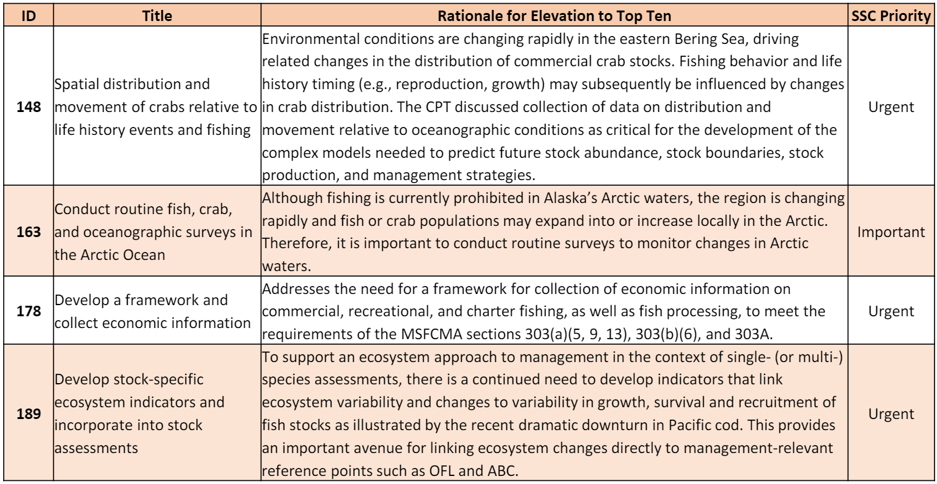
Top Ten

Slide 3
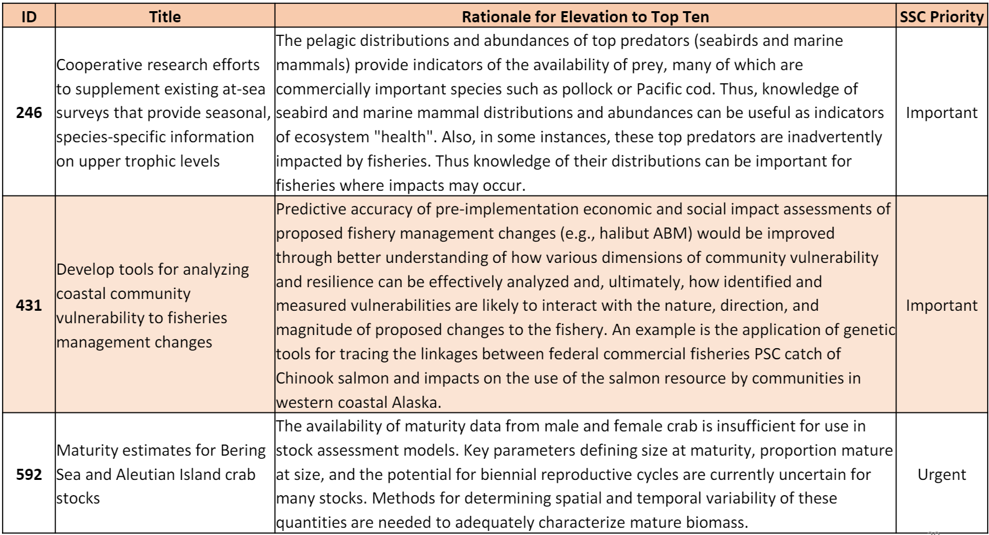
Top Ten

Slide 4
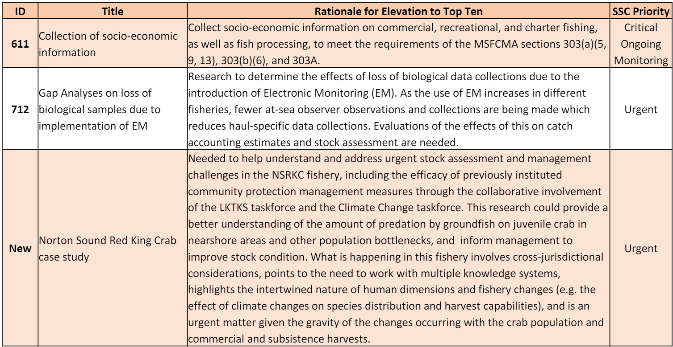
Top Ten

Slide 5
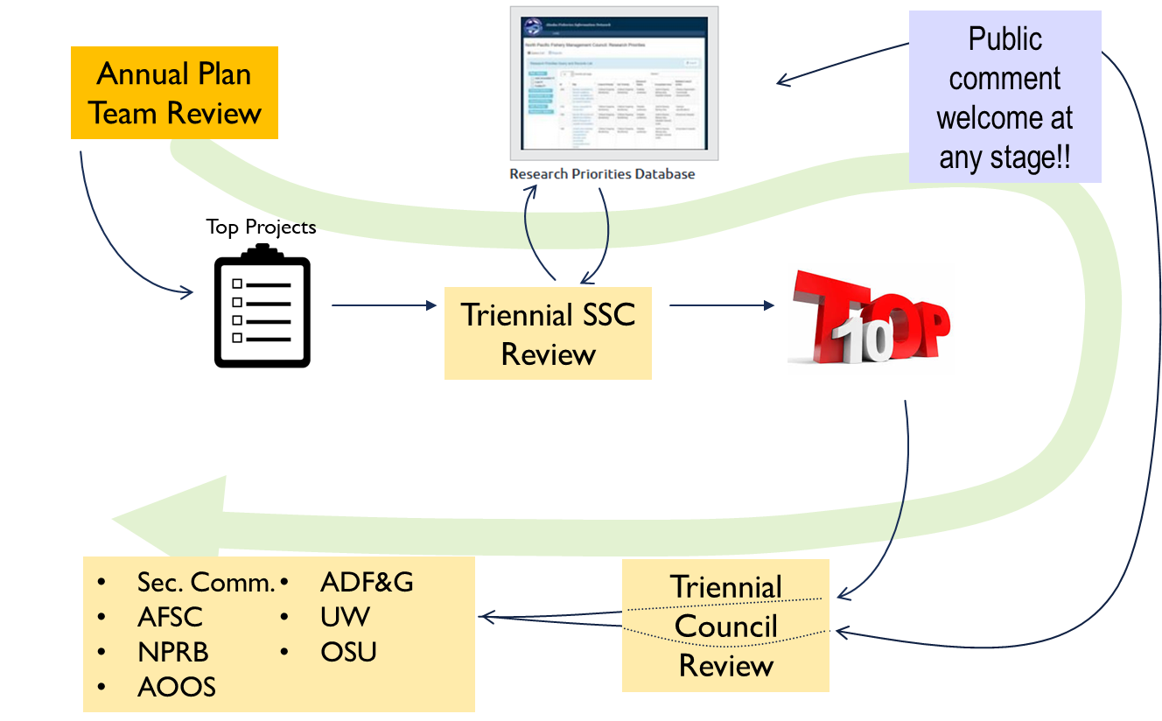
NPFMC Triennial Research Priority Review Process

Slide 6
Process
Triennial FMP Plan Teams, BSFEP Team, SSPT
    Research status, priority ranking, changes to titles and descriptions, new projects, completed projects and report availability, consolidations, deletions, any other project-specific comments, as possible.
    Recommendations for top ten
    Non-Plan Team “on-ramps”
    marine mammals, seabirds, salmon
    Council
    3-year outlook of emerging management issues
  Public comment

Slide 7
Process
SSC subgroup
  2 meetings out
    Subgroup formation
    Distribute
      -Previous Top Ten
      -Plan Team recommendations
      -Emerging management issues
  1 meeting out
    Subgroup member recommendations
    Draft new top ten
      Relevance to Council’s emerging management issues
    Draft summary statements, statistics for overall list
    Any other draft recommendations

Slide 8
Process
SSC (at triennial review meeting)
  Review recommendations from
    Previous SSC review
    Current Plan Team
    Subgroup
    Public

Slide 9
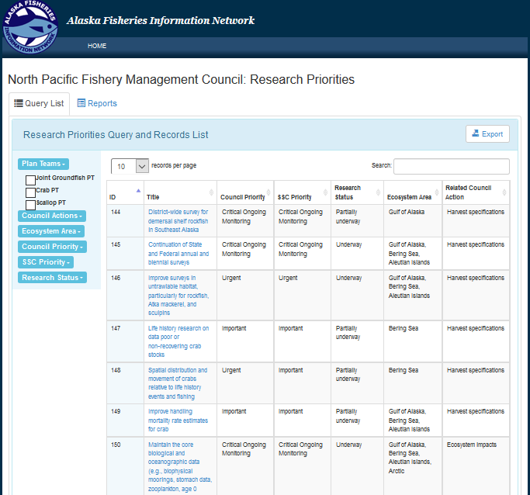

Database Updates
Date added
Funding date
Estimated project duration
Estimated completion date
Point of Contact

