Slide 1
Bristol Bay Red King Crab Assessment in Spring 2021
J. Zheng and M.S.M. Siddeek
ADF&G, Juneau

Slide 2
Response to CPT Comments
Response to CPT Comments (from May 2020):
“If time allows, a model building from 19.3 in which the prior on catchability is relaxed and estimated separately by sex (and revisited in light of the catchability implied by the BSFRF data) would be useful for comparison.”
Response: We used model 19.3b to examine the sensitivity of trawl survey catchability estimate when the CV of the prior on catchability was doubled in September 2020. The resulting catchability estimate was greater than 1.0. Different catchabilities for males and females in the NMFS survey were examined in model 19.5 in May 2020 with both sexes having the same survey selectivities. In May 2021, we add model 19.3e with the same prior and model 19.3f with doubled CV value of the prior to examine different survey catchabilities between sexes. BSFRF survey data are used in the model, so we do not use them to estimate a prior for NMFS survey catchabilities.
“Include diagnostics for VAST indices of abundance and provide rationale for accepting or rejecting the index in future iterations (but not for September 2020).”
Response: Diagnostics for VAST indices are illustrated in Appendix E.

Slide 3
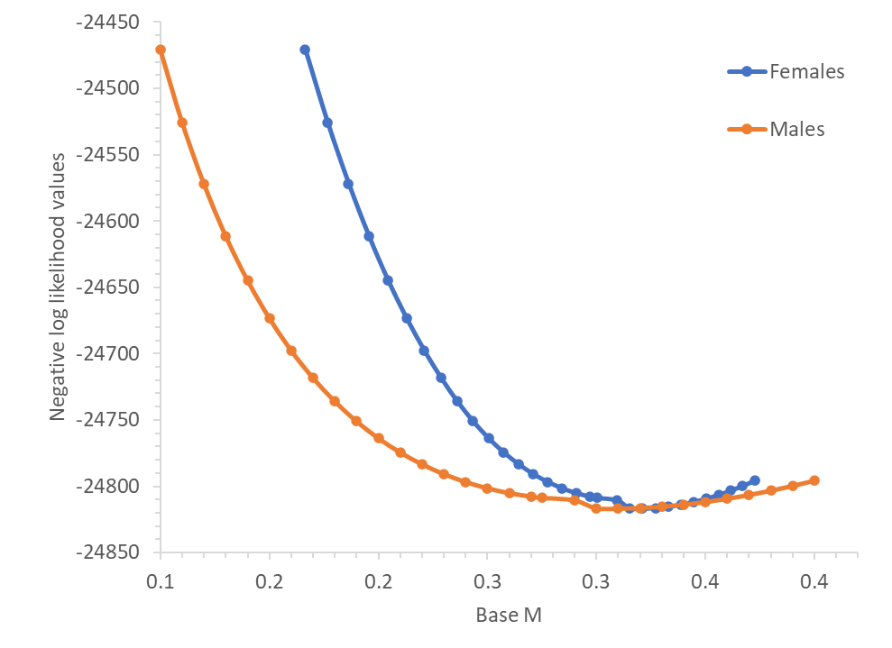
Response to CPT Comments
Response to CPT Comments (from May 2020):
“Provide justification for the assumed natural mortality for males of 0.18 yr-1. How does the 1% rule assumed in the assessment compare to empirical studies on natural mortality and longevity (e.g. Then et al. 2015)?”
Response: The 1% rule was accepted after very long, several year difficult discussions among the crab overfishing working group, CPT, and SSC. The base M for females is also higher than 0.18 for model 19.3 and the related models. Model 19.6 uses male base M of 0.257 estimated by Then et al. (2015), and we also examine a likelihood profile of base M from 0.1 to 0.4 as:
The maximum likelihood value is achieved with a base M of 0.31 for males and 0.321 for females.

Slide 4
Response to CPT Comments
Response to CPT Comments (from September 2020):
“Include a table in the assessment document providing estimates of M for all scenarios.”
Response: Included them in Table 8.
“Include a table in the assessment document that provide the differences in likelihood values between the base model and each alternative model scenario considered a candidate for status determination.”
Response: Added (Table 5c).

Slide 5
Response to CPT Comments
Response to CPT Comments (from September 2020):
“Evaluate different approaches to constraining the terminal year estimate of recruitment for the purpose of developing projections.”
Response: We plan to compare three approaches to constraining the terminal year estimate of recruitment for the purpose of developing projections:
Average of recent low recruitment period excluding the terminal year (7 years),
Average of the period used to estimate B_{35%},
Increase in the weight on annual recruitment variation & sex ratio.
Since the current GMACS version cannot carry work on (1) and (2), we examine only (3) in this report.

Slide 6
As shown in the table above with model 19.3d, increasing weight on sex ratio (forcing them close to 50% each year) has some minor impacts on recruitment estimates in the terminal year, while increasing penalty on annual variation seems not to affect the model results. Overall, changes in penalties on recruitment deviation and sex ratio have very minor impacts on terminal recruitment estimates.

Slide 7
Response to SSC Comments
Response to SSC Comments (from October 2020):
“Next year’s assessment should estimate the probability that the stock is currently in the overfished condition.”
Response: Included it in Figure 31.
“Information should be provided on the prevalence of crab bycatch excluders being used in the pot cod fishery, and whether the excluders influence the length composition of bycatch.”
Response: Will try to collect these data and analyze them in the future. Right now, very limited data are available.
“The SSC also endorses the Alaska Bering Sea Crabber’s request to include raw numbers used for PSC limits in a table in the BBRKC SAFE consistent with EBS snow crab (see Table 11 in the EBS snow crab SAFE), if it is practical to do so.”
Response: Included it in this report for years 2010-2020 in Table 8.
“The SSC looks forward to future analyses of the use of VAST estimates for this stock assessment including diagnostics and better-fitting error distributions.”
Response: Included VAST results and diagnostics in Appendix E and used VAST-estimated survey biomass in two model scenarios (model 19.3g and 19.3i) in May 2021.

Slide 8
Model Scenarios
Eight models:
  19.3: the base model adopted by the CPT and SSC in September 2020. This model has a constant M being estimated for males during 1980-1984, while maintaining a constant (base) M of 0.18 for males during other years, and an estimated constant multiplier being used to multiply male M for female M.
  19.3c: the same as model 19.3 except for updating/standardizing the observer data in the directed pot and Tanner crab fisheries. Fishing effort data used to estimate red king crab bycatch in years before the observer data in the Tanner crab fishery were available are changed from east of 1630 W to east of 1660 W, which covers the whole Bristol Bay red king crab stock. Five more years of length composition data with relatively small observed sample sizes from the Tanner crab fishery are also included.
  19.3d: the same as model 19.3c except for changing the maximum cap of effective sample size from 100 to 150 for the retained catch and total males in the directed pot fishery. The computed implied effective sample sizes for these two datasets in models 19.3 and 19.3c are close to 200 (Table 4).

Slide 9
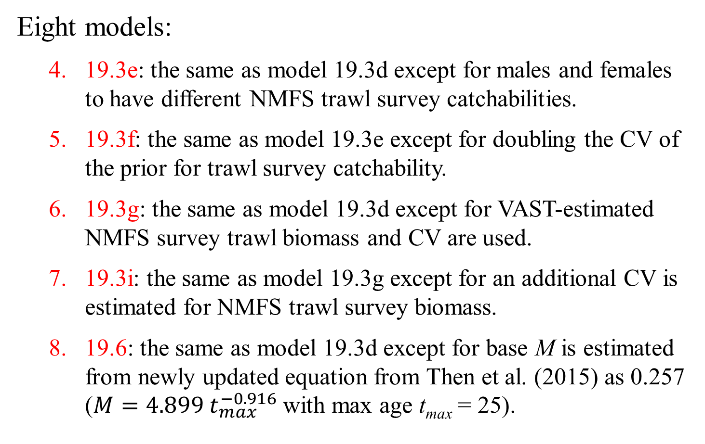
Model Scenarios
Eight models:
  19.3e: the same as model 19.3d except for males and females to have different NMFS trawl survey catchabilities.
  19.3f: the same as model 19.3e except for doubling the CV of the prior for trawl survey catchability.
  19.3g: the same as model 19.3d except for VAST-estimated NMFS survey trawl biomass and CV are used.
  19.3i: the same as model 19.3g except for an additional CV is estimated for NMFS trawl survey biomass.
  19.6: the same as model 19.3d except for base M is estimated from newly updated equation from Then et al. (2015) as 0.257 ($M=4.899 t_{max}^{−0.916}$ with max age t_{max} = 25).

Slide 10
Comparison of Models
Model | Male M | Female M | Updated obs. estimates | Max cap of ret. & total male ESS | VAST | Extra CV for NMFS sur | Diff. Q by sex
19.3 | 80-84: M1, others: 0.18 | c*male M | N | 100 | N | N | N
19.3c | 80-84: M1, others: 0.18 | c*male M | Y | 100 | N | N | N
19.3d | 80-84: M1, others: 0.18 | c*male M | Y | 150 | N | N | N
19.3e | 80-84: M1, others: 0.18 | c*male M | Y | 150 | N | N | Y
19.3f | 80-84: M1, others: 0.18 | c*male M | Y | 150 | N | N | Y
19.3g | 80-84: M1, others: 0.18 | c*male M | Y | 150 | Y | N | N
19.3i | 80-84: M1, others: 0.18 | c*male M | Y | 150 | Y | Y | N
19.6 | 80-84: M1, others: 0.257 | c*male M | Y | 150 | N | N | N

Slide 11
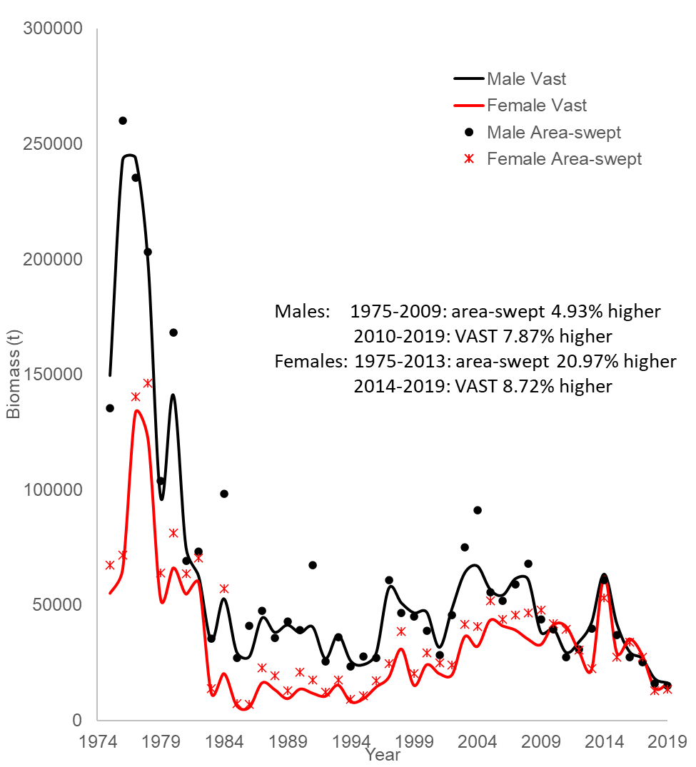
Comparison of area-swept and VAST-estimated survey biomasses for Bristol Bay red king crab from 1975 to 2019

Slide 12
Comparisons of area-swept estimates of male and female NMFS survey biomass and model prediction for model estimates in 2021 under three models. The error bars are plus and minus 2 standard deviations of model 19.3.

Slide 13
Comparisons of total survey biomass estimates by the BSFRF survey and three models (upper plot: males; lower plot: females). The error bars are plus and minus 2 standard deviations of model 19.3.

Slide 14
Comparisons of mature male biomass on Feb. 15 under three models.
Estimated trawl survey catchabilities:
Model Q
19.3 0.959
19.3c 0.958
19.3d 0.962

Slide 15
Comparisons of area-swept estimates of male and female NMFS survey biomass and model prediction for model estimates in 2021 under four models. The error bars are plus and minus 2 standard deviations of model 19.3d.

Slide 16
Comparisons of area-swept estimates of male and female NMFS survey biomass and model prediction for model estimates in 2021 under three models. The error bars are plus and minus 2 standard deviations of model 19.3g.
VAST estimated biomass.

Slide 17
Comparisons of total survey biomass estimates by the BSFRF survey and six models (upper plot: males; lower plot: females). The error bars are plus and minus 2 standard deviations of model 19.3d.

Slide 18
Comparisons of mature male biomass on Feb. 15 under eight models.
Estimated trawl survey catchabilities:
Model Q
19.3d 0.962
19.3e 0.921/0.945
19.3f 0.987/1.027
19.3g 0.949
19.3i 0.937
19.6 0.930

Slide 19
Standardized residuals of total NMFS survey biomass
19.3
19.3d

Slide 20
Comparison of estimated M and directed pot fishing mortality over time

Slide 21
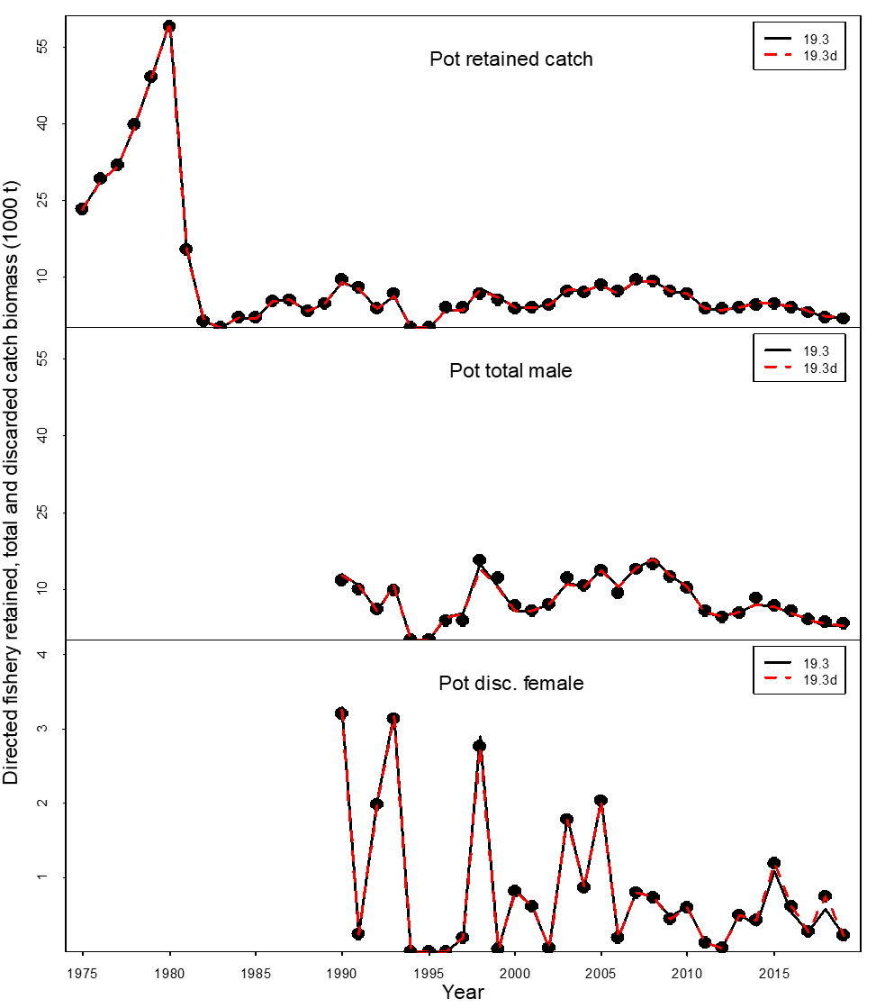
Comparisons of observed and predicted catch mortality biomass under models 19.3 and 19.3d. Mortality biomass is equal to caught biomass times a handling mortality rate.

Slide 22
Comparisons of observed and predicted bycatch mortality biomass under models 19.3 and 19.3d.
The differences of predicted bycatch biomass in the Tanner crab fishery are primarily due to change in pot-lifts from east of 163⁰W to east of 166⁰W and updated recent pot-lift values.
Mortality biomass is equal to caught biomass times a handling mortality rate.

Slide 23
Estimated selectivities (including catchability) of NMFS trawl survey during 1982-2020 with three models

Slide 24
Estimated selectivities (including catchability) of NMFS trawl survey during 1982-2020 with six models

Slide 25
Estimated selectivities of BSFRF trawl survey during 2007-08 and 2013-2016 with three models

Slide 26
Estimated selectivities of BSFRF trawl survey during 2007-08 and 2013-2016 with six models

Slide 27
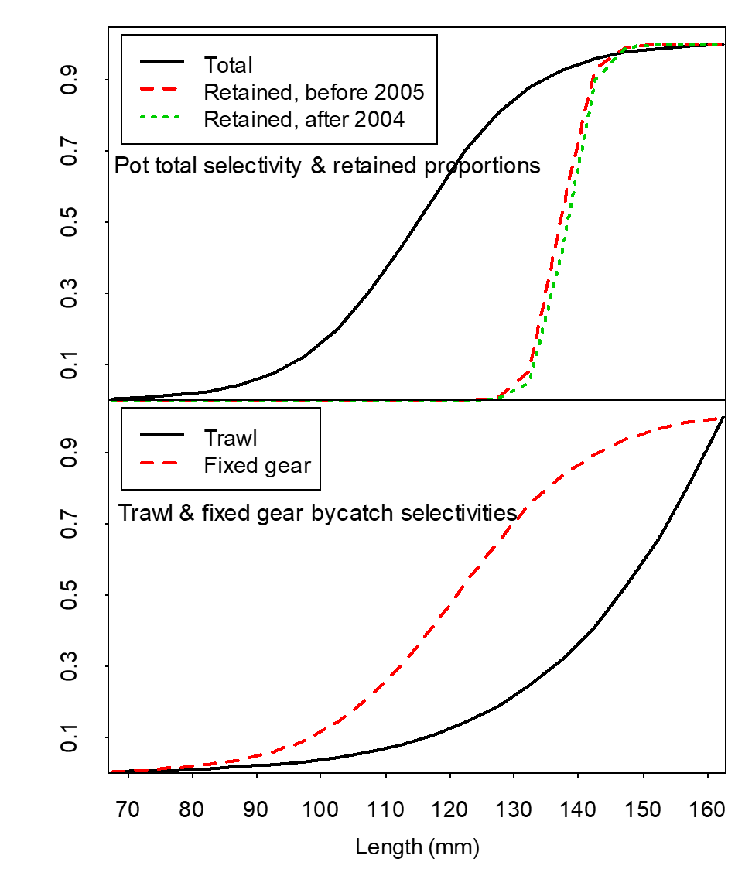
Fisheries selectivities and retained proportions
19.3
19.3d

Slide 28
Molting Probabilities
19.3
19.3d

Slide 29
Comparison of area-swept and model estimated NMFS survey length frequencies of Bristol Bay male red king crab by year under four models.

Slide 30
Comparison of area-swept and model estimated NMFS survey length frequencies of Bristol Bay female red king crab by year under three models.

Slide 31
Comparison of area-swept and model estimated BSFRF survey length frequencies of Bristol Bay red king crab by year under three models.

Slide 32
Comparison of observer and model estimated retained length frequencies of Bristol Bay male red king crab by year in the directed pot fishery under three models.

Slide 33
Comparison of observer and model estimated total length frequencies of Bristol Bay male red king crab by year in the directed pot fishery under three models.
The observed length composition data are from model 19.3d.

Slide 34
Comparison of observer and model estimated discarded length frequencies of Bristol Bay female red king crab by year in the directed pot fishery under three models.
The observed length composition data are from model 19.3d.

Slide 35
Comparison of observer and model estimated discarded length frequencies of Bristol Bay male red king crab by year in the groundfish trawl fisheries under three models.

Slide 36
Comparison of observer and model estimated discarded length frequencies of Bristol Bay female red king crab by year in the groundfish trawl fisheries under three models.

Slide 37
Comparison of observer and model estimated discarded length frequencies of Bristol Bay male red king crab by year in the groundfish fixed gear fisheries under three models.

Slide 38
Comparison of observer and model estimated discarded length frequencies of Bristol Bay female red king crab by year in the groundfish fixed gear fisheries under three models.

Slide 39
Comparison of observer and model estimated discarded length frequencies of Bristol Bay red king crab by year in the Tanner crab pot fishery under three models.

Slide 40
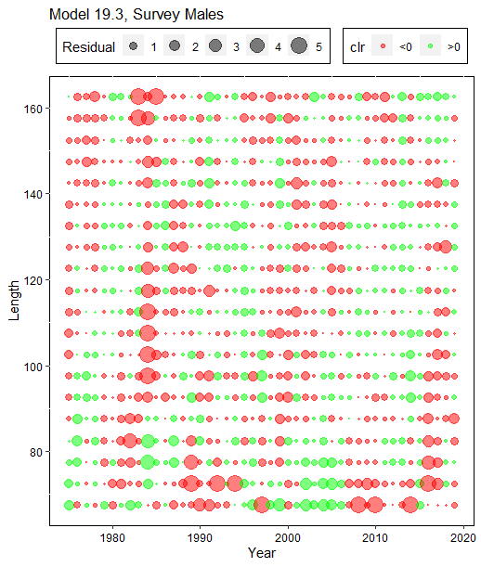
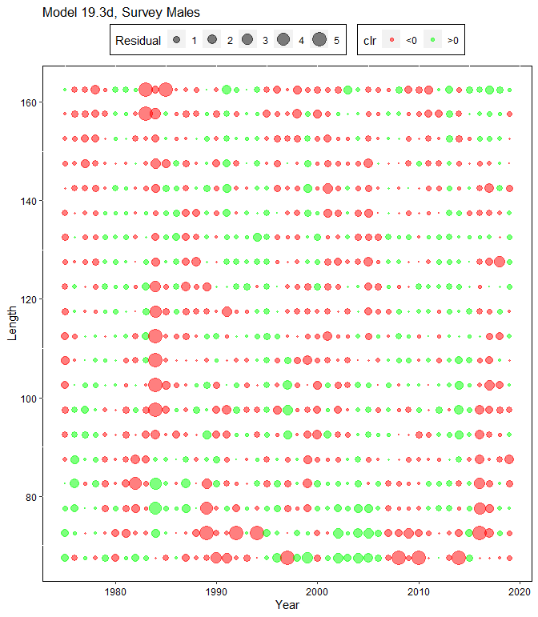
Comparison of residuals of proportions of NMFS survey male red king crab by year and carapace length (mm)

Slide 41
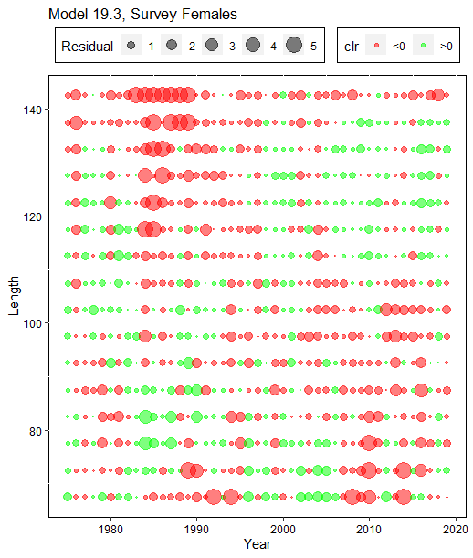
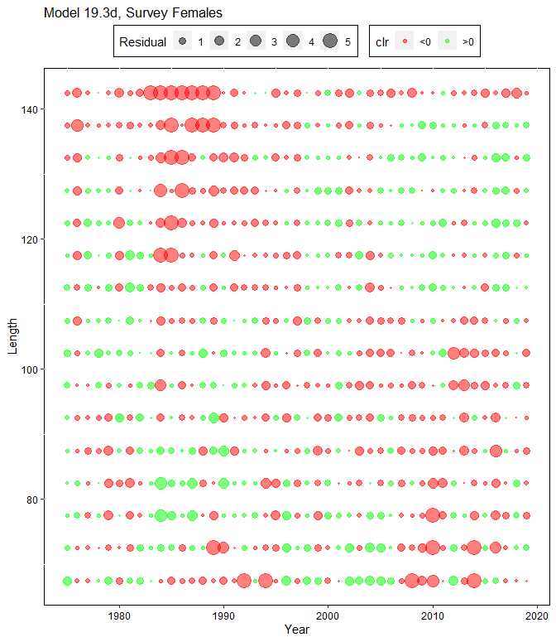
Comparison of residuals of proportions of NMFS survey female red king crab by year and carapace length (mm)

Slide 42
Models
 | 19.3 | 19.3c | 19.3d | 19.3e | 19.3f | 19.3g | 19.3i | 19.6
Pot-ret-catch | -59.87 | -58.38 | -57.32 | -57.03 | -57.67 | -54.05 | -56.74 | -59.19
Pot-totM-catch | 25.90 | 28.58 | 30.61 | 31.17 | 29.99 | 32.61 | 31.40 | 28.20
Pot-F-discC | -52.21 | -52.21 | -52.21 | -52.21 | -52.21 | -52.19 | -52.21 | -52.23
Trawl-discC | -60.98 | -60.98 | -60.98 | -60.98 | -60.98 | -60.97 | -60.98 | -60.98
Tanner-M-discC | -43.54 | -43.54 | -43.54 | -43.54 | -43.54 | -43.54 | -43.54 | -43.54
Tanner-F-discC | -43.49 | -43.47 | -43.47 | -43.48 | -43.47 | -43.44 | -43.48 | -43.51
Fixed-discC | -33.27 | -33.27 | -33.27 | -33.27 | -33.27 | -33.26 | -33.27 | -33.27
Traw-suv-bio | -33.82 | -33.68 | -33.38 | -30.19 | -30.59 | 104.60 | -61.31 | -35.71
BSFRF-sur-bio | -4.80 | -4.71 | -4.59 | -3.02 | -3.84 | -6.19 | -5.81 | -6.56
Pot-ret-comp | -3643.89 | -3645.56 | -3787.11 | -3787.12 | -3787.02 | -3789.11 | -3788.56 | -3793.65
Pot-totM-comp | -2150.62 | -2150.73 | -2223.64 | -2223.09 | -2224.19 | -2219.77 | -2224.48 | -2224.66
Pot-discF-comp | -1353.14 | -1346.66 | -1346.70 | -1346.68 | -1346.74 | -1345.73 | -1346.88 | -1346.10
Trawl-disc-comp | -5583.78 | -5583.87 | -5582.35 | -5582.80 | -5583.19 | -5586.35 | -5589.49 | -5588.38
TC-disc-comp | -790.17 | -1272.75 | -1273.08 | -1272.84 | -1273.43 | -1271.77 | -1274.29 | -1276.23
Fixed-disc-comp | -3168.76 | -3171.53 | -3171.32 | -3171.47 | -3170.67 | -3169.04 | -3171.91 | -3171.00
Trawl-sur-comp | -6717.35 | -6714.06 | -6710.20 | -6708.68 | -6711.97 | -6696.49 | -6701.23 | -6715.51
BSFRF-sur-comp | -851.44 | -851.60 | -851.13 | -850.76 | -851.97 | -852.22 | -852.22 | -858.23
Recruit-dev | 67.03 | 67.22 | 67.11 | 67.05 | 67.09 | 67.93 | 65.71 | 68.79
Recruit-sex-R | 73.72 | 73.71 | 73.73 | 73.74 | 73.74 | 73.87 | 73.75 | 73.74
Log_fdev=0 | 0.00 | 0.00 | 0.00 | 0.00 | 0.00 | 0.00 | 0.00 | 0.00
M-deviation | 44.12 | 44.27 | 44.41 | 44.38 | 44.41 | 44.92 | 44.76 | 40.00
Sex-specific-R | 0.06 | 0.05 | 0.05 | 0.05 | 0.05 | 0.08 | 0.01 | 0.00
Ini-size-struct. | 31.46 | 31.11 | 31.65 | 31.42 | 31.80 | 30.90 | 32.68 | 38.29
PriorDensity | 297.16 | 291.06 | 290.91 | 284.87 | 289.53 | 286.97 | 285.37 | 255.70
Tot-likelihood | -24051.7 | -24531.0 | -24735.8 | -24737.4 | -24739.6 | -24582.2 | -24770.4 | -24804.0
Tot-likeli-no-PD | -24348.9 | -24822.1 | -25026.7 | -25022.3 | -25029.1 | -24869.2 | -25055.8 | -25059.7
Tot-parameter | 366 | 366 | 366 | 367 | 367 | 366 | 367 | 366
MMB35% | 25444.7 | 25283.9 | 25220.6 | 25550.9 | 24790.2 | 25533.8 | 25571.1 | 21577.5
MMB-terminal | 14928.4 | 14743.0 | 14802.0 | 15366.3 | 14152.8 | 16538.3 | 17876.8 | 12866.6
F35% | 0.291 | 0.292 | 0.293 | 0.293 | 0.292 | 0.293 | 0.293 | 0.443
Fofl | 0.157 | 0.157 | 0.158 | 0.163 | 0.153 | 0.178 | 0.195 | 0.244
OFL | 2140.72 | 2099.17 | 2114.53 | 2266.73 | 1950.18 | 1950.18 | 3120.54 | 2714.94
ABC | 1605.54 | 1574.38 | 1585.90 | 1700.05 | 1462.63 | 1462.63 | 2340.41 | 2036.21
Q-male | 0.959 | 0.958 | 0.962 | 0.921 | 0.987 | 0.949 | 0.937 | 0.930
Q-female | 0.959 | 0.958 | 0.962 | 0.945 | 1.027 | 0.949 | 0.937 | 0.930
Highlighted cells in yellow color show prior density values and total negative likelihood values without prior density.
Highlighted cells in red color show values not comparable to the other models.

Slide 43
Differences between models
 | 19.3 - 19.3c | 19.3 - 19.3d | 19.3d - 19.3c | 19.3d- 19.3e | 19.3d- 19.3f | 19.3d- 19.3g | 19.3d- 19.3i |  | 19.3d- 19.6
Pot-ret-catch | -1.49 | -2.54 | 1.05 | -0.29 | 0.35 | -3.28 |  | -0.59 |  | 1.86
Pot-totM-catch | -2.68 | -4.71 | 2.03 | -0.56 | 0.62 | -2.00 |  | -0.79 |  | 2.41
Pot-F-discC | 0.00 | 0.00 | 0.00 | 0.00 | 0.00 | -0.02 |  | 0.00 |  | 0.02
Trawl-discC | 0.00 | 0.00 | 0.00 | 0.00 | 0.00 | -0.01 |  | 0.00 |  | 0.00
Tanner-M-discC | 0.00 | 0.00 | 0.00 | 0.00 | 0.00 | 0.00 |  | 0.00 |  | 0.00
Tanner-F-discC | -0.01 | -0.01 | 0.00 | 0.00 | -0.01 | -0.03 |  | 0.00 |  | 0.04
Fixed-discC | 0.00 | 0.00 | 0.00 | 0.00 | 0.00 | 0.00 |  | 0.00 |  | 0.00
Traw-suv-bio | -0.14 | -0.44 | 0.30 | -3.19 | -2.79 | -137.98 |  | 27.93 |  | 2.33
BSFRF-sur-bio | -0.09 | -0.20 | 0.12 | -1.57 | -0.75 | 1.60 |  | 1.22 |  | 1.97
Pot-ret-comp | 1.67 | 143.22 | -141.55 | 0.01 | -0.09 | 2.00 |  | 1.45 |  | 6.54
Pot-totM-comp | 0.11 | 73.02 | -72.91 | -0.55 | 0.55 | -3.87 |  | 0.84 |  | 1.02
Pot-discF-comp | -6.48 | -6.44 | -0.04 | -0.02 | 0.04 | -0.97 |  | 0.18 |  | -0.60
Trawl-disc-comp | 0.09 | -1.43 | 1.52 | 0.45 | 0.84 | 4.00 |  | 7.14 |  | 6.03
Tanner-disc-comp | 482.58 | 482.91 | -0.33 | -0.24 | 0.35 | -1.31 |  | 1.21 |  | 3.15
Fixed-disc-comp | 2.77 | 2.56 | 0.21 | 0.15 | -0.65 | -2.28 |  | 0.59 |  | -0.32
Trawl-sur-comp | -3.29 | -7.15 | 3.86 | -1.52 | 1.77 | -13.71 |  | -8.97 |  | 5.31
BSFRF-sur-comp | 0.16 | -0.32 | 0.47 | -0.36 | 0.85 | 1.09 |  | 1.10 |  | 7.11
Recruit-dev | -0.20 | -0.09 | -0.11 | 0.06 | 0.02 | -0.82 |  | 1.40 |  | -1.68
Recruit-sex-R | 0.01 | -0.01 | 0.02 | -0.01 | -0.01 | -0.14 |  | -0.03 |  | -0.01
Log_fdev=0 | 0.00 | 0.00 | 0.00 | 0.00 | 0.00 | 0.00 |  | 0.00 |  | 0.00
M-deviation | -0.15 | -0.29 | 0.14 | 0.04 | 0.00 | -0.51 |  | -0.35 |  | 4.41
Sex-specific-R | 0.02 | 0.02 | 0.00 | 0.00 | 0.00 | -0.03 |  | 0.04 |  | 0.05
Ini-size-structure | 0.36 | -0.19 | 0.54 | 0.23 | -0.15 | 0.76 |  | -1.02 |  | -6.63
PriorDensity | 6.09 | 6.25 | -0.16 | 6.04 | 1.38 | 3.93 |  | 5.53 |  | 35.21
Tot-likelihood | 479.3 | 684.1 | -47.6 | 1.60 | 3.80 | -153.60 |  | 34.60 |  | 68.20
Tot-like-no-PD | 473.2 | 677.8 | -52.3 | -4.44 | 2.42 | -157.53 |  | 29.07 |  | 32.99
Tot-parameter | 0 | 0 | 0 | -1 | -1 | 0 |  | -1 |  | 0
MMB35% | 160.79 | 224.03 | -63.25 | -330.27 | 430.40 | -313.18 |  | -350.45 |  | 3643.18
MMB-terminal | 185.36 | 126.40 | 58.96 | -564.33 | 649.25 | -1736.3 |  | -3074.8 |  | 1935.36
F35% | 0.00 | 0.00 | 0.00 | 0.00 | 0.00 | 0.00 |  | 0.00 |  | -0.15
Fofl | 0.00 | 0.00 | 0.00 | -0.01 | 0.01 | -0.02 |  | -0.04 |  | -0.09
OFL | 41.55 | 26.19 | 15.36 | -152.20 | 164.35 | 164.35 |  | -1006.0 |  | -600.41
ABC | 31.16 | 19.64 | 11.52 | -114.15 | 123.27 | 123.27 |  | -754.51 |  | -450.31
Q-male | 0.00 | 0.00 | 0.00 | 0.04 | -0.02 | 0.01 |  | 0.03 |  | 0.03
Q-female | 0.00 | 0.00 | 0.00 | 0.02 | -0.06 | 0.01 |  | 0.03 |  | 0.03
Highlighted cells in red color show values not comparable to the other models.

Slide 44
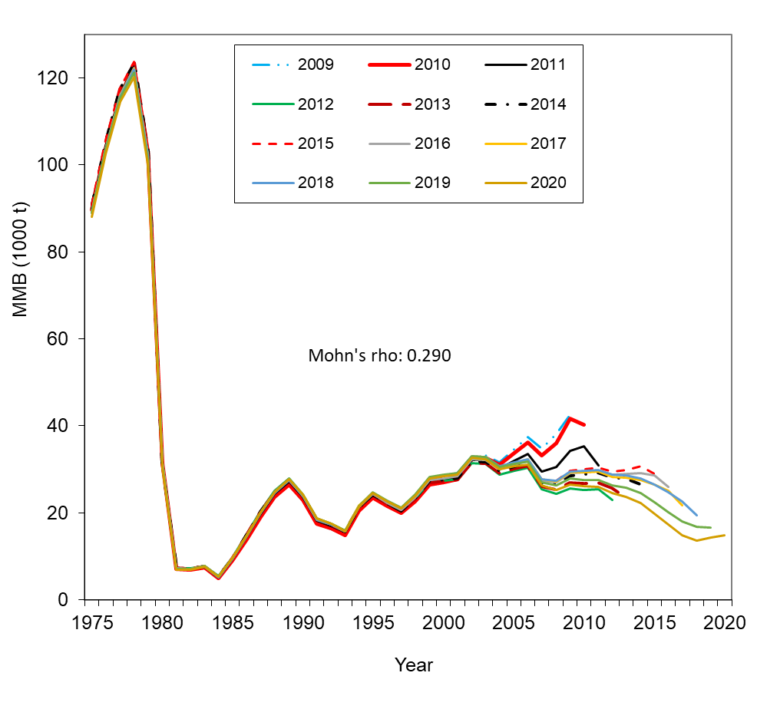
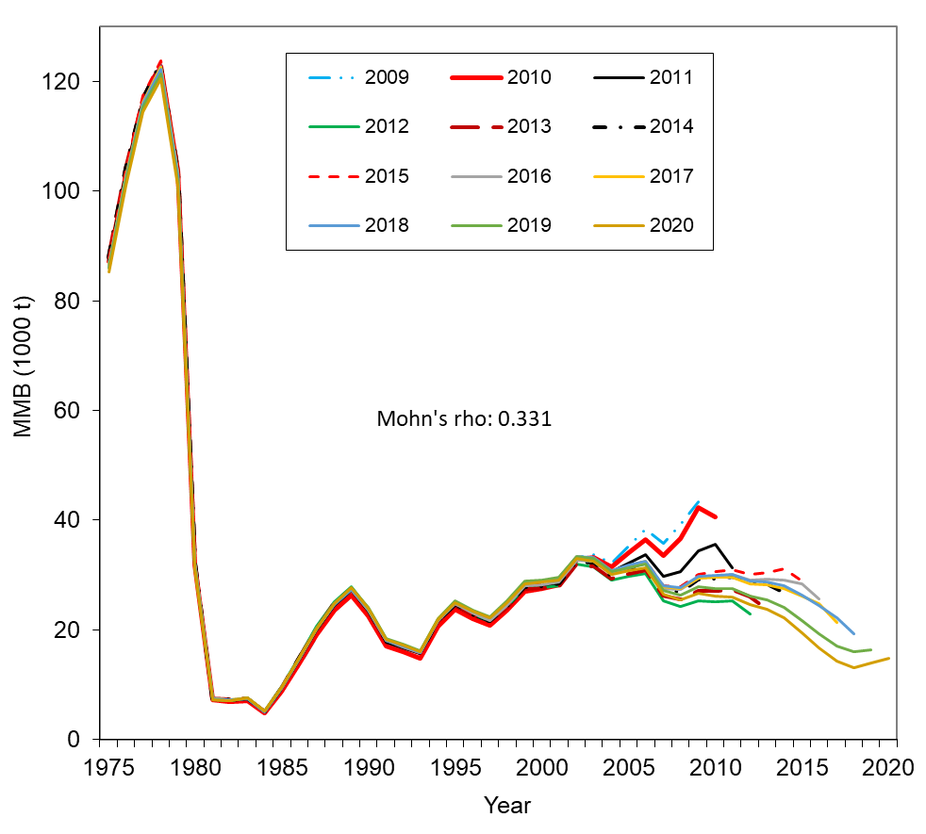
Comparison of hindcast estimates of MMB for models 19.3 and 19.3d from 1975 to 2020 made with terminal years 2009-2020
Model 19.3
Model 19.3d

Slide 45
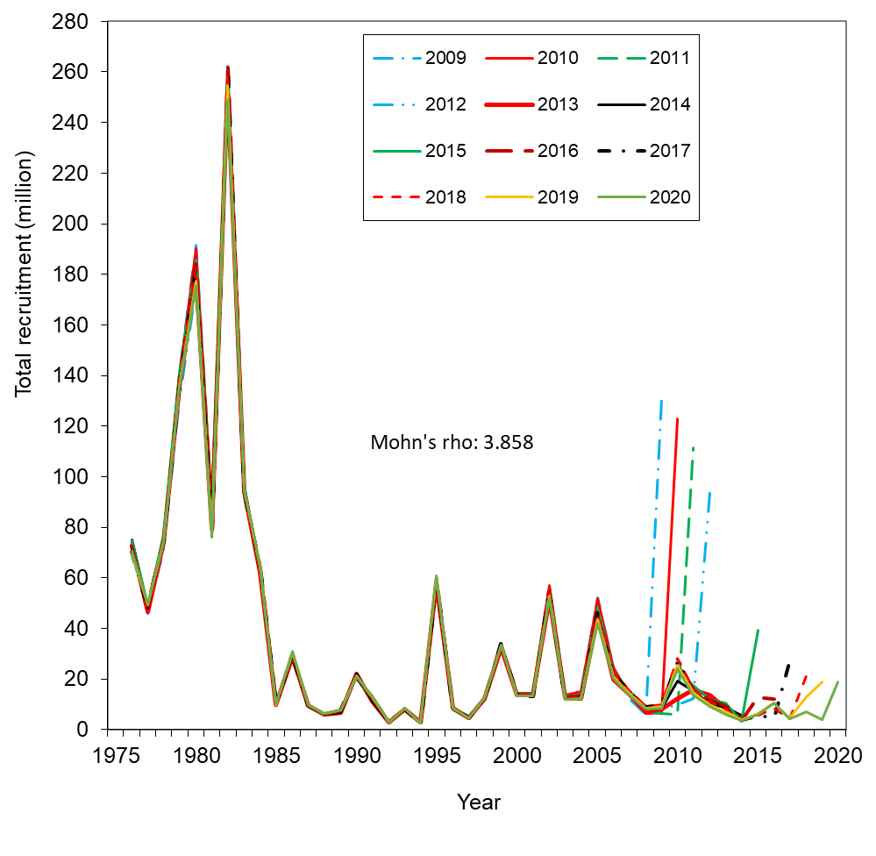
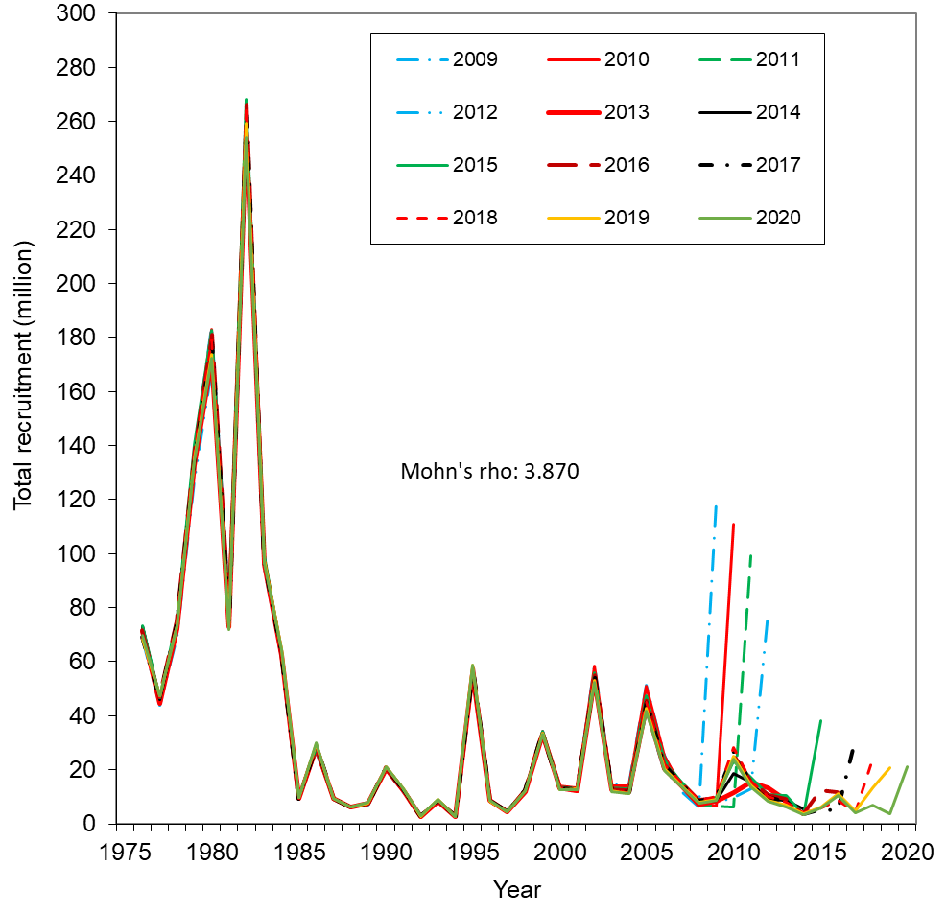
Comparison of hindcast estimates of total recruitment for models 19.3 and 19.3d from 1976 to 2020 made with terminal years 2009-2020.
Model 19.3 Model 19.3d

Slide 47
Model 19.3
Model 19.3d

Slide 48
Cumulative probabilities of estimated MMB in 2020 under model 19.3d with the MCMC approach. About 10.1% probability is below the minimum threshold.

Slide 49
Summary
Generally, higher base M than 0.18 results in higher likelihood values with the maximum likelihood value under base M = 0.31. However, higher base M results in much higher F_{35%} value.
Among eight models, model estimated relative NMFS survey biomasses are similar, especially for models 19.3, 19.3c, 19.3d, 19.3e, 19.3f, 9.3g, and 19.6.
Absolute mature male biomasses for all eight models have a similar trend over time, and differences are very small except for higher biomass estimates for model 19.6 before 2015 and VAST models during recent 15 years.
Estimated results are similar for models 19.3d and 19.3e, indicating that separating NMFS survey catchabilities for sex has only very small impacts on the results.
As expected, with a higher CV of the Q prior, model 19.3f estimates higher trawl survey catchabilities (>1.0 for females), thus resulting in overall lower absolute biomass estimates.
Higher biomass estimates during recent years for VAST models (19.3g and 19.3i) than other models are resulted from higher survey biomass estimates in recent years by VAST.

Slide 50
Recommendations
Model 19.3c is model 19.3 with updated pot fishery observer data, and model 19.3d is model 19.3c with a better cap of effective sample sizes for retained and total male catches. Thus, model 19.3d is preferred over models 19.3 and 19.3c.
Based on data fits and biomass estimates, two models (19.3e and 19.3f) with two NMFS survey catchabilities do not provide advantages over model 19.3d.
Biomass estimates by VAST models (19.3g and 19.3i) result in somewhat changes in temporal trend, potentially increasing overfishing risk. Further study is needed to find out the causes of this temporal shift of VAST estimates. Model 19.6 is like a sensitivity study, and the very high base M would result in an extremely high F_{35%} value. We suggest not adopting these three models for the time being.
Overall, we recommend model 19.3d for overfishing definition determination in September 2021, and models 19.3c and 19.3e are viable alternatives.

Slide 51
Thanks

