Slide 1

C7: Analysis of Management Measures for the Area 2C and 3A Charter Halibut Fisheries for 2024
Brianna Bowman - December 2023

Slide 2
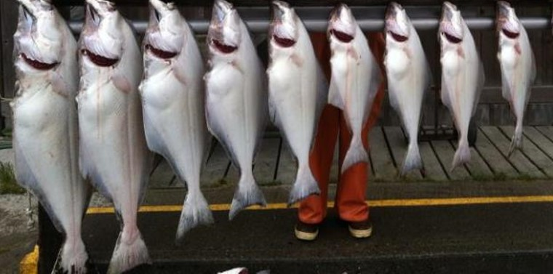
Fishery Review Through 2023

Slide 3
Preliminary Charter Estimates for 2023
Area | Mean Weight (lb) | Harvest (no. fish) | Yield (lb) | Release Mortality (lb) | Total Removals (lb) | Allocation (lb) | Overage (lb) | Overage %
2C | 9.41 | 83,605 | 786,438 | 26,338 | 812,776 | 800,000 | 12,776 | 1.6%
3A | 10.09 | 153,337 | 1,546,445 | 9,219 | 1,555,664 | 1,890,000 | -334,336 | -17.7%
2023 Regulations
2C –
One fish bag limit
Reverse slot size limit of less than or equal to 40 inches or greater than or equal to 80 inches
Closed on Mondays starting July 24th
3A –
Two fish bag limit: one fish of any size, one fish less than or equal to 28 inches
One trip per vessel per day and per charter halibut permit per day
Wednesdays closed to retention of halibut
Nine Tuesdays closed to retention of halibut

Slide 4
2C Charter Halibut Removals
Removals (Mlb) after CSP implementation

Slide 5
2C Effort

Slide 6
3A Charter Halibut Removals

Slide 7
3A Effort

Slide 8
Businesses and Vessels Harvesting Halibut
2C
3A
 | Businesses | Vessels
2014 | 246 | 520
2015 | 241 | 515
2016 | 248 | 532
2017 | 248 | 537
2018 | 244 | 534
2019 | 256 | 545
2020 | 192 | 386
2021 | 232 | 496
2022 | 235 | 523
2023 | 238 | 535
 | Businesses | Vessels
2014 | 259 | 399
2015 | 250 | 407
2016 | 240 | 388
2017 | 227 | 374
2018 | 232 | 391
2019 | 226 | 399
2020 | 203 | 343
2021 | 231 | 392
2022 | 220 | 387
2023 | 215 | 383

Slide 9
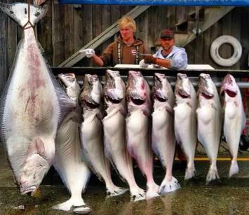
Analysis of Management Measures for 2024

Slide 10
Charter allocation for 2024
Allocations are currently unknown
The IPHC’s interim agreement has expired limiting information on potential Regulatory Area TCEYs and allocations for 2024
We have used the 2023 allocations as a reference for this analysis
 | 2023 Allocation
2C | 0.80 Mlb
3A | 1.89 Mlb

Slide 11
2C – Status Quo Forecast
Table 2C.3
83,487 halibut
  95% confidence interval 81,038 – 85,936 halibut
Used preliminary 2023 effort as 2024 forecast
  2C regulations in 2023 specifically targeted effort by closing days
HPUE used data from 2009 – 2019 and 2022-2023
    Substantial HPUE increases in 2020 and 2021, likely related to changes in size limits
  Figure 2 in the analysis document

Slide 12
2C – Status Quo Forecast
Status Quo Regulations:
One fish bag limit
Reverse slot limit of less than or equal to 40 or greater than or equal to 80 inches
Mondays closed starting July 24th
Projected average weight: 9.94 lbs
Release mortality: 35,481 lbs
Table 2C.3
Status Quo Regulations Removals Projection | 0.865 Mlb

Slide 13
2C – management measures for 2024
Reverse Slot ranging from 32 – 50 inches on the low end and 50 – 80 inches on the upper end
Reverse Slot with day closures with savings in removals displayed for each day of closure
  Analyzed for each day from May 15 – September 15 or for the entire season
  Analyzed for lower slot limits ranging from 32 inches to 50 inches, and an upper slot limit of 80 inches
Differential Reverse Slot displayed in removals
  Analyzed for lower slot limits ranging from 40-45 inches at the beginning of the season, changing to a range of 35-40 inches for the end of the season, and an upper slot limit of 80 inches throughout
  Analyzed to change lower slot limits on July 1, July 15, and August 1

Slide 14

2C – Reverse Slot Limit
Table 2C.5
Lower limits of 32 – 50 inches, upper limits
of 50 – 80 inches
Removal estimates range from 0.664 Mlb to 1.868 Mlb
Lower Slot Limit | Forecast of Removals Going to Discard Mortality (Mlb)
32 | 0.027
33 | 0.029
34 | 0.030
35 | 0.031
36 | 0.033
37 | 0.035
38 | 0.036
39 | 0.038
40 | 0.039
41 | 0.040
42 | 0.041
43 | 0.042
44 | 0.044
45 | 0.045
46 | 0.046
47 | 0.048
48 | 0.049
49 | 0.050
50 | 0.052
Options Below 2023 Allocation (0.80 Mlb)?
Yes

Slide 15
2C – Reverse Slot limit with DAILY SAVINGS
Table 2C.5 a-g
Same as reverse slot analysis
Removals can be calculated using the standard reverse slot and any combination of day closures, permitting size limits are consistent (Table 7a-g)
Lower limits of reverse slot 32 – 50 inches, upper limit of 80 inches
Evaluated each day of the week
Options Below 2023 Allocation (0.80 Mlb)?
Yes

Slide 16
2C – differential slot limit
Tables 2C.6
Lower limits of reverse slot 40-45 inches to 35 – 40 inches after July 1, July 15 and August 1
Removal estimates range from 0.820 Mlb to 1.043 Mlb
Options Below 2023 Allocation (0.80 Mlb)?
No
However – differential slot limit results can be used in combination with the day closure results

Slide 17
2C – Summary
Management Measures | Options Below 2023 Allocation (0.80 Mlb)?
Status Quo (reverse slot with lower limit of 40 inches and upper limit of 80 inches) | No
Reverse slot limit with U32-U50 on the low end and O50-O80 on the high end. | Yes
Reverse slot limit with U32-U50 on the low end and O80 on the high end, analyzed with a day of the week closures presented in savings per day | Yes
Reverse slot limit with U40-U45 change to U35-U40 after July 1, July 15, or August 1 | No

Slide 18
2C – Implementation Considerations and summary
At this stage, it appears that 2C will likely need to adopt more restrictive management measures to remain within allocation (if the allocation ends up being similar to last year)
There are options within likely range of allocations for 2024
Day of the week closures
Reverse slot limit

Slide 19
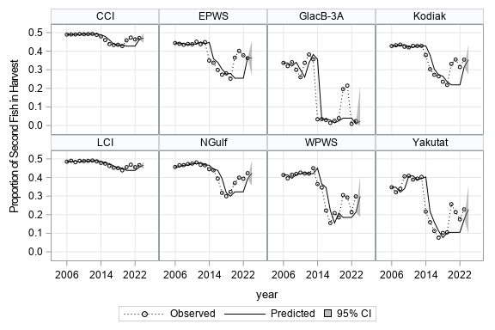
3A – Status Quo Forecast
158,160 halibut
  95% confidence interval 153,378 – 162,942 halibut
  2023 effort was used as forecast
  HPUE forecast used data through 2019 and 2022-2023
  Figure 3 in the analysis document for Effort and HPUE
  Figure 4 is proportion of second fish in the harvest

Slide 20
3A – Status Quo Forecast
Status Quo Regulations:
Two fish bag limit: one any size, one less than or equal to 28 inches
One trip per vessel per day and per charter halibut permit per day
Wednesdays closed to retention of halibut
Nine Tuesdays closed to retention of halibut
Status Quo Regulations Removals Projection | 1.695 Mlb

Slide 21
3A – management measures for 2024
Day of the week closures on Tuesdays from June 1 – August 31 or for the entire season
Maximum size limits of 26 – 32 inches on one fish
Annual limits of 2 – 4 fish
Any combination of the above management measures

Slide 22
3A – Changes to Maximum Size Limit combine with Tuesday Closures
Table 3A.11
Assumes all other status quo management measure (including closed Wednesdays)
Projected for 26-to-32-inch size limits on one fish
Projected under various numbers of closed Tuesdays throughout year
  Specific dates in Table 3A.10
Projected removals assume closing days will have maximum effect, no shifting of effort to other days
Removal estimates range from 1.513 Mlb to 2.045 Mlb
Options Below 2023 Allocation (1.89 Mlb)?
Yes

Slide 23
3A – Maximum Size Limits Combined with Annual Limits
Table 3A.13
Assume all other status quo management measures
Projected for 26-to-32-inch size limits on one fish
Projected for annual limits of two to four fish
Annual limits of two to four fish could reduce harvest projections by 14.9% to 3.3%, respectively (Table 3A.12)
Removal estimates range from 1.366 Mlb to 1.780 Mlb
Would require a recording requirement
Past violations of annual limits have included 0.2 – 1.0% of anglers
Options Below 2023 Allocation (1.89 Mlb)?
Yes

Slide 24
3A – Maximum Size Limits Combined with Annual Limits and Tuesday Closures
Table 3A.14
Assume other status quo management measures
Projected for 26-to-32-inch size limits on one fish
Projected for annual limits of two to four fish
Projected under various numbers of closed Tuesdays throughout year
Projected removals assume opening days will have maximum effect
Removal estimates range from 1.281 Mlb to 1.975 Mlb
Options Below 2023 Allocation (1.89 Mlb)?
Yes

Slide 25
3A – Summary
Management Measures | Options Below 2023 Allocation (1.89 Mlb)?
Status quo (two-fish bag limit with a 28-inch maximum size limit on one fish, one trip per vessel and one trip per CHP per day, Wednesday closures all year, and two Tuesdays closed) | Yes
Day of the week closures on Tuesdays from June 1 – August 31 or for the entire season | Yes
Maximum size limits of 26 – 32 inches on one fish | Yes
Annual limits of 2 – 4 fish | Yes
Combination of the above management measures | Yes

Slide 26
3A – Implementation Considerations and summary
Day of the week closures
Annual limits
Release mortality
Many options within likely range of allocations for 2024

Slide 27
Acknowledgements
Ben Jevons and Kayla Carr – logbook data summaries and review
Diana Tersteeg and Mike Jaenicke – Southeast data
Clay Mckean and Marian Ford – Southcentral data
Countless technicians – halibut measurements and angler interviews
Sarah Marrinan – Council Staff
Sarah Webster – ADF&G Fisheries Scientist
Funding:
State of Alaska General Funds
DJ-WB Federal Aid in Fish Restoration
Fish and Game Fund

