Slide 1
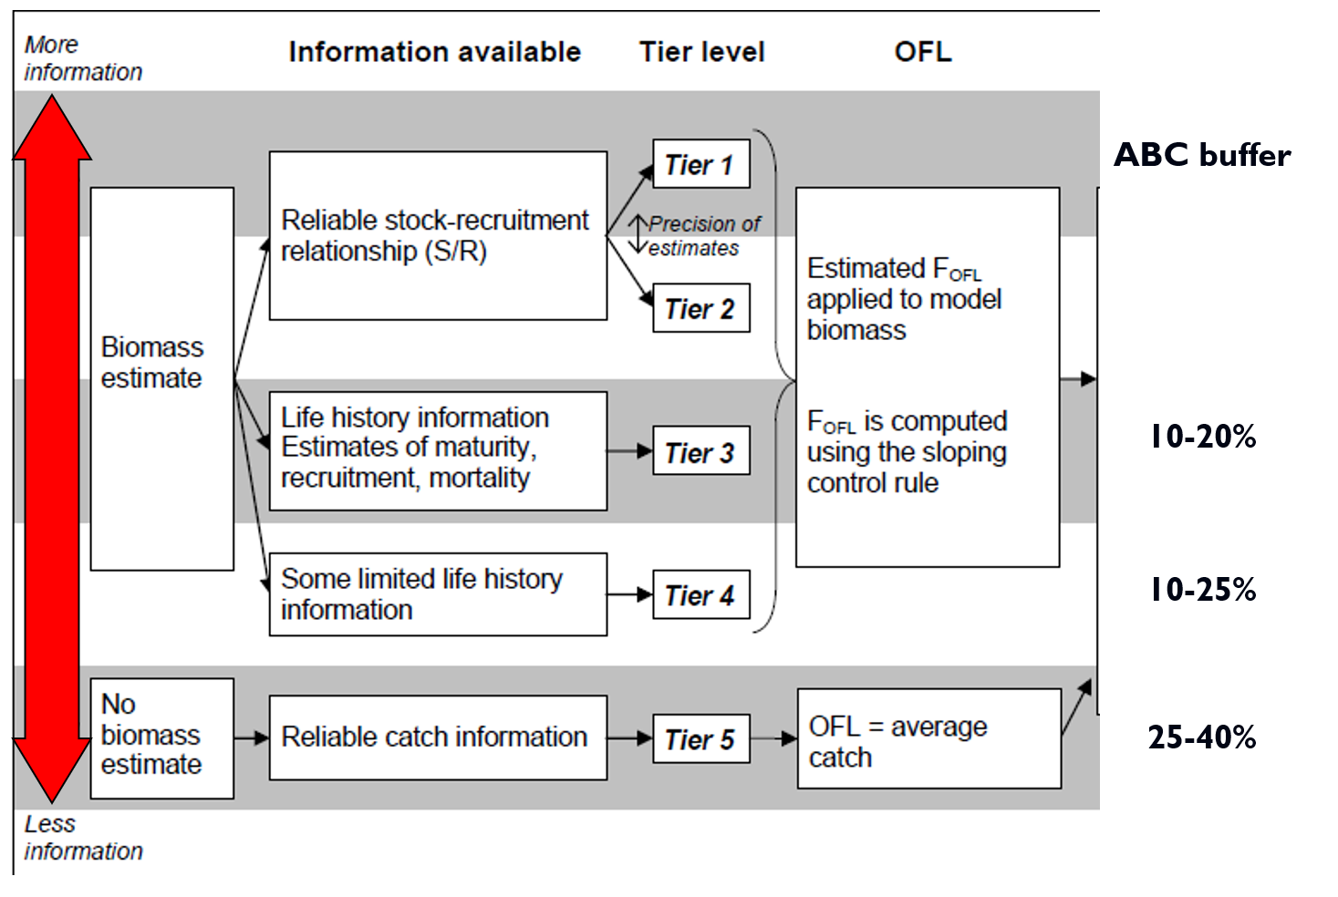
Risk table considerations for crab, May CPT meeting
SSC ranges for crab ABCs

Slide 2
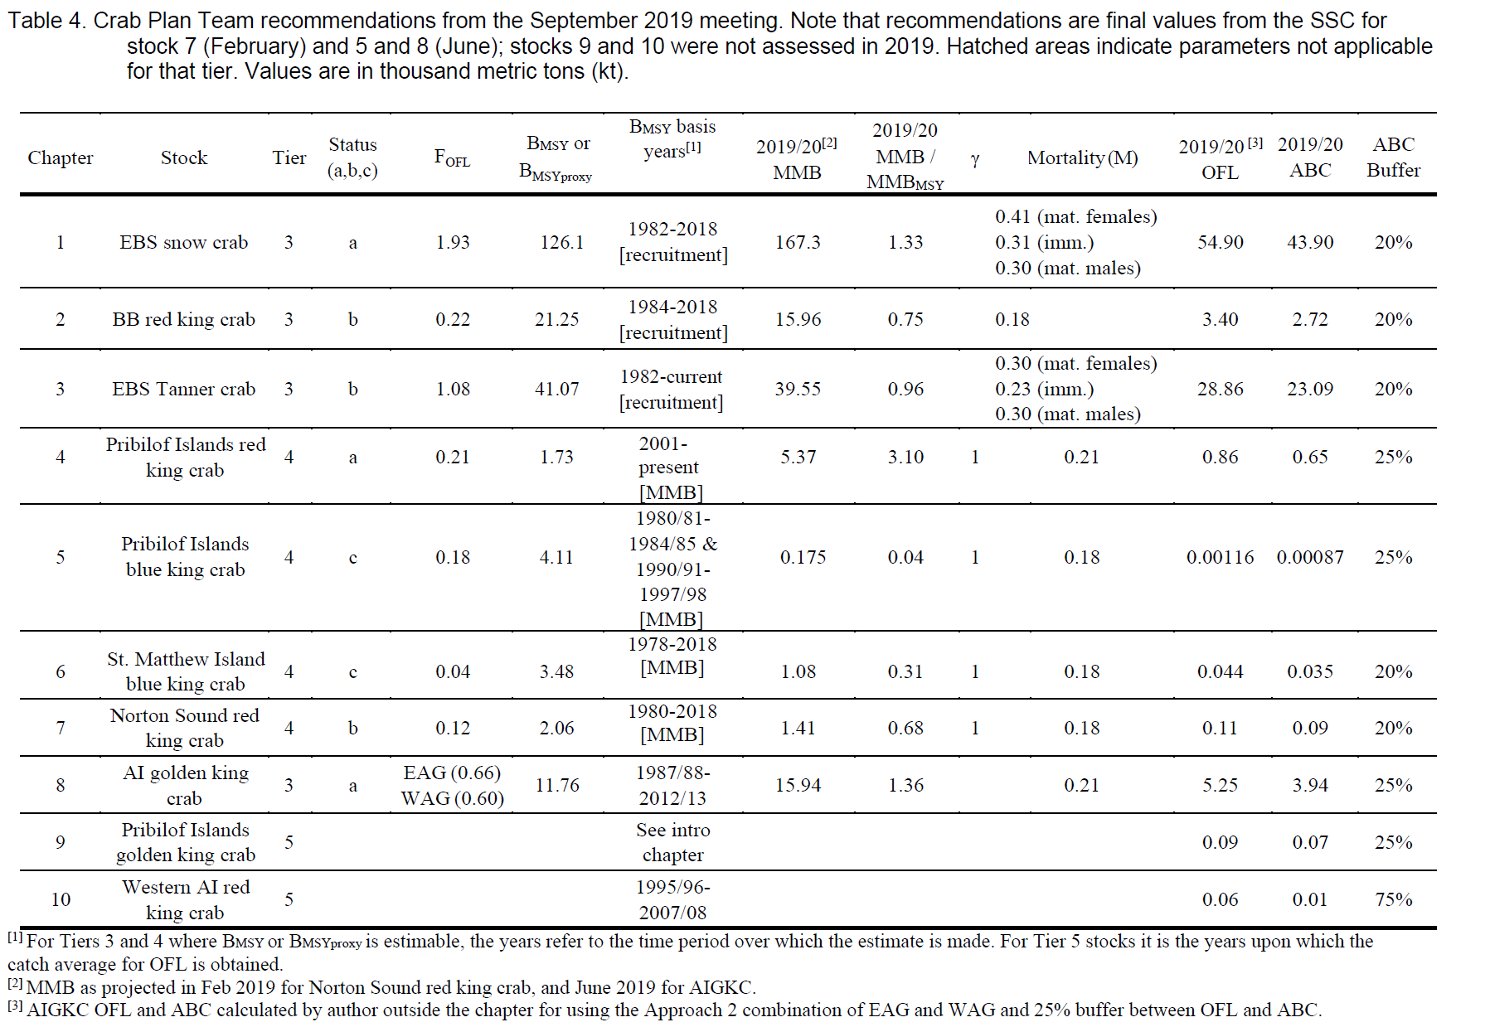

Slide 3
A few observations on crab ABC recommendations
ABC recommendations for crab follow a different framework than for groundfish.
For crab stocks the maximum permissible ABC is specified according to a P* of 0.49, which results in a small buffer between ABC and OFL.
The SSC/CPT has gradually adopted a convention in which the recommended ABC is always lower than the maximum permissible ABC and linked to tier level of the stock.
For each assessment, CPT recommends whether the ABC buffer should be increased or reduced to account for circumstances associated with the assessment.
The SSC then either accepts the CPT recommendation, or makes its own recommendation.

Slide 4
Design criteria for a risk evaluation framework
The framework should document the criteria that are used making reductions in ABC.
ABC reductions should be calibrated, so that a more extreme situation results in a stronger response.
ABC reductions should be consistent, so that similar situations result in a similar response across different stock assessments.
Framework should provide a set of guidelines or defaults (rather than inflexible rules).

Slide 5
Risk Table Criteria
 | Assessment-related considerations | Population dynamics considerations | Environmental/ecosystem considerations | Fishery Performance
Level 1: Normal | Typical to moderately increased uncertainty/minor unresolved issues in assessment. | Stock trends are typical for the stock; recent recruitment is within normal range. | No apparent environmental/ecosystem concerns | No apparent fishery/resource-use performance and/or behavior concerns
Level 2: Substantially increased concerns | Substantially increased assessment uncertainty/ unresolved issues. | Stock trends are unusual; abundance increasing or decreasing faster than has been seen recently, or recruitment pattern is atypical. | Some indicators showing an adverse signals relevant to the stock but the pattern is not consistent across all indicators. | Some indicators showing adverse signals but the pattern is not consistent across all indicators
Level 3: Major Concern | Major problems with the stock assessment; very poor fits to data; high level of uncertainty; strong retrospective bias. | Stock trends are highly unusual; very rapid changes in stock abundance, or highly atypical recruitment patterns. | Multiple indicators showing consistent adverse signals a) across the same trophic level as the stock, and/or b) up or down trophic levels (i.e., predators and prey of the stock) | Multiple indicators showing consistent adverse signals a) across different sectors, and/or b) different gear types
Level 4: Extreme concern | Severe problems with the stock assessment; severe retrospective bias. Assessment considered unreliable. | Stock trends are unprecedented. More rapid changes in stock abundance than have ever been seen previously, or a very long stretch of poor recruitment compared to previous patterns. | Extreme anomalies in multiple ecosystem indicators that are highly likely to impact the stock. Potential for cascading effects on other ecosystem components | Extreme anomalies in multiple performance indicators that are highly likely to impact the stock

Slide 6
The table is applied by evaluating the severity of four types of considerations that could be used to support a scientific recommendation to reduce the ABC from the maximum permissible.
These considerations are
Application guidelines
Stock assessment considerations
Population dynamics considerations
Environmental/ecosystem considerations
Fishery performance

Slide 7
Assessment considerations—
Data-inputs: biased ages, skipped surveys, lack of fishery- independent trend data; model fits: poor fits to fits to fishery or survey data, inability to simultaneously fit multiple data inputs;
Model performance: poor model convergence, multiple minima in the likelihood surface, parameters hitting bounds;
Estimation uncertainty: poorly-estimated but influential year classes; retrospective bias in biomass estimates.
Population dynamics considerations—decreasing biomass trend, poor recent recruitment, inability of the stock to rebuild, abrupt increase or decrease in stock abundance.
Examples of the types of concern

Slide 8
Environmental/ecosystem considerations—adverse trends in environmental/ecosystem indicators, ecosystem model results, decreases in ecosystem productivity, decreases in prey abundance or availability, increases or increases in predator abundance or productivity.
Fishery performance—fishery CPUE is showing a contrasting pattern from the stock biomass trend, unusual spatial pattern of fishing, changes in the percent of TAC taken, changes in the duration of fishery openings.
Examples of the types of concern

Slide 9
Applicability for BSAI crab stocks
The risk table seems feasible to apply to BSAI crab stocks.
Its utility would be to provide support and documentation for the recommendation to increase, reduce, or maintain the ABC buffer.
By forcing reconsideration of buffer rationales in every new assessment, it may help address the concern that ABC buffer only gets larger over time.
As we enter a period of rapid environmental change in Alaska marine waters, extreme conditions and assessment surprises are likely to occur more often.
Adjusting ABC buffers should be regarded as a tool for rapid response, rather than a strategic approach to environmental variation (see ACLIM)

Slide 10
SSC Risk Table Workshop, Feb 5 2021
In February, the SSC established the following timeline and process for finalizing guidance to stock assessment authors.
Date/Meeting | Action | Who
June 2021 | Assemble full workshop report | SSC/Workshop Session lead
June 2021 | Preliminary recommendations | SSC/NPFMC
September 2021 | Comment and recommendations | CPT/GPT
October 2021 | Finalize 2021 recommendations | SSC/NPFMC

Slide 11
Excerpts from SSC preliminary recommendations
The SSC concluded that the risk table framework is working well.
The SSC recognizes that within the context of the risk tables, “risk” is the risk of the ABC exceeding the true (but unknown) OFL.
The SSC recommends that risk tables are produced each year for all groundfish (and perhaps crab) stocks and stock complexes in the fishery.
The SSC recommends that the fishery/community performance column should focus on information that would inform the biological status of the resource.
The SSC encourages the inclusion of LK/TK/S as a source of knowledge about the condition of the stock.
The SSC suggests a potential revision to the category levels: from the existing four to three categories (normal, increased, extreme).

