Slide 1



RQE and elogbooks
2026 end-of-season review
Ben JevonS, kayla buster, & Kristopher Carroll
Division of Sport fish
Guide registration and logbook programs

Slide 2
reminder
eLogbook/RQE issues: Kayla Buster – Research Analyst & Technical Support kayla.buster@alaska.gov; 907-267-2337
Complaints and issues: Ben Jevons – Program Coordinator ben.Jevons@alaska.gov; 907-267-2299

Slide 3
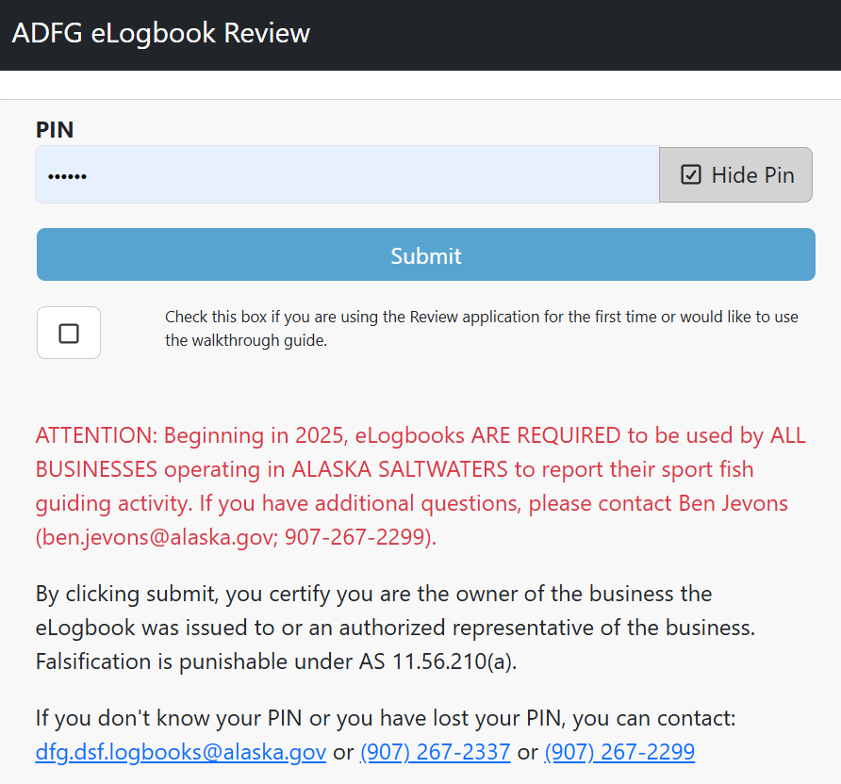
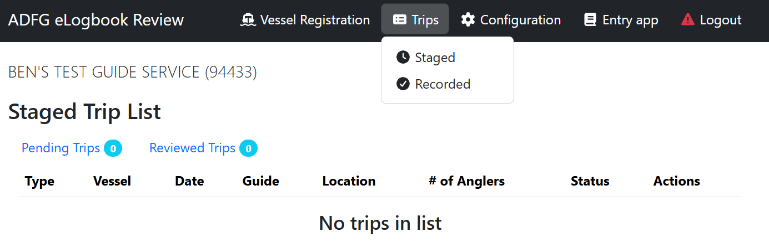
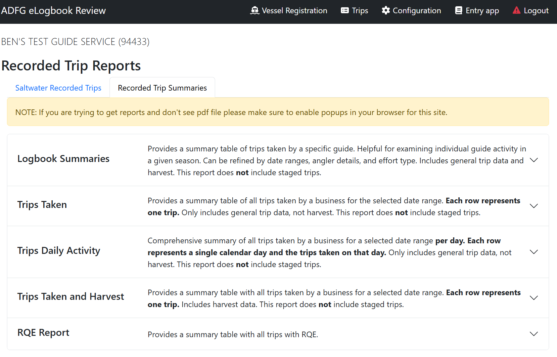
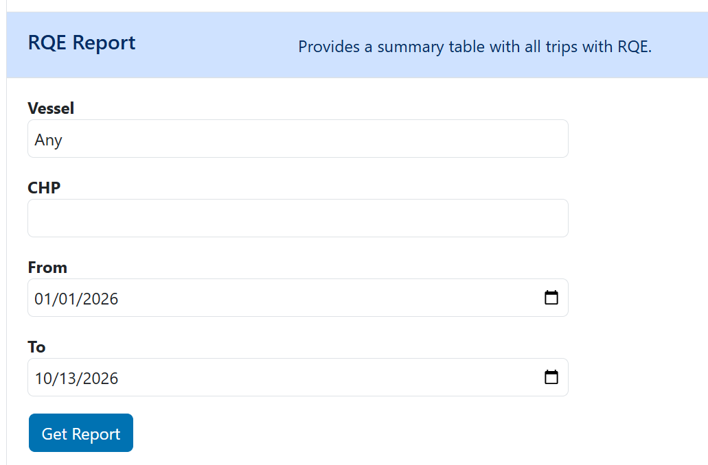
reminder:
stamps can be tracked using elogbooks:
“eLogBook” is composed of two web-based applications
  Review Application: designed for business owners.
  Entry Application: designed for guides. (What you will see)
USE THIS ONE
TO TRACK RQE STAMPS
Stamps can be tracked through the Review Application
Navigate to:
  Sign in with PIN → Trips → Recorded → Recorded Trip Summaries → RQE reports

Slide 4
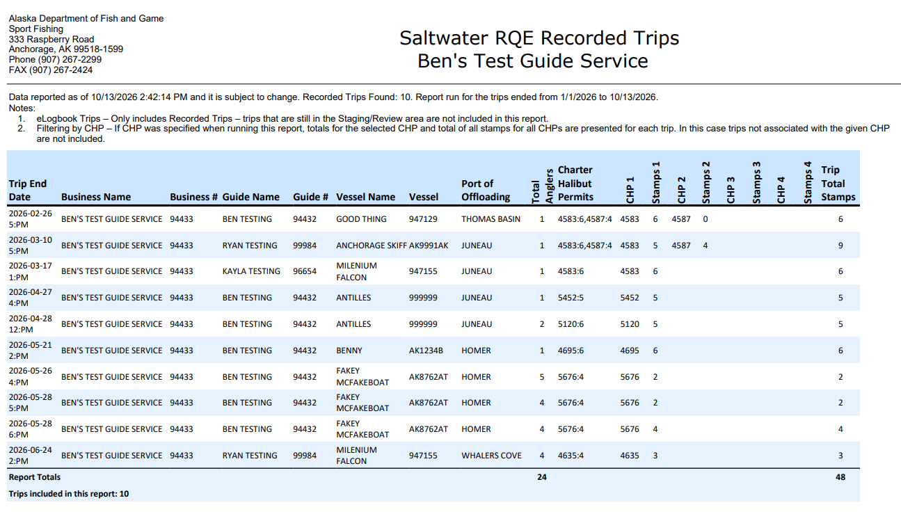
reminder:
stamps can be tracked using elogbooks:

Slide 5
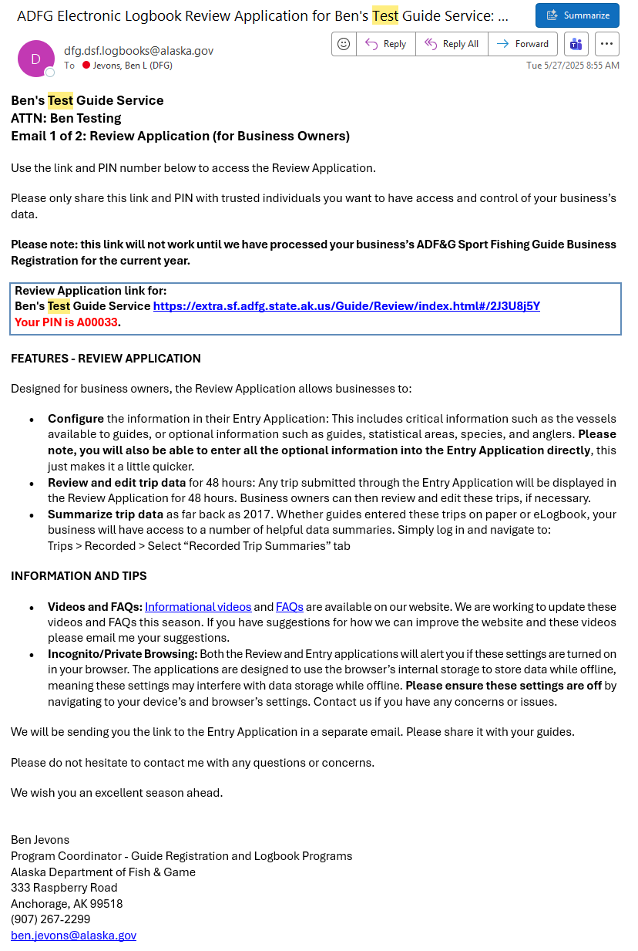
Remember, your review app links are emailed
Secure pin contained in the email if you need us to re-send your email, please reach out

Slide 6
Recreational Quota Entity (rqe)
    TO DATE, eLOGBOOK DATA REFLECTS:
    185,000+ STAMPS
    39,000+ HALIBUT TRIPS
    429 BUSINESSES REPORTING
    TOTAL ESTIMATED REVENUE ~ 3.7 MILLION DOLLARS
IPHC Area | Businesses | Trips (halibut) | Anglers | Stamps | Revenue
3A | 207 | 15,154 | 98,322 | 89,139 | $1,782,780
2C | 222 | 24,278 | 104,041 | 96,231 | $1,924,620

Slide 7
Adf&g’s role:
    ADF&G’s involvement in the RQE implementation centers around three primary tasks:
      Development: construct systems to validate stamp use.
      Outreach: inform and support industry in correct RQE activity.
      Data corrections: resolve issues with stamp validations and provide corrections to eLogbook data.
    Tasks 2 & 3 will continue throughout the lifespan of the program.
    Outreach needs may reduce, but corrections are not anticipated to decline.

Slide 8
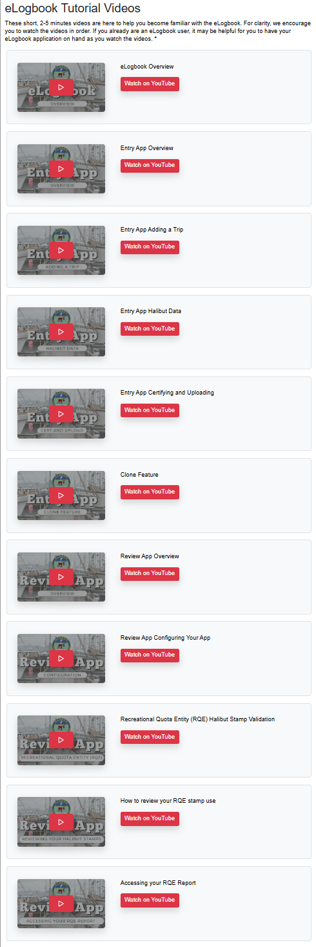
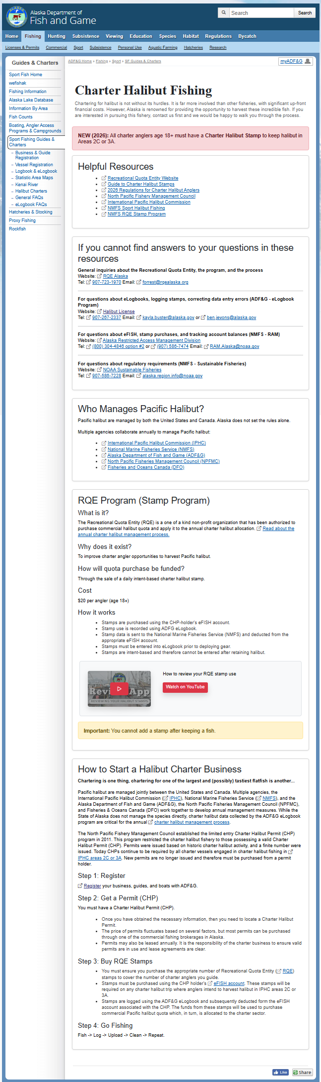
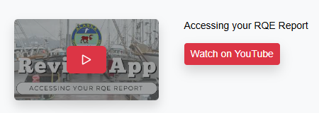
Adf&g outreach:
    Updated tutorial videos
    Pre-season, mid-season, and end-of-season reminder emails.
    Maintained call/email support for questions
    Updated charter halibut page on ADF&G eLogbook site.
    Pre-season webinars (x6)
    Hosted 1:1 trainings for lodges and businesses when requested (~20-25)
    Pre-season enforcement webinar/meeting (x2)
    In-person pre-season meetings:
      Kodiak
      Homer/Seward
      Juneau
    Post season RQE follow-up meeting (x2)
    Post season survey

Slide 9
Adf&g outreach:
    Updated tutorial videos
    Pre-season, mid-season, and end-of-season reminder emails.
    Maintained call/email support for questions
    Updated charter halibut page on ADF&G eLogbook site.
    Pre-season webinars (x6)
    Hosted 1:1 trainings for lodges and businesses when requested (~20-25)
    Pre-season enforcement webinar/meeting (x2)
    In-person pre-season meetings:
      Kodiak
      Homer/Seward
      Juneau
    Post season RQE follow-up meeting (x2)
    Post-season survey

Slide 10
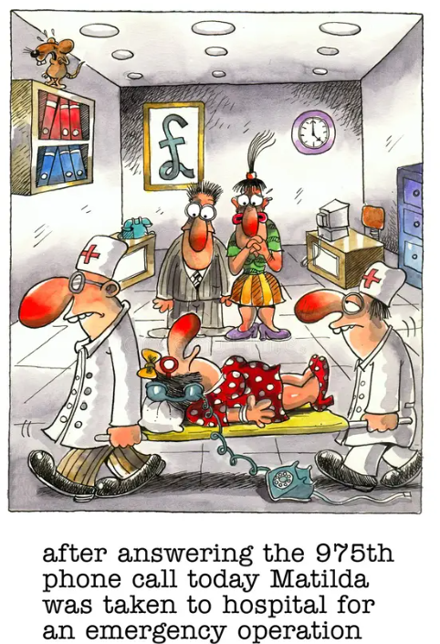
Rqe elogbook corrections:
    Data correction involves both technical support and physical data changes:
    535 trips corrected to date
    Calls? … plenty
    Peak edits in June/July
    Errors did not slow due to understanding RQE. Many businesses had errors all season.

Slide 11
Intent-based:
    How well did businesses adhere to the intent-based design?
    Based on a subset:
      Exclude youth
      Exclude GAF
      Trips where endorsements = total anglers
    95-97% of the trips had endorsements = validations.
    This suggests a high likelihood that for the remainder of trips there is little to no ‘harvest-based’ validation happening.
 | 2C | 3A
Endorsements | 31,206 | 28,022
Validations (stamps) | 29,761 | 27,232
% endorsements validated | 95% | 97%

Slide 12

Intent-based:
    How well did businesses adhere to the intent-based design?
    Based on a subset:
      Exclude youth
      Exclude GAF
      Trips where endorsements = total anglers
    95-97% of the trips had endorsements = validations.
    This suggests a high likelihood that for the remainder of trips there is little to no ‘harvest-based’ validation happening.
 | 2C | 3A
Endorsements | 31,206 | 28,022
Validations (stamps) | 29,761 | 27,232
% endorsements validated | 95% | 97%
GOOD JOB, TEAM!

Slide 13
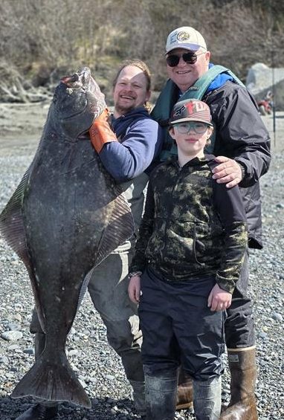
Thank you!
Questions?
Ben Jevons
907-267-2299
Ben.Jevons@alaska.gov
Kayla BUSTER
907-267-2337
Kayla.BUSTER@alaska.gov
ANNELOES TYERS
907-267-2367
Anneloes.tyers@alaska.gov

