Slide 1

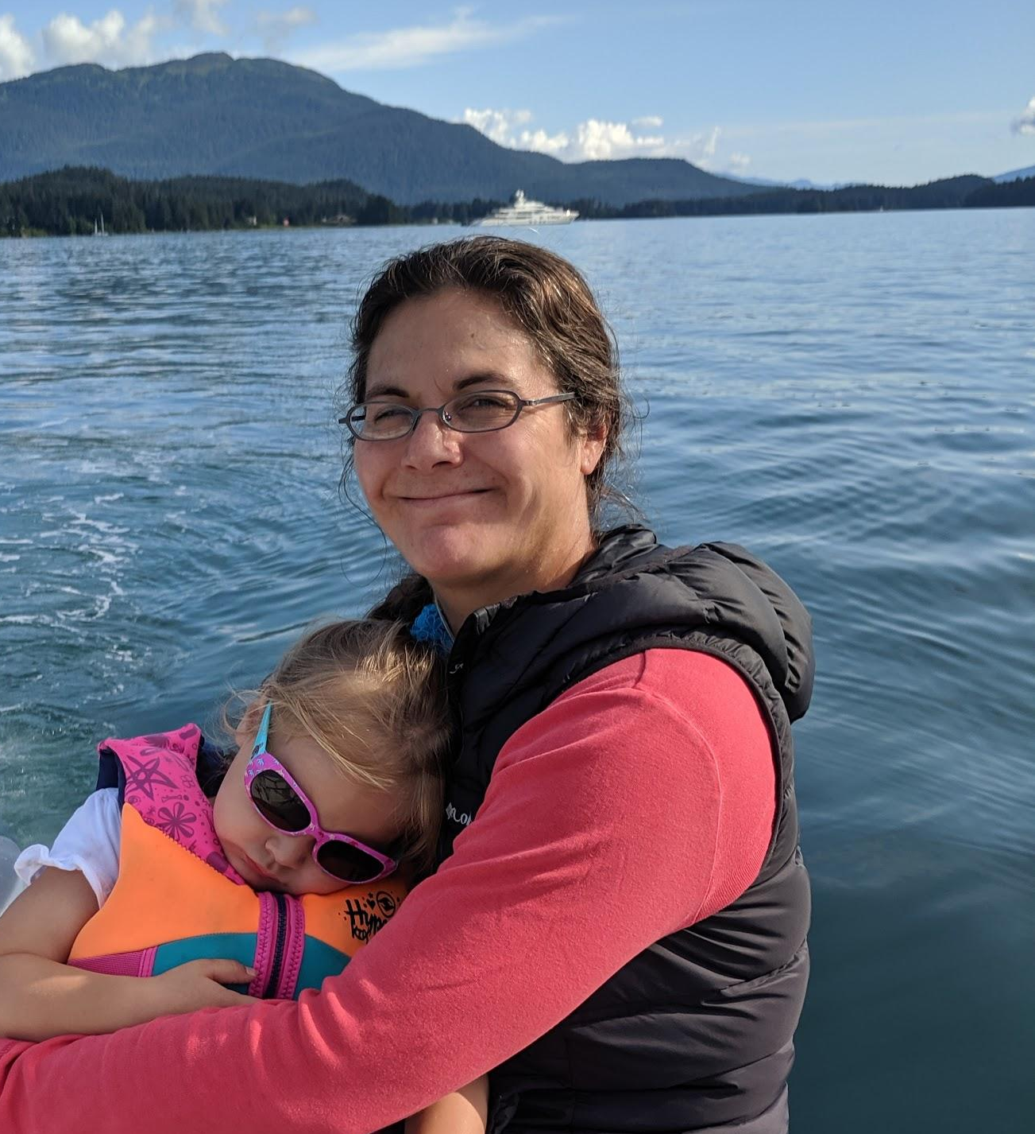

Ecosystem Socioeconomic Profile (ESP)
Sablefish
(Report Card)
Editors: Kalei Shotwell, Dan Goethel, Alison Deary, Katy Echave, Ben Fissel, Dana Hanselman, Chris Lunsford, Kevin Siwicke, Jane Sullivan, Marysia Szymkowiak, Abigail Tyrell, Ben Williams, Stephani Zador
Contributors: Mayumi Arimitsu, Steve Barbeaux, Curry Cunningham, Bridget Ferriss, Jens Nielsen, Clare Ostle, Patrick Ressler, Cara Rodgveller, Elizabeth Siddon, Kally Spalinger, Jordan Watson, Sarah Wise

Slide 2
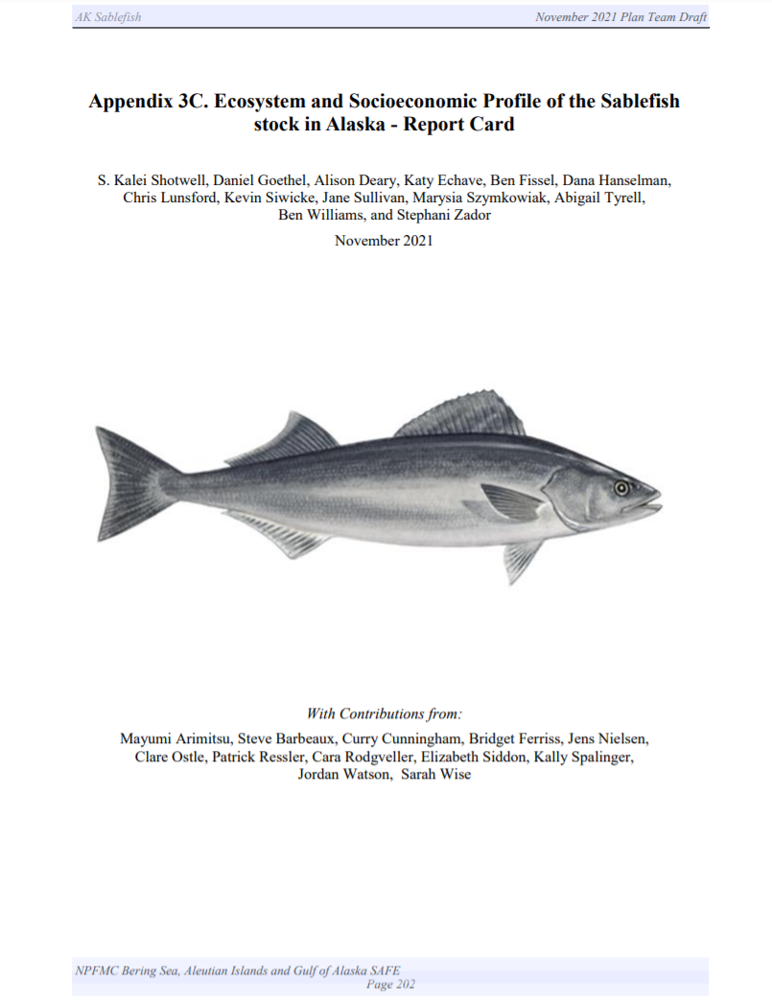
Overview
Appendix in SAFE report
Full ESPs in 2017-2019
Partial ESP in Nov 2020
Report card in Nov 2021
  Simplified template allows for including current year data
  Some indicators missing due to cancellations, data timing
13 editors, 12 contributors
Pp. 202-227

Slide 3
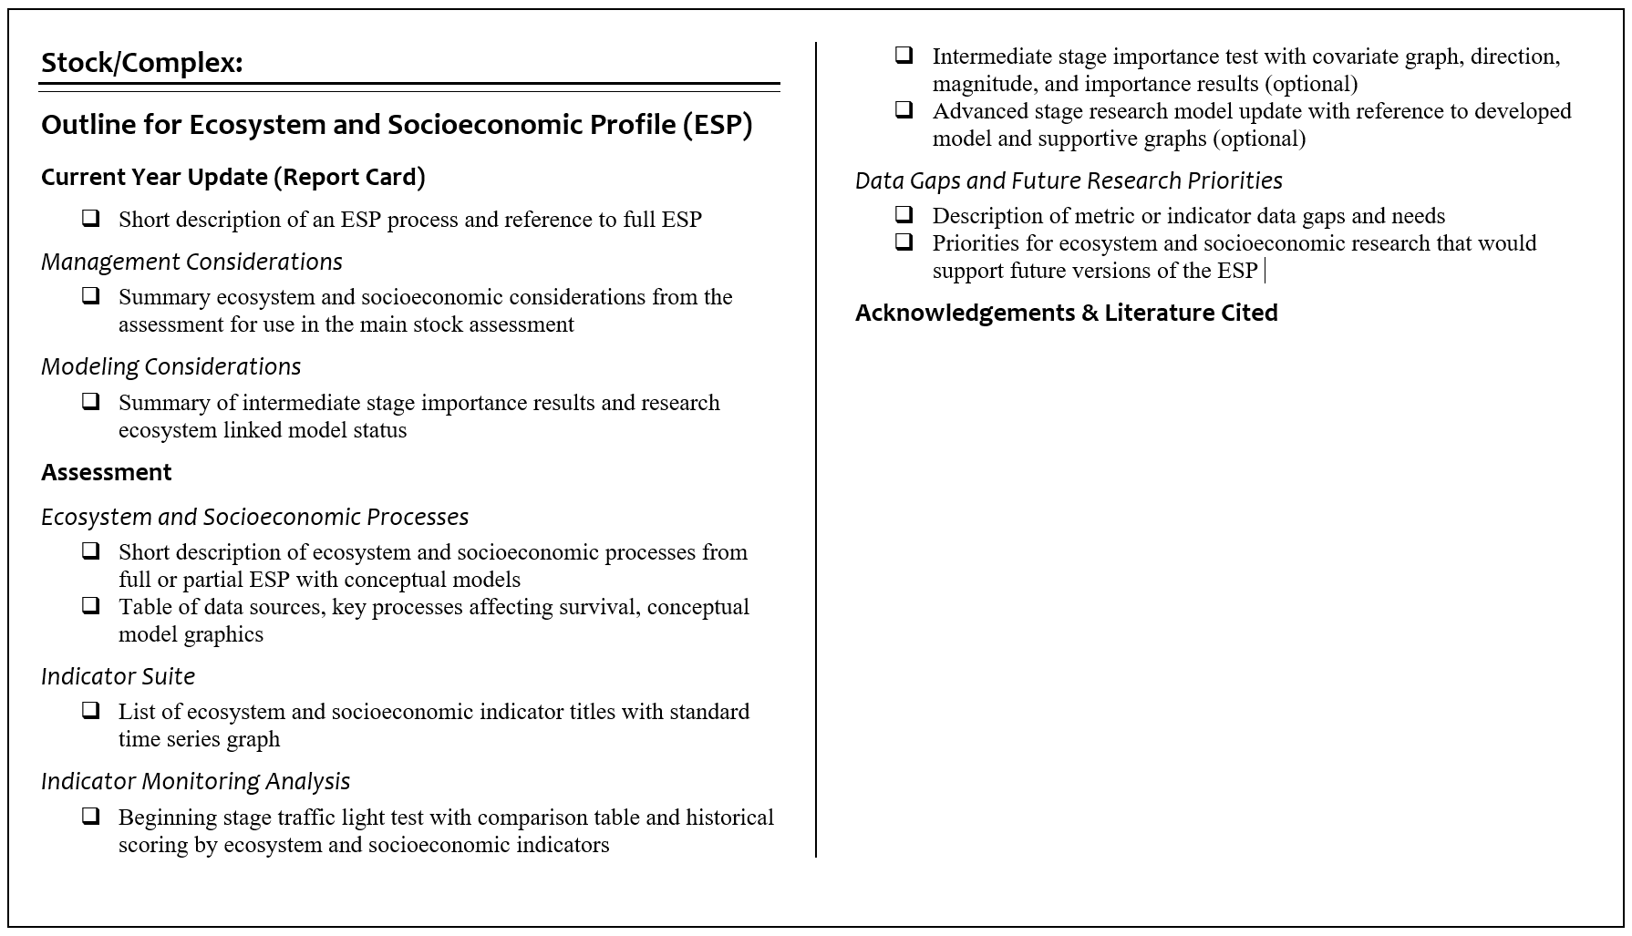
ESP Report Card Template
Notes:
Report card template, will discuss main elements from the Assessment section and then finish with a summary of the management and modeling considerations

Slide 4
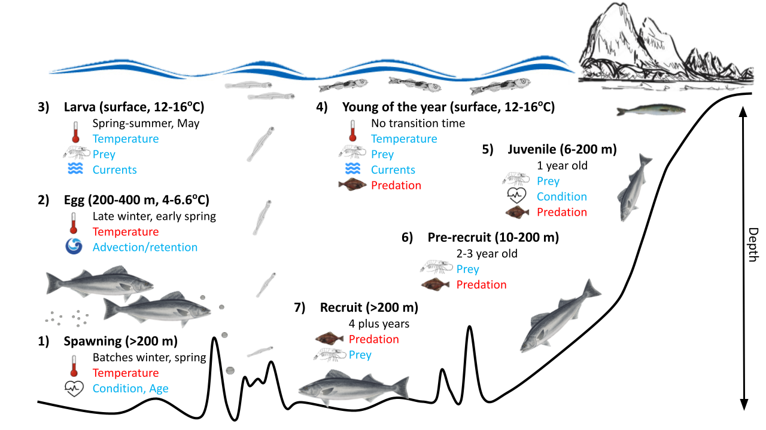
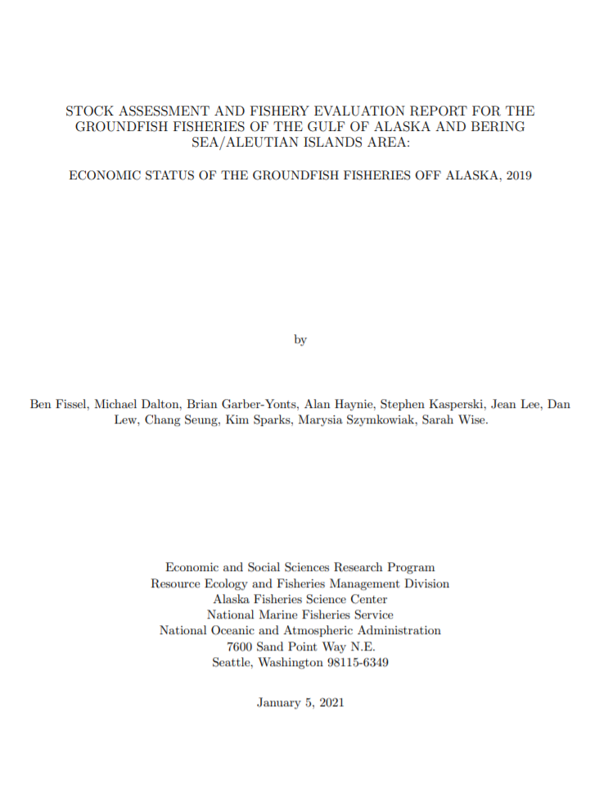
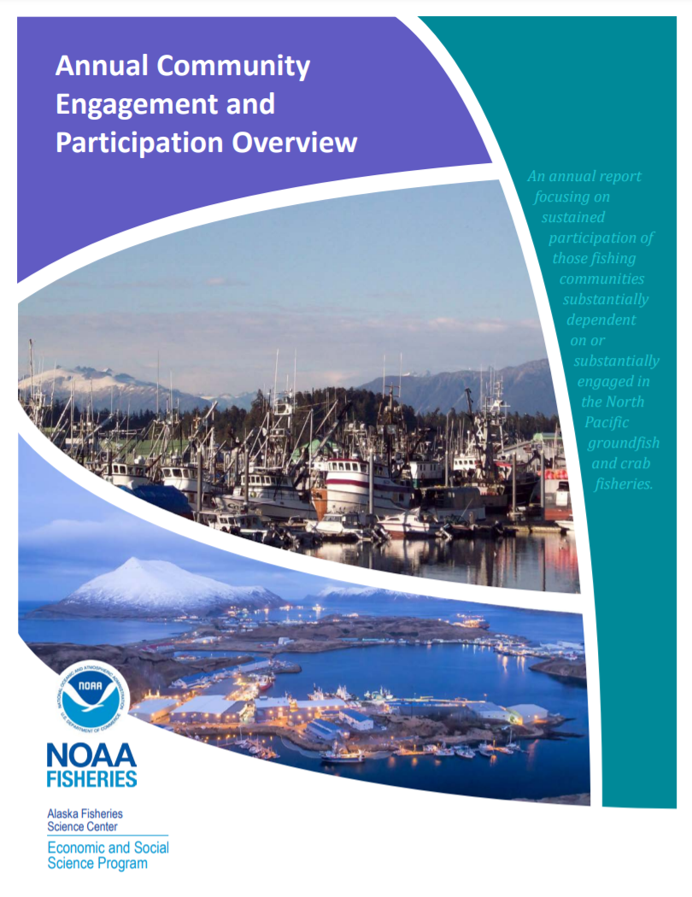
Processes
Ecosystem
  Short summary of life history, similar to ESR risk categories
  Includes conceptual model for reference
Socioeconomic
  Pared down EPR, focus on stock health, fishery behavior
  Reference but not redundant with Econ SAFE or ACEPO

Slide 5
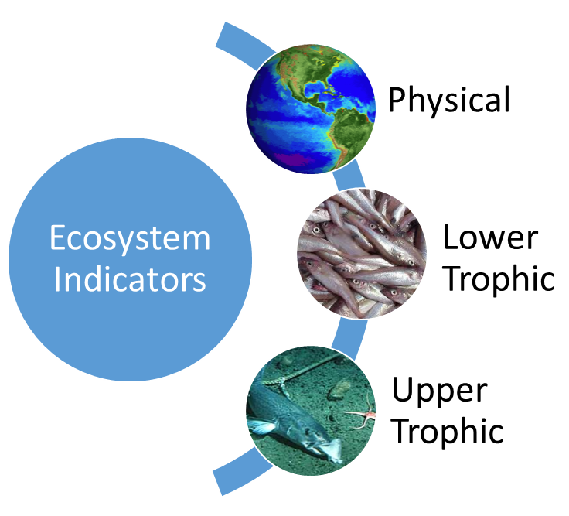
Ecosystem Indicators
+
Annual Marine heatwave index (model)
Bottom temperature (longline survey)
Sea surface temperature (2, satellite)
Chlorophyll a biomass (2, satellite)
Spring bloom peak timing (satellite)
Copepods community (2, CPR)
Euphausiids (acoustic backscatter)
YOY growth (auklet seabird diets)
Juvenile CPUE (ADF&G nearshore)
Juvenile CPUE (bottom trawl survey)
Spawner mean age, evenness (2, model)
Age 4 (juv) condition (longline survey)
Arrowtooth biomass (model)
Incidental catch sablefish (ATF fishery)
Adult condition (longline survey)
-
+
+
-
+
+
+
+
+
+
+
-
-
+

Slide 6
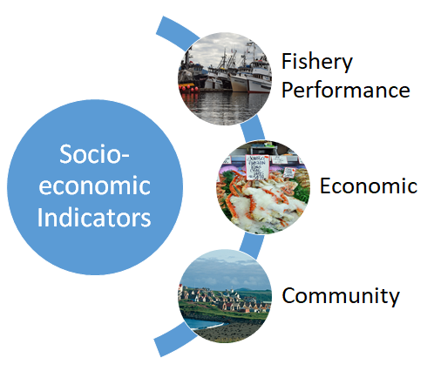
Socioeconomic Indicators
+
CPUE longline fishery GOA
CPUE pot fishery BSAI
Incidental catch (GOA fisheries)
Incidental catch (BSAI fisheries)
Fish condition GOA fishery
Fish condition BSAI fishery
Ex-vessel value
Ex-vessel price per pound
+
-
-
+
+
X

Slide 7
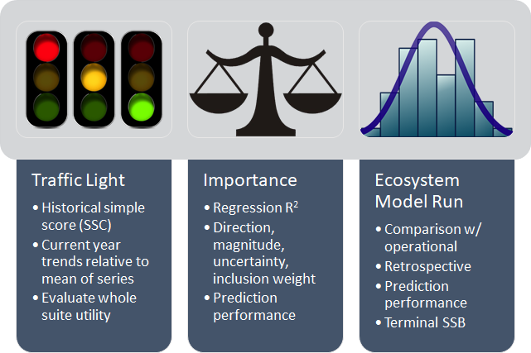
Indicator Monitoring Analysis
Beginning Stage
Intermediate Stage
Advanced Stage

Slide 8
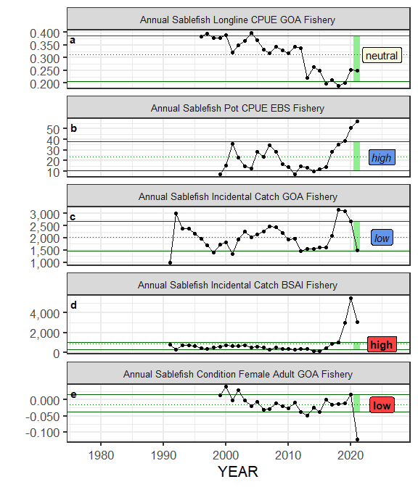
Traffic Light
Time series and Table
  Historical time series of indicators suite (~ starts 1977)
  Evaluate a given year 1 stdev from the long term mean
  High (H), low (L), neutral (N), color is relationship with stock
Summary Score
  Score by category last 20 yrs
  Sum of H, L, N, color is -1,1
Positive relationship
Negative relationship
Notes:
Indicator status is evaluated based on being greater than (“high”), less than (“low”), or within (“neutral”) one standard deviation of the long-term mean. A sign based on the anticipated relationship between the indicator and the stock is assigned to the indicator where possible. If a high value of an indicator generates good conditions for the stock and is also greater than one standard deviation above the mean, then that value is colored blue (italics) and receives a +1 score. If a high value generates poor conditions for the stock and is greater than one standard deviation above the mean, then that value is colored red (bold) and receives a -1 score. All values less than or equal to one standard deviation from the long-term mean are average and receive a 0 score.

Slide 9
Traffic Light Table
Note: new this year for report card
Notes:
The indicator time series graphic only evaluates the most current year for the traffic light, so we also include a table of the last five years that is useful for understanding status and trends.
Here are the ecosystem indicators and note the highlighted areas. The majority of physical and lower trophic level indicators are neutral this year. The CPUE of sablefish in the nearshore large mesh survey by ADF&G remains high, the age 4 condition has improved to neutral in 2020, indicating sufficient prey resources for the 2016 year class, and the incidental catch of sablefish in the arrowtooth fishery has decreased to average over the past two years, suggesting less overlap with a major competitor as the larger year classes of sablefish move off the shelf toward adult slope habitat.

Slide 10
Traffic Light Table
Note: new this year for report card
Notes:
Here is the traffic light table for socioeconomic indicators. Note the increase to average for the longline CPUE in the GOA and the continued high CPUE for the pot fishery in the Bering Sea. Incidental catch of sablefish for all fisheries in the GOA has declined from a high to a low this year, but remains high in the BSAI fisheries. Condition of large female sablefish in the GOA has declined to a low but there were very few samples this year compared to last year (likely due to EM, COVID, prices, etc). The Exvessel value and price of the fishery remains low in 2020 as it was in 2019 likely due to small fish.

Slide 11
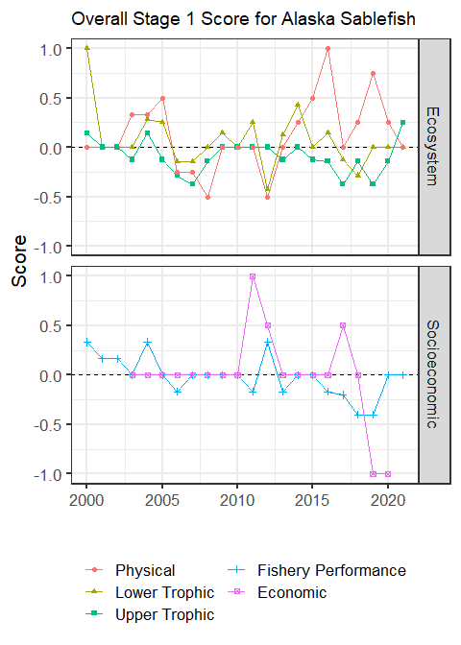
Traffic Light Score
Ecosystem (16 of 22 total)
  Physical < to average
  Lower trophic remains average
  Upper trophic > to above average
Socioeconomic (7 of 8 total)
  Fishery performance > to average
  Economic lagged by one year and remains very low
7 indicators missing
Notes:
Some indicators missing due to lagged or delayed surveys or because they were stock assessment model output and those model were not finalized yet.

Slide 12
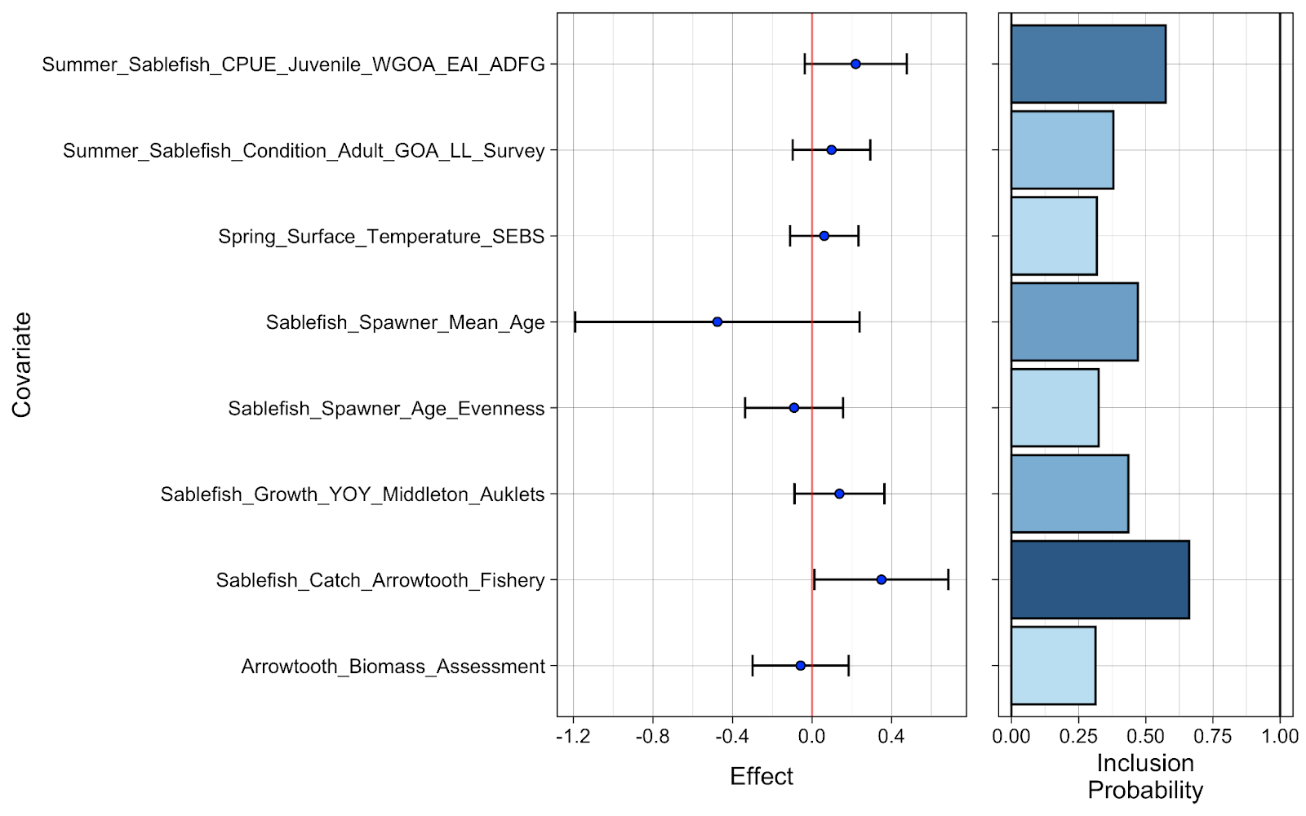
Importance
Notes:
Intermediate stage importance tests continue to show the CPUE of sablefish in the nearshore large mesh survey and the incidental catch of sablefish in the arrowtooth fishery as covariates with high inclusion probability (>0.5 as see in the yellow box) for explaining sablefish recruitment.

Slide 13
Considerations
Management Summary
  Cooling overall in GOA, still warm in EBS, plankton average
  YOY growth average, juveniles high nearshore, avg offshore
  Survey condition avg or below avg, fishery condition poor
  BSAI pot CPUE & incidental catch high, value & price low
Modeling Summary
  2 potential covariates for sablefish recruitment
  Several potential research ecosystem models (life cycle model with IBM, temperature projection model, tag model)
Notes:
Potential covariates: Summer nearshore juvenile CPUE from ADF&G survey, Incidental catch from arrowtooth fishery in GOA
Potential research ecosystem models: Spatially explicit life cycle model linked to individual based model (currently updated for EFH, G. Gibson), Temperature linked projection model (M. Veron), Tag-integrated model for time-varying natural mortality

Slide 14
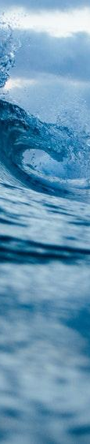
Next Steps
2022 Request for Indicators (RFI)
  Use ESP data gaps and research priorities
  ESP team creates RFI in Jan
  Indicators submitted and reviewed in Feb
  If new indicators, then initiate partial ESP
2022 ESP
  If partial, in Sept and include info on historical use of sablefish in coastal communities (SSC)
  Report card of current data in Nov

Slide 15
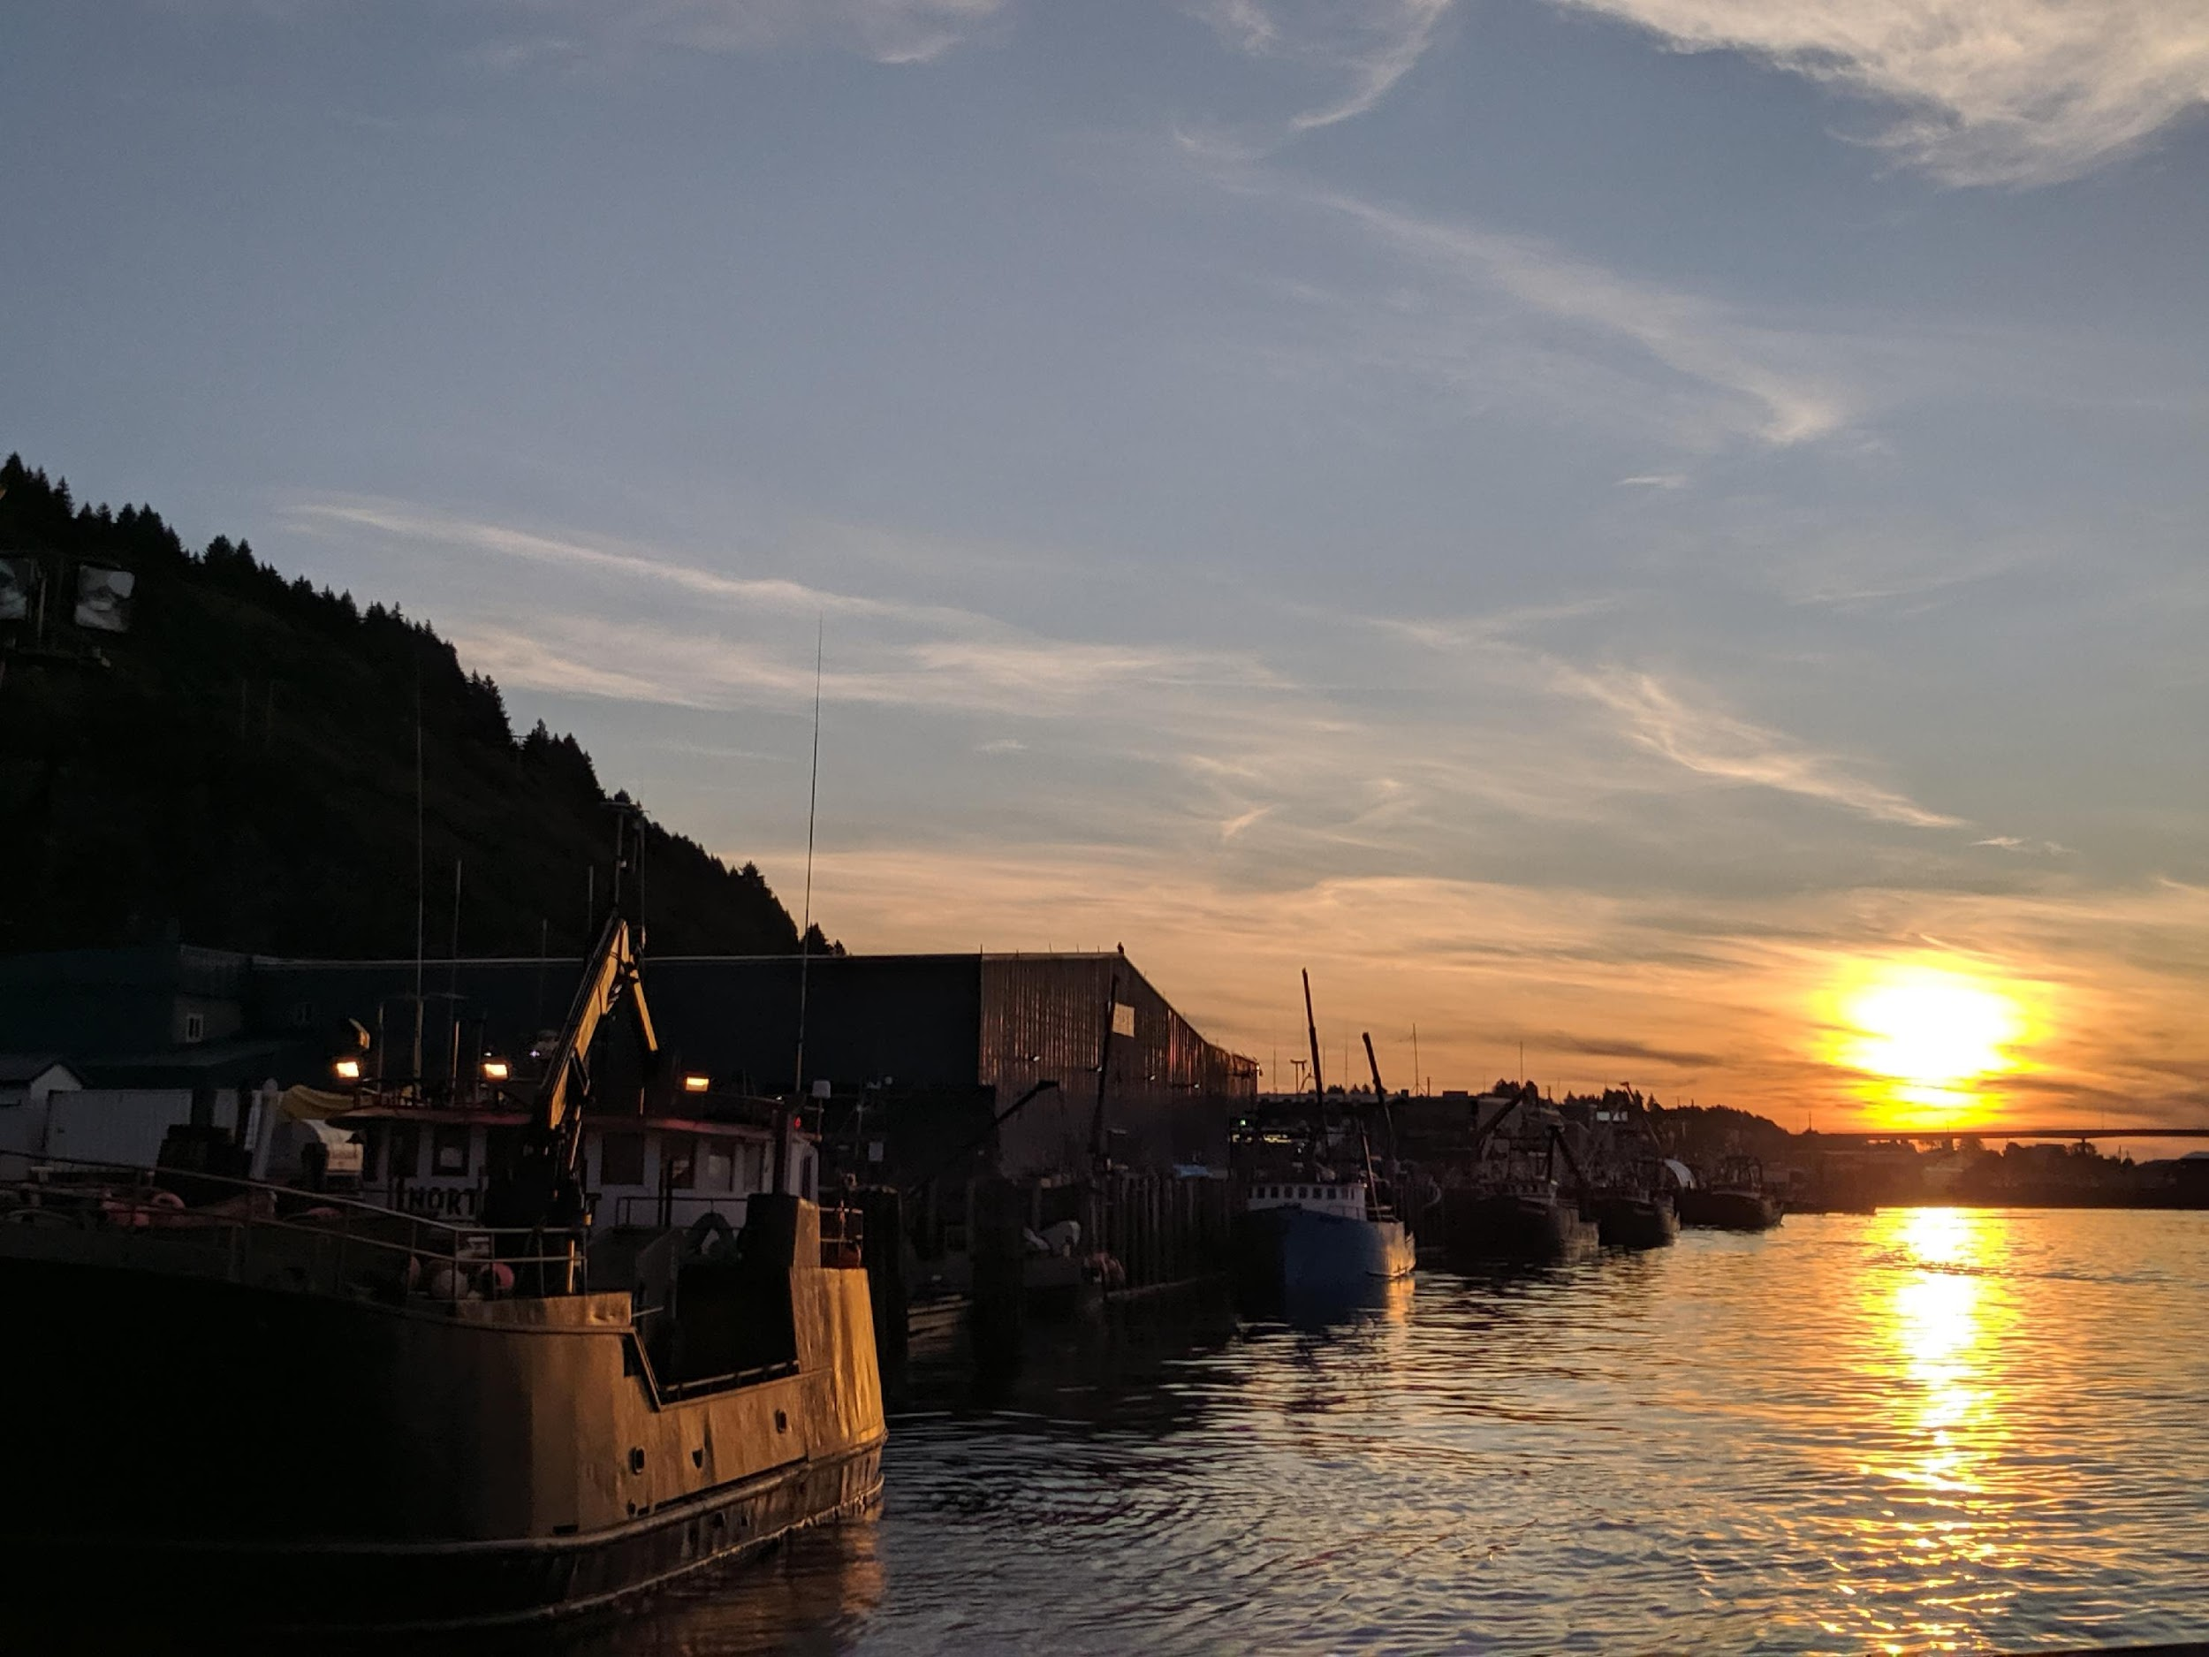
Questions?
Contact:
Kalei Shotwell, NOAA-AFSC
Kalei.Shotwell@noaa.gov

