Slide 1

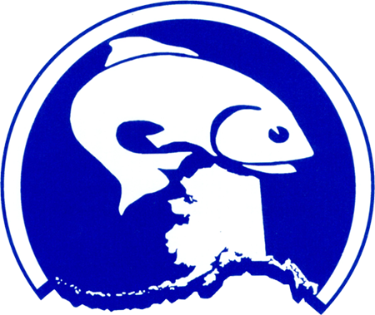
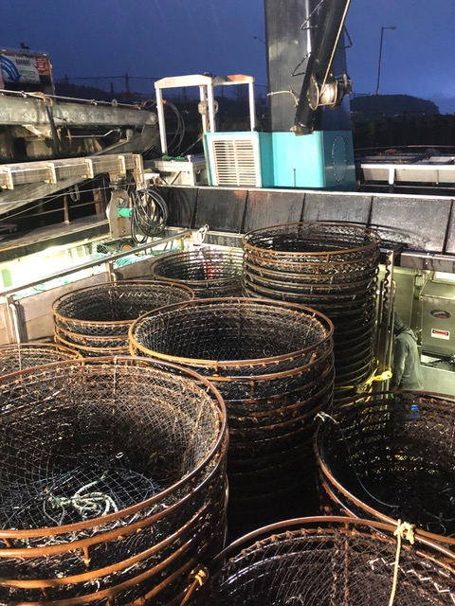


Gulf of Alaska Sablefish Pots Review
Presentation to the IFQ Committee
March 2021
Sam Cunningham & Sara Cleaver, NPFMC

Slide 2

History of Action, p9
GOA Amendment 14 (1985): banned the use of pots for fishing for sablefish
2006 - on : Council receives testimony and written comment concerned with whale depredation in the HAL fishery
April 2015 – Council establishes preferred alternative for GOA sablefish pots
Jan 2017 – GOA Amendment 101 regulations effective

Slide 3
Amendment 101, p10
Allow the use of pot longline gear in the GOA Sablefish IFQ fishery.
Element 1. Pot limits / pot tags
Element 2. Gear retrieval
Element 3. Gear specifications
Element 4. Retention of incidentally caught halibut
Notes:
Element 1. Pot limits
Limit of 120 pots per vessel in WY and SEO.
Limit of 300 pots per vessel in WGOA and CGOA.
Option 1. Require identification tags for each pot.
Pot tags must be attached to the vessel’s pots before leaving port. Pots registered to one vessel must be returned to shore before being registered to another vessel.
Element 2. Gear retrieval
Gear cannot be left for more than 5 days without being moved in CGOA and WY.
Gear cannot be left for more than 7 days without being moved in WGOA.
In SEO, gear cannot be left on the fishing grounds when the vessel to which the pots are registered leaves the grounds to make a delivery.
All sablefish pots set in GOA must be removed prior to the end of the season and cannot be set before the beginning of the season.
Element 3. Gear specifications
Require both ends of the sablefish pot longline set to be marked with a 4-buoy cluster including a hard ball with “PL” (pot longline) marking on one buoy, flagpoles, and radar reflectors, including ADF&G number or Federal fisheries permit number on buoys.
Element 4. Retention of incidentally caught halibut
Require the retention of halibut caught incidentally in sablefish pots, provided the sablefish IFQ holder also holds sufficient halibut IFQ, and provided that the IPHC adopts complementary regulations that would allow NMFS to authorize retention of halibut caught incidentally in the sablefish pot longline fishery under the requirements of regulations implementing this program.
Additionally, all vessels using pot longline gear are required to use logbooks and VMS. Add a data field, or fields, to the Prior Notice of Landing for a pot longline vessel to declare the number of pots fished, lost, and/or still fishing.
IFQ holders fishing sablefish pots are encouraged to work cooperatively to develop electronic reporting protocols for reporting the location of pots being fished and/or pots left on the fishing grounds, as well as any other methods or methodology that may enhance the sablefish pot longline fishery.

Slide 4
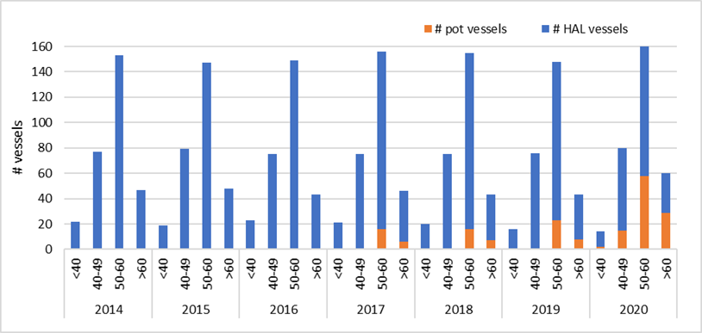
Participation: Vessels, p12
Table 2-1, p12
GOA Sablefish IFQ Vessels by Gear Type
Year | # Pot vessels | # HAL vessels | All vessels that fished GOA sablefish IFQ | Vessels that used both pot and HAL
2014 |  | 299 | 299
2015 |  | 293 | 293
2016 |  | 290 | 290
2017 | 22 | 276 | 283 | 15
2018 | 23 | 270 | 281 | 12
2019 | 32 | 251 | 265 | 18
2020 | 104 | 219 | 254 | 69
Figure 2-1, p14

Slide 5
Participation: Processors and Ports of Landing, p17
Table 2-9, p20

Slide 6
Effort: Trips, p22
Figure 2-2, p22
Mixed-gear trips, table 2-13 p23
Year | One gear type | # Mixed HAL and pot trip | Total trips
2017 | 4131 | 15 | 4146
2018 | 4056 | 8 | 4064
2019 | 4126 | 21 | 4147
2020 | 3641 | 169 | 3810

Slide 7
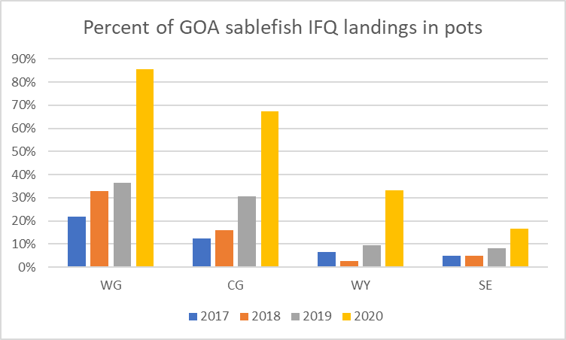
Sablefish Harvest, p23
Figure 3-1, p24
Figure 3-2, p25

Slide 8
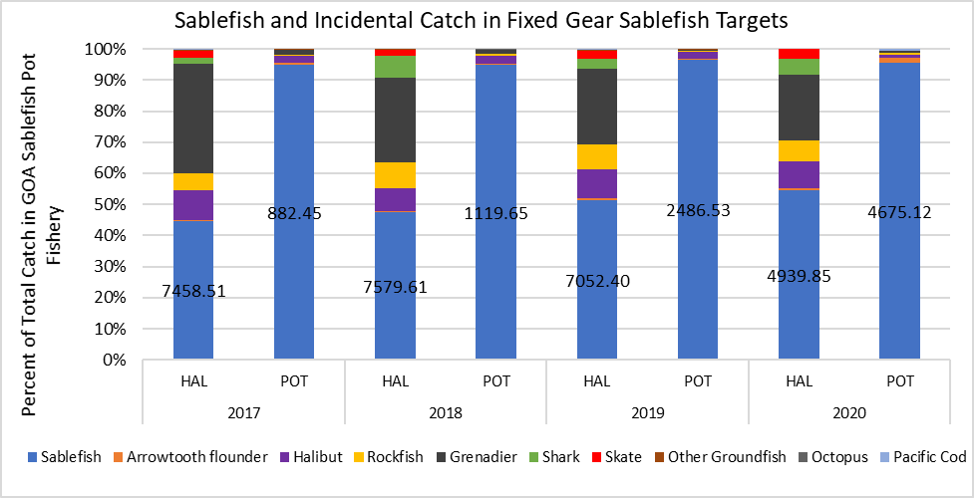
Incidental catch, p29
Figure 4-1, p30

Slide 9
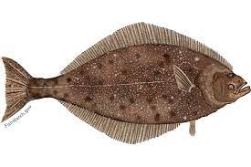
Incidental catch: Pacific halibut, p32
Table 4‑4, p33
Halibut as a percent of total catch in the GOA sablefish IFQ fisheries
 | 2017 |  | 2018 |  | 2019 |  | 2020
 | HAL | POT | HAL | POT | HAL | POT | HAL | POT
weight (mt) | 1575 | 20 | 1182 | 32 | 1285 | 54 | 783 | 51
% of total catch | 9% | 2% | 7% | 3% | 9% | 2% | 9% | 1%
Table 4-5, p33
Year | Discarded (mt) | Retained (mt) | Total (mt) | % Retained
2017 | 4 | 16 | 20 | 82%
2018 | 2 | 30 | 32 | 94%
2019 | 16 | 38 | 54 | 70%
2020 | 22 | 29 | 51 | 57%

Slide 10
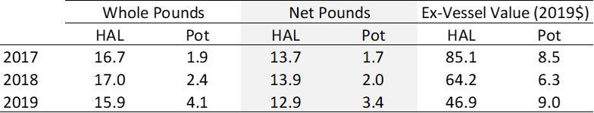
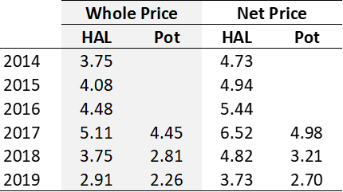
Fishery Revenues, p34
Table 5-2, p35
GOA sablefish IFQ catch volume (million lbs.) and ex-vessel value (million 2019$) by gear type
Table 5-3, p36
GOA sablefish IFQ ex-vessel price per pound (2019$) by gear type, based on whole weight (round weight) and net weight
Notes:
Total ex-vessel revenue and ex-vessel price per pound (2019$) declined over the 2017-2019 period, tracking with a broad trend in the value of the fishery due to fish size and changes in foreign market demand for a variety of reasons. In 2019 and 2020, the pot gear category showed an increase in the proportion of fish landed at larger market sizes (3 lbs. and up) while the size distribution of HAL gear catch remained consistent with previous years. Ex-vessel price per pound data for 2020, which are only preliminary data at present, indicate that pot gear harvest values on a per pound basis are catching up to or surpassing HAL gear harvest at the market category level (Section 5).

Slide 11
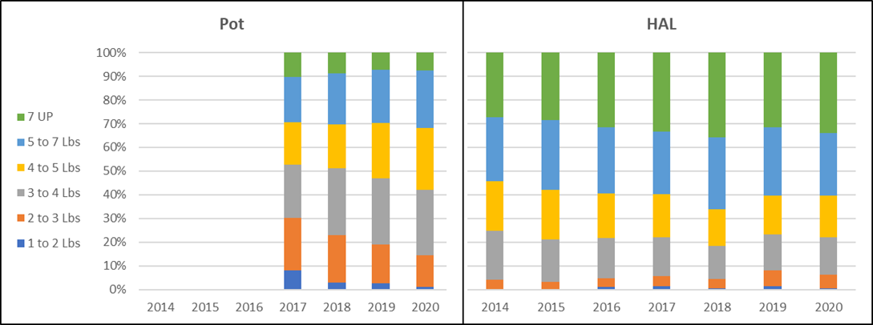
Fishery Revenues, cntd
Figure 5-1, p37
Percent landed weight of GOA fixed-gear sablefish (H&G), by gear type and market category (2014 through 2020)

Slide 12
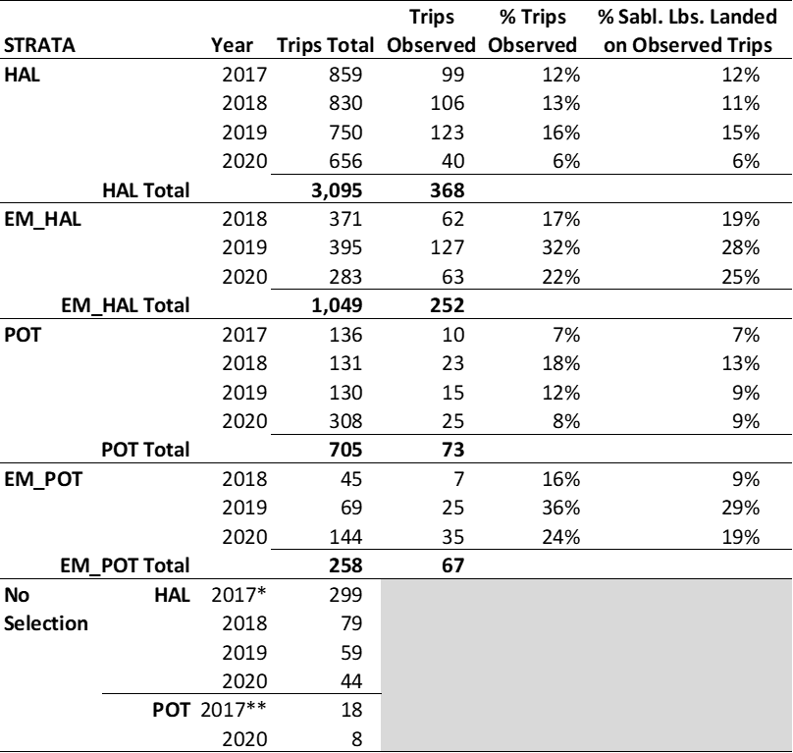
Monitoring, p40
Table 6-2, p44
Impacts of the COVID-19 pandemic on observer deployment in 2020
2017 to 2020 period 88 EM vessels fished with HAL gear (1,049 trips) and 29 EM vessels fished with pot gear (258 trips).
The proportion of trips monitored with EM was 24% for HAL and 26% for pot gear
Pots have introduced new challenges for EM reviewers and a need to have different Vessel Monitoring Program (VMP) designs.
Notes:
impacts from the COVID-19 pandemic significantly reduced the agency’s capacity to deploy observers; emergency waivers were issued for the partial coverage observer program during March-July except for vessels departing from Kodiak.
The recent expansion of pot gear use into new vessel categories is reflected in terms of the observer coverage and electronic monitoring (EM) deployments across the GOA sablefish IFQ fishery. Adoption of pot gear by vessels in the EM pool has required NMFS and participants to coordinate in updating vessel monitoring plans, in some cases requiring the use of an additional camera for a sorting table (Section 6).

Slide 13
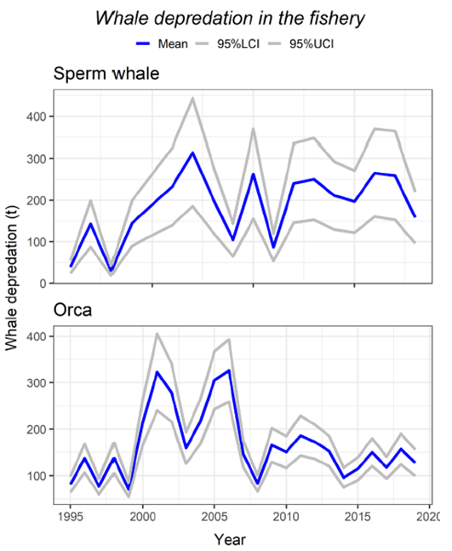
Whale Depredation & Stock Assessment Considerations, p46
Figure 7-1 p48

Slide 14
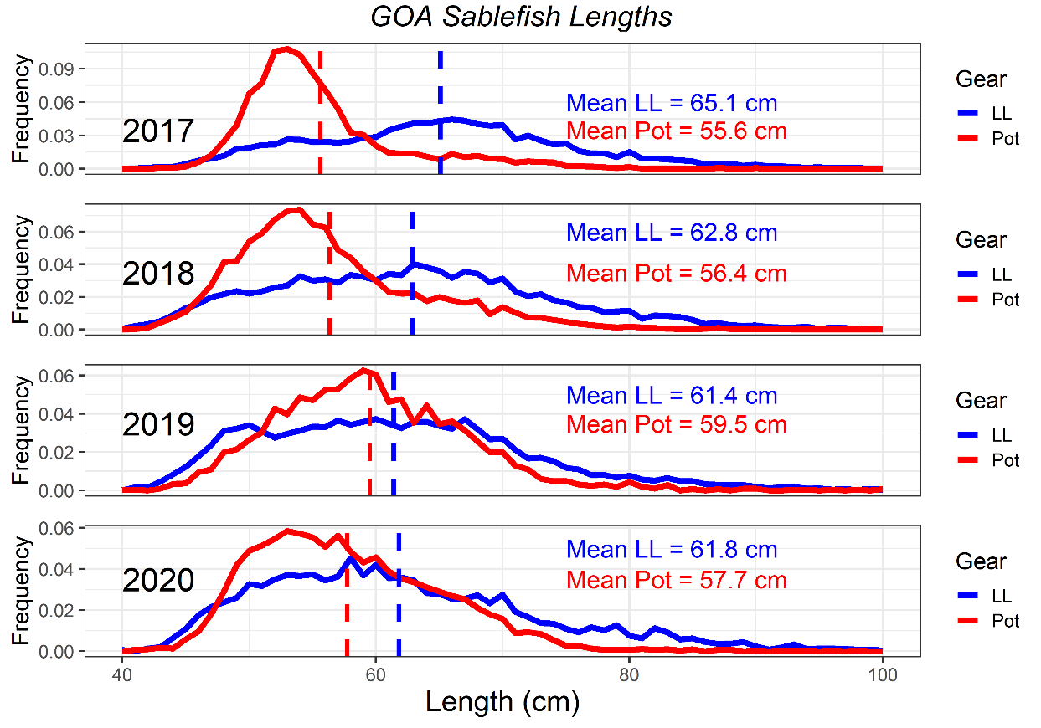
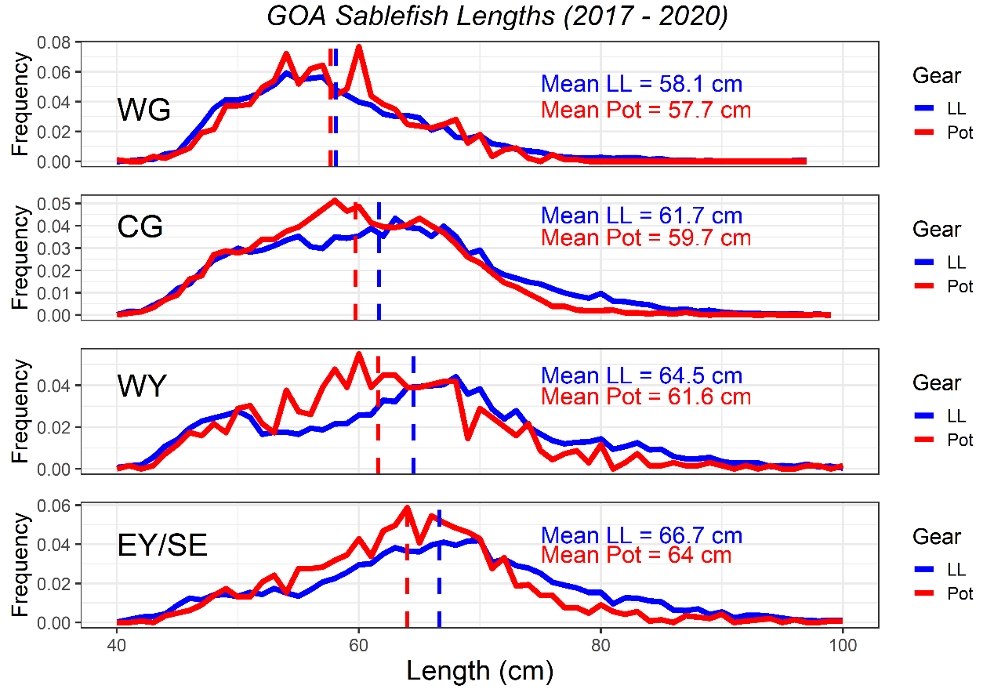
Size selectivity, p50
Figure 7-2
Figure 7-3

Slide 15
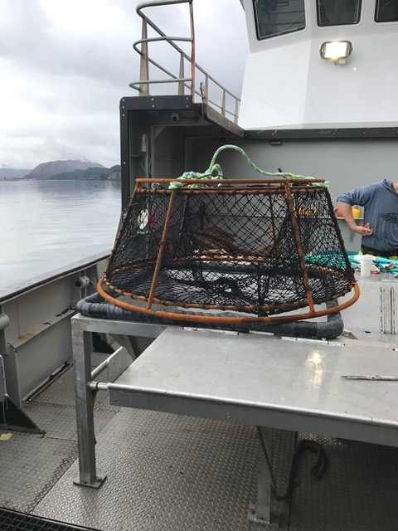
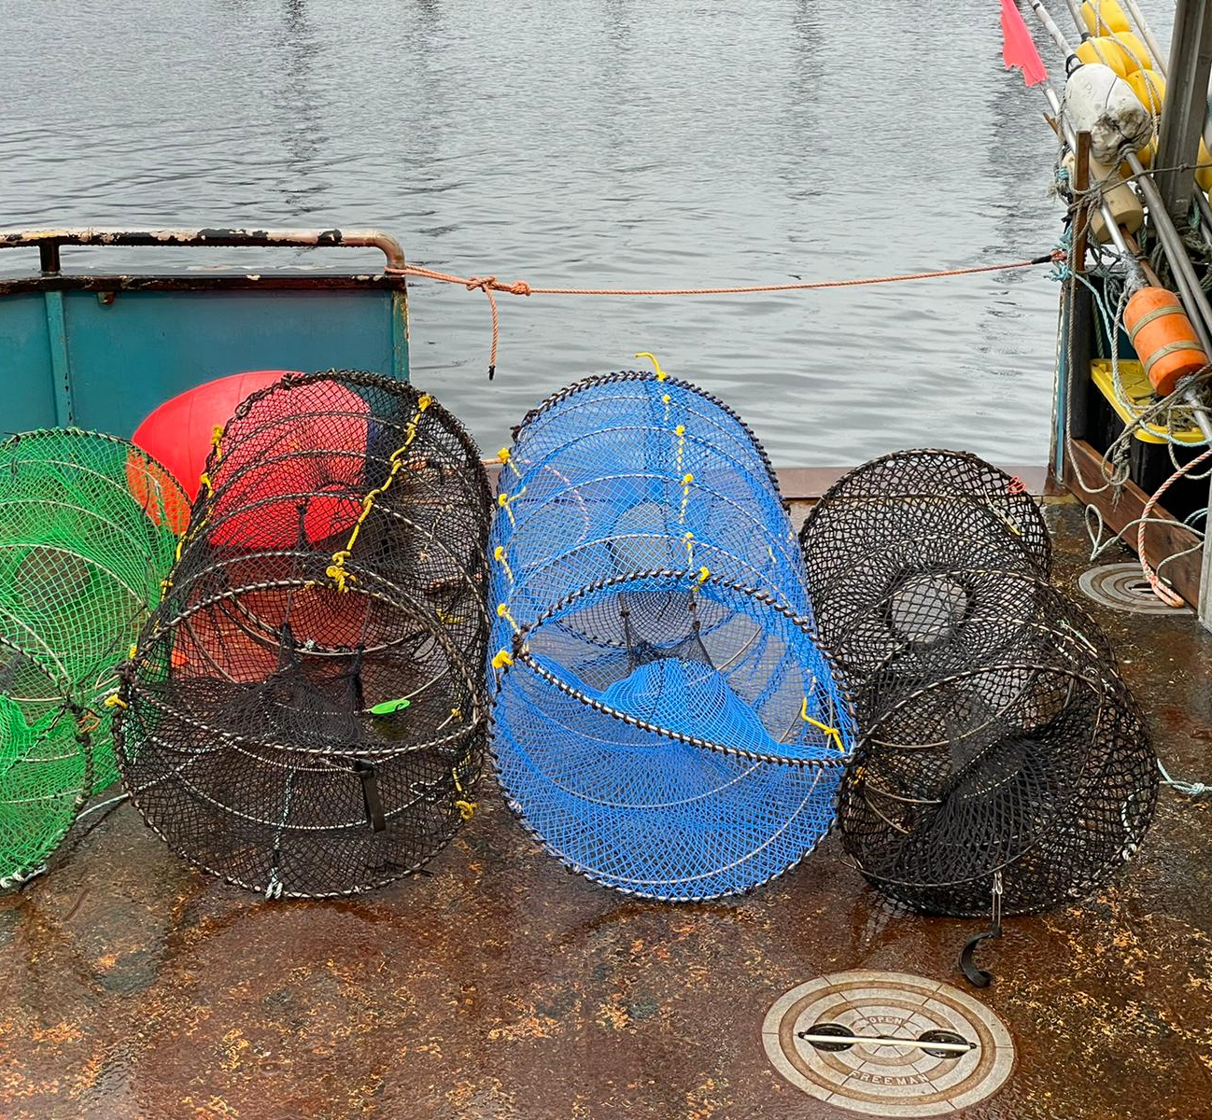
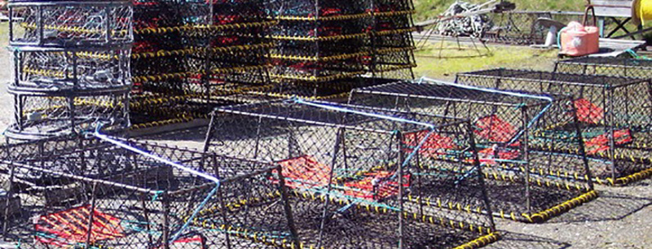
Vessel and gear characteristics, p52
Notes:
https://www.fisheries.noaa.gov/alaska/commercial-fishing/longline-pot-gear-gulf-alaska-ifq-sablefish-fishery-frequently-asked

Slide 16
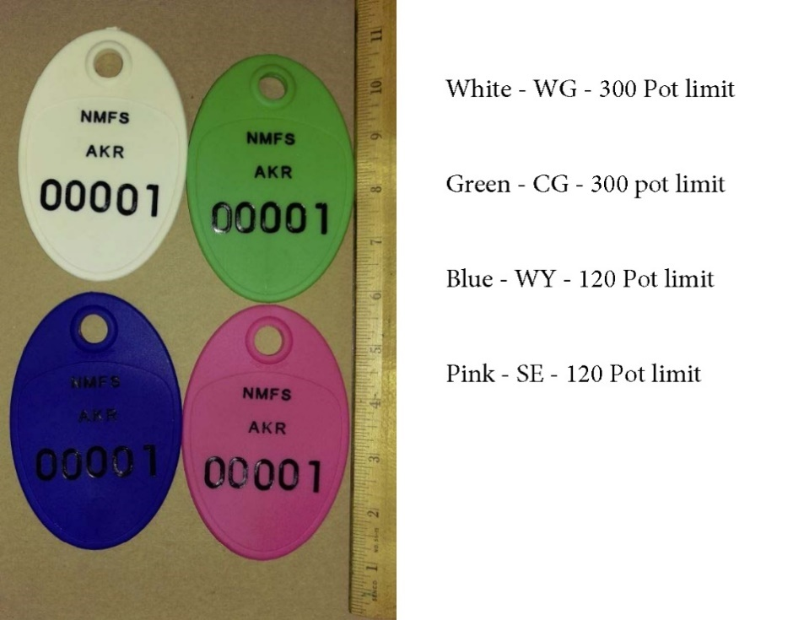
Management: Pot tags, p57
NMFS recommends the Council consider whether pot tags continue to be a necessary provision of this program as they are costly to implement.
According to enforcement and Coast Guard representatives, this gear marking requirement has not been useful for the enforcement of pot limits
NMFS also suggests changes to regulations to combine the IFQ sablefish pot longline gear: vessel registration and request for pot gear tags application form with the IFQ sablefish request for replacement of pot longline gear tags application form

Slide 17
Automatic Identification System (AIS), p60
FCC regulations do not currently allow AIS on fishing gear
December 2020: U.S. Congress passed H.R. 6395 – National Defense Authorization Act (NDAA) “Authorization of the use of Automatic Identification Systems Devices to Mark Fishing Equipment.
    requires the FCC, in consultation with the Coast Guard and other parts of the Executive Branch, to consider authorizing AIS for this use and whether it can be consistent with the core safety purpose of AIS.
    does not guarantee that such authorization will be granted
    rulemaking process for this consideration must be initiated no later than the end of June 2021.
Notes:
For this report, the analysts felt it appropriate to revisit the regulatory status of AIS use on fishing gear due to continued interest among fishery participants and anecdotal reports that some amount of AIS gear-marking has occurred in this fishery and other fisheries, including some outside of the Alaska region. This report does not presume to resolve the question of whether AIS is being used for gear-marking or lay out a path for FCC authorization, which would be outside of the purview of the Council and NMFS Alaska Region.
In December 2020, the U.S. Congress passed H.R. 6395 – National Defense Authorization Act (NDAA) for Fiscal Year 2021, which became law on January 1, 2021 (Public Law No: 116-293). Section 11206 of the NDAA is titled “Authorization of the use of Automatic Identification Systems Devices to Mark Fishing Equipment. The law requires the FCC “to initiate a rulemaking proceeding to consider whether to authorize covered devices [i.e., devices used to mark fishing equipment] to operate in radio frequencies assigned to the Automatic Identification system” no later than the end of June 2021. The law requires the FCC, in consultation with the Coast Guard and other parts of the Executive Branch, to consider authorizing AIS for this use and whether it can be consistent with the core safety purpose of AIS. The law does not guarantee that such authorization will be granted.
https://www.congress.gov/bill/116th-congress/house-bill/6395.

Slide 18
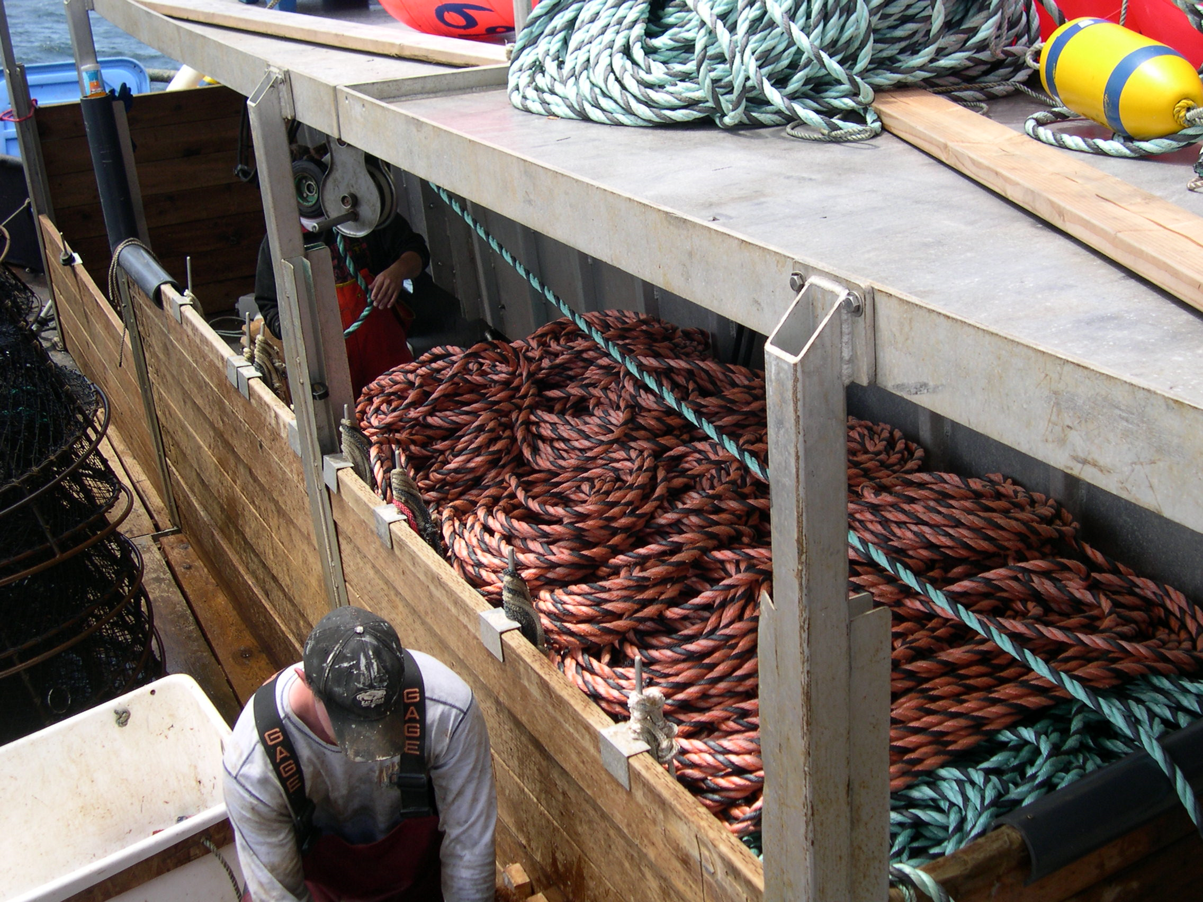
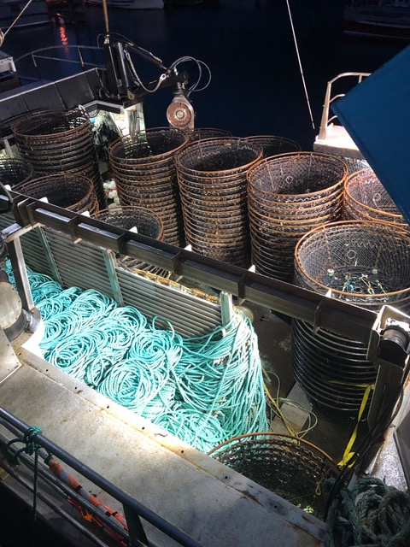
Topics that would benefit from stakeholder input, p62
Gear conflicts
Grounds preemption/gear retrieval requirements
Gear innovation
Gear specifications
Cost of gear conversion

Slide 19
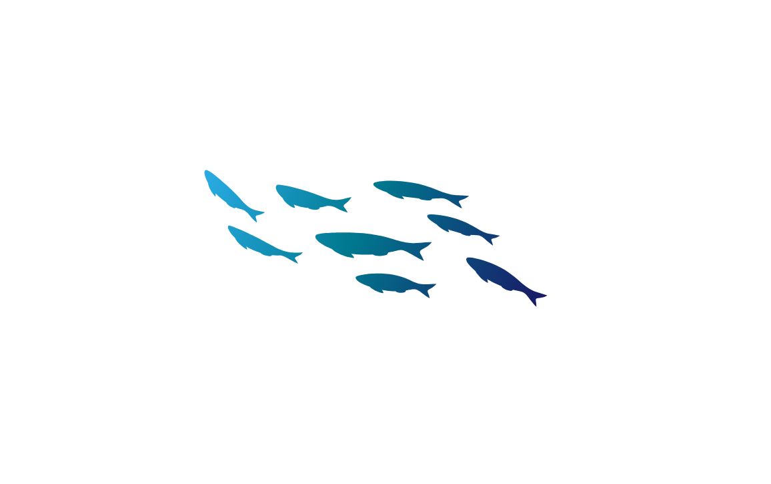
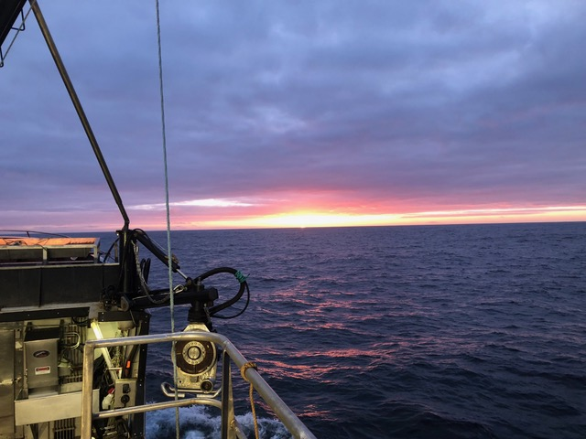
Questions?
Sara Cleaver
Sara.cleaver@noaa.gov
Sam Cunningham
Sam.Cunningham@noaa.gov
907-271-2809

Slide 20
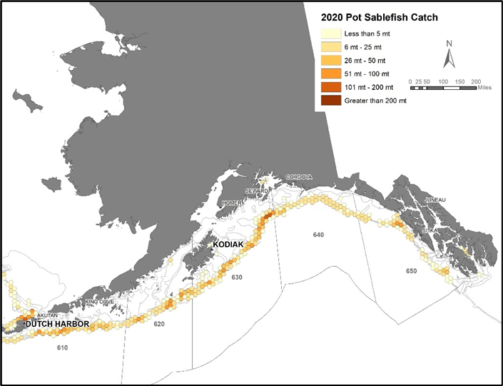
Figure 3‑5 p28
Spatial distribution of sablefish catch by pot gear, 2020

