Slide 1


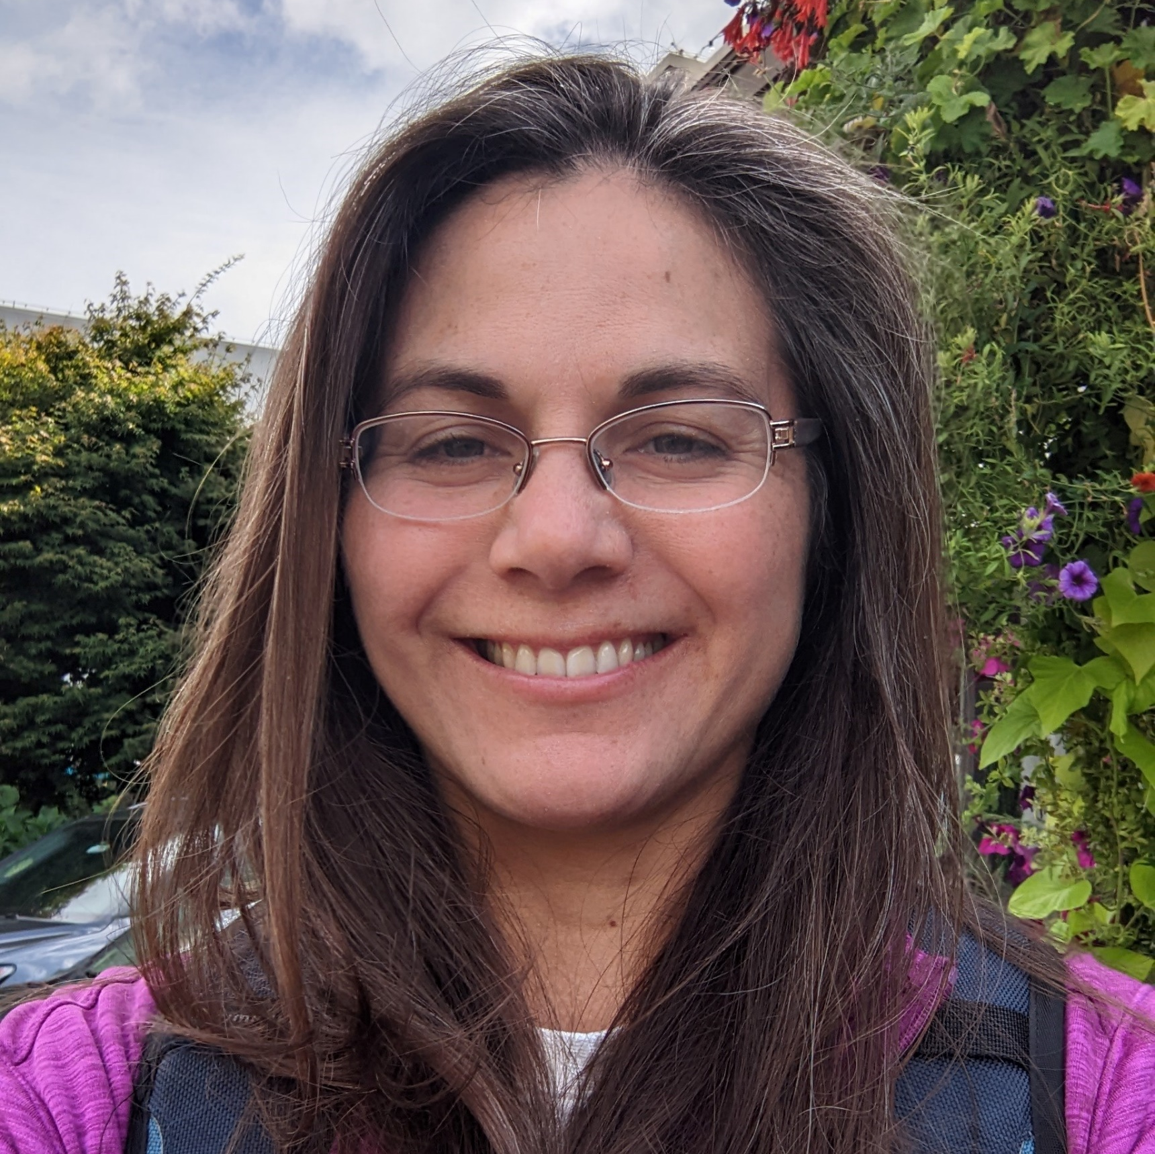

Ecosystem & Socioeconomic Profile:
Sablefish Report Card
Kalei Shotwell, November Groundfish Plan Team 2022
Editors: S. Kalei Shotwell, Dan Goethel, Alison Deary, Bridget Ferriss, Katy Echave, Chris Lunsford, Kevin Siwicke, Elizabeth Siddon, Jane Sullivan, Marysia Szymkowiak, Ben Williams
Contributors: Mayumi Arimitsu, Steve Barbeaux, Matt Callahan, Curry Cunningham, Dana Hanselman, Ben Fissel, Jean Lee, Jens Nielsen, Krista Oke, Clare Ostle, Patrick Ressler, Cara Rodgveller, Kally Spalinger, Abigail Tyrell, Jordan Watson, Sarah Wise

Slide 2
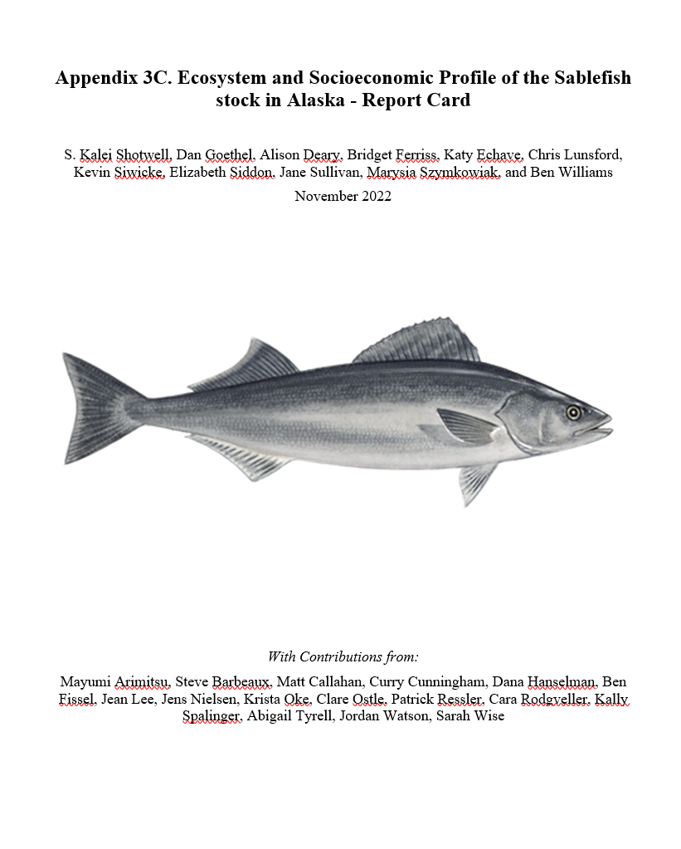
Overview
Appendix in SAFE Report
  Full ESPs in 2017-2019
  Partial ESP in 2020
  Report Card in 2021
Report Card in 2022
  Simplified template, current data
  11 editors, 16 contributors
Full Updated ESP in 2023
Pp. 110-139

Slide 3
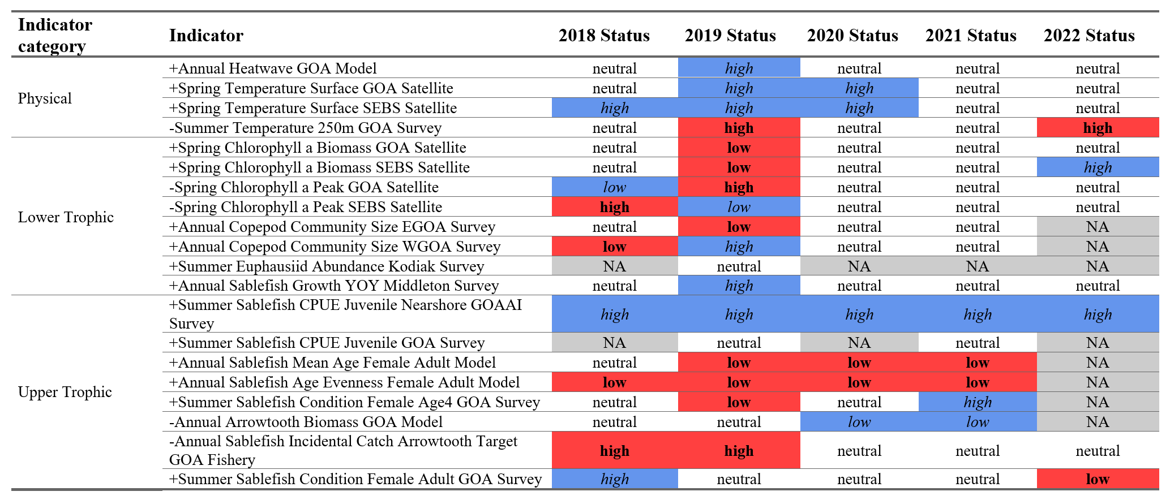
Ecosystem Summary Table

Slide 4
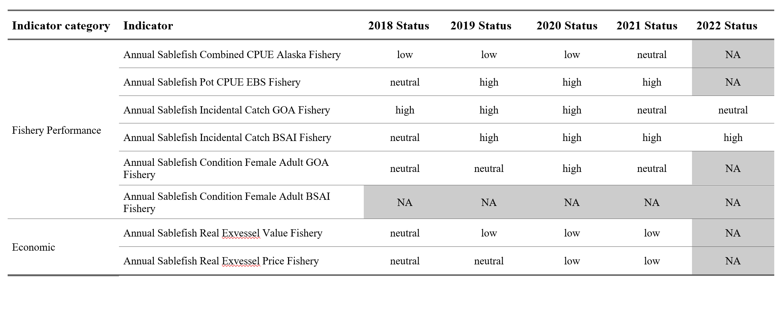
Socioeconomic Summary Table

Slide 5
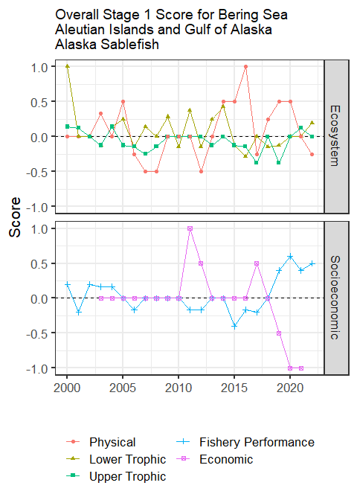
Traffic Light Score
Ecosystem (18 of 20 total)
  Physical < to below average
  Lower trophic > to above average
  Upper trophic < to average
Socioeconomic (7 of 8 total)
  Fishery performance above average
  Economic (lagged) below average
  Community not at this time

Slide 6
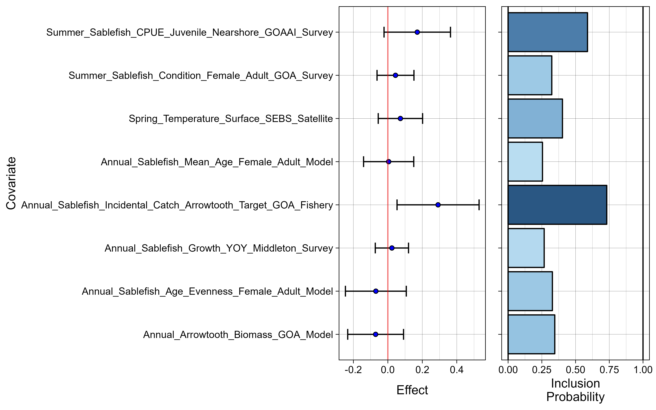
Importance Results
Two indicators with importance > 0.5, same indicators as last year:
Juvenile sablefish CPUE in ADF&G nearshore survey
Incidental catch of sablefish in the arrowtooth fishery

Slide 7
Considerations Highlights
Management Summary
  Surface temps warm overall and bottom temp above average in GOA, plankton variable
  YOY growth slightly below average, but mean length above average, nearshore juveniles above average, length frequencies support strong 2019 year class
  Condition above average for 2017 year class, female adult condition below average in both the survey and fishery
  New fishery CPUE indicators similar trends, pot CPUE at all time high, value & price low
  Incidental catch sablefish in arrowtooth fishery increased, slight decrease overall in GOA and BSAI
Modeling Summary
  2 potential covariates for sablefish recruitment, consistent with last year
  Several potential research ecosystem models (life cycle, temp projection model, tag model)

Slide 8

Next Steps
Request for Indicators (RFI) in 2023, use ESP data gaps and research priorities, indicators submitted in January, reviewed in February by ESP teams
Plan to run full update for sablefish ESP in 2023 following the RFI process
New importance methods evaluation project and testing within the sablefish ESP framework
Working on community section with several groups, emphasis on historical use of sablefish in coastal communities (SSC)

Slide 9
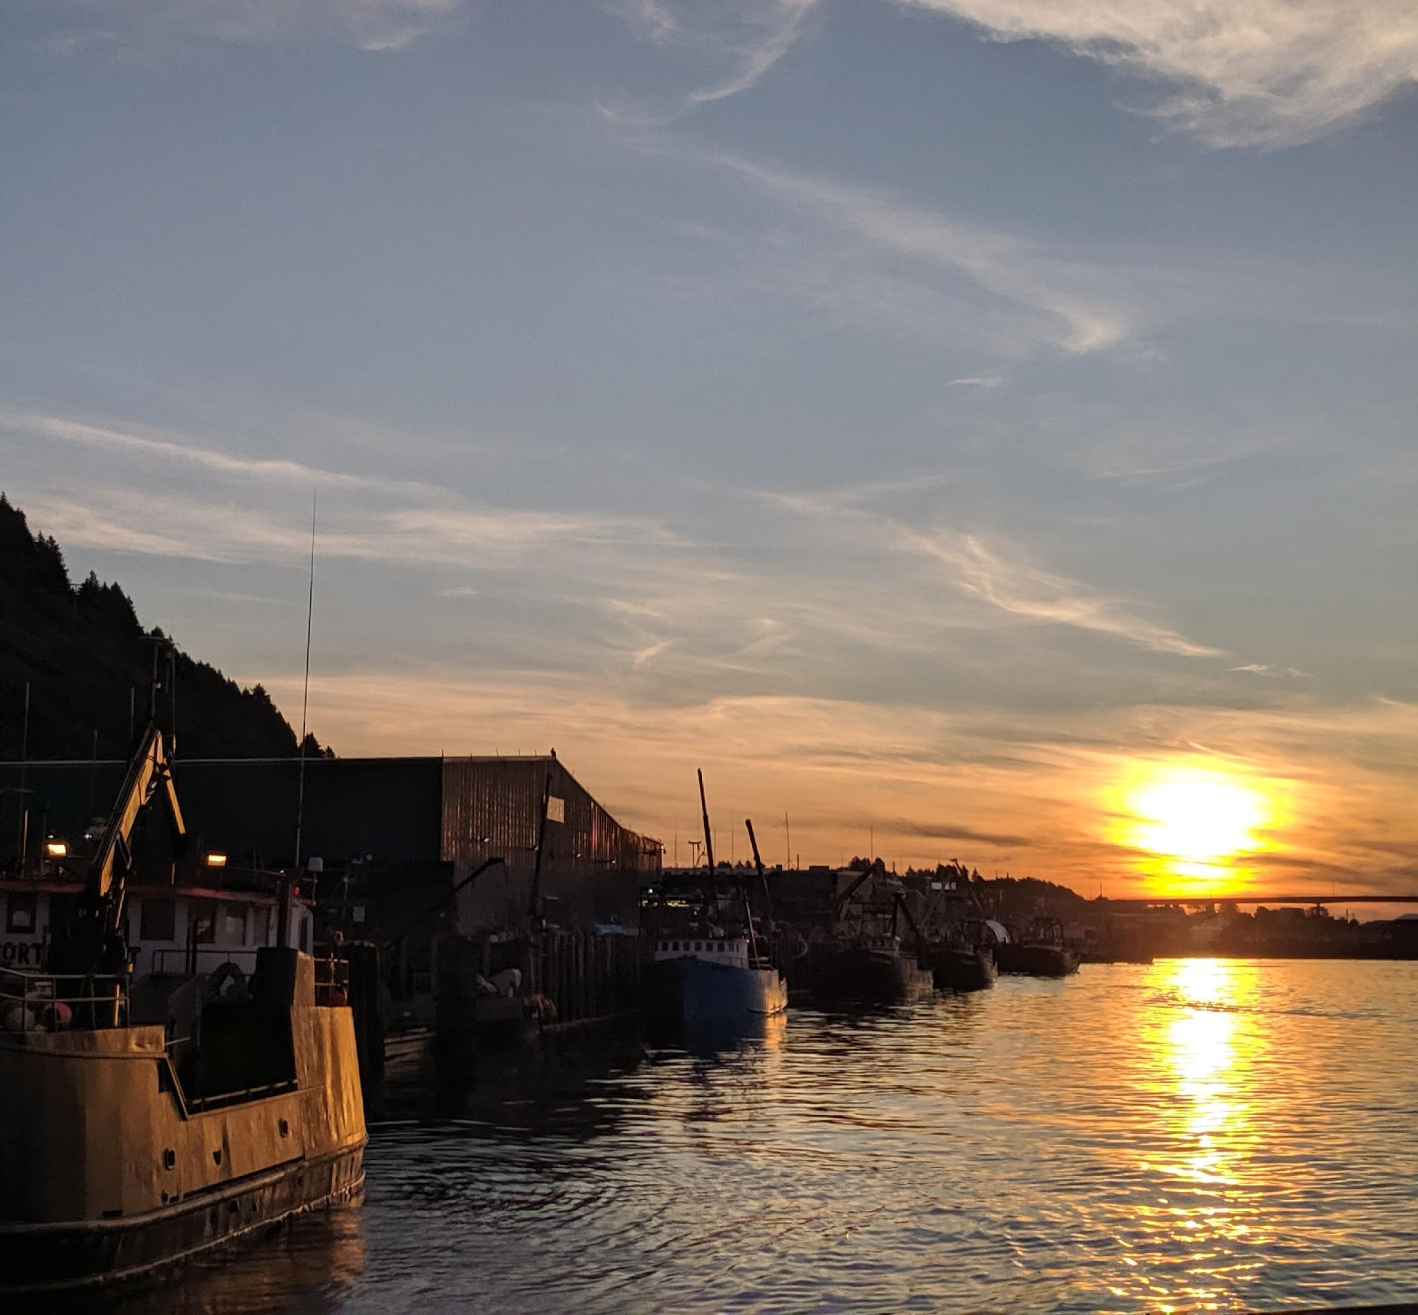
Questions?
Kalei Shotwell
NOAA-AFSC
Kalei.Shotwell@noaa.gov

