Slide 1
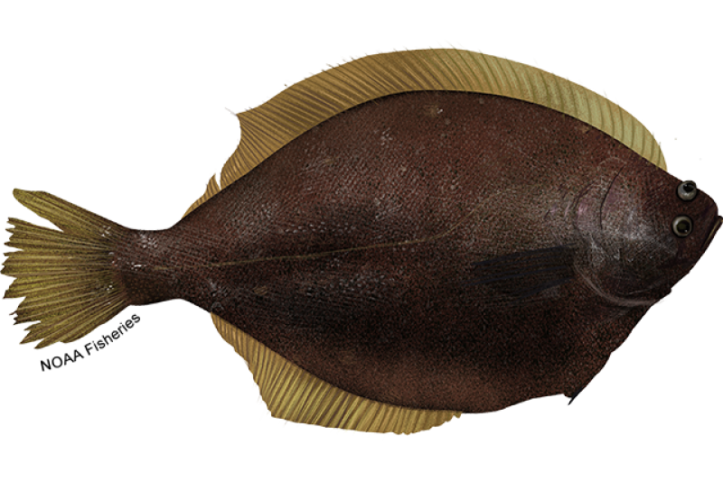
Model selection for the Yellowfin Sole stock assessment in the eastern Bering Sea and Aleutian Islands
Ingrid Spies, Meaghan Bryan, Jim Ianelli

Slide 2
Model 22.1: (2022 BSAI YFS model)
Single sex survey selectivity curve.
Model 23.0 (Model 22.1 base model)
Single fishery selectivity curve rather than separate parameterizations for males and females.

Slide 3
Motivation:
Parsimony
SSC (December 2020): …male and female fishery selectivity curves very similar post 1980s, so there appears to be no measurable difference between the two sexes.
Removing parameters that cannot be estimated well (mcmc posteriors). Explorations with the mcmc adnuts package indicated that male and female fishery selectivity parameters in the early portion of the time series were poorly estimated.

Slide 4
Sensitivity analysis
This fishery selectivity curve was estimated using male and female data.
Likelihood optimizes the difference between the observed and predicted age composition. Predicted age composition is a function of selectivity.
The model changes the fishery selectivity parameters to optimize the fit for both males and females.

Slide 5
Time-varying fishery selectivity curves for Models 23.0 and 22.1 were similar:
Variable estimates during the early 1960s.
In Model 22.1, the variability is also present between males and females.
The single fishery selectivity is also variable in early years.

Slide 6
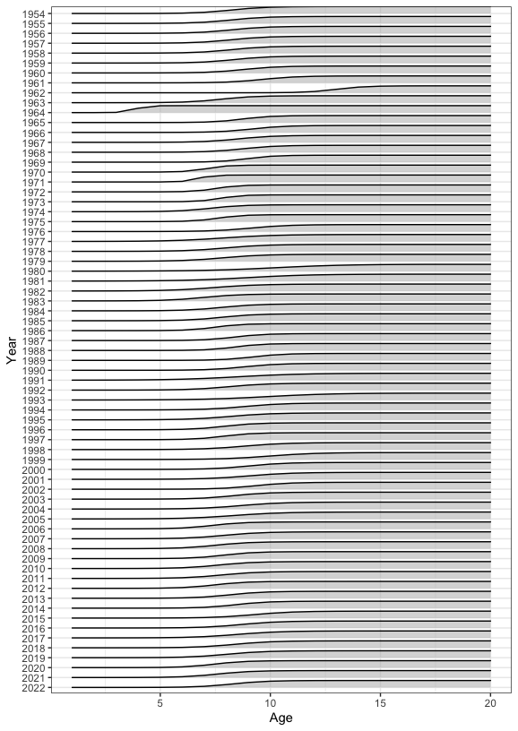
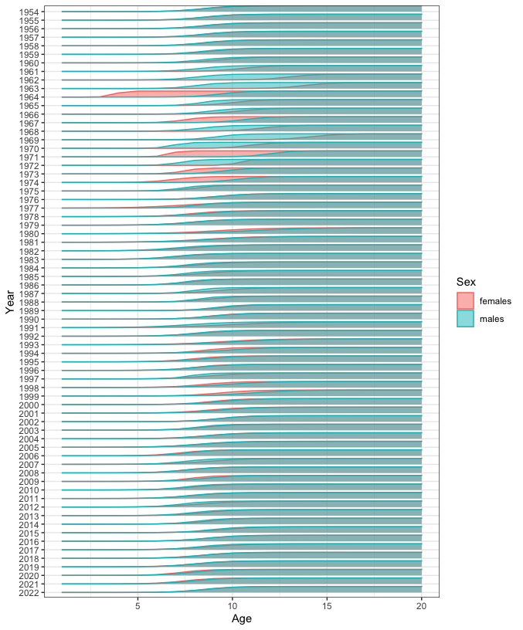

Slide 7
Overall and component likelihoods and AIC for Model 23.0 and 22.1
Likelihood component | Model 22.1 | Model 23.0
Survey | 88.756 | 88.288
Catch | 0.0092 | 0.0089
Age fishery | 627.25 | 744.95
Age survey | 1091.88 | 1092.95
Recruitment | 37.36 | 38.48
Selectivity (fishery) | 70.6 | 34.4
Q prior | 1.326 | 1.333
Objective fxn value | 1920.27 | 2003.38
Number parameters | 518 | 378
AIC | 7312.2 | 6645.0
Objective function value did not decrease, but
when decrease in
number of parameters
was considered in the AIC, Model 23.0 is a better fit.

Slide 8
Estimates of total and spawning biomass, and numbers at age, did not differ between Model 22.1 and Model 23.0, except in years prior to ~1985.

Slide 9
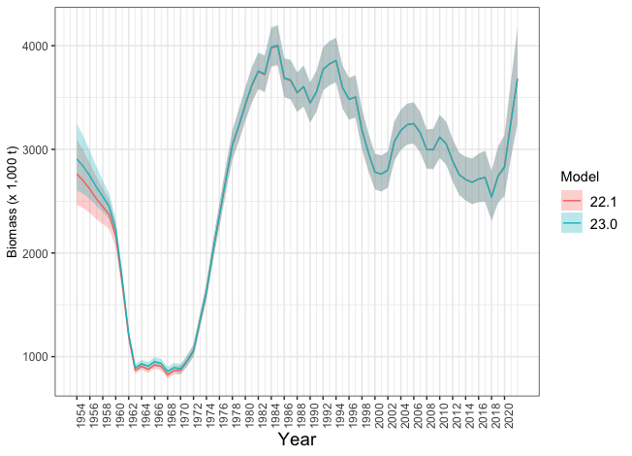
Total (age 2+) biomass for yellowfin sole, using Model 22.1 and Model 23.0

Slide 10
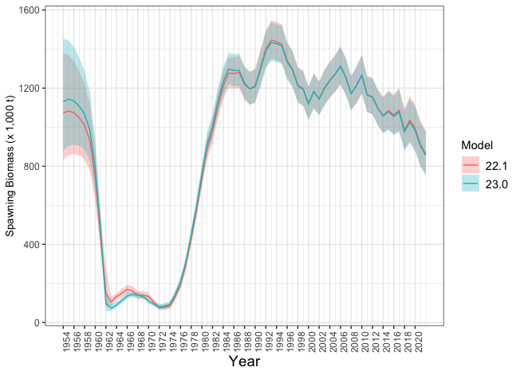
Total (age 2+) spawning biomass for yellowfin sole, using Model 22.1 and Model 23.0

Slide 11
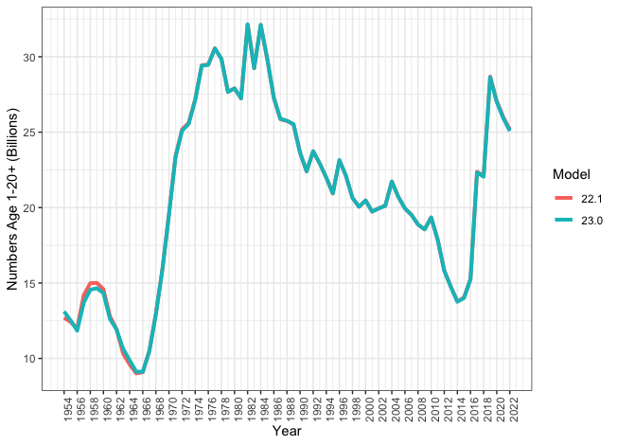
Numbers at age for yellowfin sole, using Model 22.1 and Model 23.0

Slide 12
Conclusions
Overall, this analysis provides support for Model 23.0. The authors recommend moving forward with Model 23.0 for the 2023 Yellowfin Sole assessment.

