Slide 1
Building a size-structured model for weathervane scallops
Tyler Jackson
March, 2025 Scallop Plan Team

Slide 2
Last Cycle…
Established the idea of ‘core’ and ‘non-core’ stock for assessment
Move on from goal of age-structured model
Data-limited modelling approach for surveyed, ‘core’ areas (REMA, Sullivan et al. 2022)
Hypothetical OFL calculation using split F_{OFL} control rule
  Sloping control rule with max F_{OFL} = M for ‘core’ stock
  Total catch (i.e., status quo) OFL for ‘non-core’ stock

Slide 3
Last Cycle…
Established the idea of ‘core’ and ‘non-core’ stock for assessment
Move on from goal of age-structured model
Data-limited modelling approach for surveyed, ‘core’ areas (REMA, Sullivan et al. 2022)
Explore simple size/stage structured models that make more comprehensive use of available data – GMACS, see SMBKC
Hypothetical OFL calculation using split F_{OFL} control rule
  Sloping control rule with max F_{OFL} = M for ‘core’ stock
  Total catch (i.e., status quo) OFL for ‘non-core’ stock

Slide 4
Generalized Model for Assessing Crustacean Stocks
Generalized size structured modelling framework used extensively by BSAI crab stocks: GitHub
Designed specifically for crustacean stocks, but flexible enough to develop a simple scallop model – try KSH first
At this point, advantageous over CASA (Sullivan et al., 1990) because of familiarity

Slide 5
Model Dimensions
Model runs from 1993/94 – 2023/24
Single sex (i.e., males + females combined)
No shell condition, no maturity groups
10 mm size classes from 31 mm – 160+ mm
Two fleets: directed fishery, dredge survey

Slide 6
Annual Structure: May 1 – Apr 30
Dredge Survey
SSB
Fishery
May | Jun | Jul | Aug | Sep | Oct | Nov | Dec | Jan | Feb | Mar | Apr
Nat M
Nat M
Nat M, Growth, Recruitment

Slide 7
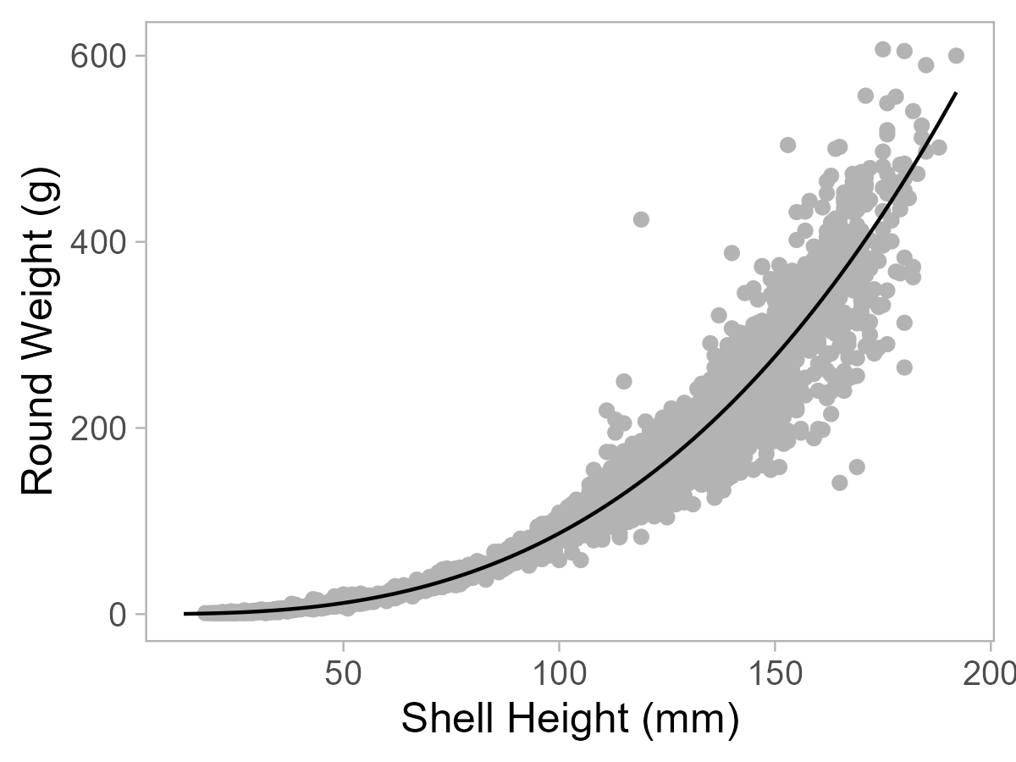
Biological Info and Natural Mortality
Knife-edge maturity at 71 mm (Jackson et al. 2021)
  This does not affect population dynamics, just SSB
Weight at length is allometric
(from survey data)
All sizes are legal
Natural Mortality = 0.13 (FMP)

Slide 8
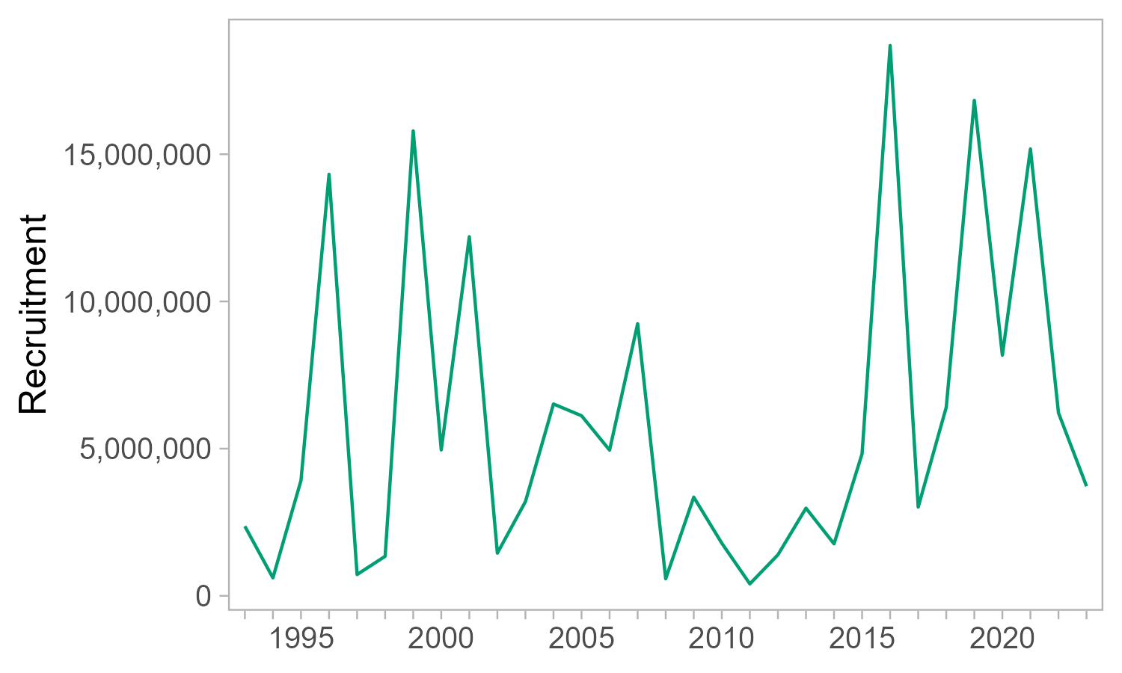
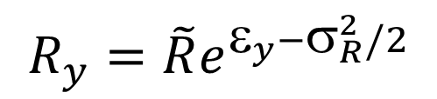
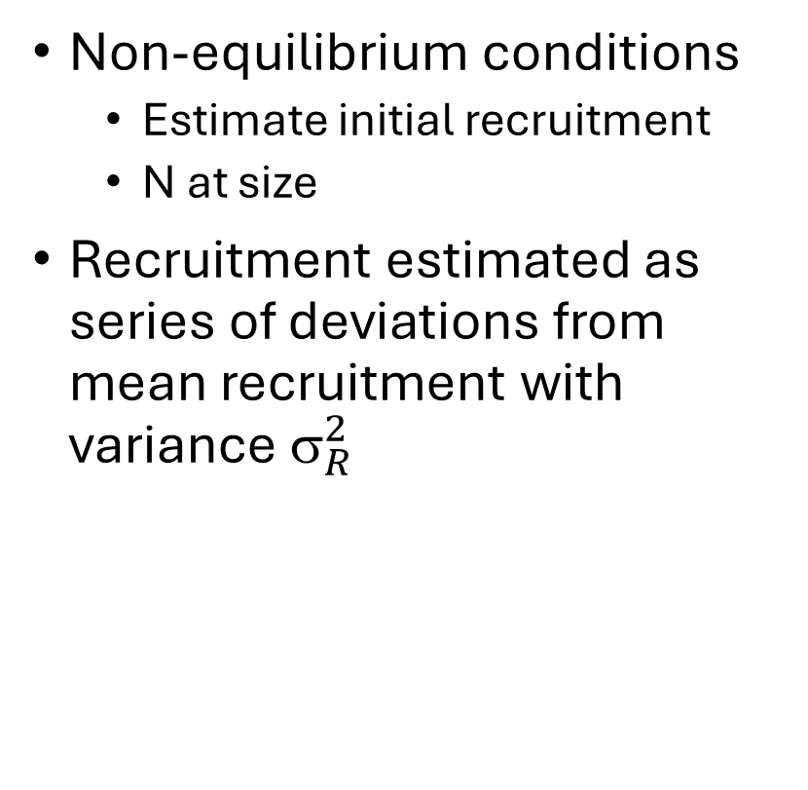
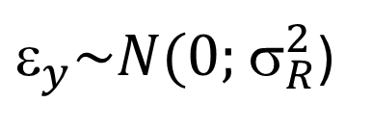
Initial Conditions and Recruitment
Non-equilibrium conditions
  Estimate initial recruitment
  N at size
Recruitment estimated as series of deviations from mean recruitment with variance $_{R}^{2}$
$$R_{y}=\tilde{R}e^{ε_{y}−σ_{R}^{2}/2}$$
$_{y}\sim N(0;$ $_{R}^{2}$)

Slide 9
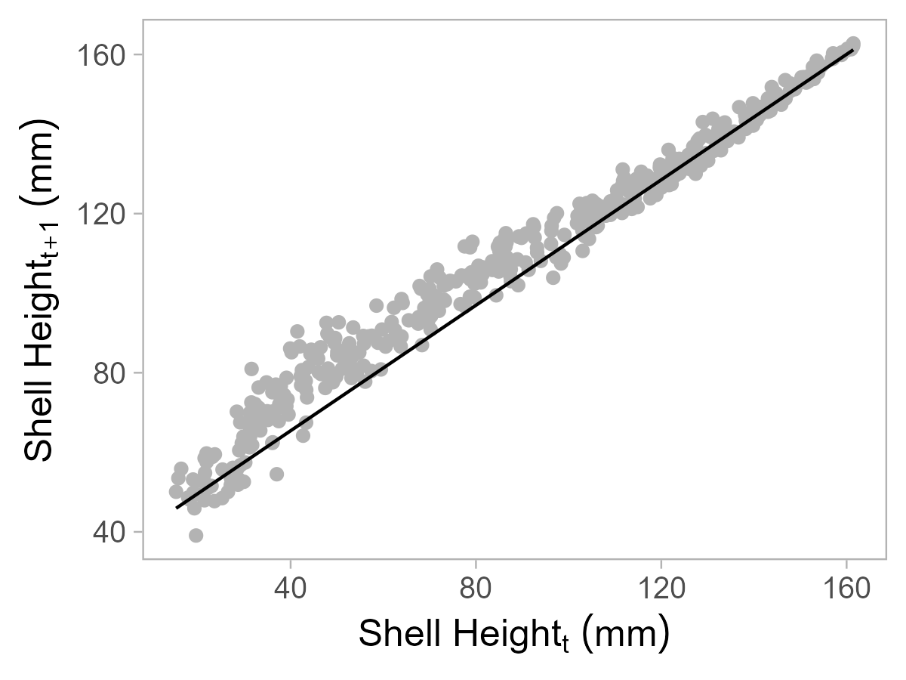
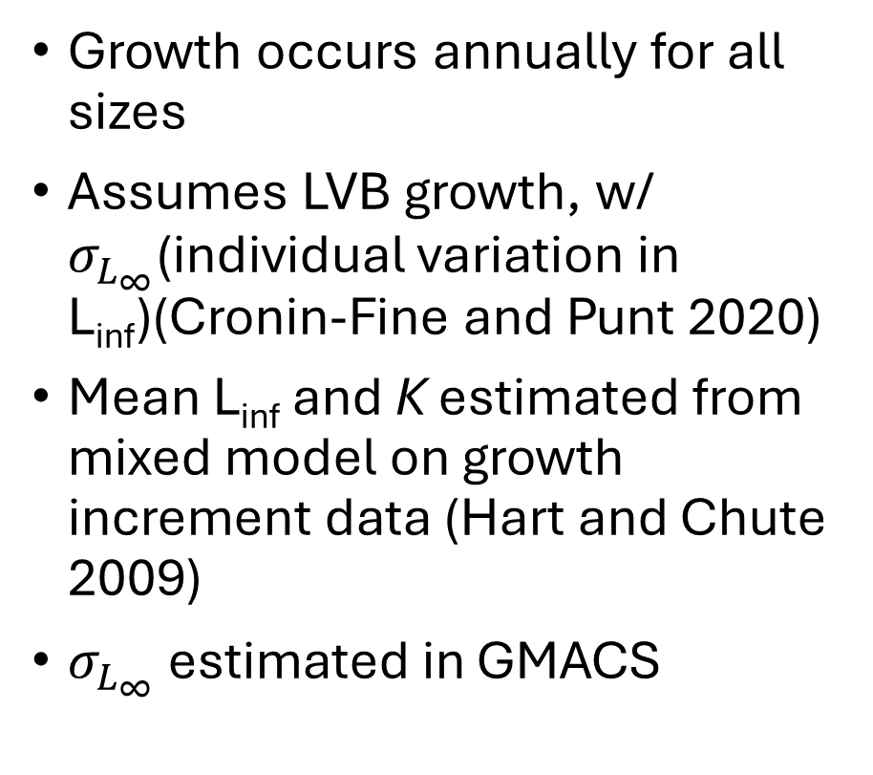
Growth Transition
Growth occurs annually for all sizes
Assumes LVB growth, w/ $σ_{L_{∞}}$(individual variation in L_{inf})(Cronin-Fine and Punt 2020)
Mean L_{inf} and K estimated from mixed model on growth increment data (Hart and Chute 2009)
$σ_{L_{∞}}$ estimated in GMACS

Slide 10
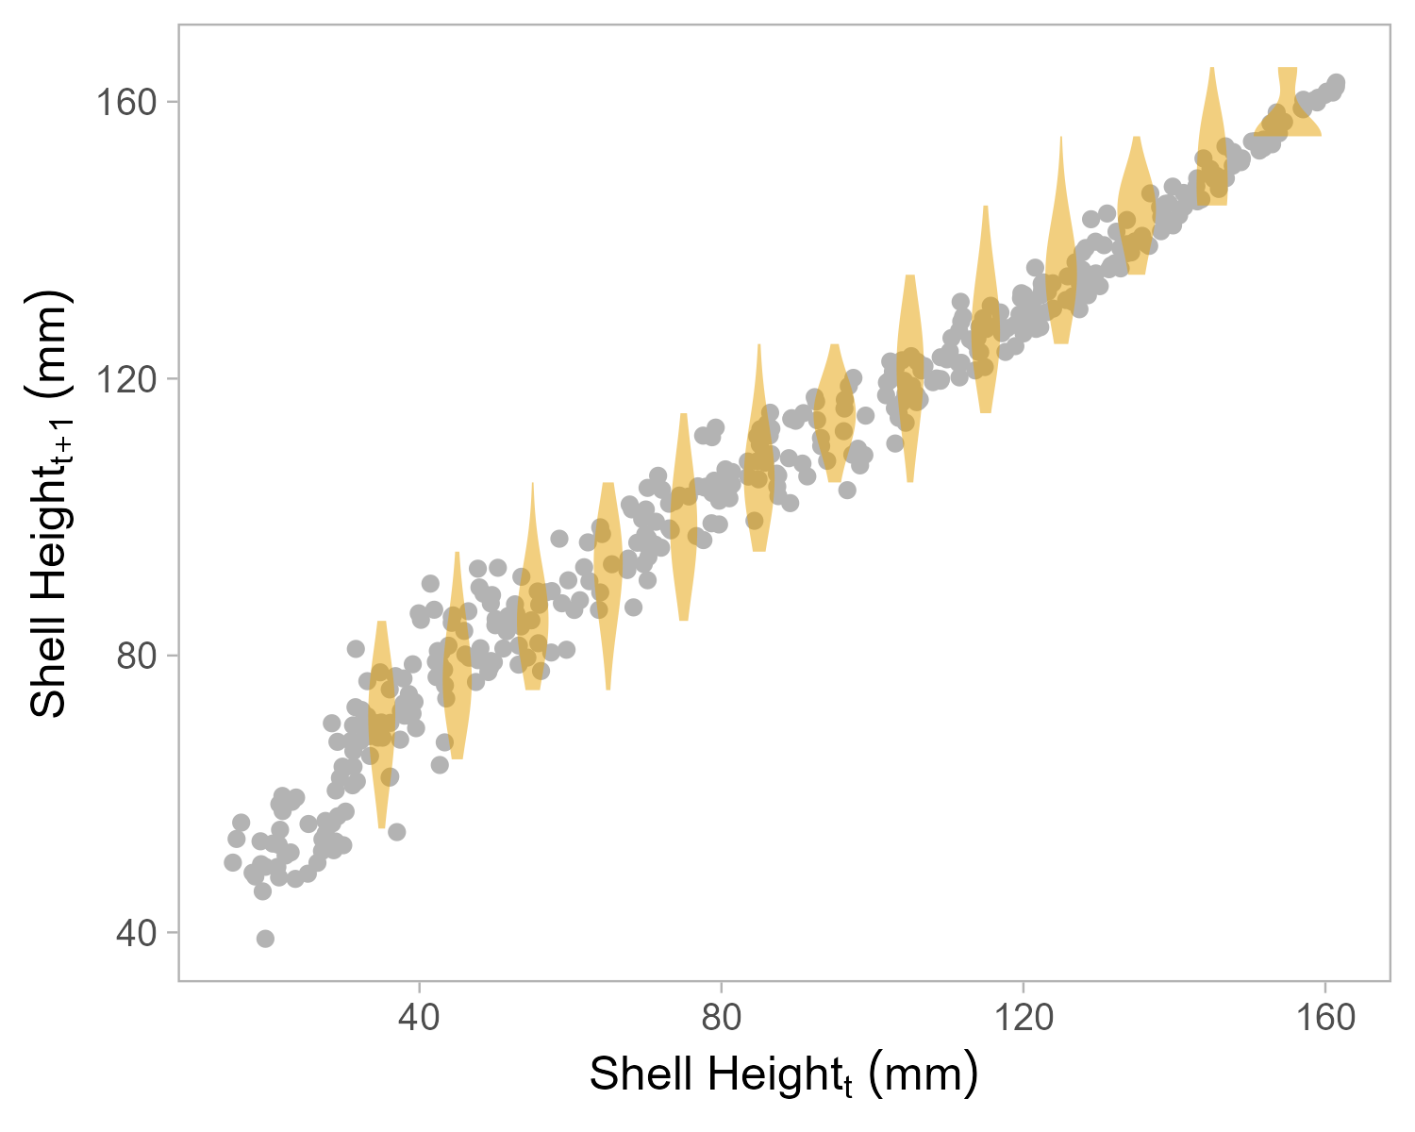
Growth Transition

Slide 11
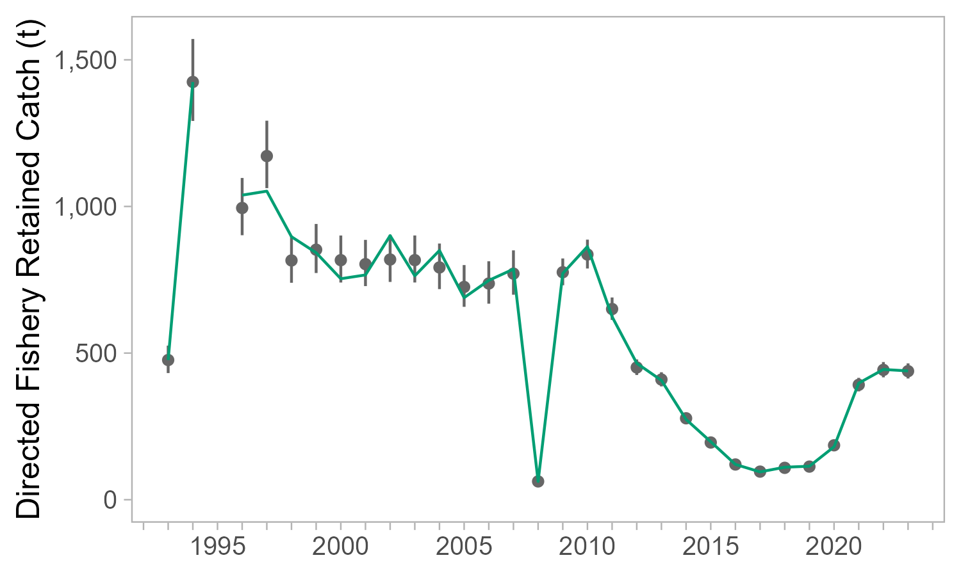
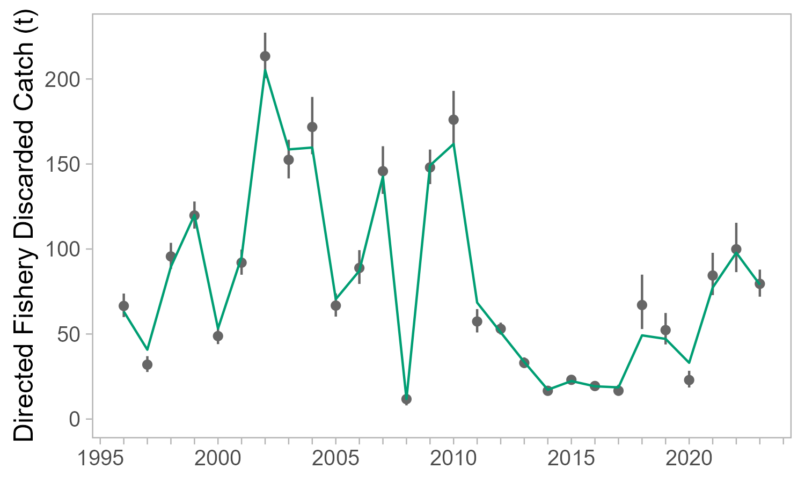
Catch Data
Round biomass
Logistic Selectivity
Retained catch 1993/94 –
  1993 – 2008 CV = 0.05
  2009 – present CV = 0.03
Discarded catch 1996/97 –
  20% discard morality
  CV computed from observer data

Slide 12
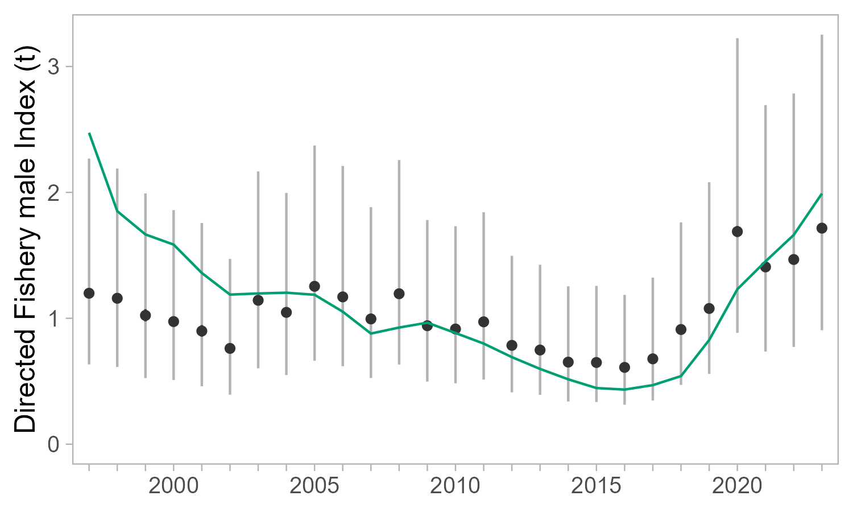
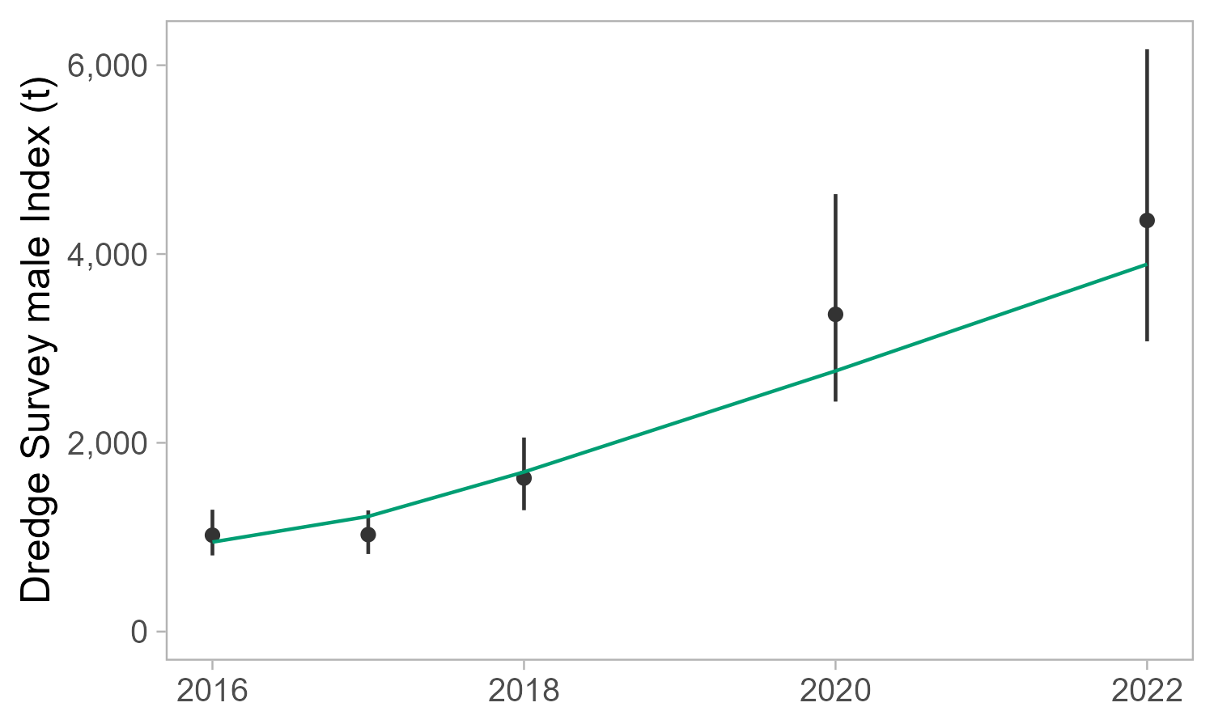
Index Data
Standardized CPUE 1996/97 –
  Added observation error
  Time Invariant Catchability
  Logistic Selectivity
Survey Biomass 2016 –
  Catchability estimated
  Logistic Selectivity

Slide 13
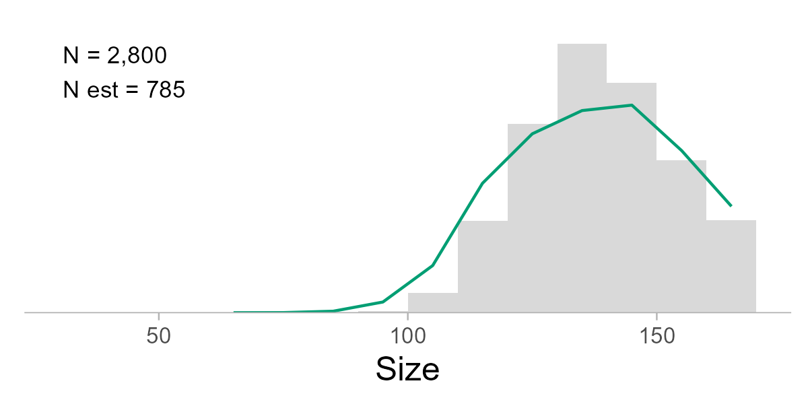
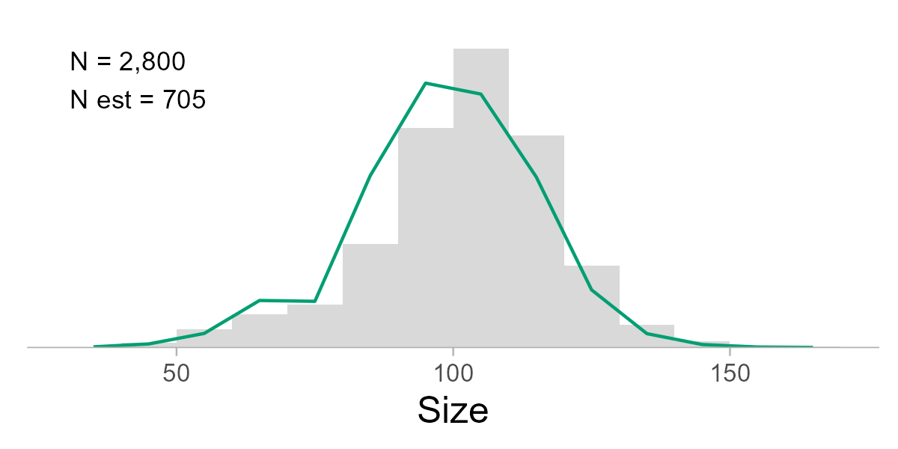
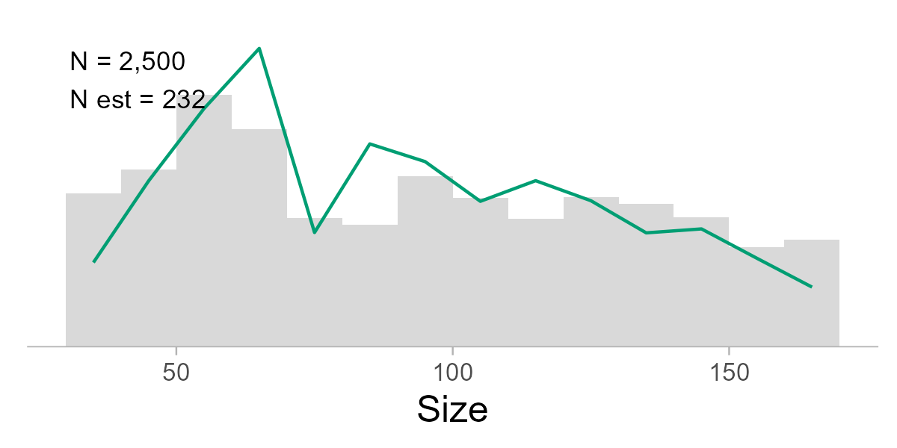
Shell Height Composition
Retained
Dirichlet multinomial likelihood, overdispersion estimated
Retained 1993/94 –
  Input N = 100
Discarded 1996/97 –
  Input N = 100
Survey 2016/17 –
  Input N = 500
  Overdispersion at lower bound
Discarded
Survey

Slide 14
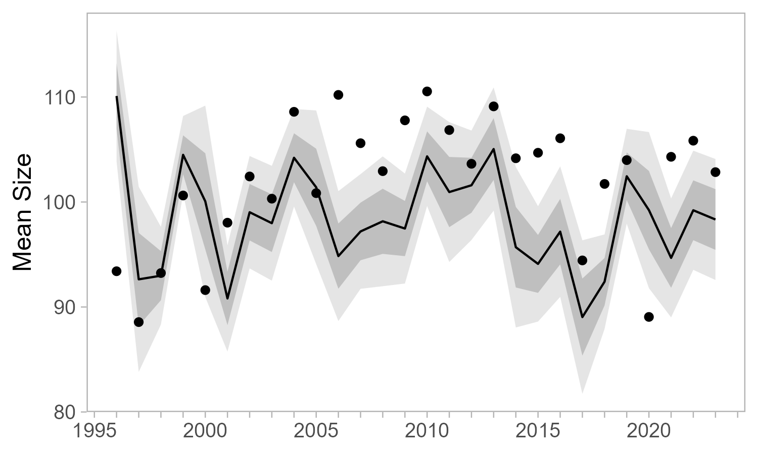
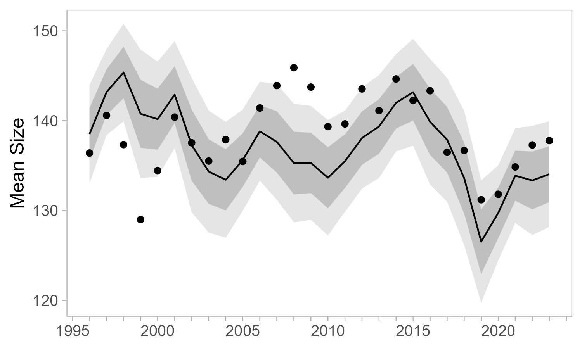
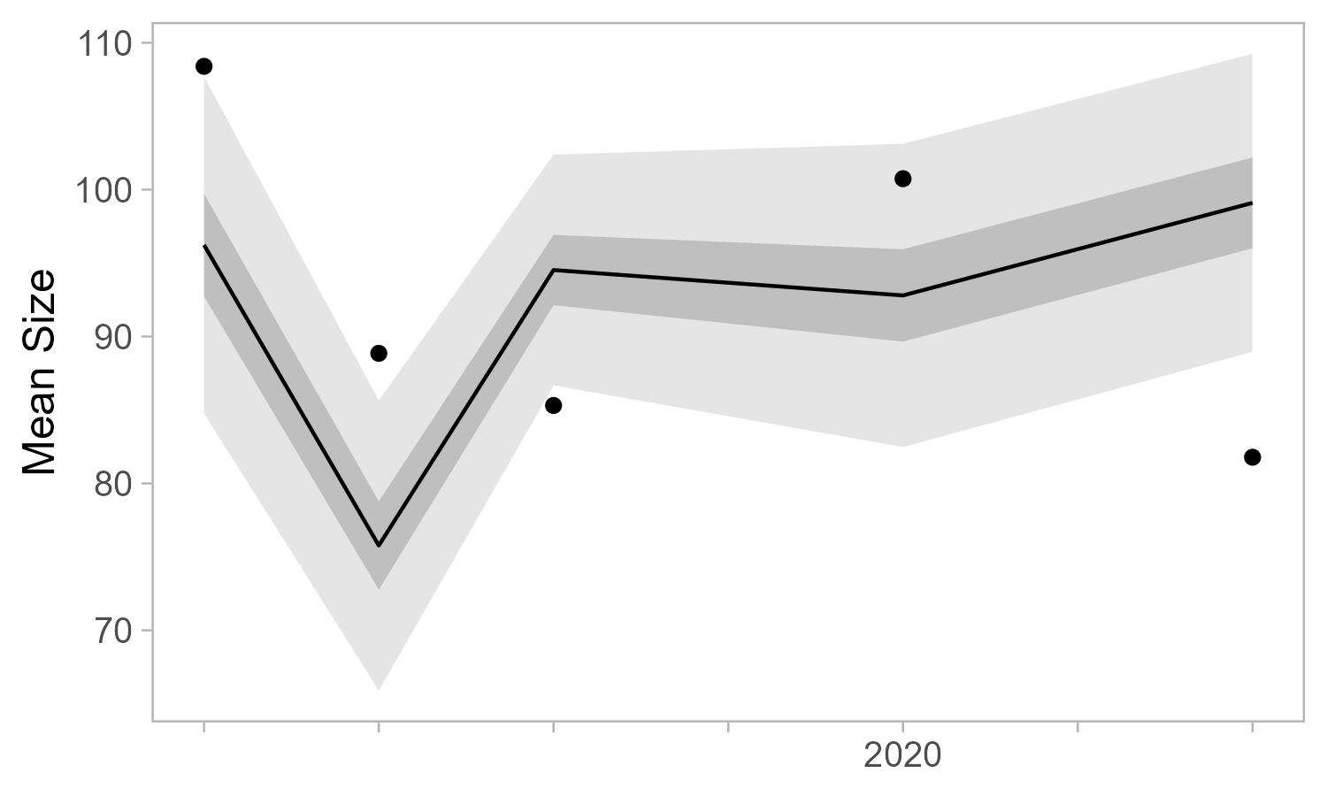
Shell Height Composition
Discarded
Retained
Survey

Slide 15
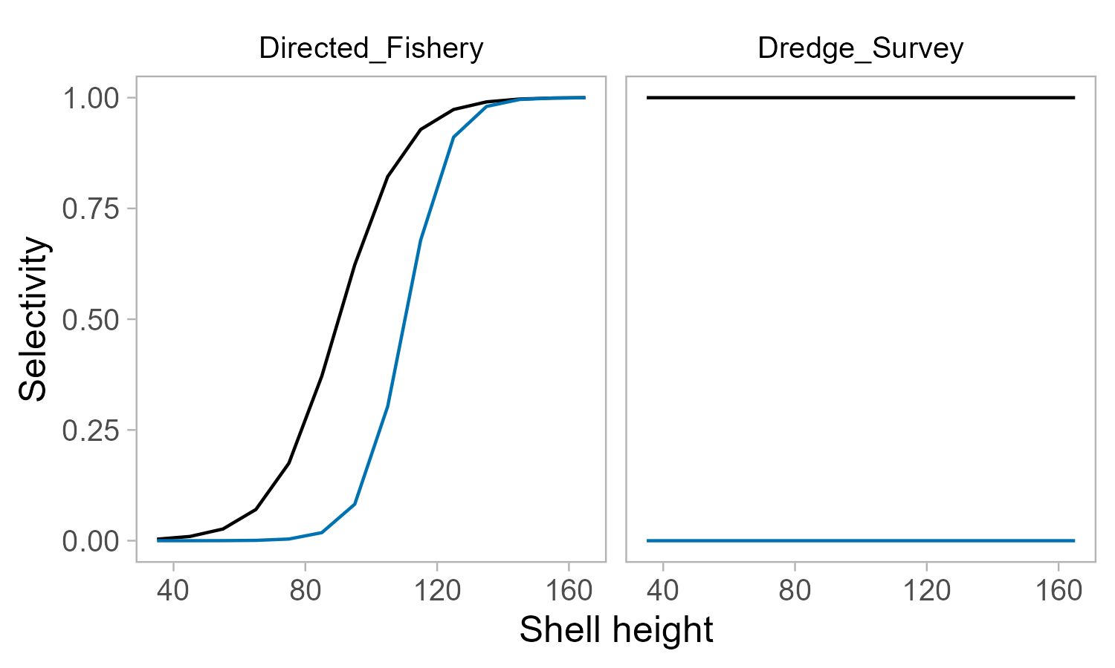
Selectivity

Slide 16
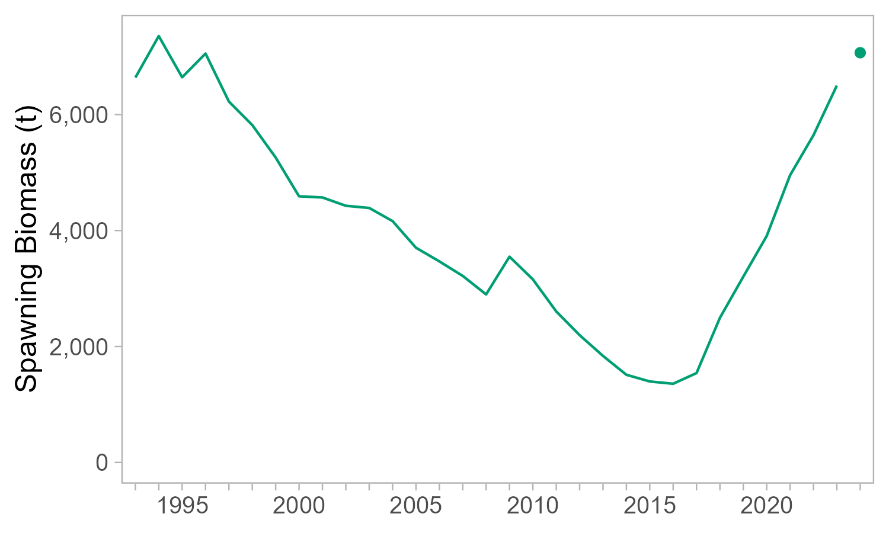
Spawning Biomass

Slide 17
What now?
Model appears to generally capture population dynamics, though with clear misspecification
Requires further diagnostics and exploration
Trying to avoid too much added complexity – we lack capacity for maintenance and don’t require fine resolution for management
Need a fairly general framework to apply to KNE, WKI, EKI/YAK
  Explorations using YAK data were not quite as promising…

Slide 18
Feedback?
Progress?
Not the direction we want?

